Slide 1
Topic 3
Gradient

Slide 2
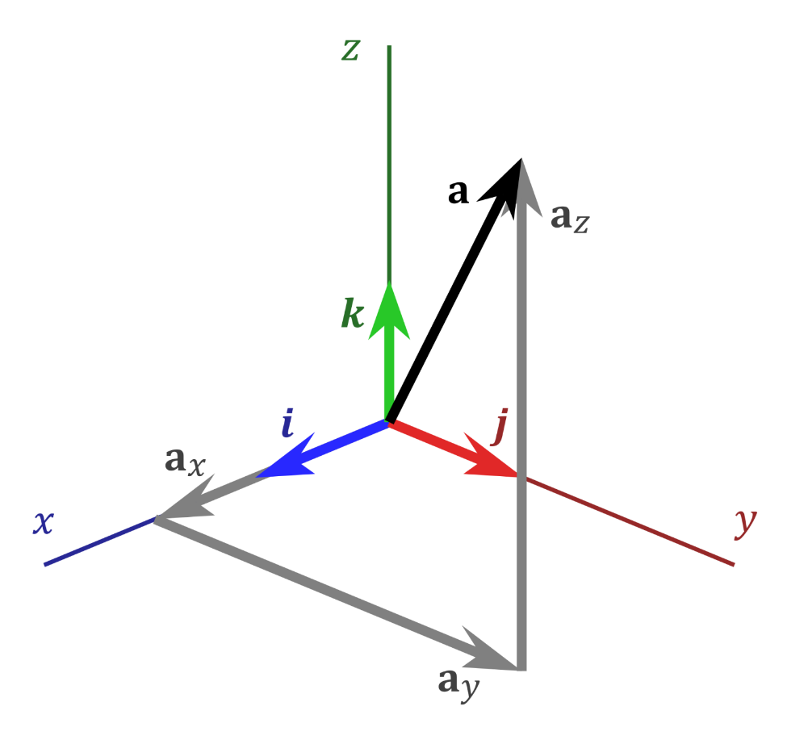
Vector Notation
There are many ways to denote a vector:
$\vec{OA}$, a, a, $\tilde{a}$, $\overset{⃑}{a}$

Slide 3
Vector Notation
And many ways to write the components of a vector:
$$\overset{⃑}{a}=\overset{⃑}{a_{x}}+\overset{⃑}{a_{y}}+\overset{⃑}{a_{z}}$$
$$\overset{⃑}{a}=(a_{x},a_{y},a_{z})$$
$$\overset{⃑}{a}=a_{x}\hat{i}+a_{y}\hat{j}+a_{z}\hat{k}$$

Slide 4
Vector Notation
And many ways to write the components of a vector:
$$\overset{⃑}{a}=\overset{⃑}{a_{x}}+\overset{⃑}{a_{y}}+\overset{⃑}{a_{z}}$$
$$\overset{⃑}{a}=(a_{x},a_{y},a_{z})$$
$$\overset{⃑}{a}=a_{x}\hat{i}+a_{y}\hat{j}+a_{z}\hat{k}$$
Don’t confuse notation of:
$a_{x}$ and $f_{x}$

Slide 5
Unit Vectors
$\hat{i},\hat{j}$ and $\hat{k}$ are unit vectors, i.e. they have a magnitude of 1 and denote orthogonal directions in x, y, and z, respectively.

Slide 6
Vector Calculus
$$Two key vector products are:$$
The scalar product or dot product $\overset{⃑}{a}∙\overset{⃑}{b}$
And the vector product or cross product $\overset{⃑}{a}×\overset{⃑}{b}$

Slide 7
Vector Calculus
Dot product
$$\overset{⃑}{a}∙\overset{⃑}{b}=a_{x}b_{x}+a_{y}b_{y}+a_{z}b_{z}$$
Dot product always returns a scalar value.
$$\overset{⃑}{a}∙\overset{⃑}{b}=\overset{⃑}{b}∙\overset{⃑}{a}$$

Slide 8
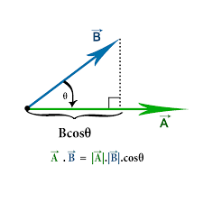
Vector Calculus
Dot product

Slide 9
Gradient Operator
$$\overset{⃑}{∇}$$
Represented by del or nabla (harp) symbol

Slide 10
Gradient
Gradient operator:
$$\overset{⃑}{∇}=\frac{∂}{∂x}\hat{i}+\frac{∂}{∂y}\hat{j}+\frac{∂}{∂z}\hat{k}$$

Slide 11
Gradient
Gradient vector can be written in many different ways:
$$\overset{⃑}{∇}f(x,y,z)=\frac{∂f}{∂x}\hat{i}+\frac{∂f}{∂y}\hat{j}+\frac{∂f}{∂z}\hat{k}$$
$$\overset{⃑}{∇}f\left(x,y,z\right)=f_{x}\hat{i}{+f}_{y}\hat{j}+f_{z}\hat{k}$$
$$\overset{⃑}{∇}f(x,y,z)=\left(\frac{∂f}{∂x},\frac{∂f}{∂y},\frac{∂f}{∂z}\right)$$
$$\overset{⃑}{∇}f\left(x,y,z\right)=\left(f_{x},f_{y},f_{z}\right)$$
$$\overset{⃑}{∇}f\left(x,y,z\right)=grad f$$

Slide 12
Gradient
Gradient vector can be written in many different ways:
$$\overset{⃑}{∇}f(x,y,z)=\frac{∂f}{∂x}\hat{i}+\frac{∂f}{∂y}\hat{j}+\frac{∂f}{∂z}\hat{k}$$
$$\overset{⃑}{∇}f\left(x,y,z\right)=f_{x}\hat{i}{+f}_{y}\hat{j}+f_{z}\hat{k}$$
$$\overset{⃑}{∇}f(x,y,z)=\left(\frac{∂f}{∂x},\frac{∂f}{∂y},\frac{∂f}{∂z}\right)$$
$$\overset{⃑}{∇}f\left(x,y,z\right)=\left(f_{x},f_{y},f_{z}\right)$$
$$\overset{⃑}{∇}f\left(x,y,z\right)=grad f$$
Careful!

Slide 13
Gradient
Note:
$$\overset{⃑}{∇}f(x,y,z)=\frac{∂f}{∂x}\hat{i}+\frac{∂f}{∂y}\hat{j}+\frac{∂f}{∂z}\hat{k}$$
is a vector operator acting on a scalar function, whose result is a vector.

Slide 14
Gradient
Gradient vector has two important properties:
At any point, $\overset{⃑}{∇}f$ points in the direction of maximum change and its magnitude $\left|\overset{⃑}{∇}f\right|$ is the maximum rate of change.
$\overset{⃑}{∇}f$ is perpendicular to the surface f = constant

Slide 15
Gradient
Gradient vector has two important properties:
At any point $\overset{⃑}{∇}f$ points in the direction of maximum change and its magnitude $\left|\overset{⃑}{∇}f\right|$ is the maximum rate of change.
$\overset{⃑}{∇}f$ is perpendicular to the surface f = constant

Slide 16
Gradient
At any point $\overset{⃑}{∇}f$ points in the direction of maximum change
$\overset{⃑}{∇}f$ is perpendicular to the surface f = constant

Slide 17
Gradient
Magnitude of the gradient vector (maximum rate of change of the function):
$$\left|\overset{⃑}{∇}f\right|=\sqrt[2]{{\left(\frac{∂f}{∂x}\right)}^{2}+{\left(\frac{∂f}{∂y}\right)}^{2}+{\left(\frac{∂f}{∂z}\right)}^{2}}$$

Slide 18
Gradient
Example:
Determine the direction and maximum rate of change of f(x,y) for
$$f\left(x,y\right)={x^{2}+y}^{2}$$

Slide 19
Gradient
Example:
Look at points (1,1) and (-1,-1)

Slide 20
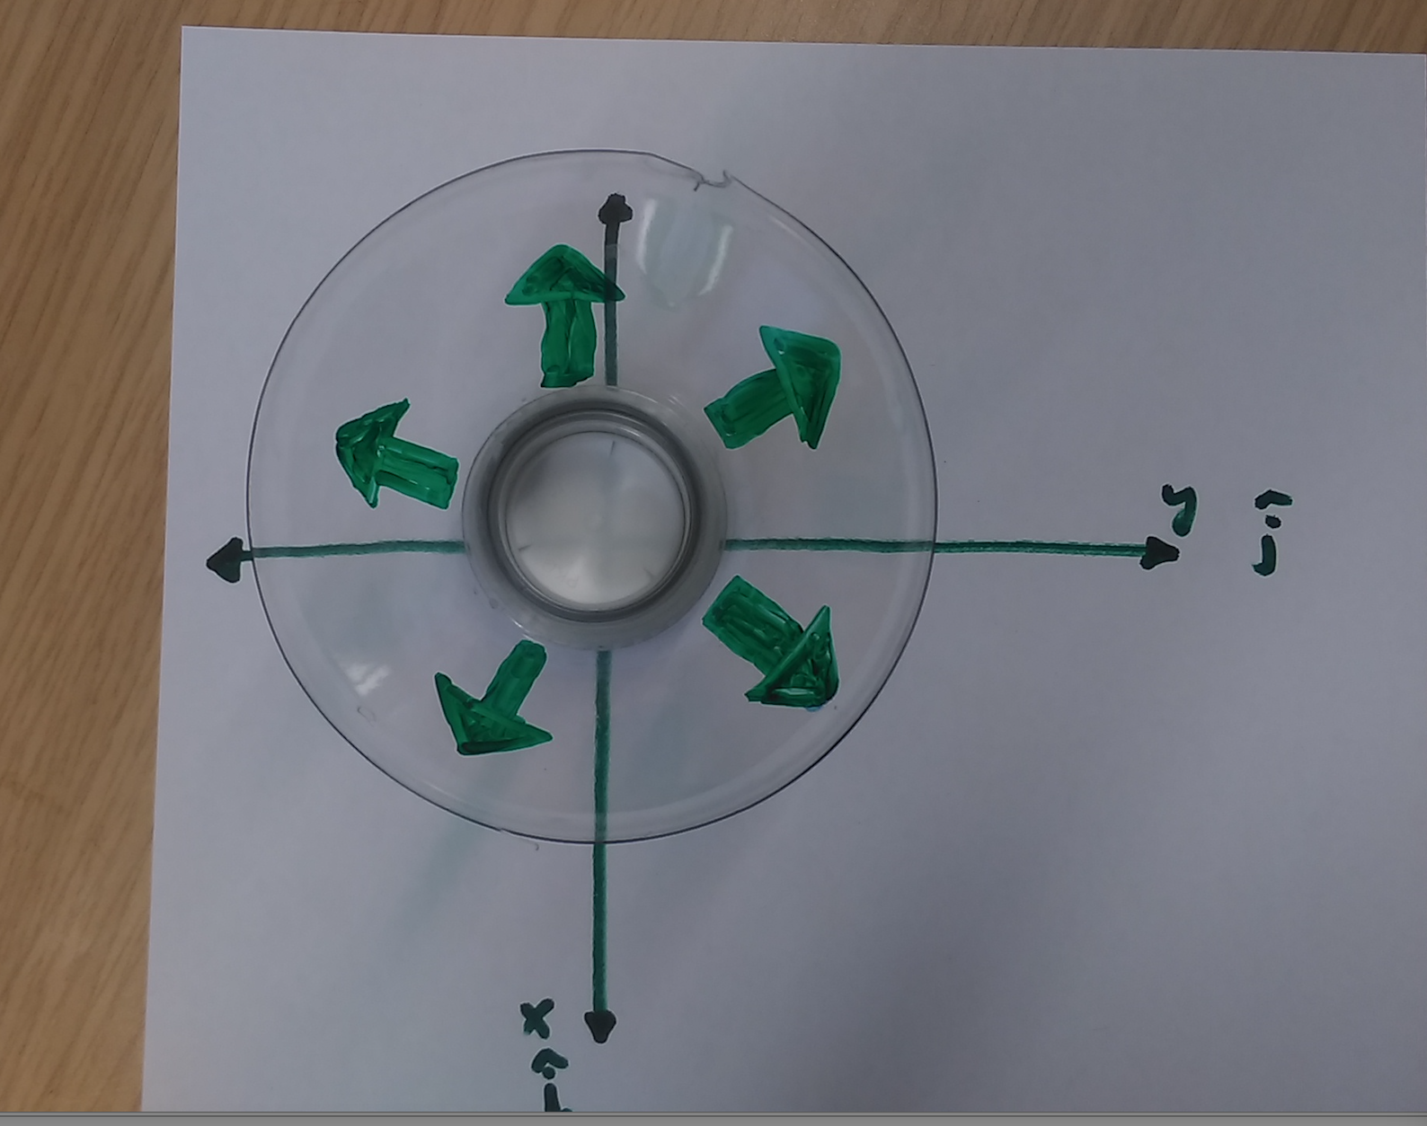
Gradient
Example:

Slide 21
Gradient
Example:
Evaluate the direction and magnitude of greatest change for the function
$f\left(x,y\right)={{(x−2)}^{2}+(y−2)}^{2}$
Look at points (3,3) and (1,1).

Slide 22
Gradient
Generalise this to calculate the gradient of a function in direction of any vector $\overset{⃑}{v}$:
Calculate $\overset{⃑}{∇}f$
Calculate $\left|\overset{⃑}{v}\right|$
Calculate unit vector $\hat{v}={\overset{⃑}{v}}/{\left|\overset{⃑}{v}\right|}$
4. $\overset{⃑}{∇}f.\hat{v}$ is then the gradient in the direction of $\hat{v}$

Slide 23
Gradient
Example:
For the function:
$$f\left(x,y\right)=3x^{2}y+{2y}^{2}$$
Find
(a) the maximum rate of increase at the point (1,1) and
(b) the rate of change in the direction $\left(3,4\right)$ at this point.

Slide 24
Next – Mathematics of Divergence

