Slide 1
Properties and Distribution of Clouds
SOEE3410 : Lecture 3
Ken Carslaw (k.s.carslaw@leeds.ac.uk)
Lecture 1 of a series of 5 on clouds and climate
Properties and distribution of clouds
Cloud microphysics and precipitation
Clouds and radiation
Clouds and climate: forced changes to clouds
Clouds and climate: cloud response to climate change

Slide 2
The aims of the cloud lectures
Understand the role of clouds in climate change
Human effects on clouds
Response of clouds to climate change – feedbacks
This requires an understanding of
Cloud “microphysics”
Basic macro and microscopic properties and processes (cloud drop formation, ice formation, rainfall formation) and the main controlling factors
Cloud interaction with radiation
Reflection of solar radiation and absorption of longwave (terrestrial) radiation

Slide 3
Expectations
You need to:
Follow-up the background reading. It is supporting (not extension) material
Answer the questions that are set in each lecture
I will:
Be available after lectures and on email to answer specific questions
Arrange a revision class to help pull all the science together

Slide 4
Content of Lecture 3
Cloud types, classification and distribution
Importance in the climate system
Basic physical properties

Slide 5
Recommended Reading for This Lecture
Hamblyn, R (2001) The Invention of Clouds. New York: Farrar, Straus and Giroux
Houze’s Cloud Atlas (gallery)
http://www.atmos.washington.edu/gcg/Atlas

Slide 6
What is a Cloud?
World Meteorological Organisation definition:
“An aggregate of minute, suspended particles of water or ice, or both, that are in sufficient concentrations to be visible.”
Now also includes clouds that are nearly invisible to the eye, but visible from satellite: sub-visible clouds

Slide 7
Development of Cloud Classification
Luke Howard in 1803 (English Chemist) and Jean Baptiste Lamarck in 1802 (French naturalist)
Howard’s Latin-based nomenclature adopted (Published in Tilloch’s Philosophical Magazine)
Three basic cloud types:
Cirrus (Latin: hair) - fibrous and wispy
Stratus (Latin: flat) – sheet-like laminar clouds
Cumulus (Latin: heaped up) - strong vertical architecture

Slide 8
Development of Cloud Classification
1880s: Observations suggested that clouds occupy 3 distinct levels
High clouds (cloud base >7 km above ground level)
Middle-level clouds (cloud base between 2 and 7 km)
Low clouds (cloud base <2 km)
Further refinements in 1891 and 1926
Publication of International Cloud Atlas in 1932 and by WMO in 1956. Pictorially updated 1989.
World Meteorological Organisation (1987) International Cloud Atlas, vol II. Geneva: WMO

Slide 9
The Ten Cloud Types, Species and Varieties
Genera | Species | Varieties
Cirrus (Ci) | uncinus, fibratus, spissatus, castellanus | intortus, radiatus, vertebratus
Cirrostratus (Cs) | nebulosus, fibratus
Cirrocumulus (Cc) | castellanus, floccus, lenticularis | undulatus
Altocumulus (Ac) | castellanus, floccus, lenticularis | translucidus, opacus, undulatus, perlucidus
Altostratus (As) | none | translucidus, opacus
Nimbostratus (Ns) | none | none
Stratocumulus (Sc) | castellanus, lenticularis | perlucidus, translucidus, opacus
Stratus (St) | fractus, nebulosus
Cumulonimbus (Cb) | calvus, capillatus
Cumulus (Cu) | fractus, humulis, mediocris, congestus

Slide 10
Low Stratiform Clouds
Stratus
Stratocumulus
usually liquid
<2 km
<2 km
Nimbostratus
Fog
deep (up to cirrus levels)
Drops, snowflakes, ice
<2 km
Fog/Stratus
Humid air passing over
a cold surface. Can drizzle.
Nimbostratus form in warm fronts. Steady precipitation
Diagrams redrawn from Houze’s Cloud Atlas

Slide 11
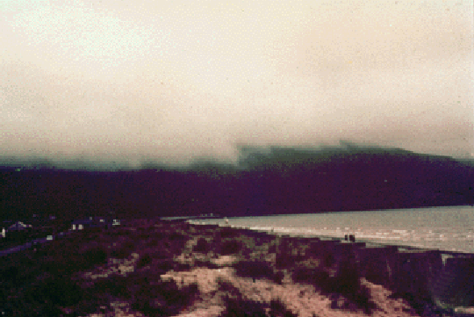
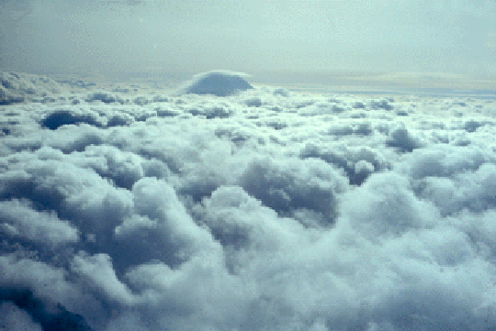
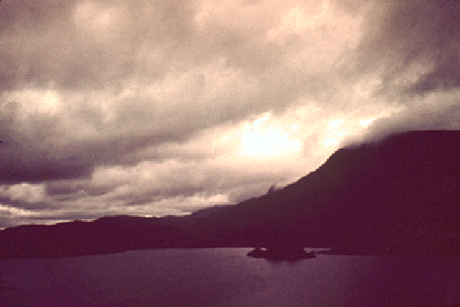
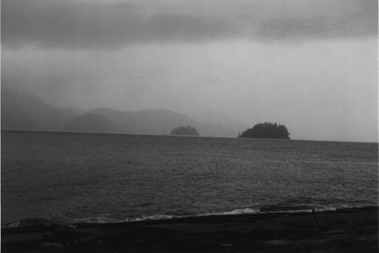
Stratus/Stratocumulus

Slide 12
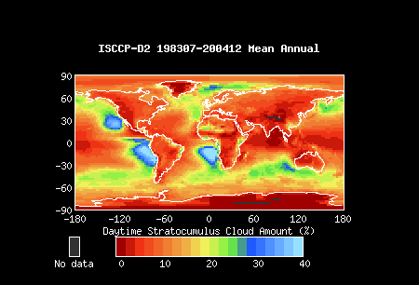
Global Distribution of Stratus Clouds
International Satellite Cloud Climatology Project (ISCCP)
http://isccp.giss.nasa.gov/

Slide 13
Stratiform Clouds and Climate
Net cooling effect on the climate
Largest areal coverage of any cloud type
Coverage greatest over the dark oceans
Susceptible to changes in reflectivity (albedo) due to changes in aerosol
The only cloud type in climate models that responds to changes in aerosol

Slide 14
Cumuliform Clouds
Cumulonimbus
strong winds
ice
Cumulus
congestus
-40ºC
ice, hail, snow
Cumulus
liquid and ice
liquid
liquid
Updraughts of air (1 ms⁻¹ to >30 ms⁻¹), unstable atmosphere, warm surface

Slide 15
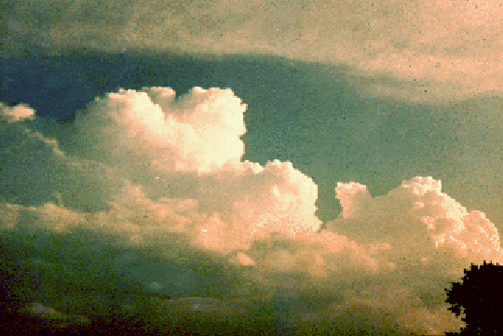
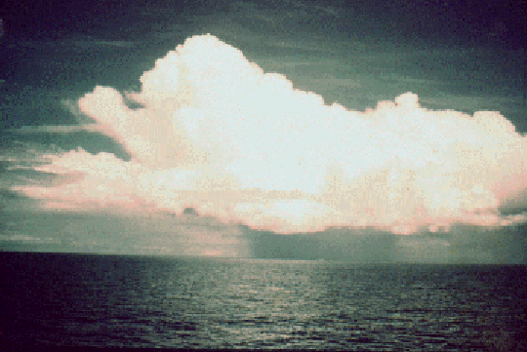
Cumuli

Slide 16
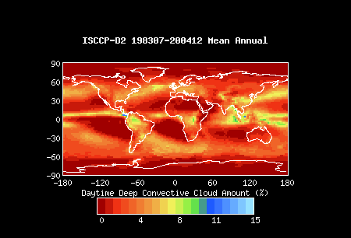
Global Distribution of Deep Cumulonimbus Clouds

Slide 17
Cumuli Clouds and Climate
Cb account for substantial vertical transport of latent heat
Cb account for much of world’s hazardous/damaging weather and flooding
Response to changing aerosol is being investigated
Possible changes in precip intensity, cloud depth, latent heat release

Slide 18
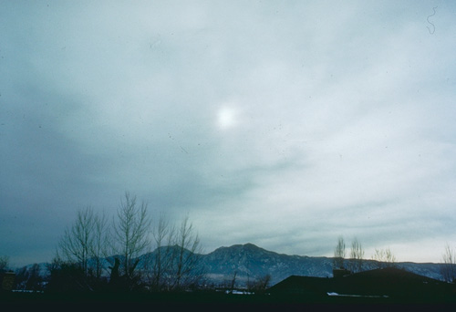
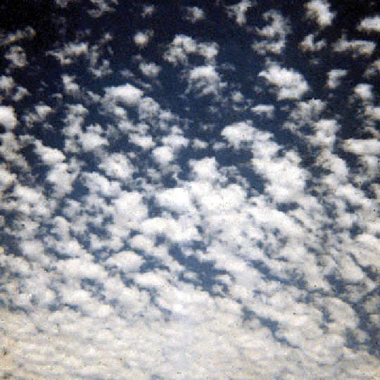
Alto Clouds
Altostratus
Altocumulus
liquid and ice
2-7 km
2-7 km
Large-scale uplift of air (e.g., in a front) at rate of a few cm s⁻¹

Slide 19
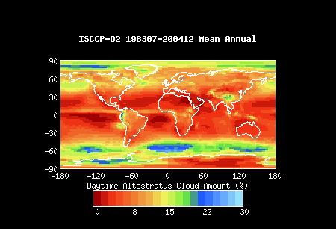
Global Distribution of Altocumulus Clouds

Slide 20
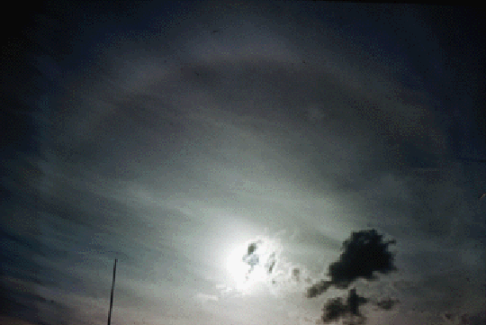
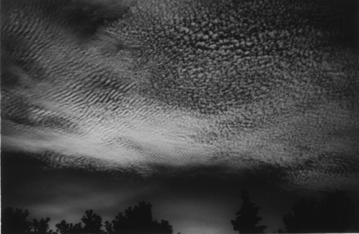
Cirrus Clouds
Cirrostratus
Cirrocumulus
ice
ice
halo
>7 km
>7 km
22º
Ice blown off top of cumulonimbus, large scale uplift

Slide 21
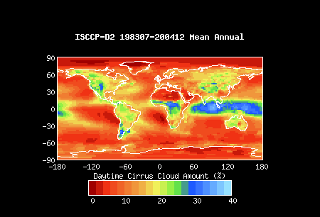
Global Distribution of Cirrus Clouds

Slide 22
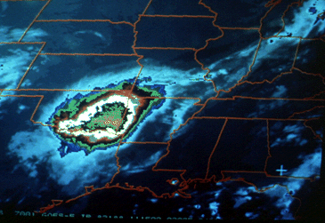
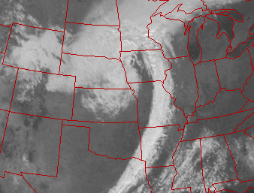
Cloud Systems
Mesoscale Convective System
Mid-latitude frontal cyclone
A group of convective storms covering several
hundred km. Severe rainfall, damaging winds,
flooding
Form in westerly wind belts of mid-latitudes.
Contain fronts and most of the cloud types
of previous slides.

Slide 23
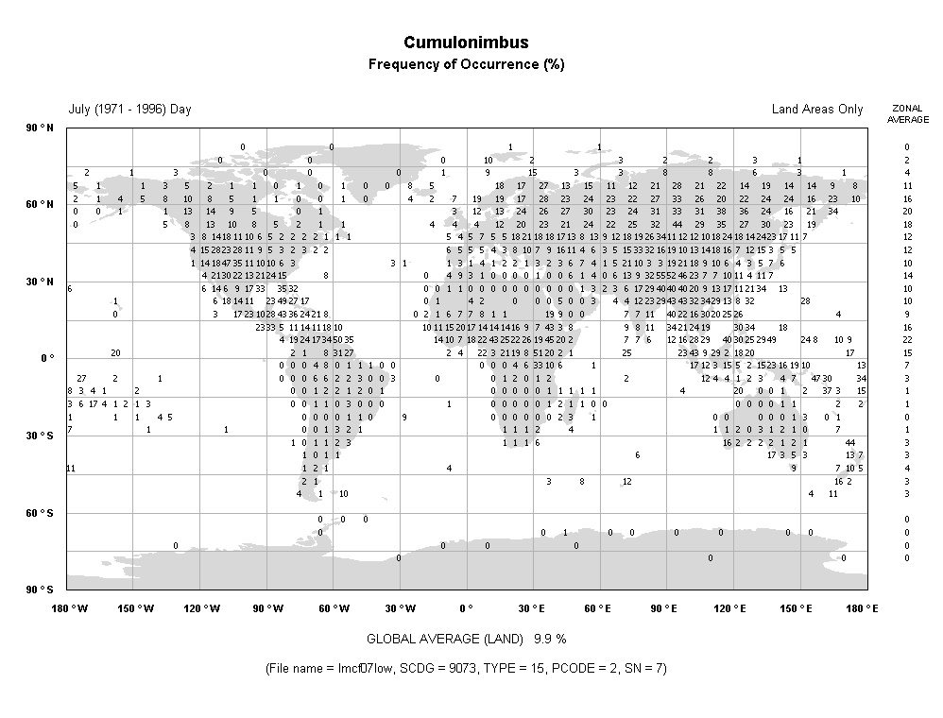
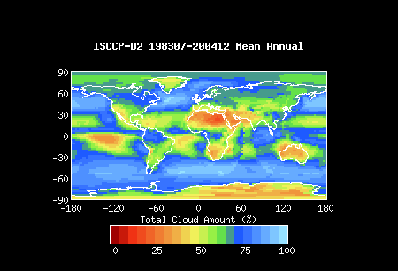
Measurements of global cloud types and coverage
Observations from surface stations
http://www.atmos.washington.edu/~ignatius/CloudMap/index.html
Observations from satellite
http://isccp.giss.nasa.gov/products/browsed2.html

Slide 24
Occurrence of Clouds (Oceanic areas)
Type | Frequency of occurrence (%) | Areal coverage over oceans (%)
Stratus and Stratocumulus | 45 | 34
Cumulus | 33 | 12
Cumulonimbus | 10 | 6
Nimbostratus | 6 | 6
Altostratus and altocumulus | 46 | 22
Cirrus | 37 | 13
Global average over oceans |  | 64.8

Slide 25
Occurrence of Clouds: Land areas (Ocean Areas)
Type | Frequency of occurrence (%) | Areal coverage over oceans (%)
Stratus and Stratocumulus | 27 (45) | 18 (34)
Cumulus | 14 (33) | 5 (12)
Cumulonimbus | 7 (10) | 4 (6)
Nimbostratus | 6 (6) | 5 (6)
Altostratus and altocumulus | 35 (46) | 21 (22)
Cirrus | 47 (37) | 23 (13)
Global average over oceans |  | 52.4
Ocean area values are given in parentheses

Slide 27
Physical Characteristics of Stratus Clouds
Location | Sc cloud base (km) | St cloud base (km) | St Thickness (km)
Moscow (USSR) | 1.07 | 0.47 | 0.38
Hamburg (DE) | 0.98 | 0.85 | 0.46
Cologne (DE) | 1.36 | 0.87 | 0.36
Mildenhall (UK) | 1.22 | 0.96 | 0.74
Susterberg (UK) | 0.9 | 0.7 | 0.5
Why are Sc cloud bases higher than St?

Slide 28
Microphysics of Stratus Clouds
Droplet concentration (cm⁻³) | Liquid water content (g m⁻³) | Mean droplet diameter (volume weighted) (μm) | Location
<500 | 0.09-0.63 | <19 | Arctic stratus
312 | - | - | Washington State
350 (Marine) 500 (Continental) | <0.3 | 7-11 | Off California coast
100-250 | 0.1-0.9 | 12-22 | Over UK
From Aerosol-Cloud-Climate Interactions, Ed P. V. Hobbs, Academic Press

Slide 29
Microphysics of Cirrus Clouds
10⁰
Typical crystal concentration in continental cirrus is 0.01-1 cm⁻³
Particle size varies with IWC and T
mm-size at –40 ºC
10-100 μm at –60ºC
10⁻¹
Continental cirrus
Ice water content (g m⁻³)
10⁻²
10⁻³
Tropical cirrus
10⁻⁴
-80 -70 -60 -50 -40 -30 -20
Temperature (ºC)

Slide 30
Questions for this lecture
At what approximate heights in the atmosphere do stratocumulus and cirrus clouds occur?
What explains the global distribution of stratus and cirrus clouds?
When you leave this lecture, what clouds are visible?
Define liquid water content
If a stratocumulus cloud has a liquid water content of 0.2 g m⁻³ and a droplet concentration of 200 cm⁻³, what would the mean droplet size be?
Extensions:
What is the “liquid water path” of a cloud of 1km depth with the microphysical properties of the previous question?
Why might satellite observations provide inaccurate information about cloud type, height and thickness?

Slide 31
Next lecture
Cloud microphysics
Drop formation – factors controlling drop number and size
Rain formation – what is needed?
The ice phase

