Slide 1
Introduction to MATLAB 3 Scripts, Functions,…real programming
Ian Brooks Institute for Climate & Atmospheric Science School of Earth & Environment
i.brooks@see.leeds.ac.uk

Slide 2
Scripts
Any set of Matlab commands saved to a (text) file with .m file extension
Whole script can be run simply by entering the filename (without .m) on the command line
Executes in the interactive workspace exactly as if you entered each line by line
Script can access existing variables
Any variables created by script remain in workspace when it has finished running

Slide 3
Example script: bams_fig8.m
figure
orient landscape
wysiwyg
clear all
load /worker/twelve/coastal_waves/jun07/data/section_jun07_3
sub1=subplot(2,2,1);
section_plot(gtheta,x,y,[],[],[],'x',[],'nonew');
extcontour(x(:,1),y,grhum,'label','color','w','fontsize',[9]);
txt=findobj(sub1,'type','text');
set(txt,'color','w')
xlimit=get(gca,'xlim');
ylimit=get(gca,'ylim');
aa=text([xlimit(1)],ylimit(2)+0.05*diff(ylimit),'a');
set(aa,'fontsize',[11],'fontweight','bold','color','k');
sub2=subplot(2,2,2);
section_plot(gmws,x,y,[],[],[0 30],'x',[],'nonew');
[xx,yy,gu]=reducegrid(x(:,1),y,gxuic,2,2);
[xx,yy,gv]=reducegrid(x(:,1),y,gxvic,2,2);
windvec(xx,yy,gu,gv,'screen','nonew','w');
xlimit=get(gca,'xlim');
ylimit=get(gca,'ylim');
bb=text([xlimit(1)],ylimit(2)+0.05*diff(ylimit),'b');
set(bb,'fontsize',[11],'fontweight','bold');

Slide 4
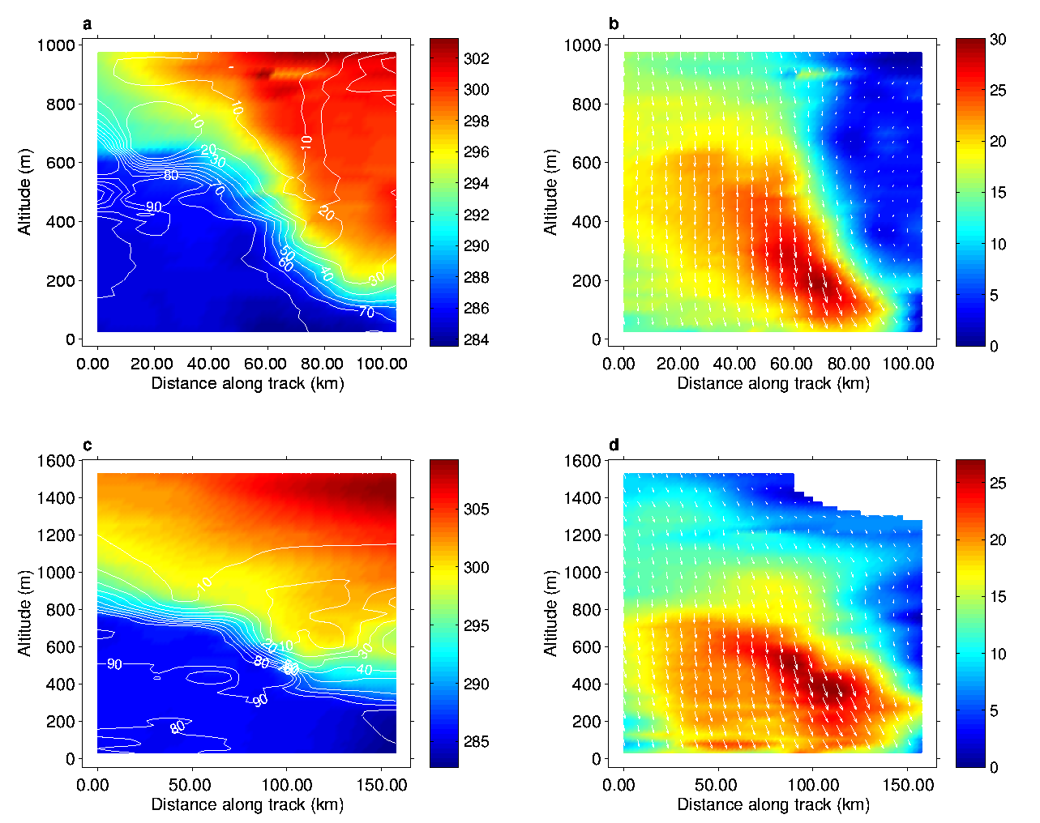

Slide 5
Functions
A MATLAB function is very similar to a script, but:
Starts with a function declaration line
function [out1,out2]=function_name(in1)
May have defined input arguments
May have defined output arguments
Executes in its own workspace: it CANNOT see, or modify variables in the calling workspace – values must be passed as input & output variables

Slide 6
Structure of a Function M-file
Keyword: function
Function Name (same as file name .m)
Output Argument(s)
Input Argument(s)
function [s,c,t] = allTrig(x_deg)
% input angle in degrees
% output sin, cos, tan
x_rad = 2*pi*x_deg./360;
s = sin(x_rad);
c = cos(x_rad);
t = tan(x_rad);
Online Help
MATLAB
Code
Notes:
Structure of a Function M-file
function y = mymean(x)
%MYMEAN Average or mean value.
% For vectors, MYMEAN(x) returns the
% mean value. For matrices, MYMEAN(x)
% is a row vector containing the mean
% value of each column.
[m,n] = size(x);
if m == 1
m = n;
end
y = sum(x)/m;
Required
You must use the keyword function on the first line of your
function M-file.
When you save your function M-file make certain that the
function name is the same as the filename.
You are saving this function file from the MATLAB
Editor/Debugger and therefore, this file has a *.m extension.
MATLAB code – Contains the MATLAB expressions to
be executed as part of function.
Optional
Input/Output argument(s) – These define the internal
variable names.
Online help – Comment lines following immediately after
the function definition line. (The first line in the Online
Help is referred to as the “H1” line. The percent (%) symbol
must be the first character in the line. The lookfor
command uses the H1 lines in its search.)
Command Line Syntax
When calling a function from the command line, MATLAB searches the path for an M-file with the specified name (does not search for the function name in the text).
Input variable name(s) defined in the first line of the function are used in the function code. The results produced by the function code must be stored in variable(s) with the same name as the output argument(s).

Slide 7
There are many functions built-in or supplied with MATLAB.
A few very basic functions are built in to the matlab executable
Very many more are supplied as m-files; the code can be viewed in command window by entering: >> type function_name
or in the editor by entering
>> edit function_name
Supplied m-files can be found, grouped by category, in $matlab_root_dir/toolbox/catagory

Slide 8
Workspaces or Stacks in MATLAB
MATLAB (or base) workspace:
For command line variables.
Function workspaces:
Each function has its own workspace for local variables.
Communicate to function workspace via inputs and outputs.
(Promotes structured coding and prevents name conflicts.)
Global workspace:
Global variables can be shared by multiple workspaces.
(Must be initialized in all relevant workspaces.)
NOTE: Script files share the workspace of the function they are called from, or the base workspace if called from the command line.
Notes:
Workspaces or Stacks in
MATLAB
Each M-file function has an area of memory, separate from
the MATLAB base workspace, in which it operates. This
area is called the function workspace, with each function
having its own workspace context. While using MATLAB,
the only variables you can access are those in the calling context,
be it the base workspace or that of another function. The variables that you pass to a function must be in the calling context, and the function returns its output arguments to the calling workspace
context. You can, however, define some variables as global
variables explicitly, allowing more than one workspace context to access them.
MATLAB (or Base) Workspace
For command line variables.
Function Workspaces
Each function has its own workspace for local variables.
This workspace communicates with the function workspace via
inputs and outputs (promotes structured coding and prevents
name conflicts).
Global Workspace
Global variables can be shared by multiple workspaces (must be initialized in all relevant workspaces).
Script files share the workspace of the function they are called from, or the base workspace if called from the command line.
Below are some functions related to working with M-file function workspaces.
mlock – Prevent M-file from being cleared
munlock – Allow M-file to be cleared
persistent – Persistent variables keep their value from one function call to another. They are removed only when the function is cleared from memory. However the M-file can be locked with mlock.

Slide 9
Function Help
MATLAB uses the ‘%’ character to start a comment – everything on line after ‘%’ is ignored
A contiguous block of comment lines following the first comment, is treated as the ‘help’ text for the function. This block is echoed to screen when you enter >> help function_name This is very useful…use it when writing code!

Slide 10
e.g. help text from a function to calculate equivalent potential temperature
>> help epot
MATLAB FUNCTION EPOT
Calculates theta_e by Bolton's formula (Monthly Weather Review 1980 vol.108, 1046-1053)
usage: epot=epot(ta,dp,pr)
outputs
epot : equivalent potential temperature (K)
inputs ta : air temp (K)
dp : dew point (K)
pr : static pressure (mb)
IM Brooks : july22 1994

Slide 11
function epot=epot(ta,dp,pr)
% MATLAB FUNCTION EPOT
% Calculates theta_e by Bolton's formula (Monthly Weather % Review 1980 vol.108, 1046-1053)
%
% usage: epot=epot(ta,dp,pr)
%
% outputs
% epot : equivalent potential temperature (K)
% inputs ta : air temp (K)
% dp : dew point (K)
% pr : static pressure (mb)
%
% IM Brooks : july22 1994
% ensure temperatures are in kelvin
ta(ta<100)=ta(ta<100)+273.15;
dp(dp<100)=dp(dp<100)+273.15;
% where dewpoint>temp, set dewpoint equal to temp
dp(dp>ta)=ta(dp>ta);
% calculate water vapour pressure and mass mixing ratio
mr=mmr(dp,pr);
vap=vp(dp);
% calculate temperature at the lifing condensation level
TL=(2840./(3.5*log(ta) - log(vap) - 4.805))+55;
% calculate theta_e
epot=ta.*((1000./pr).^(0.2854*(1-0.28E-3*mr))).* ...
exp((3.376./TL - 0.00254).*mr.*(1+0.81E-3*mr));
What it does
How it’s called
What input and outputs are (and units!)
Good coding practice, note what and why…you will forget

Slide 12
Editing code
Can use ANY ascii text editor
Windows: Notepad
Linux: vi, emacs, k-edit, kate,…
Matlab has a built in editor, to start it:
> edit
or to edit an existing code
> edit filename.m
Matlab editor will:
Color-code text according to context/syntax
Highlight incorrect syntax (errors)
Highlight points where code could be more efficient

Slide 13
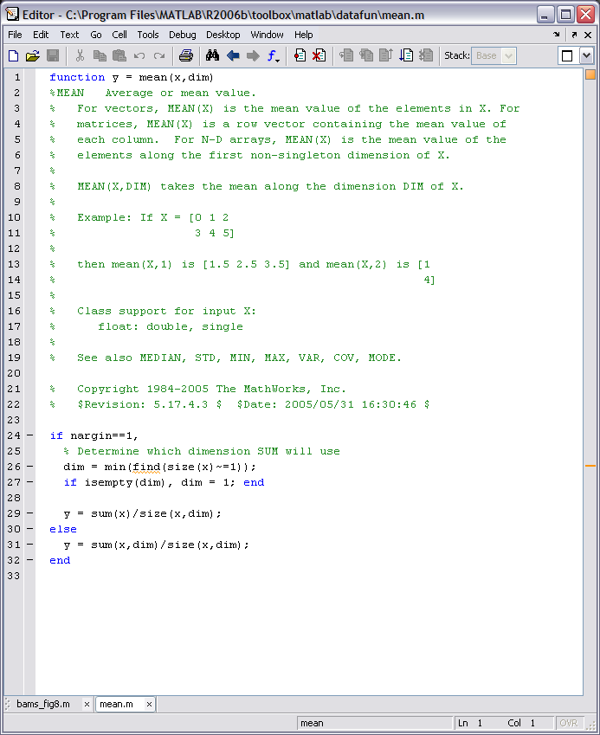
Code state:
green: perfect
red: errors
orange: hints
Line numbers
(given by error messages)
Code optimisation flag
Words highlighted blue are reserved words

Slide 14
The parts of a function
Function declaration line (header) defines input & output variables
Assignment statements assign values to variables, modify values of existing variable
Output statements display outputs: graphics, numeric values, write files…
Programme flow-control decision making (logic), loop control, iteration

Slide 15
Function declaration
[out1,out2]=afunction(in1,in2,in3,in4) it is not necessary to use ALL of the output arguments (variables) when calling the function.
It is possible to write functions to handle variable numbers of inputs & outputs – e.g. use of optional inputs, or changing behaviour in response to number of outputs called.
You CANNOT use more inputs/outputs than defined in the function declaration.
output variables
Input variables

Slide 16
Handling optional input/output variables
nargin – returns number of input arguments used in actual function call
nargout – returns number of output arguments used in actual function call
function [x,y]=myfunction(a,b,c) % …help text… if nargin<3 c=1; end
…rest of code…
Set a default value if an input variable is not supplied

Slide 17
If, else, elseif
Generic form:
example
if condition
statements;
elseif condition
statements;
else
statements;
end
if A<0
disp(‘A is negative’)
elseif A>0
disp(‘A is positive’)
else
disp(‘A is neither’)
end
condition – a logical statement: evaluates to true (1) or false (0)
statements – and other valid matlab statements
disp function displays a string in command window

Slide 18
Don’t need all the parts of if/then/else
if condition
statements;
else
statements;
end
if condition
statements;
end

Slide 19
for loops
N.B. can specify non-integer values for n
but can only use integers as array indices
Generic form:
example
for n = firstn:dn:lastn
statements;
end
for n = 1:10
x(n)=n^2;
end
N.B. loops are rather inefficient in MATLAB, the example above would execute much faster if vectorized as
>> x=[1:10].^2;
If you can vectorize code instead of using a loop, do so.

Slide 20
while loops
Initialise control variable before starting loop
Generic form:
example
while condition
statements;
end
n = 1;
while n <= 10
x(n)=n^2;
n=n+1;
end
Modify control variable within loop
The statements within the while loop are executed repeatedly while the condition is true. Example does exactly the same as the for loop in previous example (another inefficient loop).
If the condition is false when first tested, the statements in the while loop will never be executed.

Slide 21
while loops are often used where it is not known in advance how many iterations of the loop will be required
done = false;
count = 0;
while ~done
count = count + 1;
lasta = a2;
a2 = fix((B2-B1)/(PWR*da))*da;
if abs(a2-lasta)<(3*da)
done=1;
end
end
The values of lasta and a2 change each time round the loop, iteration continues until the condition in if statement is true

Slide 22
Keeping code readable
Indent code within blocks – i.e. Between pairs of:
if...end
if...else...elseif...end
while...end
for....end
Indent one level for EACH nested block of code.
Indenting makes it MUCH easier to read your code, and thus easier to debug.

Slide 23
Pre-allocating arrays
Matlab stores arrays as contiguous blocks of memory. If an array grows inside a loop
e.g.
for n=1:5000
X(n) = n.^2;
end
Then matlab may have to keep moving the location of the variable in memory – repeatedly copying it – this slows down the code. If you know how big the variable needs to be, predefine it to pre-allocate the required block of memory.
A = [1:500000];
x = zeros(size(A));
for n = 1:length(A)
x(n) = somefunction(A(n));
end

Slide 24
Debugging code
If you have an error in your code, and error message will be displayed when it is run, e.g.
??? Error: File: quadplot.m Line: 14 Column: 23
Unexpected MATLAB expression.
This (usually) gives a hint as to the type of error, and the location in the code. NB. Since matlab code is not compiled (in traditional sense) errors are identified ONLY when that line of code is run.
If you can’t figure out the problem just by examining the code…

Slide 25
...use interactive mode inside a function
Add temporary statements to code to display information you need as it runs:
Use the keyboard function
This halts execution of the function and returns command to the keyboard/command window, but leaves you in the function’s workspace – can inspect variables, change values, etc. Enter return to resume running the function
(N.B. if used inside a loop, control will be passed to keyboard on every iteration)

Slide 26
Setting breakpoints
Matlab editor has a ‘debug’ menu
Set breakpoints to stop code at a particular point and allow you to step through line by line
Set conditional breakpoints that stop execution if a certain condition is met
Set stop-on-error flag – code will stop and pass control to keyboard if an error or warning is encountered
(warnings are non-fatal errors, code will still run but is technically invalid, e.g. divide by zero)

Slide 27
ctrl-c
If code is running much longer than seems reasonable – it may be stuck in an infinite loop
Condition for exiting a while loop never met
Condition being tested in wrong place
Control variable ina for loop getting reset so its maximum value is never reached
Can force code to stop with ctrl-c

Slide 28
Non-fatal errors
Just because your code doesn’t have any syntax errors, and runs OK, doesn’t mean it does what you intended.
If the results you get don’t make sense, you probably have an error in the logic underlying your code…welcome to life as a programmer!

Slide 29
Strings
MATLAB treats strings as arrays of characters
A 2D ‘string’ matrix must have the same number of characters on each row!
>> name = [‘Ian’,’Brooks’]
name =
IanBrooks
>> name=[‘Ian';‘Brooks']
??? Error using ==> vertcat
All rows in the bracketed expression must have the same
number of columns
>> name=[‘Ian ';‘Brooks']
Name =
Ian
Brooks

Slide 30
Can concatenate strings as:
>> firstname = ‘Ian’;
>> secondname = ‘Brooks’;
>> fullname = [firstname,‘ ’,secondname]
fullname =
Ian Brooks
Strings defined within single quotation marks
⇒ quotation mark within a string needs double quoting (2 single quotes)
>> thetitle = 'Ian Brooks’’s matlab class'
thetitle =
Ian Brooks’s matlab class

Slide 31
String functions
strcmp(str1,str2) - returns true (1) if str1 & str2 are equal
findstr(S1,S2) - returns index to location of any occurrences of shorter string in longer
strfind(text,pattern) - returns index to occurrences of pattern in text
See also…
strncmp, strmatch,…helpdesk string functions section

Slide 32
Good programming style
Break the job down into discrete parts – write the code to do each part
For complex tasks start with a flow chart or algorithm
COMMENT you code
Use meaningful variable names – they can be as long as needed
If part a section of code needs to run more than once…think about making it a separate function or sub-function
Good code management
Keep code in one or more dedicated directories – separate from data
Use meaningful function names
Include a ‘help’ section of comments at the start of each function – include details of inputs/outputs and any options
Beg/borrow/steal code from colleagues…don’t waste time reinventing something that’s already been done. Almost all programming is changing existing code, not writing new stuff! (honest!)

Slide 33
Helping you stay organised
Save groups of related functions in their own directory…
By application
By project
Matlab will only find code that is:
Part of core matlab installation
In the current working directory
On the search path
Can add directories to the path with the addpath command, e.g.:
> addpath d:\matlab\meteorology
startup.m file: if this file exists on the path, it will be run automatically at startup:
Windows network install:
M:\matlab – directory should be created when matlab first run. Put startup.m in here
LINUX
/home/USERNAME/matlab

Slide 34
Put any code you ALWAYS want run into startup.m
Example startup.m file (from my laptop)
%-------------------------------------
% Matlab startup file for IMB's laptop
%-------------------------------------
%-- add paths for my m-files –
addpath d:/matlab/aerosol
addpath d:/matlab/coastal
addpath d:/matlab/lidar
addpath d:/matlab/ndbc
addpath d:/matlab/page
addpath d:/matlab/sections
addpath d:/matlab/sharem
addpath d:/matlab/sonics
addpath d:/matlab/wavelet
addpath d:/matlab/LEM
addpath d:/matlab/GPSbook
addpath d:/matlab/FAAM
addpath d:/matlab/FAAM/winds
addpath d:/matlab/faam/bae
addpath d:/matlab/TREX
addpath d:/matlab/SEASAW
addpath d:/matlab/SEASAW/turbulence
addpath d:/matlab/SEASAW/SBWR
addpath d:/matlab/tethersonde
addpath d:/matlab/chilbolton
addpath d:/matlab/ASCOS
addpath d:/matlab/ASCOS/scratch
addpath d:/matlab/sodar
% COARE bulk flux algorithm
addpath d:/matlab/bulkflux/cor2.5
addpath d:/matlab/bulkflux/cor2.6
addpath d:/matlab/bulkflux/cor3.0
addpath d:/matlab/bulkflux/gasflux/CO2
addpath d:/matlab/bulkflux/gasflux/ozone
% netCDF Tools
addpath d:/matlab/MEXCDF % my netCDF functions
addpath d:/matlab/MEXCDF/mexnc
addpath d:/matlab/MEXCDF/mexnc/tests
addpath d:/matlab/MEXCDF/snctools
addpath d:/matlab/MEXCDF/snctools/tests
%-- add path for generic data --
addpath d:/matlab/coastlines % coastline data
%----------------------------------------------------------------------
%-- set default figure options –
set(0,'DefaultFigurePaperUnits','inches')
% v6 defaults to cm for EU countries
set(0,'DefaultFigureRenderer','painters')
% v7 default OpenGL causes problems

