Slide 1
Agent-based modelling
Dr. Minh L. Kieu
Prof. Nick Malleson
Dr. Jaiqi Ge
GEOG5927 Predictive Analytics 2019

Slide 2
What are we doing today?
All about the individual
Learning about agent-based modelling
  What is it?
  What are the key concepts?
Big Data and Smart Cities

Slide 3
How does this fit within the course?
Clustering, segmentation, data mining, responsive modelling
Microsimulation:
  building a population
  Applying within responsive modelling
Increasingly moving from aggregate to the individual
This part of the course represents the next stage in modelling…

Slide 5
Time-table
14.00 - 16.00 Monday 26th November 2018: Lectures
  What is an ABM? (MK)
  Key concepts in ABM (MK)
  Big Data, Smart Cities and ABM (MK)
9:30 – 12:30 (NM) & 13:30 – 16:30 (MK) Wednesday 28th November 2018: Practicals
  Assignment 2
  Introduction to Netlogo
  Netlogo practicals

Slide 6
What is Agent-based modelling?

Slide 7
Aggregate vs Individual Level
‘Traditional’ modelling methods work at an aggregate level, from the top-down
  E.g. Regression, spatial interaction modelling, location-allocation, etc.

Slide 8
Aggregate vs. individual-level
Aggregate models work very well in some situations
  Homogeneous individuals
  Interactions not important
  Very large systems (movement of people)
But they miss some important things:
  Low-level dynamics, i.e. “smoothing out” (Batty, 2005)
  Interactions and emergence
Unsuitable for modelling complex systems
Notes:
Batty, M. (2005). Agents, cells, and cities: new representational models for simulating multiscale urban dynamics. Environment and Planning A, 37:1373–1394.

Slide 9
What is a complex system?
Lots of individual components (individuals, organisations)
Each have a relationship with other components
Changes over space
Changes over time
Unknown what the outcome is (emergence).

Slide 10
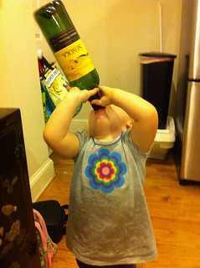
Aggregate vs. individual-level
Systems are driven by individuals
  (cars, people, ants, trees, whatever)
Not controlled by god
Bottom-up modelling
  An alternative approach to modelling
  Rather than controlling from the top, try to represent the individuals
  Account for system behaviour directly
Picture by Wayan Vota
(http://www.flickr.com/photos/dcmetroblogger/)

Slide 11
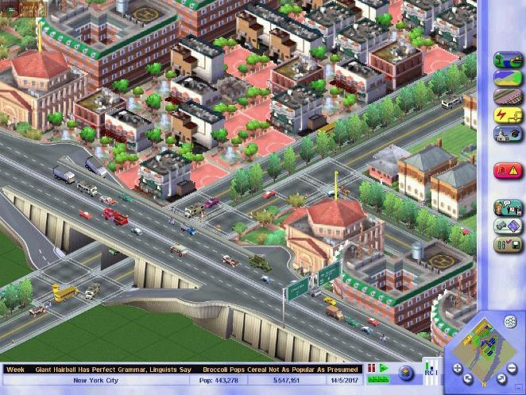
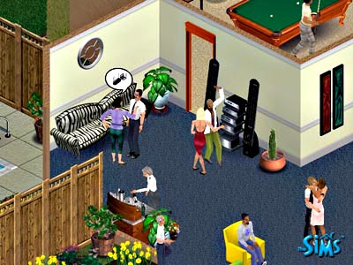
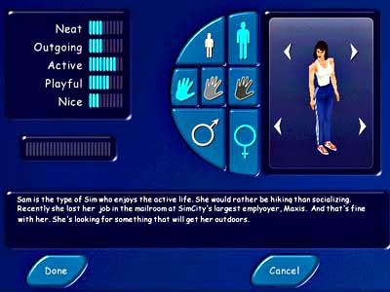
Agent-Based Modelling (ABM)
Autonomous, interacting agents
Represent individuals or groups
Situated in a virtual environment

Slide 12

Example: SimCity
https://www.youtube.com/watch?v=vS0qURl_JJY
Photo attributed to James Cridland

Slide 13
What is an agent? (I)
No universal definition
But most people agree that agents should exhibit some of the following criteria
Autonomy
  Act independently, free from central control
  Control its own state and make independent decisions
Notes:
https://www.bartlett.ucl.ac.uk/casa/pdf/paper110.pdf

Slide 14
What is an agent? (II)
Heterogeneity
  Agents should not normally be identical
  Groups of similar agents are formed from the ground-up (e.g. by agents interacting with each other)
Reactivity
  Agents can sense their environment and respond to changes
  Responses should be goal-directed

Slide 15
What is an agent? (III)
Bounded rationality
  Agents should not have full knowledge of the world (this would be very unrealistic)
  Environmental perception can be limited
  Choices will not be perfectly rational – they can make mistakes
Interactive
  Agents can communicate with each other
  Could be dependent on environment (e.g. distance)

Slide 16
What is an agent? (IV)
Mobile
  Often agents will be able to navigate a space.
Learning / adaption
  Agents should be able to adapt future decisions, based on past experiences

Slide 17
How does this differ from microsimulation?
What is microsimulation?
The generation at time t = 0 of a population sample P made up of n individuals.
Each individual has a set of attributes.
Attributes can be updated over time.
Initial population often taken from population samples in large scale surveys (more later).

Slide 18
How does it differ from ABM?
M’sim: units representing individuals/households are generated. Rules can be applied to each unit. Individuals updated at end of each iteration.
ABM: units representing individuals/households are generated. Rules can be applied to each unit. Individuals can be updated asynchronously.
BUT individuals can interact with each other.

Slide 19
Appeal of ABM (I)
Most ‘natural’ way of thinking about social systems
  Individual actions drive the system
Modelling emergence
  “A phenomenon is emergent when it can only be described and characterised using terms and measurements that are inappropriate or impossible to apply to the component units”
  - Gilbert (2004) page 3.
Notes:
Gilbert, N. (2004). Agent-based social simulation: dealing with complexity. http://www. econ.iastate.edu/tesfatsi/ABM.DealingWithComplexity.Gilbert.pdf [accessed - January 2007].

Slide 20
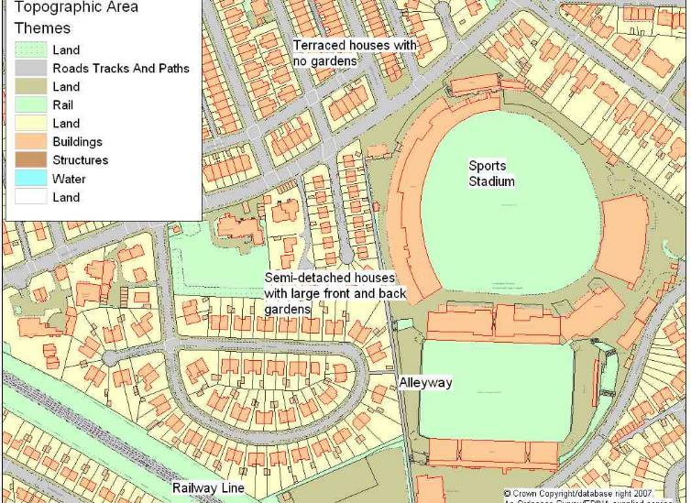
Appeal of ABM (II)
Can include physical space / social processes
Designed at abstract level: easy to change scale
Notes:
“The appeal is undeniable: it appears obvious that individual-level decision making is the fundamental driver of social systems” (O’Sullivan et al. 2012)

Slide 21
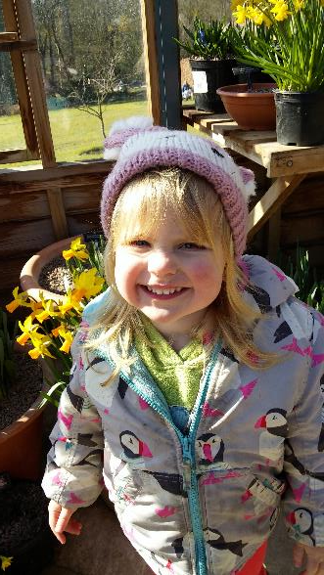
Disadvantages of ABM (I)
Known unknowns
  We don’t know exactly what someone will do.
  So we guess
    E.g. There is a 30% change of attending this morning’s lecture, and 70% chance of staying in bed
Models that use randomness like this are probabilistic
The need to run many times to ensure robust results
Calibrating and validating
Notes:
‘Known unknowns’ comes from a quote by Donald Rumsfeld:
“... there are known knowns; there are things we know that we know.
There are known unknowns; that is to say, there are things that we now know we don't know.
But there are also unknown unknowns – there are things we do not know we don't know.”
See the wikipedia article: https://en.wikipedia.org/wiki/Unknown_unknown

Slide 22
Disadvantages of ABM (II)
Computationally expensive.
  Complicated agent decisions
  Lots of decisions!
  Multiple model runs (robustness)
Modelling “soft” human factors
  Benefit that we can include complex psychology
  But this is really hard!
Potential to over-complicate
  Need to think carefully about what to include
Notes:
Over-complication: If the model is too complicated to analyze, all we have done is to replace one poorly understood object of study with another, which we know to be incomplete! (O’Sullivan et al. , 2012)

Slide 24
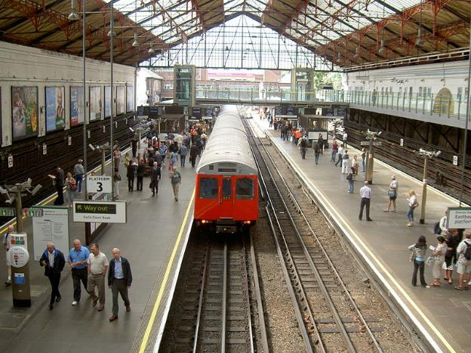
Example 1:
Train Station simulation model
https://urban-analytics.github.io/dust/p/2018-07-15-abmus-da.html#/StationSim-videos

Slide 25
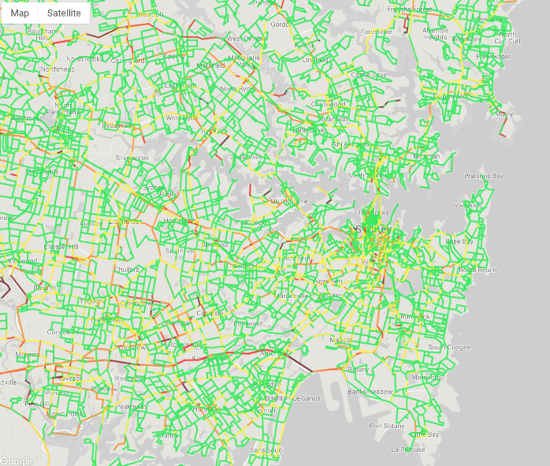
Example 2:
Large-scale simulation of urban traffic incidents
https://youtu.be/_wzuBVzpI1A
Project info:
http://adait.io/inno-pii.html

Slide 26

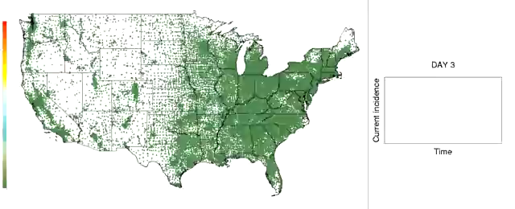
Example 3: Simulation of a pandemic flu outbreak in the continental United States, initially introduced by the arrival of 10 infected individuals in Los Angeles
Each dot represents a Census tract and changes color from green to red as more people in that tract become infected
Source: http://tinyurl.com/4oxxx3l & http://tinyurl.com/4lerjwv
Notes:
Focus is on peoples movement throughout the continent (Ran on a super computer)
Large-scale agent-based simulation involves 280 million people,
Uses demographic and worker flow data at the Census tract level,
Long-range travel statistics, to describe the geographic movement of people.

Slide 27
Summary points
ABM allows us to model the individual
It is different from microsimulation: there is no interaction between units in microsimulation.
By giving agents rules, we can simulate different behaviours.
More on how we do this and the data we use in the next lectures.

Slide 28
Key Concepts in ABM
Dr. Minh L. Kieu
Prof. Nick Malleson
Dr. Jaiqi Ge
GEOG5927 Predictive Analytics 2019

Slide 29
This lecture
Complex systems
Emergence
Interaction
Behaviour

Slide 30
This lecture
Complex systems
Emergence
Interaction
Behaviour

Slide 31
Complex Systems
Systems that exhibit the following features can be called ‘complex’.
Complex systems are
  Non-linear: Relationship between two variables is not linear (Predator-prey)
  Driven by large numbers of variables
  Have emergence as a key feature
  Can demonstrate spatial and temporal variance

Slide 32
This lecture
Complex systems
Emergence
Interaction
Behaviour

Slide 33
Emergence: What is it?
Simple rules -> complex outcomes
  In the past, we have assumed that complex phenomena are driven by a complex mechanism
  This is not always the case
Possible to prove the with simple computer programs
  Agent-based models are one example, others to follow…

Slide 34
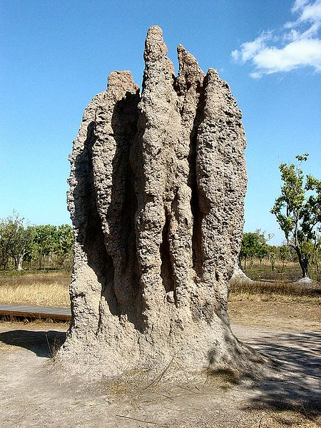
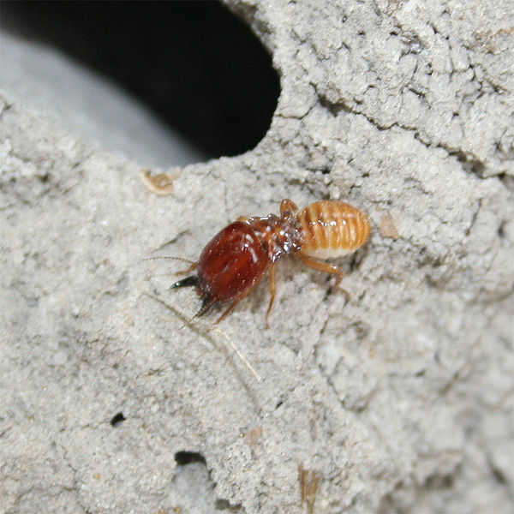
Emergence: What is it?
“A property of a collection of simple sub-units that comes about through the interactions of the subunits and is not a property of any single subunit”
- Gary Flake
“The way that complex systems and patterns arise out of a multiplicity of relatively simple interactions”
- Wikipedia
“The whole is greater than the sum of its parts.”
- Aristotle (?)
Attribution: Discott
https://en.wikipedia.org/wiki/User:Discott
Attribution: Yewenyi at the English language Wikipedia
https://en.wikipedia.org/wiki/User:Yewenyi

Slide 35
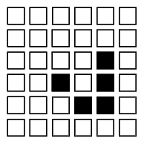
Example: The Game of Life
A cellular automata
Beautiful example of simple rules leading to complex outcomes
Cells can be alive (black) or dead (white)
Rules for each cell:
  If dead, and alive neighbours = 3 → Alive
  If alive, and alive neighbours < 2 → Die of loneliness
  If alive and alive neighbours > 3 → Die of overcrowding
  Otherwise, stays as it is.
Notes:
OK, I got a little over-excited with the Game of Life. Don’t worry too much about this, you’re not going to have to recount the rules for the game of life in an exam. The point is that this is a beautiful example of the way that complex patterns can emerge from the simplest of rules. Just sit back and marvel at the pretty patterns ☺
You can run different creatures here… http://www.bitstorm.org/gameoflife/
This site also gives the rules, thus…
For a space that is 'populated':
Each cell with one or no neighbors dies, as if by loneliness.
Each cell with four or more neighbors dies, as if by overpopulation.
Each cell with two or three neighbors survives.
For a space that is 'empty' or 'unpopulated'
Each cell with three neighbors becomes populated.
MORE ON GAME OF LIFE FROM Matt PArker
An in-depth intro to Game of Life can be found at Wolfram Mathworld and (for the less brave) on Wikipedia
http://mathworld.wolfram.com/GameofLife.html
http://en.wikipedia.org/wiki/Conway%27s_Game_of_Life
Here are the patterns I showed:
Glides: http://en.wikipedia.org/wiki/Glider_%28Conway%27s_Life%29
Glider gun: http://en.wikipedia.org/wiki/Gun_%28cellular_automaton%29
Various spaceships: http://www.conwaylife.com/wiki/Spaceship
Turing machine: http://rendell-attic.org/gol/tm.htm
Gemini organism: http://conwaylife.com/wiki/Gemini

Slide 36
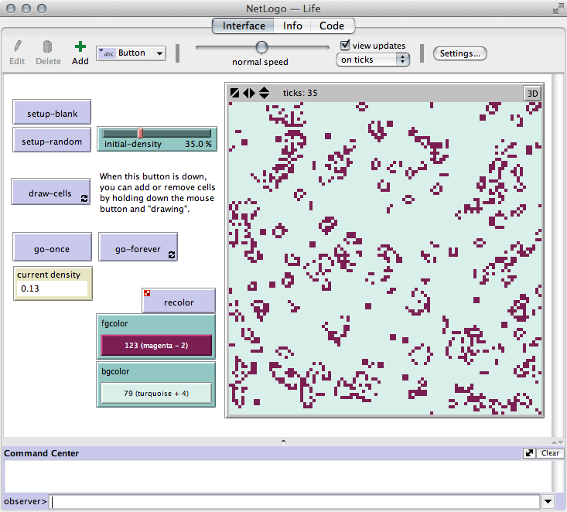
The Game of Life in NetLogo
‘Life’ model

Slide 37
Emergence: why is it important?
Key message: Complex structures can emerge from simple rules
Emergence is hard to anticipate
Cannot be deduced from solely analysis of individuals’ behaviour
Emergence is a characteristic of complex systems

Slide 38
Emergence: why is it important?
Global (macro) level patterns are the result of micro interactions.
Individual-level modelling is focused on understanding how macro-level patterns emerge from micro-level through the process of simulation.
Macro: global scale e.g. the largest scale you are modelling at e.g. regional, country
Micro: small scale e.g. individuals, households

Slide 39

Real Example: Segregation – Schelling
Thomas Schelling (Harvard) looked at racial segregation.
  You will experiment with his model in the practical this Wednesday!
NETLOGO
Notes:
Models of Segregation (in Strategic Theory and Its Applications, Thomas C. Schelling (1969) The American Economic Review, Vol. 59, No. 2, Papers and Proceedings of the Eighty-first Annual Meeting of the American Economic Association. (May, 1969), pp. 488-493.
http://links.jstor.org/sici?sici=0002-8282%28196905%2959%3A2%3C488%3AMOS%3E2.0.CO%3B2-S

Slide 40
This lecture
Complex systems
Emergence
Interaction
Behaviour

Slide 41
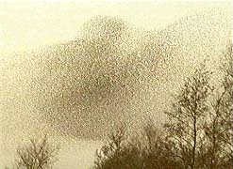
Interactions:
Global and Local
Attribution: Yewenyi at the English language Wikipedia
https://en.wikipedia.org/wiki/User:Yewenyi
Interactions: a key part of agent-based models
  One of the most powerful elements for modelling complex systems
Global interactions
  Macro scale of the model: these can result in immediate massive changes on all agents. E.g.:
    A new policy on migration
    Climate change
    Limits on number of children couples allowed to have.
Local interactions
  Interactions that occur at the micro or meso level. These only affect those in the local vicinity.

Slide 42
Interactions
Interactions can be spatially constrained:
  Neighbourhood feuds
  Car crashes
Or a-spatially (e.g. across social networks):
  Exchange of information between students about a cool new CAMS Masters course…! Not explicitly spatially defined.
  Twitter
From interactions, new information, new interactions etc emerge.
Interactions add to the complexity of the system.
Getting the interactions correct is crucial.

Slide 43
As the experts say…
“In an agent-based model we can model interactions explicitly as ways that individual agents affect each other and their environment. Consequently, the effects of interaction, and even the kinds of interaction, can depend on the state of the agents (including…their location) and on their environment”
    Railsback and Grimm p.169, (2012)

Slide 44
Types of Interactions
Direct interaction: agents directly interacting with each other affect each other e.g. exchanging information.
Mediated or indirect interaction: agents interact indirectly via a mediating resource e.g. competition for a shared resource.

Slide 45
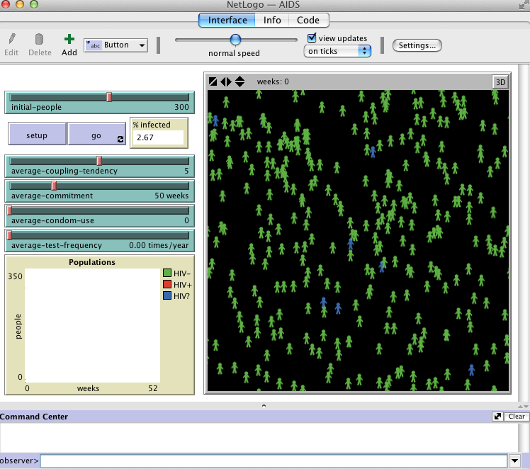
Simple Example: Direct Interaction
NetLogo > Models Library > Social Science > AIDS
Simulates the spread of HIV through an isolated population.
Turtle = Human
People form sexual relationships
  Stand still in a relationship
  Otherwise walk around
Everyone tests for HIV occassionally
Infected status:
  Green -> uninfected
  Blue -> infected (unknown)
  Red -> infected (known)
Known infected always use a condom (and these never fail)

Slide 46
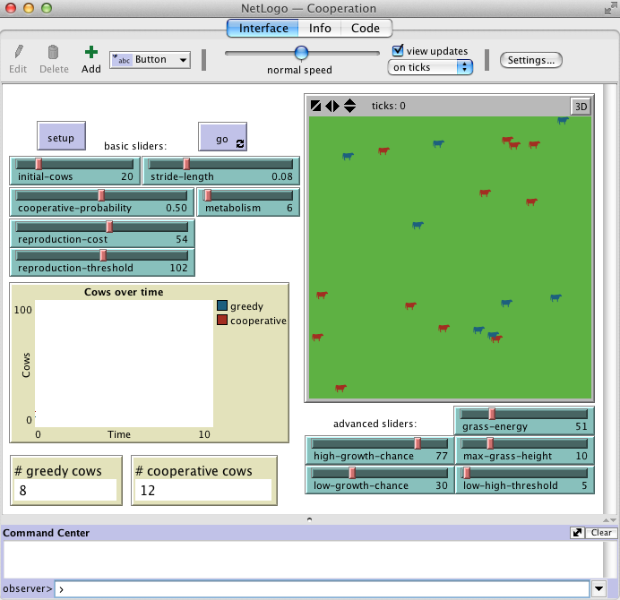
Simple Example: Indirect Interaction
NetLogo > Models Library > Social Science > Cooperation
Turtle = Cow
Patch = Amount of grass on each patch variable. Short grass grows more slowly.
Cows are competing for a resource. Successful cows reproduce more often
Two behaviours:
  Cooperative: don’t eat short grass
  Greedy: always eat
  “Cooperative agents leave more food for the overall population at a cost to their individual well-being”

Slide 47
This lecture
Complex systems
Emergence
Interaction
Behaviour

Slide 48
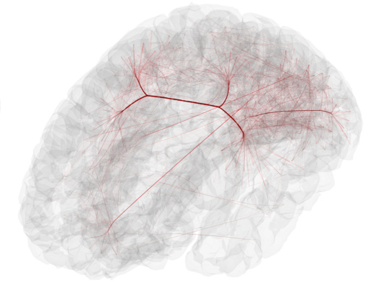
Modelling Behaviour
Great advantage of ABM!
But lots of important decisions about what to include in a model (and how).
Photo attributed to Arts Electronica (CC BY-NC-ND 2.0)

Slide 49
Modelling Behaviour
Choose a number between 1 and 4
What percentage of people will choose
  1 : ?
  2 : ?
  3 : ?
  4 : ?
Notes:
https://www.polleverywhere.com/multiple_choice_polls/OLaZoLv2B2BQsFR
This example, from Kennedy (2012), shows that human behaviour is not random.
“The most common response is “three” and there is a secondary effect of this task: people feel a need to explain why they chose whatever answer they did. The second most common answer is “two”. Very few people decide to respond with either “one” or “four”. Sadly, there is not a serious study of this behaviour but undocumented sources suggest that the response statistics are close to 50% for “three”, 30% for “two” and about 10% for the other two answers. “
“This behaviour is interesting. The decision-making process should be simple, but it certainly does not appear to be a simple random selection among equally likely options. What this shows us is that people cannot even be random when they want to be. Further, if this task had been modeled as a uniform random dis- tribution among equally likely choices, it would have been very different from actual behaviour. |”
Modelling Human Behaviour in Agent-Based Models
William G. Kennedy
Kennedy, W.G., 2012. Modelling Human Behaviour in Agent-Based Models, in: Heppenstall, A.J., Crooks, A.T., See, L.M., Batty, M. (Eds.), Agent-Based Models of Geographical Systems. Springer Netherlands, pp. 167–179.

Slide 50
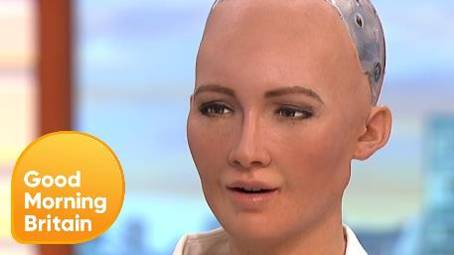
Humans are not random!
Modelling Behaviour
  Humans are not random!
  Human behaviour flows from three main sources: desire, emotion and knowledge (Plato)
  How to identify important behaviours?
https://www.youtube.com/watch?v=kWlL4KjIP4M
Notes:
Human behaviour flows from three main sources: desire, emotion and knowledge (Plato)
How do we identify important behaviours?
Published literature
Talking to the experts
Numerical experimentation
Rigorous data analysis

Slide 51
How do I know what behaviour is important?
Through the use of black magic!
  Published literature
  Talking to the experts
  Numerical experimentation
  Rigorous data analysis
It is important to carefully research all the information there is about the system you are interested in modelling.

Slide 52
So, do I model the entirety of an organism’s behaviour?
Two camps of thinking in building these models:
  Keep it descriptive, stupid (KIDS)
  Keep it simple, stupid (KISS)
No ‘correct’ way to model behaviour.
  We recommend identifying the most important behaviour and building that into your models.
Two contrasting views of KISS and KIDS approaches:
Axelrod, R. (1997). Advancing the art of simulation in the social sciences. In Conte, R., Hegselmann, R., and Terna, P. (eds) Simulating Social Phenomena , pages 21–40. Springer-Verlag, Berlin. (Note: this book is available in the library, the author has also made a draft of the chapter available online: http://www-personal.umich.edu/~axe/research/AdvancingArtSim2005.pdf ).
Edmonds, B. and Moss, S. (2005). From KISS to KIDS: an ‘anti-simplistic’ modelling approach. In Davidsson, P., Logan, B., and Takadama, K., editors, Multi Agent Based Simulation 2004, Lecture Notes in Artificial Intelligence , pages 130–144. Springer. Available online: http://cfpm.org/cpmrep132.html (also here).

Slide 53
(Human) Behaviour in Agent-Based Models
Great advantage of ABM!
But really, really difficult
  Subjective choices
  Complex psychology
  (Seemingly) irrational behaviour
Photo attributed to Arts Electronica (CC BY-NC-ND 2.0)
A number of different ways of implementing behaviour have been proposed

Slide 54
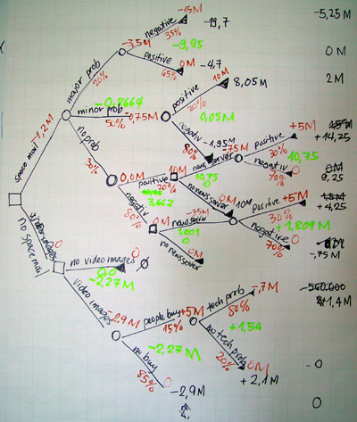
Rule-based Systems
Simple rule-based systems
IF < hunger > is below < hungerThreshold1 > THEN agent-dies.
IF < hunger > is above < hungerThreshold2 > THEN address-another-goal.
IF < hunger > is between < hungerThreshold1 > and < hungerThreshold2> THEN search-for-food.
Kennedy (2012)
Node-based
  Similar to decision trees

Slide 55
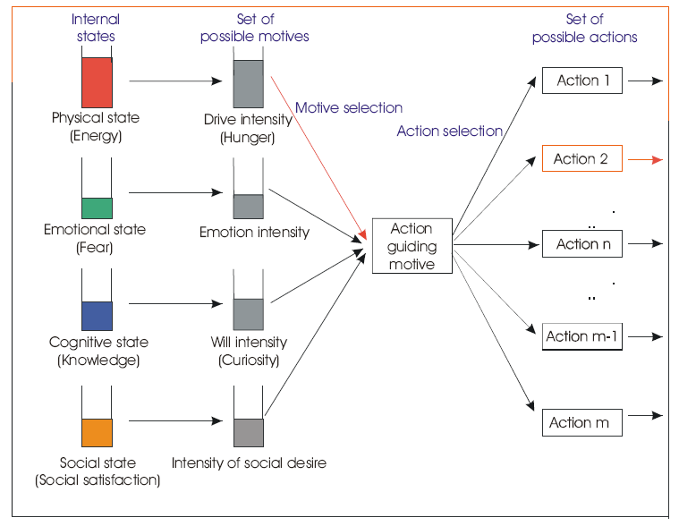
PECS
Physical conditions, Emotional states, Cognitive capabilities and Social status
Internal states
  Physical
  Emotional
  Cognitive
  Social
Motives
  Intensity functions determine motive strength
  Include level of need, personal preference, environment, others..
  Strongest motive becomes action guiding motive

Slide 56
Examples of behaviour

Slide 57
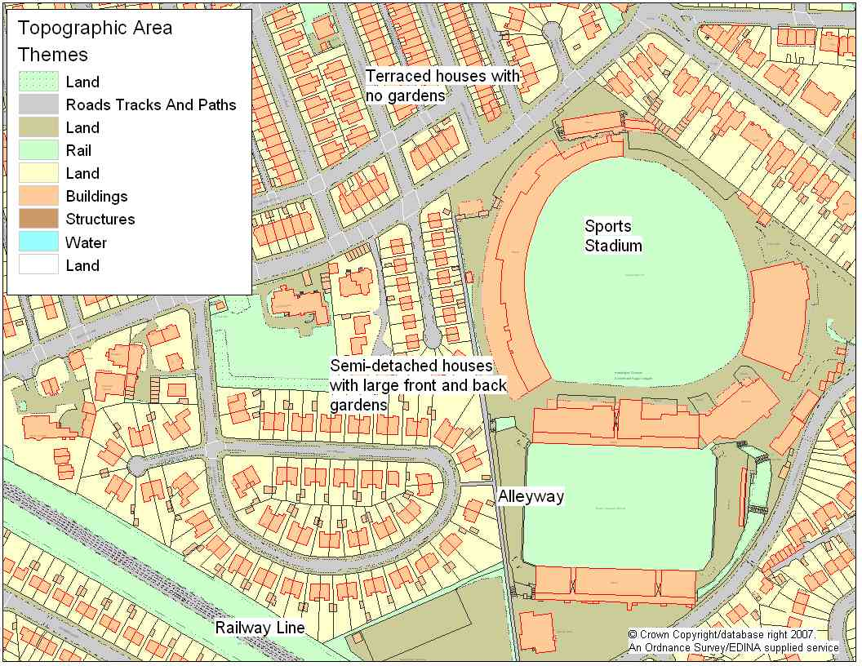
Simulating Crime: PECS (Cognitive model)
Complex phenomena
  Individual people’s behaviour (victims, guardians, offenders)
  Immediate physical environment
  Social context
  Individual awareness spaces
Interactions are key
Aggregation hides the underlying dynamics

Slide 58
Interaction & Behaviour Example:
Modelling Burglary
Notes:
This example is from Nick’s PhD research:
Malleson, N. (2010). Agent-Based Modelling of Burglary. PhD Thesis, School of Geography, University of Leeds. (Available online: http://www.geog.leeds.ac.uk/fileadmin/downloads/school/people/postgrads/n.malleson/thesis-final.pdf )

Slide 59
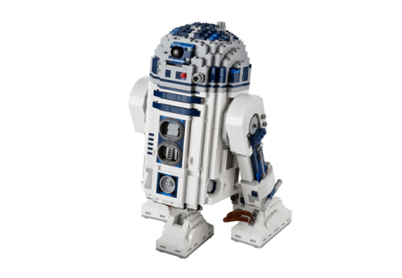
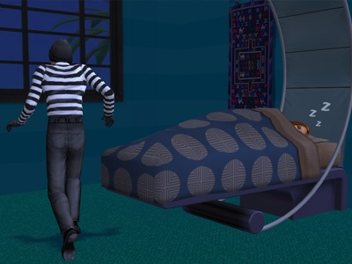
Burglary ABM –
More Realistic
Virtual Environment
  Physical objects: houses, roads, bars, busses etc.
  Social attributes: “communities”
  Virtual victims and guardians
Virtual Burglar Agents
  Use criminology theories/findings to build realistic agent behaviour
  PECS

Slide 60
Summary
Key concepts to understand when designing and building an ABM:
Emergence: sum is greater than the parts
Complex systems: Exhibit non-linearity and emergence. Very difficult to predict!
Interactions: How the agents interact with each other and the environment
Behaviour: Crucial to get right. Reliant on good quality data.

Slide 61
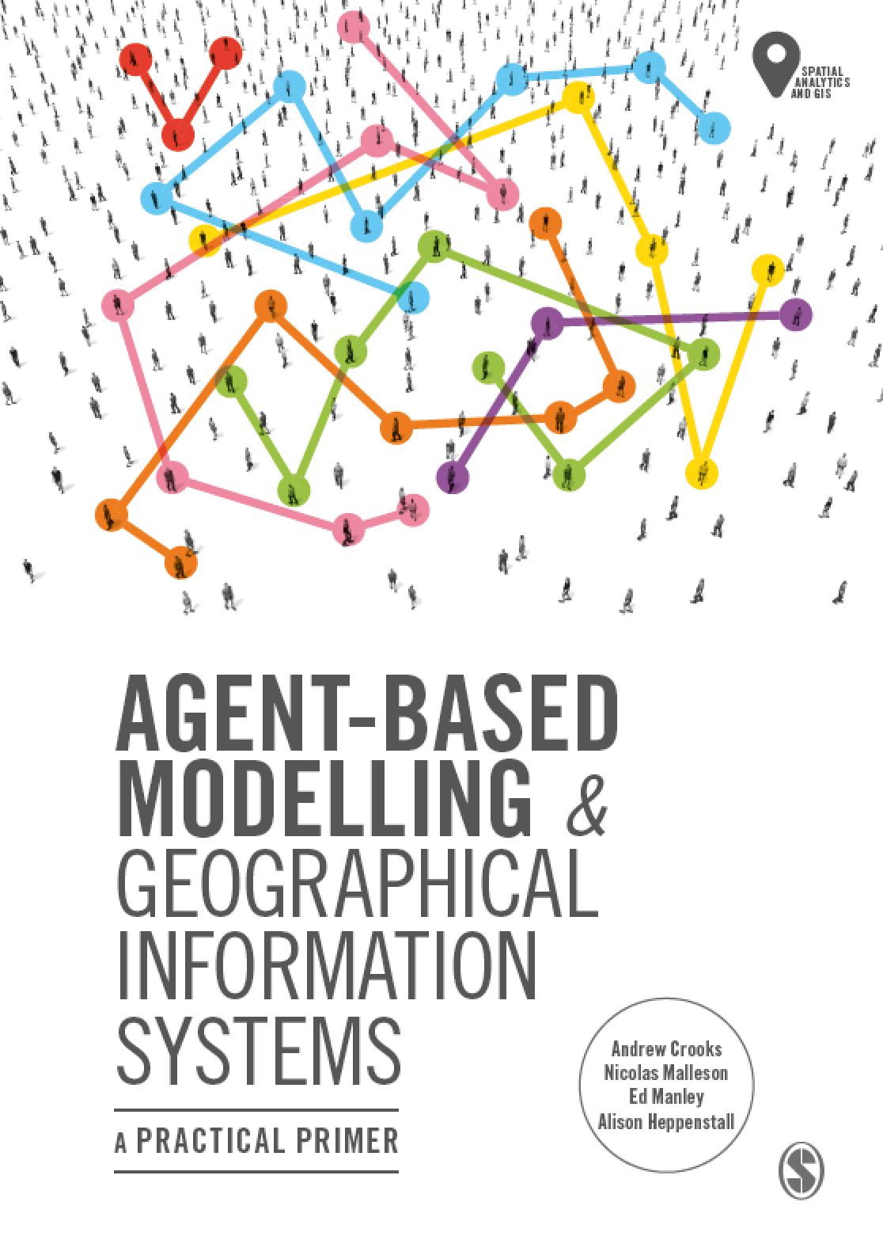
Chapter 4
Building Agent-Based Models with NetLogo
Notes:
This chapter provides an overview of the programming language and concepts that are used within NetLogo. NetLogo basics, such as how to create a simple environment, commands and procedures, are presented with step by step instructions for creating a simple model. Following this basic model, more advanced features are introduced. The overall aim of this chapter is to provide an understanding of the main components that make a NetLogo program. Subsequent chapters build upon the basics presented here.

Slide 62
Learning Objectives
By the end of this chapter, students will be able to:
Identify some of the tools that are commonly used to do agent-based modelling
Use NetLogo to run agent-based models
Understand the meaning of the most common NetLogo commands and how the program has been organised

Slide 63
Overview
An overview of tools for agent-based modelling
An introduction to NetLogo:
  The Program itself
  Turtles and Patches
  Variables
  Flow Control
How to write good code

Slide 64
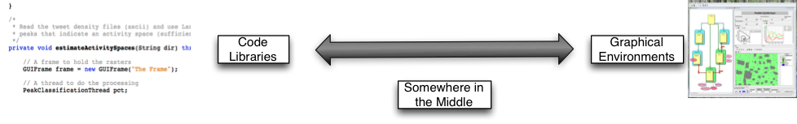
Software Tools / Platforms
What are they?
  Pieces of software to help people build models
There is a wide range of tools available:
  Computer code ('libraries')
  Entire graphical environment
  Somewhere in the middle

Slide 65
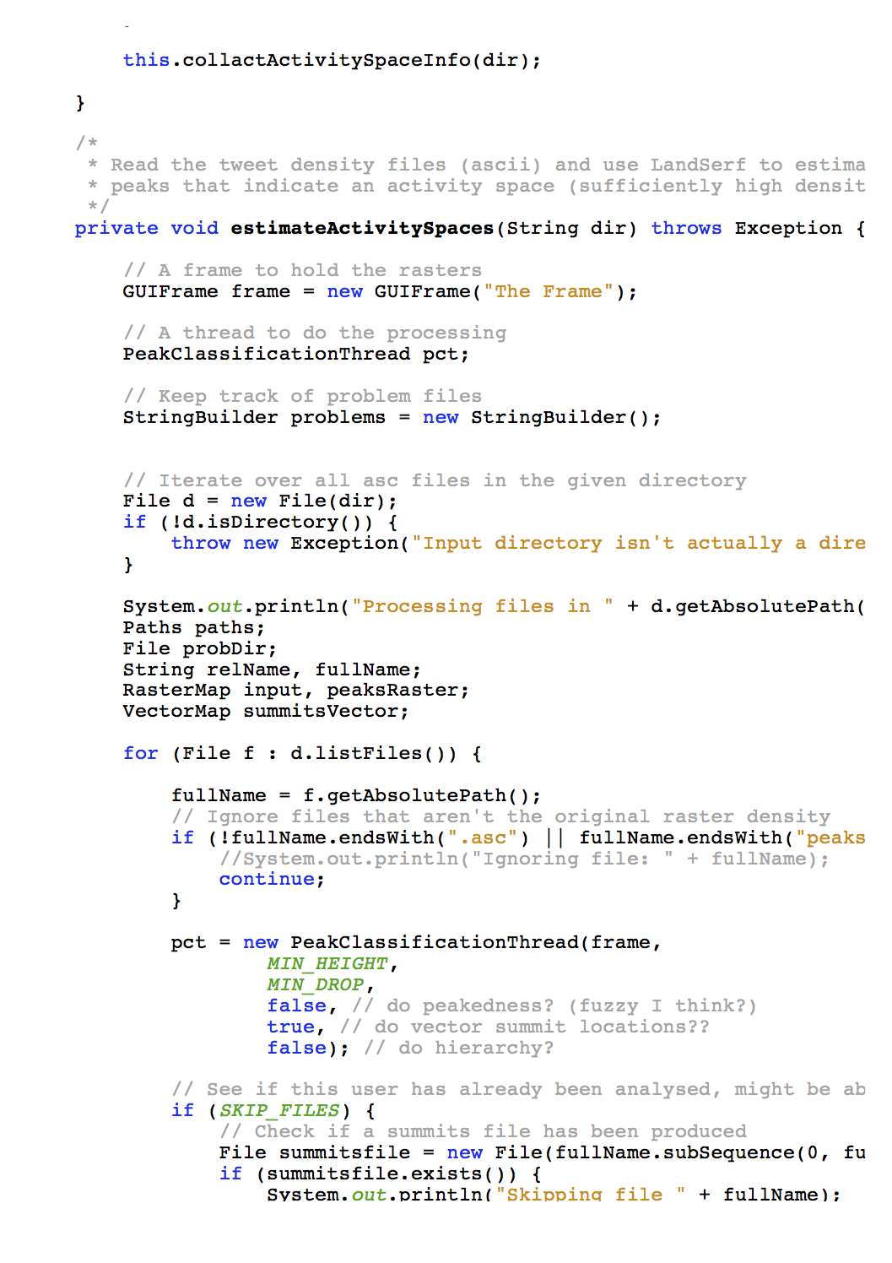
Computer code (‘libraries’)
Researchers write software to perform useful functions:
  Draw graphs
  Visualise the model
  Manage the schedule
Great for programmers
  Less time spend worrying about admin, more time on modelling
Examples:
  MASON
  Repast Simphony
  Mageo
Loads of others listed here

Slide 66
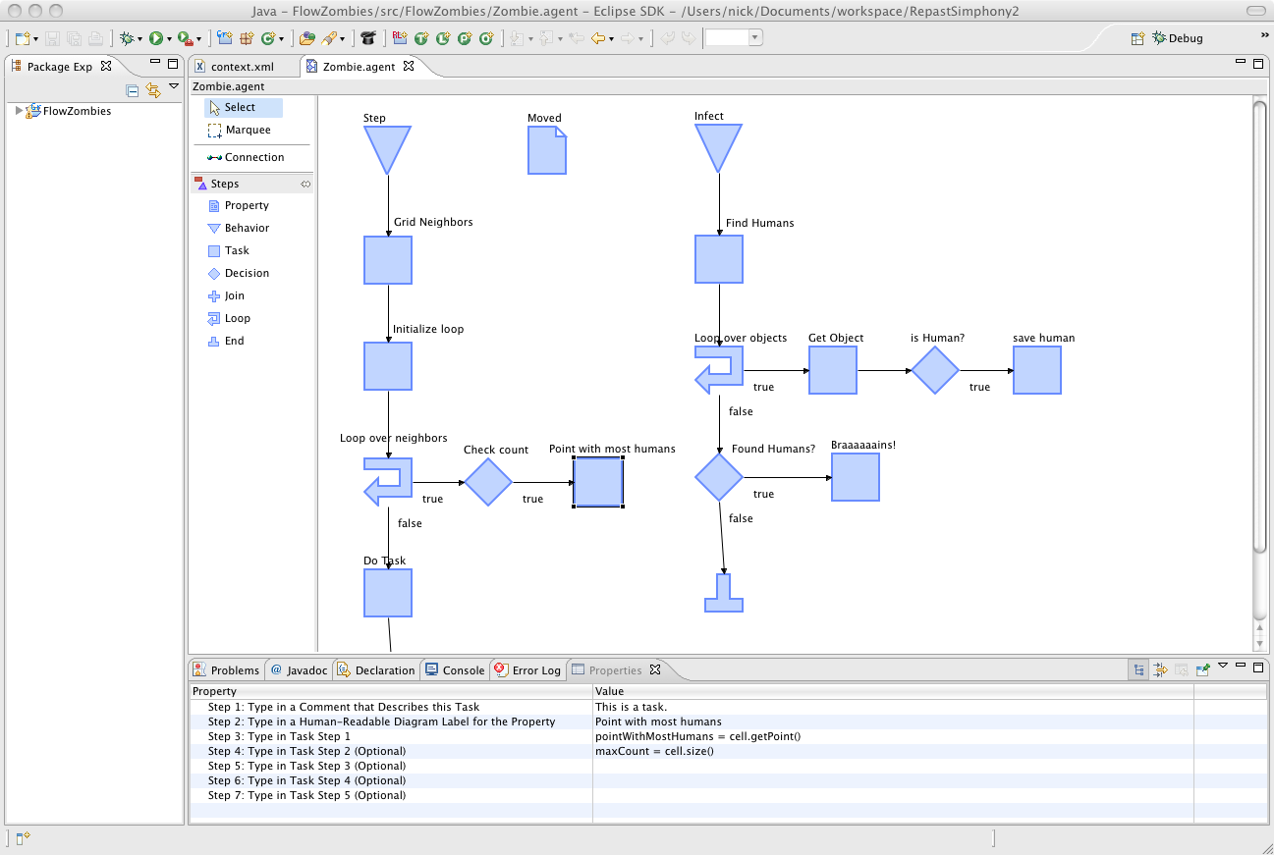
Graphical Environments
Entirely visual - no programming needed
Most useful for non-programmers
Examples
  Agent Sheets
  VisualBots
  Repast Simphony
  Modelling4All
Visual model development in Repast Simphony

Slide 67
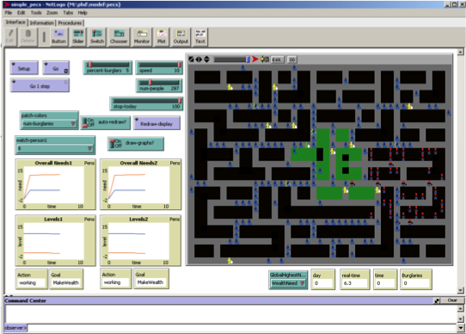
Somewhere in the middle
Some code writing, some visual development
More powerful than purely visual tools, but easier to use.
Save time having to learn to do simple tasks and concentrate on model behaviour
e.g. NetLogo
An example of a NetLogo model

Slide 68
Overview
An overview of tools for agent-based modelling
An introduction to NetLogo:
  The Program itself
  Turtles and Patches
  Variables
  Flow Control
How to write good code

Slide 69
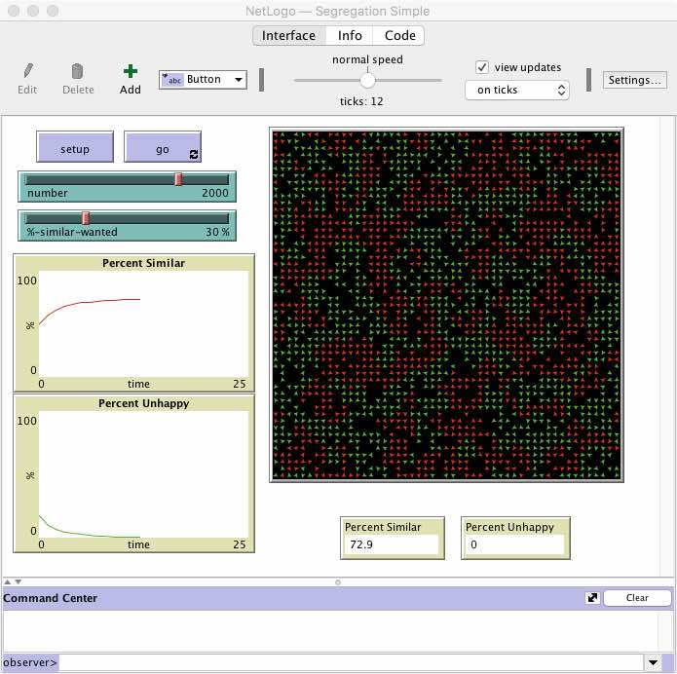
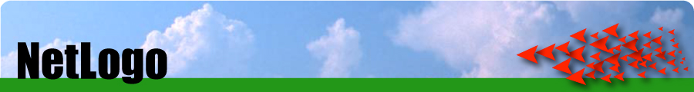
NetLogo
Based on Star Logo.
  Popular teaching tool
  Designed to be used by children
But also very powerful
  Lots of serious research is done using NetLogo
The Schelling segregation model in NetLogo

Slide 70
NetLogo
Developed by The Centre for Connected Learning (CCL) and Computer-Based Modeling at Northwestern University
Free!
Uses Java in the background
  Multi platform
  Can be converted into applets or JavaScript (and embedded in websites)
Great for quickly putting a model together and thinking through ideas
  Easy to build
  Easy to interact with models
  East to extract data and create plots
Excellent documentation: http://ccl.northwestern.edu/netlogo/docs/

Slide 71
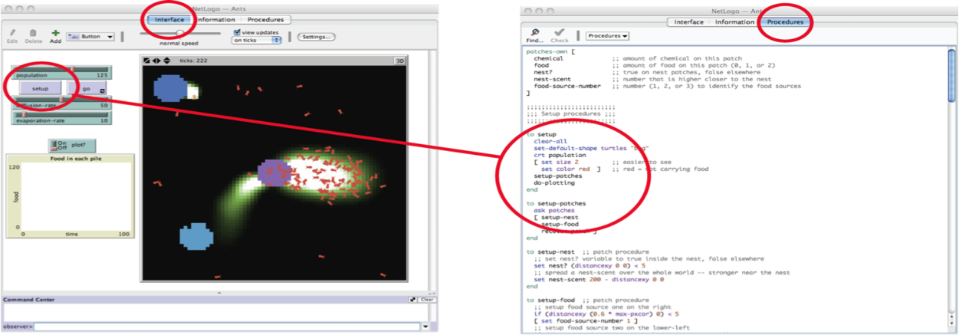
The NetLogo Program
NetLogo is has three parts:
  Graphical part (Interface) with sliders, graphs, buttons and a map
  Information (description, metadata, etc)
  Scripting part (Procedures) which contains instructions (code)

Slide 72
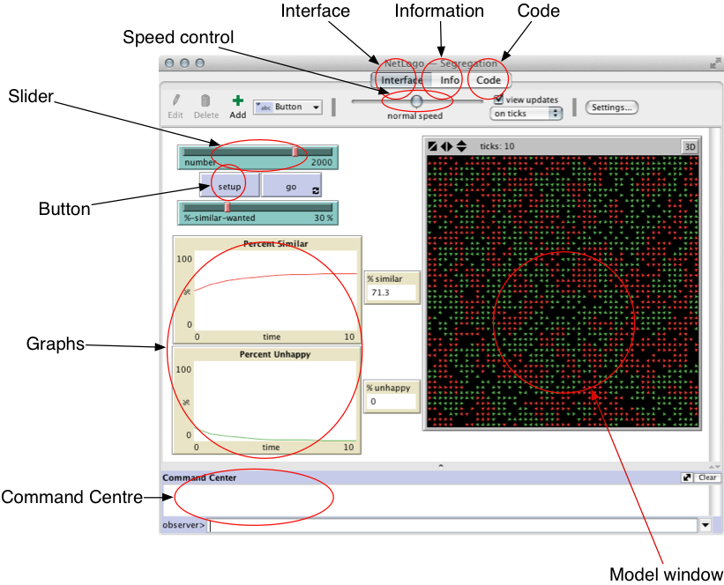
The NetLogo
‘Interface’
Tab

Slide 73
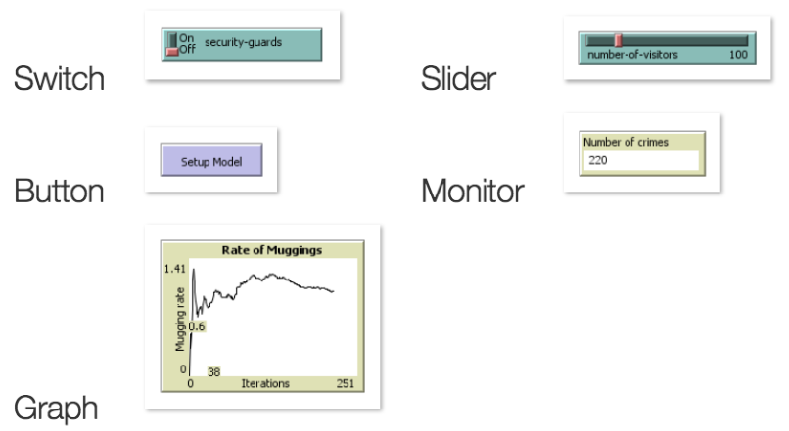
Components of the Interface

Slide 74
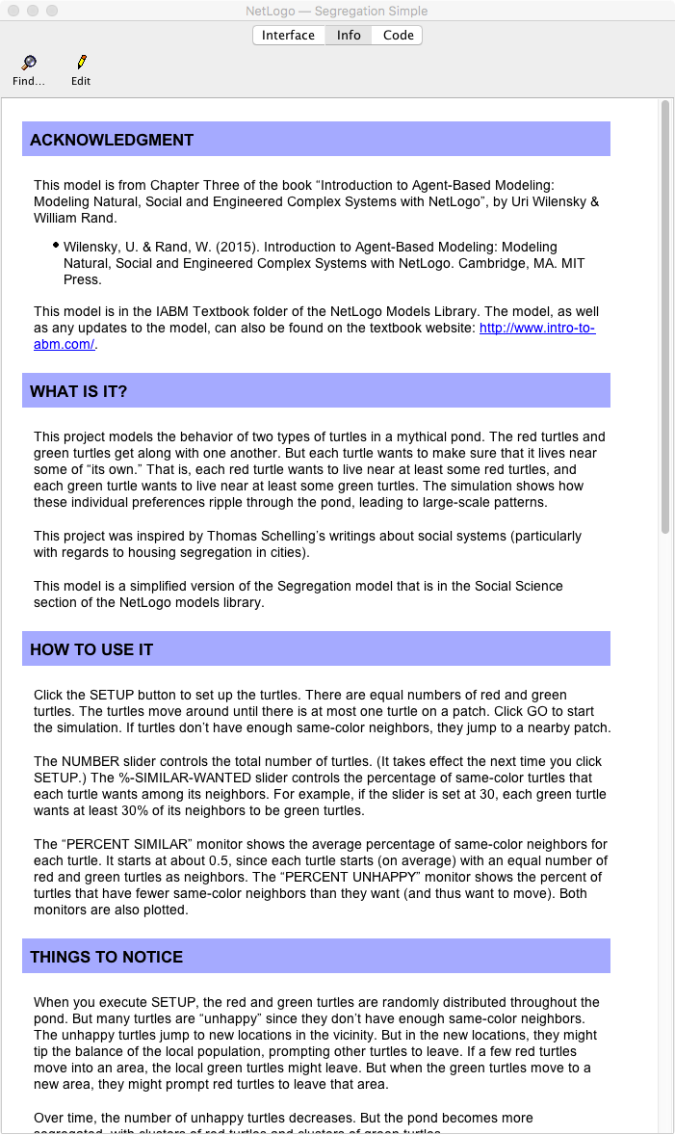
The NetLogo
‘Information’ Tab
Contains information about the model and instructions explaining how to run it
These are produced by model developers
  Yu should do this when you write your own models

Slide 75
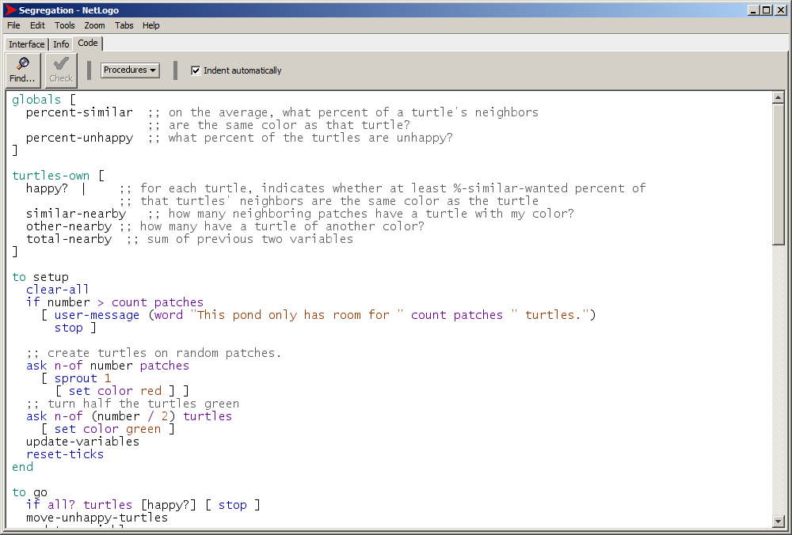
The NetLogo ‘Code’ tab
This is where you write the code
All agent rules, etc., go in here

Slide 76
NetLogo example 1 - Segregation
When you download NetLogo there are a number of examples
We will now experiment with Schelling’s famous segregation model
To see a list of the models that are available, open NetLogo and go to
  File -> Models Library
The Segregation model is listed under
  Social Science -> Segregation

Slide 77
NetLogo example 1 - Segregation
Once you have opened the Segregation model:
Click on the ‘Information’ tab (or ‘Info’ in some versions) and read about the model
Then return to the ‘Interface’ tab and experiment with the model by slowly increasing the peoples’ preference for living next to the same type (%-similar-wanted).
Try to answer these questions:
  What happens to the spatial structure of the population as it increases?
  What would you expect to see if %-similar-wanted was set to 100%? What actually happens?

Slide 78
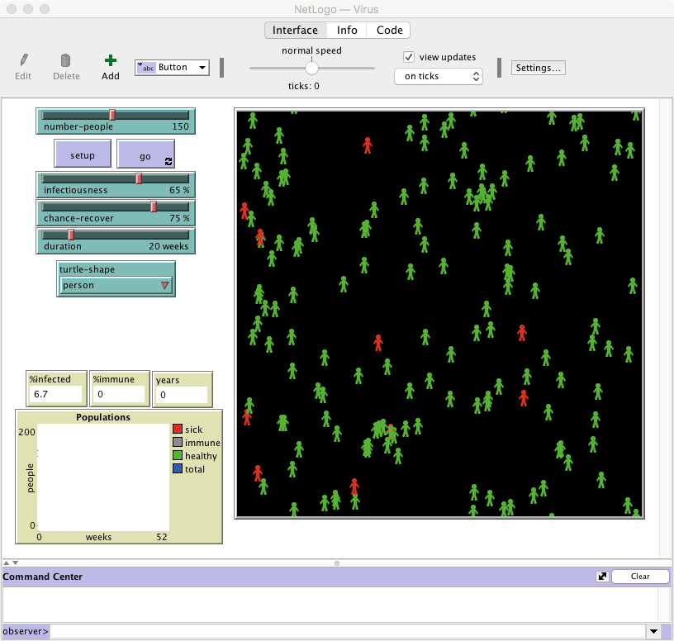
NetLogo example 2 - Virus
Now experiment with another model called Virus, which is in the Biology folder.
Again, start by reading the documentation in the Information tab.
Then experiment and answer the following:
What happens as the chance of recovering decreases? What happens when it gets to 0 (i.e. everyone who becomes infected dies)?
Does the same thing happen every time the model is run? If not, what might account for these differences?

Slide 79
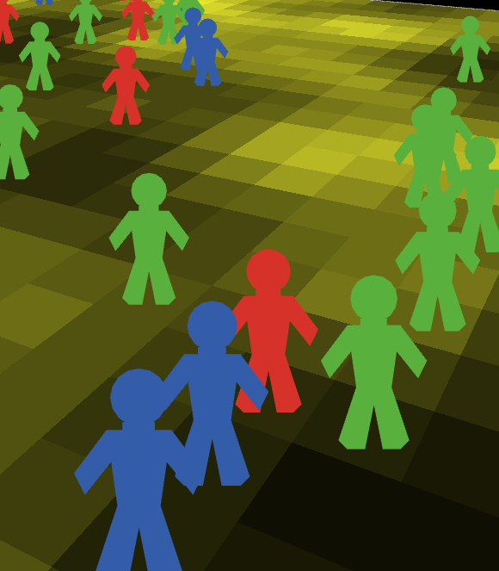
Model Concepts:
Turtles, Patches and the Observer
There are two types of objects in NetLogo: turtles and patches.
Both are agents
  They have rules that determine their behaviour
  They can interact with other agents
Main differences:
  Patches cannot move
  You can create different types of 'turtle' (e.g. person, dog, cat, car, etc.)
Why turtles?
  The 'Logo' language originally used to control robot turtles. It seems that the name 'turtle' has stuck..

Slide 80
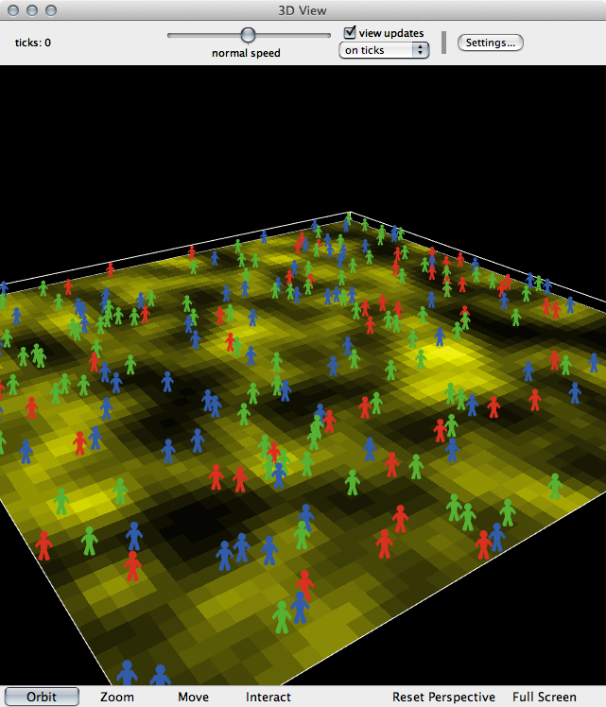
Model Concepts:
Turtles, Patches and the Observer
Also important: the observer
The 'god' of a model
Overseas everything that happens, gives orders to turtles or patches, controls other things like data input/output, virtual time, etc.

Slide 81
Model Concepts: Variables
In programming, variables are a way of storing information. E.g.
  my-name = ”Nick"
  seconds-per-minute = 60
  pi = 3.142
  infected = True
Variables can belong to different objects in the model.
Different objects can have different variable values (e.g. my-name variable would be unique to each agent)
Examples:
  Turtle variables: name, age, occupation, wealth, energy
  Patch variables: height-above-sea, amount-of-grain, building-security, deprivation
  Observer variables: total-wealth, weather, time-of-day, pi

Slide 82
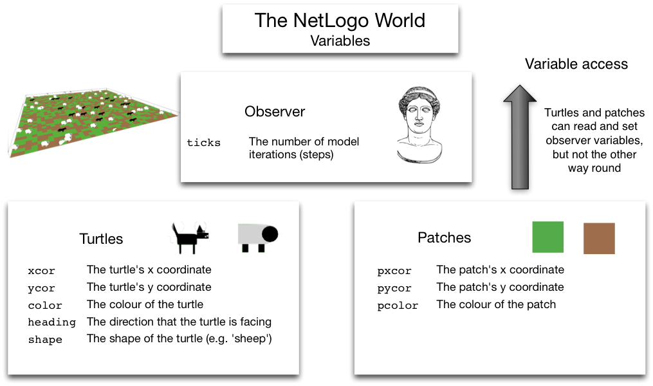
Built-In Variables
There are some variables that NetLogo uses by default

Slide 83
Model Concepts: Commands
Commands are the way of telling NetLogo what we want it to do.
Commands are very well documented
Some examples (these are explained properly in the book):
Command example | Description
show "Hello World" | Prints something to the screen
set my-age 13 | Sets the value of a variable
ask turtles [ ... ] | Ask the turtles to do something
ask turtles [ set color blue ] | Asks the turtles to turn blue

Slide 84
Model Concepts: Brackets
NetLogo uses both square [ ] and round ( ) brackets.
Round brackets are used to set the order of operations. E.g.:
  2 + 3 × 4 = 14
  (2 + 3) × 4 = 20
Square brackets are used to split up commands. E.g.:
  ask turtles [ ... ]
  the ask command expects to find some more commands inside the brackets.

Slide 85
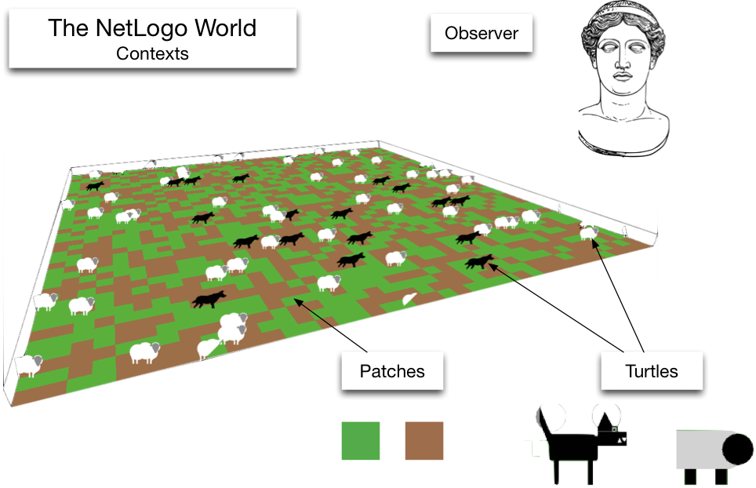
Model Concepts: Contexts
Contexts controls where commands are sent
There are three contexts:
  Observer
  Turtle
  Patch
Lots of examples that help to understand these in the book (Chapter 4)

Slide 86
Model Concepts: Flow Control
Programs are recipes
And computers are really, really stupid cooks.
Programmers need to tell the computer exactly what to do, and in what order
Geek Joke:
  Q: How do you keep a programmer in the shower forever?

Slide 87
Model Concepts: Flow Control
Programs are recipes
And computers are really, really stupid cooks.
Programmers need to tell the computer exactly what to do, and in what order
Geek Joke:
  Q: How do you keep a programmer in the shower forever?
  A: Give them a bottle of shampoo that says "lather, rinse, repeat".

Slide 88
Flow Control
Usually, NetLogo will run through your code, one line after the other
But! Sometimes there are two or more possibilities for what to do next
if statements are one example:
  if ( age < 18 )
  [ .. do something .. ]
  if ( age > 18 )
  [ .. do something else .. ]

Slide 89
Flow Control Quiz
The code below has been taken from the rules that drive the behaviour of a virtual person (or 'agent’).
What will the person do when the age variable has the values of 10, 50, or 18?
Age | Actions
10 | ?
50 | ?
18 | ?
if ( age < 18 )
[ .. go to the cinema .. ]
if ( age > 18 )
[ .. go to the pub .. ]
.. go to my friend's house ..

Slide 90
Flow Control Quiz
The code below has been taken from the rules that drive the behaviour of a virtual person (or 'agent’).
What will the person do when the age variable has the values of 10, 50, or 18?
Age | Actions
10 | Go to the cinema and then to my friend’s house
50 | Go to the pub and then to my friend’s house
18 | Just go to my friend’s house (agents who are exactly 18 don’t fit either of the if statements).
if ( age < 18 )
[ .. go to the cinema .. ]
if ( age > 18 )
[ .. go to the pub .. ]
.. go to my friend's house ..

Slide 91
Overview
An overview of tools for agent-based modelling
An introduction to NetLogo:
  The Program itself
  Turtles and Patches
  Variables
  Flow Control
How to write good code

Slide 92
Finally: Writing Good Code
Computers don't care what code looks like
But there are good conventions that we can use to make our code easier to understand by humans
Indentation
  New blocks of code should be indented (moved to the right)
  E.g. code in the if statements on previous slide
White space
  Different sections of code can be separated by lots of white space
Comments
  Comments are special parts of code that NetLogo will ignore
  Anything after a semi colon (;) is ignored
  Use comments to explain what your computer code does

Slide 93
Writing Good Code: Indentation

Slide 94
Writing Good Code: Whitespace

Slide 95
Writing Good Code: Comments

Slide 96
Summary
This lecture has introduced the main concepts that underpin NetLogo and demonstrated how to run some models
Next: Work through Chapter 4 of the book to gain some experience in using NetLogo, and to see how to create your own model.

