Slide 1







µXANES investigation of the environmental behaviour of vanadium in BOF steel slag leachates
Andrew. J. Hobson¹, Douglas. I. Stewart², Andrew W. Bray¹, William M. Mayes³, Michael Rogerson³, Alex L. Riley³ and Ian T. Burke¹
¹School of Earth and Environment and ²School of Civil Engineering, University of Leeds.
³Geography and Environmental Sciences, University of Hull

Slide 2
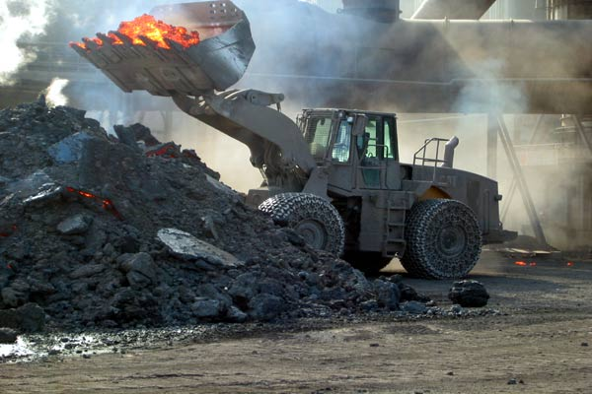
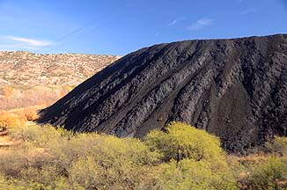
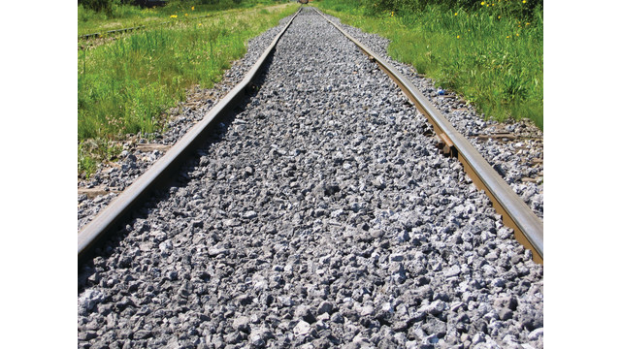
Background: Steel slags
What? Primary byproduct of steel manufacture
How much? 2015: 170 - 250 million tonnes worldwide (USGS, 2015)
Use?
  Aggregate (civil engineering)
  Acid neutralisation (soils)
  CO₂ sequestration
Problems?
Notes:
Talk about recycling here too
High lime process – discuss CaO – Ca(OH)2 – CaCO3 issues

Slide 3
Environmental impacts
1. High pH leachate
CaO + H₂O → Ca(OH)₂
Ca(OH)₂ → Ca²⁺ + 2OH⁻
Ca₂SiO₄ + 4H₂O → 2Ca²⁺ + H₄SiO₄ + 4OH⁻
= pH 11.5 – 12.5
Rainwater
Steel Slags

Slide 4
Environmental impacts
Rainwater
2. Rapid calcite deposition
Ca²⁺ + CO₂ → CaCO₃ (s) + H₂O
Steel Slags

Slide 5
Environmental impacts
Rainwater
3. Mobilisation of trace metals
e.g. V, Cr, Pb, Ni
Steel Slags

Slide 6
Vanadium in Steel Slags
Concentrated in steel slags from primary ores
430 – 1700 mg/kg in BOF slag (Proctor et al, 2000)
  This study ~700 mg/kg
Solubility/toxicity strongly influenced by oxidation state
Oxidation of V(IV) to V(V) implicated as mechanism leading to enhanced V leaching under aerobic conditions (Chaurand et al, 2007)
Notes:
Despite toxicity of V (esp V(V)) little data re. leaching behaviour

Slide 7
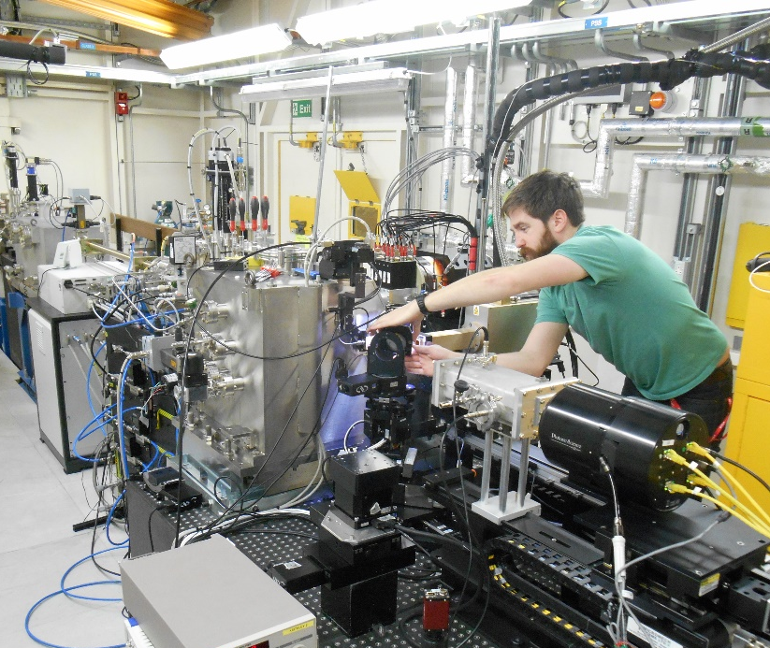
Part 1: Objectives & methods
Establish variation in V speciation before and after leaching under aerobic and anaerobic conditions
Samples leached for 6 months in Milli-Q water
SEM/EDS
  Characterise steel slag
    ID principal phases
    Locate V-bearing phases
XAS (XANES)
  Determine V speciation in:
    Unweathered material
    Aerobically weathered material
    Anaerobically weathered material
Notes:
3 aims – determine the principal mineral phases present in steel slag and which contained vanadium
Determine V speciation in unweathered material and weathered regions from both systems; aerobic and anaerobic – is there any variation between them? Do they offer any insights into mechanism of vanadium leaching from slags?
Used a variety of spectroscopy techniques including SEM imaging, EDS spot analysis and mapping and synchrotron data.

Slide 8
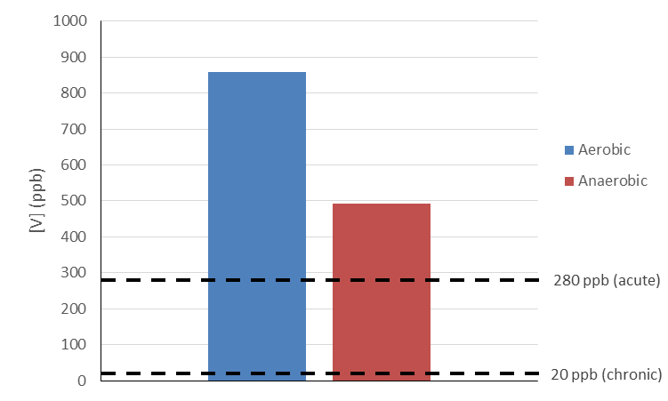
Results: Vanadium release
Threshold values from http://response.restoration.noaa.gov/sites/default/files/SQuiRTs.pdf
Notes:
Next was to work out where it was coming from!

Slide 9
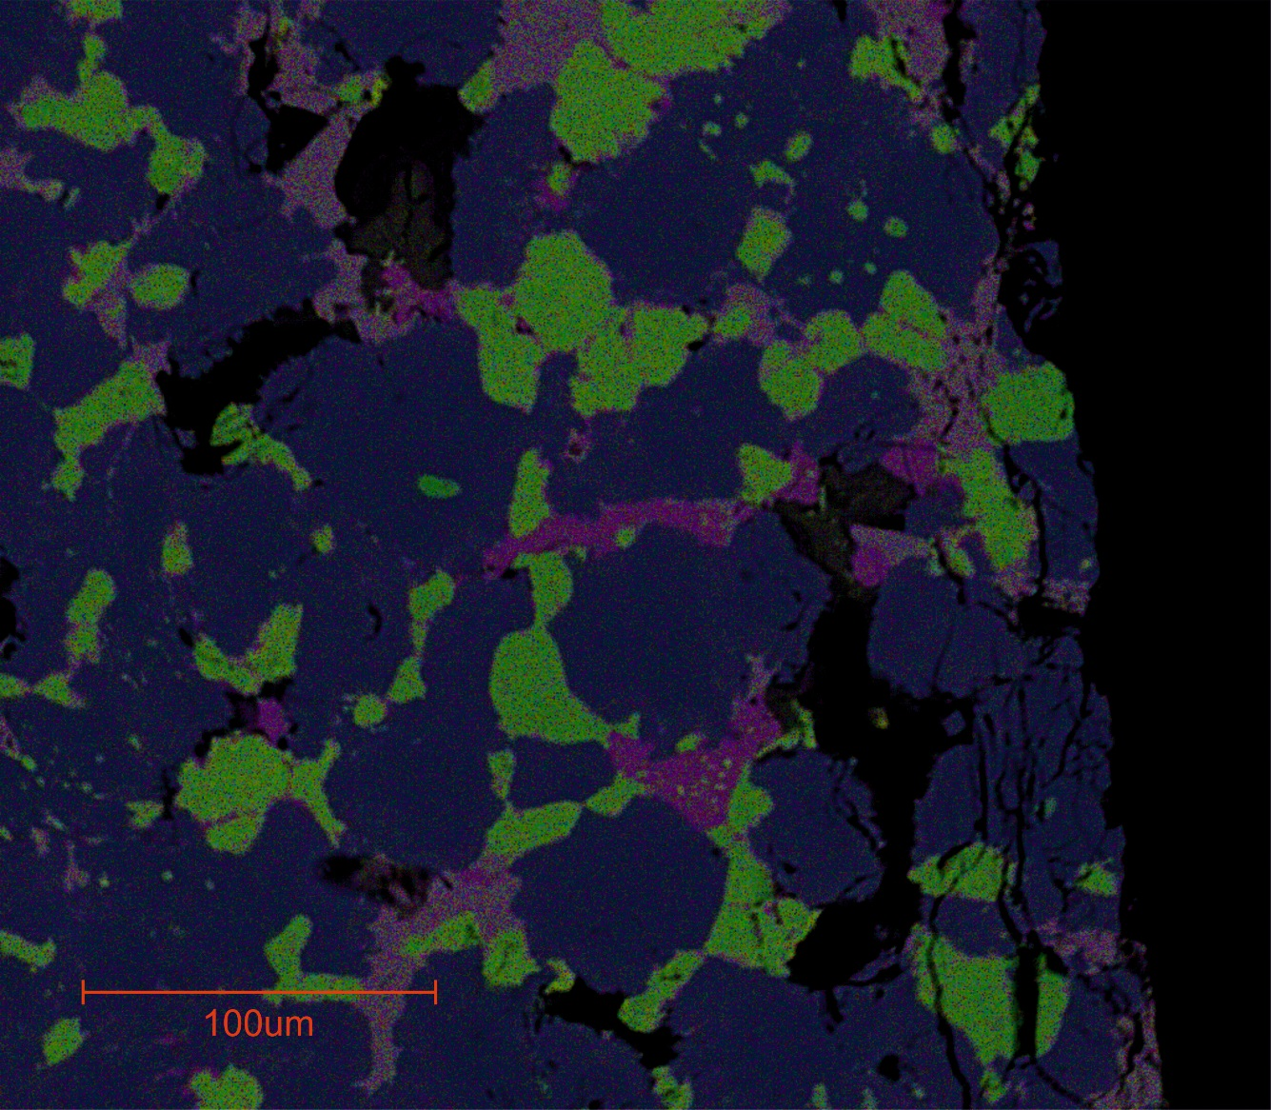
Slag composition
Ca-silicates
(Ca₂SiO₄)
CaO (free lime)
Brownmillerite
(dicalcium ferrite)
Wustite (FeO)
Notes:
4 phases – dominant dark purple phase is dicalcium silicate (aka larnite)
Purple phase is calcium oxide (aka free lime)
Light purple phase is dicalcium ferrite (aka brownmillerite)
Green phase is iron oxide (aka wustite)

Slide 10
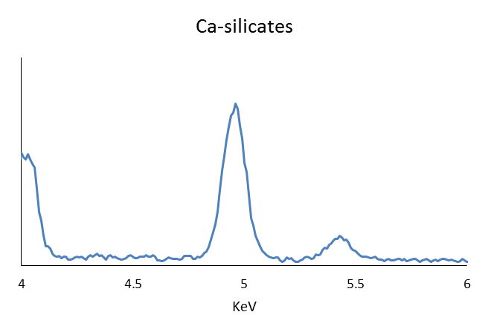
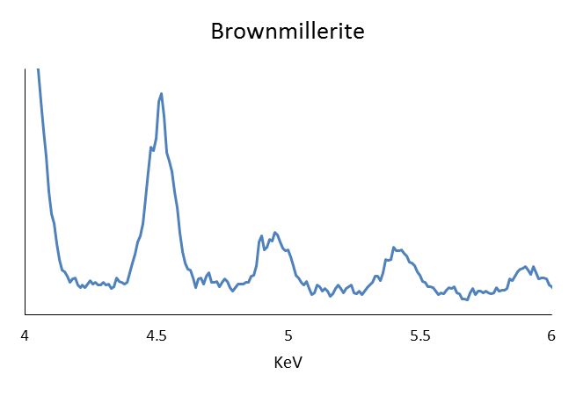
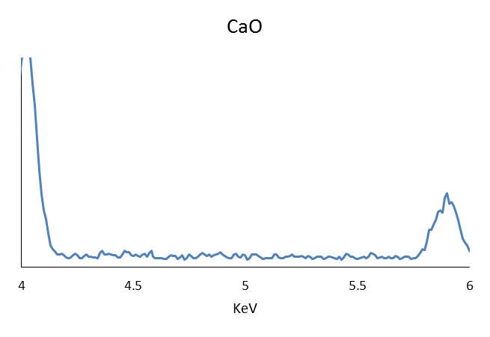
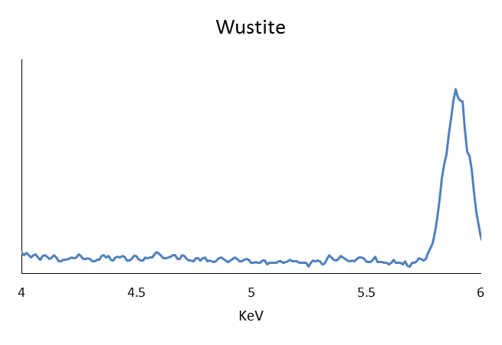
EDS
V
Ti
V
V is located in Ca-silicates and brownmillerite phases
(wt% 0.3 - 0.5% and 1.0 - 1.3% respectively)
Notes:
Used EDS spot analysis on each phase to locate vanadium host phases and approximate abundance in each phase

Slide 11
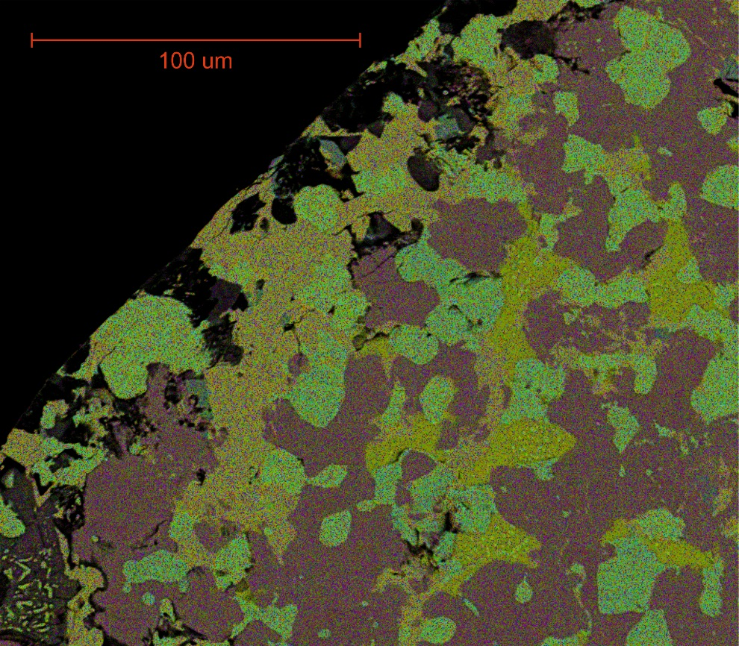
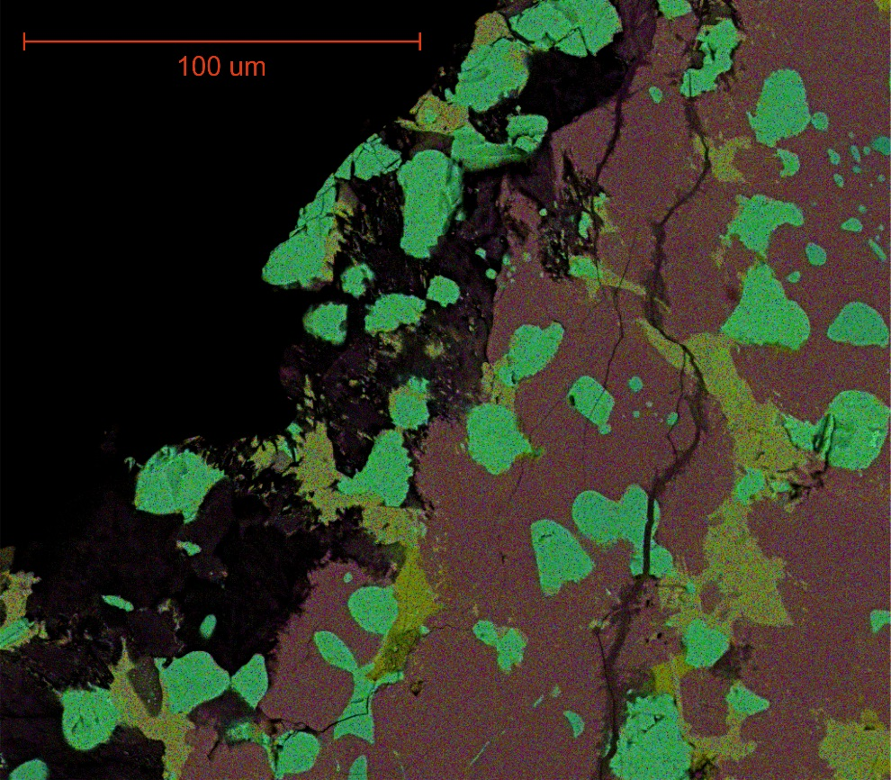
Leaching effects
Anaerobic
Aerobic
20-50 µm weathered ‘rind’ post-leaching
Notes:
Leached ‘rind’ depleted in Ca/Si i.e. leaching of free lime and Ca-silicates has taken place.
Brownmillerite and wustite phases largely unaltered.
CSH formed in black regions – present throughout the rind.

Slide 12
Calcium-Silicate-Hydrate formation
Ca₂SiO₄
C-S-H

Slide 13
XANES analysis
Brownmillerite
Calcium silicate hydrate
Experimental samples
Calcium silicate
V₂O₅ (V4+)
V₂O₅ (V5+)
Standards
Vanadate
Notes:
Spectra of experimental samples are similar to those of V(IV) and (V) standards

Slide 14
V speciation
Pre-edge peak
E_{1/2}
Ca₂SiO₄
C-S-H
V
Normalised pre-edge peak intensity
IV/V
Brownmillarite
IV
Core
Aerobic rind
Anaerobic rind
V
E_{1/2}
IV
III/IV
III

Slide 15
Vanadium release and mobility
V-release
β-Ca₂Si(V)O_{4 (s)} + 2H₂O →
2Ca²⁺ + H₂SiO₄²⁻ + 2OH⁻ + VO₄³⁻
Secondary V-containing phases
3Ca²⁺ + 2H₂SiO₄²⁻ + OH⁻ (+ xVO₄³⁻) → 3CaO·2SiO₂(xVO₄)·3H₂O _{(s)}
3Ca²⁺ + 2VO₄³⁻ ⇌ Ca₃(VO₄)_{2 (s)}
Rainwater
Steel Slags

Slide 16
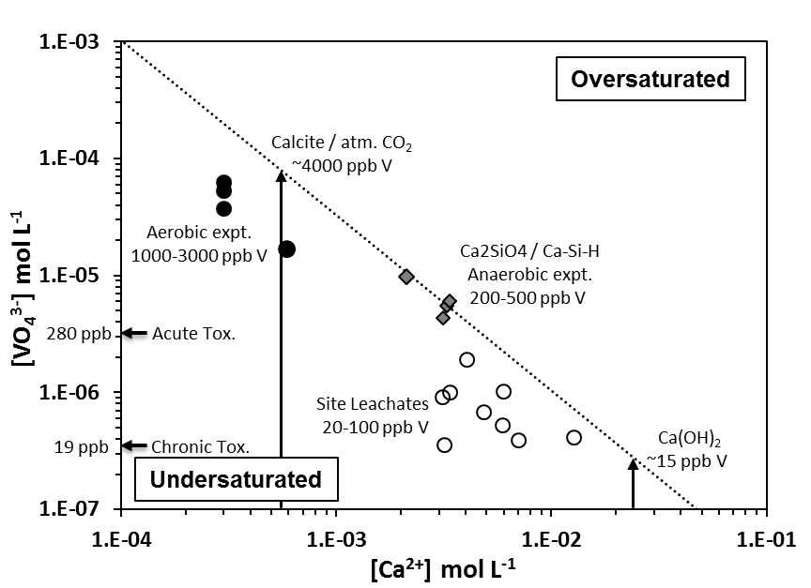
Ca₃(VO₄)₂ Solubility
[V] concentrations limited by [Ca] controlling secondary phase
Log Ksp = -17.97
8 pH 12.5

Slide 17
Part 1 Summary
V is located within Ca-silicates (0.3-0.5 wt%) as V(V) and brownmillerite (1.0-1.3 wt%) as V(IV/V)
V(V) released during dissolution of Ca-silicates:
  Ca₂Si(V)O₄(s) + 2H₂O → 2Ca²⁺ + H₂SiO₄²⁻ + 2OH⁻ + VO₄³⁻
Some V(V) incorporated into CSH (secondary phase):
3Ca²⁺ + 2H₂SiO₄²⁻ + OH⁻ (+ xVO₄³⁻) → 3CaO·2SiO₂·(xVO₄)·3H₂O (s)
High release in aerobic systems due to Ca sink to CaCO₃ which allows continued dissolution of Ca-silicates and associated release of V
Formation of CSH has an armouring effect – crush and weather slag prior to use to reduce V release

Slide 18
Part2: V mobility at Leachates springs
CO₂ in gassing
Steel Slags
River flow→
Groundwater outflow

Slide 19
CaCO₃ precipitation
CO₂ In gassing
CO₂ _{(g)} ⇌ CO₂ _{(aq)}
CO₂ + H₂O ⇌ H₂CO₃
H₂CO₃ ⇌ HCO₃⁻ + H⁺ ⇌ CO₃²⁻ + H⁺
H⁺ + OH⁻ ⇌ H₂O
Ca²⁺ + CO₃²⁻ ⇌ CaCO_{3 (s)}
Overall reaction
Ca²⁺ + CO₂ + 2OH⁻ → CaCO₃ _{(s)} + H₂O
CO₂ in gassing
Steel Slags
Groundwater outflow

Slide 20
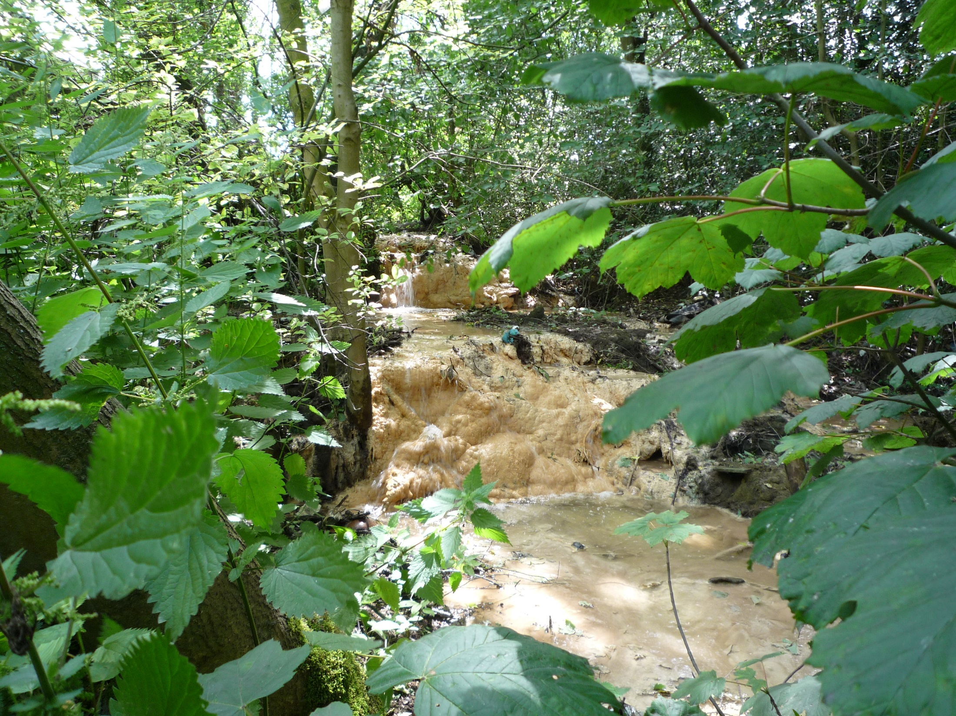
Consett Steel Works, Co. Durham, UK

Slide 21
Site Data – Howden Burn, Consett
No change in conservative elements
(i.e. no dilution)
pH reduction & Ca removal
Co = 104 ±31 ppm
Co = 127 ±57 ppm
Si Co = 1300 ±340 ppb
Al Co = 129 ±39 ppb
Concurrent Trace Metal Removal
Co = 58 ±8 ppb

Slide 22
Experimental
Site Leachate – Ca(OH)₂ type ~35 ppb V (+Fe)
Slag Leachate – Ca₂SiO₄ type ~ 500 ppb V (+Si)
Sim. Leachate – 10 % Ca(OH)₂
+ 2500 ppb VO₄³⁻ (for XAS)
All initially pH ~12 & CO₂ free
Slag
Leachate

Slide 23
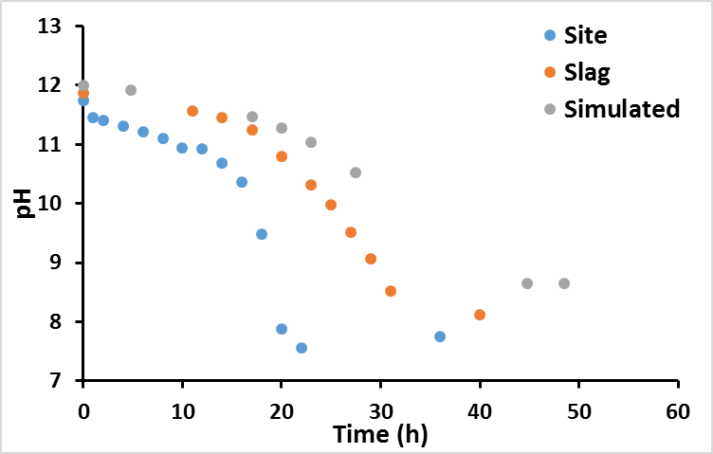
Results – pH

Slide 24
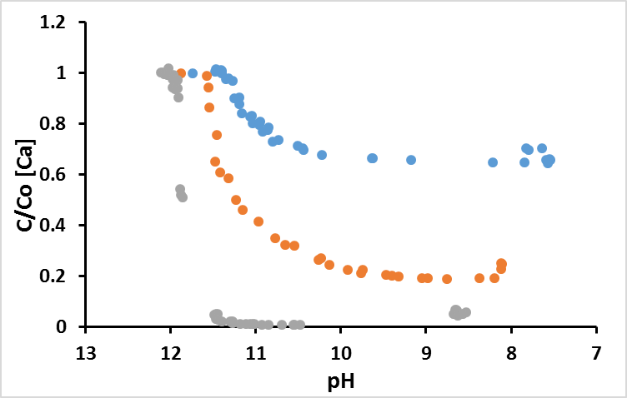
Results – Calcium
Site [Ca] = 194 ppm
Graph of C/Co [Ca] vs pH– three leachates CaCO3 only systems
Slag [Ca] = 89 ppm
Sim. [Ca] = 75 ppm
Total [Ca] removal very similar in all systems; ~60-80 ppm

Slide 25
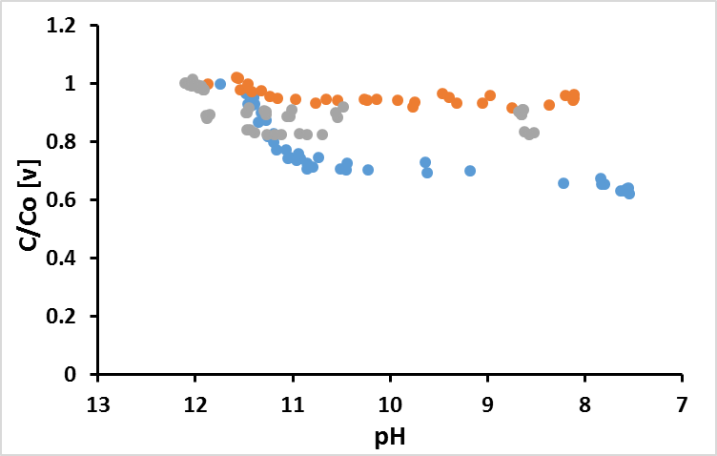
Results – Vanadium
Slag [V] = 510 ppb
Sim. [V] = 2510 ppb
Graph of C/Co [V] vs pH– three leachates CaCO3 only systems
Site [V] = 35 ppb
[V] removed: Site = ~13 ppb; Slag = ~30 ppb; Sim. = 400 ppb

Slide 26
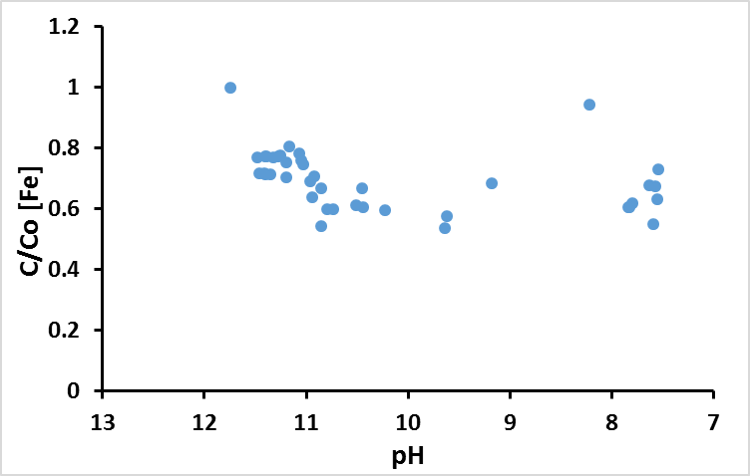
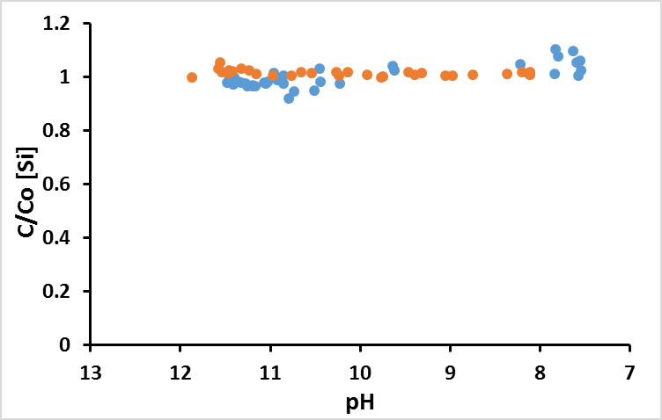
Results – Fe
Results – Si
Slag [Si] = 21 ppm
Site [Fe] = 166 ppb
Site [Si] = 1.6 ppm
Slag & Sim. [Fe] = n.d.
Sim. [Si] = n.d.
60-70 ppb Fe removed in Site leachate system

Slide 27
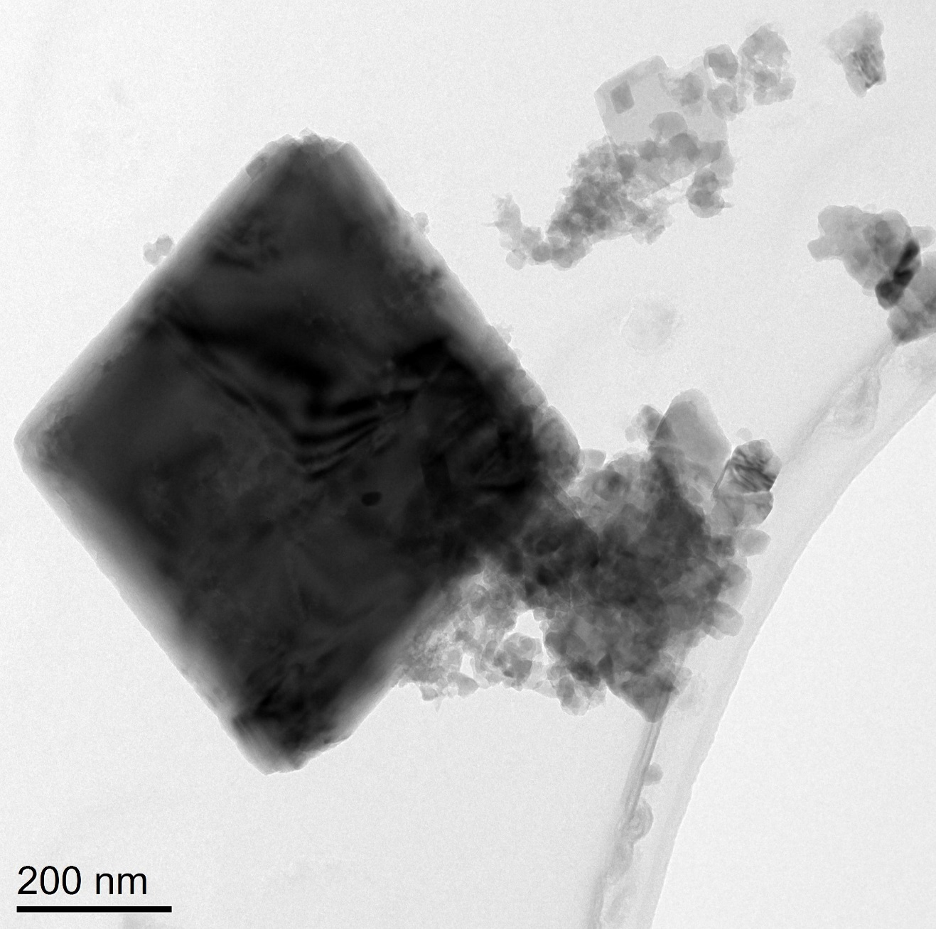
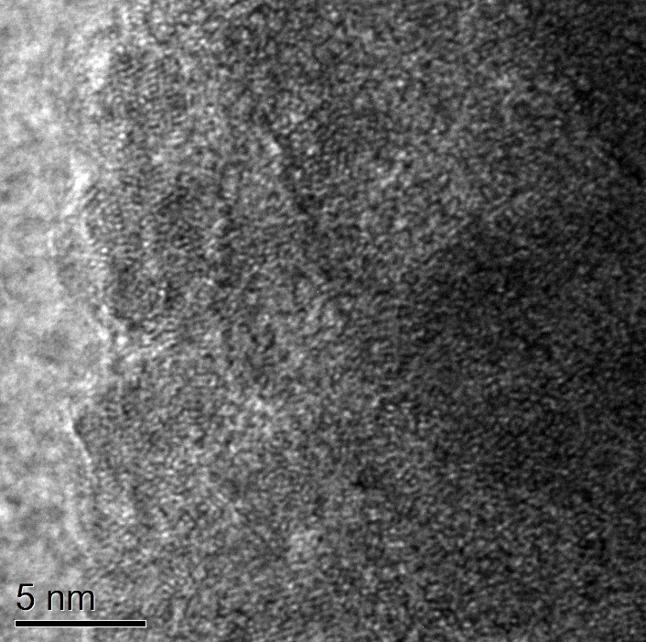
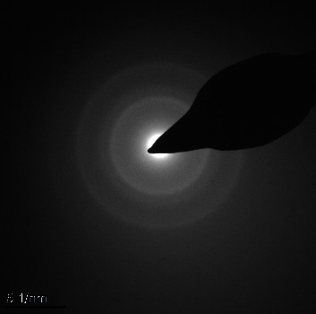
TEM – site leachate ppt
Low res Bright field TEM
Hi res TEM
0.145 nm
0.250 nm
Calcite
SAED
EDS spectra
O
Fe
C
Fe
Fe-O rich particles
Cu
Si
Ca
Fe
Na
Ca
Al
P
S
Cl

Slide 28

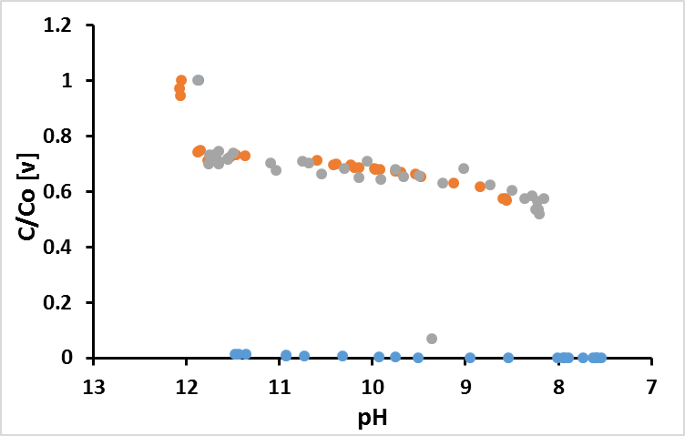
Goethite amended systems
unamended data
Slag
Graph of C/Co [V] vs pH– three leachates FeOOH systems
Sim.
Site

Slide 29
Vanadium K-edge XANES
V⁵⁺ aqueous
V⁵⁺-Kaolinite
V⁵⁺-Al(OH)₃
V⁵⁺-FeOOH
Sim. +FeOOH
Slag +FeOOH
Site +FeOOH
Sim. +Kaolinite
Slag +Kaolinite
Site +Kaolinite
Sim. unamend
Slag unamend
Site unamend
All Vanadium present as V⁵⁺
0.5
Diamond Light Source, UK, Beamline i18
Data collected from CaCO₃ precipitates (pH ~8)

Slide 30
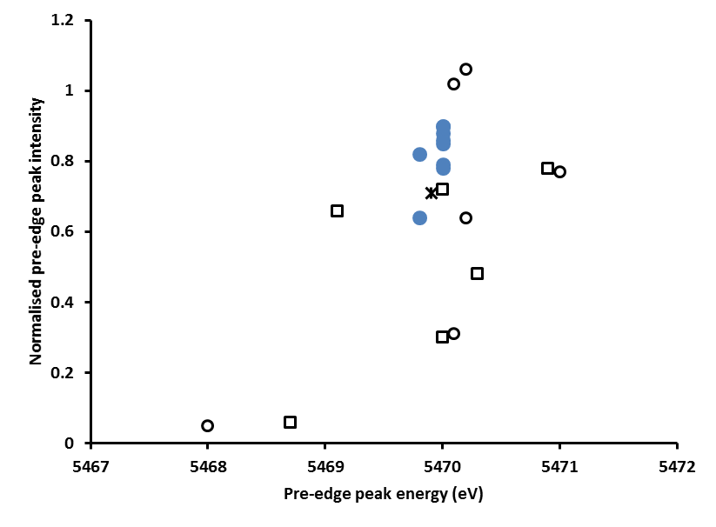
V – XANES interpretation
Distortion in VO₄ tetrahedral leads to reduced peak intensity
adsorption / incorporation
Experimental
Samples
(T_{d}) V⁵⁺
(P_{y}) V⁵⁺
V⁵⁺-FeOOH
V⁵⁺-Kaol.
(P_{y}) V⁴⁺
NaVO₃
V⁵⁺-Al(OH)₃
(O_{h}) V⁵⁺
(O_{h}) V⁴⁺
Measurement
uncertainty
(O_{h}) V³⁺

Slide 31
V-FeOOH EXAFS
A)
B)
VO₄
V-Fe
A) Sim. +FeOOH (0.2% w/w)
B) V-FeOOH std. (2% w/w)
Peacock and Sherman, 2004

Slide 32

Part 2 Summary
CO₂ in gassing = modest V removal via sorption to neoformed phases
Interaction with stream sediments = complete V removal via adsorption to iron(oxy)hydroxides
Steel Slags
Groundwater outflow
Vanadium will accumulate in near field sediments; no far field impacts

Slide 34
Oversaturated
Calcite / atm. CO₂
~4000 ppb V
Aerobic expt.
1000-3000 ppb V
Ca2SiO4 / Ca-Si-H
Anaerobic expt.
200-500 ppb V
280 ppb
Acute Tox.
Site Leachates
20-100 ppb V
19 ppb
Chronic Tox.
Ca(OH)₂
~15 ppb V
Undersaturated

