Slide 1
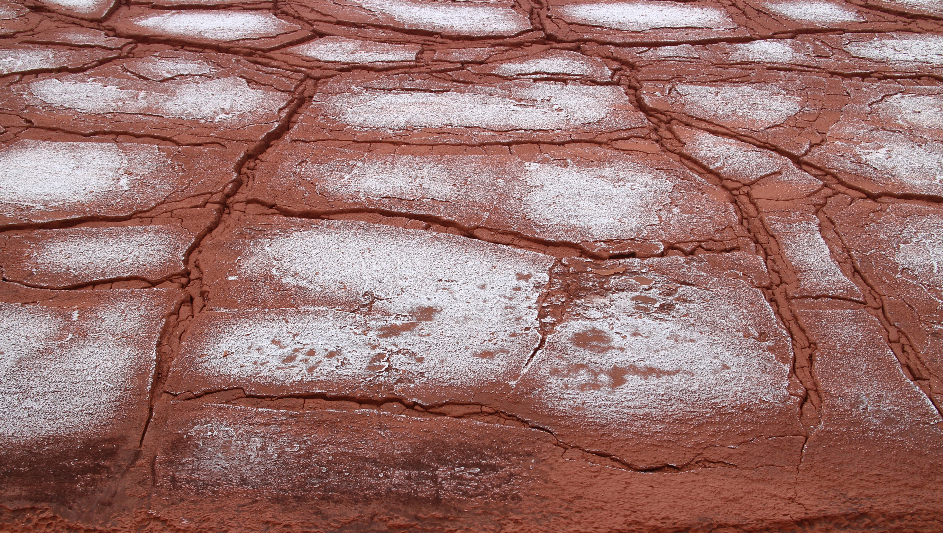
Establishment of a soil layer within bauxite residues using organic matter and gypsum
Andy Bray, Doug Stewart, Ronan Courtney, Will Mayes & Ian Burke

Slide 2
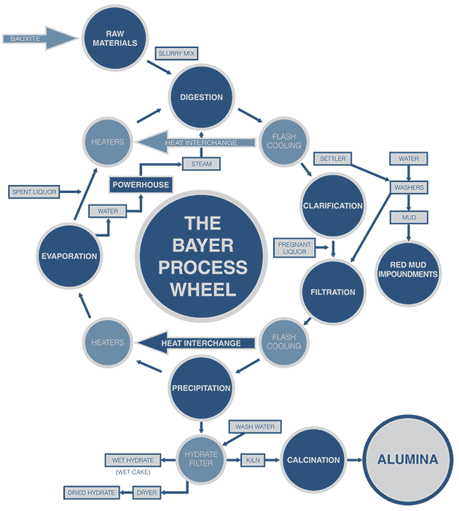
Bauxite Residue/Red Mud
By product in the production of alumina (Al₂O₃)
1 ton Alumina = 1-2 tons of Red Mud
Since 2012 global annual alumina production > 100 million tonnes/year

Slide 3
Stade, Germany
Barcarena, Brazil
Hayes, Jamaica
Worsley, Australia
Lanjigarh, India

Slide 4
NaOH
Red mud characteristics
~30 % wt. solids
Of those solids:
~30 % Fe oxides and (oxy)hydroxides
~10 % Al (oxy)hydroxides
Ca(OH)₂
Sodalite Na₆(Al₆Si₆O₂₄).2NaOH
Cancrinite Na₆(Al₆Si₆O₂₄ ).2CaCO₃
High pH
High salinity
Sodalite
$${Na}_{6}\left({Al}_{6}{Si}_{6}O_{24}\right).2NaOH+ 24H2O↔8{Na}^{+}+8{OH}^{−}+{6Al(OH)}_{3}+{6H}_{4}{SiO}_{4}$$
Cancrinite
$${Na}_{6}\left({Al}_{6}{Si}_{6}O_{24}\right).2Ca{CO}_{3}+ 26H2O↔6{Na}^{+}{+ 2Ca}^{2+}+ 8{OH}^{−}+2{HCO}_{3}^{−}+ {6Al(OH)}_{3}+{6H}_{4}{SiO}_{4}$$

Slide 5
High alkalinity
High salinity
Mobility of potentially toxic metals (Al, V)

Slide 6
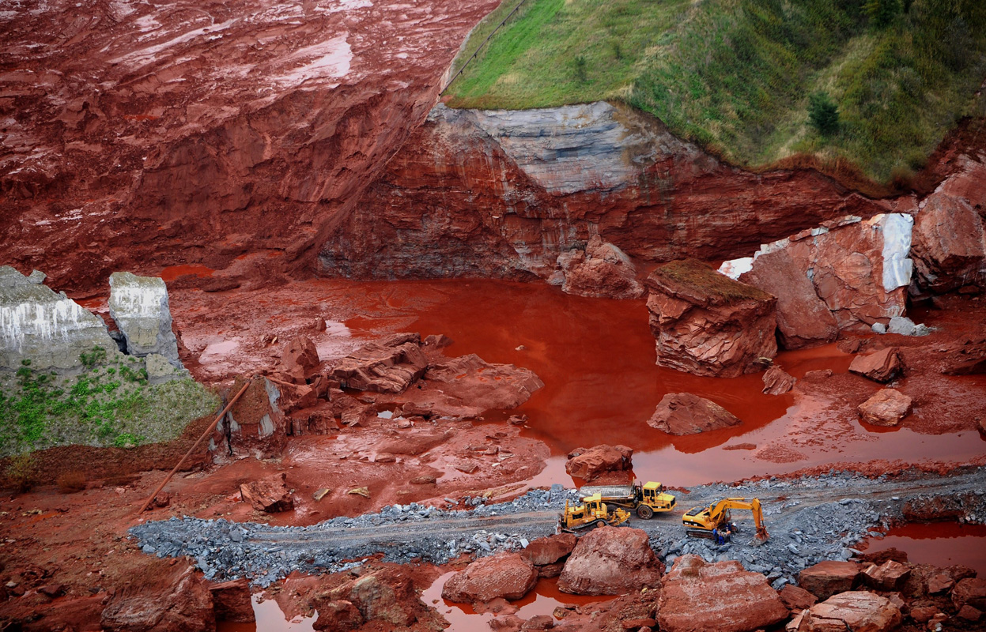
Associated Press

Slide 7
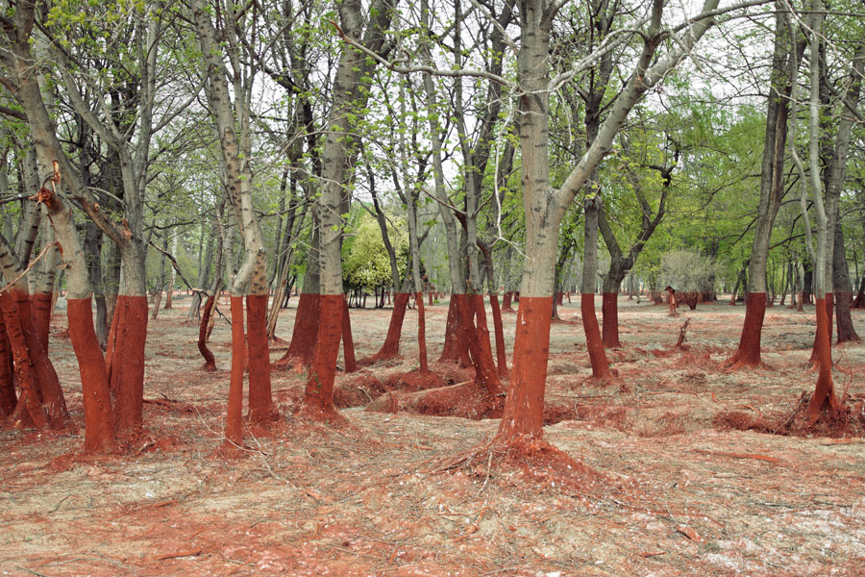
Palíndromo Mészaros

Slide 8
Amended
No gypsum
Unamended
Process sand
Process sand
Organic matter
Organic matter
Gypsum
20 cm
20 cm

Slide 9
20 years later…

Slide 10
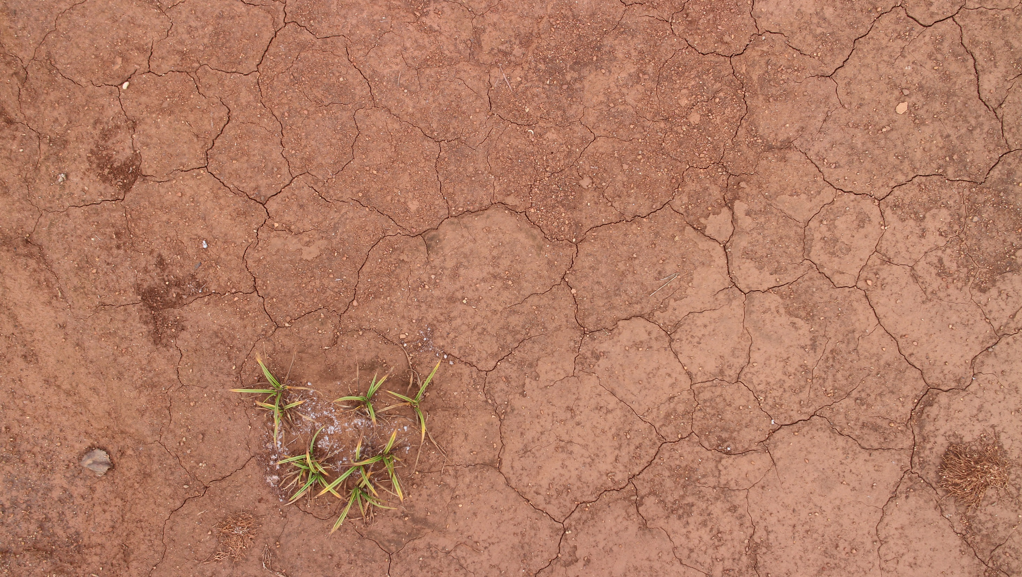
Unamended

Slide 11
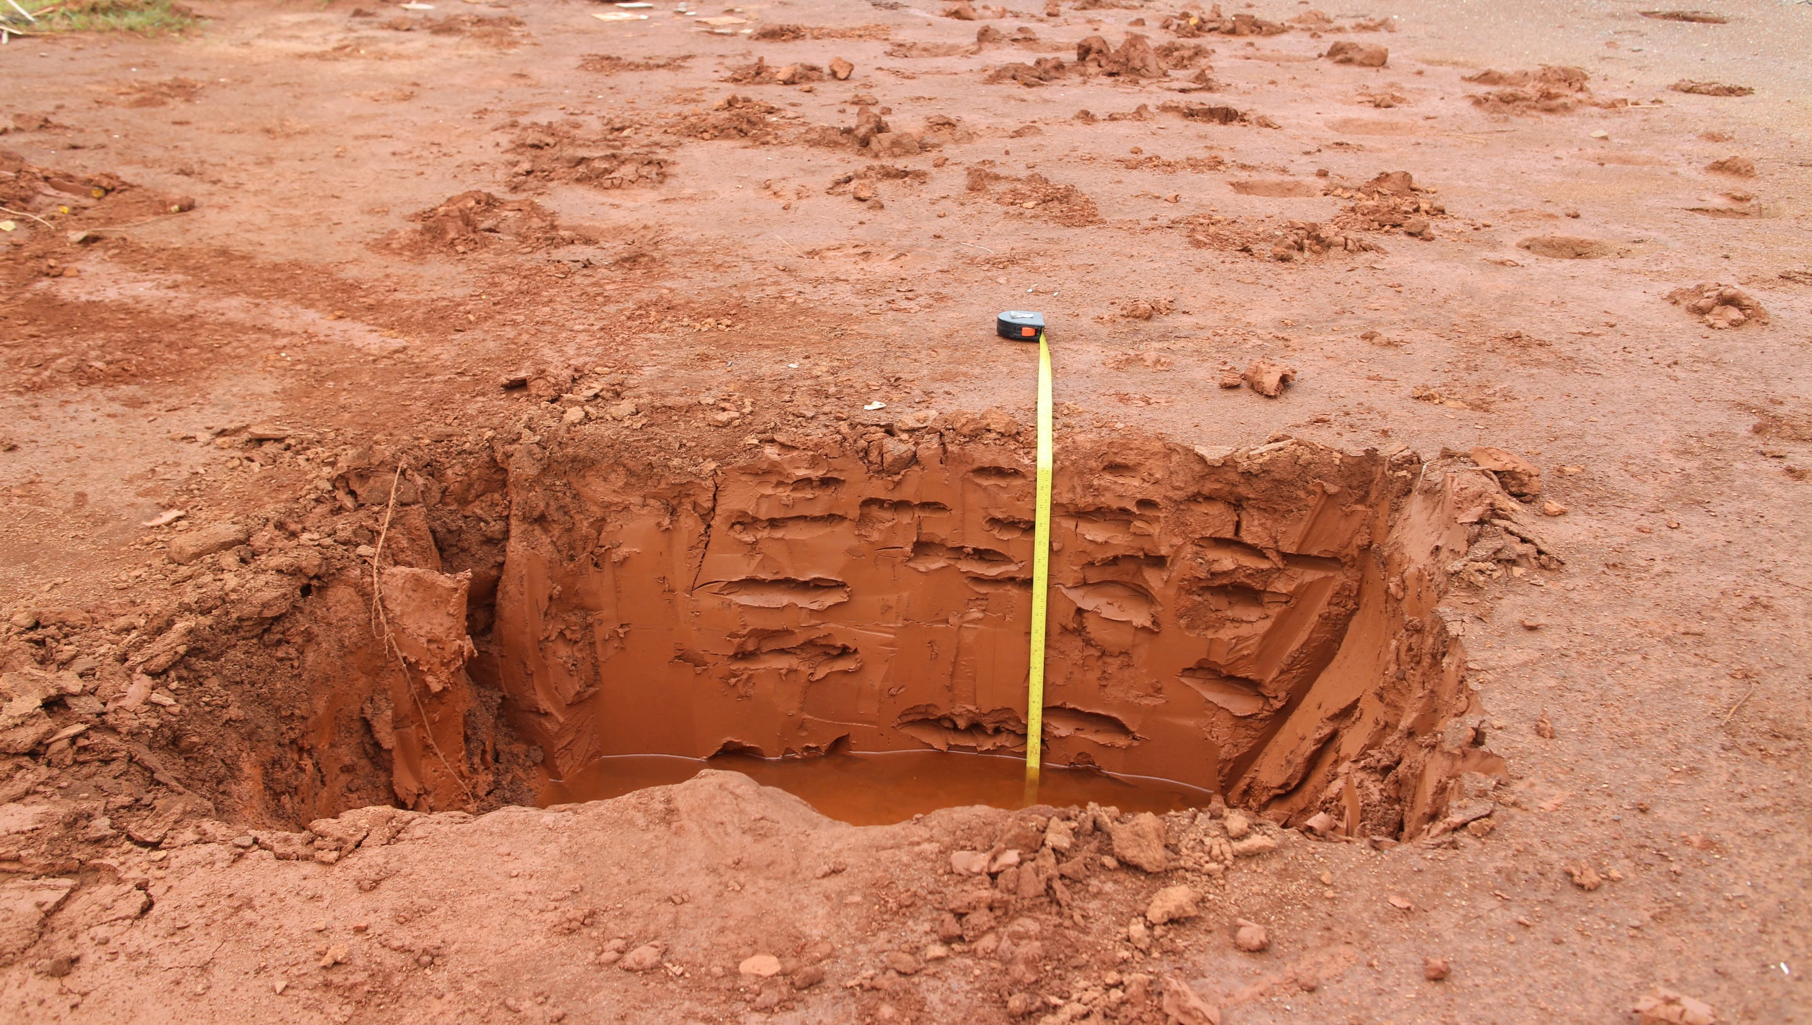
Unamended

Slide 12
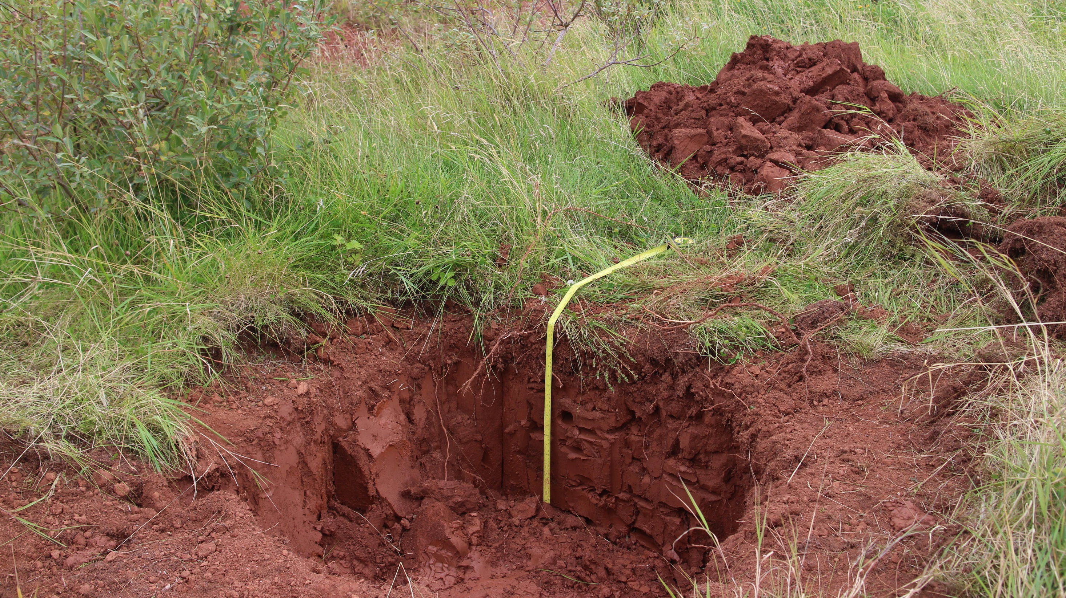
No gypsum

Slide 13
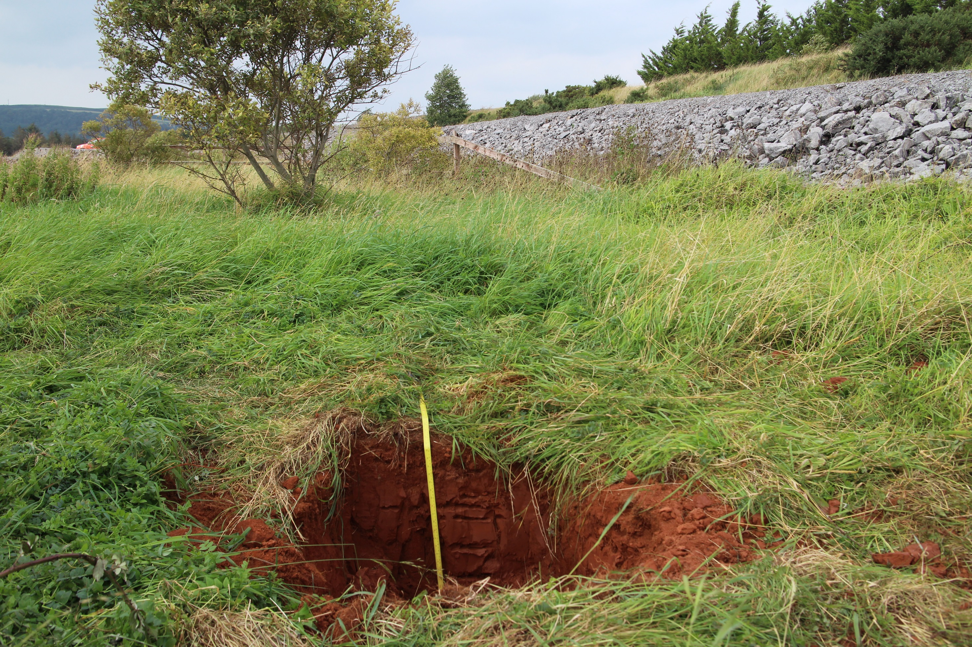
Amended
Holcus lanatus – Yorkshire Fog
Trifolium pratense – Red Clover

Slide 14
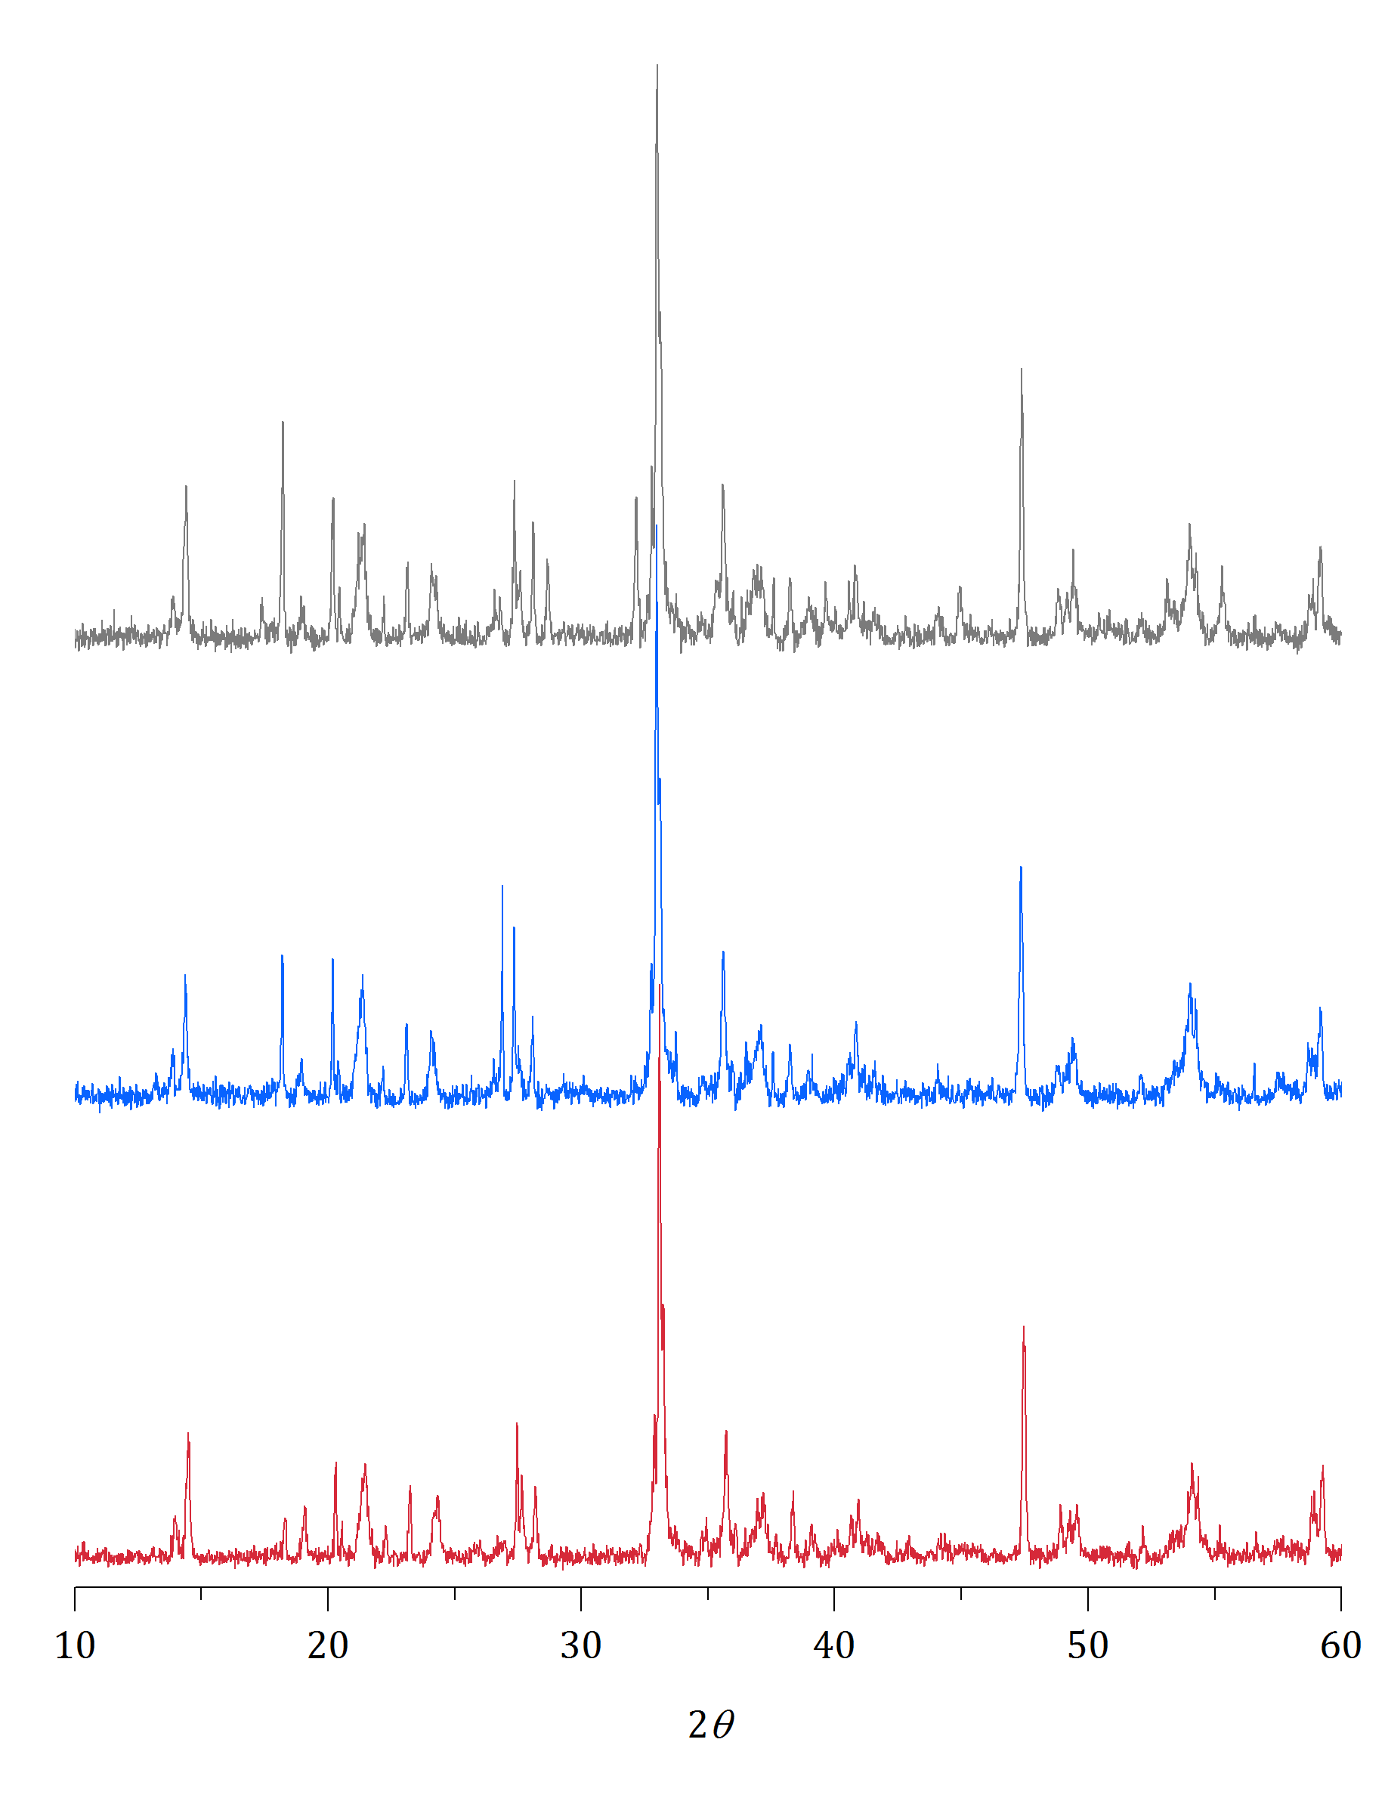
Cancrinite
Cancrinite/sodalite
Amended
No gypsum
Unamended

Slide 15
AND GEOCHEMICAL DATA

Slide 16
Cancrinite
Cancrinite/sodalite
Amended
No gypsum
Unamended

Slide 17
H₂O extraction Amended No gypsum Unamended
Na
Al
V

Slide 18
High pH PO₄ extraction Amended No gypsum Unamended
Al
V
Al
V

Slide 19
Amended
Unamended

Slide 20
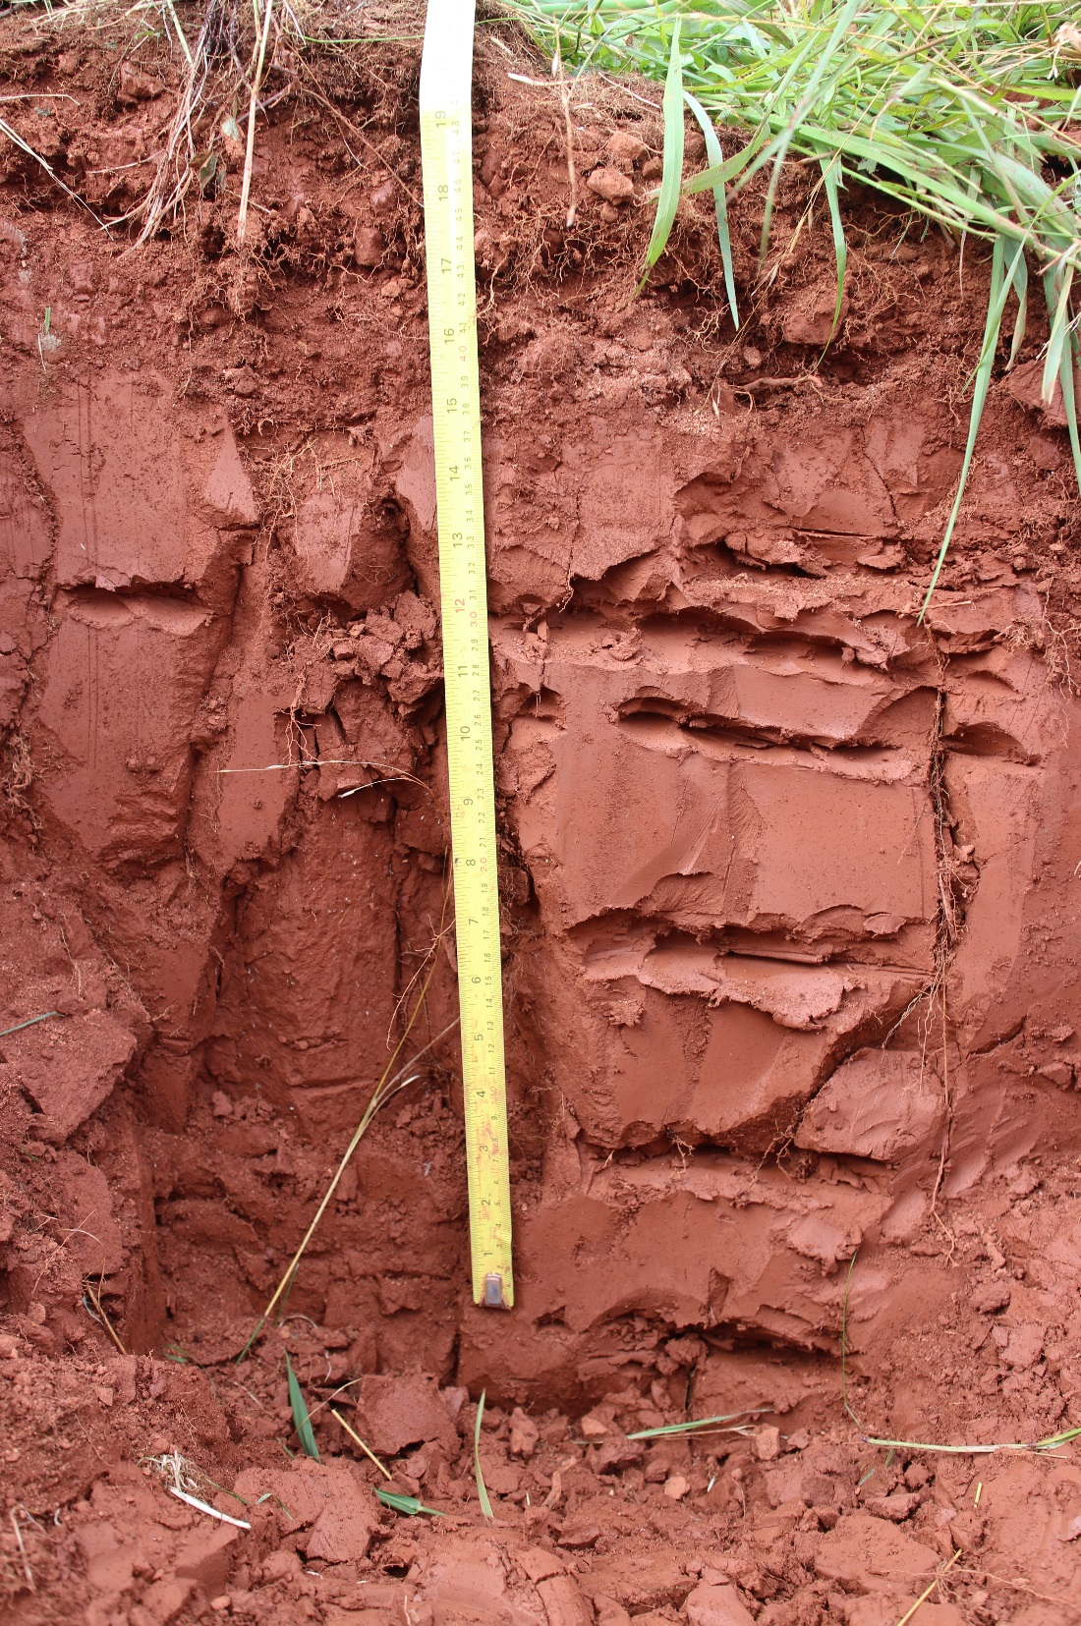
Plant symbiosis
Rhizobia
Rhizosphere fungi & bacteria
Organic exudates
Amended
pH buffering by organic acids?
~5 nanomoles litre⁻¹
Unamended

Slide 21
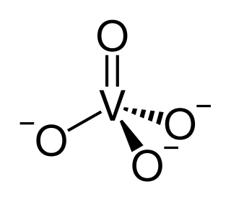
NaOH
Bauxite
Ca(OH)₂
Al
Fe
Si, Ti
Gibbsite, Boehmite, Diaspore
Goethite,
Haematite
Clays,
Anatase, Ilmenite
V^{(IV)}
V^{(V)}
High pH
High temp
Oxygen present
Al oxyhydroxides
Fe oxyhydroxides
Titanium oxides
V^{(V)}
Bayer Process Characteristic Solids
(Cancrinite, Sodalite, Hydrogarnet)

Slide 22
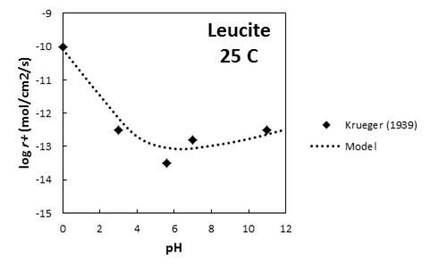
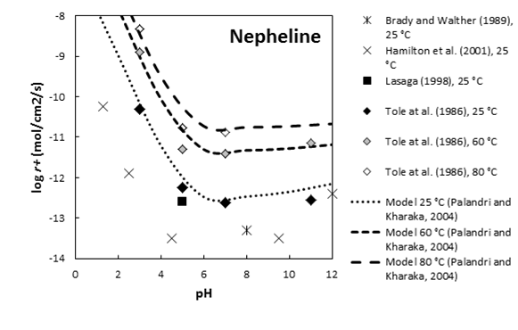
Sodalite
$${Na}_{8}\left({Al}_{6}{Si}_{6}O_{24}\right)(OH)_{2}$$
Cancrinite
$${Na}_{6}{Ca}_{2}\left({Al}_{6}{Si}_{6}O_{24}\right)({CO}_{3})_{2}$$
Katoite
$${Ca}_{3}{Al}_{2}{(SiO_{4})}_{3−x}{(OH)}_{4x} x=1.5−3$$
Cancrinite
$${Na}_{6}{Ca}_{2}\left({Al}_{6}{Si}_{6}O_{24}\right)({CO}_{3})_{2}+ 26H2O↔6{Na}^{+}{+ 2Ca}^{2+}+ 8{OH}^{−}+2{HCO}_{3}^{−}+ {6Al(OH)}_{3}+{6H}_{4}{SiO}_{4}$$
(Burke et al., 2012)
(Declercq, personal comms.)

Slide 23
Al
Neutralisation:
Decreases feldspathoid dissolution – preventing Na and V release.
Reduces Al solubility
V

Slide 24
High alkalinity
High salinity
Mobility of potentially toxic metals (Al, V)

Slide 25
20 Year
7 Year
Unamended
Process sand
Organic matter
Gypsum
Process sand
Organic matter
Gypsum
20 cm
20 cm

Slide 26
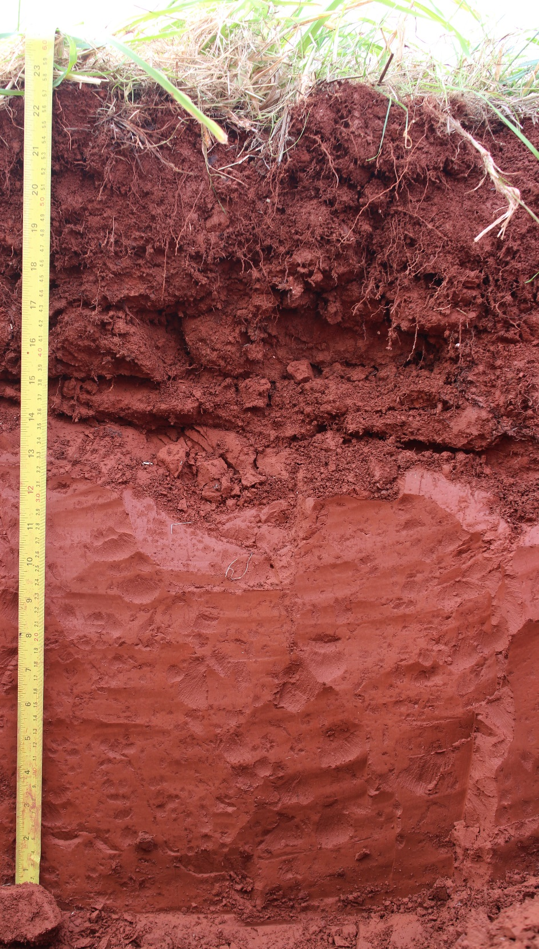
Na

Slide 27
H₂O extraction
Al
V

Slide 28
Improves substrate structure, stability, and drainage
Process sand

Slide 29
Improves substrate structure, stability, and drainage
Process sand
Gypsum
1% w/w gypsum can buffer bauxite residue to pH 7.5-8.5.
Additional Ca binds to abundant OH

Slide 30
Improves substrate structure, stability, and drainage
Process sand
1% w/w gypsum can buffer bauxite residue to pH 7.5-8.5.
Additional Ca binds to abundant OH
Organic matter
Gypsum
Provides organic bound and available nutrients.
Friendlier environment for plant and rhizospheric life.

Slide 31
Feldspathoid + Water ↔ Alkalinity + Salinity + stuffs
Surface organic activity increases CO₂ penetration and produces H⁺
Shift to an organic controlled dynamic remediation means longer term stability

Slide 32
↓ alkalinity
↓ salinity
↓ mobility
Red Mud + gypsum + organic matter + sand =
Cap and cover estimate for 1.7km² = €15 million
gypsum and organic matter estimate = €1.5 million
NERC R³AW grant: NE/L014211/1

