Slide 1






A universal uptake mechanism for cobalt(II) on soil constituents: Ferrihydrite, kaolinite, humic acid, and organo-mineral composites
Woodward G.L.¹, Peacock C.L.¹, Otera Fariña A.², Thompson O.R.³, Brown A.P⁴
and Burke I.T.¹
¹ School of Earth and Environment, & ⁴ School of Chemical and Process Engineering, University of Leeds, UK.
² Department of Physical Chemistry, University of Santiago de Compostela, Spain.
³ National Nuclear Laboratory, Warrington, UK.

Slide 2
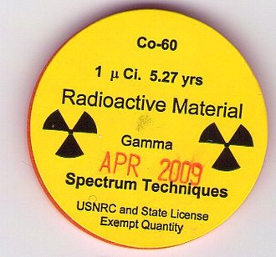
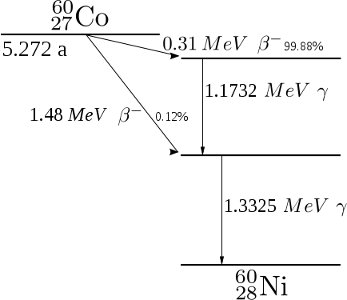
Cobalt Contamination
Cobalt is commonly released into the environment from vehicle exhausts, coal power plants, and is produced in the manufacturing of special steels.
Phytotoxic, ecotoxic (Ca uptake mechanism) and genotoxic
Radioactive ⁶⁰Co is potent beta-gamma radionuclide with a half-life of 5 years.
Is present in cooling waters of nuclear power plants. Commonly used medical source in radiotherapy.

Slide 3
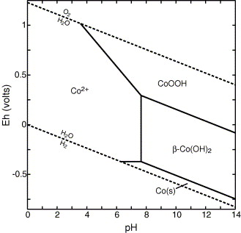
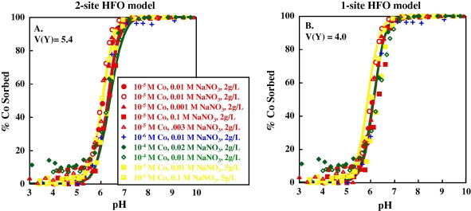
Environmental Behaviour of Co
most commonly present as Co²⁺(aq) ion
– tendency to form Co(OH)₂(s) at high pH
Mobility considered to be sorption controlled at low to neutral pH
Landry C. J., Koretsky C. M., Lund T. J., Schaller M. and Das S. (2009) Surface complexation modeling of Co(II) adsorption on mixtures of hydrous ferric oxide, quartz and kaolinite. Geochim. Cosmochim. Acta 73, 3723–3737.
Jeffrey G. Catalano, Jeffrey A. Warner, Gordon E. Brown (2005) Sorption and precipitation of Co(II) in Hanford sediments and alkaline aluminate solutions, Applied Geochemistry, 20, 193-205.)

Slide 4
Mechanistic Understanding of Co(II) Sorption
Mismatch!
Spectroscopic work – evidence of Co(OH)₂ formation at mineral surfaces.
Macroscopic investigations – tend to assume that uptake is controlled by surface complexation reactions with charged sites
No HR electron microscopic investigations
No consideration of organic matter interactions
Landry C. J., Koretsky C. M., Lund T. J., Schaller M. and Das S. (2009) Surface complexation modeling of Co(II) adsorption on mixtures of hydrous ferric oxide, quartz and kaolinite. Geochim. Cosmochim. Acta 73, 3723–3737.
O’Day P. A., Brown JR G. E. and Parks G. A. (1994) X-Ray Absorption Spectroscopy of Cobalt(II) Multinuclear Surface Complexes and Surface Precipitates on Kaolinite. J. Colloid Interface Sci. 165, 269–289.

Slide 5
Objectives of This Study
Investigate Co sorption behaviour with common soil constituents (i.e. iron oxides, clays, humic acid) and organo-mineral mixtures
Determine the sorption mechanism of Co using combination of synchrotron EXAFS spectroscopy & HR Transmission Electron Microscopy
Produce a good model description of the sorption processes that reconciles macro and micro-scale observations

Slide 6
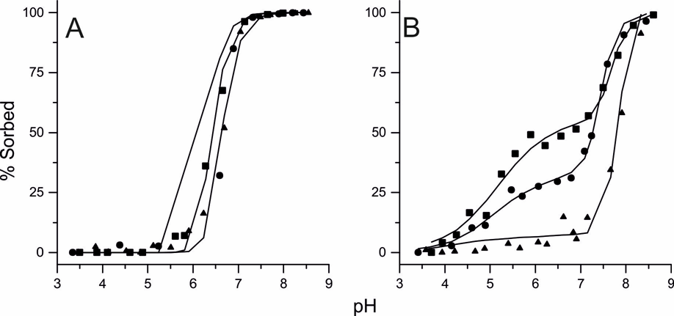
Co²⁺ Sorption to Ferrihydrite and Kaolinite
1 g L-1 mineral; 10⁻⁵ mol L⁻¹ Co²⁺; 0.001-0.1 mol L⁻¹ NaNO₃ solution
FHY Kaolinite
FHY: single sorption edge
pH6-7; not affected by I.S.
KAOL: double sorption edge
1) pH4.5-5.5; IS dependant
2) pH 7-8; not affected by I.S.

Slide 7
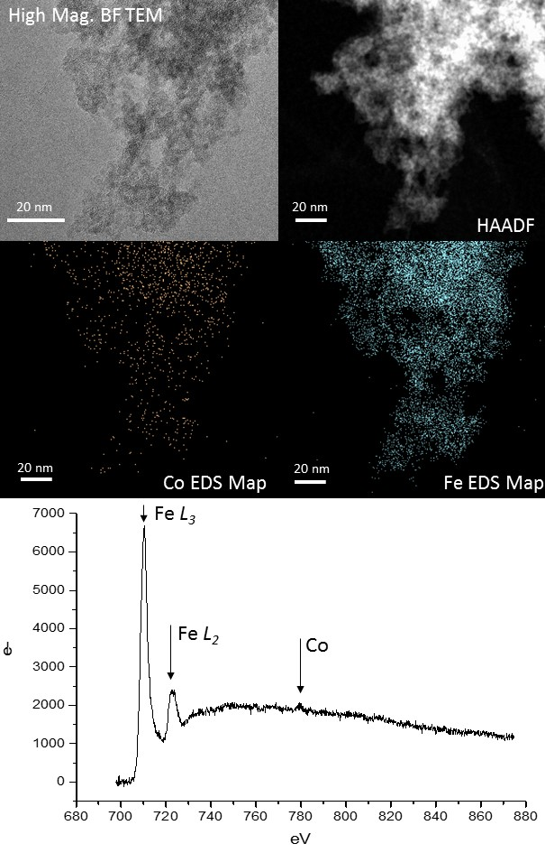
TEM Observations: FHY
1% Co at pH 7.5
Co evenly distributed on solids; no evidence of nano-scale Co(OH)₂ particles

Slide 8
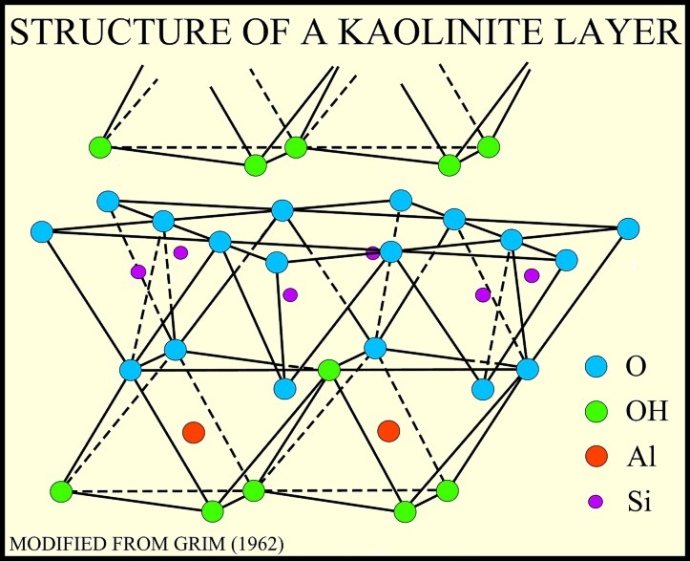
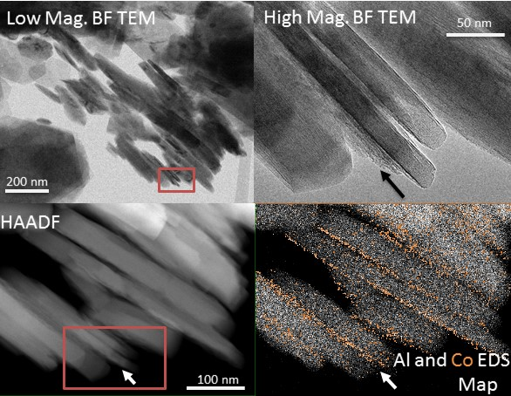
TEM Observations: Kaolinite
1% Co at pH 7.5
← Cleavage Plane
Co concentrated on specific crystal faces – uneven or rough cleavage sites ; no evidence of nano-scale Co(OH)₂ particles; associated with AlOH sites?

Slide 9
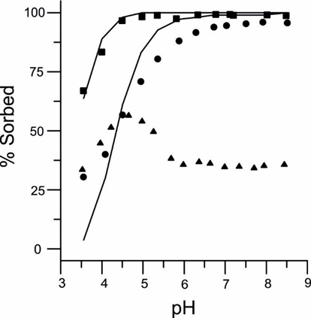
Co²⁺ Sorption to Soil Humic Acid
1 g L⁻¹ HA; 10⁻⁵ mol L⁻¹ Co²⁺; 0.001 & 0.1 mol L⁻¹ NaNO₃ solution
10 kDa ultrafiltration (~1.5 nm pores)
Co
0.2 μm filtration
(200 nm pores)
May indicate enhanced association of Co with more easily dispersed LMW Humics
Broad sorption edge from pH 3.5-7;
Affected by I.S., esp. at low pH
Dispersion of Co-HA colloids at pH > 5

Slide 10
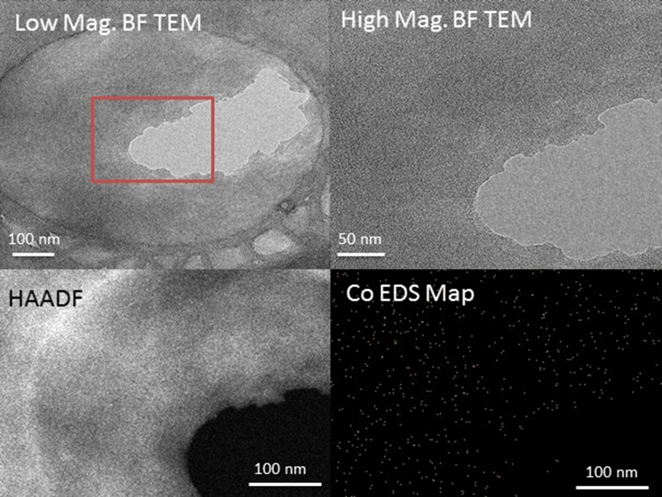
TEM Observations: HA
1% Co at pH 7.5
Co evenly distributed on solids; no evidence of nano-scale Co(OH)₂ particles

Slide 11
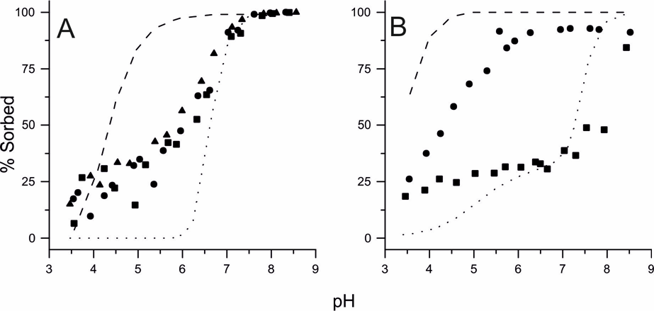
Co²⁺ Sorption to Mineral-HA composites
1 g L-1 mineral; 10⁻⁵ mol L⁻¹ Co²⁺; 0.01 mol L⁻¹ NaNO₃ solution
FHY-HA (5, 10, 17 wt% C) Kaolinite-HA (1.4, 2.2 wt% C)
Intermediate behaviour cf. pure phase systems.
FHY-HA: effect of increasing HA loading was low wt% C
Kaol-HA: strong effect of increasing HA loading

Slide 12
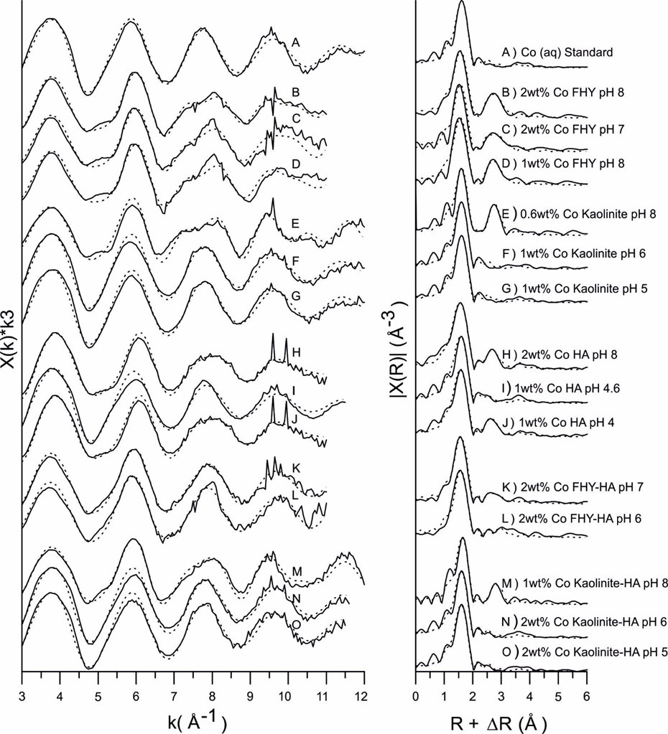
EXAFS Observations
At low pH
6 x Co – O pathways
At pH > 7
6 x Co – O pathways
1-2 x Co – Co Pathways
1 x Co – Fe / Al / C pathways
O
O
Co
O
Cr
O
O
O
O
O
O
O
O
Co
Co
Al
Cr
O
O
O
O
O

Slide 13
Surface complexation modelling
Based on formation and adsorption of Co-Co dimers to mineral / HA surface sites

Slide 14


Model Comparison to Data
Model does a good job of fitting the data from pure phases

Slide 15
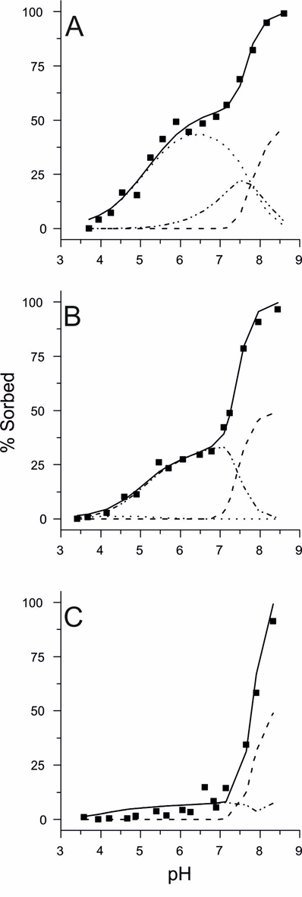
e.g. Co- kaolinite sorption
0.001 M Na
0.01 M Na
0.1 M Na
Co sorption to ion exchange sites are progressively reduced by increased competition with Na in the background solution
dashed lines show sorption to the AlOH sites, dotted lines to the XH sites, and dash-dot-dot lines to the X- sites

Slide 16
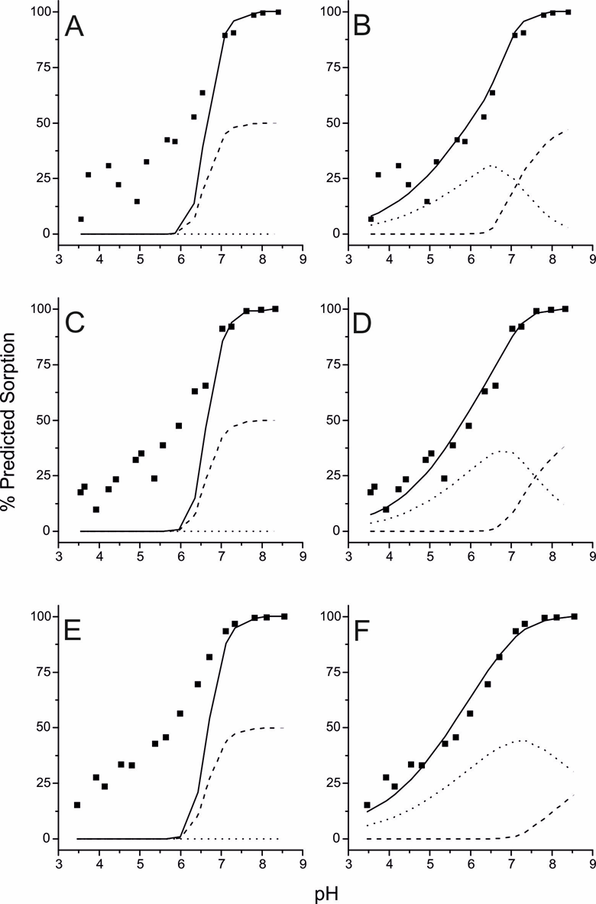
Modelling the Mineral-HA Composite Data
E.g. FHY-HA composite data
Tends to underestimate the increased sorption observed at low pH.
Much better fit when Log Ks where iterated (within allowable intervals) increasing the contribution from COO- sites
dashed lines show sorption to the FeOH site, and dotted lines show sorption to the COO- site.

Slide 17
Conclusions
EXAFS and TEM data suggests that Co sorbs to all soil components through formation of similar multinuclear bidentate inner-sphere complexes at high pH.
but at low pH on Kaolinite and humic acid sorption is via outer-sphere complexation.
It was possible to fit the sorption data for the pure component systems invoking the sorption mechanisms suggested by the EXAFS data.
However, fixing the log K’s in the composite models to the values from the pure component systems did not produce a good fit to the data.
Therefore, we conclude that Co sorption to Fh-HA and Ka-HA composites is non-additive

