Slide 1







Fate and Behaviour of Vanadium During the Aerobic Neutralisation of Alkaline Steel Slag Leachate
Andrew. J. Hobson¹, Douglas. I. Stewart², Andrew W. Bray¹, William M. Mayes³, Alex L. Riley³ and Ian T. Burke¹
¹School of Earth and Environment and ²School of Civil Engineering, University of Leeds.
³Centre for Environmental and Marine Sciences, University of Hull

Slide 2
Leachate generation
Rainwater
Steel Slags

Slide 3
Ca(OH)₂ / β-Ca₂SiO₄ dissolution
Alkalinity generation & V-release
CaO + H₂O → Ca²⁺ + 2OH⁻
β-Ca₂Si(V)O_{4 (s)} + 2H₂O →
2Ca²⁺ + H₂SiO₄²⁻ + 2OH⁻ + VO₄³⁻
Secondary V-containing phases
3Ca²⁺ + 2H₂SiO₄²⁻ + OH⁻ (+ xVO₄³⁻) → 3CaO·2SiO₂(xVO₄)·3H₂O _{(s)}
3Ca²⁺ + 2VO₄³⁻ ⇌ Ca₃(VO₄)_{2 (s)}
Rainwater
Steel Slags

Slide 4
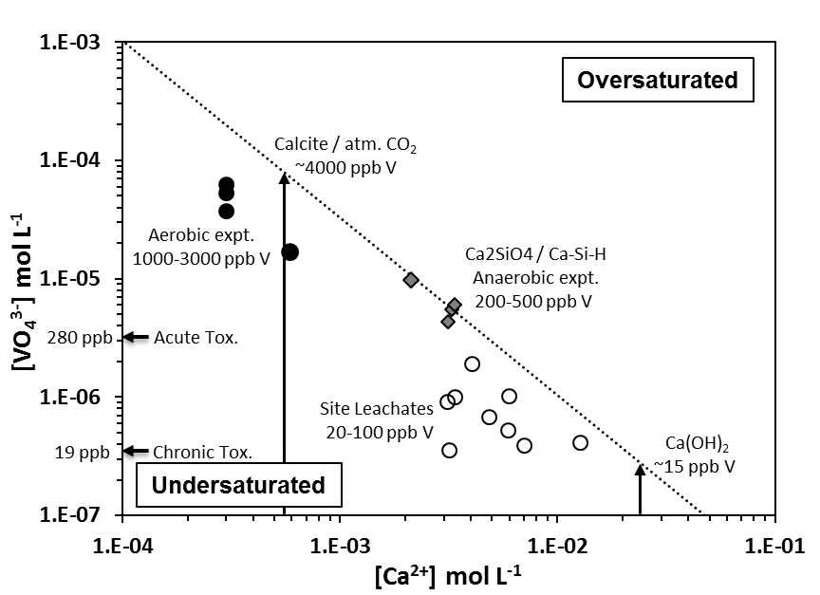
Ca₃(VO₄)₂ Solubility
[V] concentrations limited by [Ca] controlling secondary phase
Log Ksp = -17.97
8 pH 12.5
Hobson et al., in prep

Slide 5
Leachate springs
CO₂ in gassing
Steel Slags
River flow→
Groundwater outflow

Slide 6
CaCO₃ precipitation
CO₂ In gassing
CO₂ _{(g)} ⇌ CO₂ _{(aq)}
CO₂ + H₂O ⇌ H₂CO₃
H₂CO₃ ⇌ HCO₃⁻ + H⁺ ⇌ CO₃²⁻ + H⁺
H⁺ + OH⁻ ⇌ H₂O
Ca²⁺ + CO₃²⁻ ⇌ CaCO_{3 (s)}
Overall reaction
Ca²⁺ + CO₂ + 2OH⁻ → CaCO₃ _{(s)} + H₂O
CO₂ in gassing
Steel Slags
Groundwater outflow

Slide 7
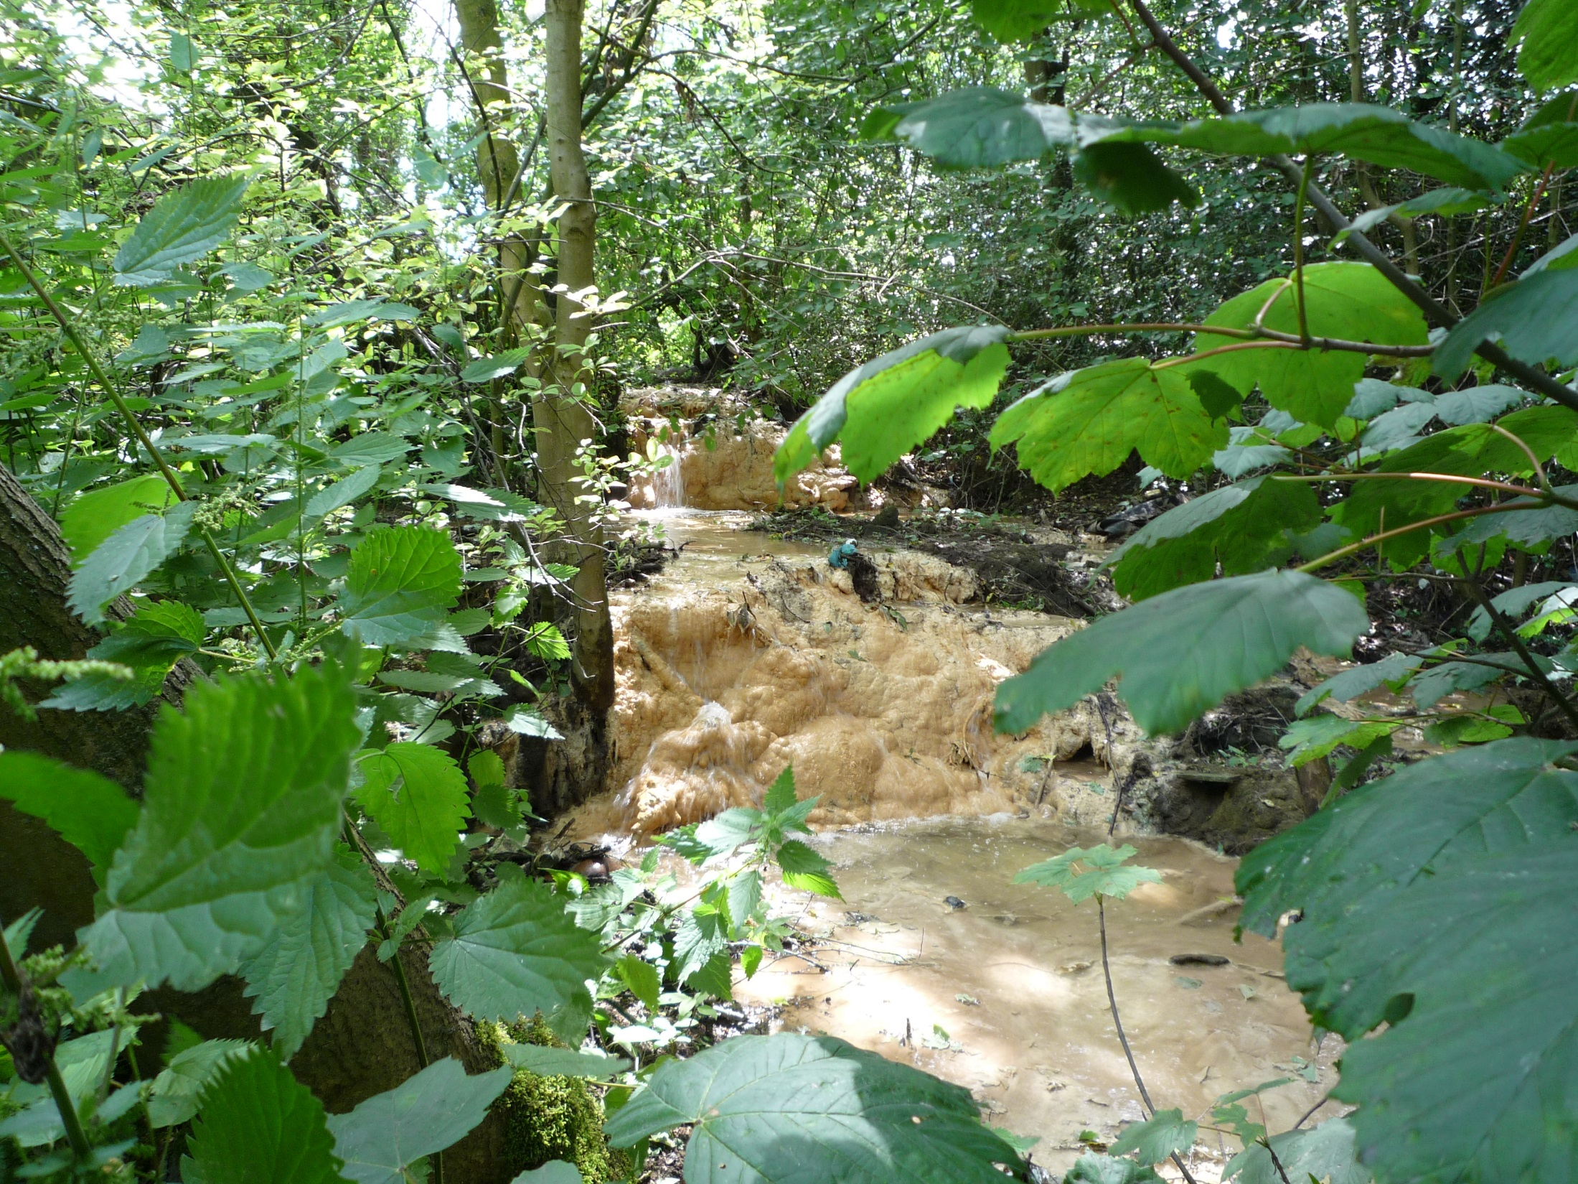
Consett Steel Works, Co. Durham, UK

Slide 8
Site Data – Howden Burn, Consett
No change in conservative elements
(i.e. no dilution)
pH reduction & Ca removal
Co = 104 ±31 ppm
Co = 127 ±57 ppm
Si Co = 1300 ±340 ppb
Al Co = 129 ±39 ppb
Concurrent Trace Metal Removal
Co = 58 ±8 ppb

Slide 9
Experimental
Site Leachate – Ca(OH)₂ type ~35 ppb V (+Fe)
Slag Leachate – Ca₂SiO₄ type ~ 500 ppb V (+Si)
Sim. Leachate – 10 % Ca(OH)₂
+ 2500 ppb VO₄³⁻ (for XAS)
All initially pH ~12 & CO₂ free
Slag
Leachate

Slide 10
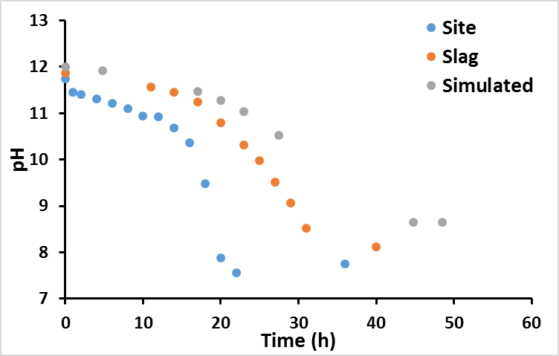
Results – pH

Slide 11
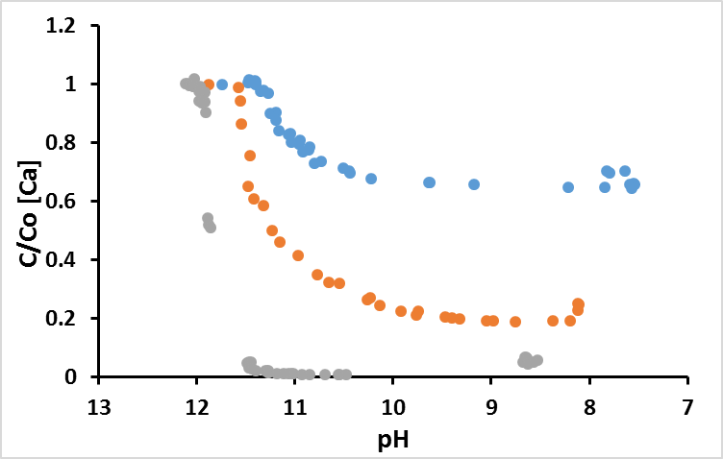
Results – Calcium
Site [Ca] = 194 ppm
Graph of C/Co [Ca] vs pH– three leachates CaCO3 only systems
Slag [Ca] = 89 ppm
Sim. [Ca] = 75 ppm
Total [Ca] removal very similar in all systems; ~60-80 ppm

Slide 12
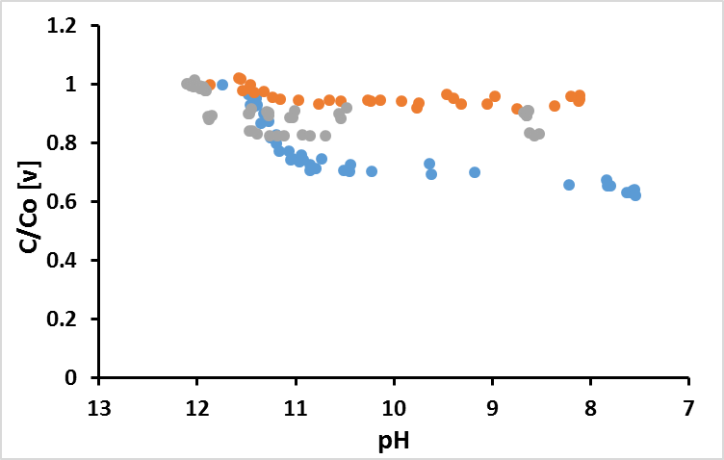
Results – Vanadium
Slag [V] = 510 ppb
Sim. [V] = 2510 ppb
Graph of C/Co [V] vs pH– three leachates CaCO3 only systems
Site [V] = 35 ppb
[V] removed: Site = ~13 ppb; Slag = ~30 ppb; Sim. = 400 ppb

Slide 13
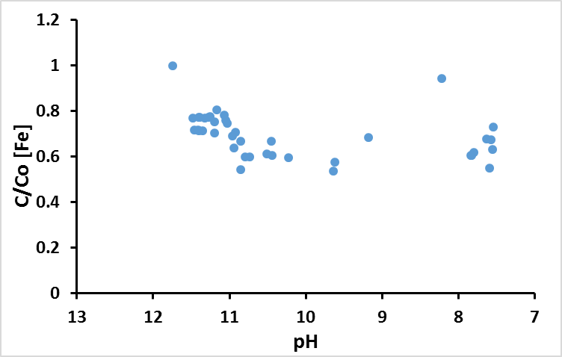
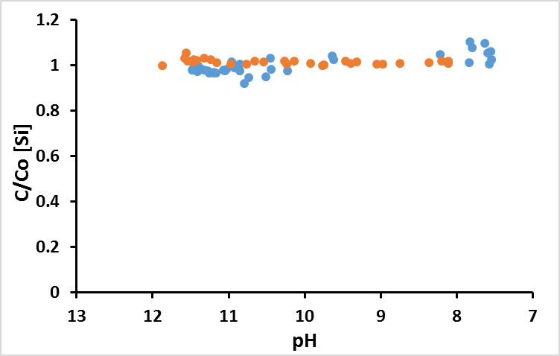
Results – Fe
Results – Si
Slag [Si] = 21 ppm
Site [Fe] = 166 ppb
Site [Si] = 1.6 ppm
Slag & Sim. [Fe] = n.d.
Sim. [Si] = n.d.
60-70 ppb Fe removed in Site leachate system

Slide 14
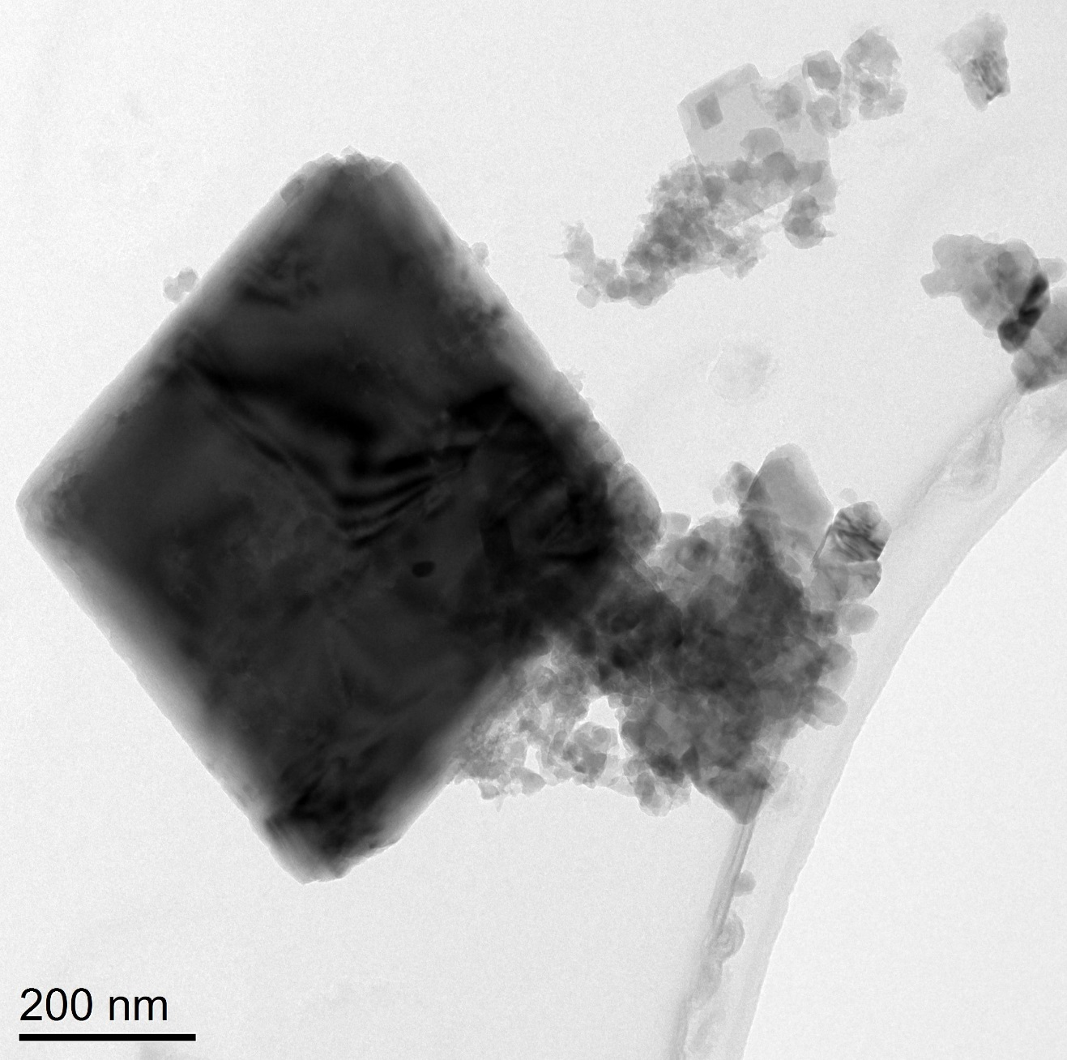
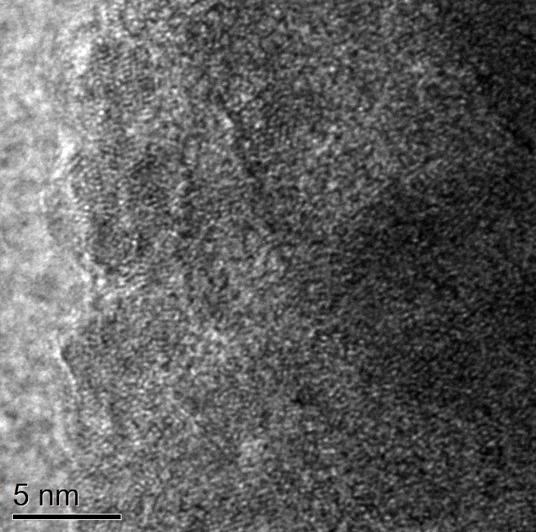
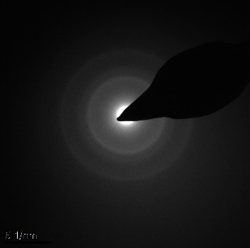
TEM – site leachate ppt
Low res Bright field TEM
Hi res TEM
0.145 nm
0.250 nm
Calcite
SAED
EDS spectra
O
Fe
C
Fe
Fe-O rich particles
Cu
Si
Ca
Fe
Na
Ca
Al
P
S
Cl

Slide 15

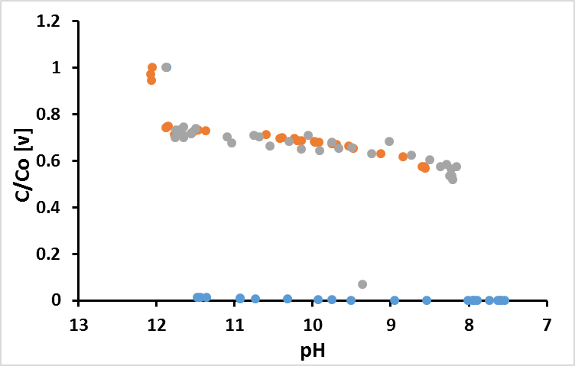
Goethite amended systems
unamended data
Slag
Graph of C/Co [V] vs pH– three leachates FeOOH systems
Sim.
Site

Slide 16
Vanadium K-edge XANES
V⁵⁺ aqueous
V⁵⁺-Kaolinite
V⁵⁺-Al(OH)₃
V⁵⁺-FeOOH
Sim. +FeOOH
Slag +FeOOH
Site +FeOOH
Sim. +Kaolinite
Slag +Kaolinite
Site +Kaolinite
Sim. unamend
Slag unamend
Site unamend
All Vanadium present as V⁵⁺
0.5
Diamond Light Source, UK, Beamline i18
Data collected from CaCO₃ precipitates (pH ~8)

Slide 17
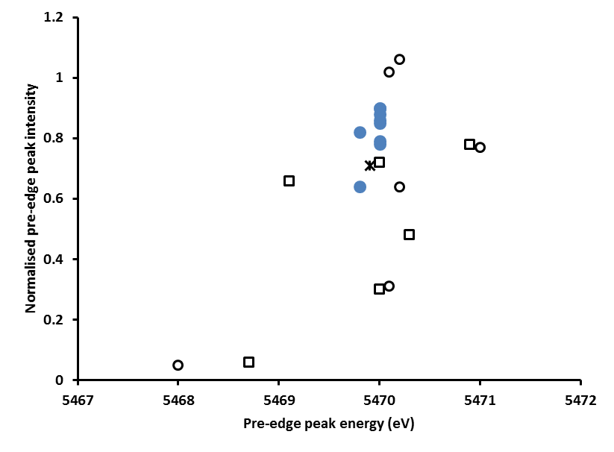
V – XANES interpretation
Distortion in VO₄ tetrahedral leads to reduced peak intensity
adsorption / incorporation
Experimental
Samples
(T_{d}) V⁵⁺
(P_{y}) V⁵⁺
V⁵⁺-FeOOH
V⁵⁺-Kaol.
(P_{y}) V⁴⁺
NaVO₃
V⁵⁺-Al(OH)₃
(O_{h}) V⁵⁺
(O_{h}) V⁴⁺
Measurement
uncertainty
(O_{h}) V³⁺

Slide 18
V-FeOOH EXAFS
A)
B)
VO₄
V-Fe
A) Sim. +FeOOH (0.2% w/w)
B) V-FeOOH std. (2% w/w)
Peacock and Sherman, 2004

Slide 19

Conclusions
CO₂ in gassing = modest V removal via sorption to neoformed phases
Interaction with stream sediments = complete V removal via adsorption to iron(oxy)hydroxides
Steel Slags
Groundwater outflow
Vanadium will accumulate in near field sediments; no far field impacts

Slide 21
Oversaturated
Calcite / atm. CO₂
~4000 ppb V
Aerobic expt.
1000-3000 ppb V
Ca2SiO4 / Ca-Si-H
Anaerobic expt.
200-500 ppb V
280 ppb
Acute Tox.
Site Leachates
20-100 ppb V
19 ppb
Chronic Tox.
Ca(OH)₂
~15 ppb V
Undersaturated

