Slide 1

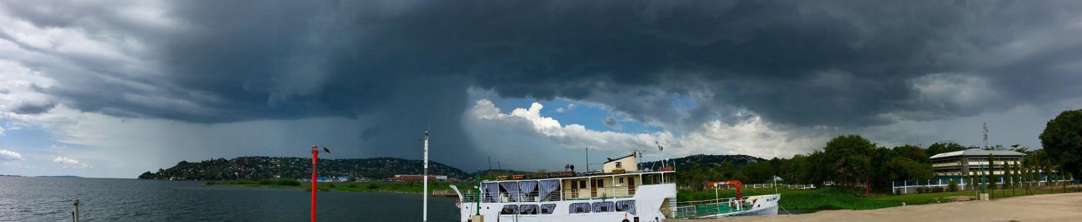
Severe weather over East Africa
Cathryn Birch^{1,2}
Beth Woodhams¹, John Marsham^{1,2}, Caroline Bain², Stuart Webster², Paul Barrett², Jennifer Fletcher¹, Andrew Hartley², Solomon Mangeni³, Todd Lane⁴
¹University of Leeds, ²Met Office, ³Uganda National Met Authority, ⁴University of Melbourne

Slide 2
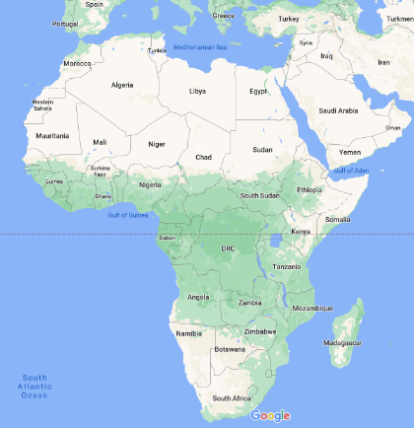
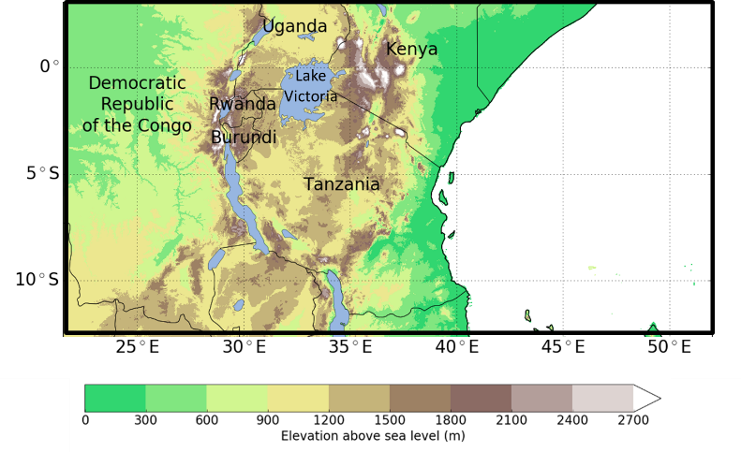

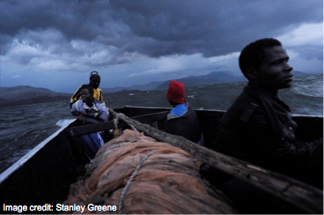
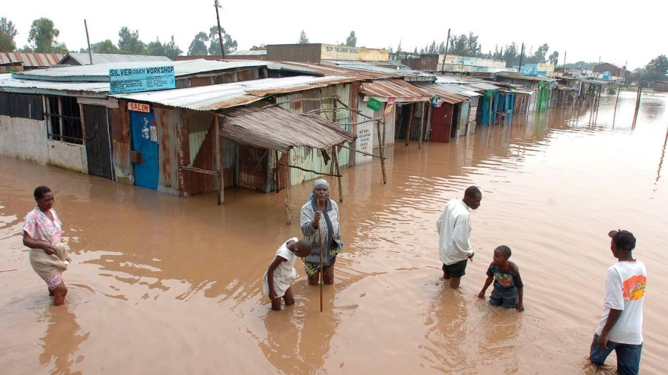
East Africa
2010/2011 drought
Hotspot for individual severe weather events
Vulnerable to seasonal and decadal rainfall variability

Slide 3
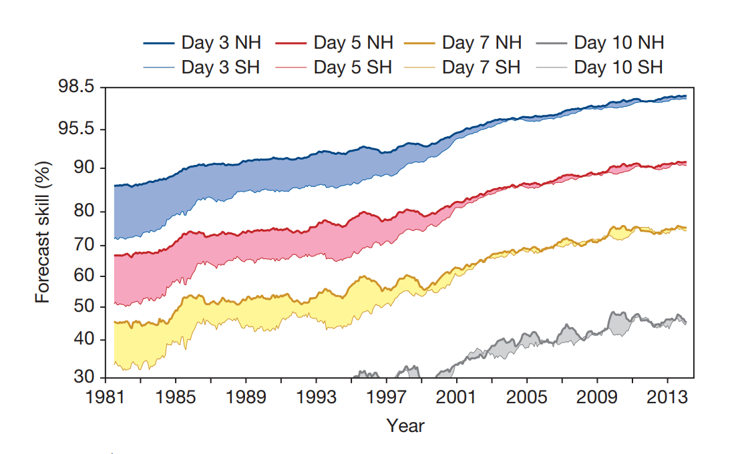
Extra-tropical weather forecast skill
Useful forecast
A 7 day forecast today is as good as a 3 or 4 day forecast in 1980
Forecast skill has increased by a day per decade
Bauer et al. 2015

Slide 4
Global NWP forecasts of rainfall
Brier Skill Score for exceedance of 20mm in 1 day forecast
Modest skill
No skill
Limited skill
Vogel et al. Weather and Forecasting 2020
Almost no skill relative to climatology over most of sub-Saharan Africa
Slightly better over East Africa
Lack of routine observations, type of convective systems
Notes:
As a skill score, the
BSS has a range from -1 to 1. A perfect forecast would achieve a score of BSS = 1,
whilst a forecast with no skill relative to the reference forecasts would achieve BSS = 0.

Slide 5
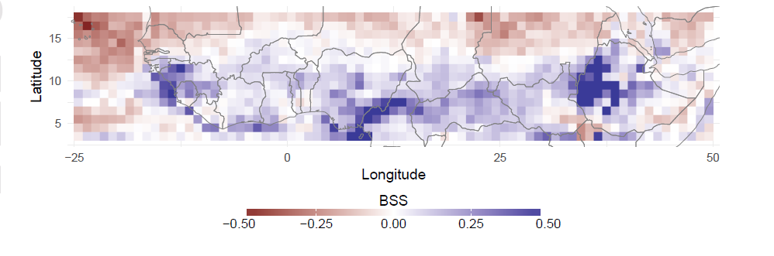
Global NWP forecasts of rainfall
Vogel et al. GRL 2020
Red = NWP forecast has higher skill
Blue = statistical forecast has higher skill
In sub-Saharan West Africa, 1-day statistical forecasts outperform global NWP
Rainfall is driven by convection within African Easterly Waves, which models struggle to represent
Further north in dry outer tropics, NWP performs better

Slide 6
Sparsity of routine observations
Global radiosonde network
Africa has some of sparest in-situ observations in the world
Reliance on satellite products in Africa – retrieved products = errors
Lack of detailed observations (e.g. radar) for process studies and model evaluation

Slide 7
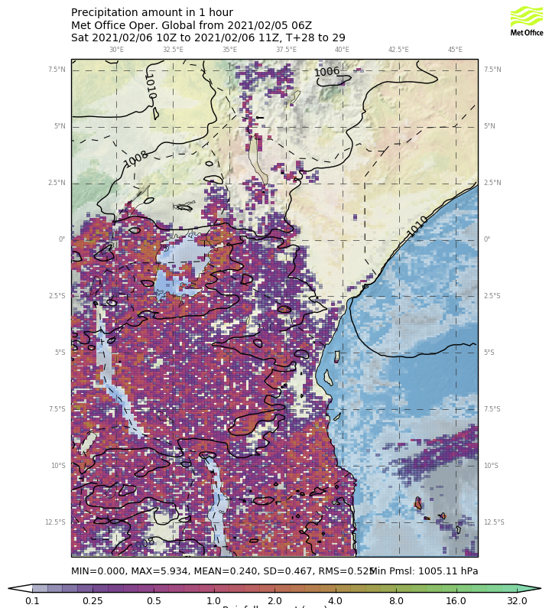
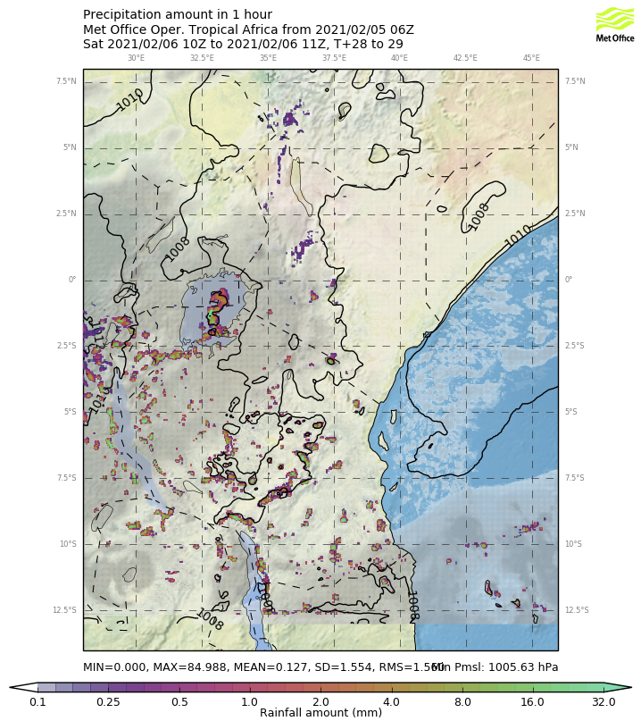
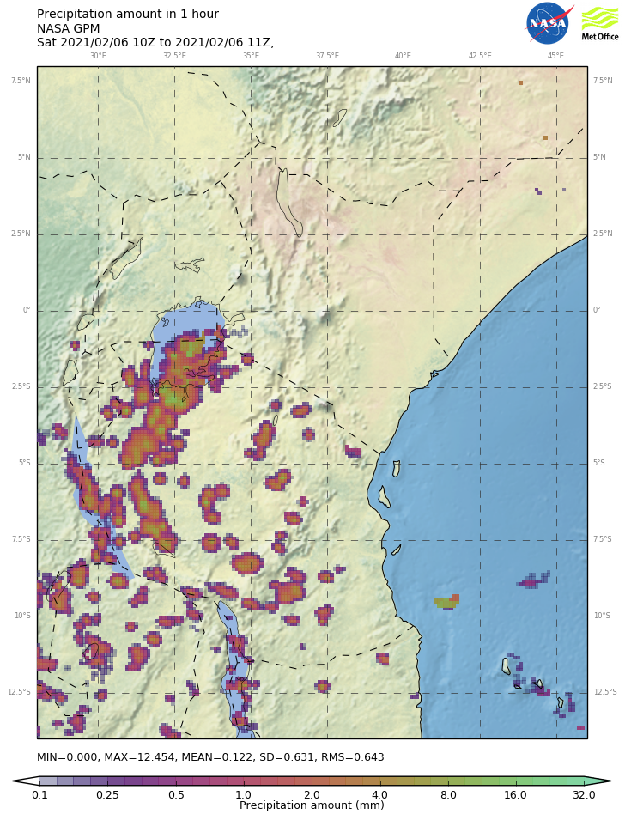
Convective-scale forecasting
Global model
Convective-scale model
GPM observations
Met Office model forecasts 6th Feb 2021
Higher-resolution allows convective processes to develop independently without the need for convection parameterisation
Big improvement in the way storms ‘look’ in forecasts

Slide 8
Convective-scale forecasts over East Africa
More skill
Useful skill > 150km scales
Convective-scale ensembles hardly worth the extra computational effort
Ensembles do not provide enough spread
Overall, skill much lower than in the extra-tropics
Useful skill
Fractions skill score
Global deterministic (MetUM)
Global ensemble (MOGREPS-G)
Convective-scale deterministic (Tropical Africa model)
Convective-scale ensemble
Woodhams et al. 2018; Cafaro et al. 2020

Slide 9
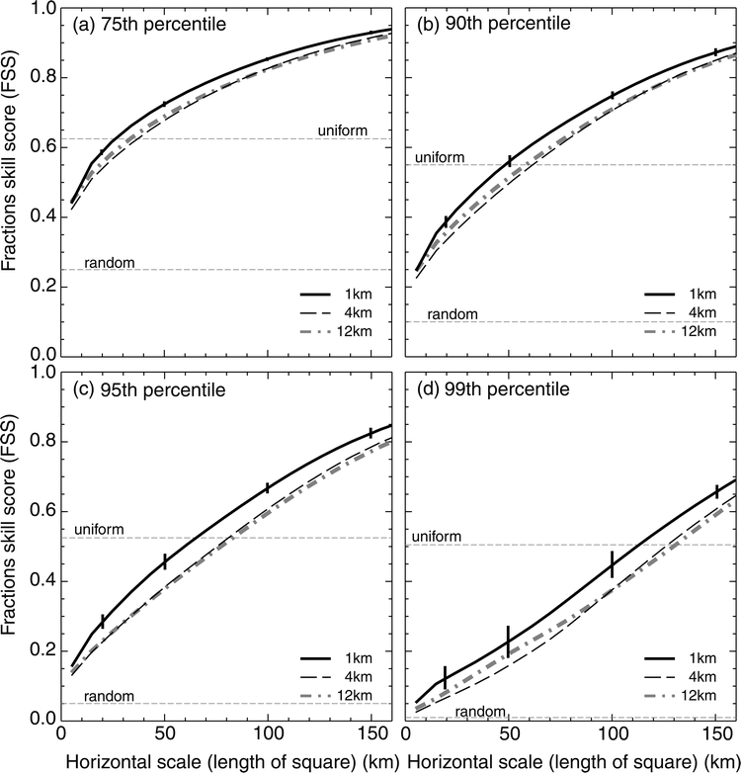
Convective-scale forecasts over East Africa
More skill
Useful skill > 150km scales
Convective-scale ensembles hardly worth the extra computational effort
Ensembles do not provide enough spread
Overall, skill much lower than in the extra-tropics
Useful skill
Fractions skill score
Global deterministic
Global ensemble
Convective-scale deterministic
Convective-scale ensemble
Woodhams et al. 2018; Cafaro et al. 2020
Roberts and Lean (2008)

Slide 10
What next?
Wait for more computing power to run higher resolution models, with more ensembles and add more processes
    Could add more complexity and noise with limited improvement in skill
    In wake of convective-scale revolution, smaller gains over longer periods of time
Improve routine observation network
  Costly and challenging
  Better observations only improve forecasts for the first 12-24 hours [e.g. van der Linden et al. 2020]
Improve model physics
  Study rainfall and storm processes in more detail
  Would lead to better parameterisations (but requires detailed observations)
Post-process existing model forecasts
  Need to better understand model biases and atmospheric processes
  Use new techniques like machine learning and artificial intelligence

Slide 11
What next?
Wait for more computing power to run higher resolution models, with more ensembles and add more processes
    Could add more complexity and noise with limited improvement in skill
    In wake of convective-scale revolution, smaller gains over longer periods of time
Improve routine observation network
  Costly and challenging
  Better observations only improve forecasts for the first 12-24 hours [e.g. van der Linden et al. 2020]
Improve model physics
  Study rainfall and storm processes in more detail -> Woodhams et al. (2019+2021)
  Would lead to better parameterisations (but requires detailed observations)
Post-process existing model forecasts
  Need to better understand model biases and atmospheric processes
  Use new techniques like machine learning and artificial intelligence

Slide 12
Lake Victoria
Lake Victoria is a hotspot for severe convective storms - occur on average 175 days per year
Storm warning service via text message
Weather forecasts are no skilful enough – storms appear quickly and are unpredictable
200,000 fishermen use the lake
3000-5000 deaths each year
Flooding

Slide 13
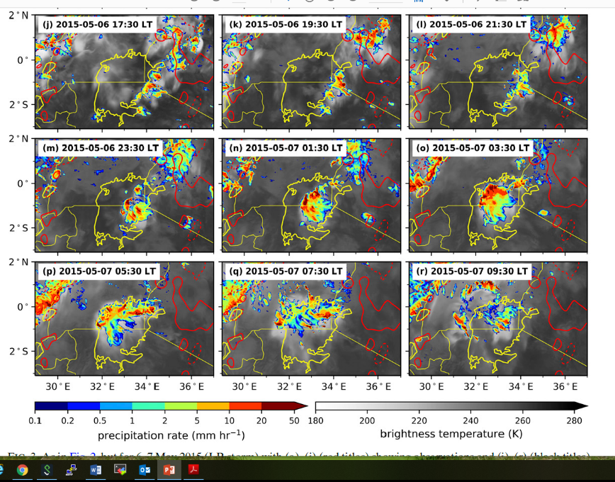
Lake Victoria
Storm over Lake Victoria 6-7th May 2015
Past studies have focused on the mean diurnal cycle of storms
Storms do not occur every day, even in the wet season, so the mean diurnal cycle is not a good predictor of storms
A basic, process-based understanding of what causes individual storms to initiate, develop and propagate is lacking
Woodhams et al. (2019)

Slide 14
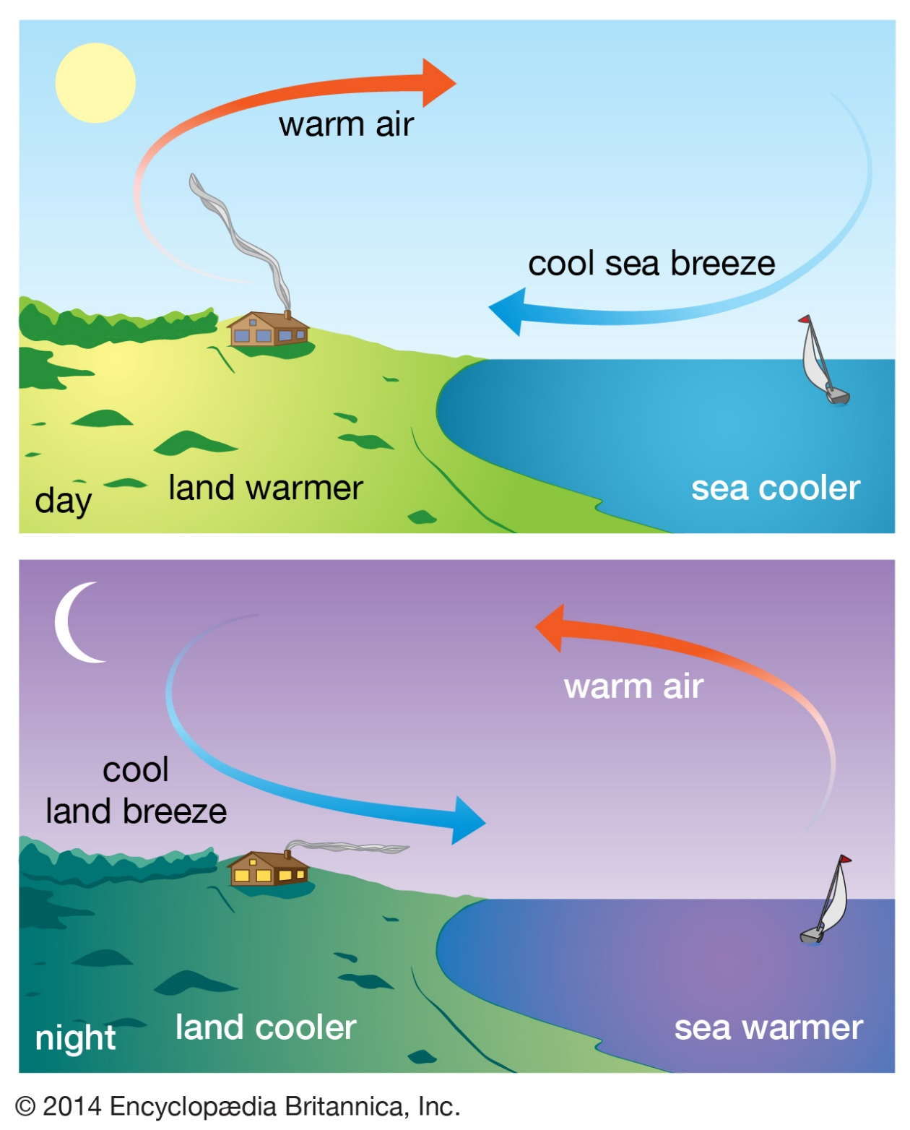
Sea breeze circulation
Lake-land breeze structures are likely important for triggering storms over Lake Victoria

Slide 15
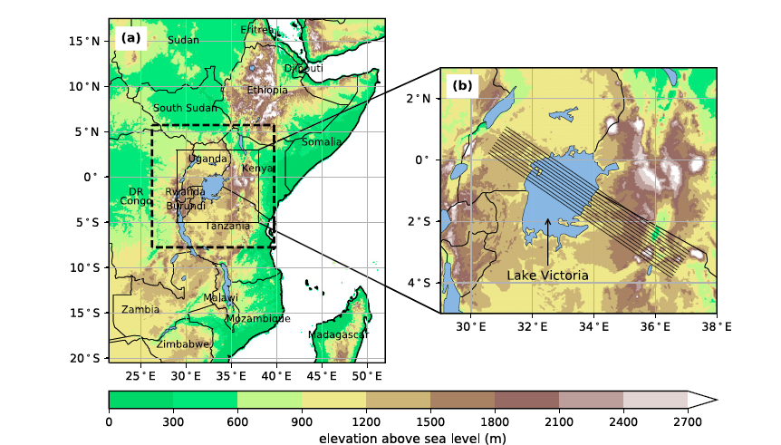
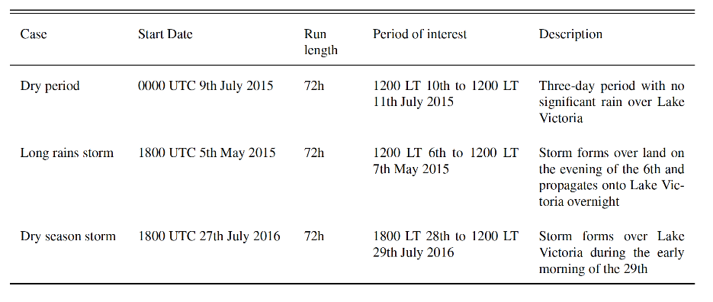
Lake Victoria
1.5km MetUM convective-scale simulations:
No storm – to understand baseline lake-land breeze
Storm in wet season
Storm in dry season
Woodhams et al. (2019)

Slide 16
No storm case

Slide 17
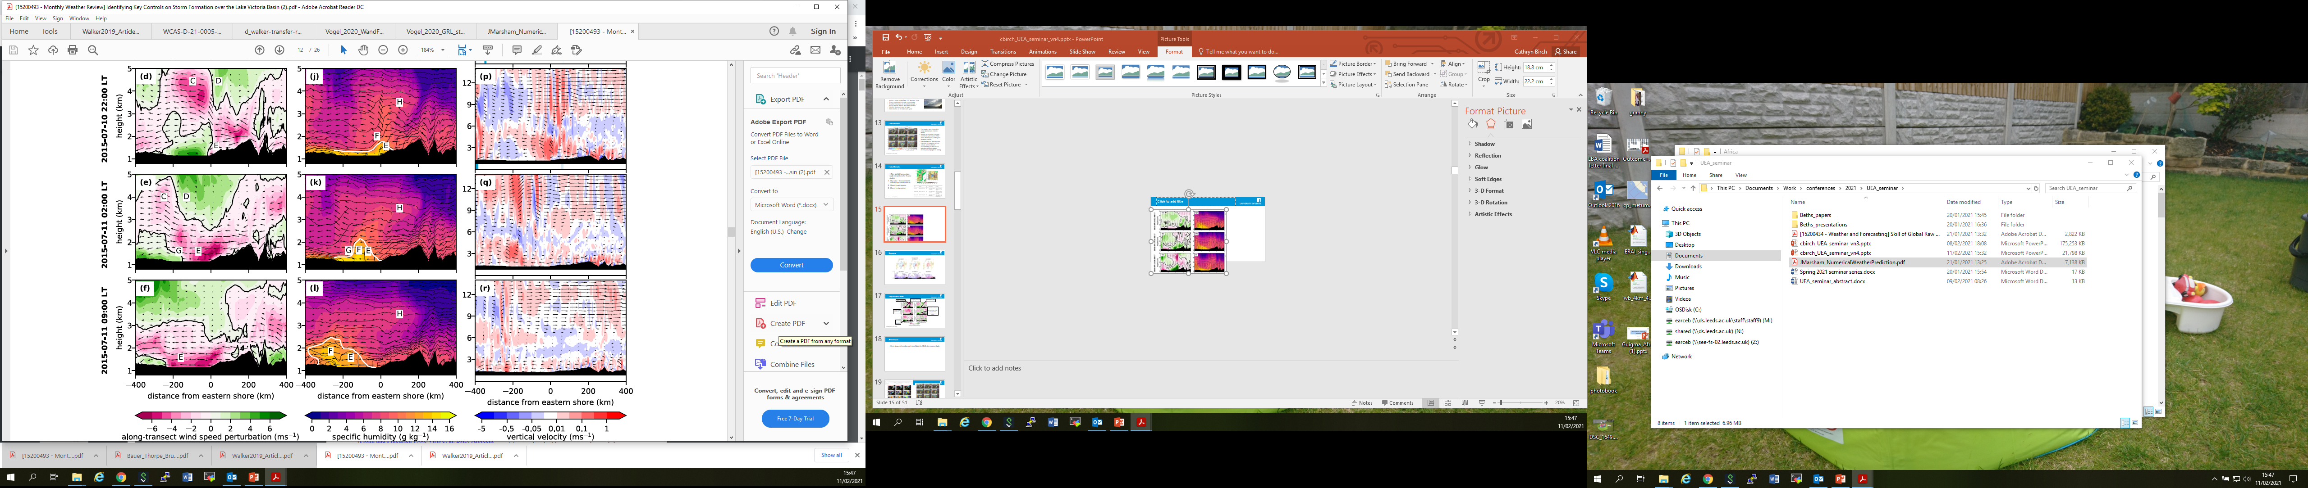
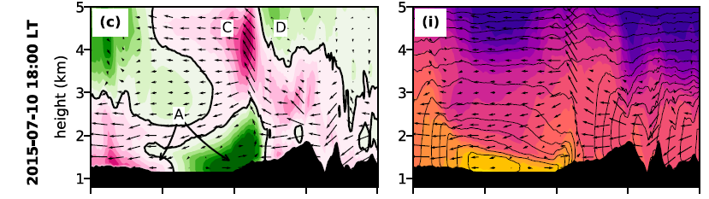
No storm case
Bulge of moisture propagates with leading edge of land-breeze front
Return flow above
Strong onshore flow in the afternoon
Convergence zone over the lake
Offshore flow, strengthened by prevailing winds and downslope mountain flow
No storm as limited moisture availability
Woodhams et al. (2019)

Slide 18
No storm case
Asymmetry due to prevailing south-easterlies
Elevated moisture bulge has potential to initiate convection (but didn’t on this day)
Atmospheric waves could be excited through collision of density currents and initiate convection
Gusty winds at the head of land breeze density current could pose a hazard to fishermen even on dry days
Woodhams et al. (2019)

Slide 19
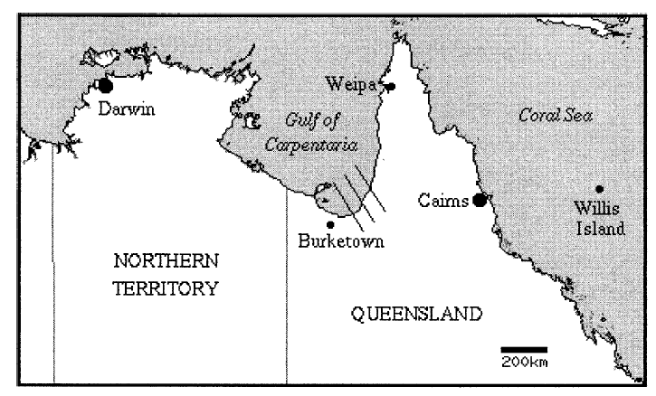

Morning glory - Australia
Sea breeze collision over land
Goler and Reeder (2004)
Collision of sea breezes of different depths excites waves

Slide 20
Storm case

Slide 21
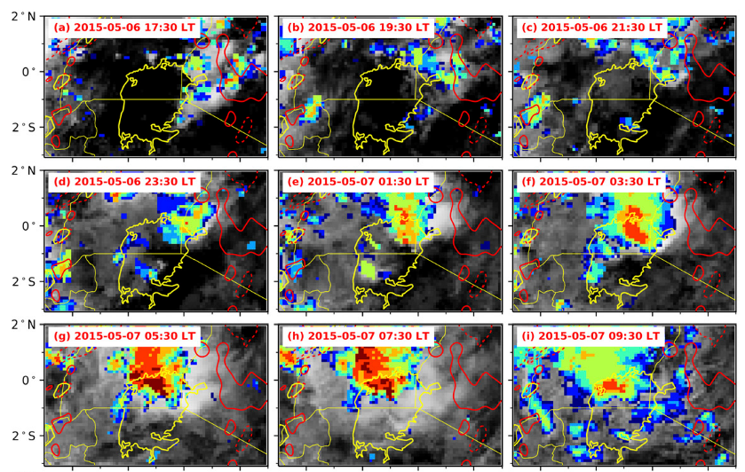
Storm case
Observations
Model simulation
Woodhams et al. (2019)

Slide 22
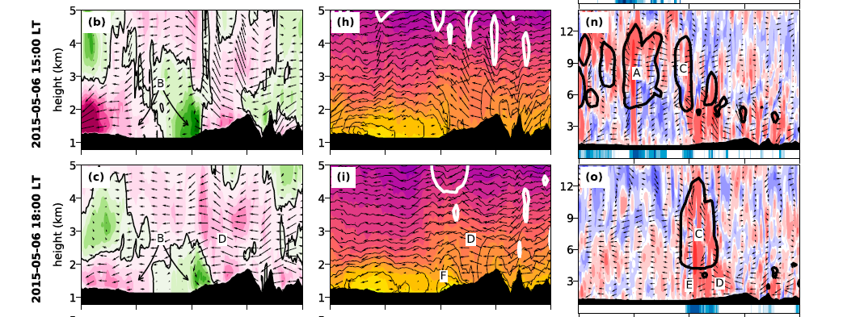
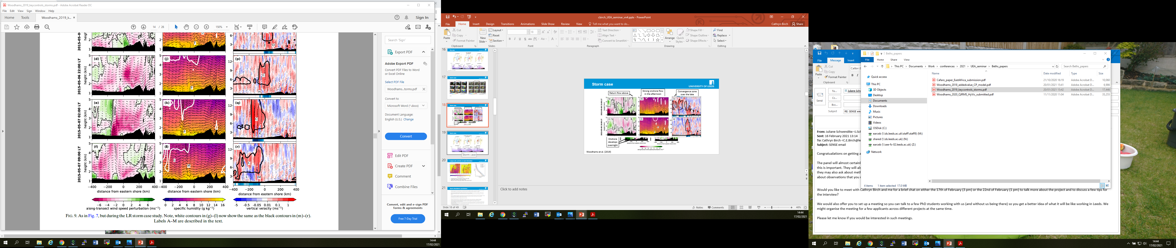
Storm case
Strong lake breeze in the afternoon
Strong prevailing south easterlies converge with lake breeze
Storm from previous day
Convergence zone along coast
Storm develops with heavy rainfall
Onshore flow weakens in the evening
Cold pool develops
Woodhams et al. (2019)

Slide 23
Storm case
Prevailing southeasterlies accelerate
Storm propagates over the lake
Cold pool
Convergence intensifies storm
Convergence between prevailing southeasteries and land breeze
Woodhams et al. (2019)

Slide 24
Storm case
Woodhams et al. (2019)

Slide 25
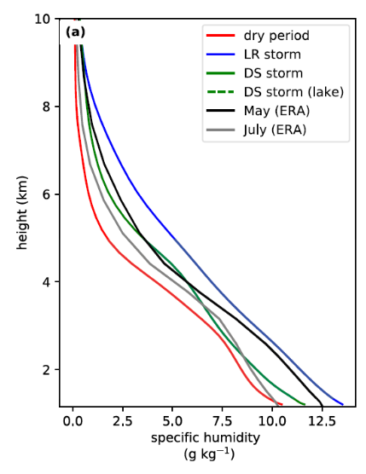
Large-scale controls on storm formation
No storm
Storm
Storm case
Mean
No storm case
Lake-land breeze convergence occurs regularly
Large-scale moisture is a key control on storm formation
Woodhams et al. (2019)

Slide 26
Lake Victoria
Controls on storm formation:
  (Near?) persistent lake-land breeze circulation
  Strength and location of lake-land breeze convergence
  Prevailing wind strength and direction
  Downslope mountain winds
  Large-scale moisture availability – varies seasonally and sub-seasonally
  Local moisture availability through evaporation
  Moisture bulge and possibly waves
  Lake-land surface temperature difference
  Storm activity on the previous day – cold pools, moisture
For accurate forecasts we likely need to simulate all above correctly
Study based on three case studies in a model
Idealised modelling needed to study land breeze collision + bulge
Lack of detailed in-situ observations to evaluate models

Slide 27

Research flights
3 research flights through HyVic pilot field campaign, part of HIGHWAY and Africa SWIFT project

Slide 28
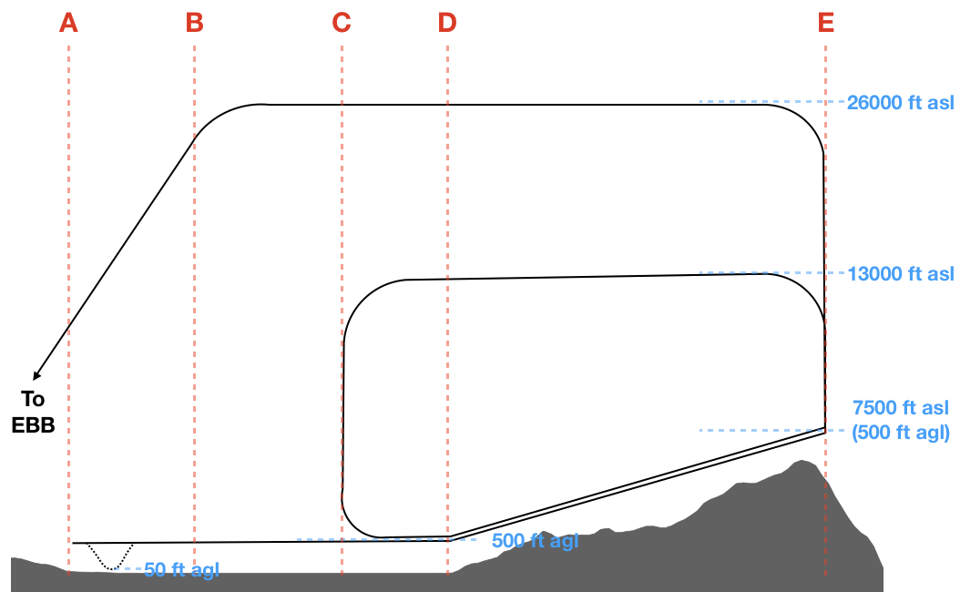
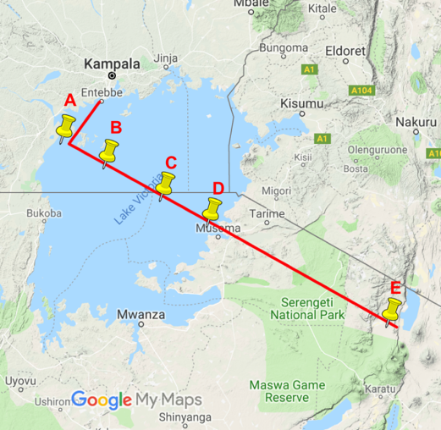


Research flights
Sondes to sample full profile
Dropsondes
To sample return flow
To sample low-level convergence and contrasts between lake and land
Image credit: weatherboy.com
26th January 2019 Evening flight: sample lake breeze
27th January 2019 Morning flight: sample land breeze and lake BL
Woodhams et al. 2021

Slide 29
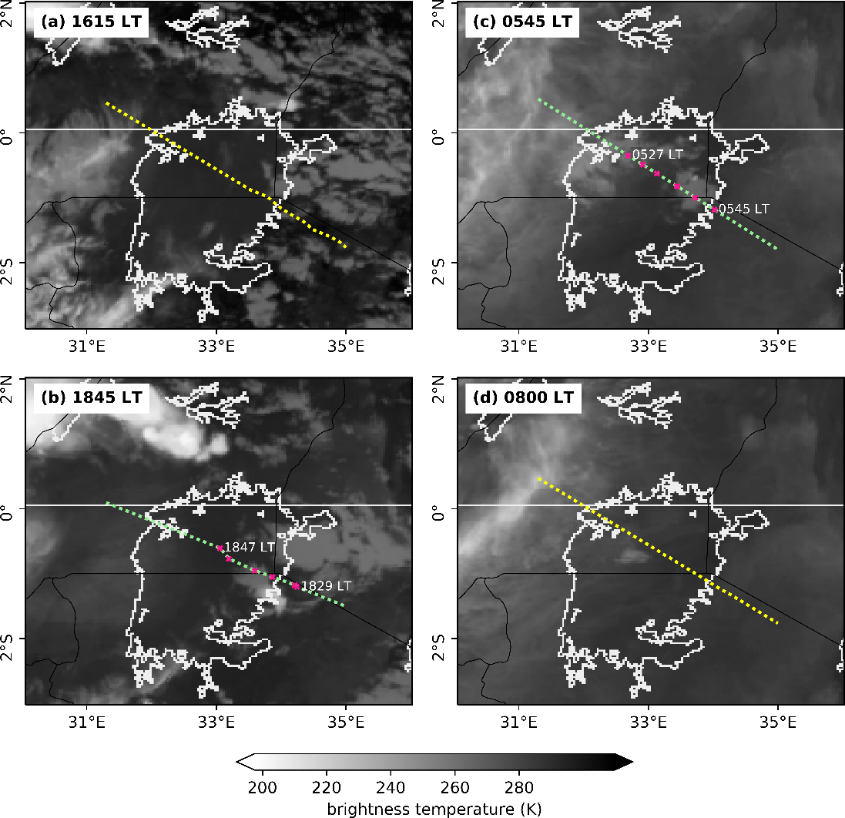
Research flights
January = dry season
Storms often occur in dry season
Clear conditions = lucky!
Ideal to capture baseline lake-land breeze circulation
Woodhams et al. 2021

Slide 30
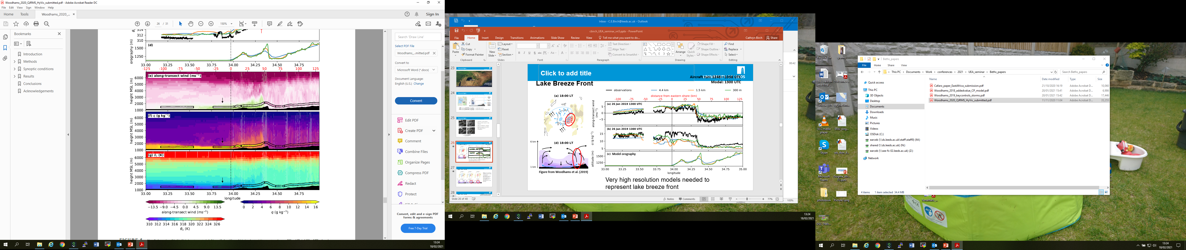
Research flights
Evening flight 300m model data + low-level aircraft observations
Return flow aloft within prevailing southeasterlies
Lake breeze front
Woodhams et al. 2021

Slide 31
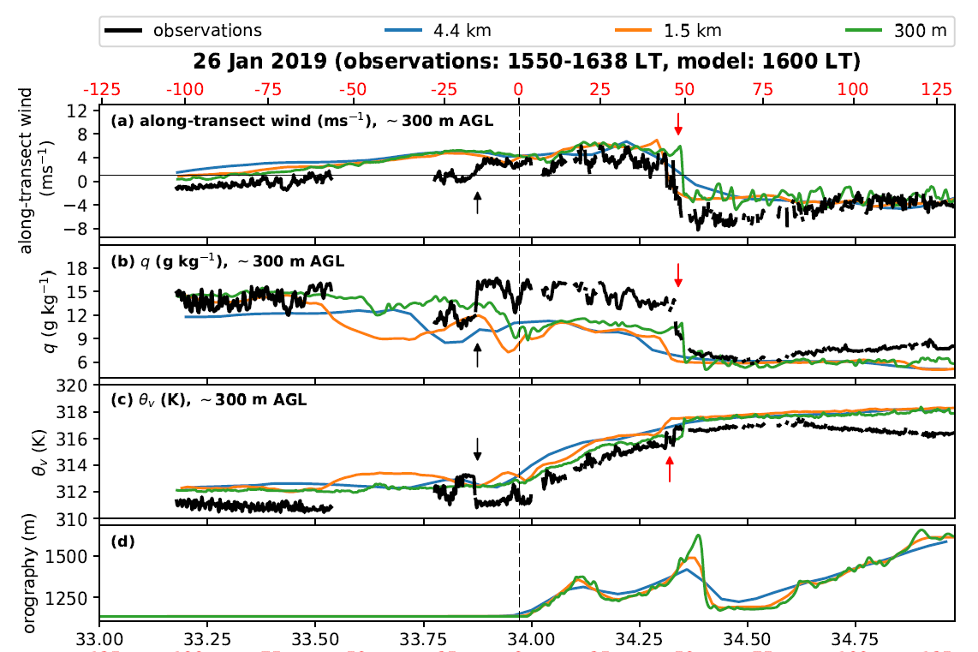
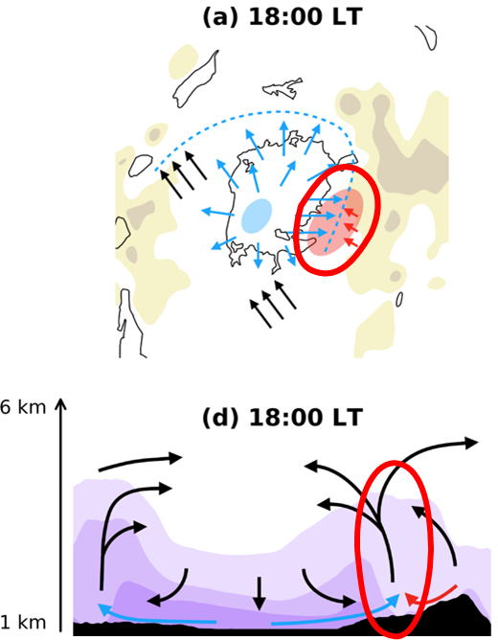
Research flights
Evening flight
model data + low-level aircraft observations
Lake breeze front much sharper in 300m model
300m model better resolves steep slopes
Woodhams et al. (2019)
Woodhams et al. 2021

Slide 32
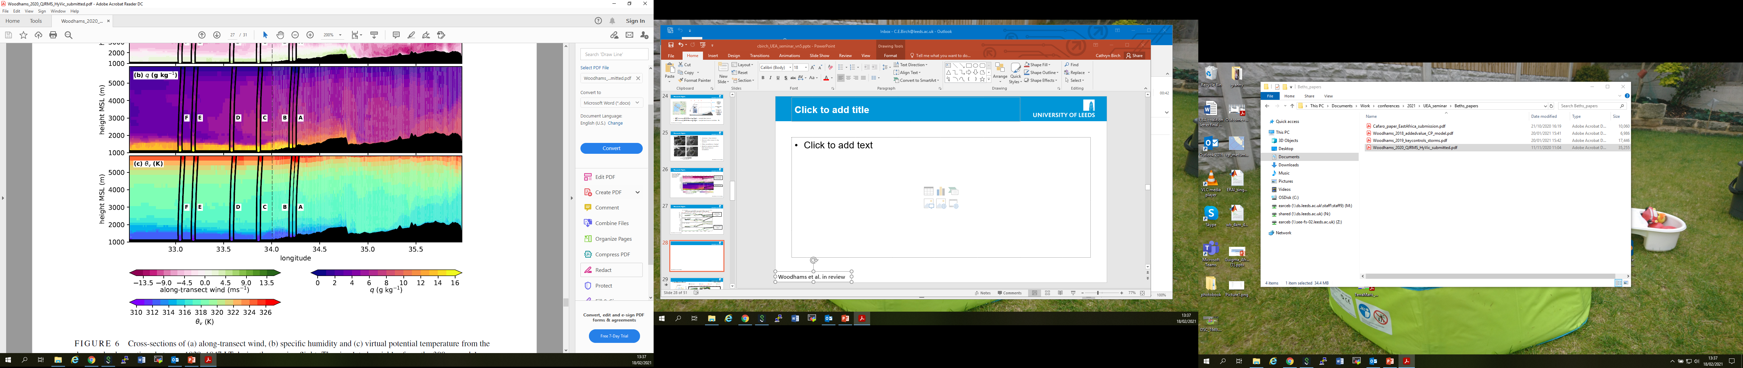
Research flights
Evening flight
300m model data + dropsonde observations
Model boundary layer too deep, warm and/or moist
Woodhams et al. 2021

Slide 33
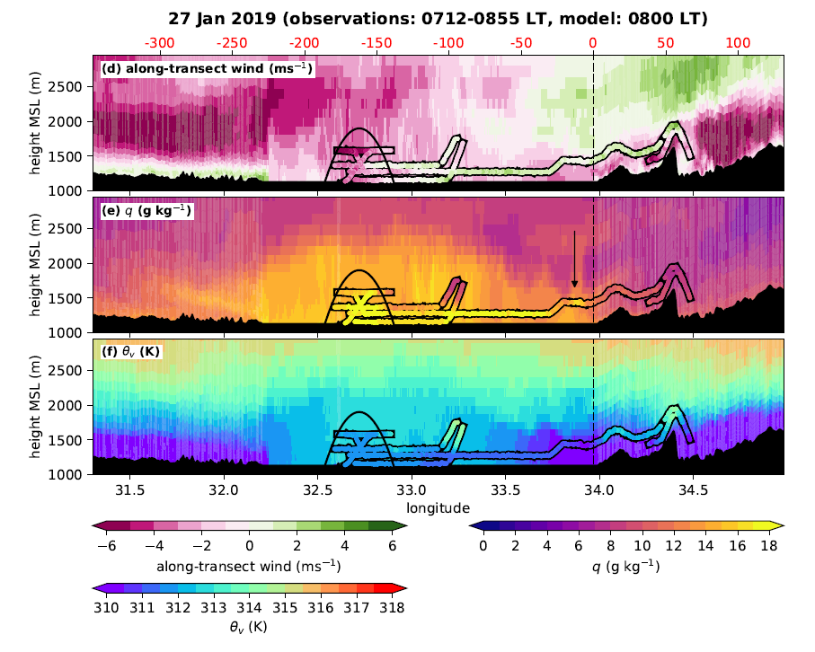
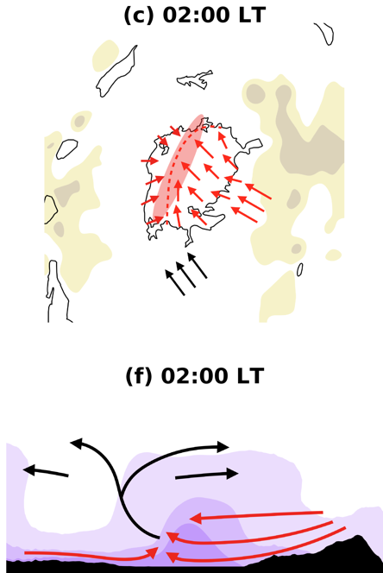
Research flights
Morning flight
300m model data + low-level aircraft observations
Low-level divergence over the lake
Bulge of elevated moisture
Bulge moved westward 10-20km in 2-3 hours
Woodhams et al. (2019)
Woodhams et al. 2021

Slide 34
Research flights
First in-situ observations of the Lake Victoria lake-land breeze circulation
First observational evidence of elevated moisture bulge over lake
Can the model represent the key controls on storm formation?
  Prevailing wind strength and direction ✓
  Large-scale moisture variability ✓
  Downslope mountain winds ✓
  (Near?) persistent lake-land breeze circulation ✓
  Strength and location of lake-land breeze convergence ?
  Moisture bulge ?
  Local moisture availability through evaporation X
  Lake temperature X
  Storm activity on the previous day – cold pools, moisture X
Storm days are more complicated to model, observe and understand

Slide 35

Research flights
HyVic Pilot Field Campaign
  Extremely successful
  Extensive modelling prior to the field campaign allowed us to target the correct time of day and vertical levels to sample, with only three flights
  Luck with the dry conditions
  Shown that a field campaign over Lake Victoria is feasible
  Shown how useful in-situ observations are for model evaluation
Much larger field campaign in the future

Slide 36
Summary
Forecast skill in the tropics remains limited, especially over Africa
Regular severe weather in East Africa
Forecast communication methods exist
More detailed, in-situ observations and process studies needed to:
  better understand the controls on storm formation
  allow more statistical studies
  diagnose model biases, leading to improved forecasts
  develop better parameterisations for global models
  understand ways to post-process forecasts to in order to improve skill
Better routine observation network

Slide 37
References
Questions?
Woodhams, B. J., C. E. Birch, J. H. Marsham, T. P. Lane, C. L. Bain, S. Webster, 2019: Identifying Key Controls on Storm Formation over the Lake Victoria Basin, Mon. Weat. Rev., https://doi.org/10.1175/MWR-D-19-0069.1
Woodhams, B. J., P. A. Barrett, J. H. Marsham, C. E. Birch, C. L. Bain, J. K. Fletcher, A. J. Hartley, S. Webster, S. Mangeni, 2021: Aircraft observations of the lake-land breeze circulation over Lake Victoria, Quart. J. Roy. Meteorol. Soc., in review.
Cafaro, C., B. Woodhams, T. Stein, C. E. Birch, S. Webster, C. Bain, A. Hartley, S. Clarke, S. Ferrett, P. Hill, 2021: Do convection-permitting ensembles lead to more skilful short-range probabilistic rainfall forecasts over tropical East Africa?, Weat. Forecasting, in review.

