Slide 1
Plants and Earth History
Alan Haywood

Slide 2
Focus of the Lecture
1. Geological time
2. Plants through time
3. Importance of plants/vegetation in the development of the Earth System
4. Reconstructing Palaeoenvironments
5. Evaluating climate models

Slide 3
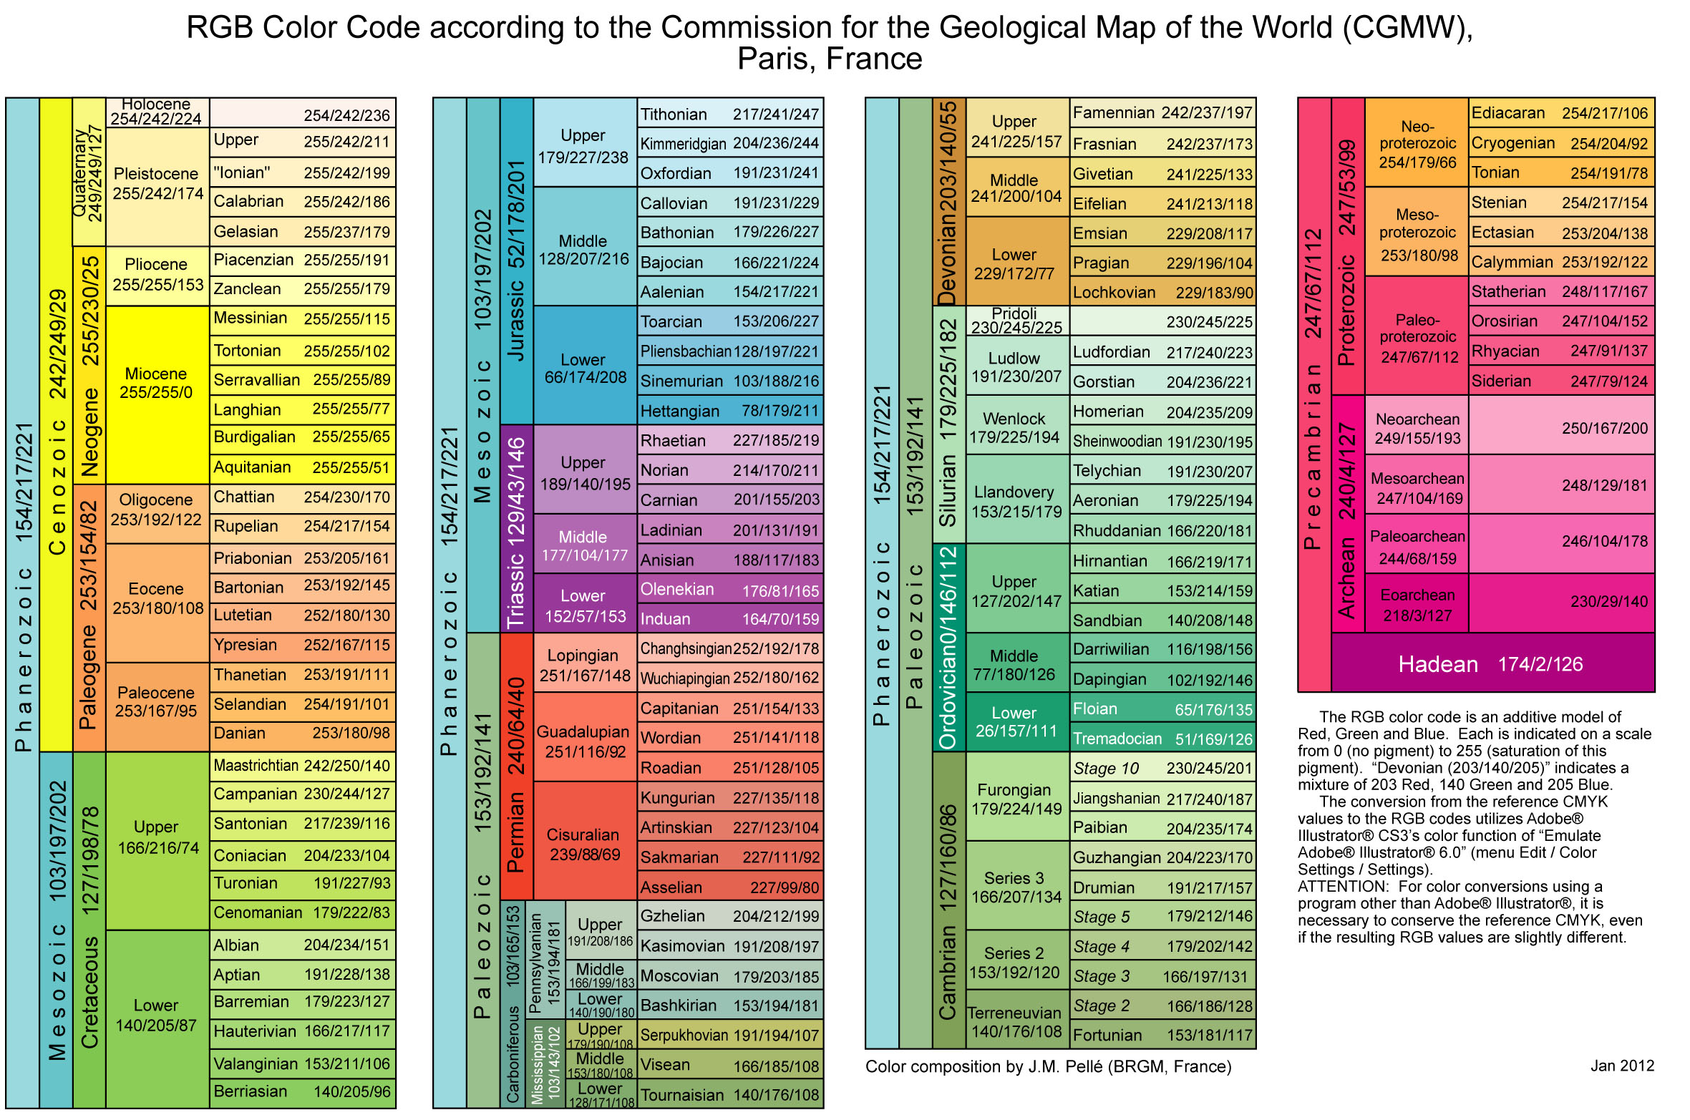
1. Geological time

Slide 4
1. Geological time

Slide 5
1. Geological time (plant development key events)
450 million yrs ago first land plants appear (Ordovician Period)
Diversification of plant types in the Early Silurian
Diversity displayed well in rocks of Devonian age (e.g. Rhynie Chert)
Most features recognised today established by the Middle Devonian
First true forest appeared by the Late Devonian
Mass extinction events appear to have promoted plant diversification
Grasses did not evolve until ~40 million yrs ago (Eocene)
Development of low CO₂-adapted plants in the Miocene (~ 15/20 Ma)

Slide 6
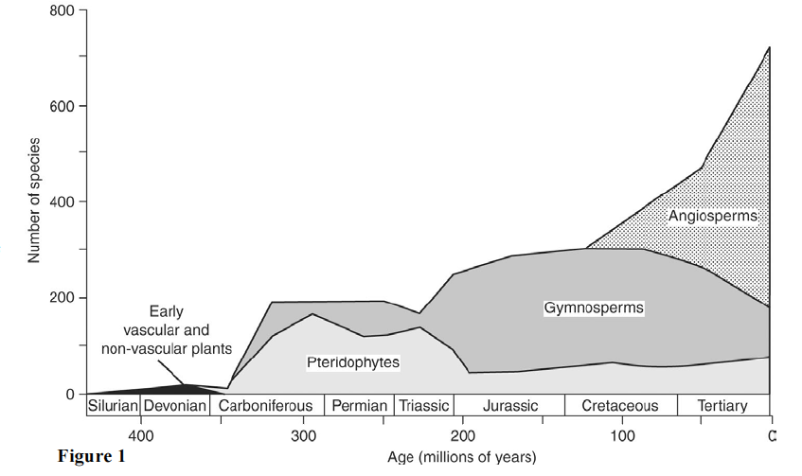
2. Evolution of plants through time
Increasing complexity…
Increasing diversity…

Slide 7
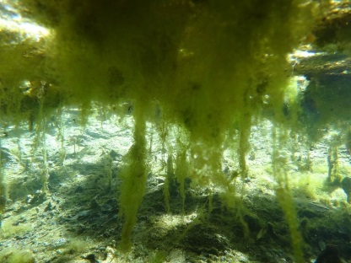
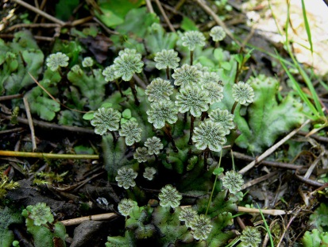
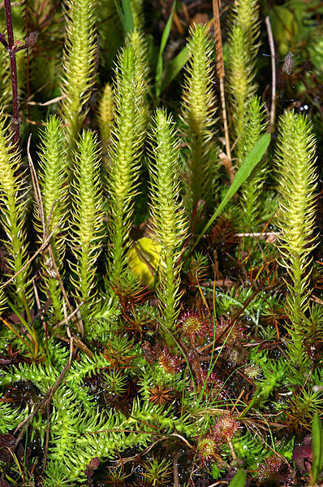
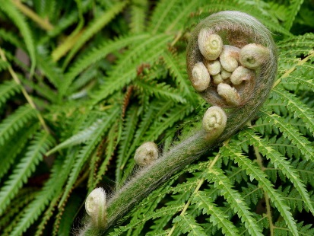
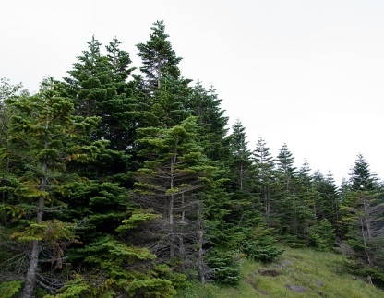
2. Evolution of plants through time
Algal mat is a layer of usually filamentous algae.
Bryophyte - all embryophytes (land plants) that do not have true vascular tissue and are therefore called "non-vascular plants”.
Lycopods - oldest extant (living) vascular plant.
Fern - any one or more of a group of roughly 12,000 species of plants belonging to the botanical group known as Pteridophyta. Unlike mosses, they have xylem and phloem (making them vascular plants).
Gymnosperms are a group of seed-producing plants that includes conifers, cycads, Ginkgo, and Gnetales.
The flowering plants (angiosperms), are the most diverse group of land plants.

Slide 8
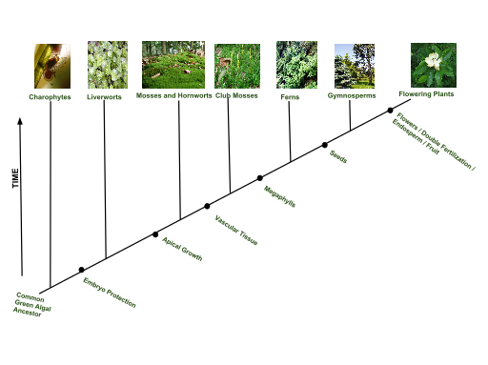
2. Evolution of plants through time

Slide 9
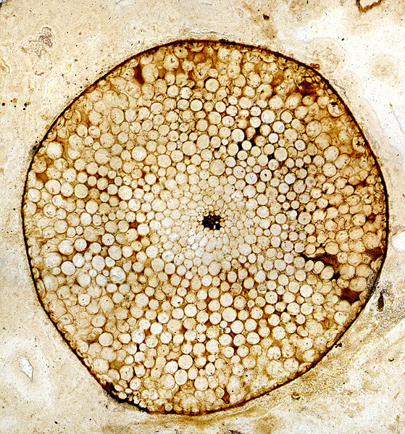
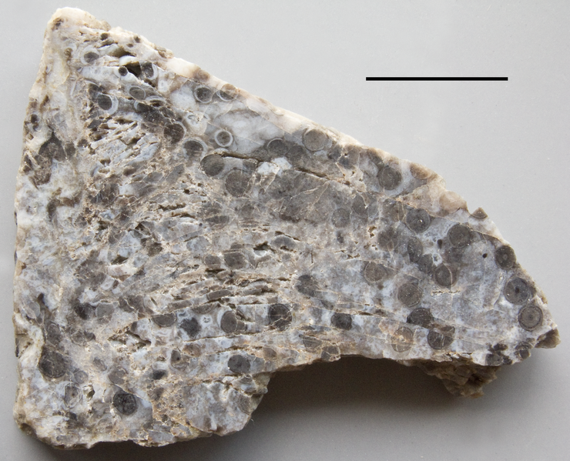
2. Evolution of plants through time
Devonian Rhynie Chert – Rhynie, Aberdeenshire, Scotland
The Rhynie chert is an Early Devonian sedimentary deposit exhibiting extraordinary fossil detail or completeness (a Lagerstätte).
A Lagerstätte is a sedimentary deposit that exhibits extraordinary fossils with exceptional preservation—sometimes including preserved soft tissues.
The chert was formed when silica-rich water from volcanic springs rose rapidly and petrified the early terrestrial ecosystem, in situ and almost instantaneously, in much the same fashion that organisms are petrified by hot springs today.

Slide 10
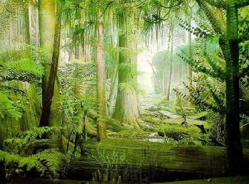
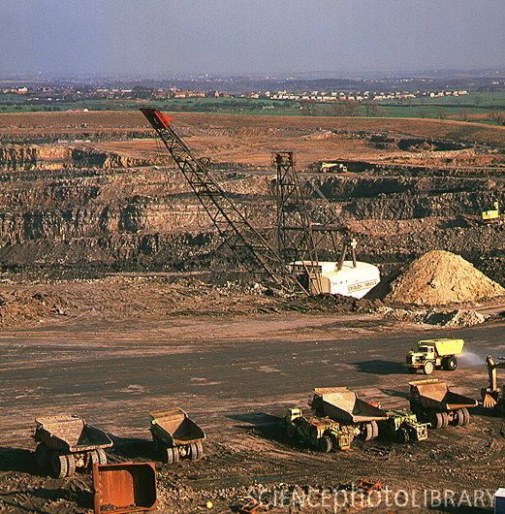
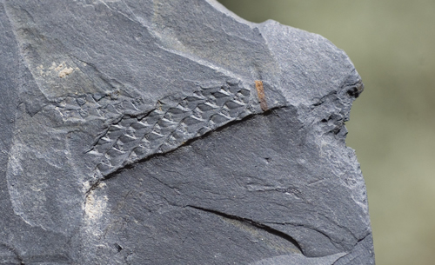
2. Evolution of plants through time
Lower Carboniferous Coal Measures in North East England
→ represent the fossilised remains of swamp vegetation which grew as luxuriant forests on the deltas ca. 300 mya

Slide 11
The Early Tertiary, about 50 million years ago,
was much warmer….
In London during the Eocene, there were crocodiles……

Slide 12
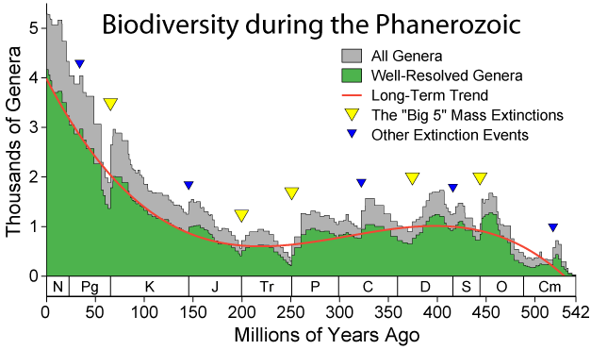
2. Evolution of plants: Extinction and Invasion

Slide 13
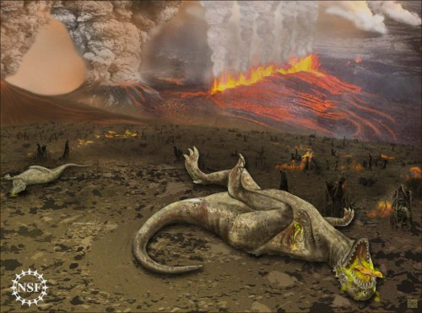
2. Evolution of plants: Extinction and Invasion
Cretaceous–Tertiary (K-T or K-PG) extinction event (65.5 Ma)

Slide 14
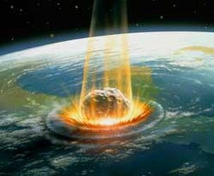
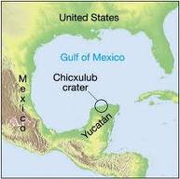
2. Evolution of plants: Extinction and Invasion
Cretaceous–Tertiary (K-Pg) extinction event (65.5 Ma)

Slide 15
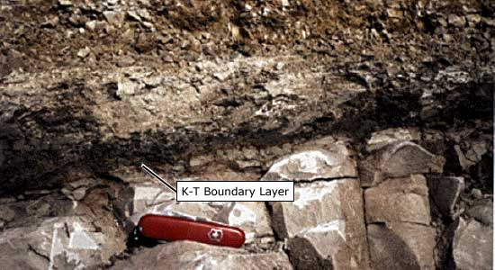
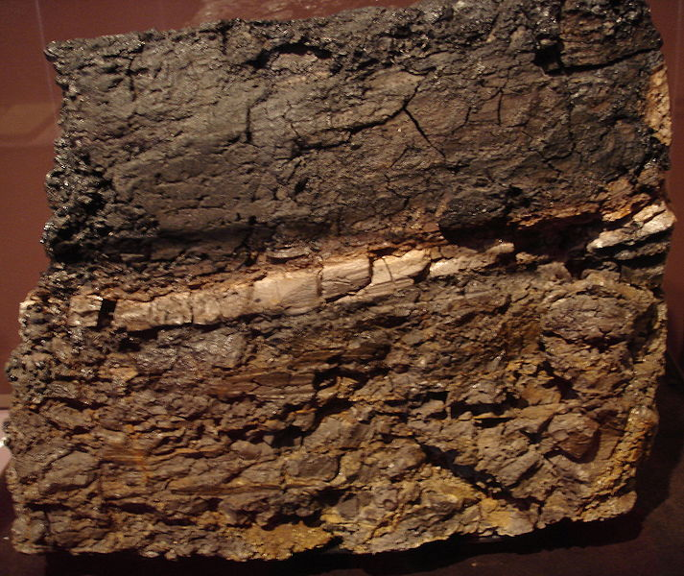
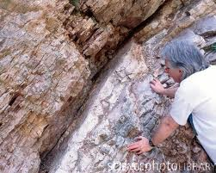
K-Pg boundary layer
A Wyoming (US) rock with an intermediate claystone layer that contains 1000 times more iridium than the upper and lower layers. Picture taken at the San Diego Natural History Museum

Slide 16
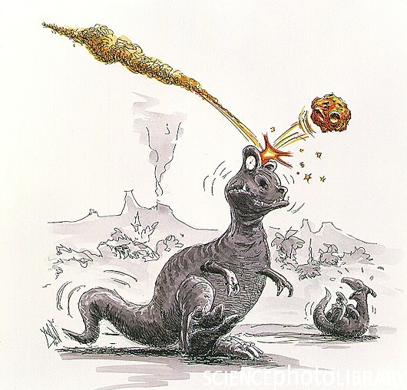
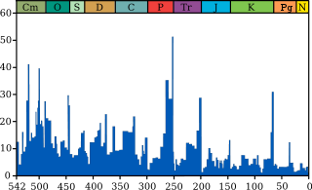
2. Evolution of plants: Extinction and Invasion
Cretaceous–Tertiary (K-T) extinction event (65.5 Ma)
P-Tr
K–T
Percentage of marine animal genera becoming extinct after: Raup & Sepkoski ,1982

Slide 17
Evolution of plants: Extinction and Invasion
Percentage of marine animal genera becoming extinct after: Raup & Sepkoski ,1982

Slide 18
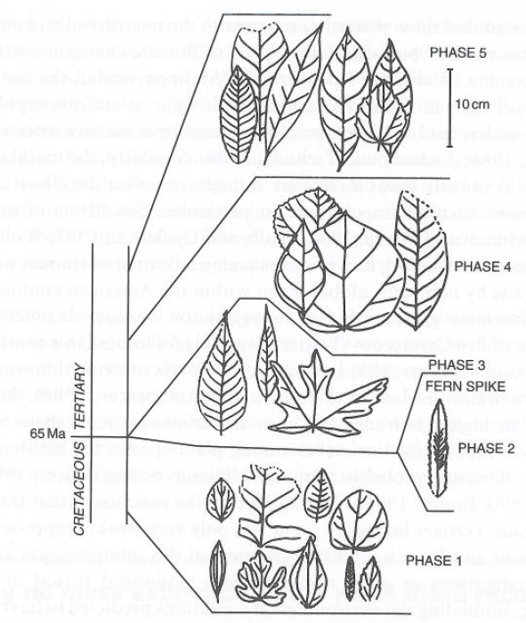
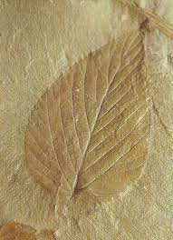
2. Evolution of plants: Extinction and Invasion
What happened to the terrestrial vegetation:
? ?
Willis, 2001

Slide 19
2. Evolution of plants: Extinction and Invasion
What happened to the terrestrial vegetation:
Fast growing
Fast spreading
→Pioneer e.g. after opening of forests
Willis, 2001

Slide 20
What happened to the vegetation:
If you go into a zoo and hammer all animals on the head you effectively have the end of the zoo..
If you to into a botanical garden and burn and chop all plants down – in 10 years time you will still have a botanic garden with the majority of plants sprouting once again (Knoll 1984)

Slide 21
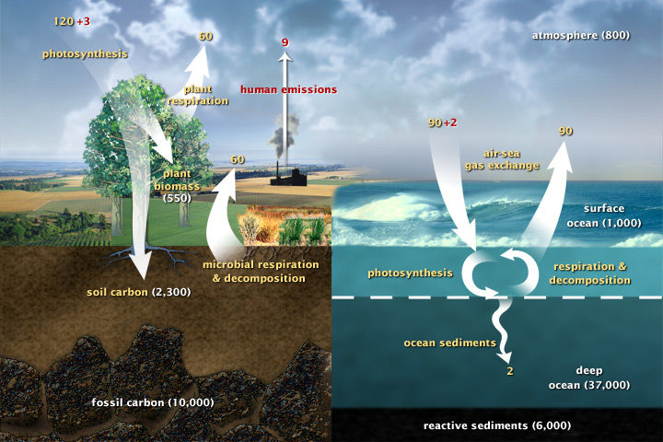
3. Importance of plants in the Earth System
GLOBAL CARBON CYCLE: Natural biogeochemical cycle
http://earthobservatory.nasa.gov/Features/CarbonCycle/page1.php

Slide 22
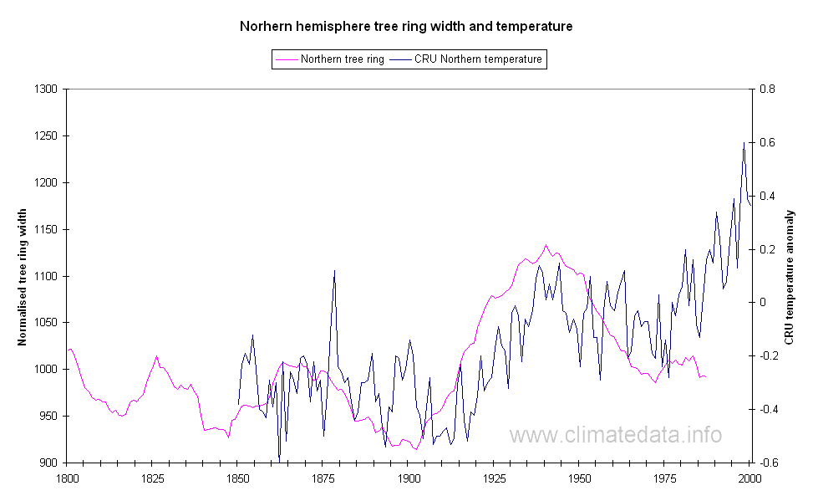
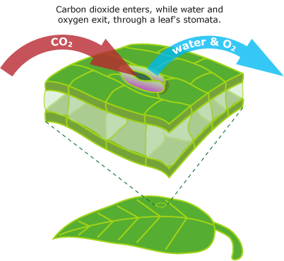
3. Importance of plants in the Earth System
LEAF STOMATA - a proxy for CO₂
CO₂ uptake versus water loss
Plants need to assimilate CO₂, stomata must be open
Water leaves plant by evapotranspiration through stomata
→ Inverse relationship between number of stomata on leaf surface and atmospheric CO₂ concentration
Notes:
22

Slide 23
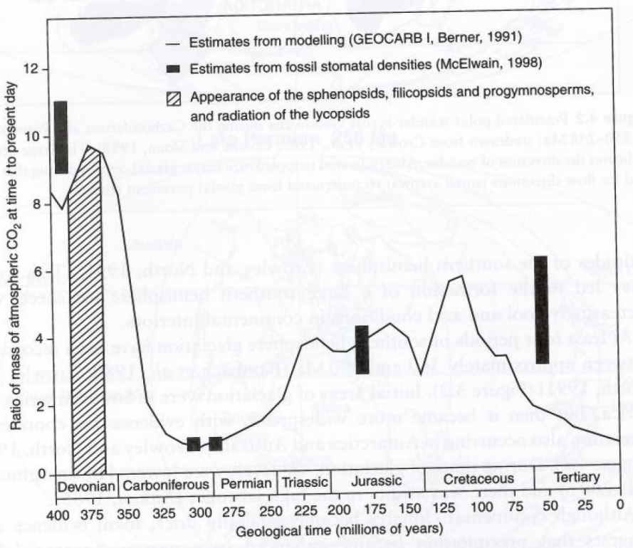
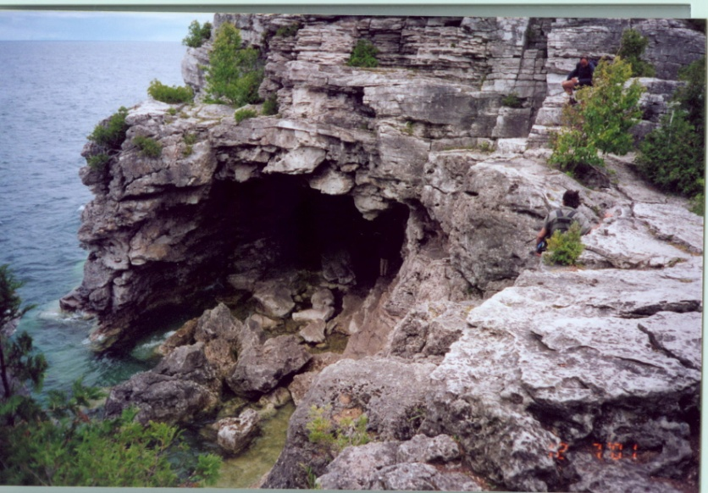
3. Importance of plants in the Earth System
Silicate weathering and Carbon Sequestration
Vascular plants and release of organic acids in soils increased
chemical weathering of silicate rocks

Slide 24
3. Important of plants
Fundamental for surface albedo
Fundamental for retarding physical weathering
Fundamental in advancing chemical and biological weathering
Fundamental for oxygen and carbon exchange with the atmosphere
Fundamental for soil development
Fundamental for other groups such as insects and the evolution of
Complex ecosystems on land

Slide 25
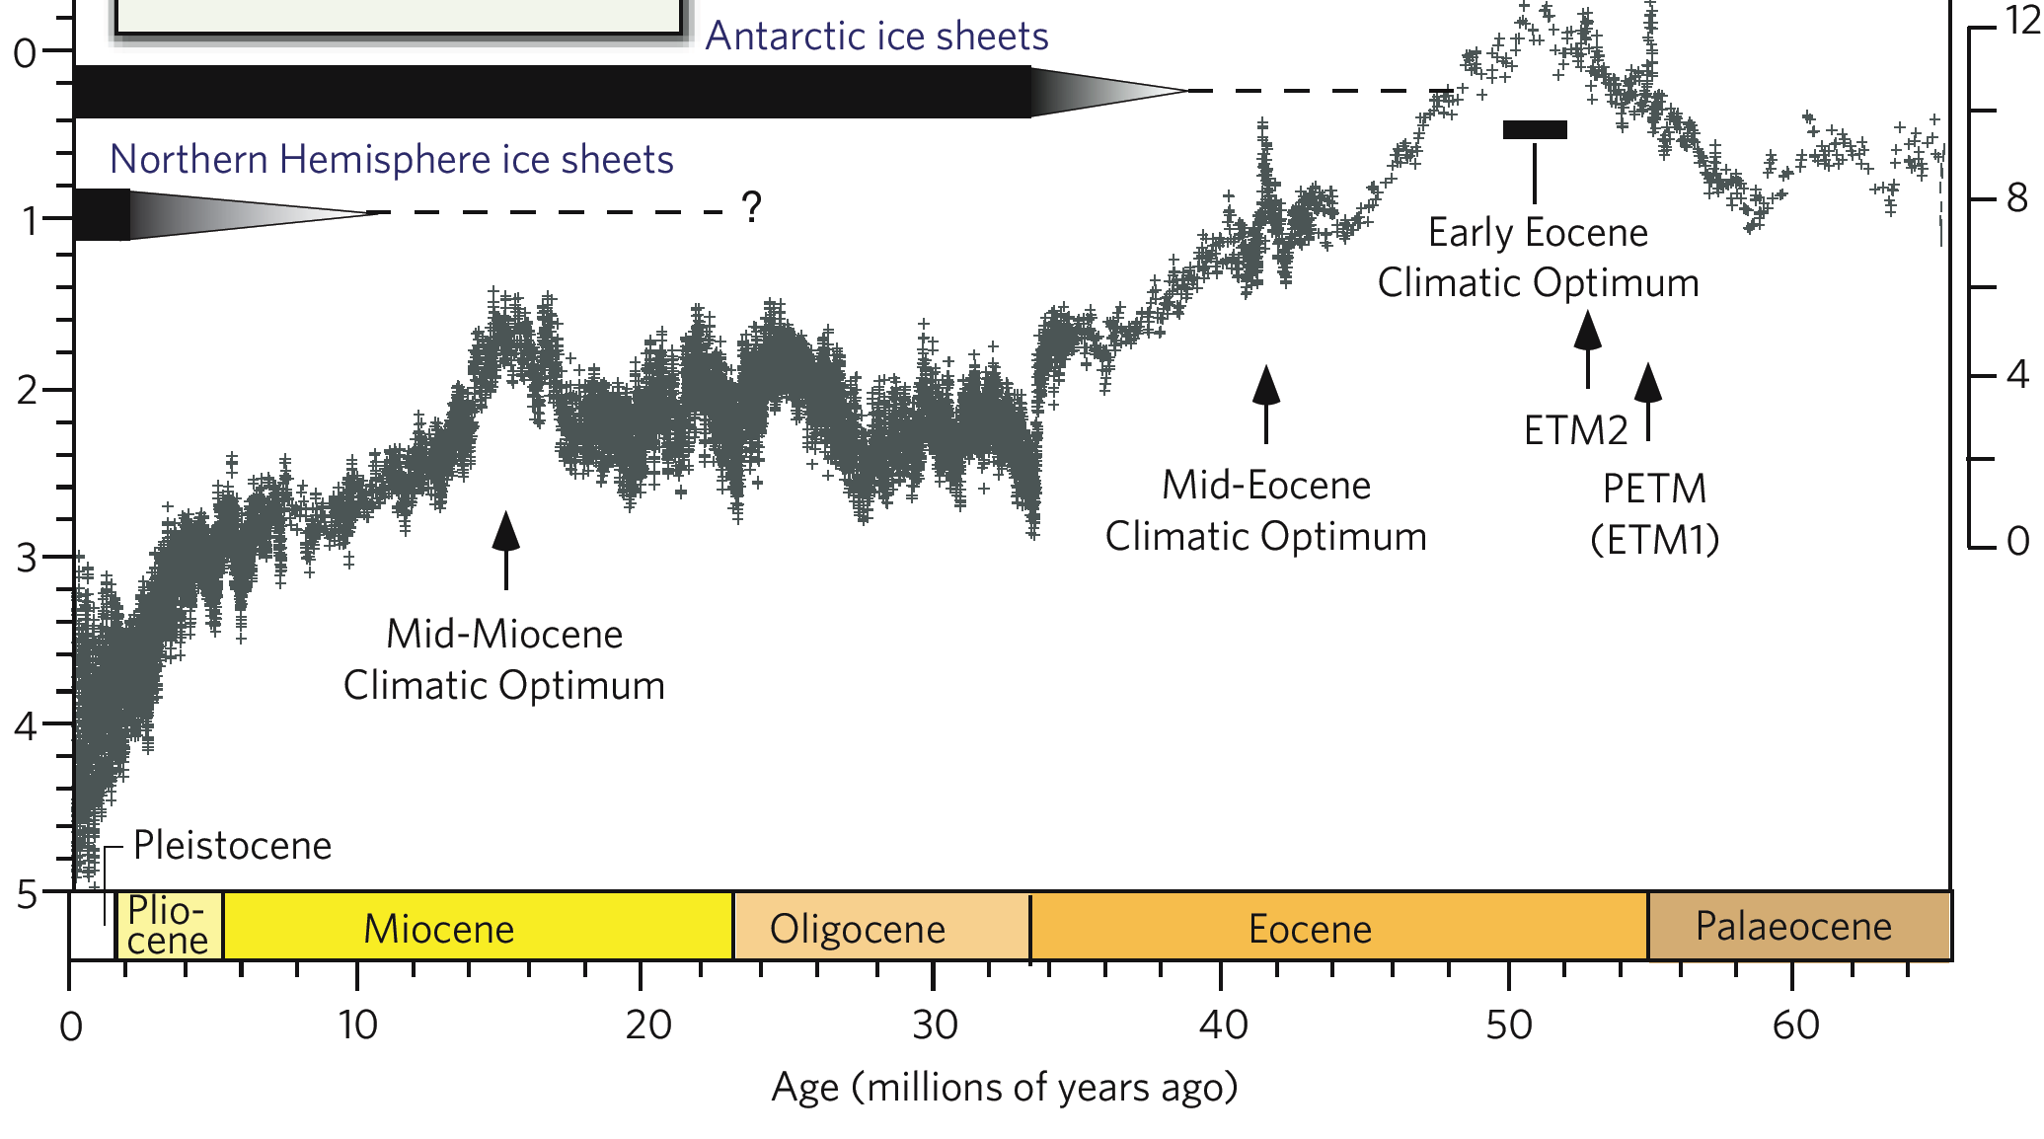
4. Plants as climate proxies
(after Zachos et al.,2001)

Slide 26
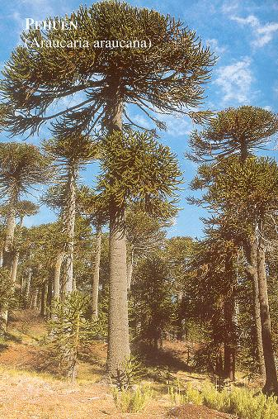
The EOCENE climate optimum
Antarctica
had rich forests

Slide 27
4. Plants as climate proxies
Macrofossil Evidence:
Seeds
Leaves and fossil wood
Packrats
and many more
Each method has its pros and cons!
Microfossil Evidence:
Pollen
Phytoliths
Microscopic Charcoal
..and many more

Slide 28
4. Plants as climate proxies
Quantitative Climate Estimates
Physiognomic Approach
Nearest Living Relative Approach (NLR)
→ based on aspects of plant architecture constrained by environmental conditions
based on the environmental tolerances of assumed living relatives

Slide 29
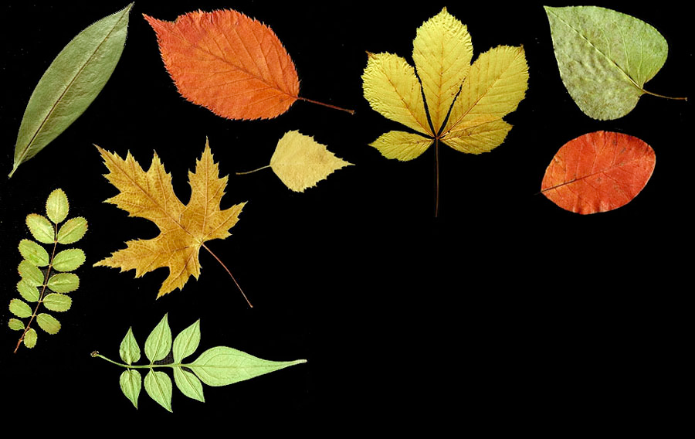
CLAMP - Climate Leaf Analysis Multivariate Program
http://www.open.ac.uk/earth-research/spicer/CLAMP/Clampset1.html (see Bob Spicer, OU)
Wolfe, J.A. 1995. Paleoclimatic estimates from Tertiary leaf assemblages. Annual Reviews of Earth and Planetary Science 23:119-142
A. Wolfe identified 31 physiognomic character states that could be scored for multivariate analysis incl. margin characteristics, size, apex and base form and shape.

Slide 30
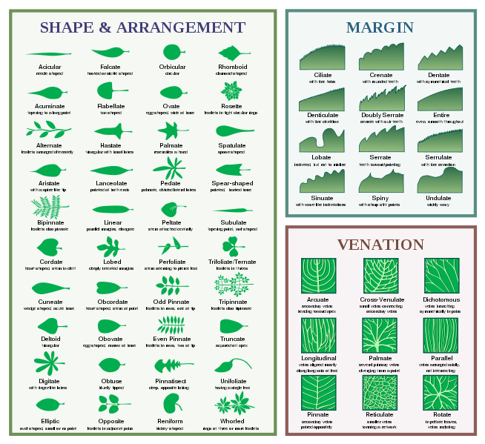
LEAF Physiognomy - a proxy for climate
→ leaf architectural characteristics carry environmental signals
E.g.:
leaf size -> water availability
leaf margin ->
mean annual temperature

Slide 31
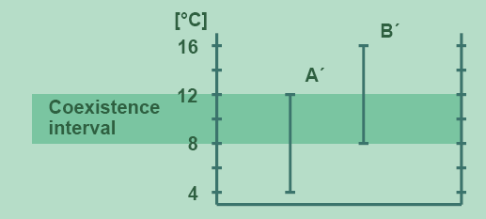
Coexistence Approach (CA)
Identifying the Coexistence Interval:

Slide 32
Coexistence Approach (CA)
Basic assumptions:
→ NLR occupies a climate region comparable to its fossil relative
→ climatic requirements of a fossil are close to those of a NLR
Requirements:
Database „Palaeoflora“ (http://www.palaeoflora.de)
Contains:
→ Nearest living relatives (NLR)
Recent distribution of NLR
Climatic requirements (Meteorological stations)

Slide 33
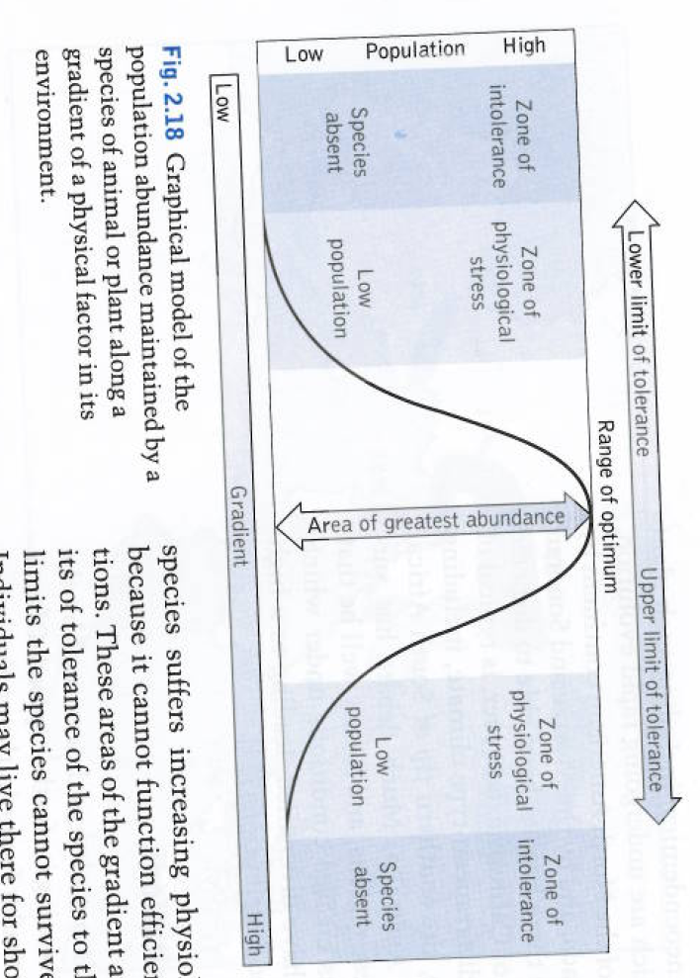
LIMITS OF TOLERANCE
ABIOTIC
amount of light
concentration of oxygen or carbon dioxide
availability of water
availability of various chemical nutrients
pH of water or soil
BIOTIC
number of parasites
degree of predation
population size
reproductive rate
types of plants able to grow in an area

Slide 34
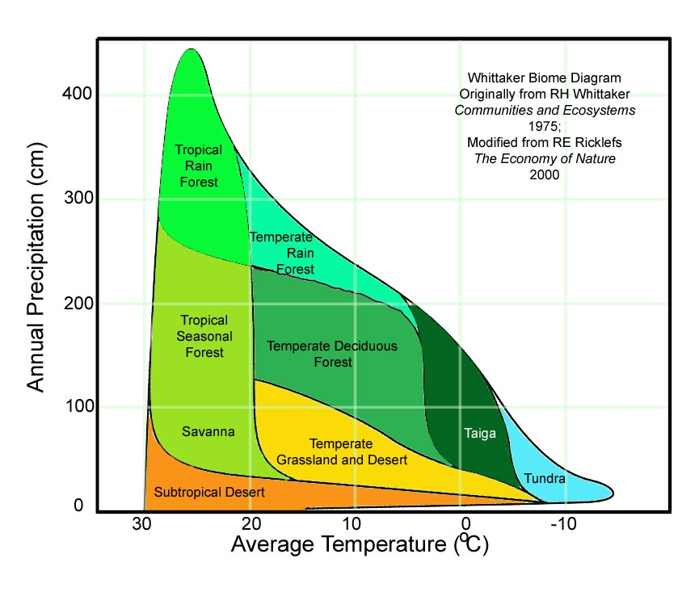
Worldwide distribution of Biomes

Slide 35
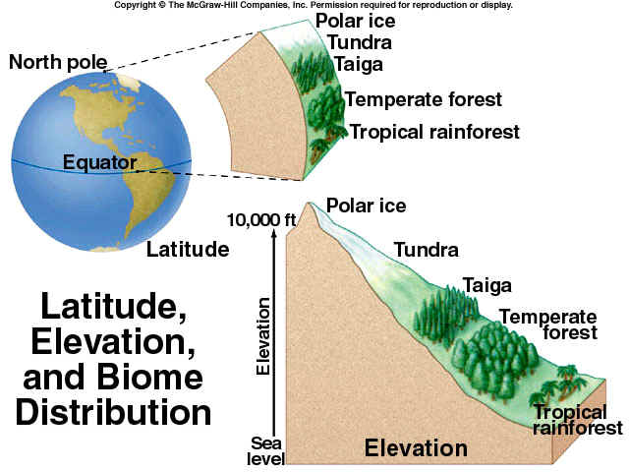
4. Plants as climate proxies

Slide 36
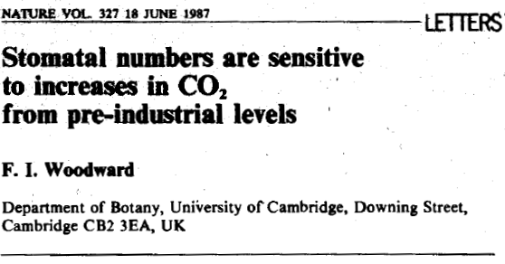
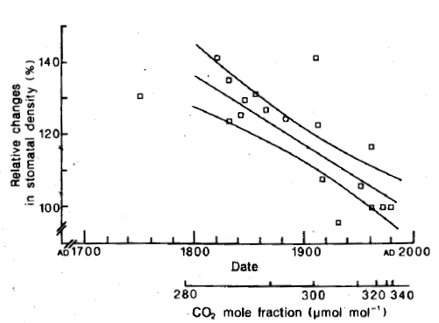
inverse correlation of stomatal frequency to CO₂ concentration
Evidence from Herbarium material and growth experiments

Slide 37
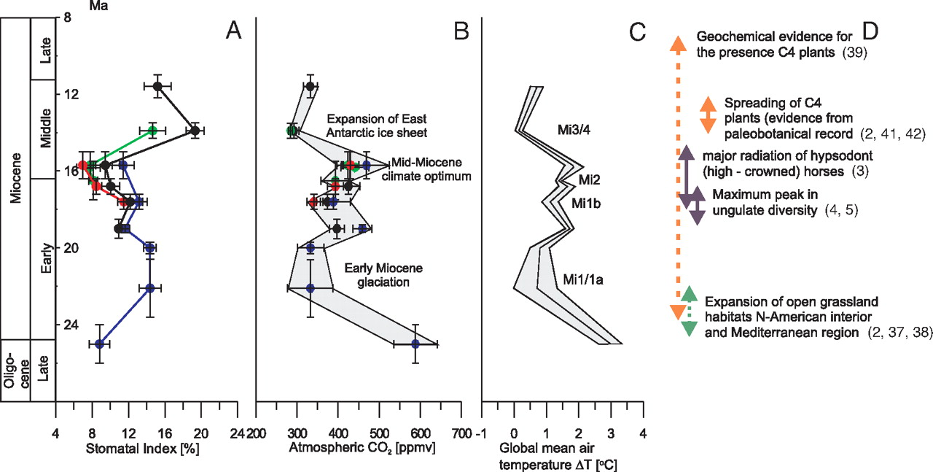
Late Oligocene-Miocene stomatal index records, inferred atmospheric CO2 fluctuations, and effects on global temperature compared with major events in terrestrial ecosystems
Kurschner et al (2008).
Copyright ©2008 by the National Academy of Sciences

Slide 38
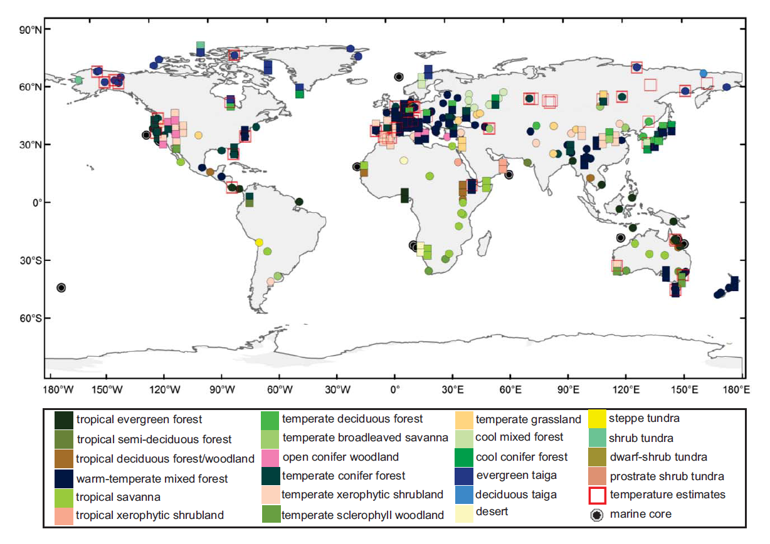
5. Evaluating climate models
45 palaeobotanical sites where surface temperature can be estimated
(Nature Climate Change– Salzmann et al. 2013)

Slide 39
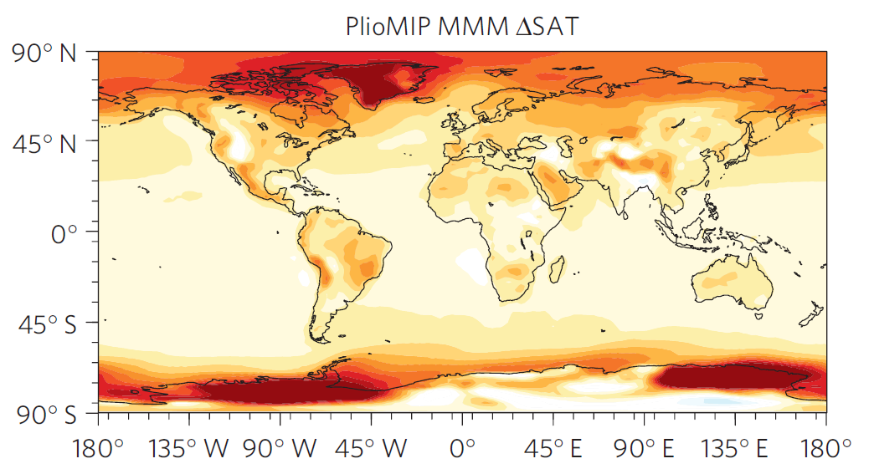
5. Evaluating climate models
(Nature Climate Change– Salzmann et al. 2013)

Slide 40
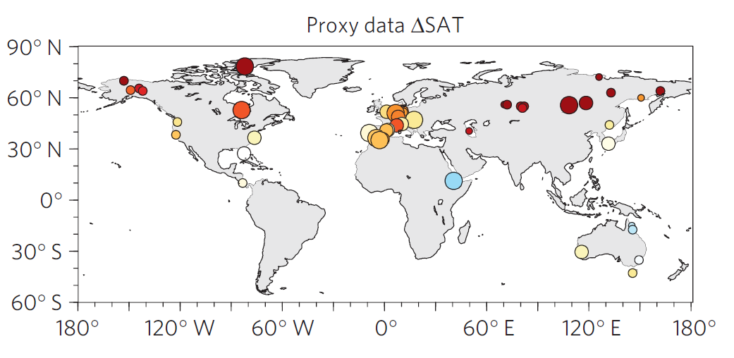
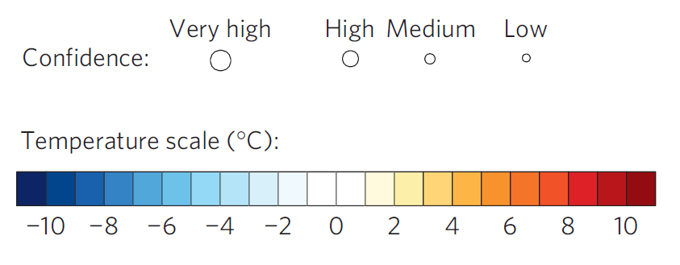
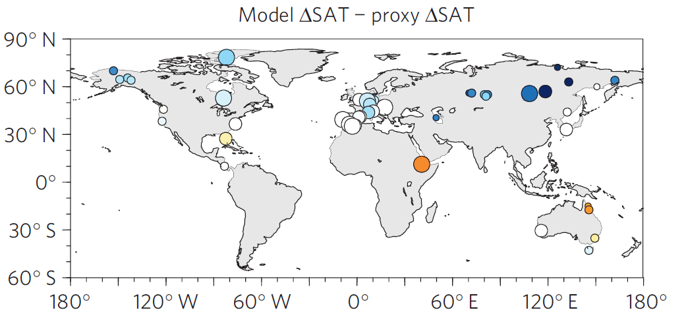
Terrestrial DMC (proxy signal versus model signal
Proxy-based temperature anomaly
Degree of data-model discordance (anomaly versus anomaly)
(Nature Climate Change– Salzmann et al. 2013)

Slide 41
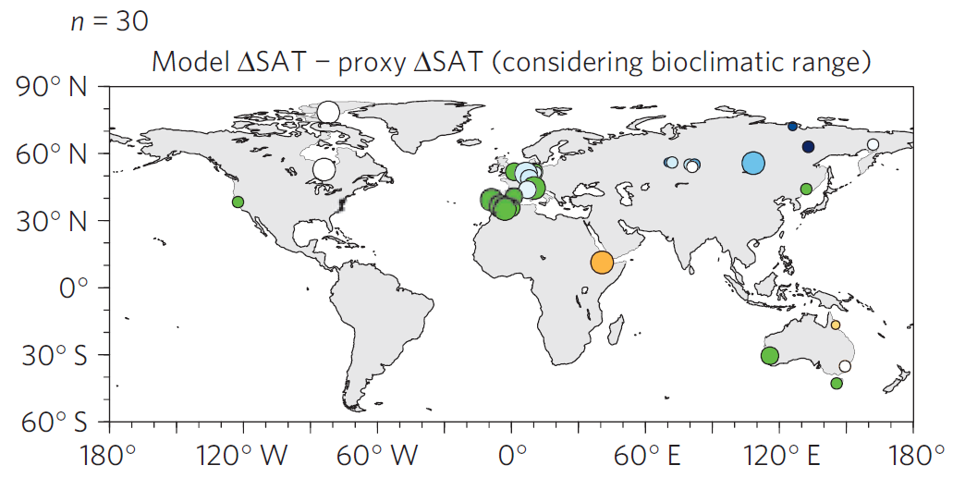
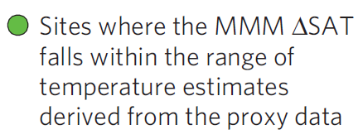
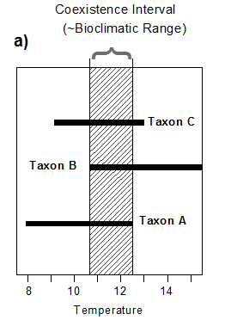
Terrestrial DMC (bioclimatic range)
(Nature Climate Change– Salzmann et al. 2013)

Slide 42
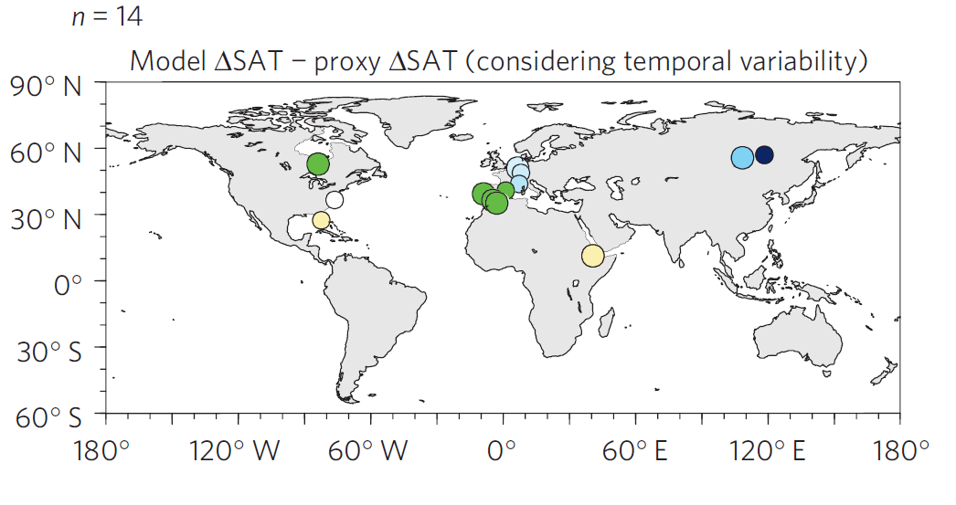
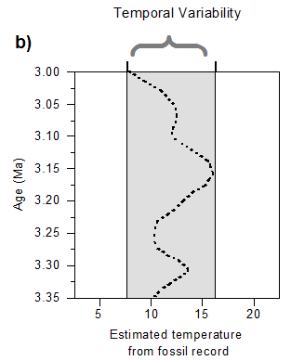
Pliocene Uncertainty…
Terrestrial DMC (temporal variability)
(Nature Climate Change– Salzmann et al. 2013)

Slide 43
Pliocene Uncertainty…
Terrestrial DMC (bioclimatic range and temporal variability)
+
(Nature Climate Change– Salzmann et al. 2013)

Slide 44
Terrestrial DMC (ensemble range)
(Nature Climate Change– Salzmann et al. 2013)

Slide 45
Pliocene Uncertainty…
Uncertainty Triangle
Data Uncertainty
Analytical, Spatial, Temporal
Boundary Condition Uncertainty
Orbital forcing, Greenhouse gases, Topography
Modelling Uncertainty
Structural, Parameter

Slide 46
Conclusions
1. Plants have a long history on our planet
2. Evolved from algal mats to complex flowering plants
3. Pivotal role in the development of the carbon cycle and climate
4. Very useful as climate proxies
5. Like all proxies plants have their limitations
6. Treat mismatches between proxy data and climate models with caution

