Slide 1

Palaeo Constraints on Climate and Earth System Sensitivity
Alan Haywood
School of Earth and Environment, University of Leeds, Leeds, West Yorkshire, UK. earamh@leeds.ac.uk
SOEE5540M

Slide 2
Learning Outcomes
To learn more about the relevance of the Pliocene to understanding future climate change
How did environments differ?
The Pliocene Model Intercomparison Project
How can we use Pliocene environmental data to constrain model estimates of ECS.
How can we use the Pliocene to constrain longer term sensitivity (Earth System Sensitivity).

Slide 3
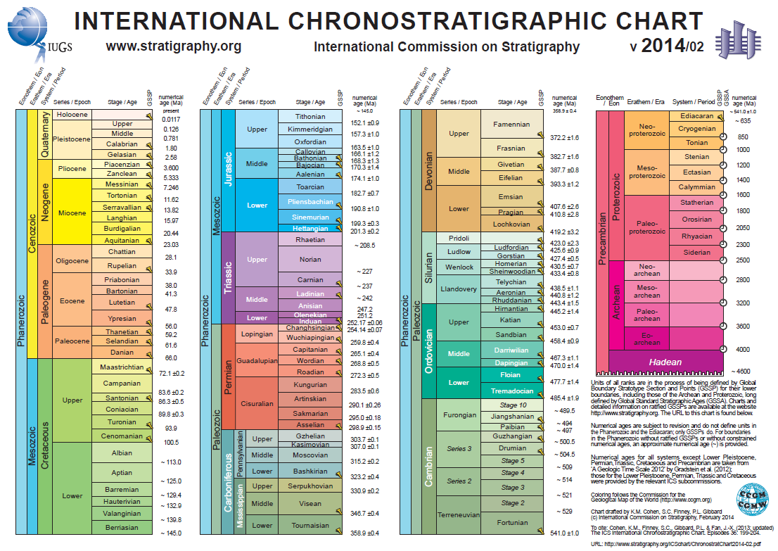
Pliocene Climate

Slide 4
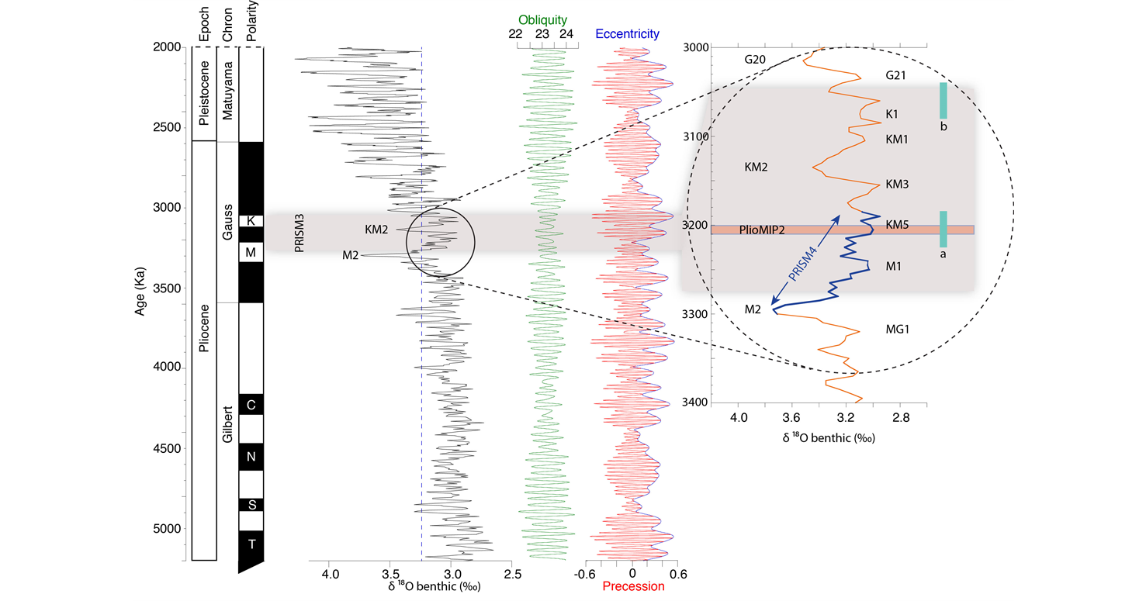
PlioMIP - time slice approach
Synthesis of community data:
PRISM4 (Foley and Dowsett, 2019)
PlioVAR (McClymont et al., 2020)
IPCC-led revision of Salzmann et al. (2008/2013)

Slide 5
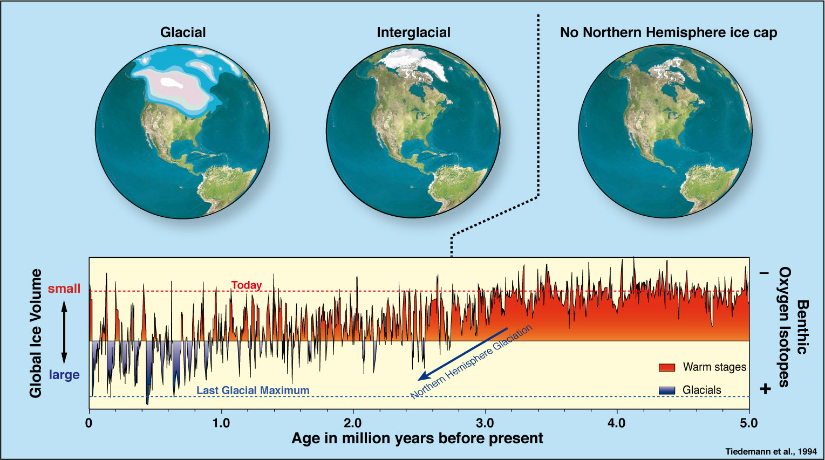
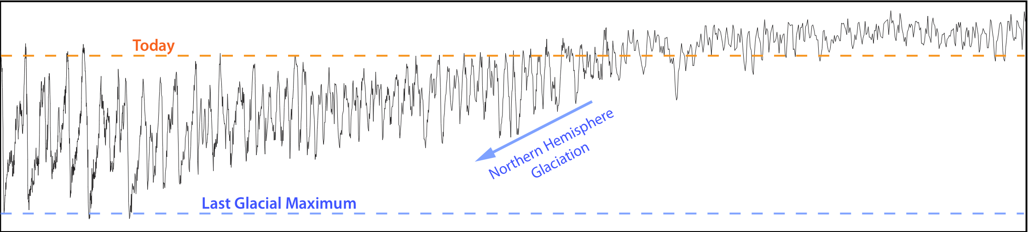
The Pliocene
LR04 Stack
Modified from
LR04 Stack: Lisiecki, L.E. and Raymo, M.E., 2005.
A Pliocene-Pleistocene stack of 57 globally distributed
benthic δ¹⁸O records. Paleoceanography, 20: PA1003.

Slide 6
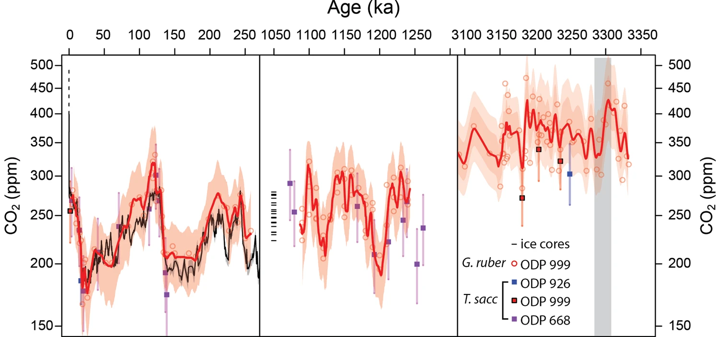
Pliocene CO₂ concentration
de la Vega, E., Chalk, T.B., Wilson, P.A. et al. Atmospheric CO₂ during the Mid-Piacenzian Warm Period and the M2 glaciation. Sci Rep 10, 11002 (2020). https://doi.org/10.1038/s41598-020-67154-8.

Slide 7
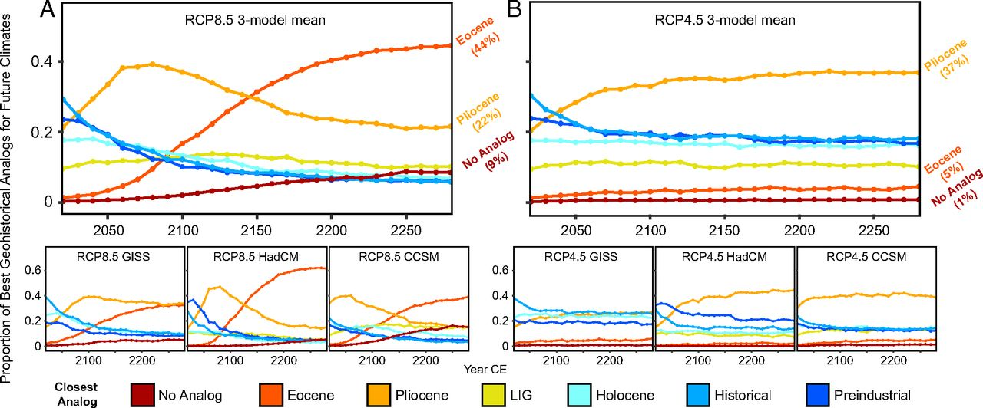
Time-series of the Closest Geohistorical Climatic Analogues (2020–2280)
K. D. Burke et al. PNAS 2018;115:52:13288-13293.
©2018 by National Academy of Sciences
Notes:
Time series of the closest geohistorical climatic analogs for projected climates, 2020–2280 CE (MD). Colored lines indicate the proportion of terrestrial grid cells for each future decade with the closest climatic match to climates from six potential geohistorical climate analogs: Early Eocene, Mid-Pliocene, LIG, Mid-Holocene, preindustrial, and historical for RCP8.5 (A) and RCP4.5 (B). No LIG simulation from GISS was available at the time of analysis.

Slide 8

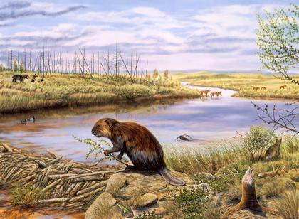
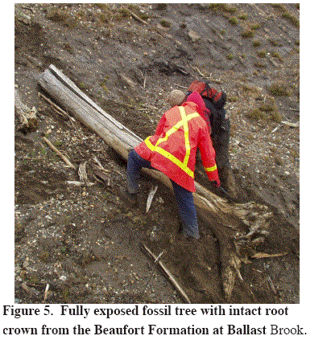



High Latitude Climate/Polar Amplification
Ballantyne et al. (2011)
Notes:
16 Institute and ca. 120 Wissenschaftler beteiligen sich an IMPETUS

Slide 9
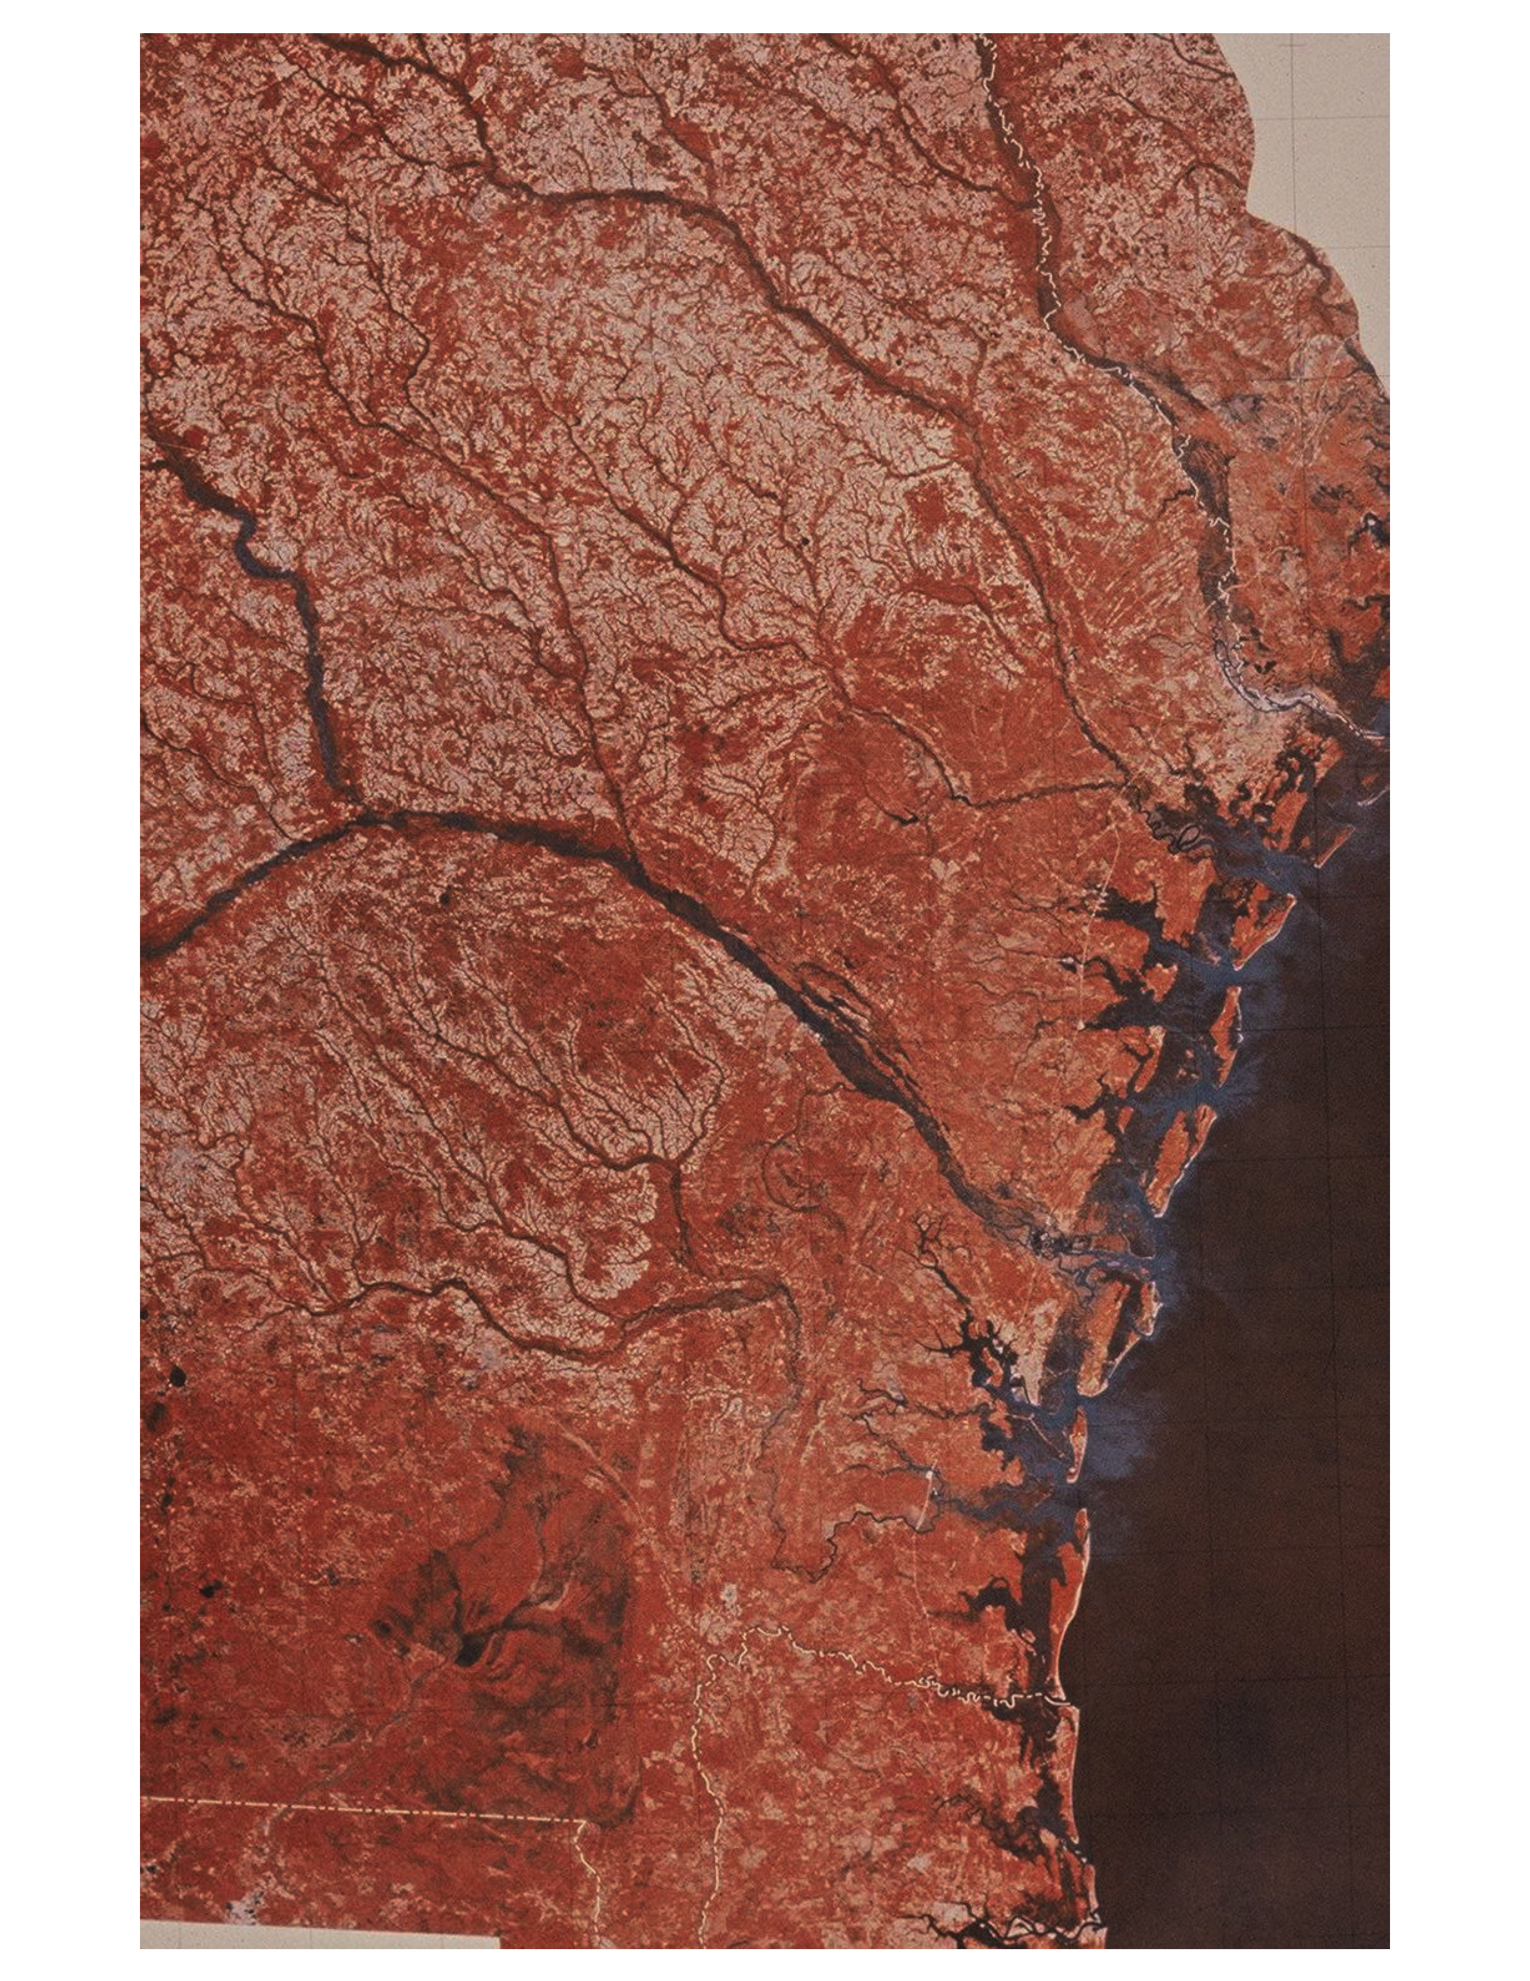
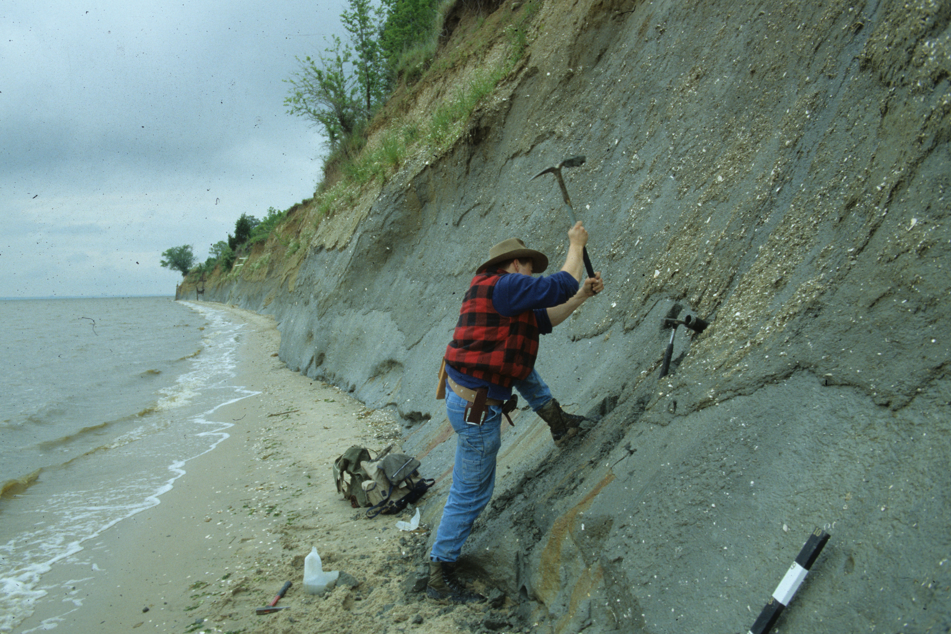
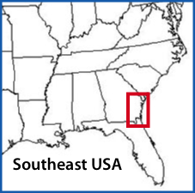
Pliocene sea-level
Atlantic Coastal Plain (ACP)
Sea-level was higher than present day…
But how much higher?
Dowsett, H.J. and Cronin, T.M., 1990. High eustatic sea level during the middle Pliocene: Evidence from
the southeastern U.S. Atlantic Coastal Plain. Geology, 18(5): 435-438.
Orangeburg Scarp, ACP

Slide 10
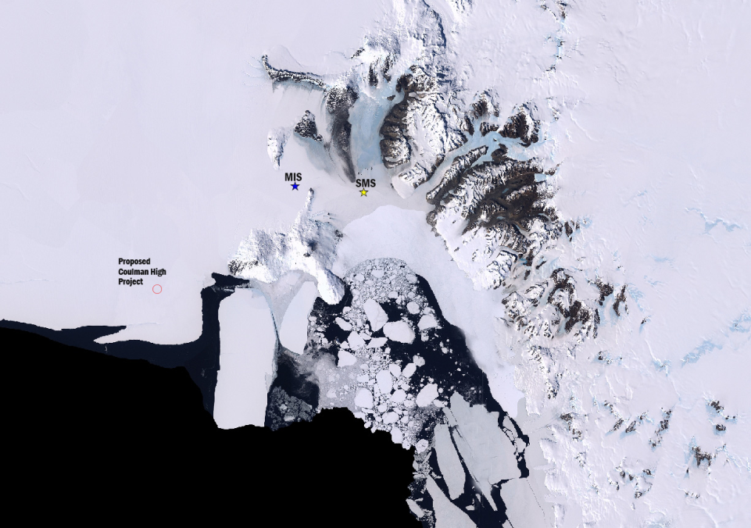
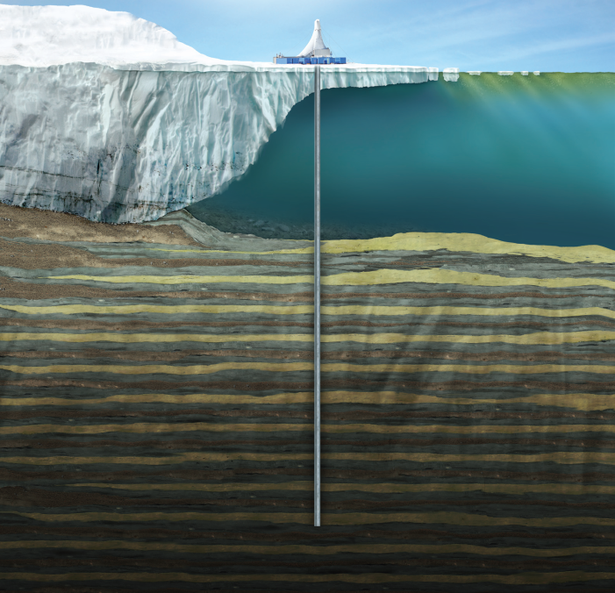
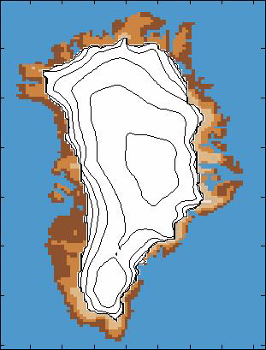
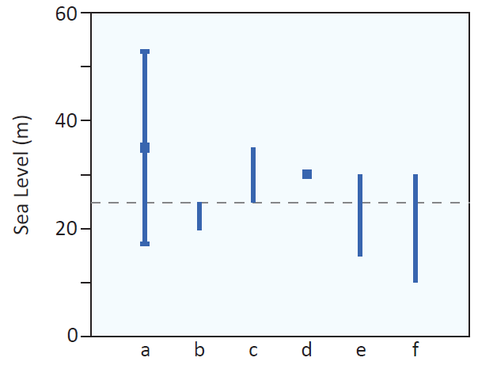
Ice Sheets and Sea Level
Notes:
16 Institute and ca. 120 Wissenschaftler beteiligen sich an IMPETUS

Slide 11
Ice Sheets - Greenland
Pliocene Ice Sheet Modelling Intercomparison Project
(PLISMIP; Dolan et al., 2012)
High confidence in ice sheet presence
Tested climate and ice sheet model dependency of simulations of the Greenland and Antarctic Ice Sheets
(Koenig et al., 2015; Dolan et al., 2015)

Slide 12

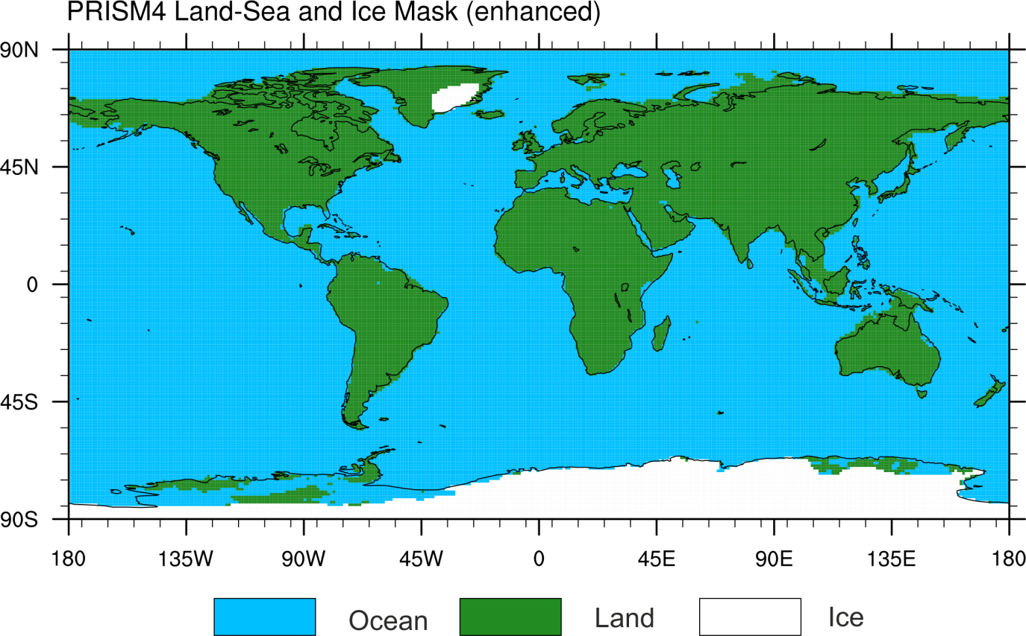
Pliocene Ice Sheets
Futher developments – soils and lakes (Pound et al. 2014).

Slide 13
Pre-Industrial and Pliocene Sea-Ice Results – Annual Cycle

Slide 14
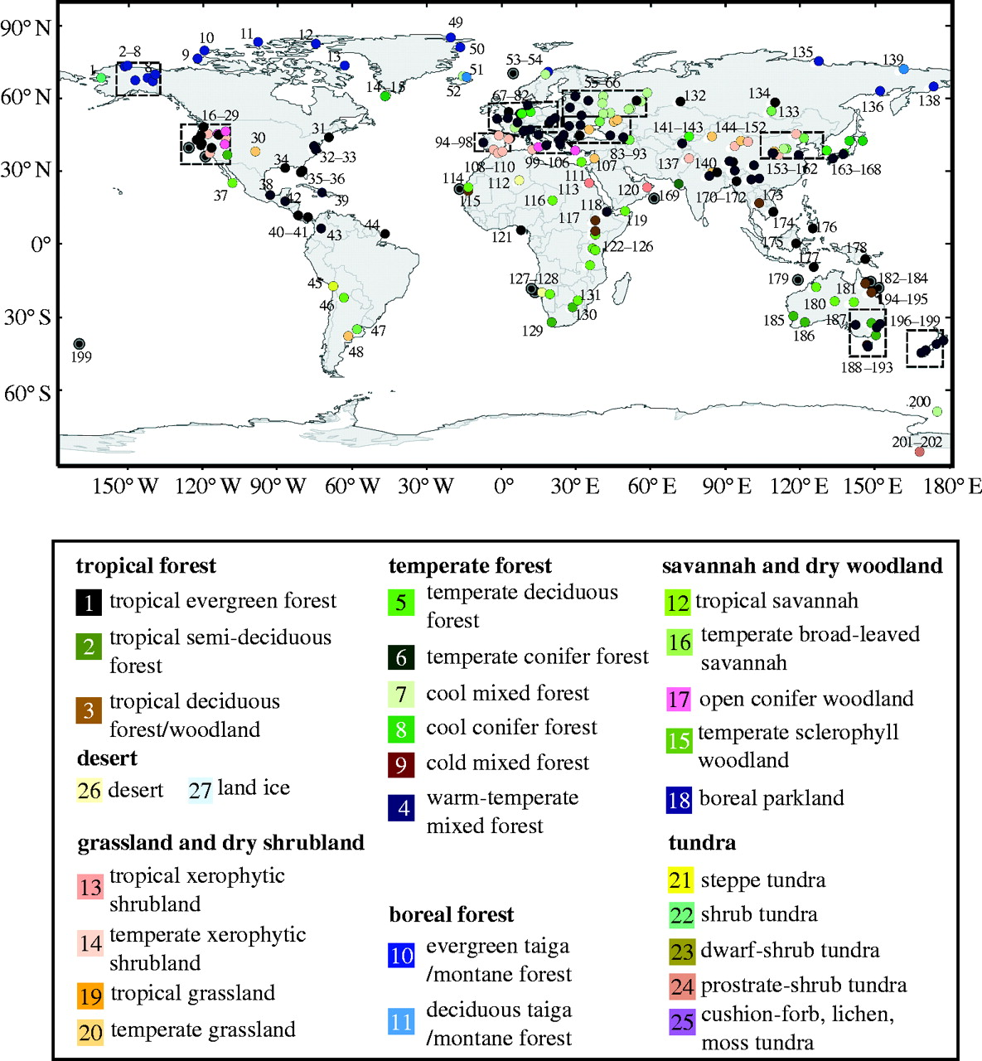
Global vegetation cover
Global distribution of Piacenzian biomes - Salzmann et al. (2008).
Loss of Tundra
Replaced by Boreal forests
Poleward shift in biome types
Sahara ‘greening’
Amazon inadequately constrained

Slide 15
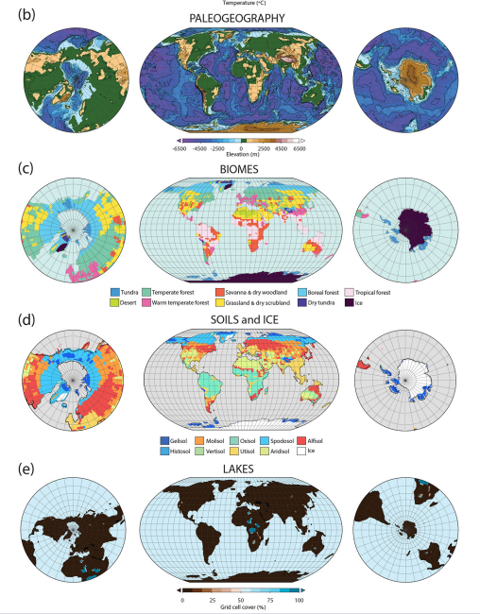
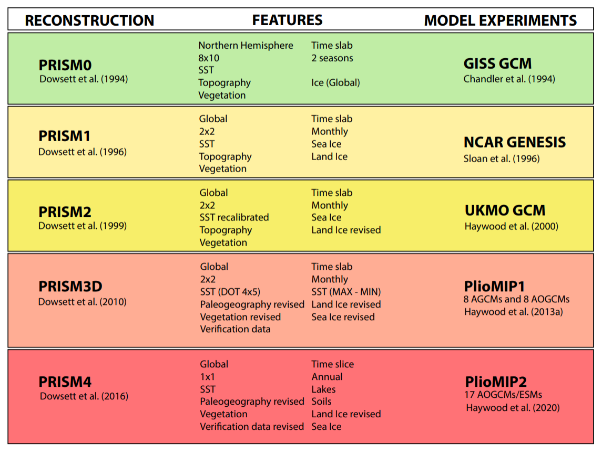
Geological Boundary Conditions
Haywood, Dowsett, Tindall (2021.)
Dowsett et al. (2016).

Slide 16
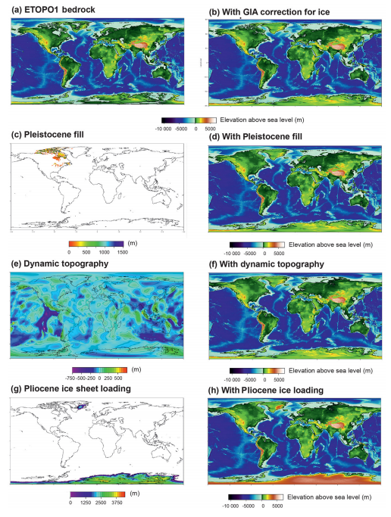
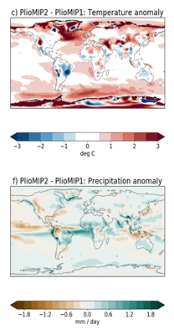
PlioMIP2: Palaeogeographic reconstruction
Dowsett et al. (2016).
Haywood, Dowsett, Tindall (2021)

Slide 17
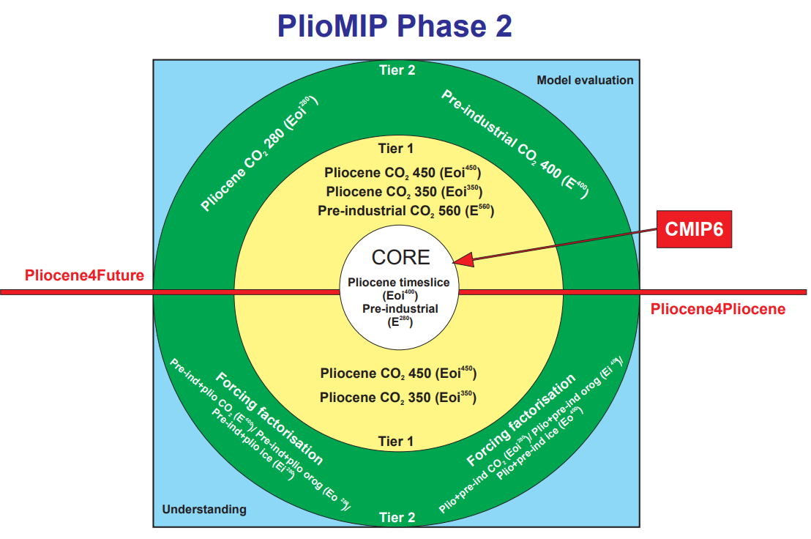
PlioMIP2 Experimental Design
Haywood et al. (2016)
Experiment notation
Controls
E280 = pre-industrial control
Eoi400 = Pliocene control
CO₂ sensitivity experiments e.g.
E400 = pre-industrial with 400 ppm
E560 = pre-industrial with 560 ppm
Eoi450 = Pliocene with 450 ppm
Eoi350 = Pliocene with 350 ppm
Forcing factorization experiments:
Based on pre-industrial conditions (E400, Eo280, Ei280)
Based on Pliocene conditions (Eoi280, Ei400, Eo400)

Slide 18
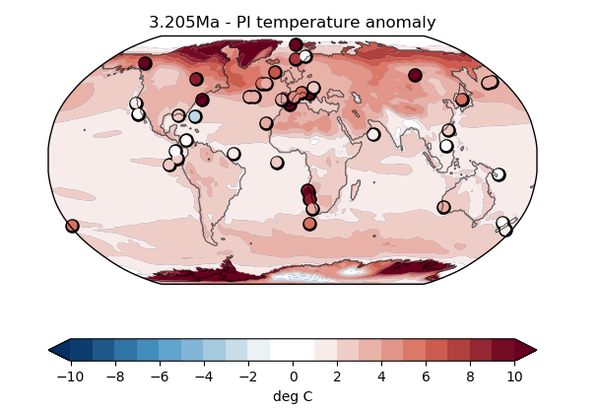
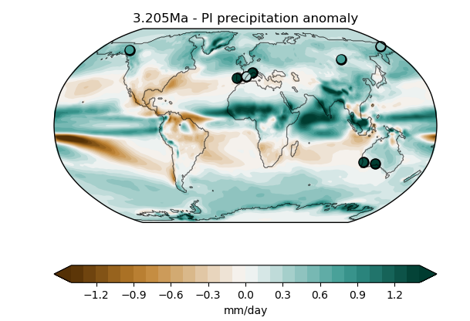
PlioMIP2 Multi-Model Mean (MMM)
Data-Model Comparison
Global mean MMM SAT increases by 3.2°C (2.7°C in PlioMIP1)
Global mean MMM precipitation increases by 0.19 mm day⁻¹ (0.14 mm day⁻¹ in PlioMIP1)
The MMM SST is within 1°C of the data for 17 of the 37 sites
PlioMIP2 model data agreement has improved relative to PlioMIP1
The MMM SST has better model-data agreement than any individual model
PlioMIP2 shows a larger global climate signal than PlioMIP1 in better agreement with the palaeo data
SST Data from Foley and Dowsett (2019); Land data provided by Ulrich Salzmann

Slide 19
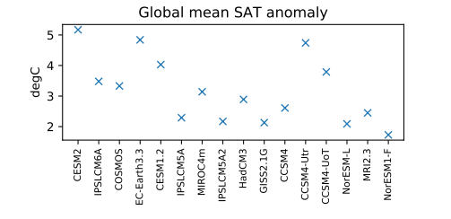
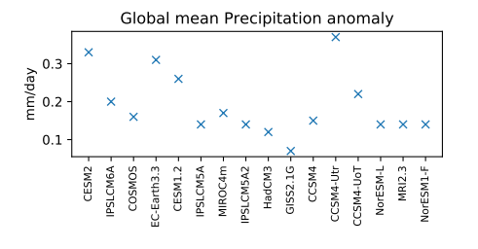
PlioMIP2 Temperature & Precipitation
- Individual Models
PlioMIP2 models have global mean SAT anomalies between 1.7°C and 5.2°C (PlioMIP1: 1.8°C – 3.6°C)
PlioMIP2: global mean precipitation anomalies are 0.07-0.37 mm day⁻¹ ⁽PlioMIP1: 0.09 – 0.18 mm day⁻¹)
Models that contributed to both PlioMIP2 and PlioMIP1 are marked with a
Many of the ‘new’ models in PlioMIP2 are sensitive and show a larger climate signal
The increased global climate signals in PlioMIP2 are largely due to the addition of more sensitive models to the ensemble

Slide 20
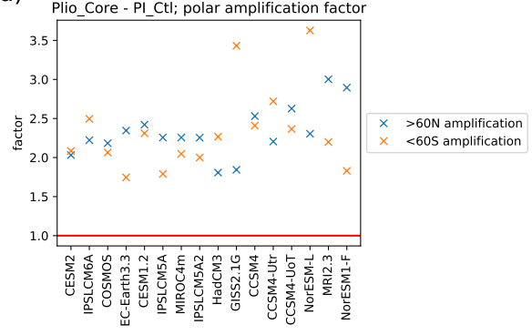
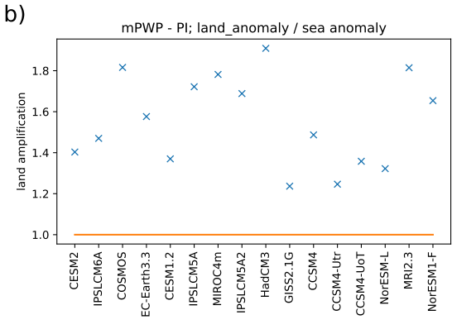
Polar Amplification and Land-Sea Temperature Contrast
In the PlioMIP2 MMM the region poleward of 60° warms 2.3 × as much as the global mean
In the MMM the Polar Amplification (PA) is the same in both hemispheres
MMM PA is the same in PlioMIP2 and PlioMIP1, but individual models show a large spread
The land warms 1.5 × as much as the ocean
Land Amplification is similar in PlioMIP2 and PlioMIP1.
Polar Amplification = 2.3
Land Amplification = 1.5
These are similar in PlioMIP2 and PlioMIP1

Slide 21
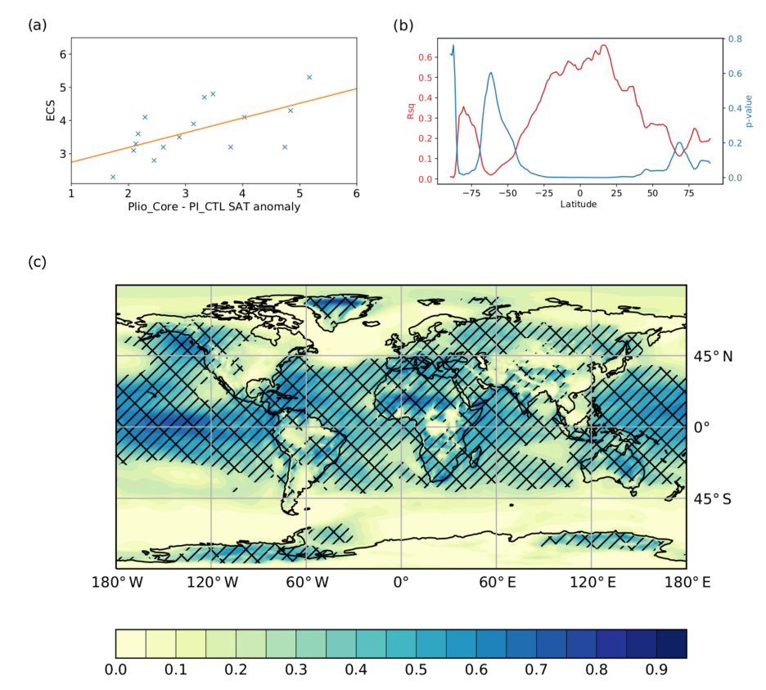
Building a statistical model
(a) The globally averaged Pliocene temperature change for each model versus the published equilibrium climate sensitivity (crosses) with line of best fit shown in orange. (b) Statistical relationships between the latitudinally averaged temperature anomaly and published climate sensitivity. The proportion of climate sensitivity that can be explained by the SAT anomaly at each latitude (Rsq) is shown in red. (c) Colours show the percentage variation in modelled ECS that is linearly related to the modelled temperature anomaly at each grid square (Rsq). Hatching shows a significant relationship (at the 5 % confidence level) between the Pliocene temperature change anomaly at that grid square and ECS.

Slide 22
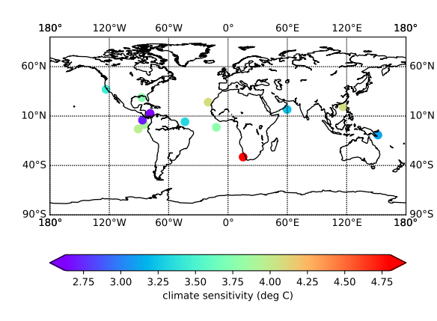
Equilibrium Climate Sensitivity (ECS)
PlioMIP2 ECS was estimated from data at individual sites using the modelling results.
ECS estimates are independent and each include a number of uncertainties due to both the data and the modelling.
PlioMIP2 ECS estimates range from 2.6°C to 4.8°C.
IPCC AR6: 2 to 4.5°C; best estimate 3°C)
ECS is estimated independently at each of the 13 sites shown. All estimated ECSs are in the range 2.6°C to 4.8°C

Slide 23
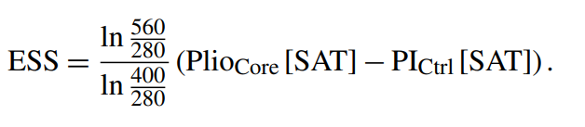
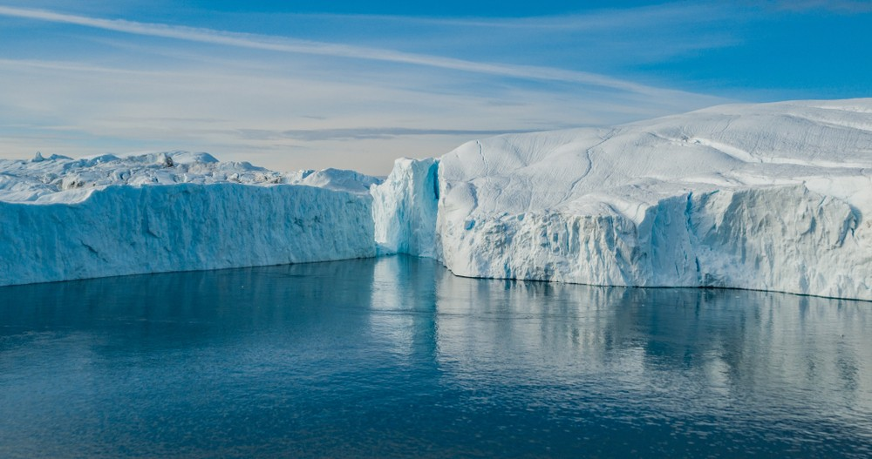

Longer-term or Earth System Sensitivity
PlioMIP1 determined a range in the ESS/CS ratio of between 1.1 and 2.0 with a best estimate of 1.5.
In PlioMIP2, which has benefited from the access to a larger array of models and new boundary conditions.
The PlioMIP2 range and best estimate of the ESS/CS ratio is 1.1 to 2.9 and 1.7 respectively.

Slide 24
Further reading
Haywood A, et al. (2020). The Pliocene Model Intercomparison Project Phase 2: large-scale climate features and climate sensitivity. Climate of the Past. 16, pp. 2095-2123.
Tierney JE, Haywood AM, Feng R, Bhattacharya T, Otto‐Bliesner BL. (2019). Pliocene Warmth Consistent With Greenhouse Gas Forcing. Geophysical Research Letters. 46 (15), pp. 9136-9144.
Haywood AM, Valdes PJ, Aze T, Barlow N, Burke A, Dolan AM, von der Heydt AS, Hill DJ, Jamieson SSR, Otto-Bliesner BL, Salzmann U, Saupe E, Voss J. (2019). What can palaeoclimate modelling do for you?. Earth Systems and Environment. 3 (1), pp. 1-18.
Burke KD, Williams JW, Chandler MA, Haywood AM, Lunt DJ, Otto-Bliesner BL. (2018). Pliocene and Eocene provide best analogs for near-future climates. Proceedings of the National Academy of Sciences. 115 (52), pp. 13288-13293.
Lunt DJ, Haywood AM, Schmidt GA, Salzmann U, Valdes PJ, Dowsett HJ. (2010). Earth system sensitivity inferred from Pliocene modelling and data. NAT GEOSCI. 3 (1), pp. 60-64.

