Slide 1

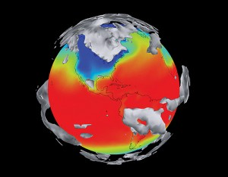
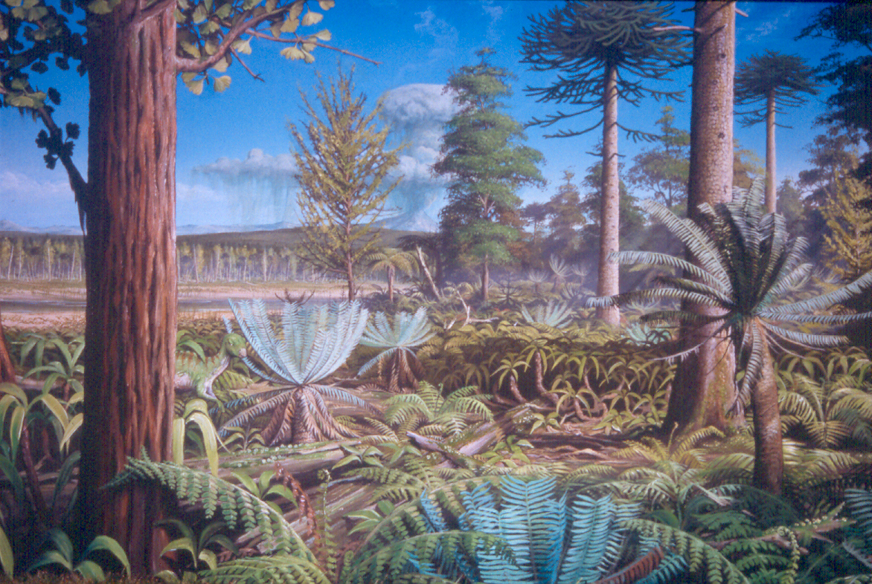
Climate Models and their application in understanding climate evolution
Prof. Alan M. Haywood
Source: Pacific Northwest National Laboratory
Artwork by James McKay ©

Slide 2
Learning Outcomes
To learn about the development of Climate and Earth System Models.
To appreciate how these models can be applied to understand the evolution of climate over geological time.
How appreciate how we must modify Climate Models in order to be able to simulate climates of the past.
How have we combined outputs from climate models with other environmental models to be able to say more about past environments.

Slide 3
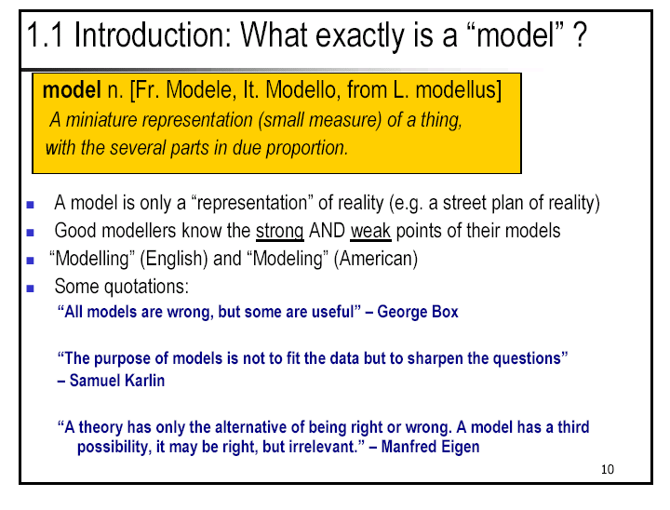

Slide 4
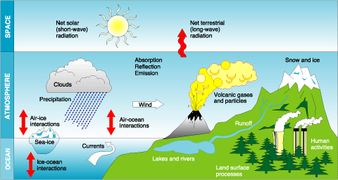
The Climate System

Slide 5
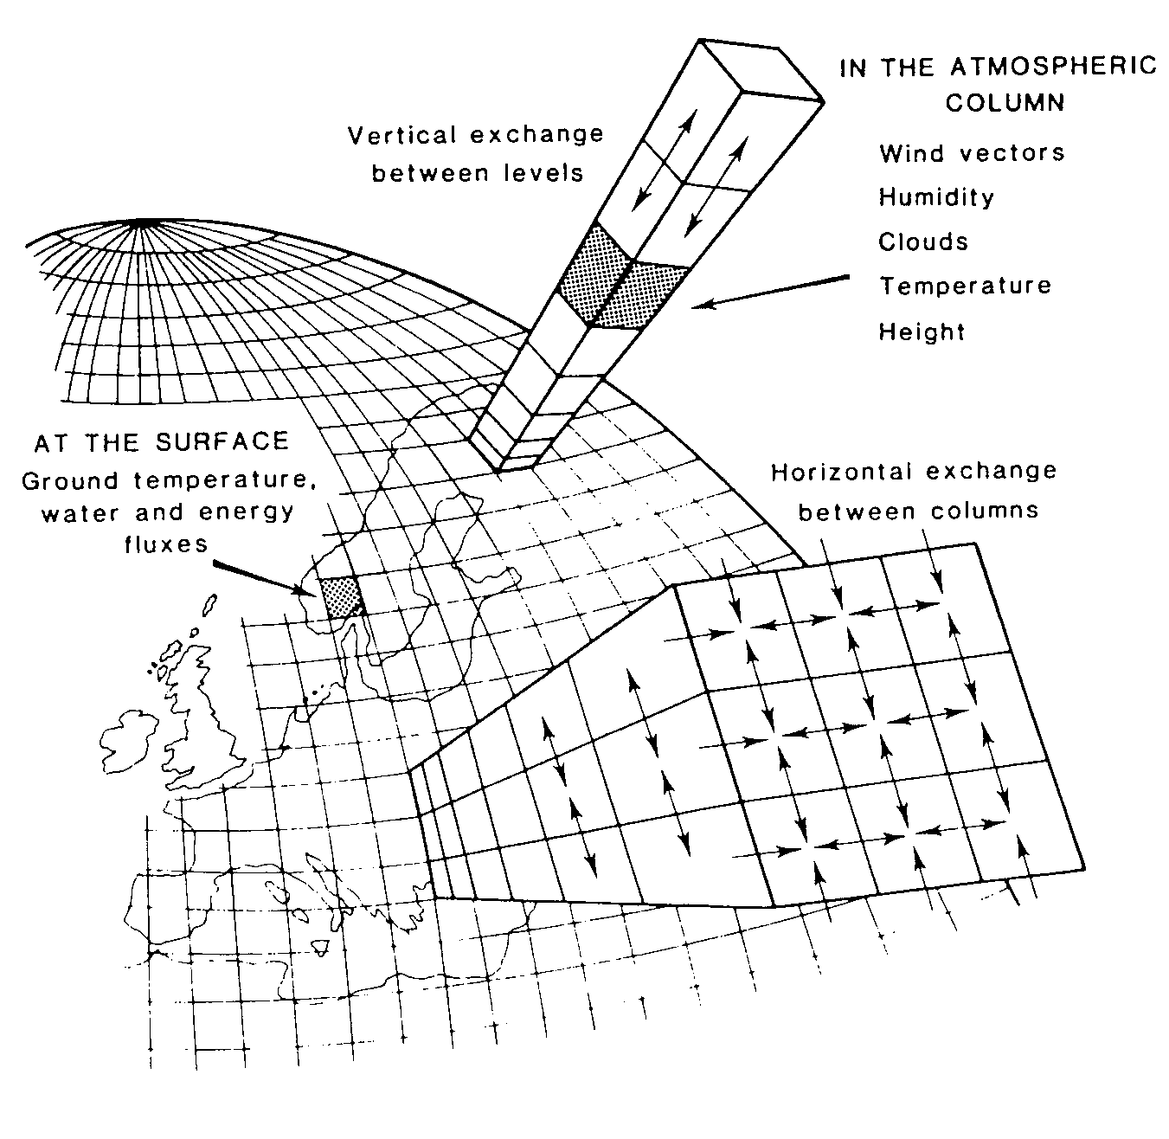
General Circulation Models
Model needs to simulate albedo, emissivity and general circulation.
Use “first principles”
Newton's Laws of Motion
1st Law of Thermodynamics
Conservation of Mass and Moisture
Hydrostatic Balance
Ideal Gas Law

Slide 6
Spectrum of Climate Models
ESM
EMIC
Complexity
Coupled Ocean Atmosphere GCM (OAGCM)
AGCM + Slab Ocean Model
Atmospheric General Circulation Models (AGCM)
Energy Balance Models (EBM’s)
Number

Slide 7
Components of an Earth System Model
Aerosols:
Dust and Sulphates
Regional Model:
High Resolution
Cryosphere-Lithosphere
Model
Atmospheric
Chemistry
Atmospheric General Circulation Model
Land Surface
Hydrology
Ocean Carbon Cycle
Ocean General Circulation Model
Terrestrial Carbon
Cycle

Slide 8
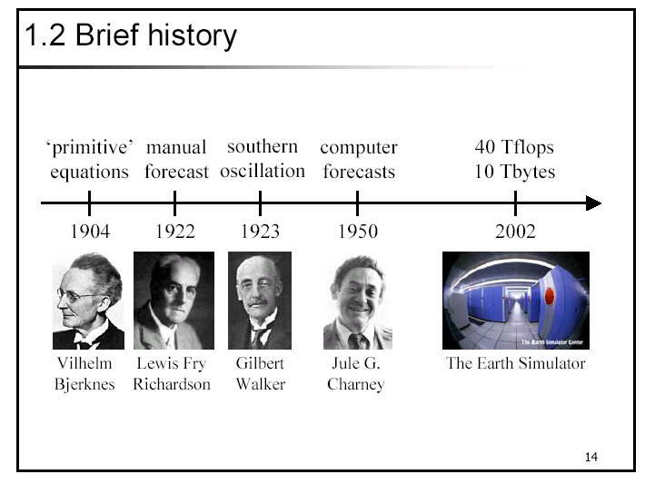
Brief history of numerical modelling

Slide 9
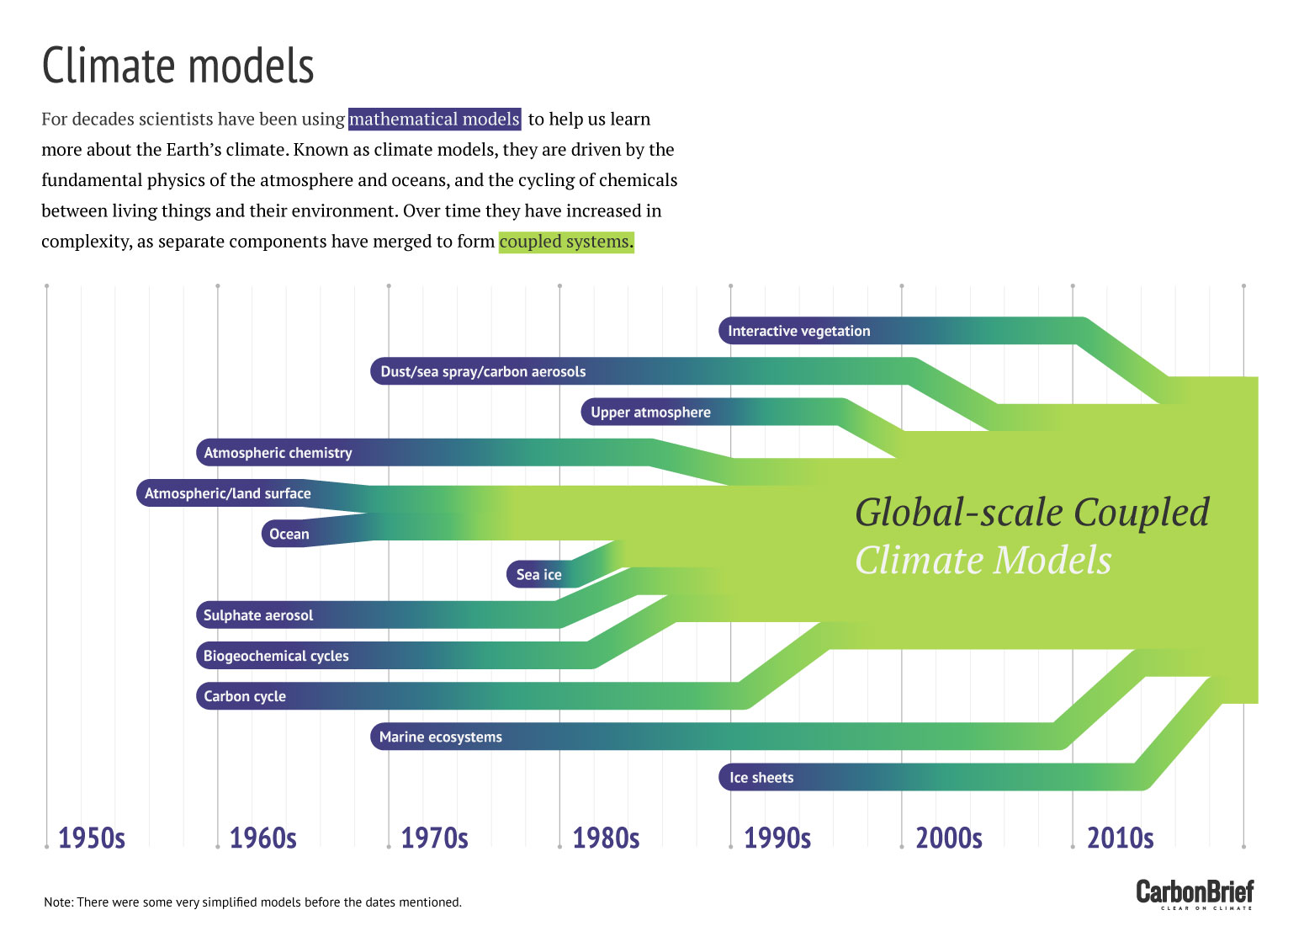
Component models are constructed off-line and coupled with the climate model when sufficiently developed
Notes:
6

Slide 10
Physical basis of climate models
The atmosphere is a fluid on a rotating planet:
  Drag at the surface and within the atmosphere affects the momentum budget
  Water vapour evaporates from the surface, condenses to form clouds and heats the atmosphere when it is lost through precipitation
  Heating from solar radiation and cooling from thermal radiation
Models therefore need to include equations for;
  3 components of wind (or vorticity & divergence), including Coriolis and drag
  equation of state and conservation of water
  thermodynamics, including heating by condensation and radiation

Slide 11
Physical basis of climate models
The ocean is also a fluid, but incompressible. It is heated by solar radiation and cooled by evaporation and thermal emission from the surface. No internal heating, but salinity strongly affects the density and hence the circulation
Additional models have been developed to include the land surface, cryosphere, atmospheric chemistry and aerosols, carbon cycle etc
Processes that are sub-grid in scale are modelled by parametrizations

Slide 12
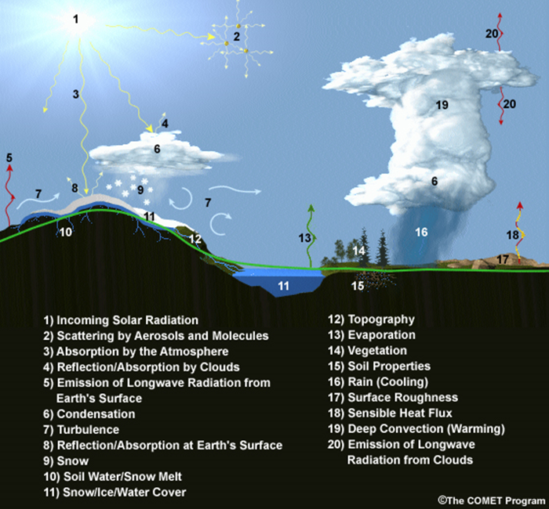
Parametrized processes in climate models

Slide 13
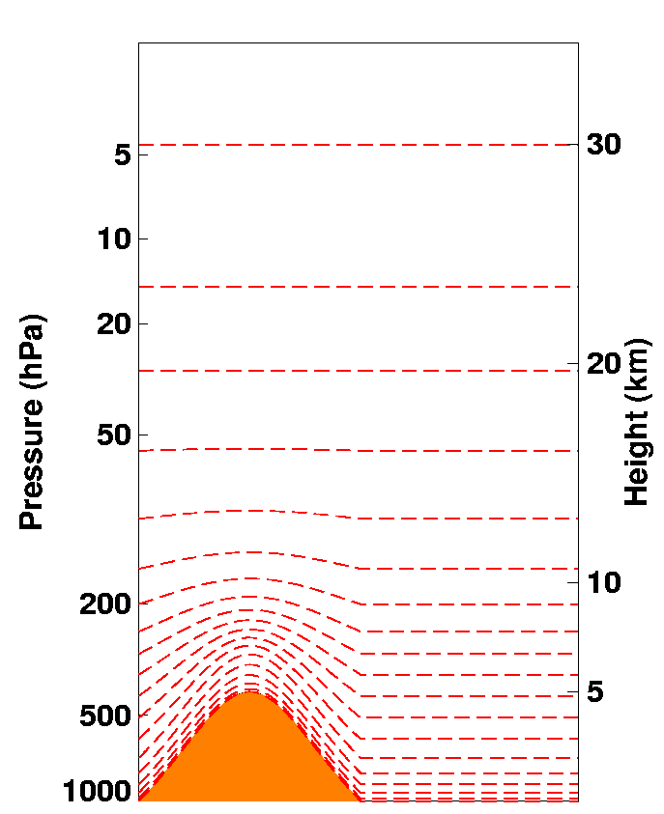
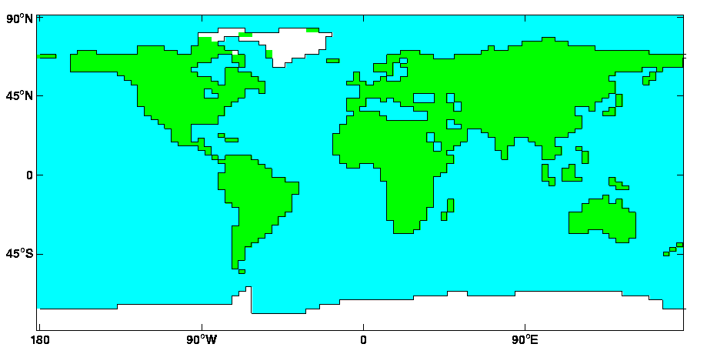
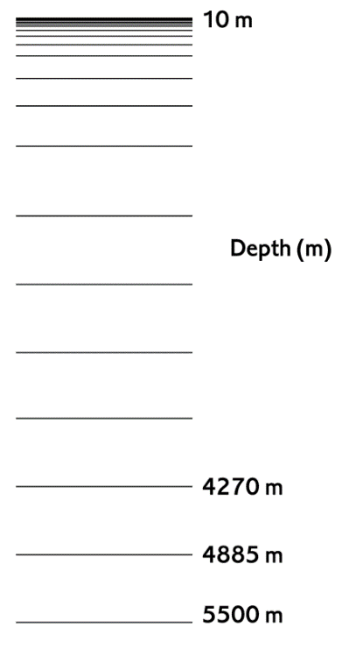

HadCM3 GCM
Atmospheric resolution: 3.75 by 2.5 degrees
19 Atmospheric Levels
Ocean resolution :1.25 by 1.25
20 Ocean Levels

Slide 14
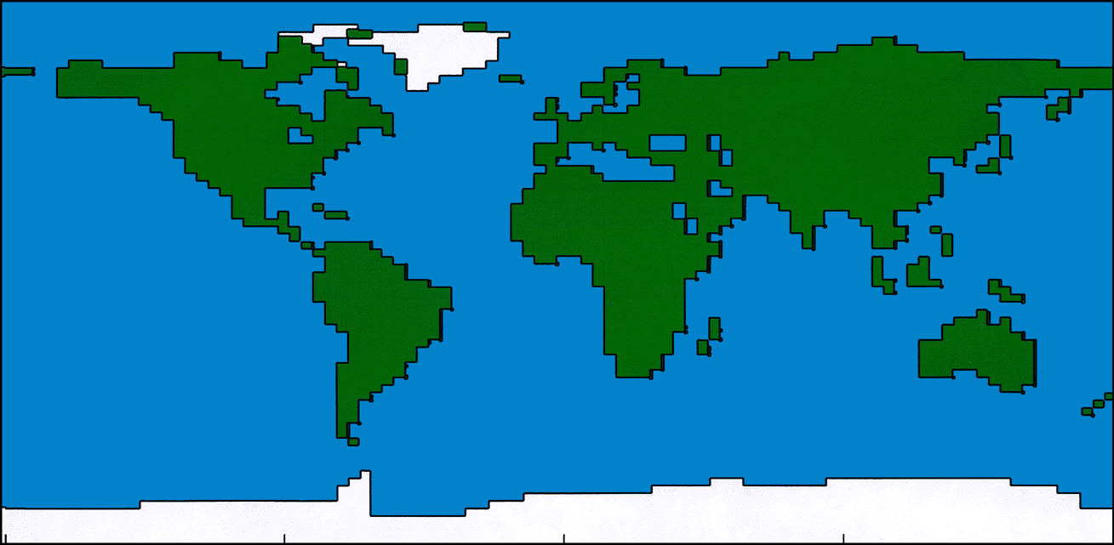
19 levels in
atmosphere
30km
2.5
lat
3.75
long
THE HADLEY
CENTRE
THIRD
COUPLED
MODEL -
HadCM3
no flux adjustments
1.25
1.25
20 levels
in ocean
-5km

Slide 15
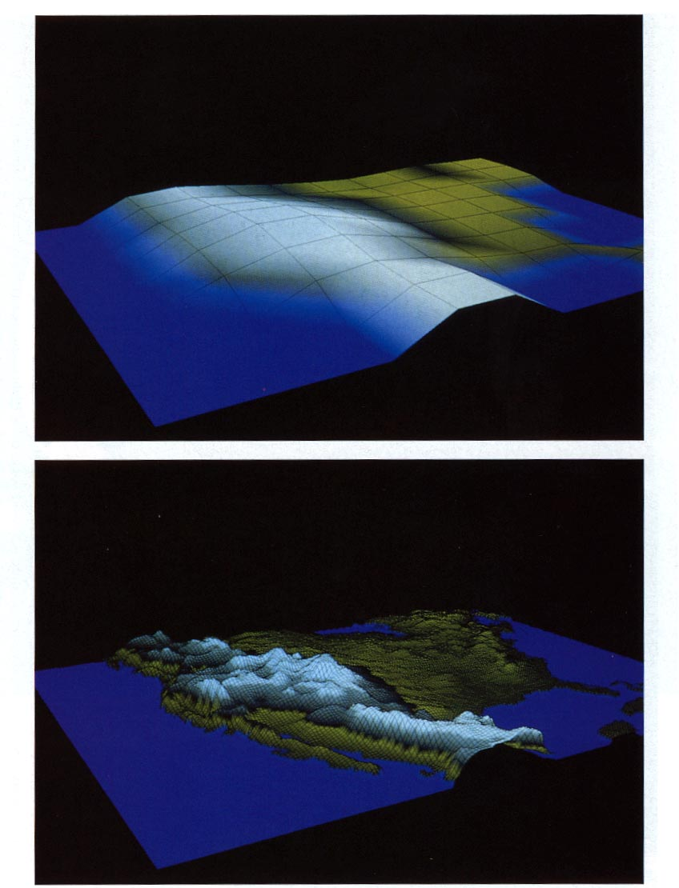
Representation of orography; the importance of resolution
The upper figure shows the surface orography over North America at a resolution of 480km, as in a low resolution climate model.
The lower figure shows the same field at a resolution of 60km, as in a weather forecasting model.
Remember that orographic processes are highly non-linear.

Slide 16
The horizontal and vertical resolutions of climate models need to be high enough to avoid numerical errors and to resolve the basic dynamical and transport processes
There is a trade-off between resolution and computing time, but model resolutions are increasing continually, as more computer power becomes available
So………

Slide 17
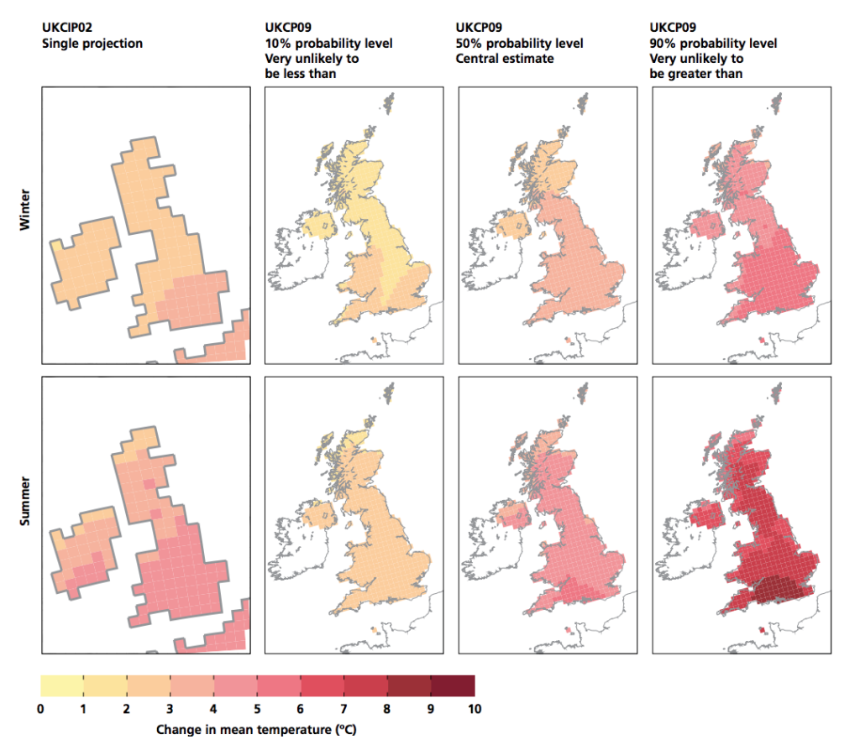
The need for information locally/regionally
Comparison of changes in seasonal average temperature, winter (top) and summer (bottom), by the 2080s under High Emissions scenarios, from UKCIP02 (far left panels) and as projected for UKCP09 at three probability levels (10, 50 and 90%). Darker red shading shows larger amounts of warming. © UK Climate Projections 2009

Slide 18
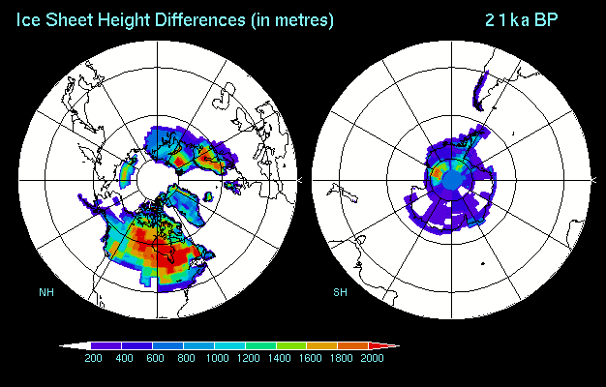
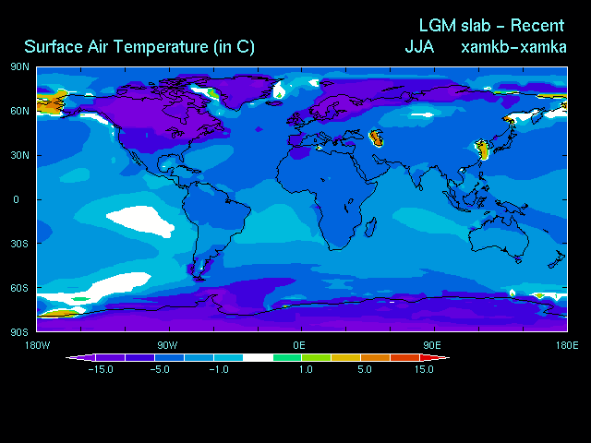
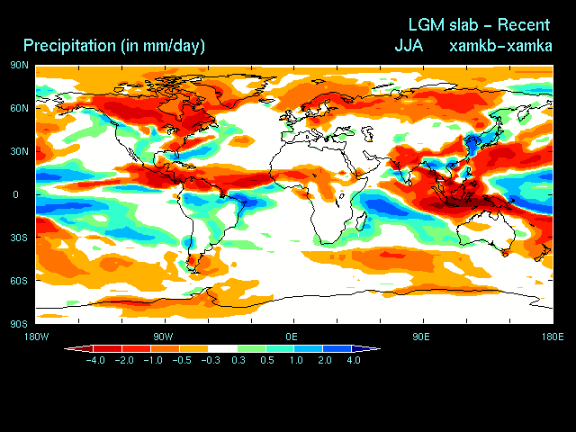
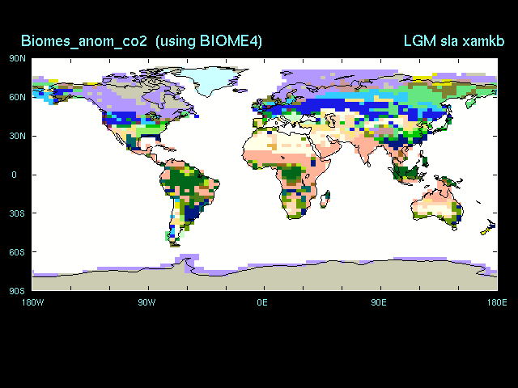
Ice Sheet Elevation
Temperature Change
From Peltier, 1994
Precipitation
Biomes
Notes:
But you don’t only see changes on the timescales of million of years.
What these four model predictions try to capture are the kind of large scale changes that have occurred over just the last 21,000 years. In the top left is an animation of how different ice sheet height was for each 1000 years starting at the LGM. The other three plots show the differences in NH summer surface air temperature, NH summer total precipitation rates and the distribution of biomes across the planet again from the LGM forward to present-day.
Major ice sheets have shrunk dramatically, temperatures have warmed considerably, precipitation patterns have been reorganised and there have been major shifts in the latitudinal positions of vegetation types.

Slide 19

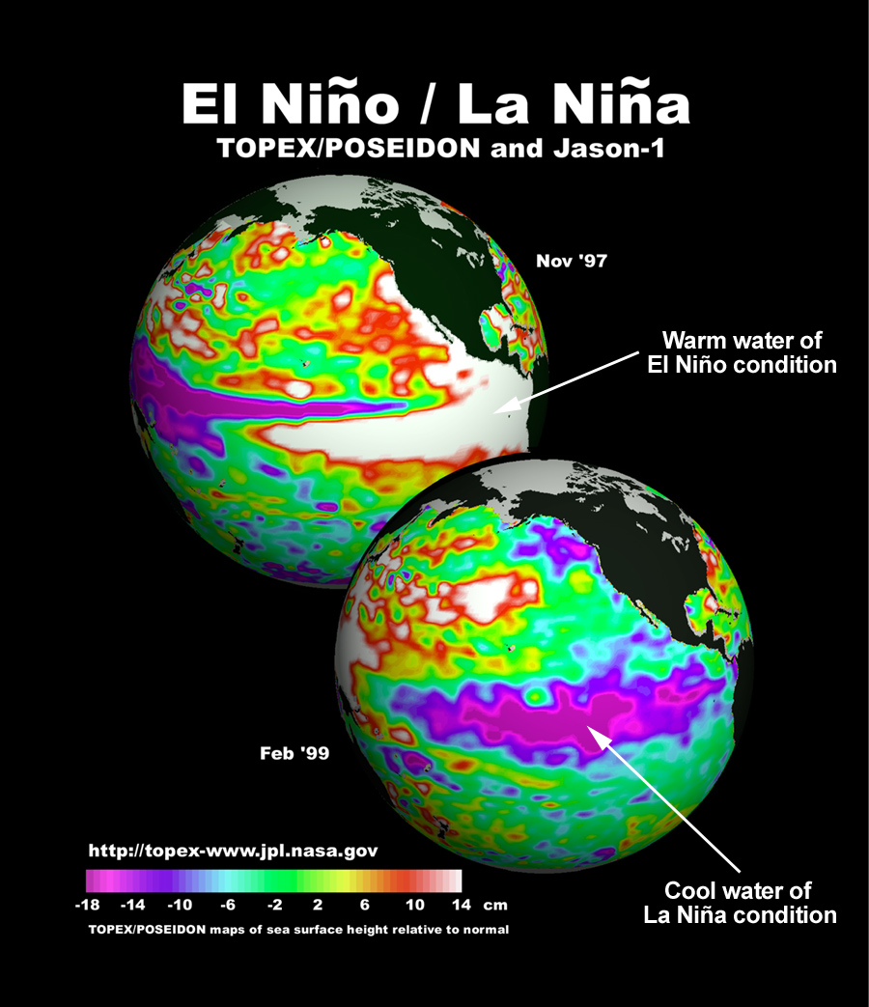
Case
Studies
1. Palaeo ENSO (El Niño Southern Oscillation)
Coupled ocean-atmosphere
phenomena
Involves large scale fluctuations
in a number of oceanic/atmospheric variables (e.g. sea surface temps.
& sea level pressure)
El Niño & La Niña opposite extremes
of ENSO
Notes:
So that’s the why covered now on to the what – the science!
Number 1: Palaeo ENSO
Exploring the behaviour of ENSO in Earth past is central to understanding how it ay alter in the future.
There isn't time to go into details here but briefly ENSO is a coupled ocean-atmosphere phenomenon cantered in and over the tropical Pacific. It involves large-scale fluctuations in a number of oceanic and atmospheric variables such as sea surface temperature, sea level pressure, etc. El Niño (warm phase) and La Niña (cold phase) episodes are the opposite extremes of the ENSO phenomena.
Both the ocean and atmosphere plays a dynamical role in ENSO
Recent work on planktonic foraminifer in the tropical Pacific has suggested that during a recent period of global warmth (the Pliocene) a permanent El Nino-like condition may have existed.

Slide 20
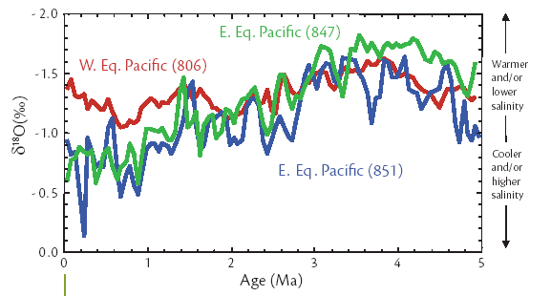
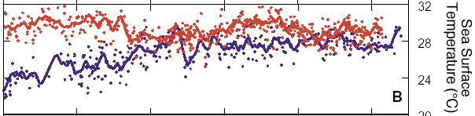


The Pliocene: a Permanent El Niño-like state?
(Wara et al., 2005; Philander & Federov, 2003)
Mg/Ca SSTs
0
3
5
Age (Ma)
Strong Gradient
No Gradient
Notes:
Lets take a look at the evidence for this………
Main evidence comes from oxygen isotope and Mg/Ca SST data indicating an altered E-W gradient across the tropical Pacific. Altered gradient caused by the warming of EEP SSTs. Shoaling of the thermocline, so the upewelling of cool waters does not reach the surface.
Feedback associated with tropical cloud cover, albedo and increase in global temperatures.
Given my own work on modelling climates of the Pliocene I was interested to see if a fully coupled Ocean-atmosphere GCM, set up with a full suite of Pliocene boundary conditions would reproduce what the data was suggesting.

Slide 21

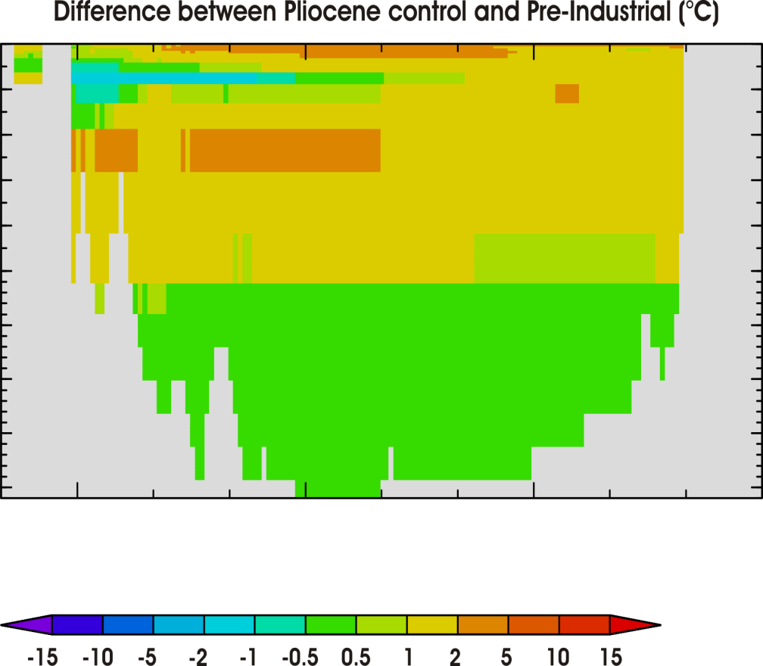

Can a model reproduce this change?
Plio^{Control} ocean temperatures (°C)
across the Pacific at 0°N
Difference between Pliocene^{Control} and Pre-Ind (°C)
0
400
1000
3000
5000
Notes:
Model agrees with estimates of a warmer EEP. However, thermocline does not shoal. WEP also warms so over all gradient remains the same.

Slide 22
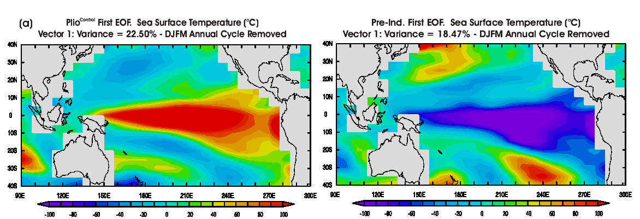
ENSO rather than permanent El-Niño!
Haywood et al. (in-press). Paleoceanography
Notes:
Analysis of the geographical region where the model predicts most variability in SSTs reveals a classic ENSO pattern of a similar magnitude, or slightly greater than present day.
Analysis of inter-annual variability of model results at the location of one of the ODP sites used to promote a permanent El Nino like state supports ENSO like variability.

Slide 23
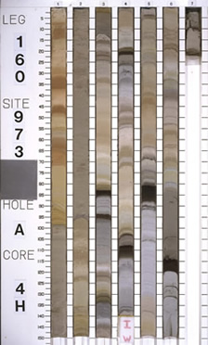
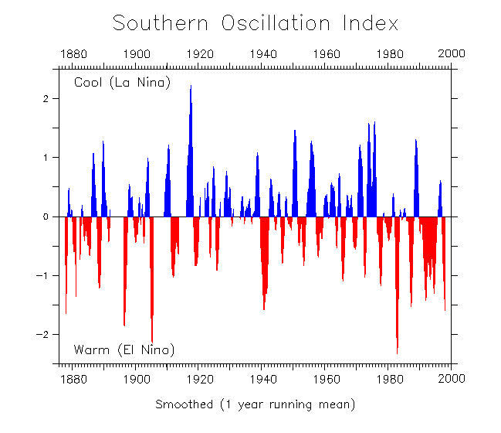

“In search of palaeo-ENSO: significance of changes in the mean state”
1 sample per 10,000 years

Slide 25
Case
Studies
2. Cretaceous Climates & Ice-Sheets
Palaeobotanical
Evidence
Cretaceous forest 120
million years ago on the
Antarctic Peninsula.
reconstruction based
on PhD of Jodie Howe,
University of Leeds/BAS,
painted by Robert Nichols.

Slide 26
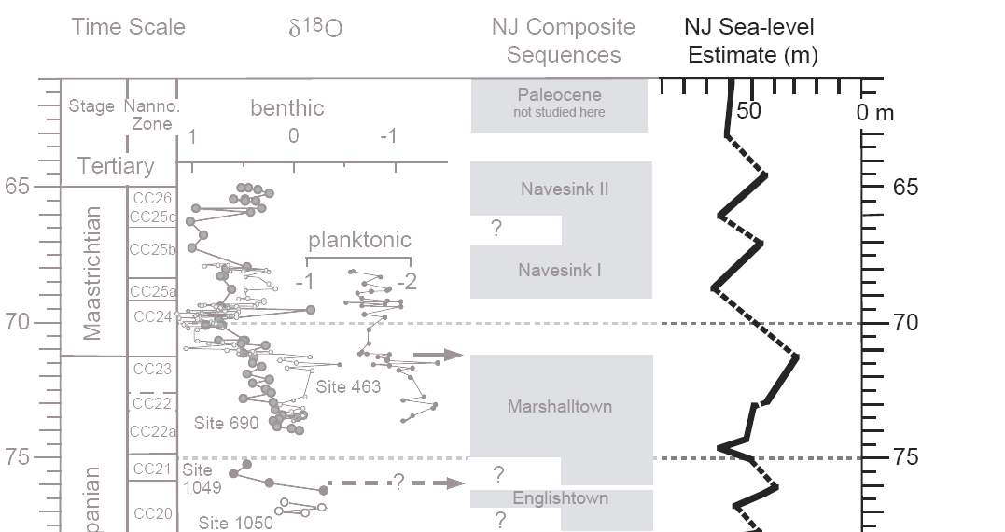
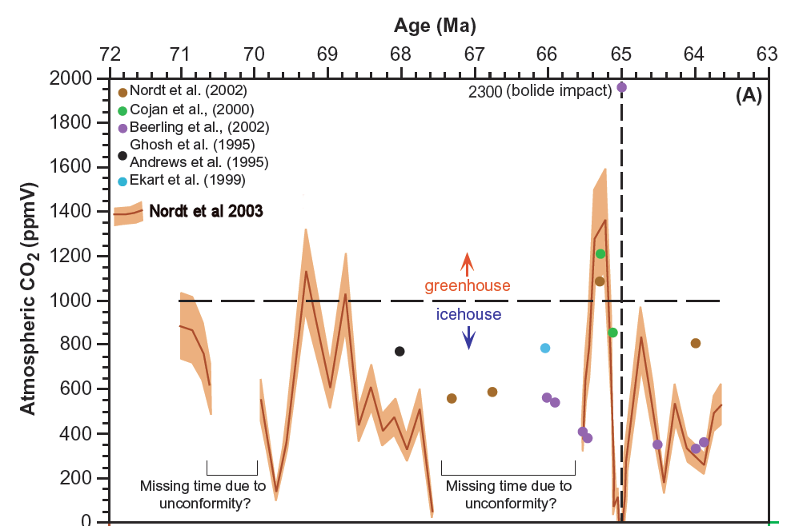
Evidence for large, rapid sea-level changes (Miller et al., 2005)
Evidence for eustatic nature
Pace and magnitude suggest glacial origin.
Suggest moderate-sized ice sheets (5 - 10 × 10⁶ km³ ).
Paced by Milankovitch forcing.
CO₂ levels through the Maastrichtian
2 greenhouse episodes 1000-1400 ppm
But suggestions of CO₂ low-points at ~70 and 66 Ma.
(Nordt et al., 2003; Beerling et al., 2002).

Slide 27
How to create a Maastrictian model
Change solar output ~0.6% less than present
CO₂ (and other gases) 4 x pre-industrial (but could be 2x to 8x.
Volcanic activity Assume same as today.
Change in orbit Same as present, but perform sensitivity simulations
Palaeogeography Including sea-level/ orography/ bathymetry/land ice
Previous modelling also required prescription of vegetation, and sea surface temperatures (or ocean heat transport) but this is no longer needed.

Slide 28
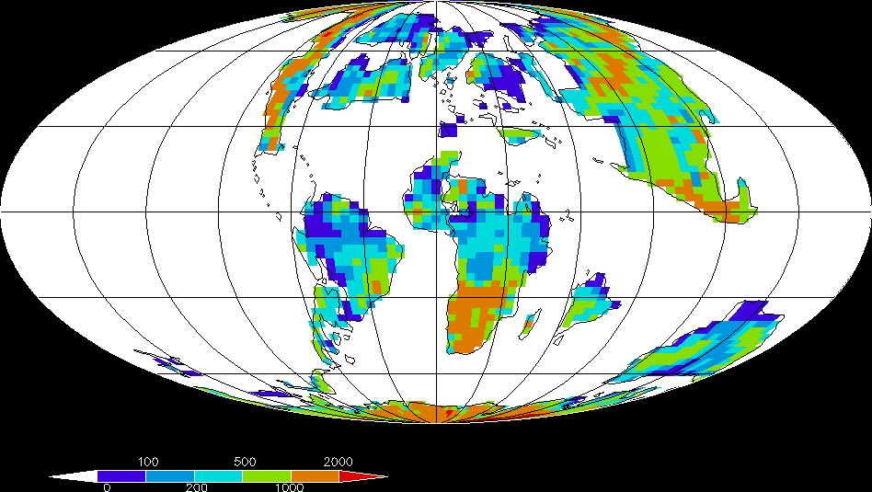
Maastrictian Orography
At climate model resolution. Original palaeogeographies from Paul Markwick

Slide 29
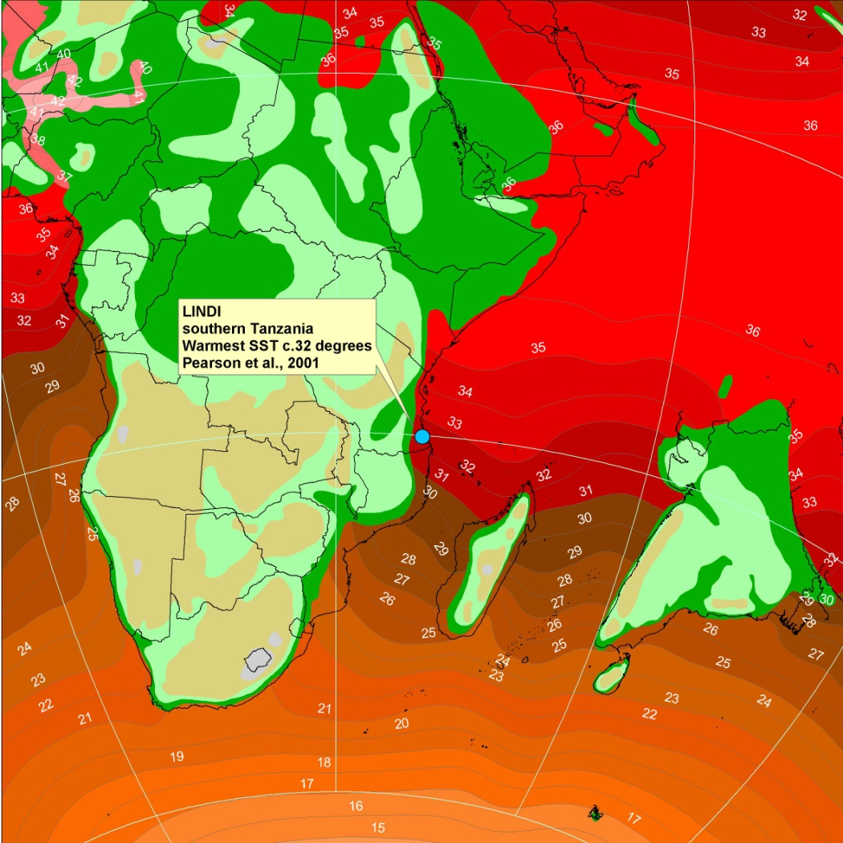
Coupled Ocean-Atmosphere Simulation:
Comparison to Oxygen Isotopes
Model predicted temperatures approx. 10C at 1000m, 8C at 2000m, and 7C at 3000m
c.f. temperatures from 14C to 7C from D’Hondt & Arthur (2002)
Paul Pearson's Maastrictian data

Slide 30
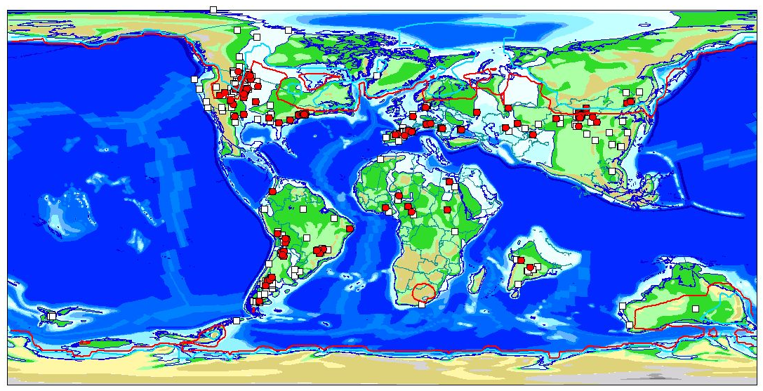
Coupled Ocean-Atmosphere Simulation:
Comparison to Vertebrate Data
Red squares= all crocs, Orange= Dinosaurs, White = Other Vertebrates
Model predicted cold month mean shown by 5C contour (red) and 0C (blue)
Paul Markwick's database

Slide 31
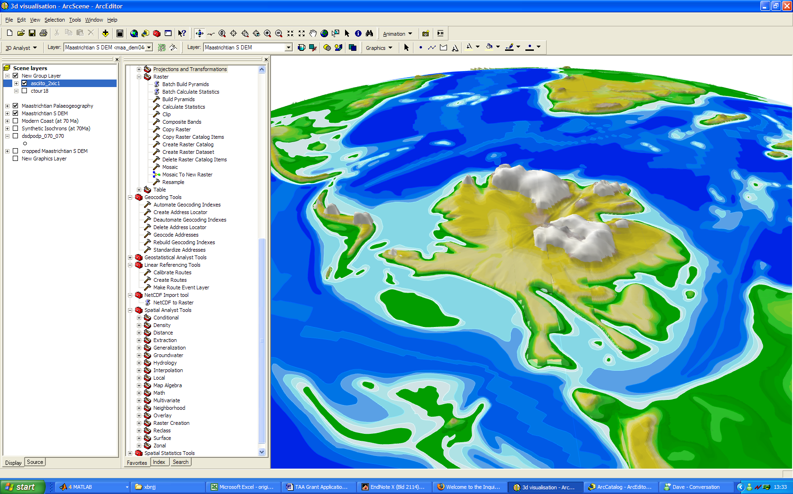
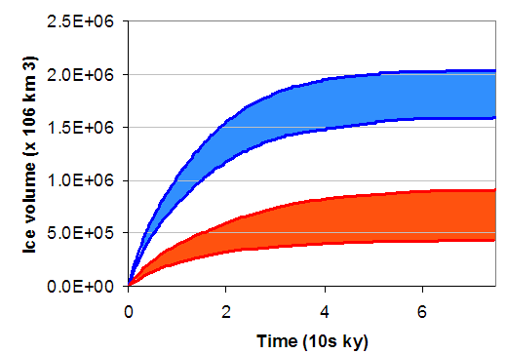
Ice Sheets in a Greenhouse World
Suite of HadCM3 derived palaeoclimates
  2, 4, and 6 x CO₂
  Further runs being carried out including 1 x CO₂
Comparison against climate proxy database
Climate then used to drive a BAS ice-sheet model.
2xCO₂
4xCO₂ + favourable orbit
2xCO₂ - ~ 2 x 10⁶ km³ ice

Slide 32
Should we be concerned by palaeo lessons on climate change?
IPCC AR6 Climate Sensitivity Range: 2.5 to 4°C (likely) globally averaged surface temperature increase for a doubling of carbon dioxide.
Hundreds of GCM experiments have been completed for time periods throughout the geological column using a wide variety of climate models.
Many experiments focused on either glacial climates or warm climates (the extremes).
“There are few legitimate examples of a climate model simulation in which the past climate conditions were overestimated”

Slide 33

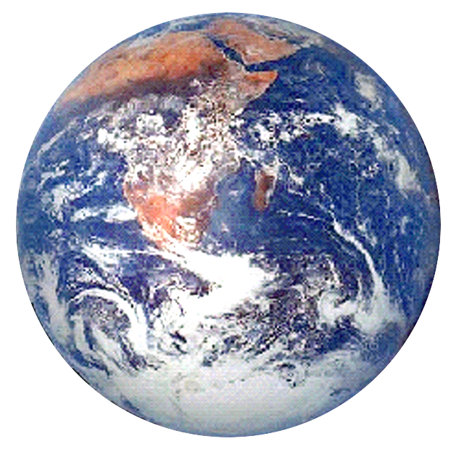
Summary
Why model?
Need for integration
How its done
Permanent El-Niño?
Glaciation in a Greenhouse word?
(Next: how we use evidence from
the past to constrain Climate Sensitivity).

