Slide 1
PETAL
Petabyte Environmental Tape Archive and Library
School of Earth & Environment, University of Leeds
Notes:
PETAL, the Petabyte Environmental Tape Archive and Library. Hosted and managed by the School of Earth & Environment. It can be used for storing any type of research data and is easily accessed via Windows, Linux and Macintosh.

Slide 2
Data Growth
Notes:
The amount of scientific data is growing at an exponential rate. The graph shows the growth rate of some other scientific organisations. E.g. National Radio Astronomy Observatory, Large Hadron Collider, European Bioinformatics Institute. As more complex mathematical and scientific models are developed, their data requirements will increase. Not just in the amount of input data that they need to accurately simulate real world processes but also in the amount of output data generated that needs to be analysed. It is estimated from the computational, observational and modelling activities within SEE based on actual usage figures, the amount of data produced within 5 years could be as much as 4PB.
Following are some examples of the types of research that are currently being performed.
Year 1 = 614TB
Year 2 = 1.3PB
Year 3 = 2.0PB
Year 4 = 2.7PB
Year 5 = 3.4PB

Slide 3
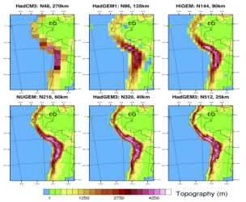
High Resolution Models
Notes:
There are quite a few different models that are currently used, that simulate many different aspects of our environment. E.g. Climate, oceans, crops.
PUSH THE PLAY BUTTON NOW
“The video shows how the model captures the large scale weather patterns of the planet.”
This can only be achieved by running the model at a high grid resolution.
The next generation of scientific models will run at even higher resolutions, producing larger volumes of data and more detailed results and analyses.
PUSH THE STOP BUTTON NOW

Slide 4
High Resolution Imagery
Notes:
Much of what we study comes from looking at the changes in our past and to see its impact on our future.
PUSH THE PLAY BUTTON NOW
“Watch the world change over the course of nearly three decades of satellite photography.”
The resolution and detail of images produced by devices such as cameras, microscopes and satellites has also significantly increased providing an even more detailed insight into our world, identifying never before seen features. E.g. Movement of glaciers, pollution, lost civilisations.
PUSH THE STOP BUTTON NOW
The question is, how are we going to store all of this data?

Slide 5
Storage Impact
There are many factors that influence the choice of storage solution:
Expected lifetime of hardware/media
Power consumption, heating/cooling
Storage capacity
Error bit rate
Footprint
Notes:
There are many factors affecting the cost, reliability and efficiency of a storage solution. Which media should be use: disk, tape, optical storage.
Tape has a much longer lifespan, nearly 30 years compared to only 3 years for disk, especially when we are required to store results for at least 10 years.
In terms of energy usage, tapes only use electricity when inside a tape drive and uses nothing when sitting on the shelf, compared to an always spinning disk drive in an air-conditioned machine room.
Tape has an error bit rate nearly 1000 times better than disk, meaning less data corruption due to the age of the media.
Tapes can be stored outside of the library to be loaded on demand, providing virtual infinite storage capacity by re-using the slots within the library, without the need to buy more hardware when more storage is required.
The tape library that we eventually purchased has a well established upgrade path that uses modular components, meaning only a small fraction of the components need to be replaced during an upgrade, retaining the bulk of the hardware, reducing upgrade costs significantly.
Tapes can survive in normal office conditions (temperature, humidity) when not being used and require very little physical storage space.

Slide 6
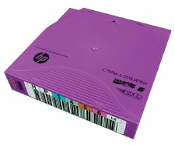
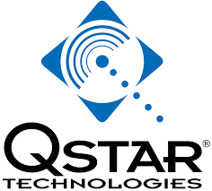
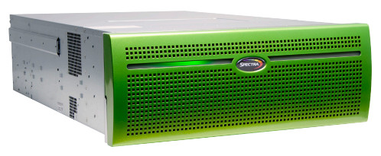
PETAL – Active Archive
Notes:
So, the solution that we eventually purchased consists of:
SpectraLogic T-950 Tape Library
SpectraLogic NTier Verde Disk
QStar Archive Manager Software
LTO-6 Tape Drives and Tapes
The service was designed for ease of use and access, to accommodate the many different types of data that it would store and how the many different users would interact with the data. E.g. How often the data is accesses? Whether it is read-only? Whether it is permanently archived? How many users access the data?
SpectraLogic is the world leader in Robotic Tape Libraries and is used by many other large research organisations around the world. E.g. NASA, NCSA, EPCC, NCI.
The QStar Archive Manager software implements an Active Archive (Hierarchical Storage Management), allowing the seamless integration between different media such as disk and tape, providing practically infinite online storage capacity.
The LTO tape format has a well defined industry based roadmap ensuring guaranteed access to the data for future generations.

Slide 7
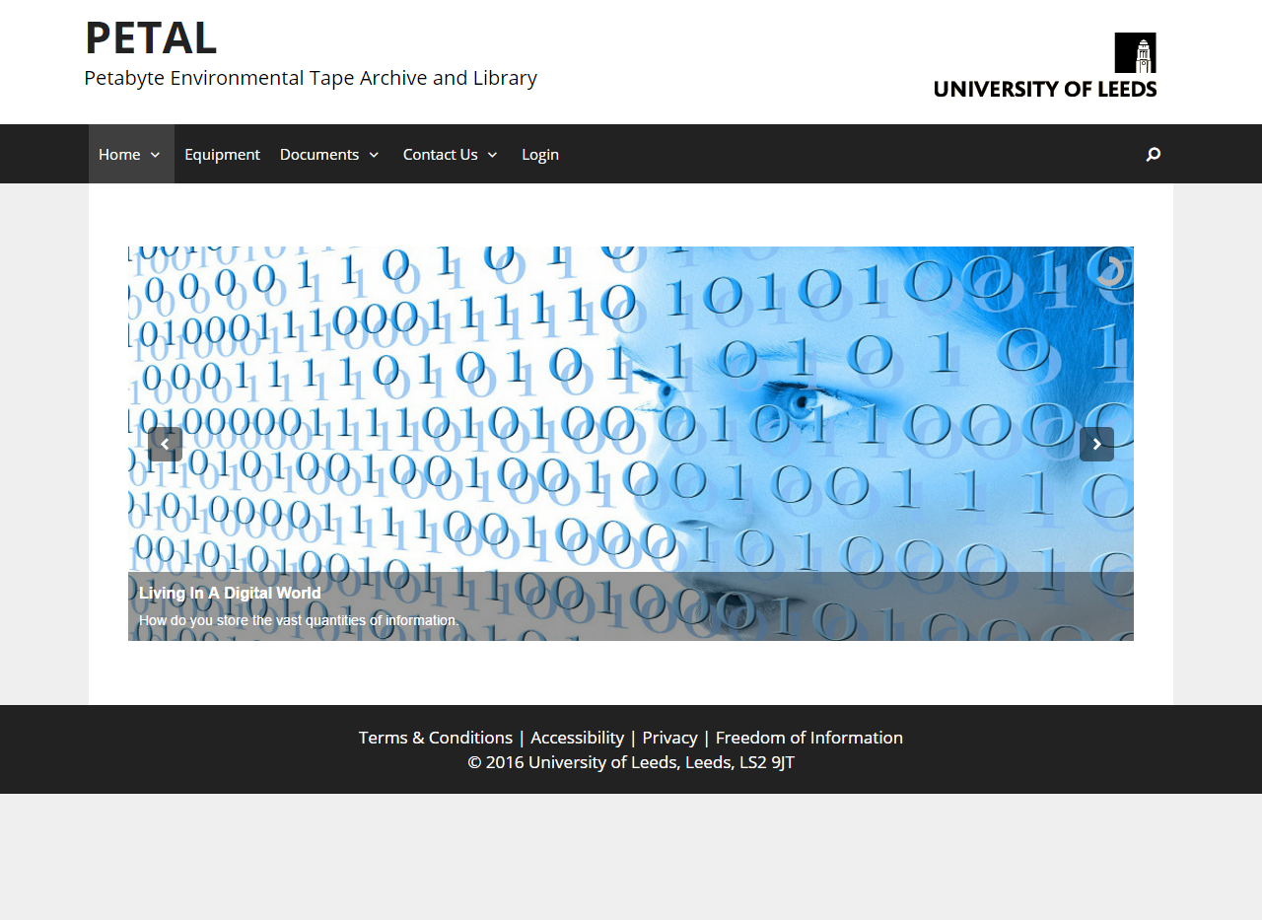
http://www.petal.leeds.ac.uk
Notes:
PETAL has a website at http://www.petal.leeds.ac.uk. You can use the website to interact with the service. E.g. Contacting support, checking the status of the service, monitoring your usage. Information about the service can be found on the website as well as instructions on how to apply for access and examples of how to use the service.

