Slide 1
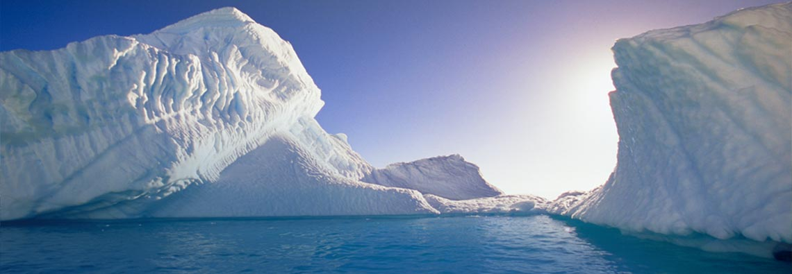
Palaeo-Atmospheric Composition
Prof Alan M. Haywood
Notes:
On Monday you will have heard from Piers Forster about the history of climate change and how an increase in carbon dioxide over the last 50 or so years (since 1960) has coincided with a general increase in global mean temperatures. Today, we will travel further back in time and look at the interaction of CO2 and climate from the palaeo record. Introduce myself – palaeoclimate modeller – climate and ice sheet modelling

Slide 2
http://pubs.usgs.gov/of/2007/1047/kp/kp03/of2007-1047kp03.pdf
Notes:
Painting of Antarctica during the cretaceous based on a scientists reconstruction of flora and fauna – Jane Francis who is now the director of BAS.
Reconstruction of the forest environment on Alexander Island during the Cretaceous, based on the work of Howe (2003) and British Antarctic Survey geologists
Robert Nicholls

Slide 3
Learning Outcomes
palaeo-prefix mainly UK specialized (US usually paleo-) /pæl.i.əʊ-/
From Greek palaios 'ancient'
older or ancient, especially relating to the geological past
To understand why it is important/interesting to study palaeoclimates
To gain an overview of atmospheric composition and climate during the Cenozoic Era
To understand the broad link between atmospheric composition (CO₂), ice sheets and climate

Slide 4

Why palaeoclimate?
Uncertainties highlighted in climate prediction involve aspects of the climate that have changed in the past (e.g. ENSO, sea level).
Palaeoclimatology can assess whether these changes are consistent with current theories of the climate system and if not, why not.
Palaeoclimate provides a unique test-bed for models that project large changes in the future to be evaluated using true out-of-sample tests of comparable magnitude.
Brown University Library
Notes:
Paleoclimatology
Paleoclimatology is the study of climate prior to the widespread availability of records of temperature, precipitation and other instrumental data. NOAA is particularly interested in the last few thousand years because this is the best dated, best sampled part of the past climatic record and can help us establish the range of natural climatic variability in a period prior to global-scale human influence.
Unfortunately, records of past climate change from satellites and human measurements (thermometers, rain gauges) generally cover less than 150 years. These are too short to examine the full range of climatic variability. For this reason, it is critical to examine climate change going back hundreds and thousands of years using paleoclimatic records from trees, corals, sediments, glaciers and other natural or "proxy" sources.
Environmental recorders can also be used to estimate past climatic conditions and thus extend our understanding far beyond the 100+ year instrumental record. "Proxy" records of climate have been preserved in tree rings, locked in the skeletons of tropical coral reefs, extracted as ice cores from glaciers and ice caps, and buried in laminated sediments from lakes and the ocean.
Why Should We Care About Climate Change?
There are several reasons why scientists study paleoclimate. For example, understanding how climate has changed on interannual to interdecadal time scales in the past can help us understand how climate may change in the future. The paleoclimate record also illustrates that the earth's climate has been subject to abrupt change. For example, changes in the frequency of extreme events such as droughts, floods and storms has a large impact on humans. Since a severe El Niño, or a drought lasting on order of a year can cost US citizens billions of dollars. Since the paleoclimate record shows that the Earth's climate system is capable of shifting dramatically to a different climate state, changes in the frequency and intensity of extreme events may be a symptom of this process. Understanding these "climate surprises" of the past is critical if we are to avoid the consequences of abrupt climatic change. It is important that scientists study abrupt climate change, as well as changes in the frequency and intensity of the past climate to enable society to prepare for potential future climate change.
The study of past climate change also helps us understand how humans influence the Earth's climate system. The climatic record over the last thousand years clearly shows that global temperatures increased significantly in the 20th Century, and that this warming was likely to have been unprecedented in the last 1200 years. The paleoclimatic record allows us to examine the causes of past climate change, and to help unravel how much of the 20th century warming may be explained by natural causes and how much may be explained by human influences.

Slide 5
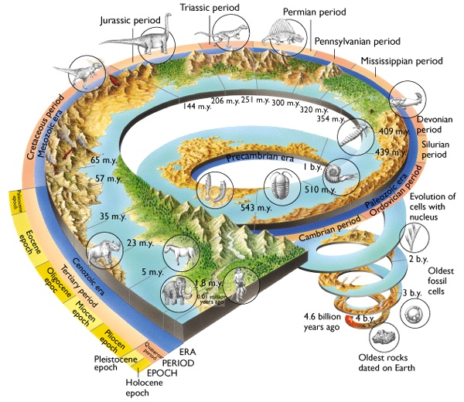
Earth History
Extinction of the dinosaurs
Onset of the Antarctic Ice Sheet
Warm Period analogous to Future?
Notes:
So what are we going to cover in today’s lecture. Here is a graphic version of Earth History….I believe in your first lecture with Anja you will have covered the formation of the Earth’s atmosphere – which is happened somewhere over here…between 4.5 and 2 billion years ago. We are going to miss out a massive part of Earth’s history and jump straight to the Cenozoic – which began with a mass extinction that saw the loss of three quarters of the plant and animal species on the planet wiped out – including the extinction of the dinosaurs.

Slide 6
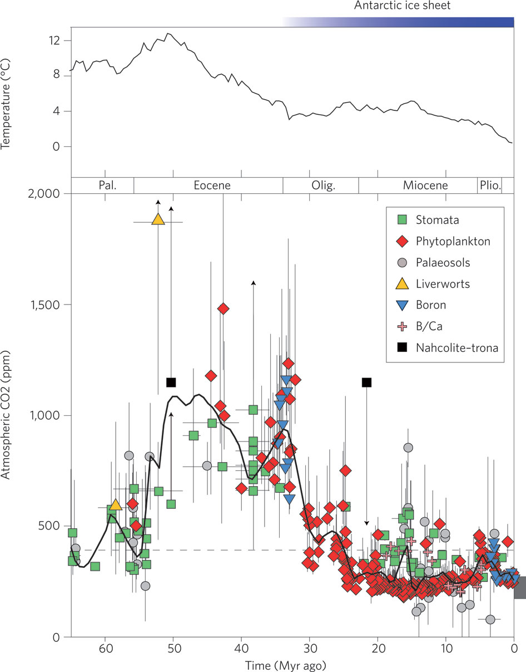
Cenozoic Climate
Deep sea temperatures track estimates of atmospheric CO₂
Carbon Dioxide (CO₂) was higher during the ‘Greenhouse’ periods of the past
Reduced over time due to silicate weathering
CO₂ is the most frequently estimated atmospheric gas from proxy records
c. 390
Vertical grey bar indicated glacial-interglacial CO₂ ranges from ice cores
Time
(Beerling and Royer, 2011)
Notes:
Deep-sea temperatures³ (upper panel) generally track the estimates of atmospheric CO₂ (lower panel) reconstructed from terrestrial and marine proxies following recent revisions (see Supplementary Information). Errors represent reported uncertainties. Symbols with arrows indicate either upper or lower limits. The vertical grey bar on the right axis indicates glacial–interglacial CO₂ range from ice cores. The top blue bar indicates approximate timing of ice-sheet development on Antarctica. Horizontal dashed line indicates the present-day atmospheric CO₂ concentration (390 ppm).
During the Greenhouse worlds of the Palaeocene and Eocene, CO2 was around 2000 ppmv (5 times greater than present day).
Gradual decline of CO2 is linked to silicate weathering - upthrusting mountain ranges expose minerals to weathering resulting in their chemical conversion to carbonates thereby removing CO₂ from the atmosphere and cooling the earth.
Co2 emission and consumption are kept in rough balance by a negative feedback resulting from the temperature dependence of silicate weathering. The feedback operates on a million year time scale.
The uncertainty surrounding the absolute level of atmospheric CO2 increases the further you go back in time.
Boundary between Eocene and Oligocene marks the first extensive glaciation of the Antarctic
The Miocene and Pliocene were on average warmer than today between 2 and 4 degrees

Slide 7
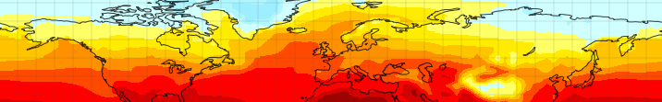
How can we measure palaeo-atmospheric composition?
Example of CO₂

Slide 8
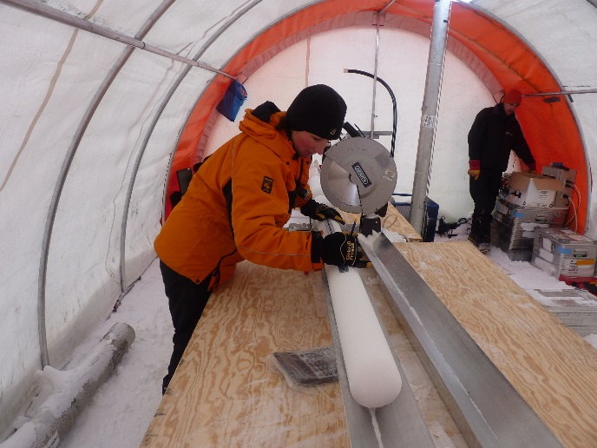
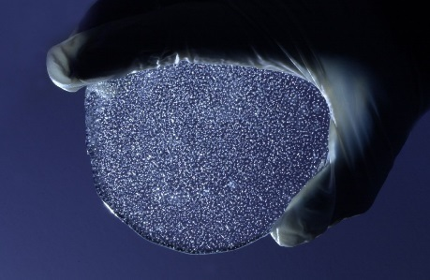
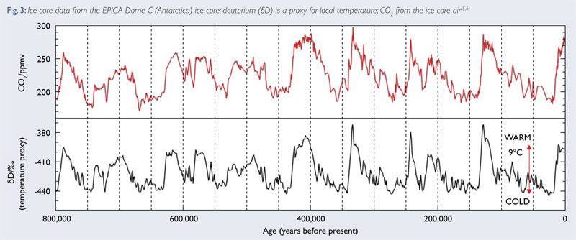
Measuring Palaeo CO₂
Ice core drilling – high resolution records of CO₂ and also Methane (CH₄)
Clearly defined glacial-interglacial cycles of the Pleistocene
Oldest record based on age of oldest ice <1 million years
Ice core data from EPICA Dome C (Antarctica) ice core: deuterium (dD) is a proxy for local temperature; CO₂ measured from the ice core air
(Jouzel et al., 2007; Lüthi et al, 2008)

Slide 9
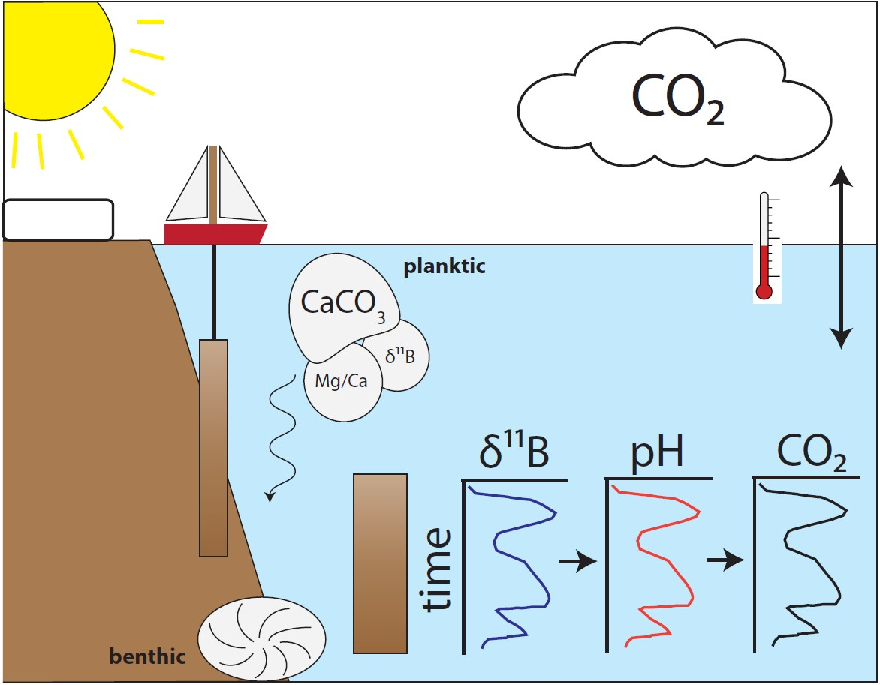
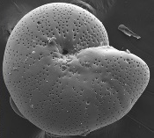
Proxies for CO₂
Number of novel techniques for estimating CO₂ levels during Earth History (based on Boron, Leaf Stomata, Phytoplankton, Palaeosols)
Boron has two stable isotopes ¹¹B and ¹⁰B (isotopic composition expressed as δ¹¹B relative to a standard)
Formation of boron in seawater is pH-dependent
CO₂ of ocean can then be calculated from pH
Image: James Rae
(Rae et al., 2014)
Notes:
A figure that can be used to represent the value of something else….
http://blogs.egu.eu/geolog/2015/09/25/geotalk-talking-about-ocean-burps-with-james-rae/
Boron has two stable isotopes, ¹¹B and ¹⁰B (approximately 80% and 20% of total B respectively), with isotopic composition expressed in delta notation as δ¹¹B relative to NIST-SRM 951 boric acid (Catanzaro et al., 1970)

Slide 10
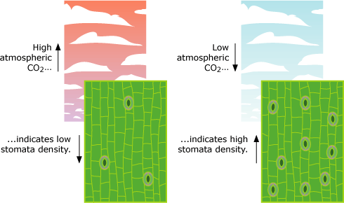
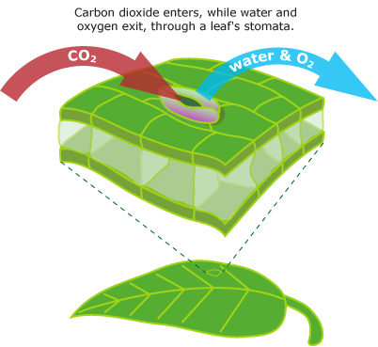
Proxies for CO₂ – Stomatal Density
Stomata are specialized epidermal cells on the leaves of plants
They allow CO₂ to enter the leaf from the air. In doing so water diffuses out of the leaf (evapotranspiration)
Balance must be struck between CO₂ gain and H₂O loss
High CO₂ concentrations in air cause plant to produce fewer stomata to conserve water (and vice versa) – this provides a basis for a CO₂ proxy based on leaf stomatal density
Images: University of California Museum of Paleontology's Understanding Evolution (http://evolution.berkeley.edu)
Notes:
A figure that can be used to represent the value of something else….
http://blogs.egu.eu/geolog/2015/09/25/geotalk-talking-about-ocean-burps-with-james-rae/
Difficult proxy as each species of plant requires a different calibration for the relationship between stomatal density and CO2 – need to find fossilised leaves!

Slide 11
Understanding the links between climate and CO₂ (and Ice!)
Eocene-Oligocene Transition (Glaciation of Antarctica)
Late Pliocene Warm Period (Analogue for Future?)
Notes:
Over the cenozoic there has been a long term trend in CO2 – reduction – due to silicate weathering - punctuated by periods of rapid change, or high levels of CO2.

Slide 12
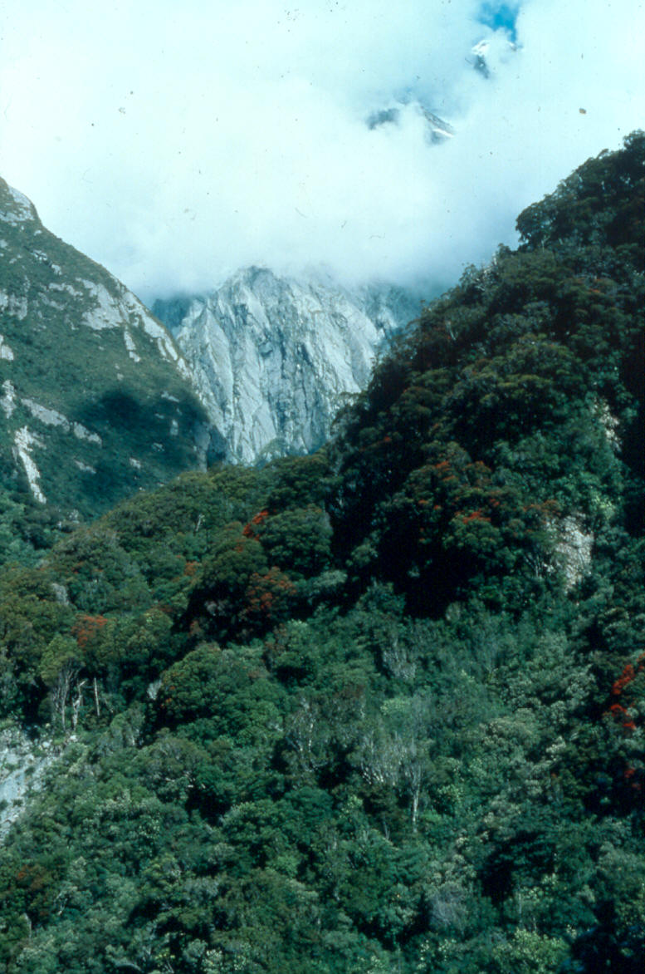
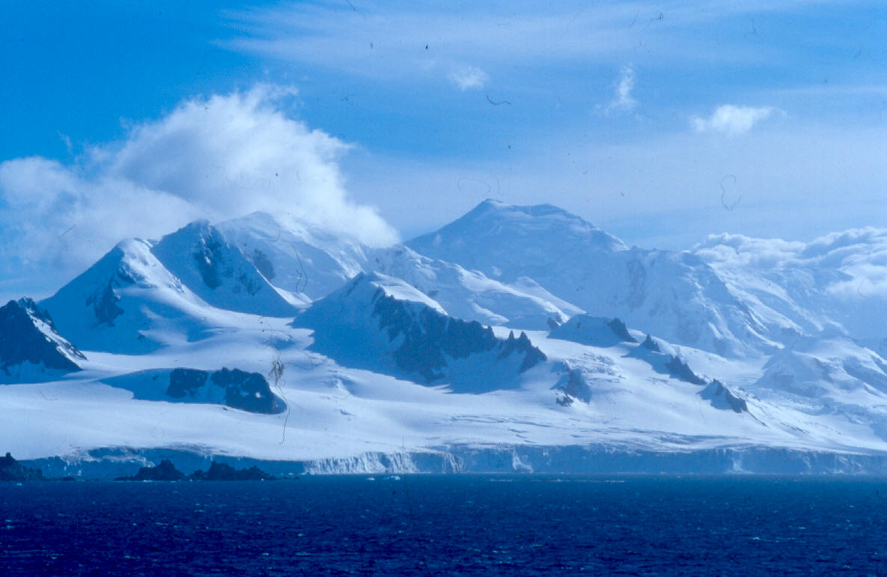
Palaeocene
Present
Glaciation of Antarctica – E-O Transition

Slide 13
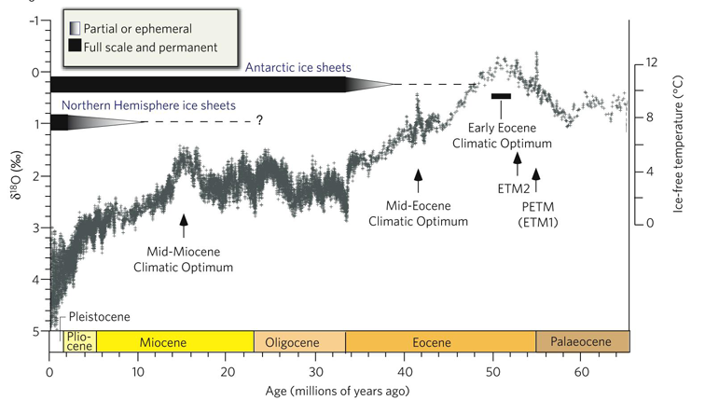
Eocene-Oligocene Transition
“Greenhouse”
Eocene-Oligocene
Transition (34Ma)
“Icehouse”
Time
Benthic oxygen isotopes are combined measure of bottom water temperatures and global ice volume
(Zachos et al., 2008)
Notes:
This is a benthic oxygen isotope curve for the last 65 million years – you can see the general trend of cooling out of the Greenhouse climate of the Palaeocene and Eocene into the cooler world of the Pliocene and Pleistocene where there was ice on both poles.
Around 34 million years ago there was a large drop in temperature (Eocene-Oligocene Transition)
This was associated with an abrupt growth of the Antarctic ice sheet

Slide 14
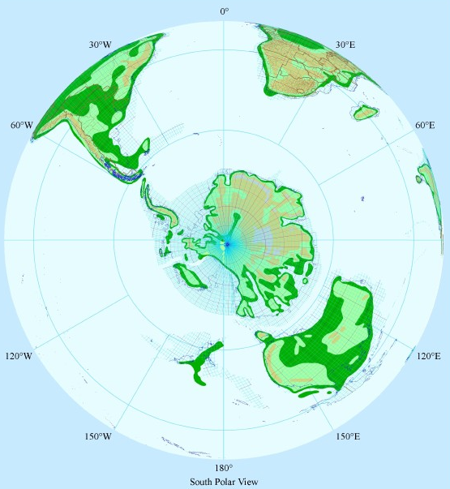
Eocene-Oligocene Climate
What caused the glaciation of Antarctica at the Eocene-Oligocene boundary?
Two main hypotheses: (1) Thermal isolation of Antarctica due to Southern Gateway opening, (2) Declining levels of atmospheric CO₂
Early Eocene

Slide 15
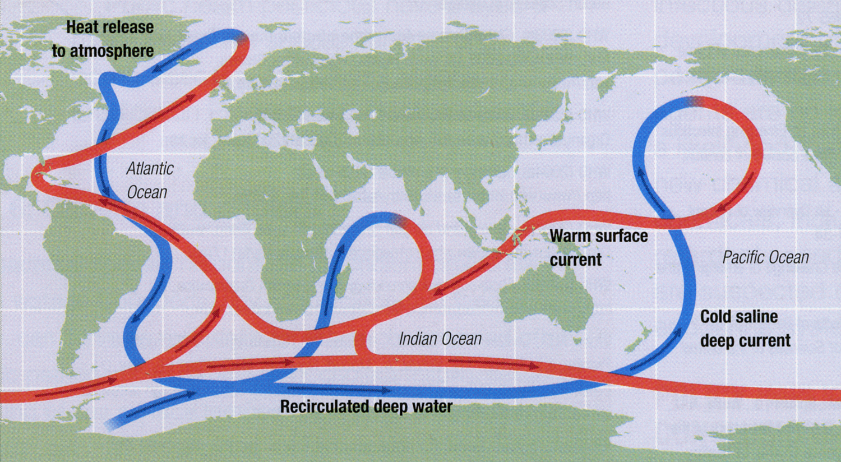
Cenozoic Gateways
Arctic
35-5 Ma
Indonesia
5 Ma ?
Panama
~ 5-4 Ma
Tasman
~ 35 Ma
Drake
~ 40 Ma

Slide 16
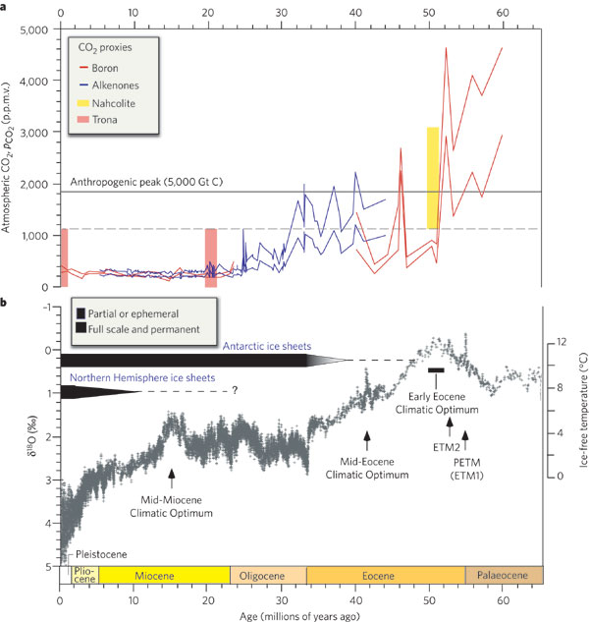
What caused the ice sheet growth?
What caused the glaciation of Antarctica at the Eocene-Oligocene boundary?
Two main hypotheses: (1) Thermal isolation of Antarctica due to Southern Gateway opening, (2) Declining levels of atmospheric CO₂
(Zachos et al., 2008)
Time

Slide 17
Testing the Hypotheses
Climate and Ice Sheet Modelling Study
(DeConto and Pollard, 2003)

Slide 18
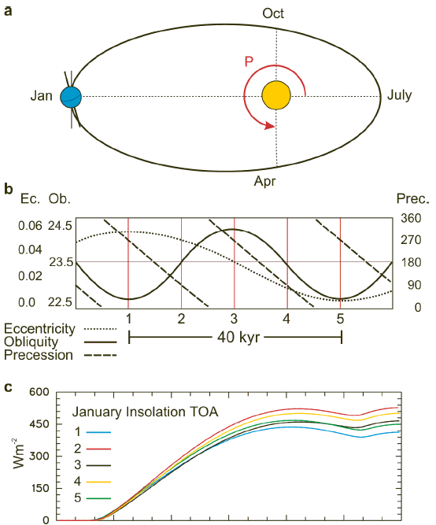
Modelling Antarctic glaciation
Orbital forcing
Climate model forcings
Present Day – Modern ANT
~34 Ma with No ANT (280 ppmv CO₂ = 1 x PAL CO₂)
~34 Ma with No ANT (3 x PAL CO₂)
(DeConto and Pollard, 2003)

Slide 19
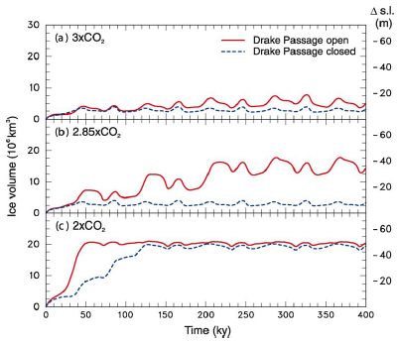
Thresholds for Antarctic Glaciation
Simulations show that the threshold for height-mass balance feedbacks to trigger large ice sheet growth in a model lies between 2 x and 3 x pre-industrial levels of atmospheric CO₂ (PAL= 280 ppmv)
Robustness of this result tested compared to the other potential forcing (opening of the Drake Passage)
Overall the parameterised opening of the Drake passage has little effect on the ice sheet size at 2 x or 3 x PAL CO₂
(DeConto and Pollard, 2003)

Slide 20
Results
(DeConto and Pollard, 2003)

Slide 21
CO₂ Decline over E-OT
Sediment core from Tanzania – used boron isotope analysis of carbonate shells of upper-ocean planktonic foraminifera to establish palaeo-surface ocean pH and infer dissolved CO₂ concentration.
Oxygen isotopes from Tanzanian core display a positive shift suggesting a drop in temperature and increase in ice volume over the E-O transition
Time
(Pearson et al, 2009)
Notes:
Geological and geochemical evidence1–3 indicates that the
Antarctic ice sheet formed during the Eocene–Oligocene transition4,
33.5–34.0 million years ago. Modelling studies5,6 suggest that
such ice-sheet formation might have been triggered when atmospheric
carbon dioxide levels (pCO2
atm) fell below a critical threshold
of 750 p.p.m.v., but the timing and magnitude of pCO2
atm
relative to the evolution of the ice sheet has remained unclear.
Here we use the boron isotope pH proxy7,8 on exceptionally
well-preserved carbonate microfossils from a recently discovered
geological section in Tanzania9,10 to estimate pCO2
atm before,
during and after the climate transition. Our data suggest that a
reduction in pCO2
atm occurred before the main phase of ice growth,
followed by a sharp recovery to pre-transition values and then a
more gradual decline. During maximum ice-sheet growth, pCO2
atm
was between 450 and 1,500 p.p.m.v., with a central estimate of
760 p.p.m.v. The ice cap survived the period of pCO2
atm recovery,
although possibly with some reduction in its volume, implying (as
models predict11) a nonlinear response to climate forcing during
melting. Overall, our results confirm the central role of declining
pCO2
atm in the development of the Antarctic ice sheet (in broad
agreement with carbon cycle modelling12) and help to constrain
mechanisms and feedbacks associated with the Earth’s biggest
climate switch of the past 65 Myr.

Slide 22
CO₂ Decline over E-OT
Boron compared with alkenone-based estimates of CO₂
Time
Reconstructed CO₂ compared with the deep-sea benthic oxygen isotope record
Data suggest reduction in CO₂ occurred before the main phase of ice growth – values consistent with modelled threshold

Slide 23
Summary
Data shows that there was a significant CO₂ decline at the Eocene-Oligocene Transition (~34 million years ago)
Temperature data from around the globe also shows a coeval cooling
Modelling studies and data point towards a significant increase in the volume of ice on Antarctica over the Eocene-Oligocene Transition, driven by decreasing CO₂ levels
Large oceanographic changes such as the opening of the Drake passage are not as important for ice sheet initiation as declining CO₂.
Notes:
A figure that can be used to represent the value of something else….
http://blogs.egu.eu/geolog/2015/09/25/geotalk-talking-about-ocean-burps-with-james-rae/
Difficult proxy as each species of plant requires a different calibration for the relationship between stomatal density and CO2 – need to find fossilised leaves!

Slide 24
Analogues for the Future?
Late Pliocene Warm Period
“The mid-Pliocene is the most recent time in Earth’s history when mean global temperatures were substantially warmer for a sustained period, providing an accessible example of a world that is similar in many respects to what models estimate could be the Earth of the late 21st Century”
IPCC AR4
Jansen et al (2007)

Slide 25
Late Pliocene
“Greenhouse”
“Icehouse”
Late Pliocene Warm Period (~3 Ma)
Time
Benthic oxygen isotopes are combined measure of bottom water temperatures and global ice volume
(Zachos et al., 2008)
Notes:
mPWP time slab as defined by the PRISM Group (3.264 to 3.025 Ma)
Chosen for study because proxy evidence (e.g. marine microfossils) established this period as a time of warmer than modern climate
Well-bounded by large isotope excursions
It was chosen for study because core studies of marine microfossils had establisher this period as a time of warmer than modern climate. Several high latitude vegetation studies also suggested substantial warmth relative to today.
And the continents were in pretty much the same position as present – which is always a good start!
MPWP is a useful period for palaeoclimate modelling, because of similar climatic boundary conditions:
Ocean Bathymetry
Patterns of oceanic circulation
Continental configuration
Presence of types of flora and fauna

Slide 26
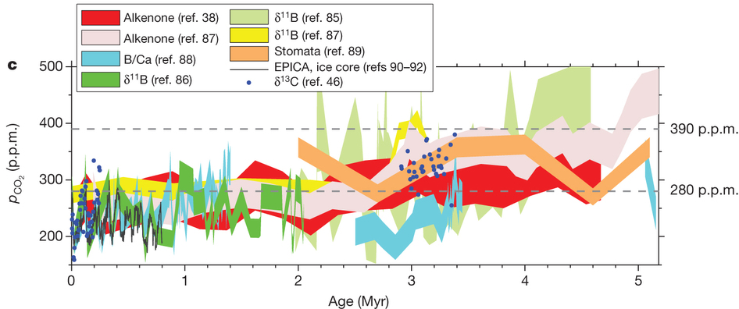
CO₂ during the Pliocene
Today!
(Federov et al, 2013: Nature)
Proxy CO₂ records from marine geochemical studies and ice-core inclusions
Late Pliocene showed CO₂ levels of up to 400 ppmv

Slide 27
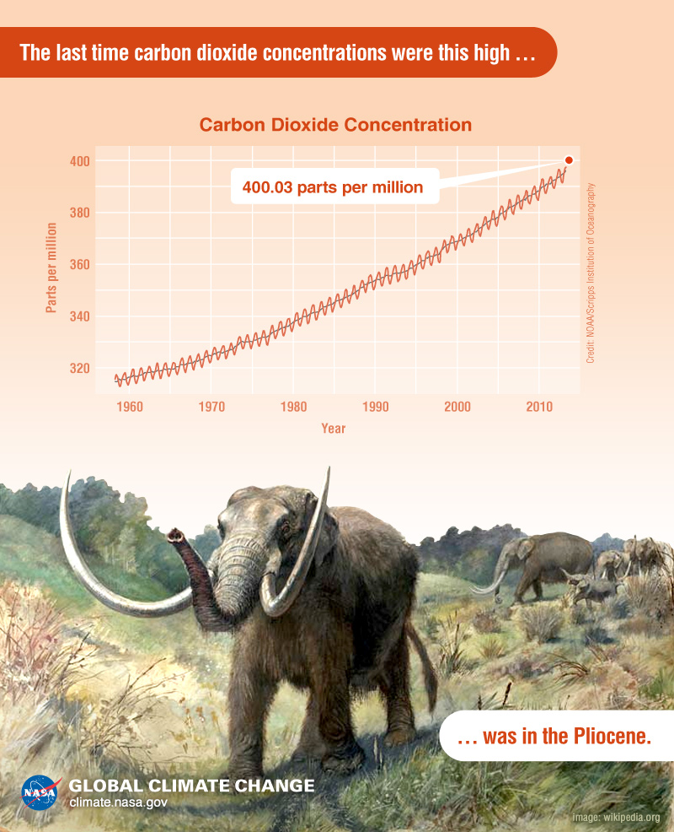
CO₂ during the Pliocene Warm Period

Slide 28
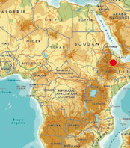
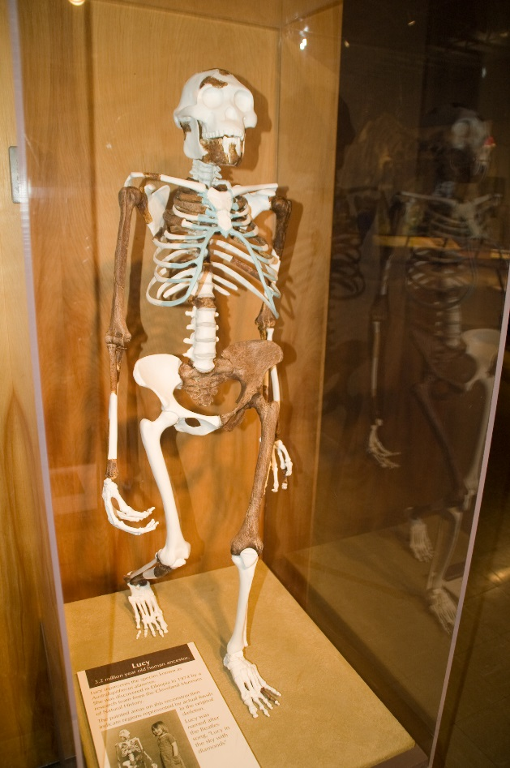
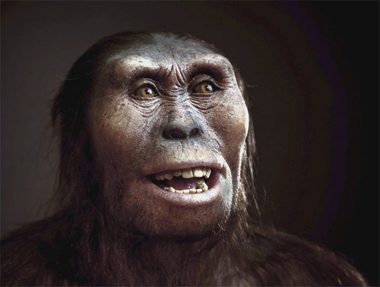
Evidence of bi-pedalism in the Pliocene
Well known fossil “Lucy” discovered in Hadar, Ethopia in 1974
Australopithecus afarensis – Hominid lineage
© 2010 Photo S. Entressangle
Lucy skeleton reconstruction, Cleveland Natural History Museum
Notes:
Also during the Pliocene, several early bipedal ancestors of humans co-existed in the African landscape. Early evidence of human ancestors comes from East African fossil localities in the rift valley sites of Ethiopia, Kenya, and Tanzania. The well-known fossil "Lucy" was discovered in 1974 in Hadar, Ethiopia. This member of the hominid lineage, named Australopithecus afarensis, was found in sediments dating to over 3 million years ago. Meanwhile, at Laetoli, Tanzania, human-like footprints were left by two individuals in a volcanic deposit over 3 million years ago. These discoveries indicate that human bipedalism must be even older, and new evidence suggests it may be as old as 6 to 7 million years.
Named after one of the finders favourite songs by the beatles! Lucy in the sky with diamonds

Slide 29
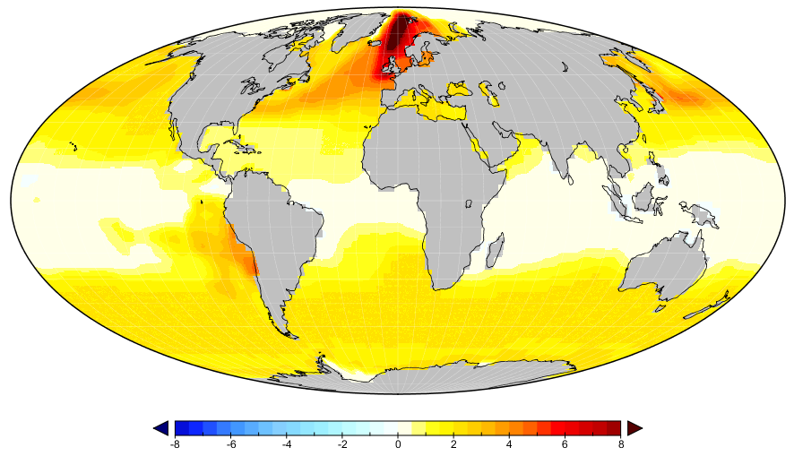

Characteristics of the Late Pliocene
Global mean temperatures 2-3 °C higher than pre-Industrial
CO₂ increase (400 ppmv)
Evidence for seasonally sea ice free areas
Reduced extent of the ice sheets – sea level estimates suggesting 25m higher than today
-8
-6
-4
-2
0
2
4
6
8
Pliocene Sea Surface Temperature Anomaly from Modern (˚C)
Reduced equator to pole surface temperature gradient
Notes:
Sea surface temperature proxies, terrestrial vegetation records estimates suggest that the climate of the mid-Pliocene was warmer than modern.
Peak-averaged global mean temperatures were estimated to have been 2-3 degrees warmer than pre-industrial, and as you can see from this plot which shows the difference between Pliocene and pre-industrial MATs, the largest temperature increase occurs in the high-latitudes.
With higher levels of CO2 and a reduction in the extent of sea ice and the ice sheets, the mid-Pliocene warm period is well suited to investigate the response of the ice sheets to a similar climate scenario as we might expect to reach at the end of this century.
Sea ice evidence only in the Arctic
Peak-averaged MPWP global mean temperatures are estimated to be 2-3˚C warmer than pre-industrial, with the largest temperature increase in the high-latitudes
Eustatic sea level estimates of 25 m higher than modern
High levels of carbon dioxide 400 ppmv
MPWP is a useful period for palaeoclimate modelling, because of similar climatic boundary conditions:
Ocean Bathymetry
Patterns of oceanic circulation
Continental configuration
Presence of types of flora and fauna

Slide 30
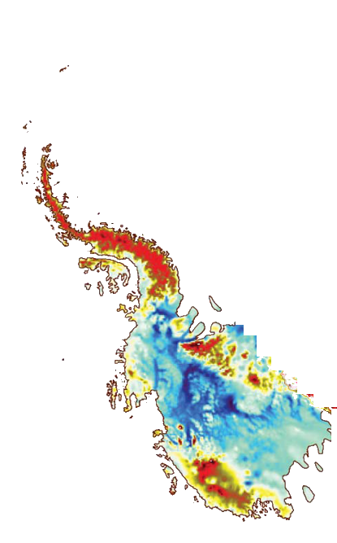
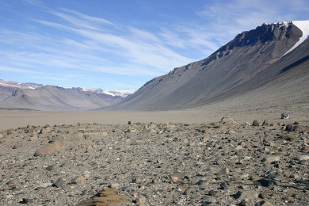
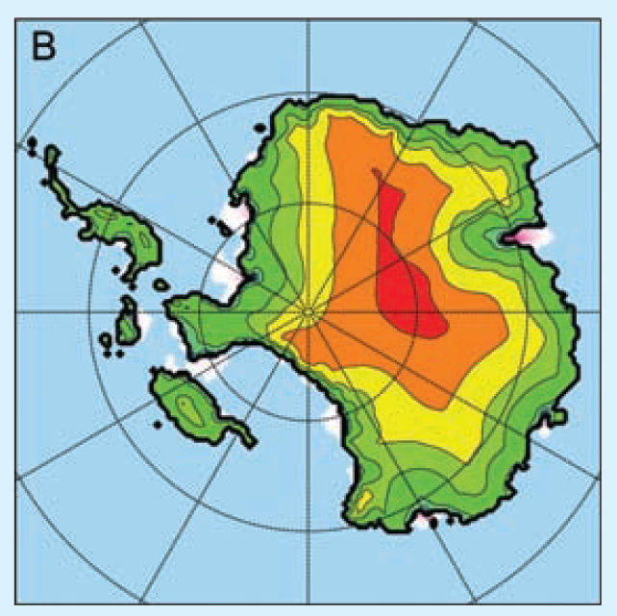
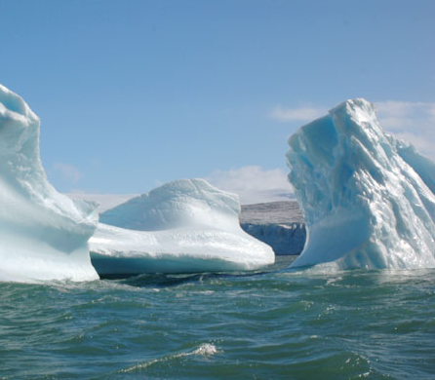
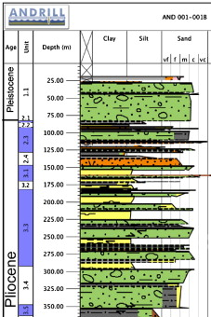
Antarctica during the Late Pliocene
Intervals of West Antarctic Ice Sheet retreat
Landscape stability in Dry Valleys?
Pollard and DeConto (2009)
Prydz Bay (ODP 1165)
Modelled WAIS collapse
ANDRILL 1B
Marine
Wilkes Land (IODP 318)
Subglacial

Slide 31
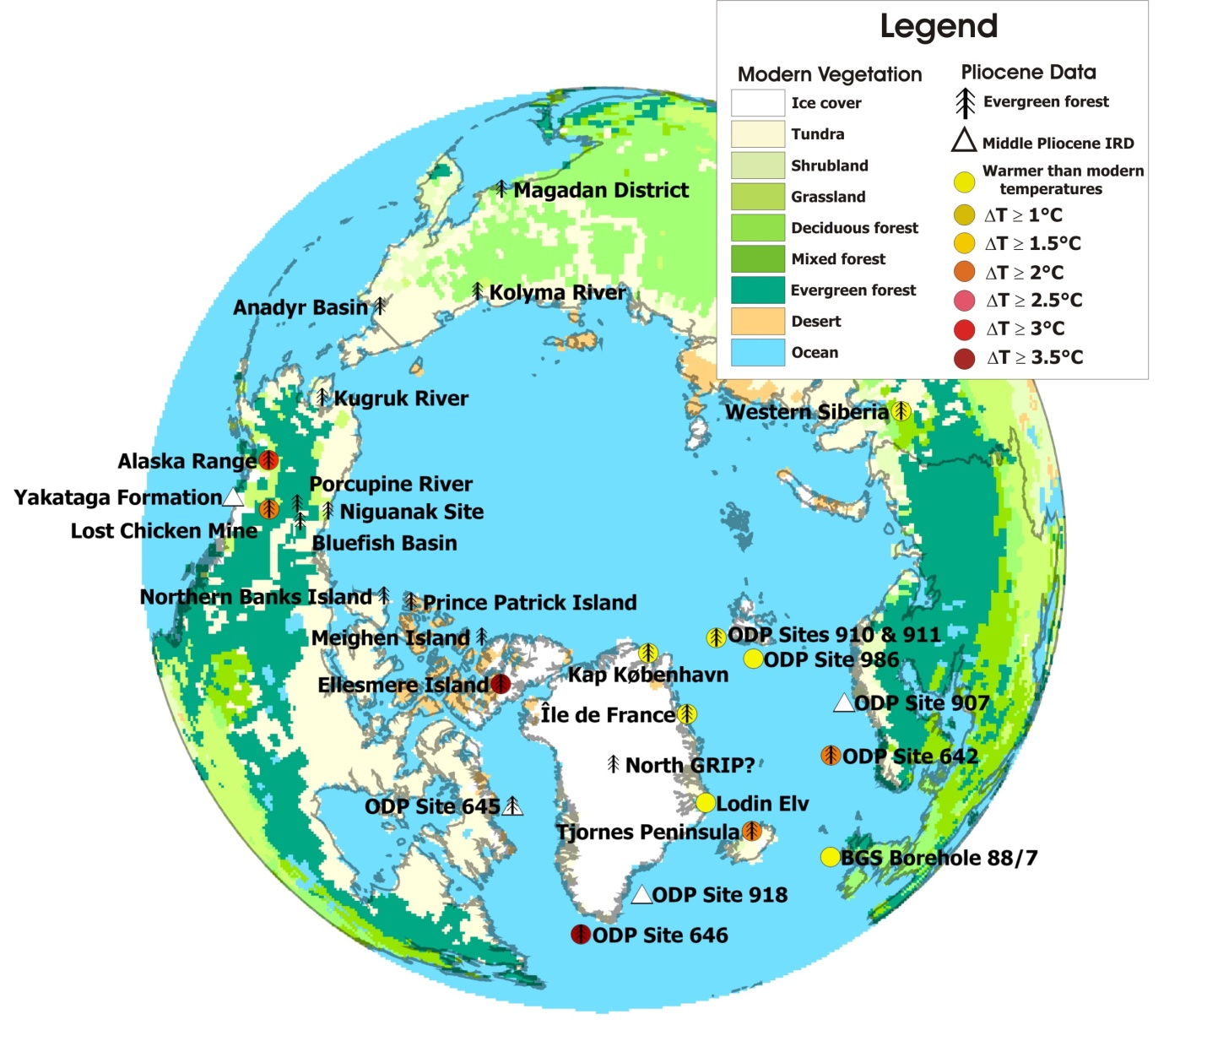
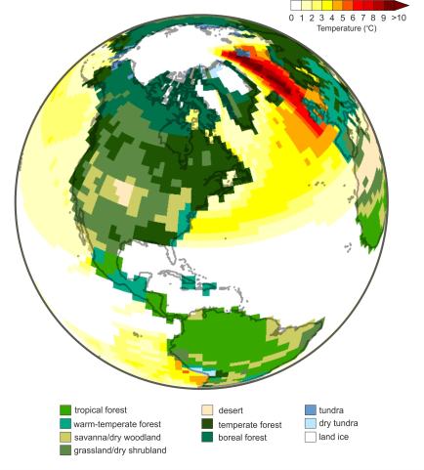
Greenland during the Late Pliocene
(Hill, 2009)

Slide 32

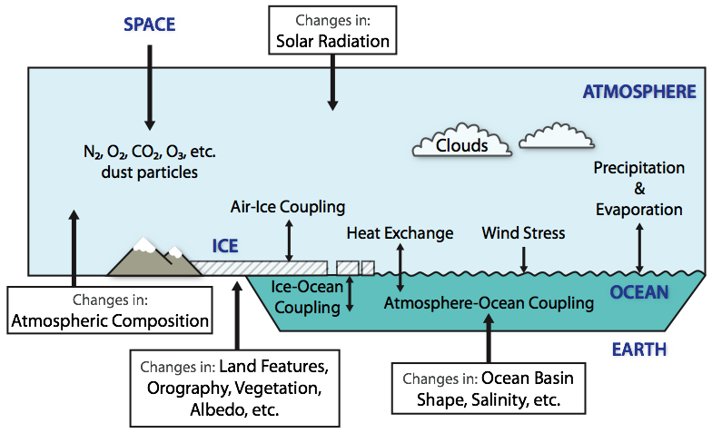
Palaeoclimate modelling at Leeds
Lead a project (PlioMIP) which compares climate model predictions of the Pliocene warm period
How well do models that are used for future projections simulate a warm climate of the past?

Slide 33
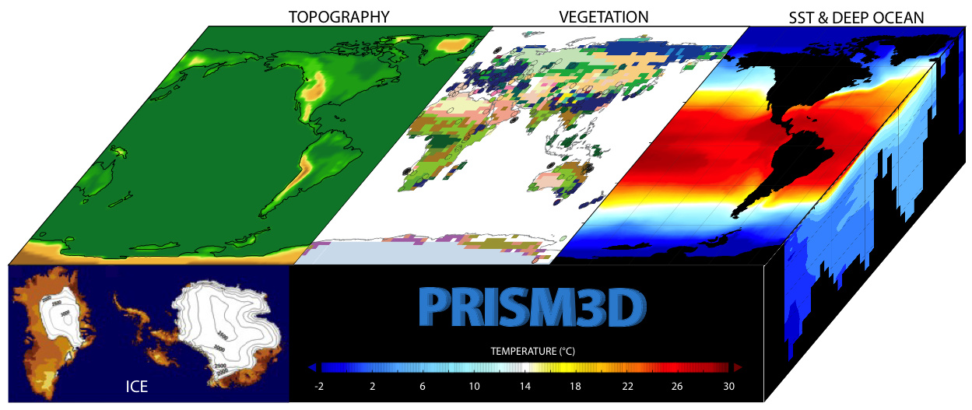
Pliocene Boundary Conditions
[4]
[6]
vegetation,
land cover
[1]
sea surface
temperature
topography
sea ice
[3]
sea level
[2]
deep ocean
temperature,
circulation
[5]
land ice
CO₂ = 400 ppmv
Notes:
Boundary conditions are things that we need to tell the model in order for it to run!

Slide 34
Pliocene Climate Simulations
Mean annual surface air temperature difference from pre-industrial for 8 atmosphere-ocean climate models
Large differences in the degree of polar amplification and the broad response over the ice sheet regions.
(Haywood et al., 2013 – Climate of the Past)

Slide 35
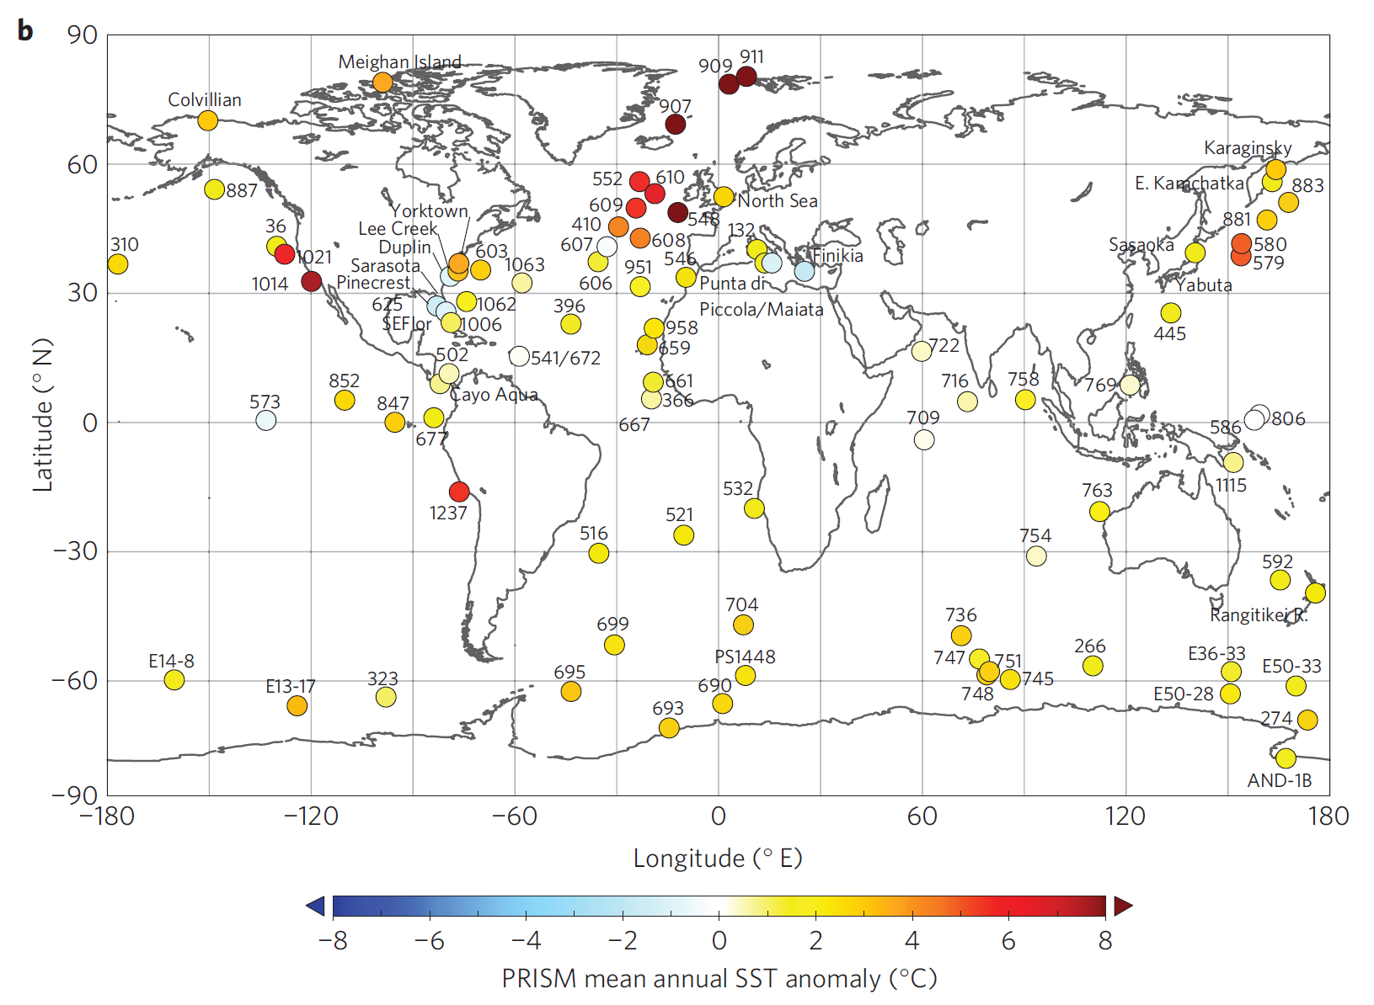
Data to test climate models
(Dowsett et al, 2013)

Slide 36
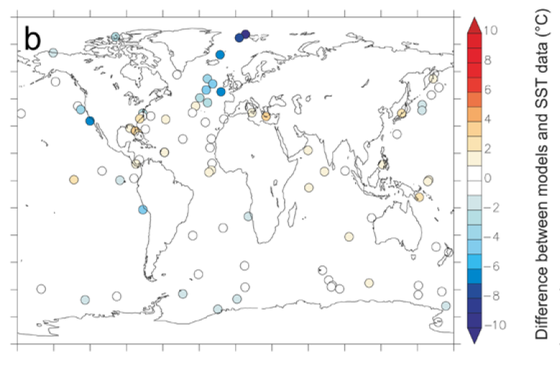
Data-Model Comparison
Point-based Mean Annual SST comparison
Red = model too warm
White = data and model agrees
Blue = model too cold
(Haywood et al., 2013 – Climate of the Past)

Slide 37
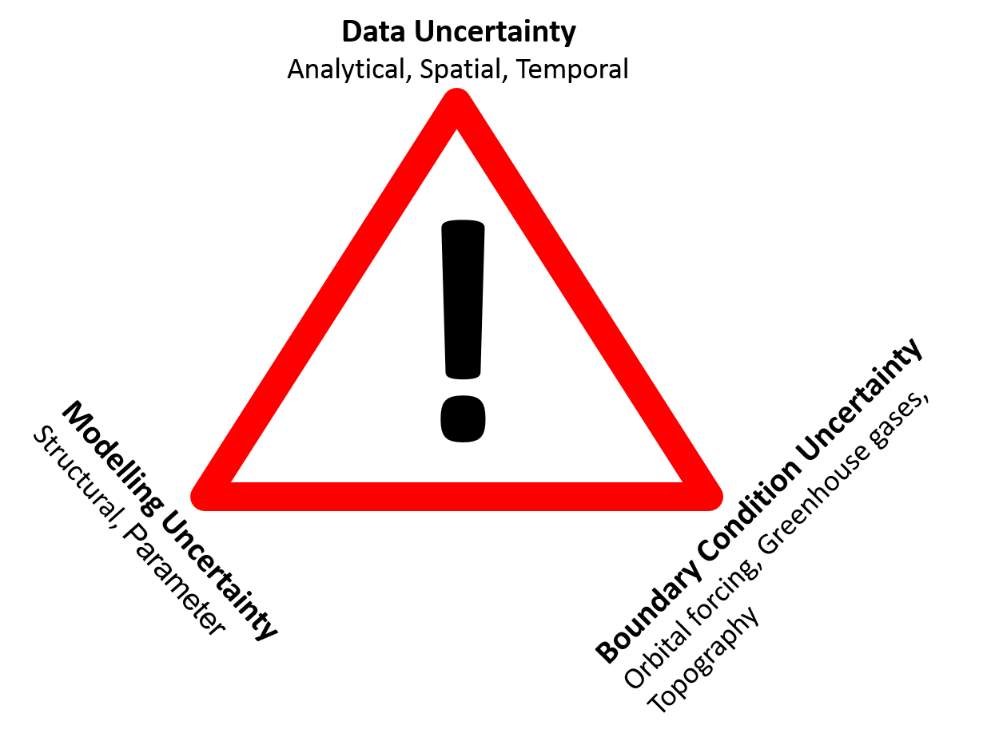
Summary
Broad areas where models predict changes in temperature correctly for the Pliocene
Regions such as the North Atlantic where models are too cold in comparison to the proxy-based estimates of sea surface temperature
We need to understand why the models and the data disagree! Are the models wrong? Is the data uncertain?
Interesting Blog (http://blogs.plos.org/models/)
All models are wrong – some are useful!

Slide 38
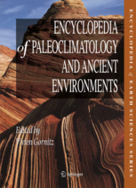
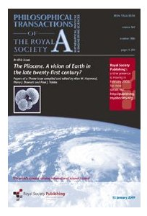


Further Reading
IPCC AR5 – information from Paleoclimate Archives
https://www.ipcc.ch/pdf/assessment-report/ar5/wg1/WG1AR5_Chapter05_FINAL.pdf
Royal Society special issue: ‘The Pliocene. A vision of Earth in the late twenty-first century?’ compiled by Alan M. Haywood, Harry J. Dowsett and Paul J. Valdes
Notes:
Deep-sea temperatures³ (upper panel) generally track the estimates of atmospheric CO₂ (lower panel) reconstructed from terrestrial and marine proxies following recent revisions (see Supplementary Information). Errors represent reported uncertainties. Symbols with arrows indicate either upper or lower limits. The vertical grey bar on the right axis indicates glacial–interglacial CO₂ range from ice cores. The top blue bar indicates approximate timing of ice-sheet development on Antarctica. Horizontal dashed line indicates the present-day atmospheric CO₂ concentration (390 ppm).

Slide 39
References
Beerling, D.J. and Royer, D.L. 2011. Convergent Cenozoic CO2 history. Nature Geosci. 4(7), pp.418-420.
DeConto, R.M. and Pollard, D. 2003a. A coupled climate–ice sheet modeling approach to the Early Cenozoic history of the Antarctic ice sheet. Palaeogeography, Palaeoclimatology, Palaeoecology. 198(1–2), pp.39-52.
DeConto, R.M. and Pollard, D. 2003b. Rapid Cenozoic glaciation of Antarctica induced by declining atmospheric CO2. Nature. 421(6920), pp.245-249.
Dowsett, H.J. et al. 2012. Assessing confidence in Pliocene sea surface temperatures to evaluate predictive models. Nature Clim. Change. 2(5), pp.365-371.
Fedorov, A.V. et al. 2013. Patterns and mechanisms of early Pliocene warmth. Nature. 496(7443), pp.43-49.
Haywood, A.M. et al. 2013. Large-scale features of Pliocene climate: results from the Pliocene Model Intercomparison Project. Clim. Past. 9(1), pp.191-209.
Hill, D.J. 2009. Modelling Earth's Cryosphere during peak Pliocene warmth, Ph.D. Thesis. Ph. D. Thesis thesis, Ph. D. Thesis, University of Bristol.
Jansen, E. et al. 2007. Palaeoclimate. In: Solomon, S., et al. eds. Climate Change 2007: The Physical Science Basis. Contribution of Working Group I to the Fourth Assessment Report of the Intergovernmental Panel on Climate Change. Cambridge, UK: Cambridge University Press.
Jouzel, J., and others: Orbital and millennial Antarctic climate variability over the last 800,000 years, Science, 317, 793-796, 2007
Lüthi, D., and others: High-resolution carbon dioxide concentration record 650,000-800,000 years before present, Nature, 453, 379-382, 2008
Pearson, P.N. et al. 2009. Atmospheric carbon dioxide through the Eocene–Oligocene climate transition. Nature. 461(7267), pp.1110-1113.
Rae, JWB, Sarnthein, M, Foster, G, Ridgwell, A, Grootes, P & Elliott, T 2014, 'Deep water formation in the North Pacific and deglacial CO2 rise' Paleoceanography., 10.1002/2013PA002570
Zachos, J.C. et al. 2008. An early Cenozoic perspective on greenhouse warming and carbon-cycle dynamics. Nature. 451(7176), pp.279-283.
Notes:
Deep-sea temperatures³ (upper panel) generally track the estimates of atmospheric CO₂ (lower panel) reconstructed from terrestrial and marine proxies following recent revisions (see Supplementary Information). Errors represent reported uncertainties. Symbols with arrows indicate either upper or lower limits. The vertical grey bar on the right axis indicates glacial–interglacial CO₂ range from ice cores. The top blue bar indicates approximate timing of ice-sheet development on Antarctica. Horizontal dashed line indicates the present-day atmospheric CO₂ concentration (390 ppm).

