Slide 1
Modelling Ancient Earth Climates Manchester Geologist Association
Alan M. Haywood
(School of Earth and Environment)

Slide 2
Goal of today’s presentation
To give you a flavour of:
Climate history of the Earth
Why climate history is useful and important
How we use computer models to investigate past climate and explore geological hypotheses for environmental change.

Slide 3
Why study palaeoclimate?
Main reason for studying palaeoclimate
Understanding how climate works
(which has implications for future climate change)

Slide 4
Why study palaeoclimate?

Slide 5
Why study palaeoclimate?
Based on the strengths of palaeoclimate research we could target certain types of past climate that would be useful.
Extremes (large signal)
Periods with large changes (large signal)
Stable periods (whole Earth system response)
Intervals with well known forcing (examine response)
Periods most like modern / future?

Slide 6
Palaeoclimate Modelling
Real World
Increasing complexity
Earth System Models
General Circulation Models
Intermediate Complexity Models
Box Models
Conceptual Models

Slide 7
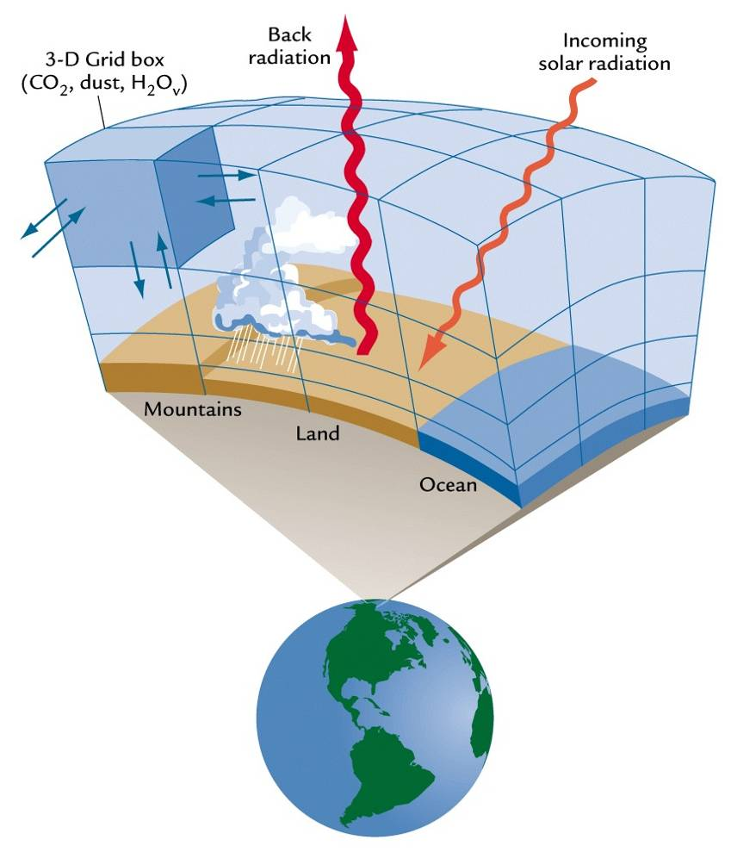
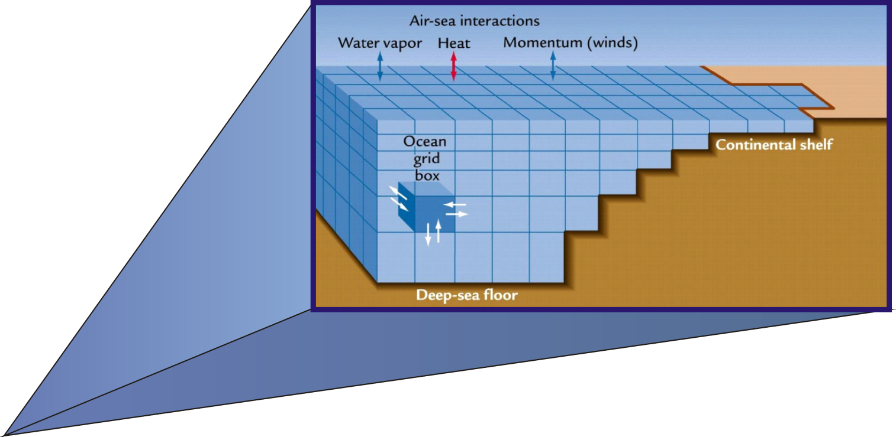
Palaeoclimate Modelling

Slide 8
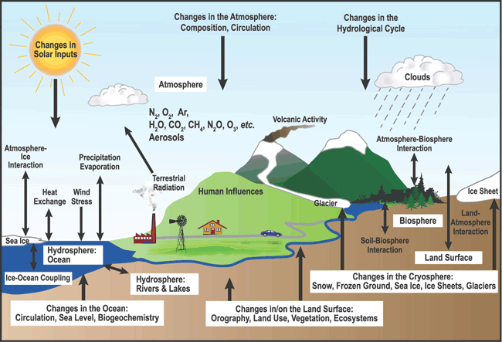
Palaeoclimate Modelling

Slide 9
Palaeoclimate Modelling
To run a modern climate model palaeoclimate simulation the computer needs to:
Solve hundreds of complex equations
in millions of grid boxes
over millions of time steps

Slide 10
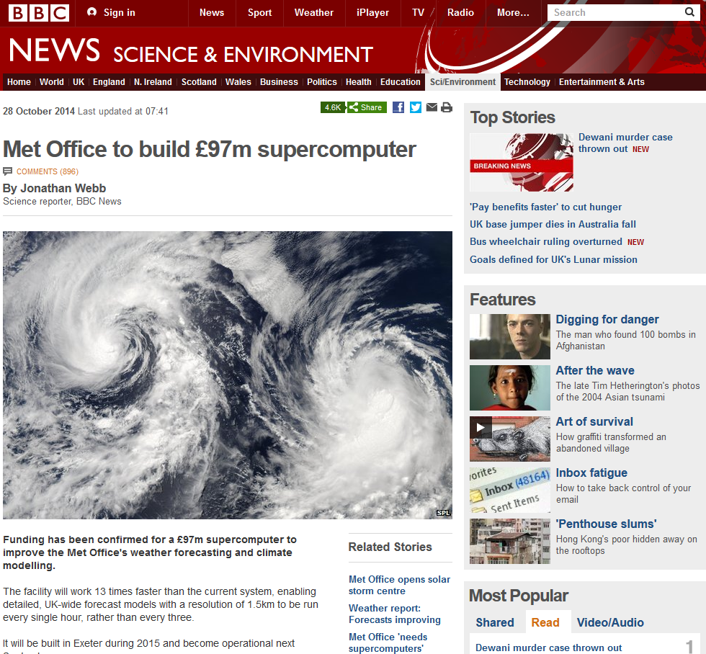
Palaeoclimate Modelling

Slide 11
Palaeoclimate Modelling

Slide 12
Palaeoclimate Modelling

Slide 13
Palaeoclimate Modelling

Slide 14
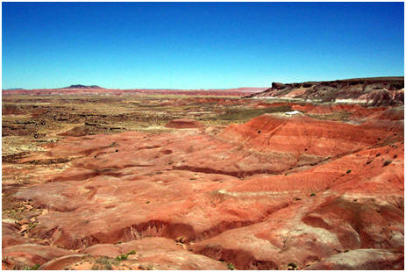
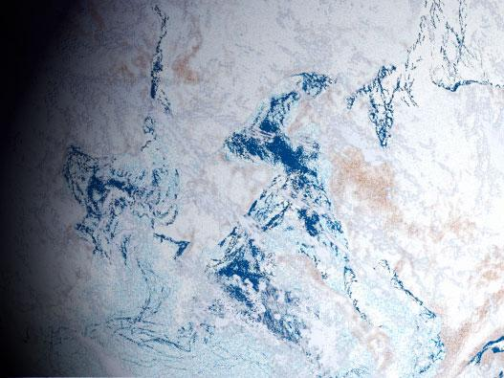
Ancient extremes title slide
Ancient Climate Extremes

Slide 15
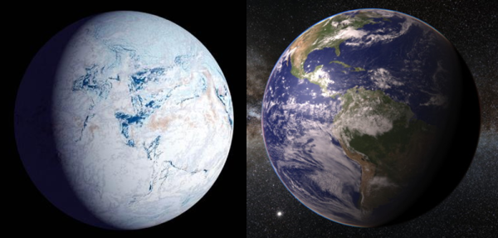
Snowball Earth

Slide 16
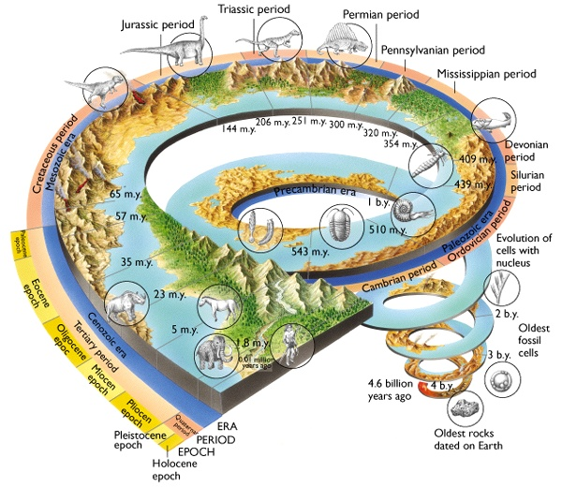
Snowball Earth
Stratigraphy

Slide 17
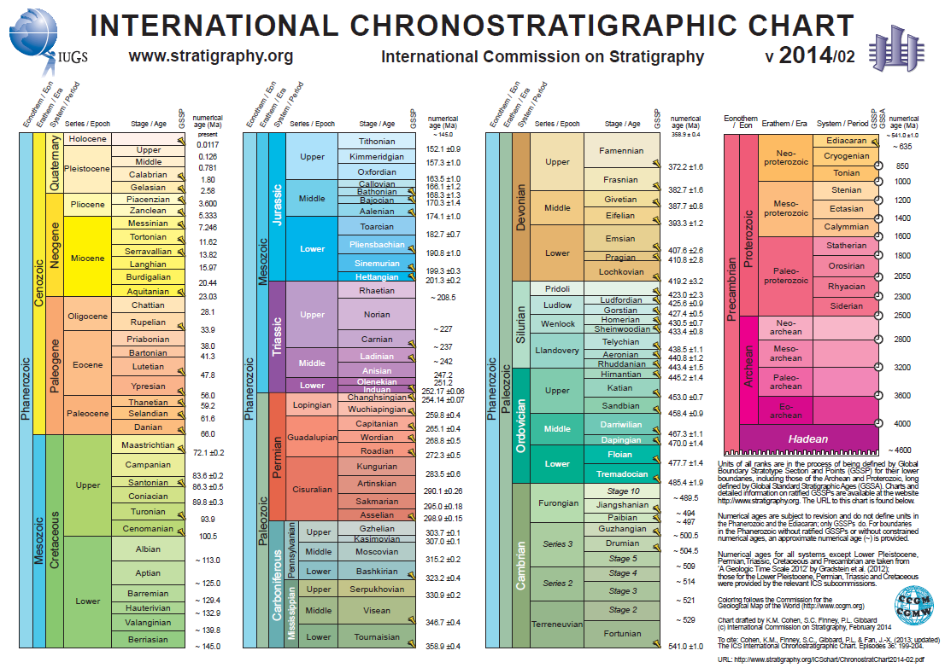
Snowball Earth

Slide 18
Snowball Earth

Slide 19
Snowball Earth

Slide 20
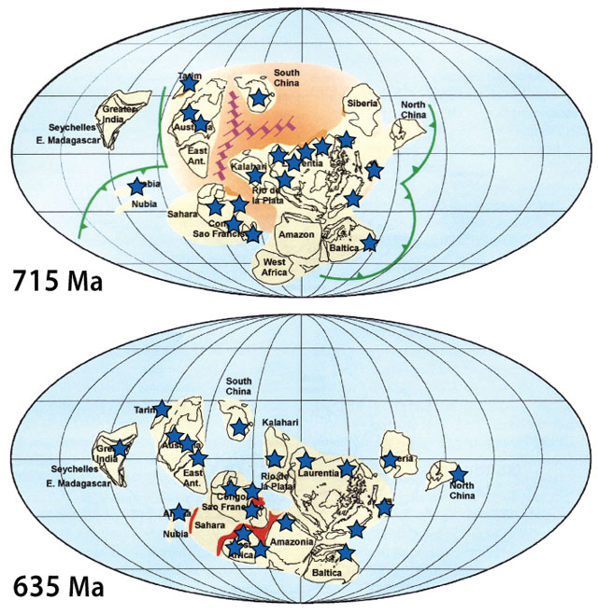
Snowball Earth

Slide 21
Snowball Earth
What caused snowball Earth?
There are some speculative suggestions, e.g. extreme axial tilt, solar system transiting a galactic dust cloud, but there are more prosaic potential climatic causes:
Faint young sun
Extremely low levels of greenhouse gas
Distribution of the continents
Reduced ocean heat transport
But are these sufficient to produce ice at the equator?

Slide 22
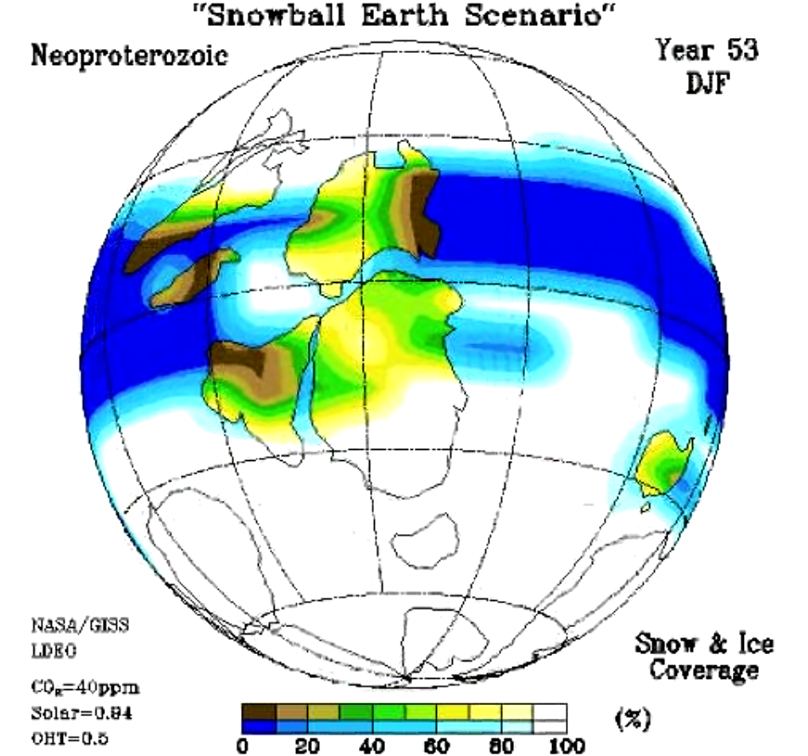
Snowball Earth
Climate model animation

Slide 23
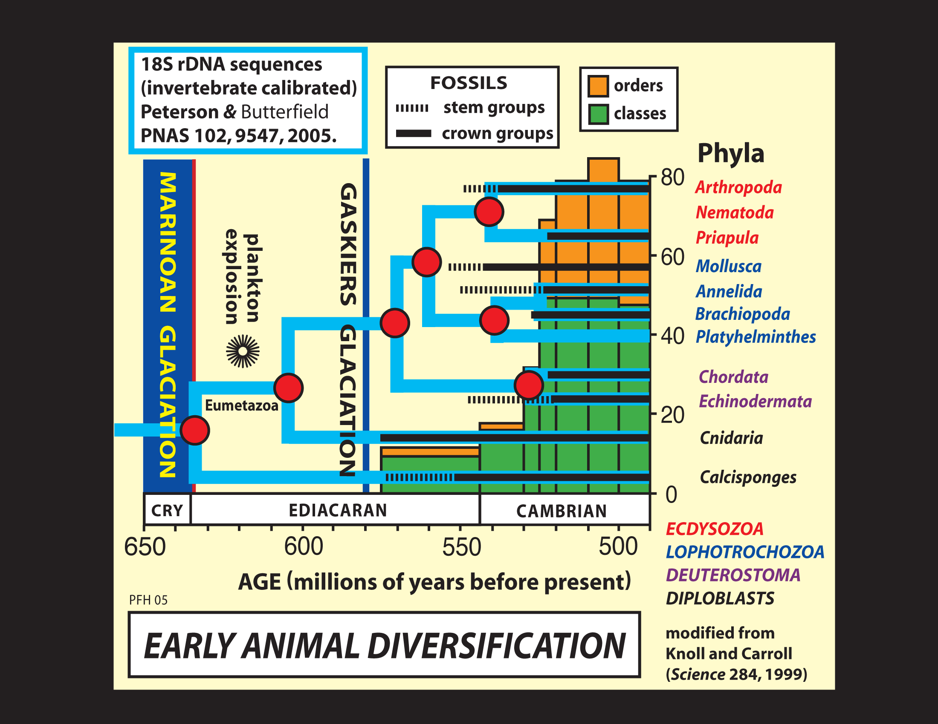
Snowball Earth
Did snowball Earth play a role in the evolution of life?

Slide 24
Phanerozoic Climate

Slide 25
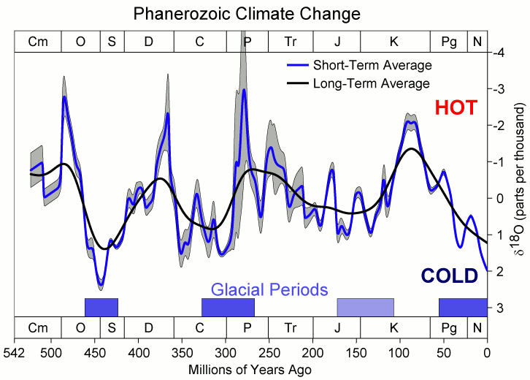
Phanerozoic Climate

Slide 26
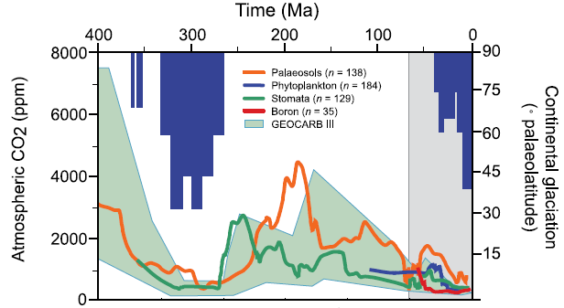
Phanerozoic Climate

Slide 27
Phanerozoic Climate
Permian

Slide 28
Permian Climate
Stratigraphy

Slide 29
Permian Climate

Slide 30
Permian Climate
Key features of Permian climate
Extremely high greenhouse gases, with CO₂ in atmosphere peaking at 3000 – 5000 ppmv or 10-18 times pre-industrial (more than burning all our fossil fuel reserves).
Pangaea and Panthalassa, supercontinent and global ocean.

Slide 31
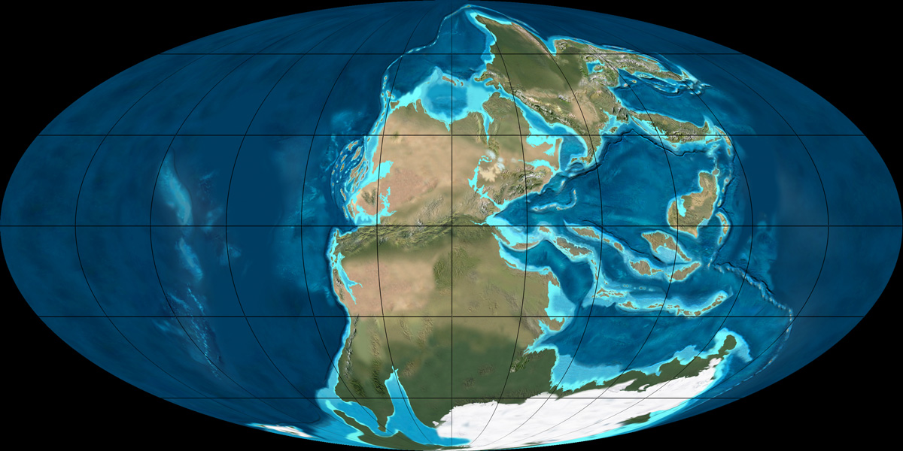
Permian Climate
Late Permian, 260 Ma; Credit Ron Blakey

Slide 32
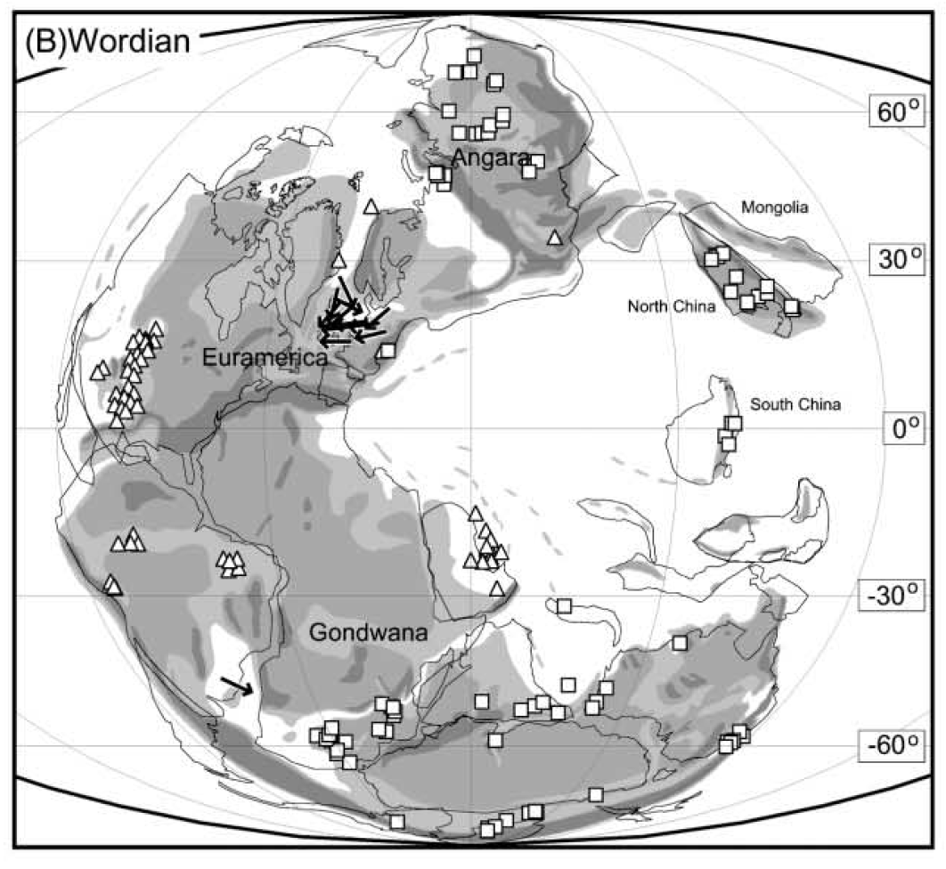
Permian Climate
Gibbs et al., 2002

Slide 33
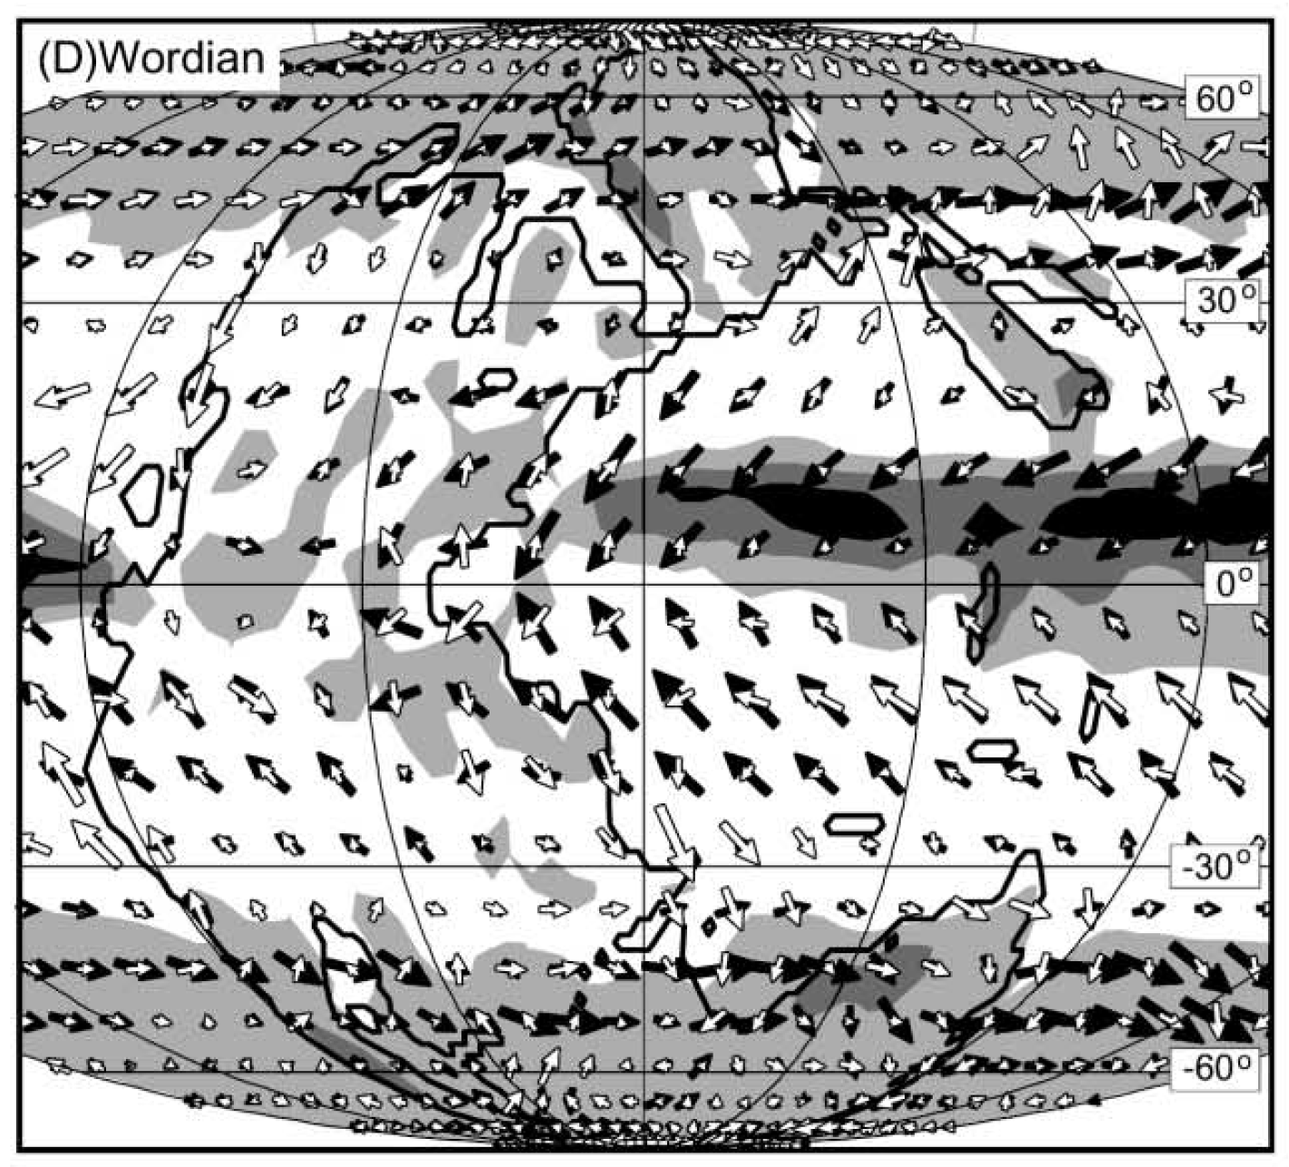
Permian Climate
Gibbs et al., 2002

Slide 34
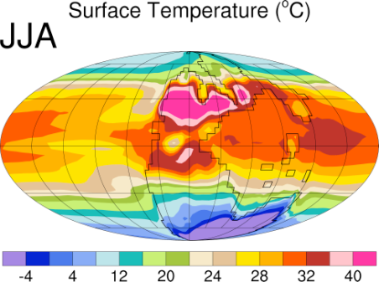
Permian Climate
Kiehl &Shields, 2005

Slide 35
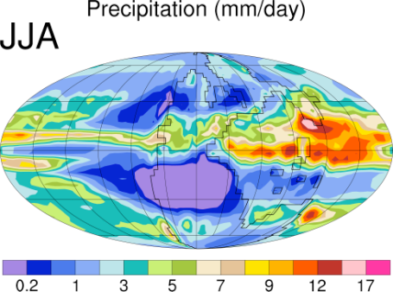
Permian Climate
Kiehl & Shields, 2005

Slide 36
Permian Climate
Kiehl & Shields, 2005

Slide 37
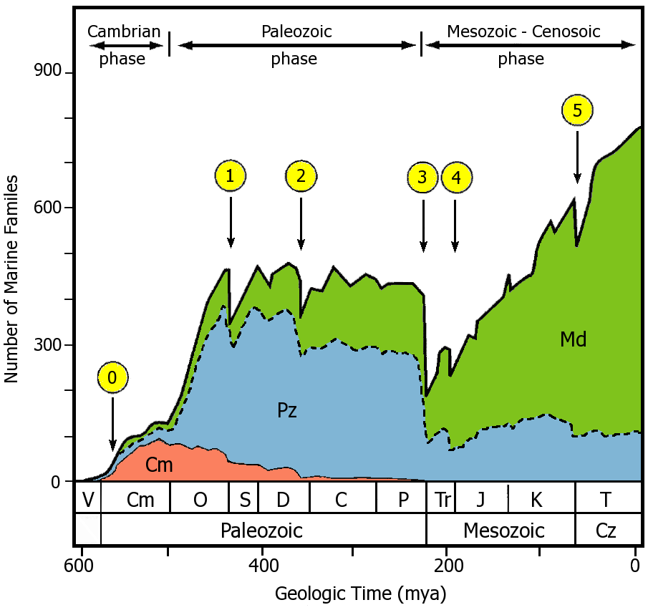
Permian Climate
Sepkoski, 1981

Slide 38
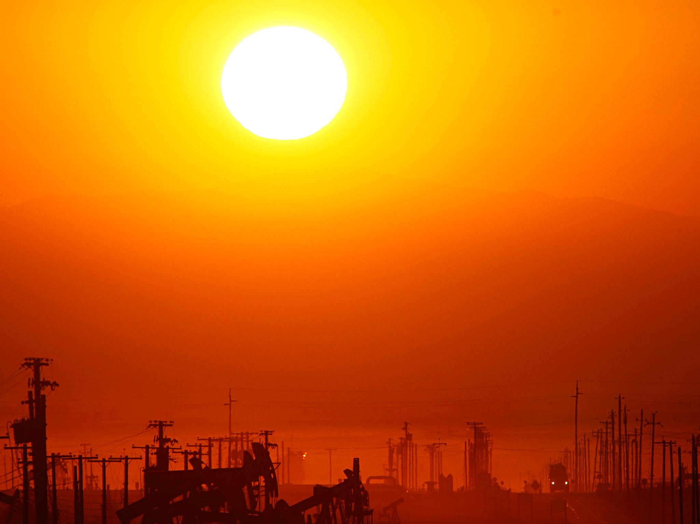
Cenozoic future analogues? title slide
Cenozoic Future Climate Analogues?

Slide 39
Cenozoic Climate

Slide 40
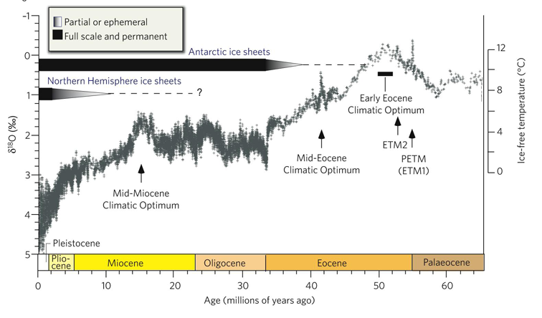
Cenozoic Climate
Hot, little ice
Cold, much ice
Zachos et al., 2008

Slide 41
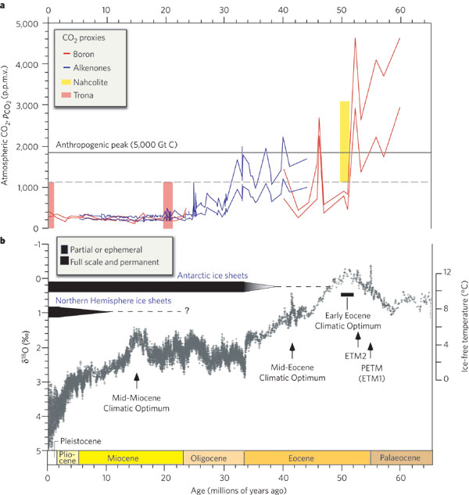
Cenozoic Climate
Zachos et al., 2008

Slide 42
Cenozoic Climate
PETM (55 Ma)
(Palaeocene-Eocene Thermal Maximum)
Pliocene
(3Ma)
Zachos et al., 2008

Slide 43
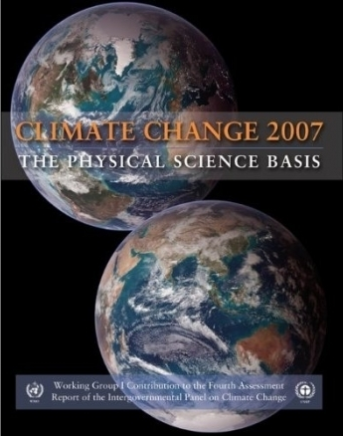
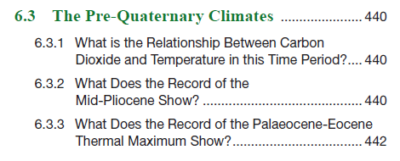
Cenozoic Climate

Slide 44
PETM Climate
Stratigraphy

Slide 45
PETM Climate

Slide 46
PETM Climate
PETM is a possible future analogue because:
Geologically rapid, transient warming.
Associated with a large carbon isotope excursion, suggesting it is driven by greenhouse gases.
Magnitude of total carbon release is similar magnitude to projected 21st century emission.
Long enough event for climate feedbacks to occur.

Slide 47
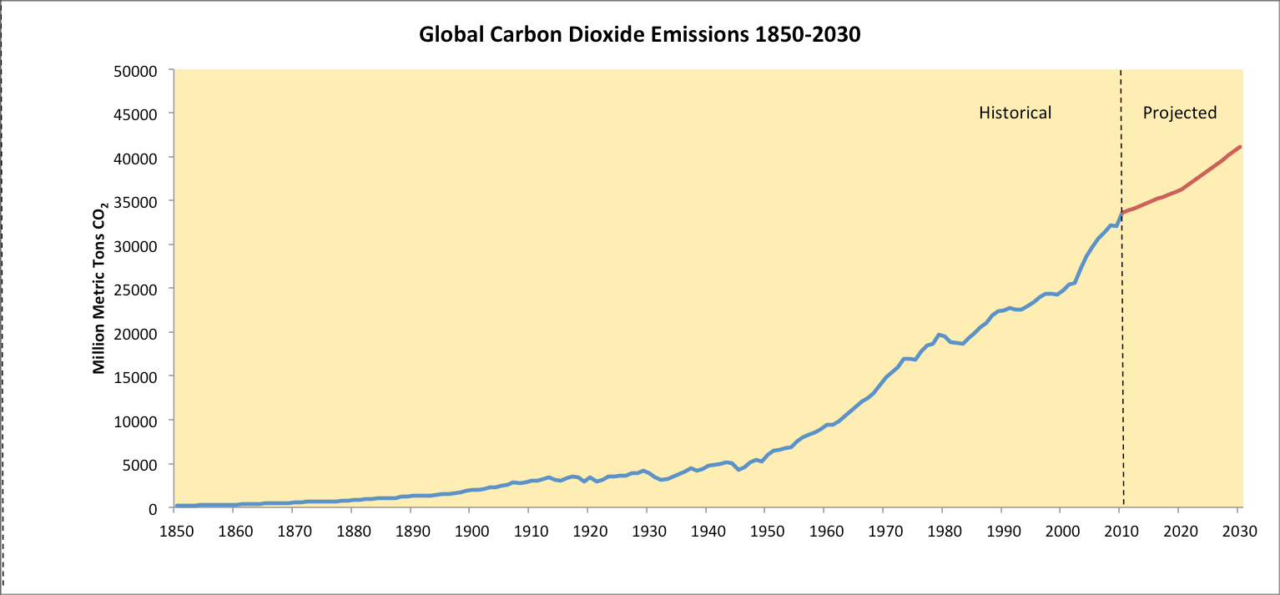
PETM Climate
PETM maximum possible carbon input rate (Cui et al., 2011)

Slide 48
PETM Climate
IPCC AR4, 2007

Slide 49
PETM Climate
Where did the PETM carbon come from?
Source | Greenhouse Gas | Reference
Comet impact | CO₂ and CH₄ | Kent et al., 2003
Wildfires | CO₂ | Kurtz et al., 2003
Uplift of marine sediments | CO₂ | Higgins and Schrag, 2006
Magmatism or volcanism | CO₂ | Storey et al., 2007
Thawing permafrost | CO₂ | De Conto et al., 2012
Methane hydrates | CH₄ | Dickens, 1995 Lunt et al., 2011

Slide 50
PETM Climate
Lunt et al., 2011

Slide 51
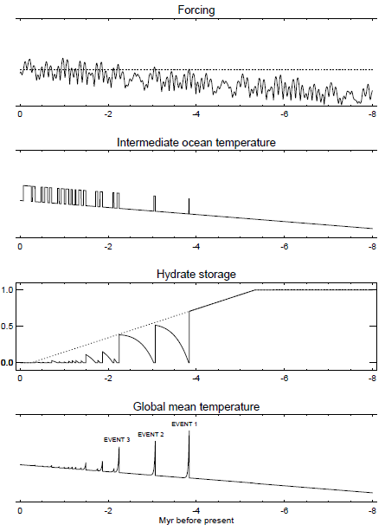
PETM Climate
Lunt et al., 2011

Slide 52
Pliocene Climate
Stratigraphy

Slide 53
Pliocene Climate

Slide 54
Pliocene Climate
Pliocene is a possible future analogue because:
Geologically recent, with very similar continental configuration.
Atmospheric CO₂ is essentially modern (400ppmv).
Last time when the Earth experienced warmer than today climate, with similar to today CO₂.

Slide 55
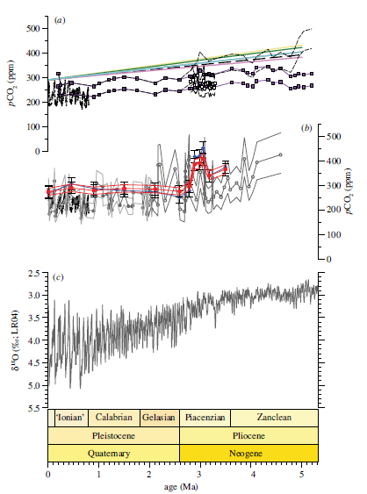
Pliocene Climate
It was the last time in Earth history that CO₂ in the atmosphere was ~ 400ppmv
Badger et al., 2013

Slide 56
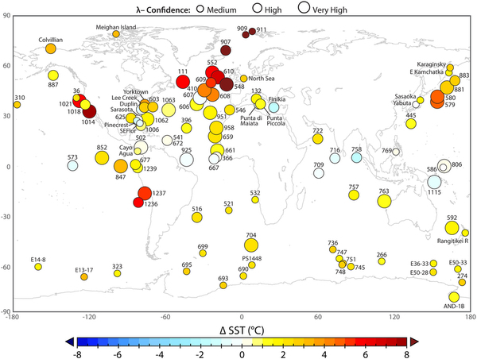
Pliocene Climate
Dowsett et al., 2012

Slide 57
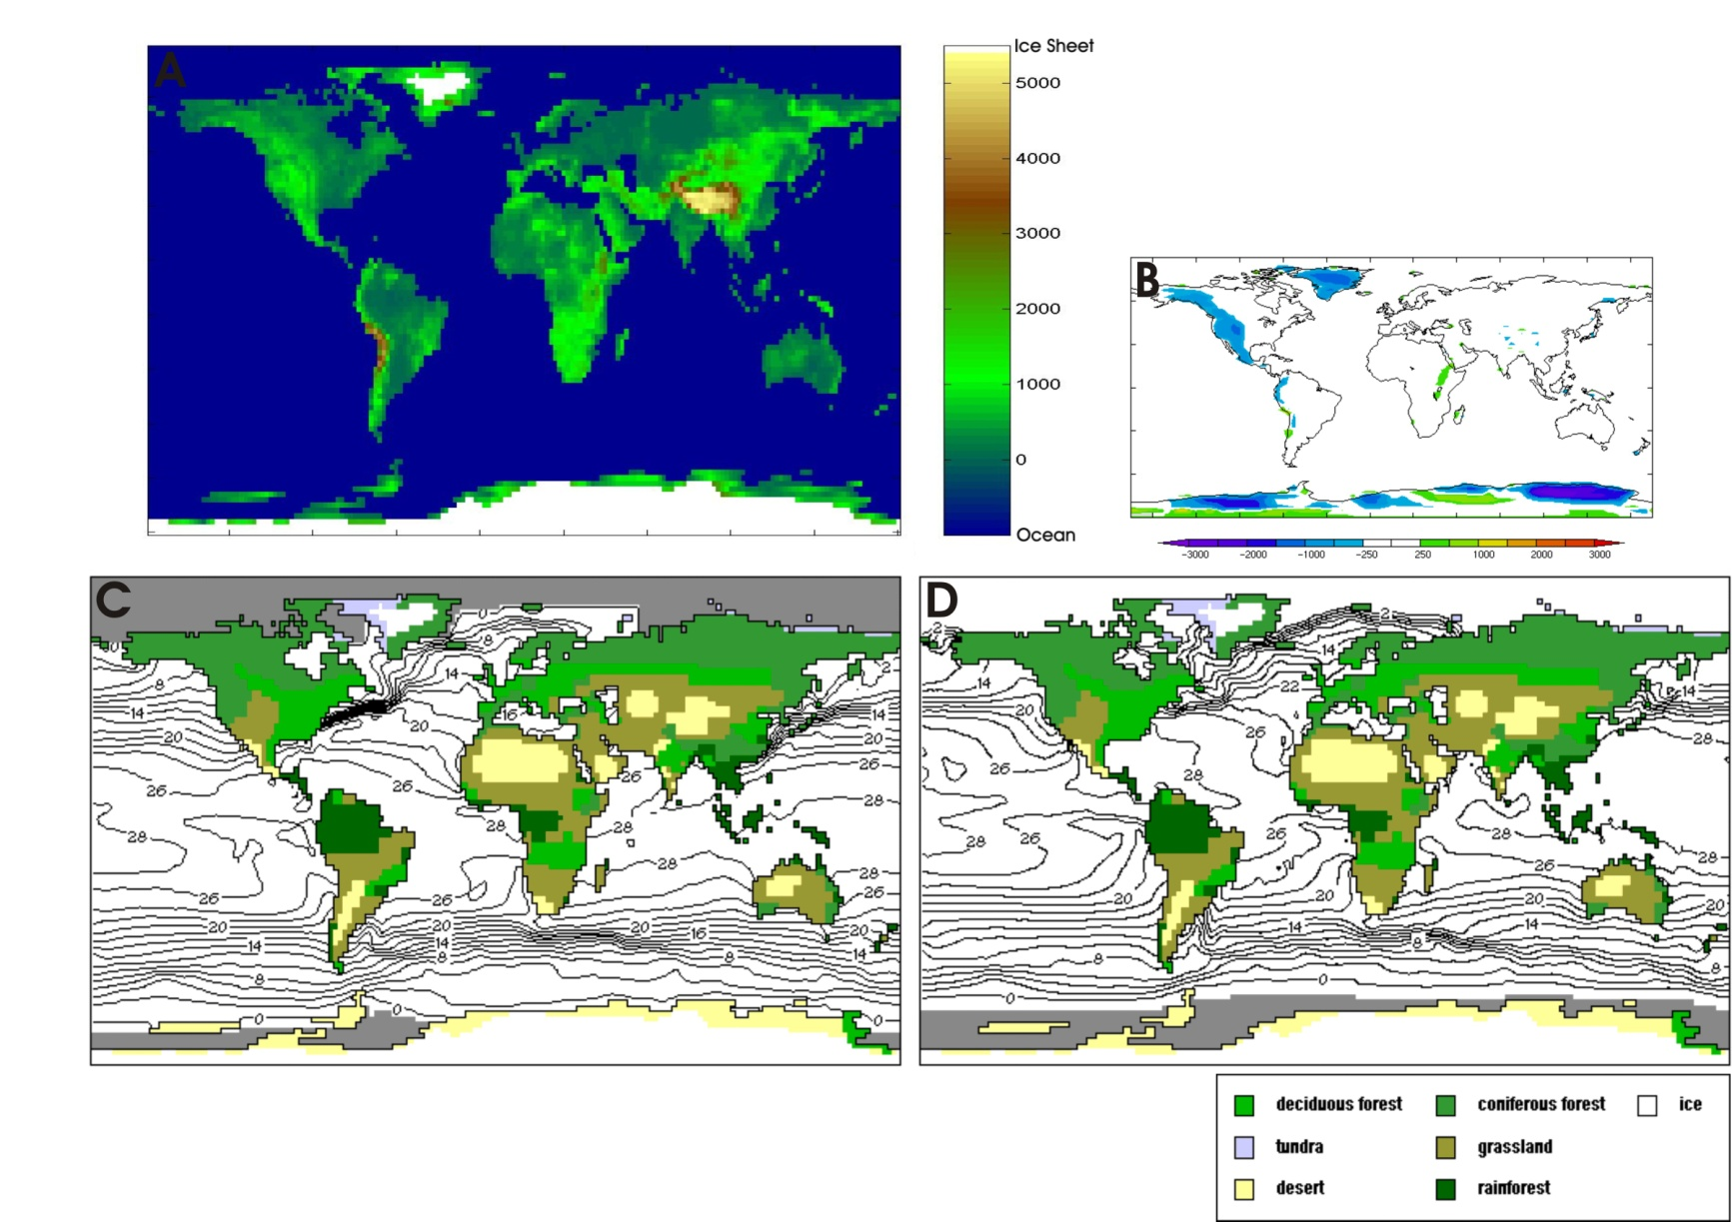
Pliocene Climate Models
Orography changed
Ice sheets reduced
Vegetation changed

Slide 58
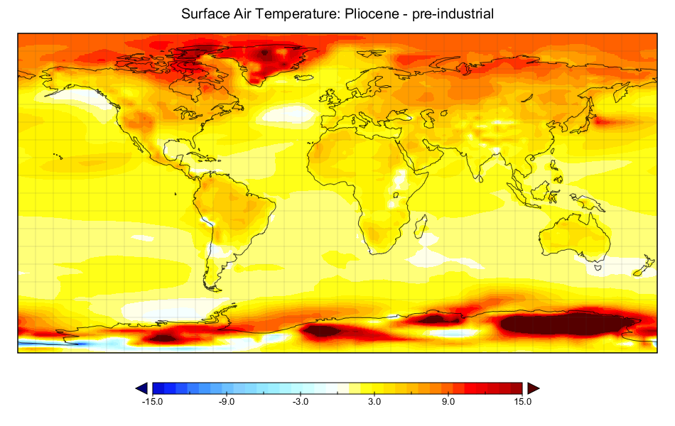
Pliocene Climate Models
Annual mean temp (°C) diff
in Pliocene @ 400 ppmv CO₂
ΔT = 3.4°C
IPCC (2007) ΔT @ 560 ppmv = 3°C
Climate sensitivity = 3 °C

Slide 59
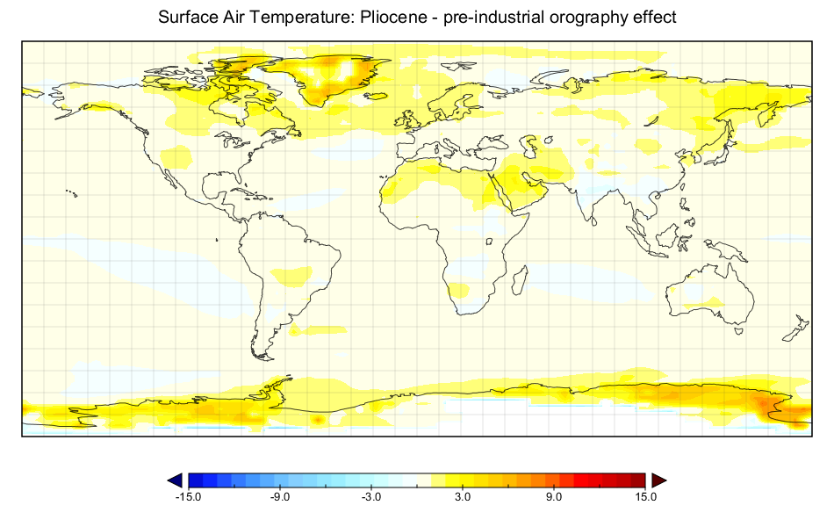
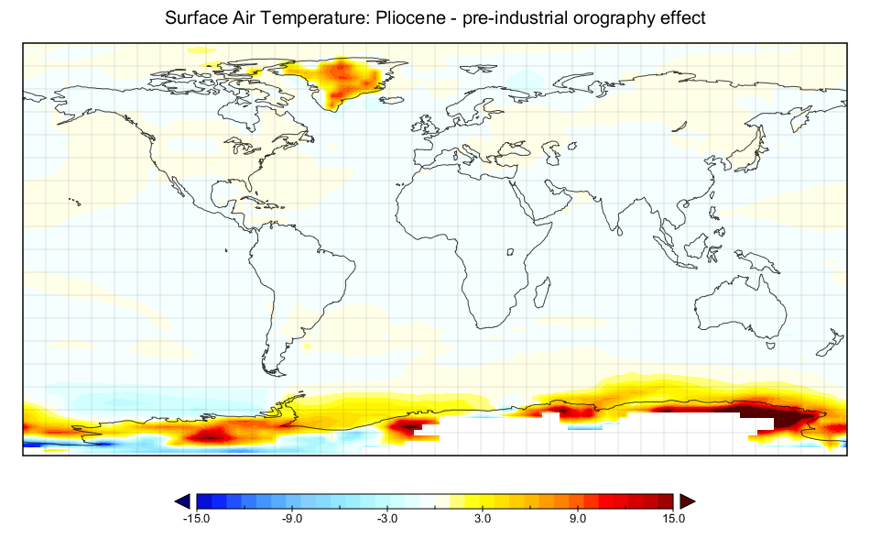
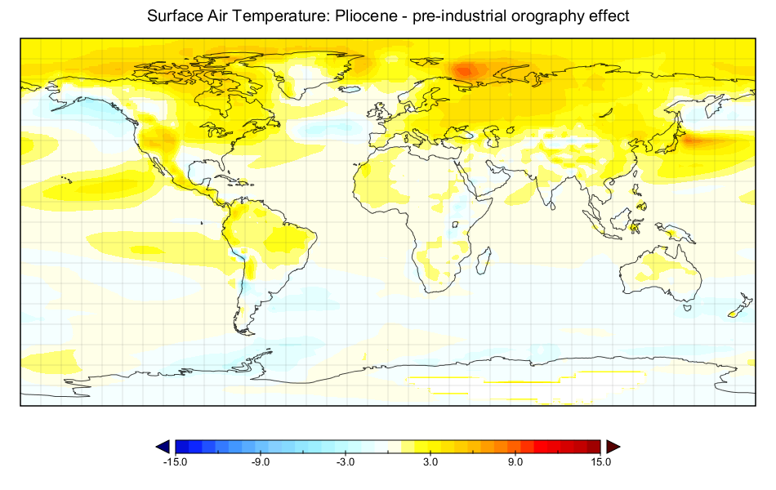
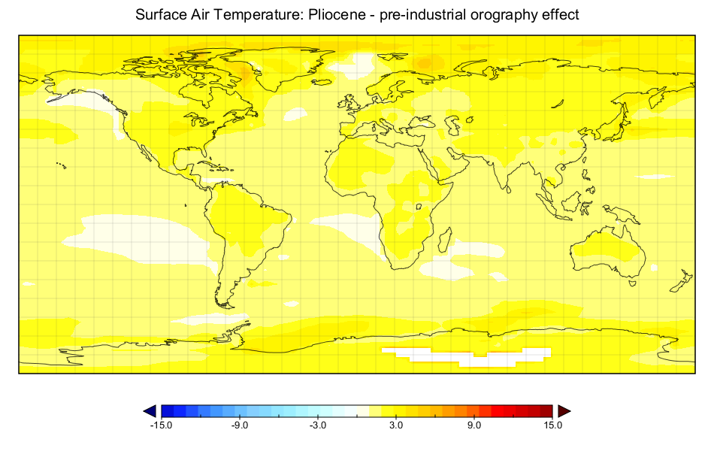
Pliocene Climate Models
Vegetation
Ice Sheets
0.7°C
0.4°C
Orography
CO₂
0.7°C
1.6°C

Slide 60
Take Home Messages
The Earth has undergone extreme changes in climate throughout its history.
Even during Snowball Earth and extreme greenhouses it has maintained its habitability to life.
Greenhouse gases are a major driver of climate.
However, there are many other parts of the Earth System that contribute to and respond to past climate changes, including the biosphere.
The models used to predict future climate changes are capable of simulating past changes and, despite not being perfect, are the best way of predicting the human impact on climate.

