Slide 1
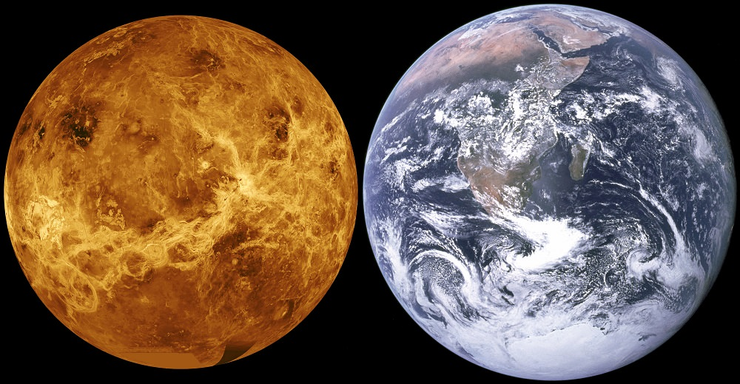
climate change is real & what we are doing about it
467 °C (872 °F)
Carbon dioxide (CO₂) = 96.5%
~15 °C (59 °F)
Carbon dioxide (CO₂) = 0.0407%

Slide 2
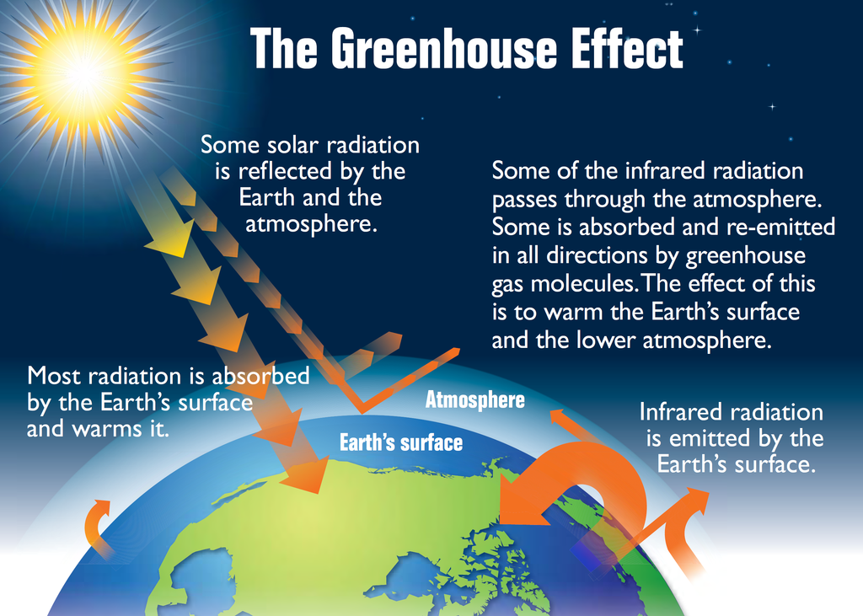
CO₂ and the Greenhouse Effect

Slide 3
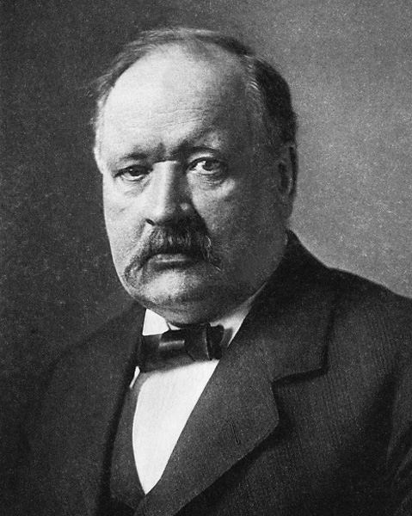
Svante Arrhenius (1852-1927)
Temperature of the ground influenced by heat-absorbing gases in the atmosphere.
Earths’ temperature would be ~20°C lower than it is without the CO₂ in the atmosphere.
Became concerned about future temperature due to CO₂ emissions from industry in 1895.

Slide 4
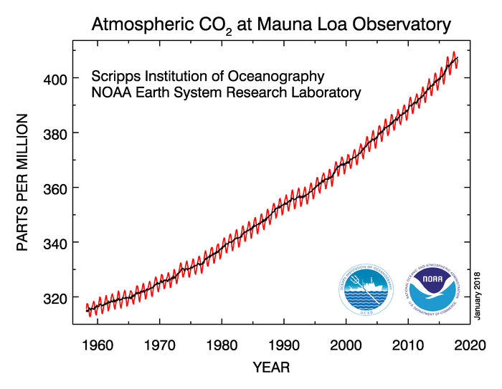
CO₂ concentration over time

Slide 5
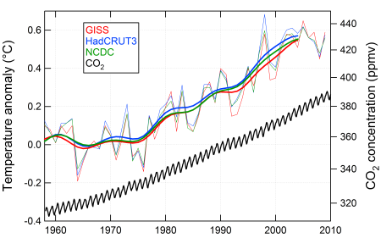
Global temperature change

Slide 6
Patterns of temperature change
Notes:
16 Institute and ca. 120 Wissenschaftler beteiligen sich an IMPETUS

Slide 7
Regional responses: Arctic sea-ice

Slide 8
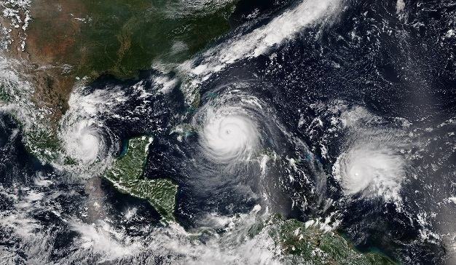
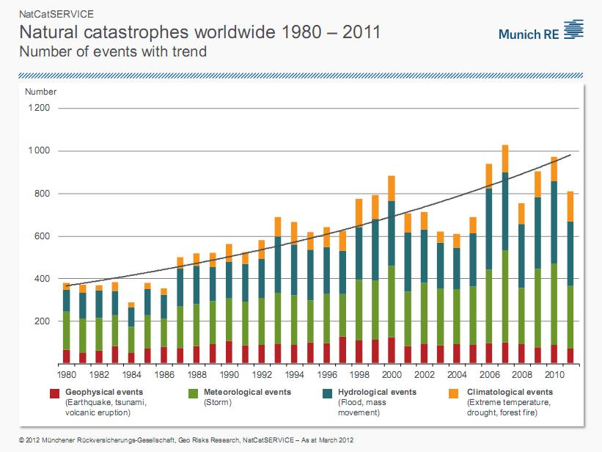
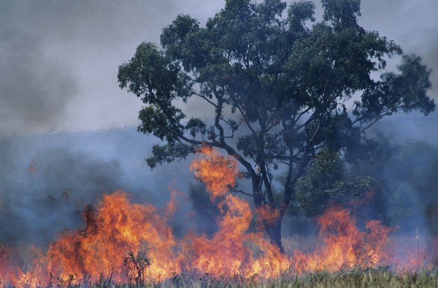
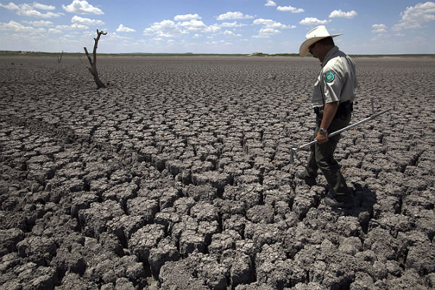
Extreme weather events

Slide 9
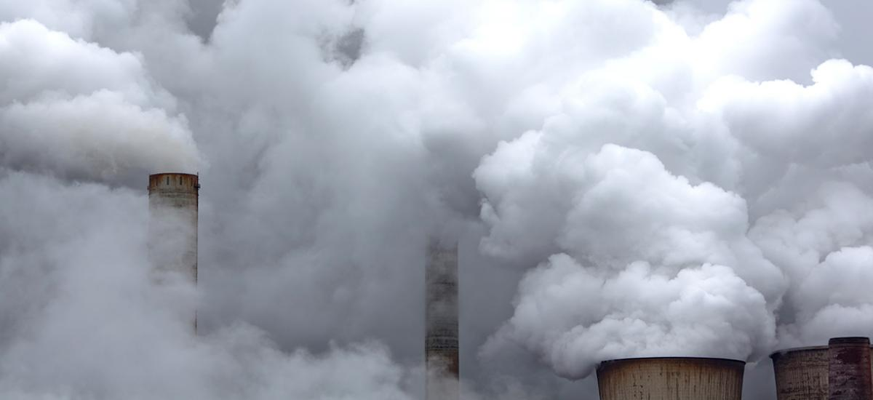
What do we need to do?

Slide 10
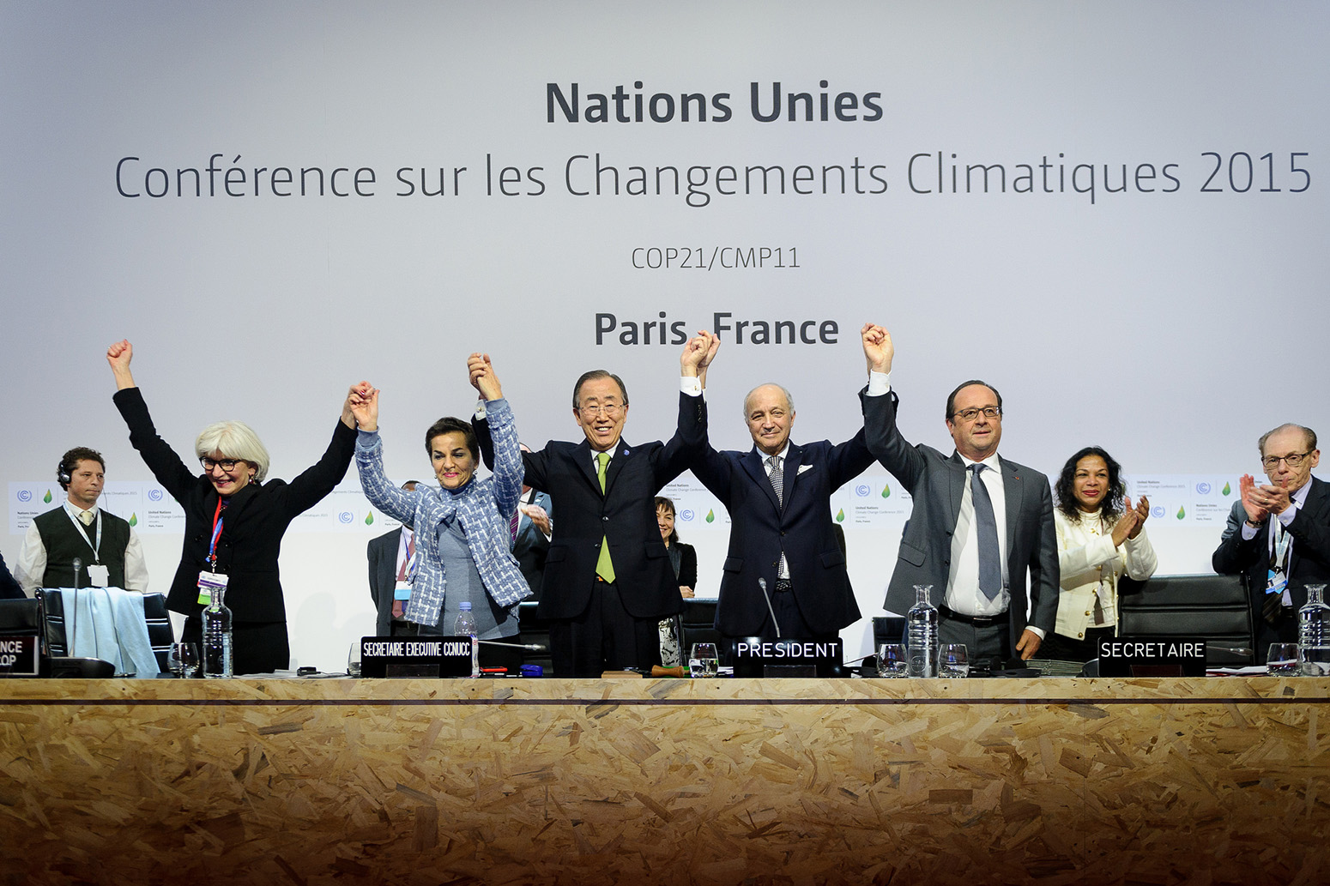
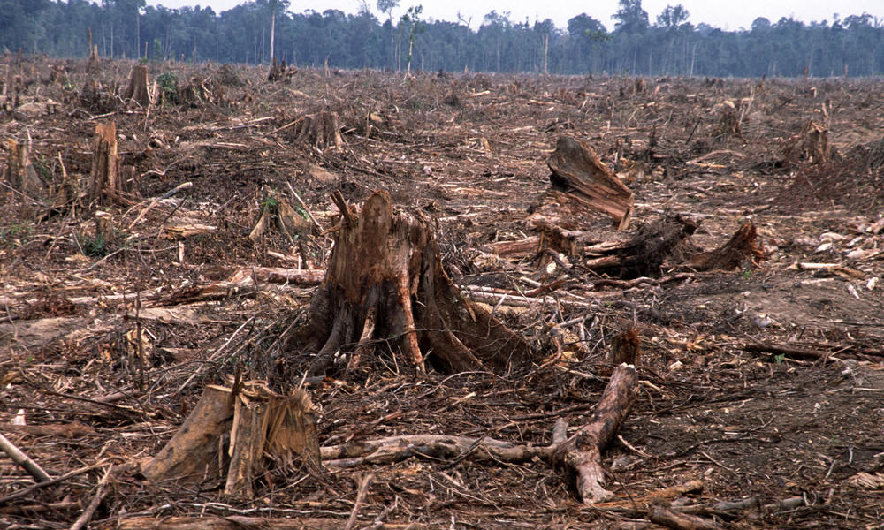
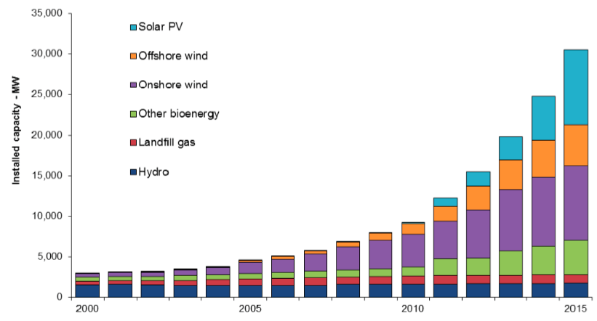
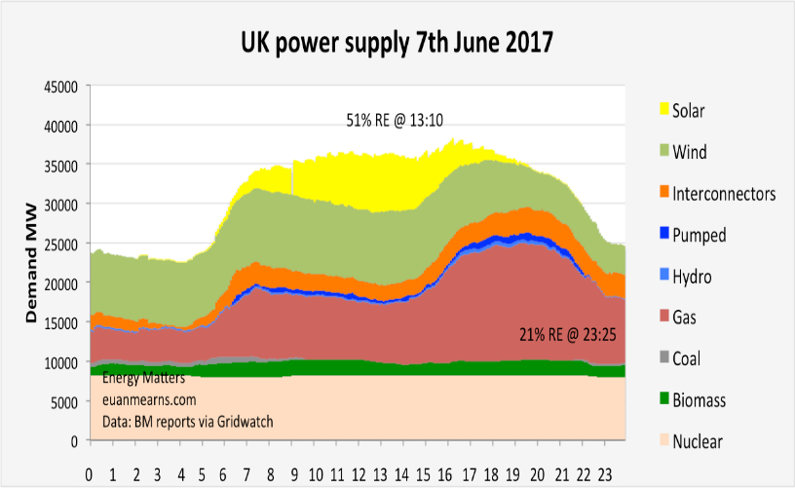
What are we doing about it?
(National/Governmental)

Slide 11
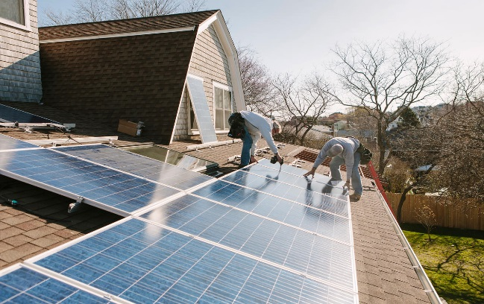
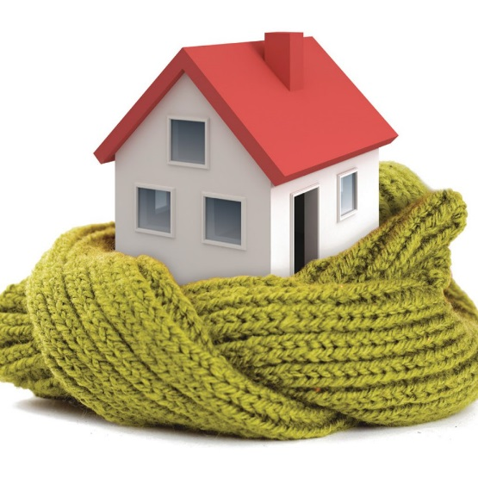
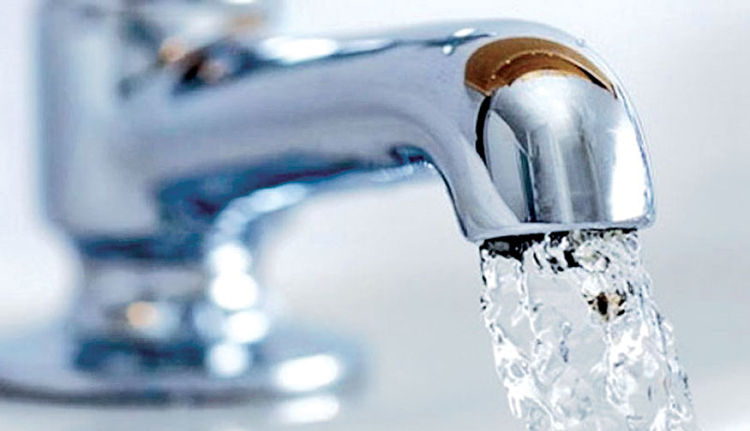
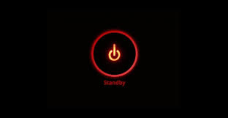
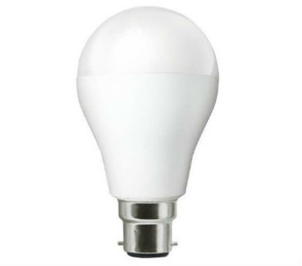
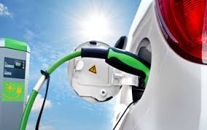
What are we doing about it?
(household or the individual)

Slide 12
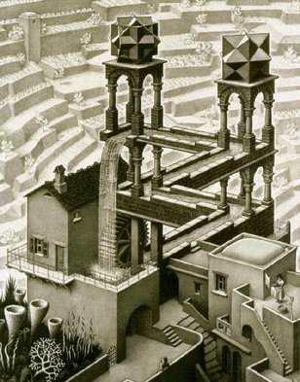
Dyslexia and Science
A term to describe information processing
challenges that some people experience.
Often shown by hand writing/ spelling, weaker reading speed.
Out of box thinking
Ability to analyses patterns/trends
Creative thinking/writing
Auditory memory
“Tell me and I forget, teach me and I may remember, involve me and I learn (B. Franklin)”.

Slide 13
