Slide 1
Modelling Climate and Water Isotope Signatures of El Niño in the Pliocene
Julia Tindall and Alan Haywood
AGU Fall Meeting
15th December 2015

Slide 2
Questions
How was the structure of El Niño different in the Pliocene? (2500 year HadCM3 simulation)
What are the reasons for these differences?
What would Pliocene El Niño look like in proxy data?
4. Which regions provide a good representation of Pliocene El Niño?
HadCM3 temperature
Transfer function
Modelled δ¹⁸O_{c}
HadCM3 δ¹⁸O_{sw}
Notes:
Slide is self explanatory, however make sure you highlight (Box point 3) that d18Oc which is measured in archives such as foraminifera and coral include a signal from both temperature and the d18osw. We will be modelling the El Nino signal in both temperature and d18osw in order to determine what the El Nino signal in these archives might be.

Slide 3
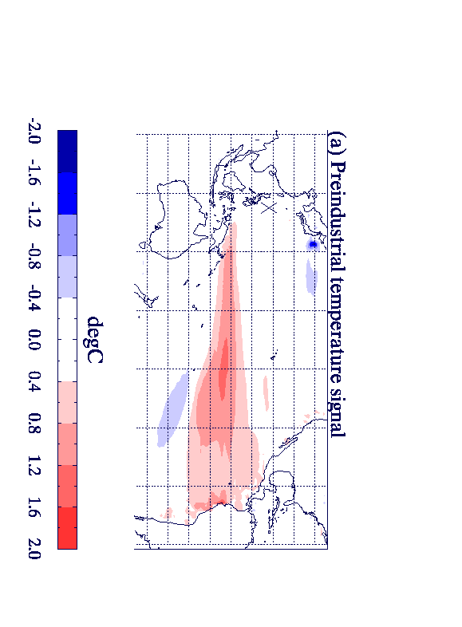
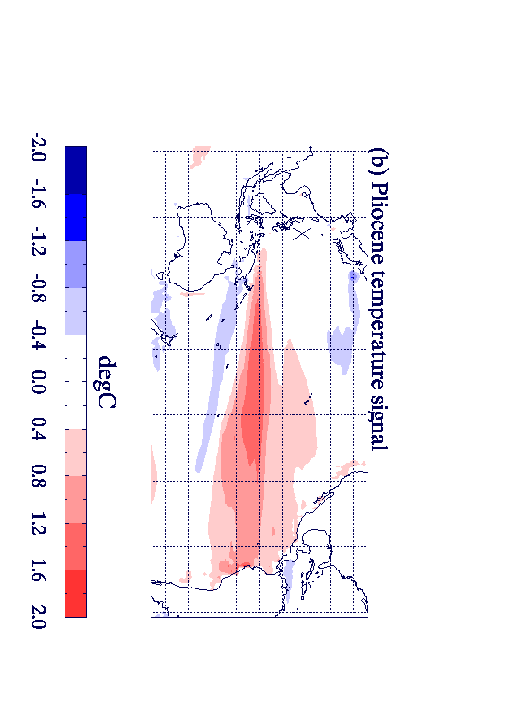
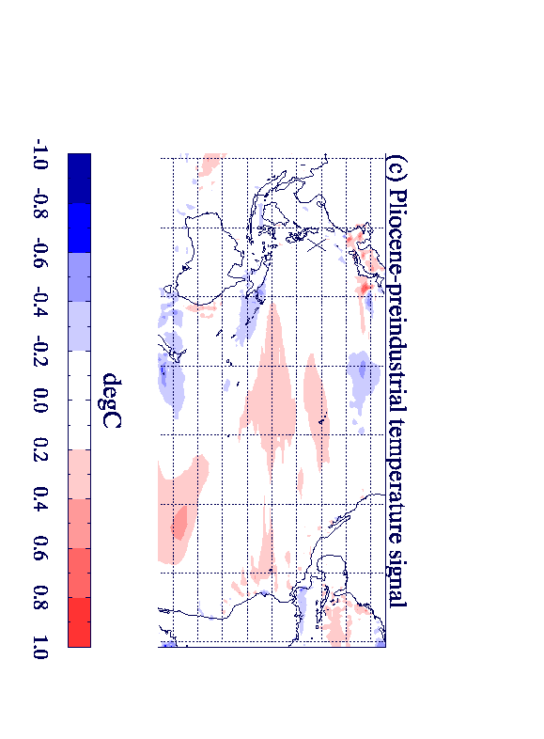
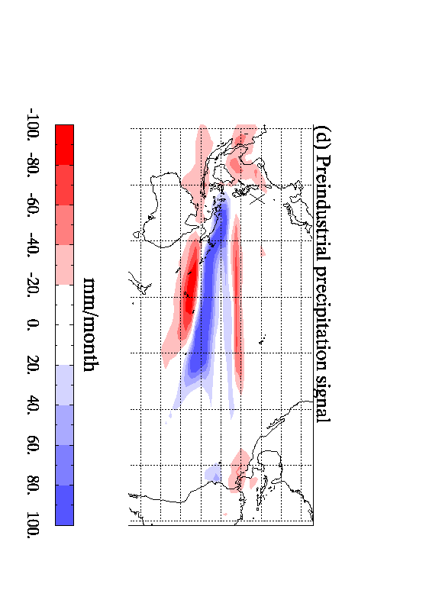
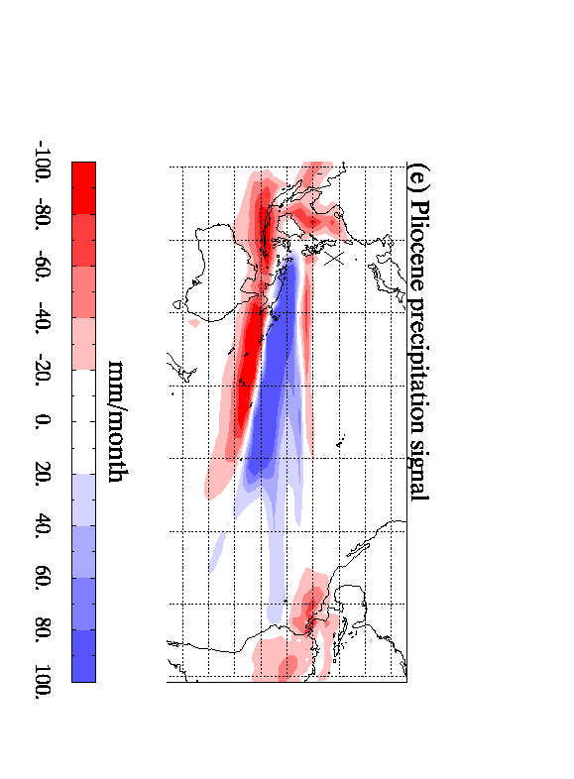
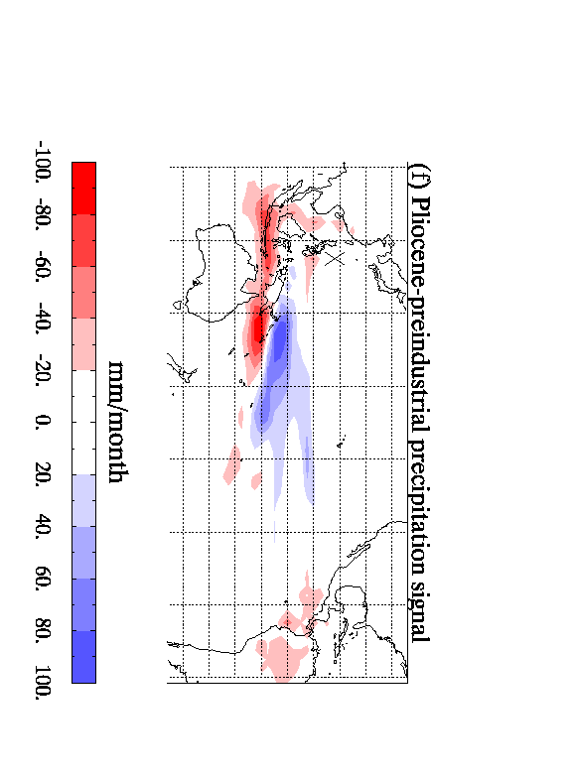
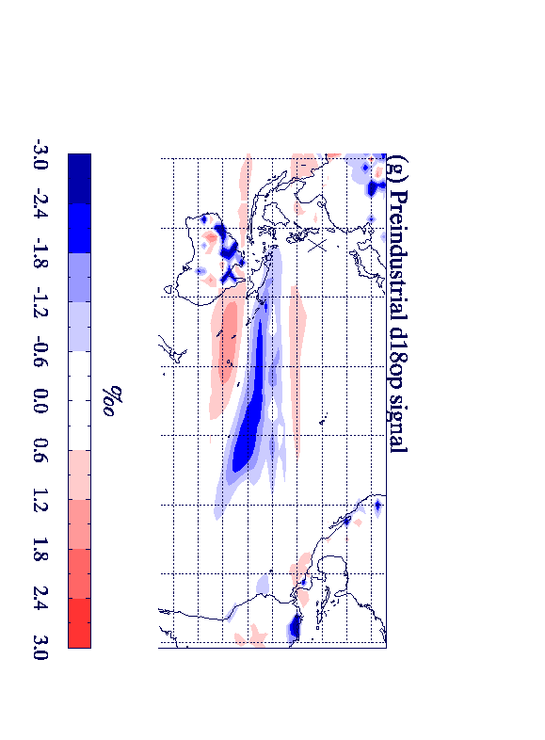
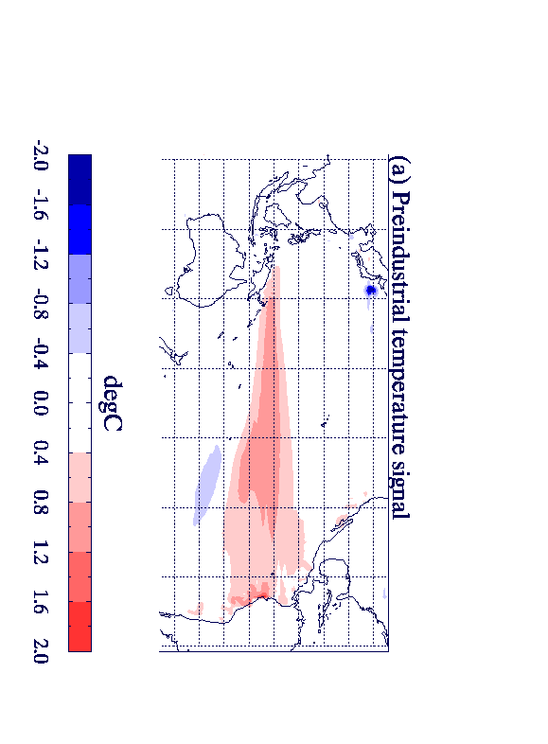
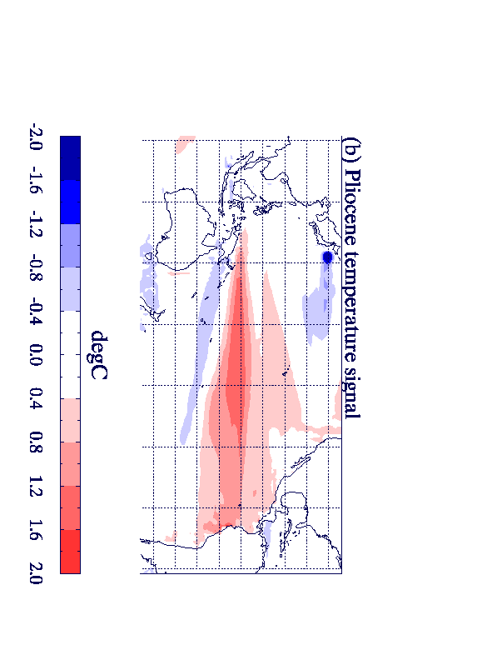
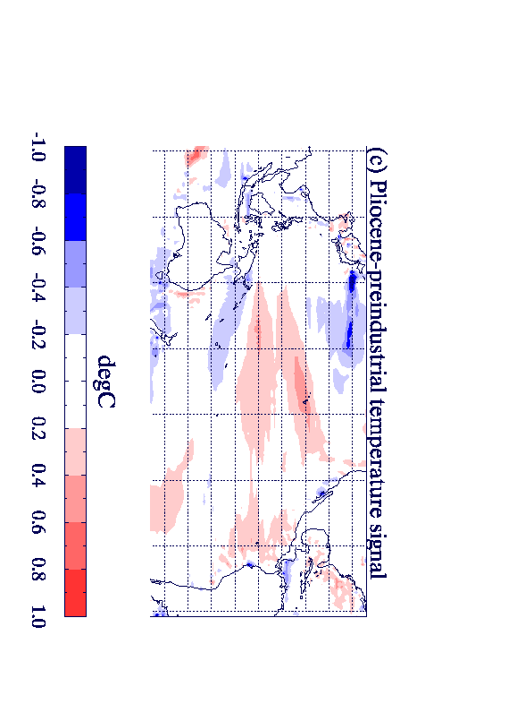
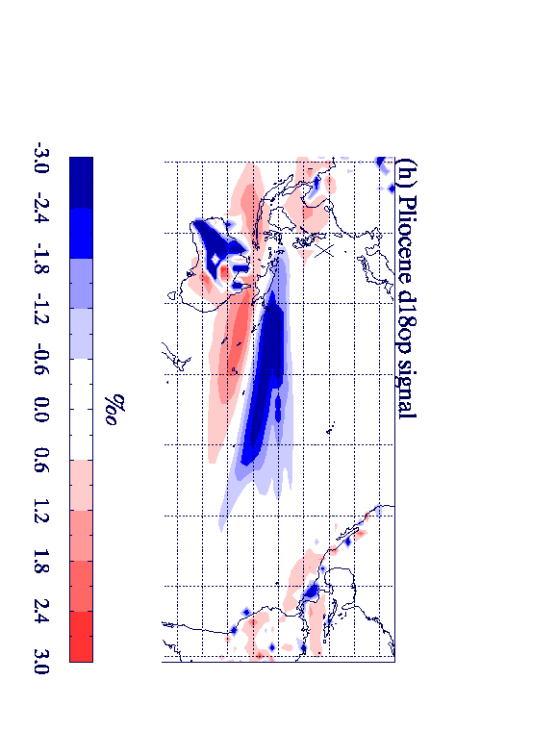
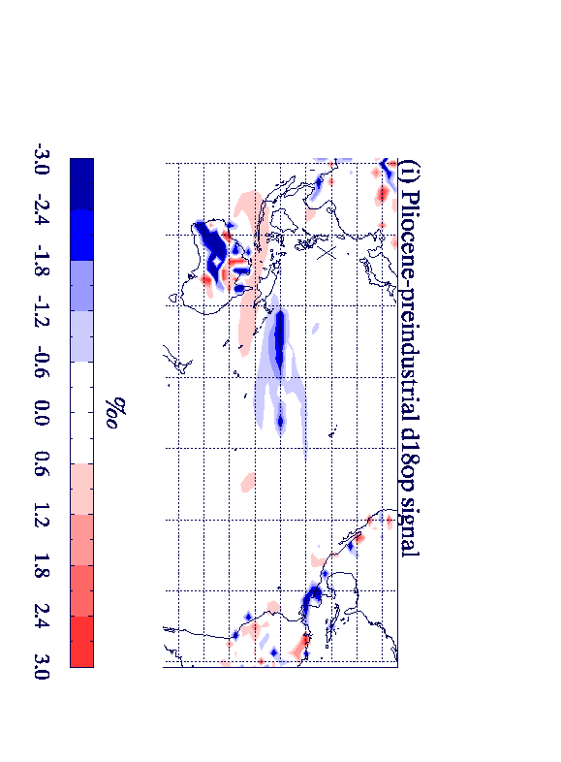
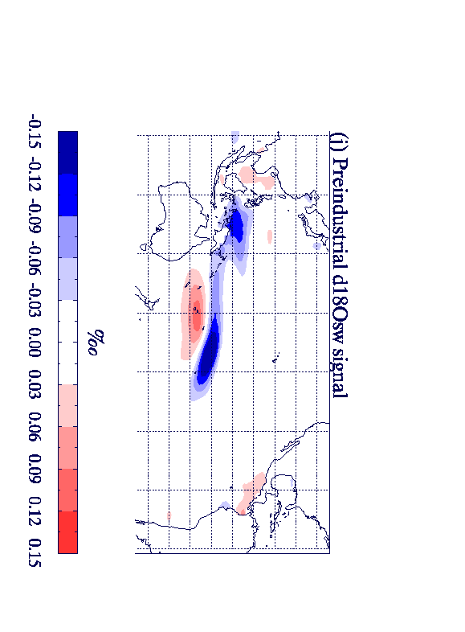
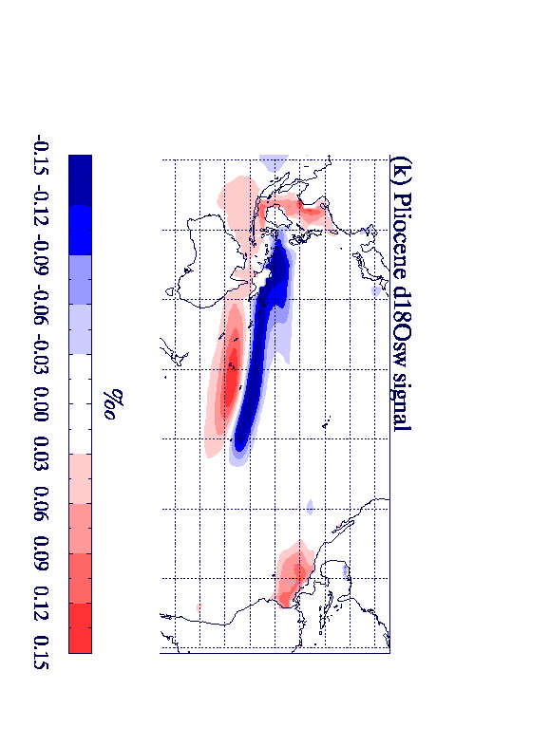
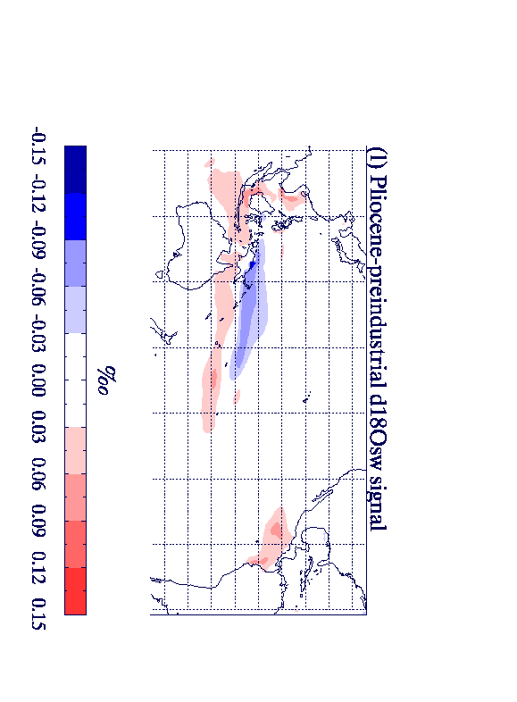
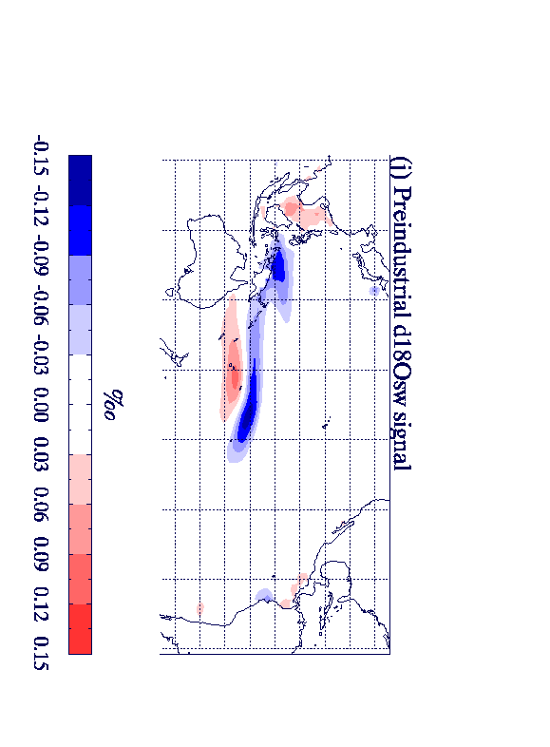
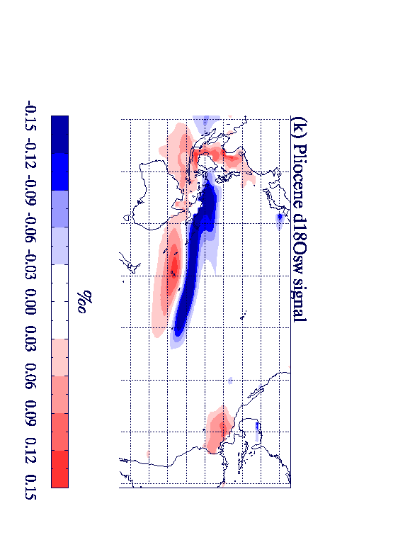
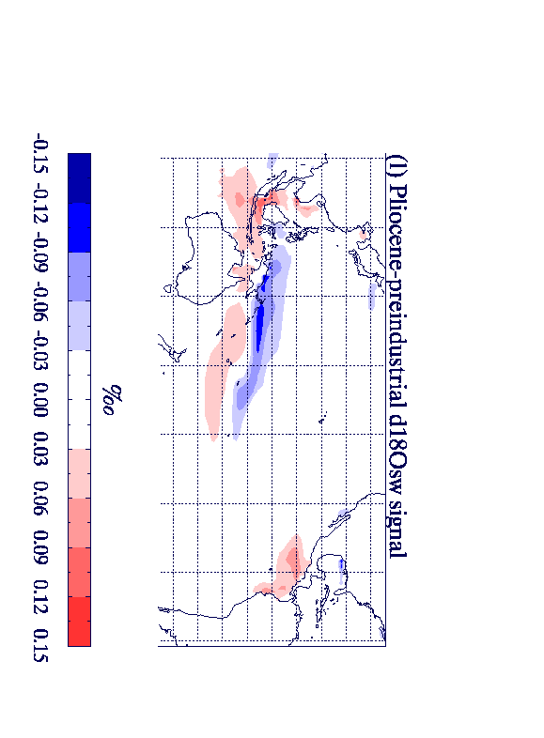
Structure of El Niño in HadCM3:
Temperature: Preind Temperature: Pliocene Temperature difference
δ¹⁸O_{sw}: Preind δ¹⁸O_{sw}: Pliocene δ¹⁸O_{sw}: difference
Notes:
This slide shows the modelled El Nino climate anomaly for the temperature and the d18sw which will combine to give the signal in paleoclimate archives.
The top row is the El Nino temperature for the preindustrial (left) the Pliocene (centre) and the difference between them (right). It is seen that the temperature signal is stronger in the Pliocene, broader and shifted towards the West.
The bottom row is the El Nino d18osw anomaly for the Preindustrial (left) the Pliocene (centre) and the difference between them (right). The reason for the difference in d18osw is that the hydrological cycle is stronger in the Pliocene, and hence the hydrological signal of El Nino is stronger in the Pliocene. Unlike temperature there are no shifts in the regions of the hydrological cycle, precipitation, d18o of precipitation or d18o of seawater. [Alan Note: precipitation is shown as an extra slide (no 17)]
On the next slide we combine the El Nino signals of temperature and d18osw to show a modelled El Nino signal in proxy data.
[FYI, but not necessarily to mention: This plot is from a 200 year subset of the whole simulation. Also note that the scale on the ‘temperature difference’ plot is reduced relative to the other temperature plots in order to highlight differences. This is not the case for d18osw, where all scales are the same. The change in d18osw between the Preind and Pliocene is relatively larger than that of temperature.]

Slide 4
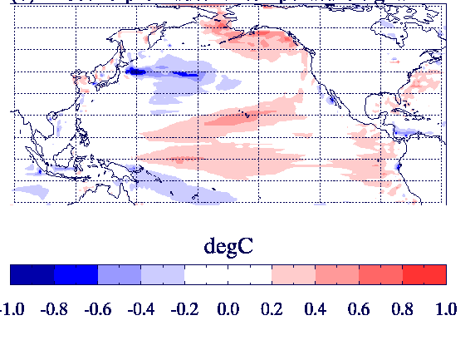
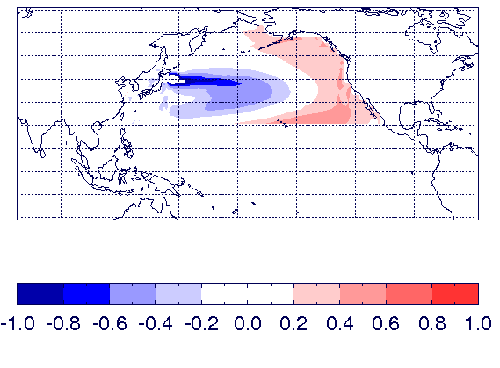
The Pacific Decadal Oscillation and its relationship with El Niño
El Niño temperature: Pliocene-preind
PDO : EOF1 of Pacific temp North of 20°N
Pliocene simulation has a stronger PDO-ENSO relationship
The PDO is typically 15% stronger in the Pliocene simulation
Caution: Centennial scale variability➔ relationship not constant
Notes:
The plot on the left shows again how the El Nino temperature signal differs between the Pliocene and the preindustrial. However this time the focus includes the North Pacific (it is not limited to the tropics), and the differences in El Nino teleconnections between the two climates can be clearly seen.
The plot on the right shows the first EOF of Pacific temperature North of 20N; which represents the ‘Pacific Decadal Oscillation’ mode of variabity.
It can be seen that there these two patterns look very similar, implying that the PDO could explain some of the differences in the El Nino temperature signal between the Pliocene and the Preindustrial.
This is indeed the case for two reasons:
1. Even though there is a relationship between the PDO and ENSO for both the Pliocene and the Preindustrial, this relationship is stronger in the Pliocene, meaning that a PDO signal and an ENSO signal are more likely to occur at the same time.
2. In addition the PDO is stronger in the Pliocene simulation enhancing the signal further.
However please note that that there is large centennial scale variability in ENSO, the PDO and the relationship between them so even though the patterns seen here are typical they are not ubiquitous. [FYI: I would estimate 80-90% of our 200 year subsets see an Pliocene –preindustrial El Nino temperature pattern that looks like the PDO, so it may be reasonable to remove the caution].
PDO is about 15% stronger in the Pliocene simulation
The centennial scale variability means that although this is true in general it is possible to find centuries where this is not the case

Slide 5
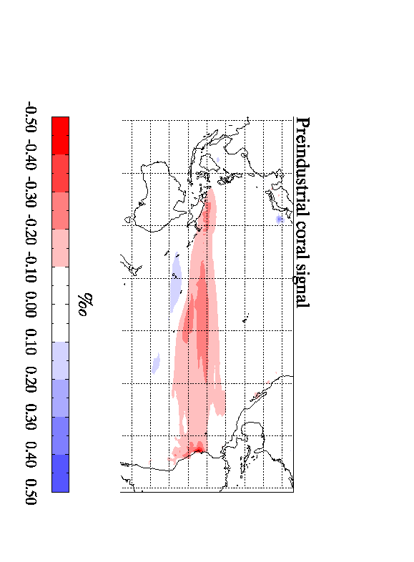
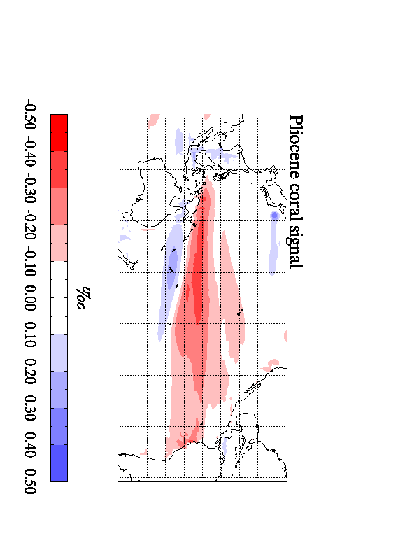
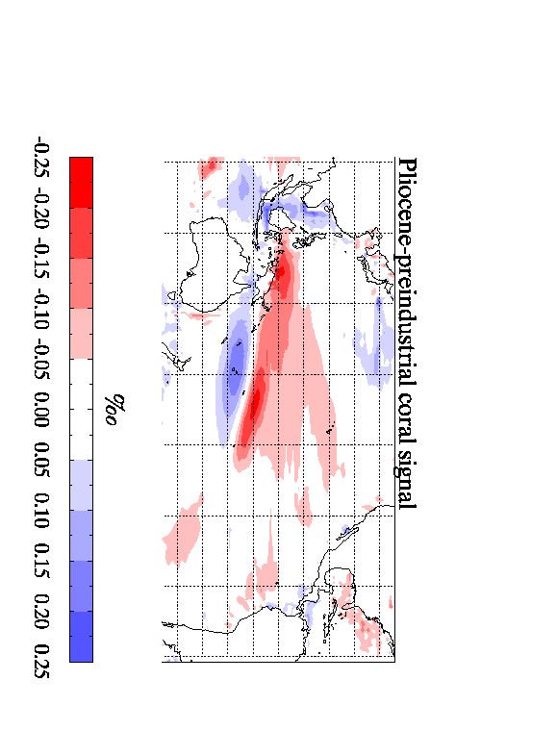
Structure of El Niño in HadCM3 (coral):
δ¹⁸O_{c}: Preind δ¹⁸O_{c}: Pliocene δ¹⁸O_{c}: difference
Temperature difference δ¹⁸O_{sw} difference
Notes:
This shows the modelled signature of El Nino (relative to ‘normal’ conditions) in coral data. For the Preindustrial (left), the Pliocene (centre) and the difference between them (right). [FYI: Note the scale is reduced on the difference plot]. We see very little change between the two climates in the eastern half of the Pacific, but in the western half of the Pacific the change can be significant.
The extra plots (that appear as an animation) show how the difference in the coral signal between the Pliocene and the preindustrial can be attributed to the temperature difference and the d18osw difference. The largest difference in modelled coral between the two climates is due to the d18osw difference, and is due to the hydrological cycle being stronger in the Pliocene, however temperature also has an important effect.
The next slide will look at the temperature difference in more detail.

Slide 6
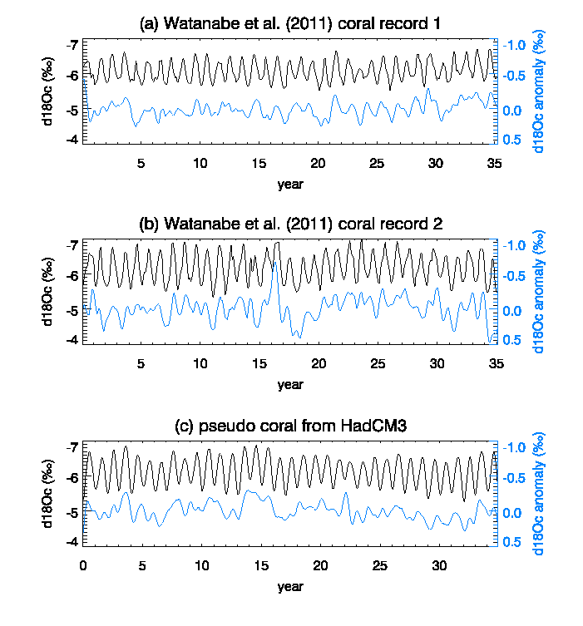
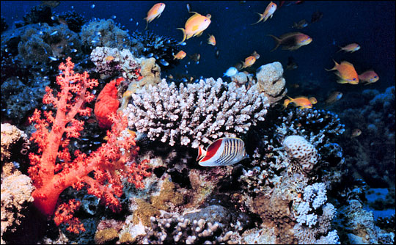
Model-data comparison for Pliocene coral
Notes:
We now include a model-data comparison in order to validate our Pliocene simulation.
This plot shows some Pliocene aged coral data (from Watanabe et al 2011) from the marked site in the West Pacific.
Watanabe analysed two separate corals from this region (shown by figures a and b) where the black line is the raw data and the blue line is the data after removal of an annual cycle.
For this location we have also produced ‘pseudo-coral’ d18o from HadCM3 which is shown by figure c. It can be seen that the HadCM3 pseudo coral agrees very well with the data in terms of absolute values/amplitude of annual cycle/ and anomalies.
Therefore the HadCM3 pseudo coral can be used to assess what information about El Nino could likely be detected in ‘real’ corals.

Slide 7
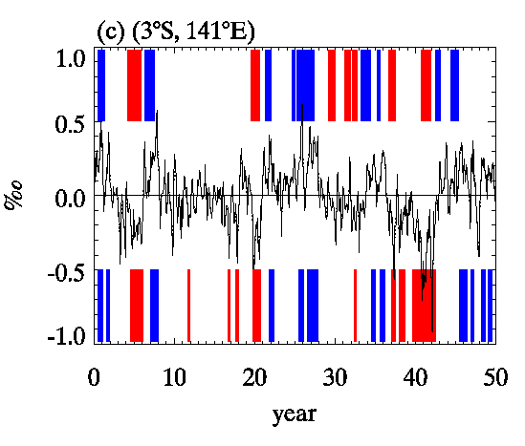
Can El Niño be detected in Coral data?
True/Target
El Niño/ La Nina events
⬅ HadCM3 ‘pseudo-coral’ at site
⬅ El Niño/ La Nina estimated from the ‘pseudo coral’
This ‘pseudo coral’ has a skill* of 0.71.
(Where 1.0 is perfect skill and 0.0 is random chance).
$$skill=\left(\left\{\frac{1}{3}\left(correct EN+correct LN+correct normal\right)\right\}−\frac{1}{3}\right)/\frac{2}{3}$$
Notes:
For the marked site in the Western Pacific we have plotted the ‘pseduo coral’ d18oc derived from HadCM3.
First ‘appear’ animation: The times when the model was in a state of El Nino or La Nina are shown by these red and blue bars. So we now want to assess whether these events could be detected in the ‘pseudo coral’ data from this single location.
Second ‘appear’ animation: We used a threshold value such that extreme low values in the pseudo coral indicate El Nino while extreme high values indicate La Nina – these are the times (point them out) where the pseudo coral indicated El Nino/La Nina events. These appear to match quite well with the target El Nino events (top) derived from the model.
Third ‘appear’ animation: We have calculated a ‘skill score’ for our pseudo coral using the equation shown, and this coral has a skill of 0.71.
[FYI - threshold: The threshold for detecting El Nino/La Nina was an anomaly 0.5standard deviations above/below the mean which persisted for 5 months
FYI – skill: I calculated the fraction of EN events that were correctly predicted, the fraction of LN events that were correctly predicted and the fraction of ‘normal events’ that were correctly predicted.
These fractions were added together and divided by 3 – this gives a number, s1, where s1 is between 0 and 1: where 1 is everything accurately perfectly and 0 is nothing predicted accurately, and each event type (EN/LN/normal) contributes equally to s1.
However it is unlikely that nothing would be predicted accurately as random chance would give s1=1/3. We therefore normalised s1 to produce the skill by skill=(s1-1/3)/2/3]. This normalised number is therefore a measure of the skill above random chance, a skill of 1.0 is still perfect accuracy but now a skill of 0.0 is random chance or 1/3 predicted accurately, a skill of 0.5 is half of the events that are not due to random chance predicted accurately).

Slide 8
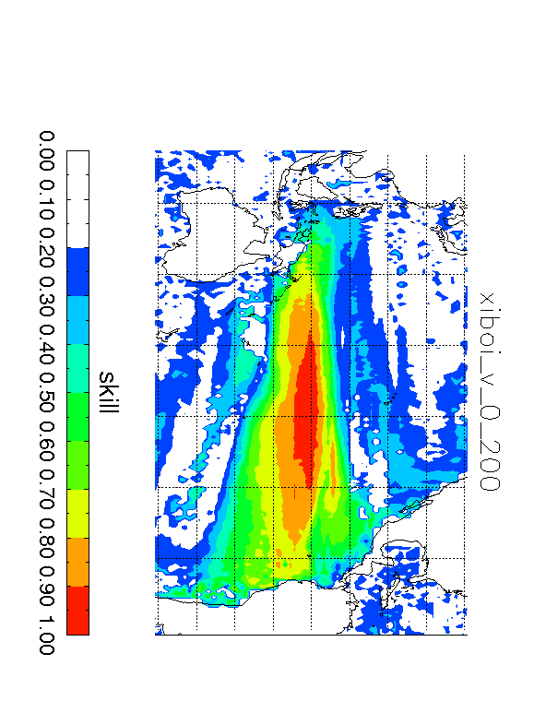
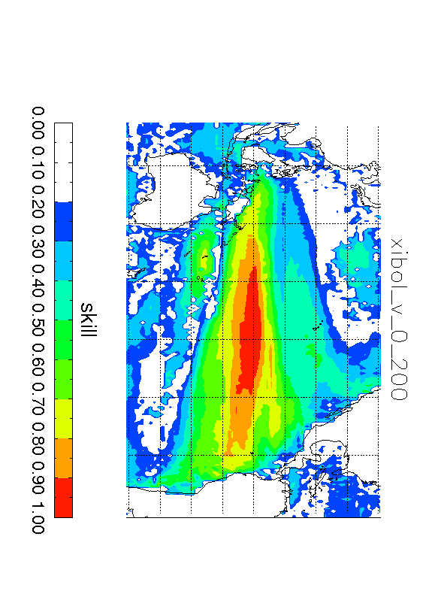
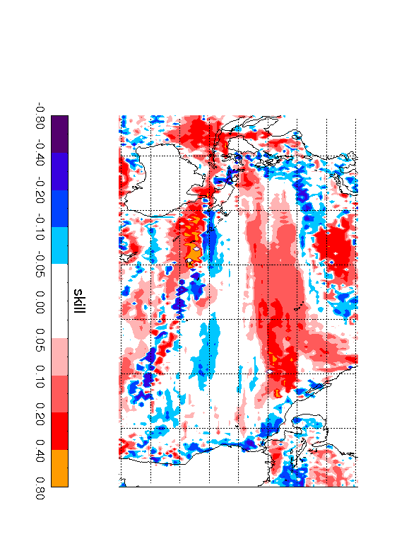
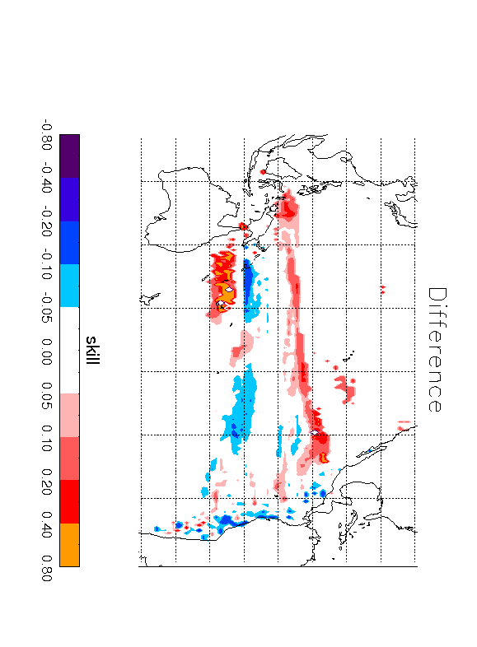
Where can El Niño be detected in coral data? HadCM3 results.
Preindustrial skill Pliocene skill Difference
Difference in
high skill regions
Notes:
We now make a pseudo coral at every point in the tropical pacific and calculate the ‘skill’ of that pseudo coral.
This has been done for the preindustrial (left) and the Pliocene (centre). The difference between the two is shown on the right.
It can be seen that over the central pacific, there is very good skill for the Pliocene and the preindustrial and little difference between them.
However away from this region the skill is usually greater in the Pliocene simulation because the El Nino temperature signal is more widespread in the Pliocene simulation.
Perhaps the most important difference is the region just to the east of Australia where there is no skill in the preindustrial but has a skill score of 0.7 in the Pliocene. This is the region where the hydrologial cycle and its effect on d18osw is important.
Although the Pliocene simulation generally have greater skill, in some regions the skill is too low for differences to be relevant, so we have also plotted (animation appear) the difference in high skill regions. Generally Pliocene has better skill but care needs to be taken in the blue regions where the effects of d18osw on coral are acting in the opposite direction to the effects of temperature and thus damping the signal.
SKILL was calculated as follows:
X=(correctly detected elnino/total el nino) + (correctly detected lanina/total la nina) + ( correctly detected normal/total normal) ; allowing for 2 months margin or error
SKILL=((X/3)-0.33) / 0.66 ; to give a normalised skill between 0 and 1 and random chance producing a skill of zero.

Slide 9
Can El Niño be detected in planktonic foraminifera data?
Age ma
Location 90W 3S
Data from Scroxton et al (2011)
Notes:
We are now going to use the HadCM3 simulations to investigate whether El Nino can be detected in planktonic foraminifera data.
To investigate El Nino in this data it is perhaps better to look at individual foraminifera measurements rather than bulk foraminifera data, as was done by Scroxton et al 2011 from the site (marked) in the Eastern Pacific.
Individual foraminifera represent data from a 2-4 week period, and extreme values, which do not fit with the standard seasonal cycle (like those on this plot) can be attributed to ENSO variability.

Slide 10
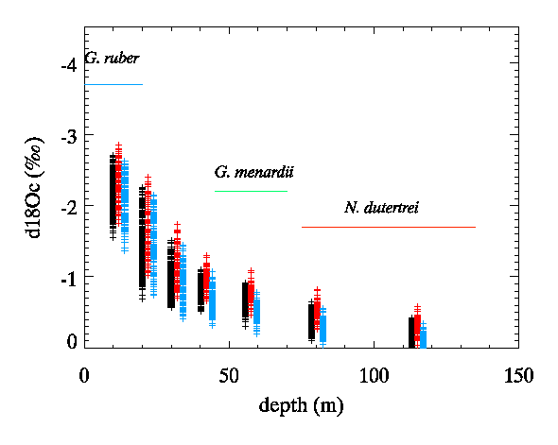
Results for the pre-industrial
Location 90W 3S
WARMER
COLDER
El Niño
La Nina
Notes:
Modelling individual foraminifera from HadCM3 can be used to investigate the method.
This figure shows the same site in the eastern Pacific, each cross represents a foraminifera modelled using temperature and d18osw from a single month. We have separated data into El Nino conditions (red), La Nina conditions (blue) and ‘normal’ conditions (black). This has been done from the surface of the ocean down to 120m.
These results are from the preindustrial, and it can be seen that the most extreme warm values do indeed represent El Nino conditions while the most extreme cold values do represent La Nina conditions.

Slide 11
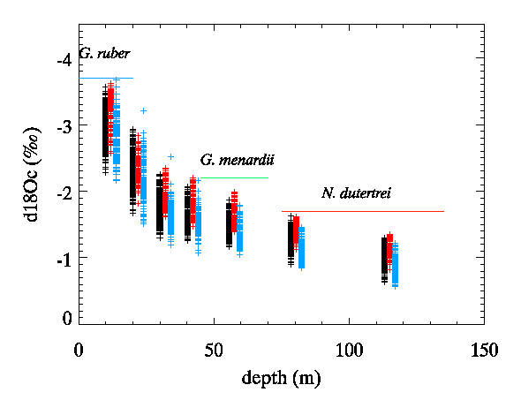
Results for the Pliocene
Location 90W 3S
WARMER
COLDER
El Niño
La Nina
Notes:
For this site in the Pliocene, this is not the case. While the extreme cold values do represent La Nina conditions, the most extreme warm values do not represent El Nino conditions.
So at this site a method which seems appropriate for preindustrial data does not appear appropriate for the Pliocene – at least not in the top ocean layers.

Slide 12
Why are results different for the modern and the Pliocene at this location?
1. δ¹⁸O(seawater) is more variable in the Pliocene. In this region, δ¹⁸O(seawater) variability is not related to ENSO and so large δ¹⁸O(seawater) variability can contaminate the results
Pre-Industrial
Pliocene
Notes:
We have found two reasons for this descrepency.
(The first is described on this slide)

Slide 13
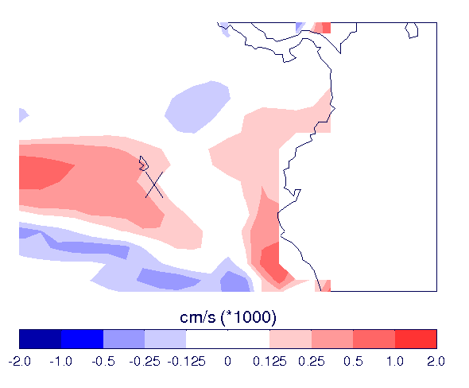
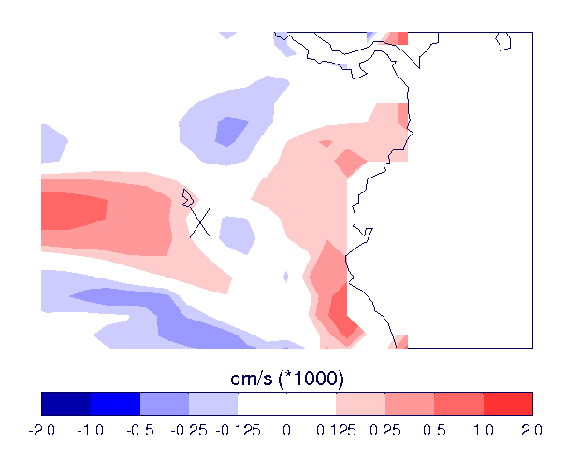
Why are results different for the modern and the Pliocene?
2. The site is on the edge of an upwelling zone in the modern. In the Pliocene it lies between upwelling and downwelling zones meaning that interannual variability at this location can be large.
Pre-industrial
Pliocene
Notes:
The second is described here:
This also shows that the exact location of data may be very important for understanding El Nino, especially for planktonic foraminifera where we do not have a timeseries of data, and anomalies in a single month may be incorrectly attributed to ENSO.

Slide 14
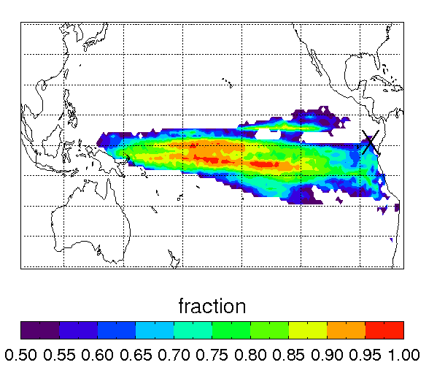
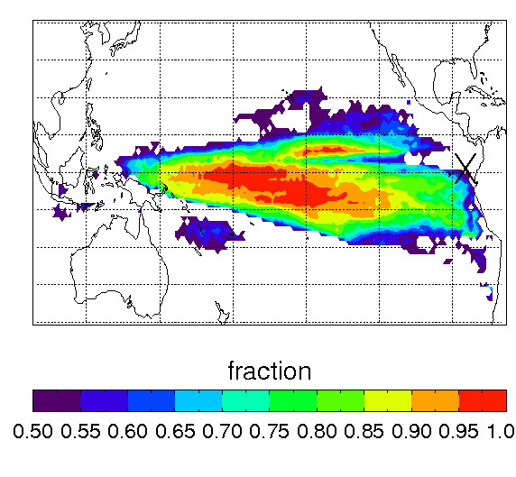
Where can El Niño be detected in individual planktonic foraminifera data? Fraction of modelled extreme events that are due to ENSO.
Pre-industrial Pliocene
Notes:
The previous slide showed that extreme events may not always be due to ENSO variability.
Here we have considered the fraction of extreme events that are due to ENSO at every location.
The scroxton site is marked with a cross and is right on the edge of a region of where ENSO can be detected using this method, which explains the results of the previous slide.
However this method is generally better for the Pliocene than the preindustrial (provided the site is chosen with care). In the Pliocene a greater fraction of the extreme events are due to ENSO than in the preindustrial

Slide 15
Conclusions
In the Pliocene HadCM3 suggests El Niño events were:
Stronger
Temperature anomaly shifted to the West
More strongly related to the PDO
El Niño events have a stronger signal in proxy data in the western half of the Pacific due to
Shift in temperature
Intensification of hydrological cycle throughout tropics
Skill in predicting El Niño from proxy data can change between the Pliocene and preindustrial but is usually:
Similar for coral data
Better in the Pliocene for individual planktonic foraminifera data.
Research leading to these results has received funding from the European Research Council under the European Union’s Seventh Framework Programme (FP7/2007-2013) / ERC grant agreement no. 278636.
Notes:
Alan – FYI: I think that these are the conclusions from the presentation that are robust.
However one thing to be aware of is that ENSO is not predicted perfectly in HadCM3 for the modern (extra slides 18 & 19), hence all of the maps are indicative of the processes only and are not intended to be definitive. Perhaps we could discuss on Thursday where/if this should be mentioned.

Slide 16
EXTRA SLIDES

Slide 17
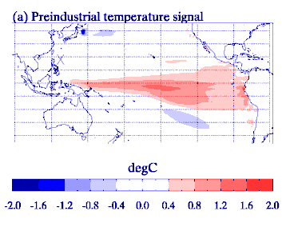
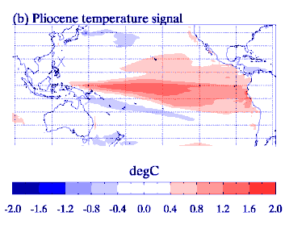
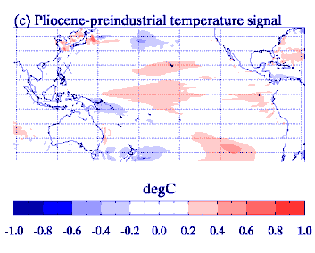
Structure of El Niño in the Pliocene: 2. Precipitation

Slide 18
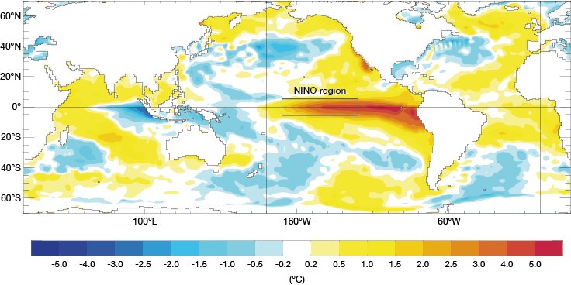
HadCM3 modern El Nino
HadCM3 El Nino temperature
anomaly preindustrial
November 1997 SST anomaly (strong El Nino)

Slide 19
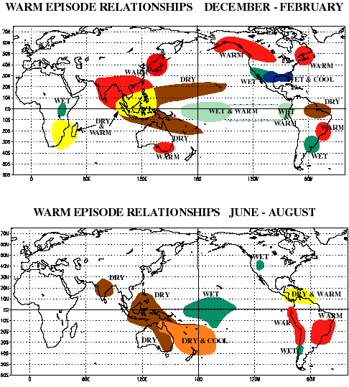
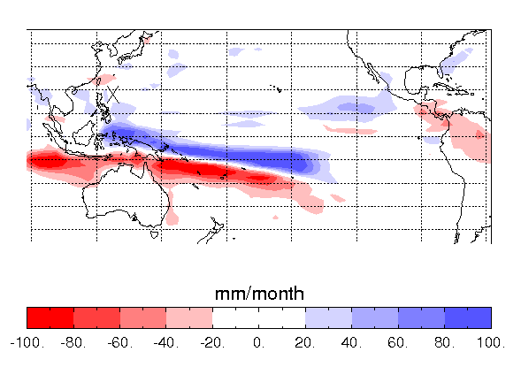
Data-model comparison to interpret Pliocene El Nino
For the modern this region is drier in El Nino years. These precipitation patterns are not correctly reproduced by HadCM3.
Perhaps compare data with another HadCM3 region.
HadCM3 modern precipitation
El Nino - long term mean
Notes:
Shows that HadCM3 does not quite get the precipitation pattern correct

Slide 20
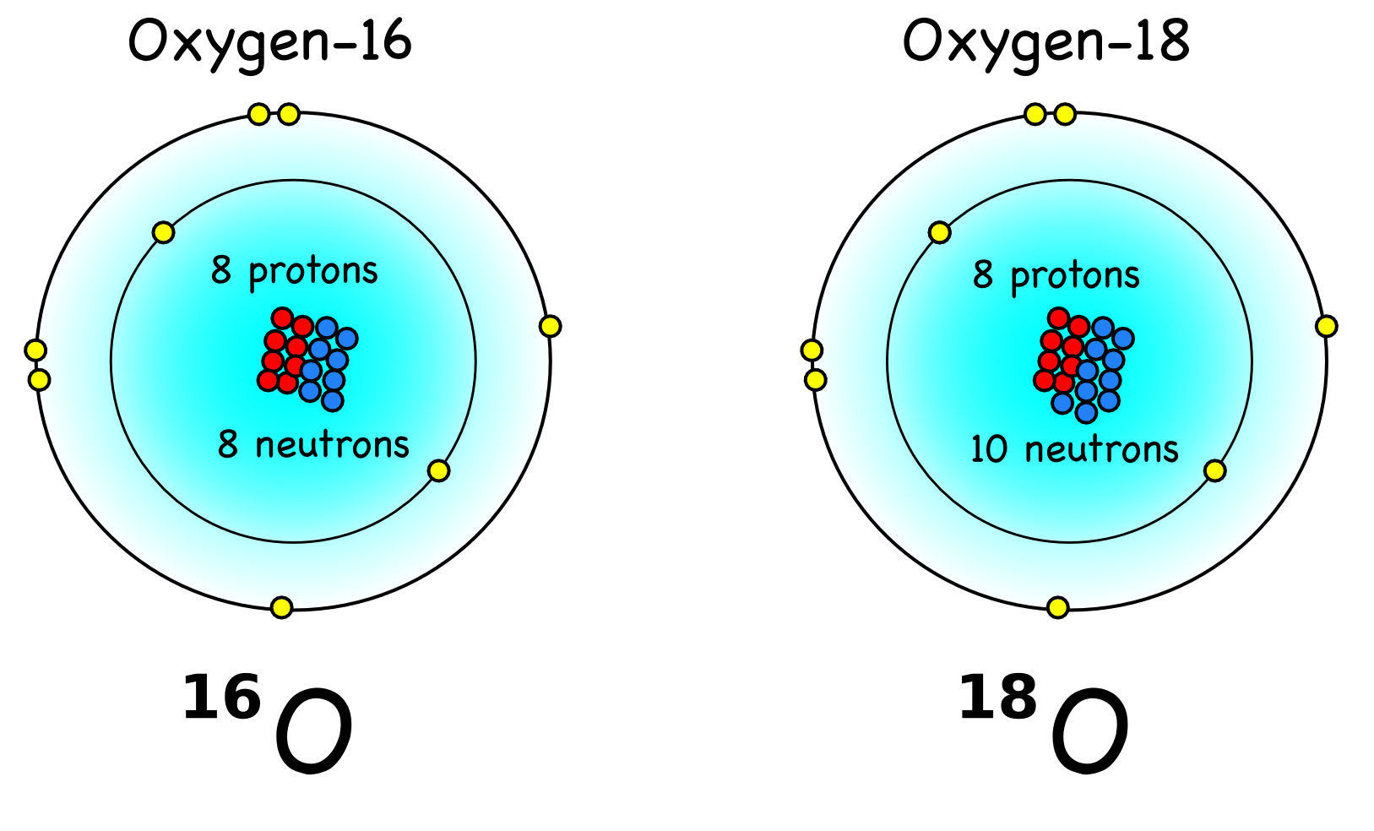
What is δ¹⁸O?
All natural waters contains some oxygen-16 and some oxygen-18.
Anything which incorporates water will incorporate some oxygen-16 and some oxygen-18.
δ¹⁸O is a measurement
of the relative amounts of
oxygen-16 and oxygen-18.
Different values of δ¹⁸O are expected for different climates.

Slide 21
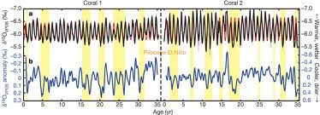
El Nino Characteristics Present-day
THE THEORY
Warmer temperatures➔reduced δ¹⁸O_{coral}
Less precipitation ➔increased δ¹⁸O_{p}
➔increased δ¹⁸O_{sw}
➔increased δ¹⁸O_{coral}
BUT what is happening here?

Slide 22
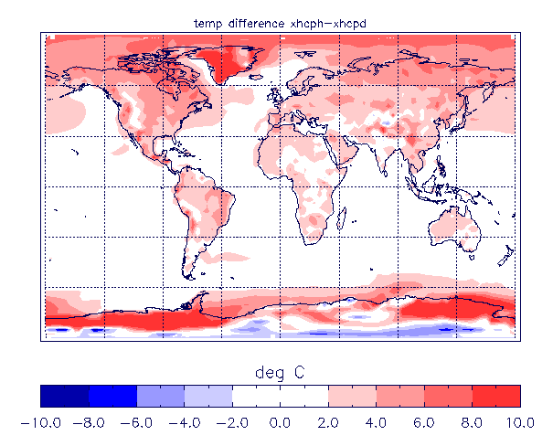
1. The climate → the Pliocene
Mid Pliocene (~3.205Ma)
CO₂ ~405ppm
Continents similar to today
Ice volume reduced by 1/3
Orbit close to modern
HadCM3 – annual temperature difference
Mid Pliocene – Pre-industrial.
Notes:
Check reasonable vs observations.

Slide 23
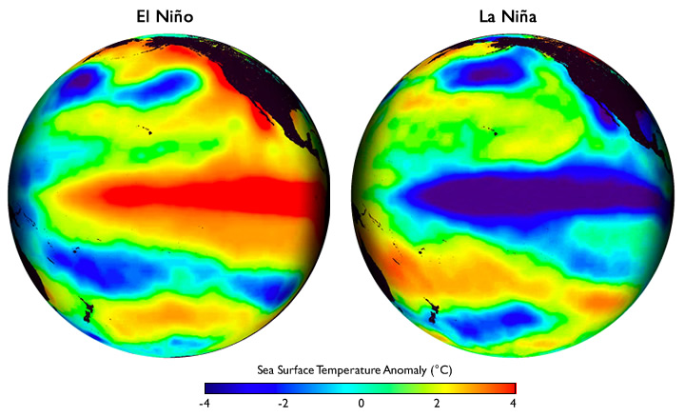
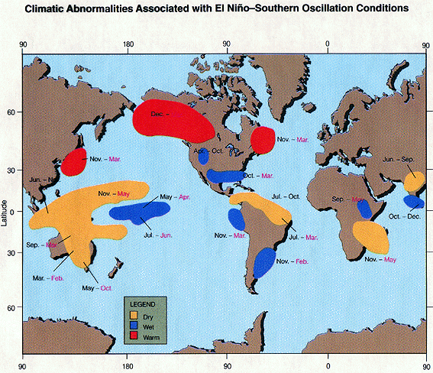
2. The variability ➔ ENSO
The El Niño Southern Oscillation (ENSO)
Tropical Pacific phenomena that dominates Earth’s interannual climate variability
El Niño – warm episode
La Nina – cold episode
There is an ENSO signal in temperature, precipitation, atmospheric pressure, depth of thermocline etc.
Notes:
The El

Slide 24
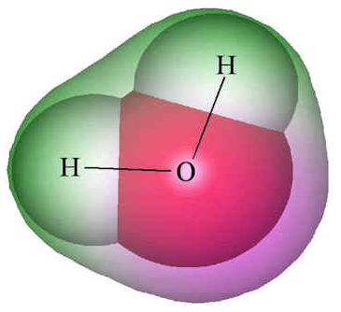
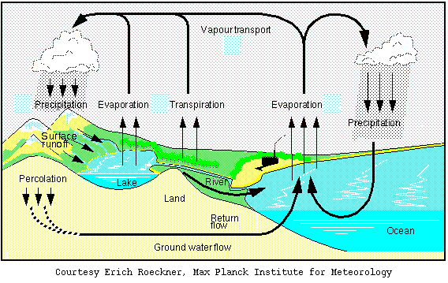
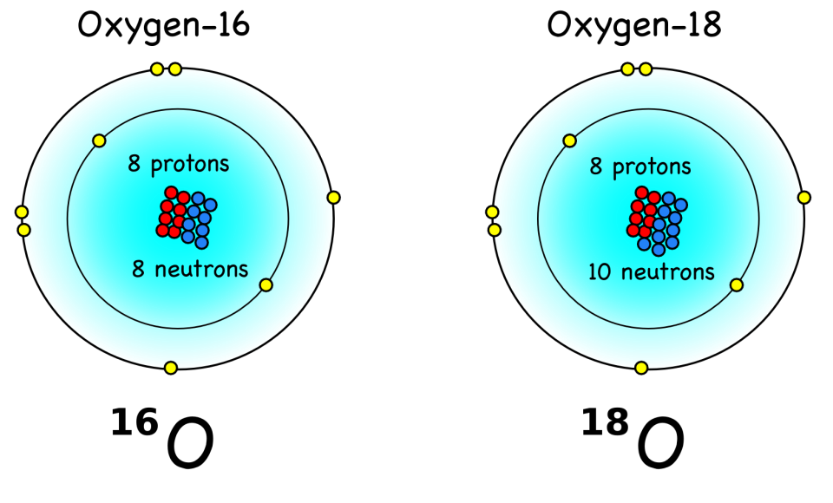
3. The modelling ➔ water isotopes
HadCM3 coupled atmosphere-ocean – water isotope GCM
δ¹⁸O
Notes:
Check reasonable vs observations.

Slide 25
Typical changes in δ¹⁸O(seawater)
This can be combined with temperature to estimate Pliocene coral δ¹⁸O or foraminifera δ¹⁸O

