Slide 1
Modelling Climate and Water Isotope Signatures of El Niño in the Pliocene
Julia Tindall and Alan Haywood
AGU Fall Meeting
15th December 2015

Slide 2
Questions & Methods
How was the structure of El Niño different in the Pliocene? (2500 year HadCM3 simulation)
What are the reasons for these differences? (including relationship with Pacific Decadal Oscilation)
What would Pliocene El Niño look like in proxy data?
4. Which regions provide a good representation of Pliocene El Niño?
HadCM3 temperature
Transfer function
Modelled δ¹⁸O_{c}
HadCM3 δ¹⁸O_{sw}

Slide 3
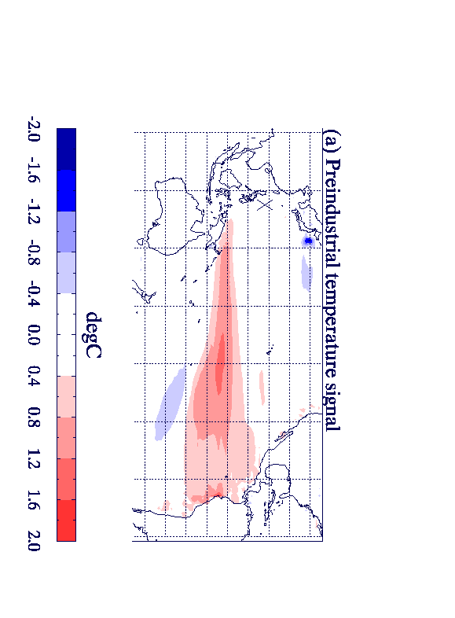
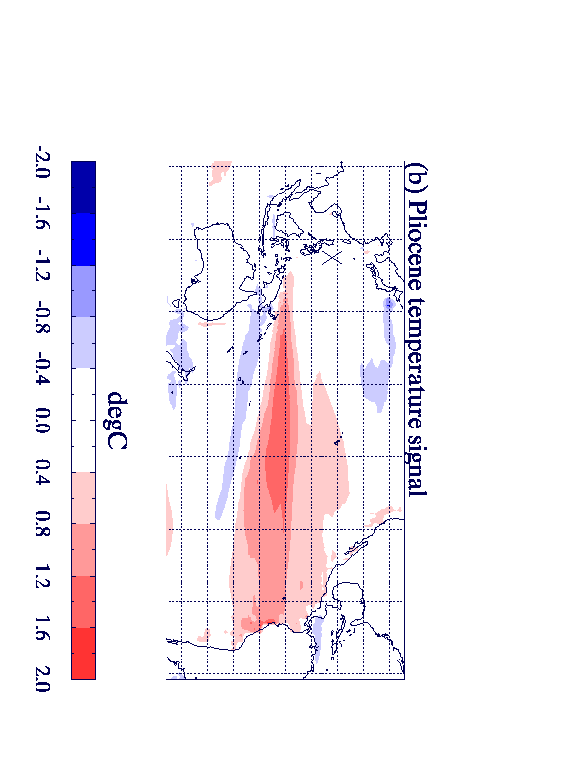
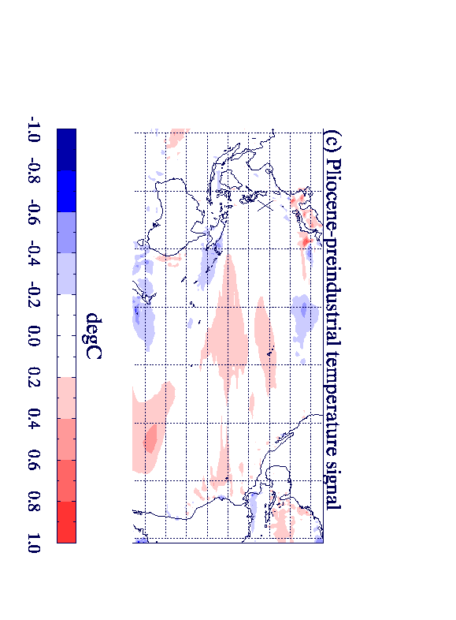
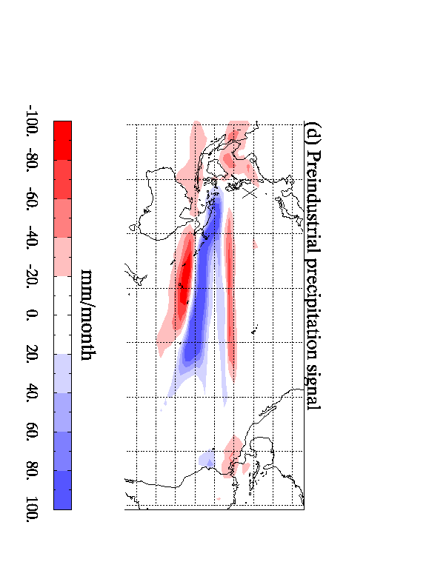
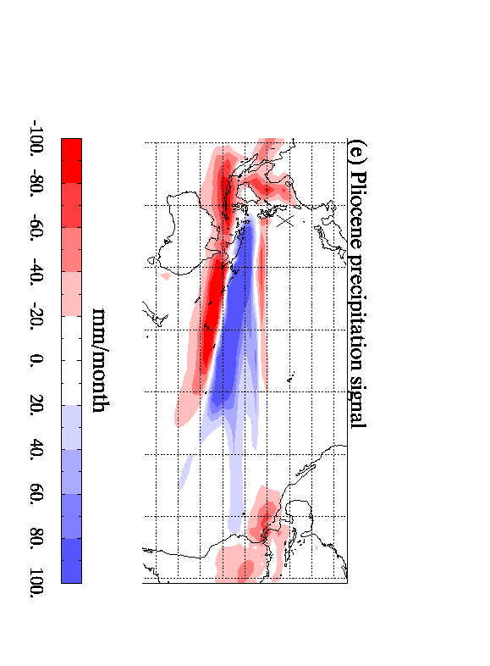
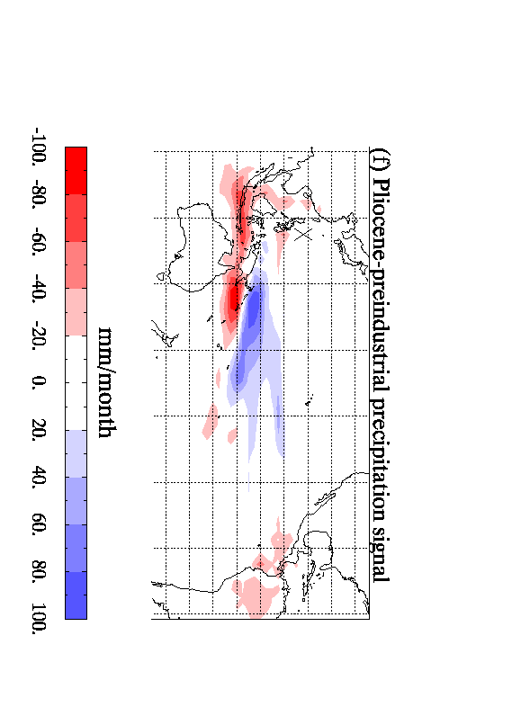
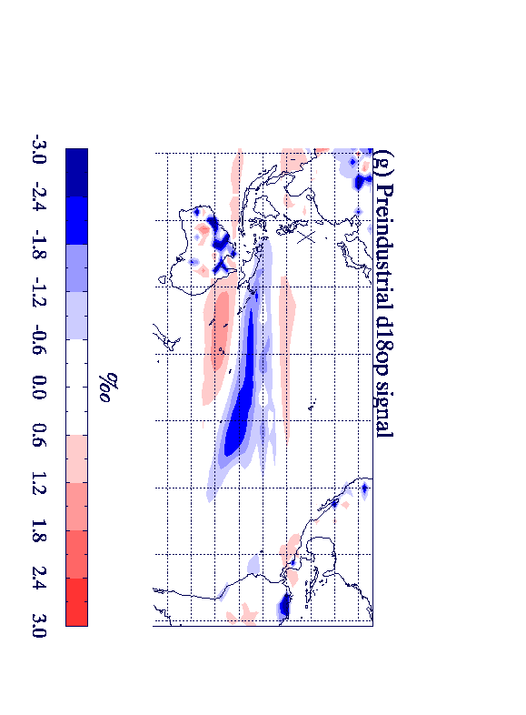
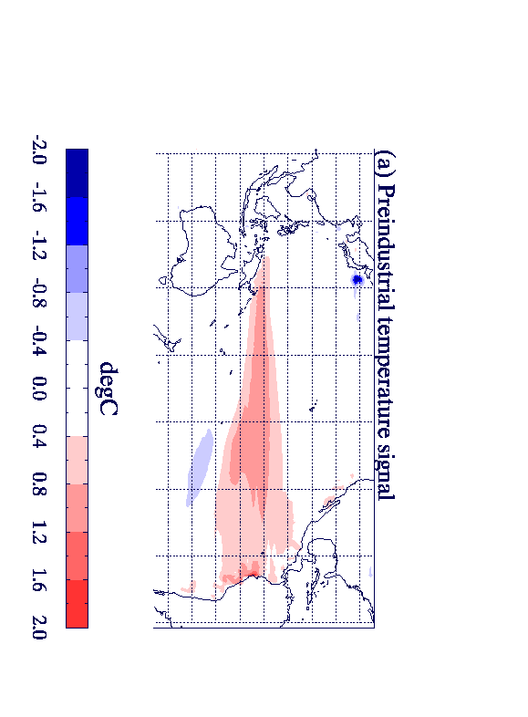
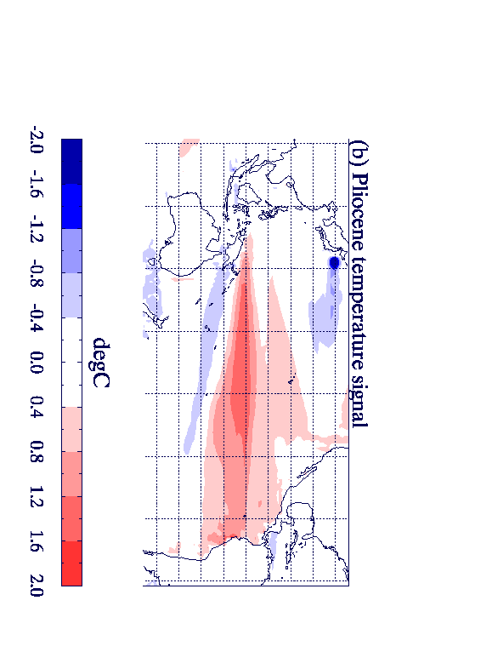
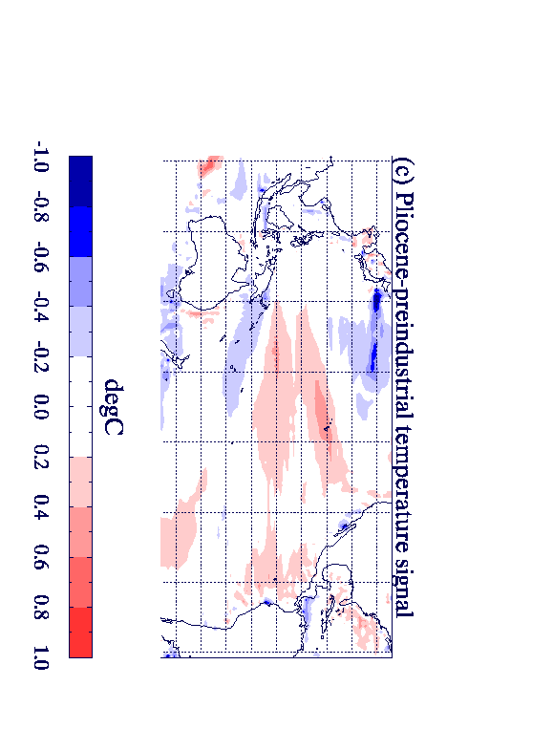
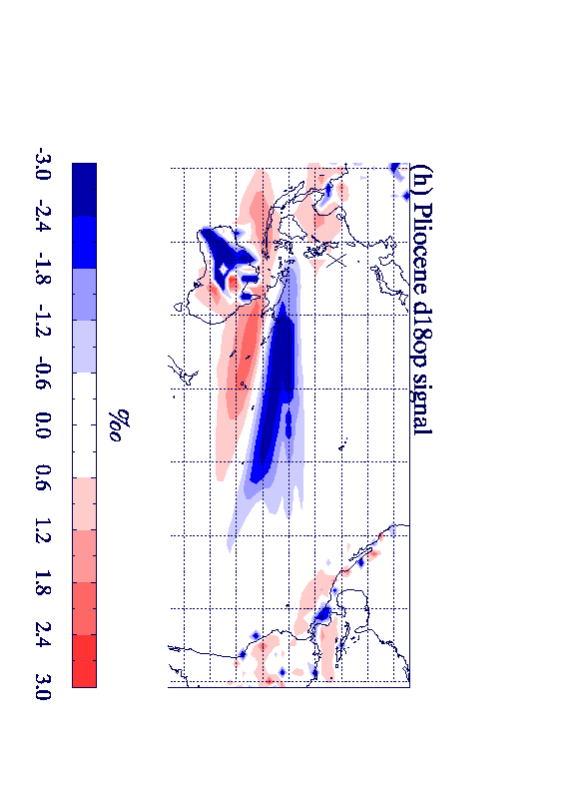
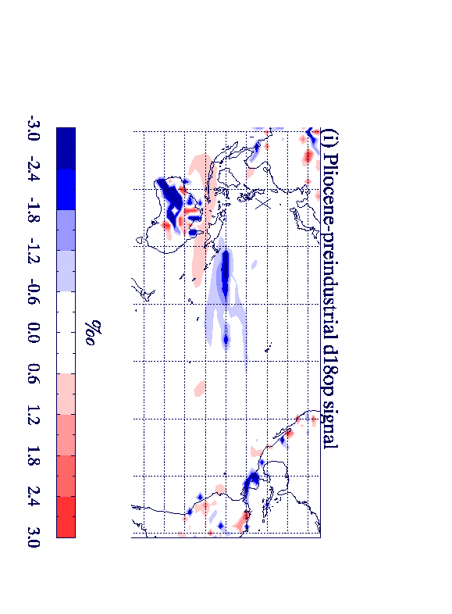
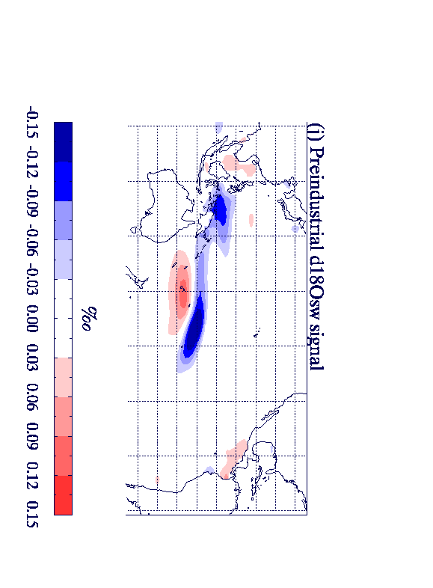
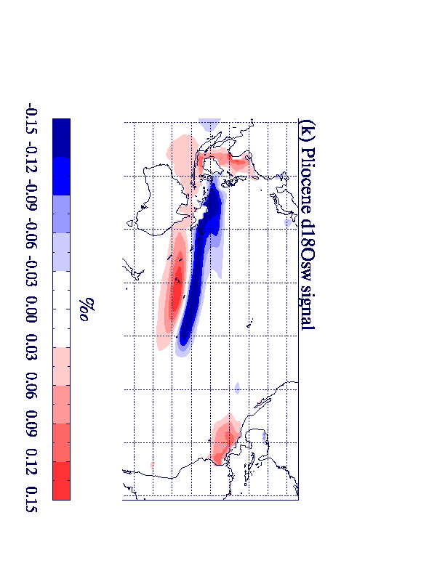
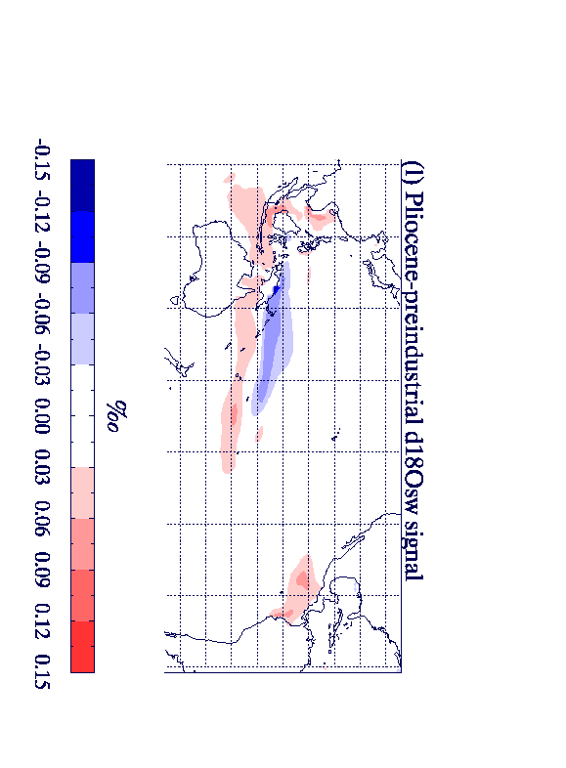
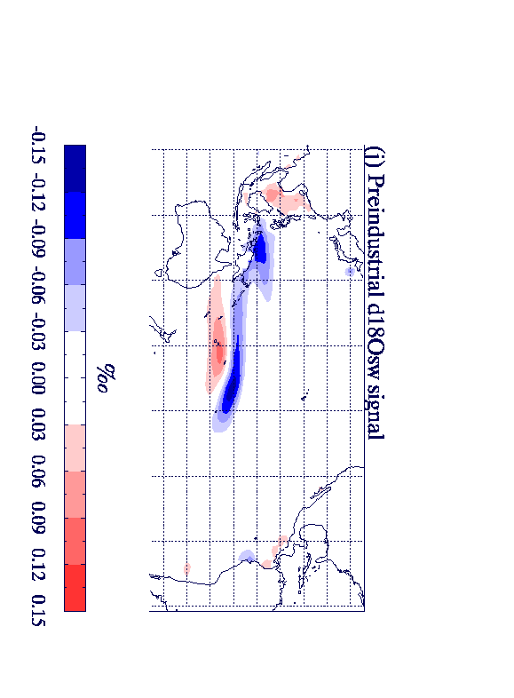
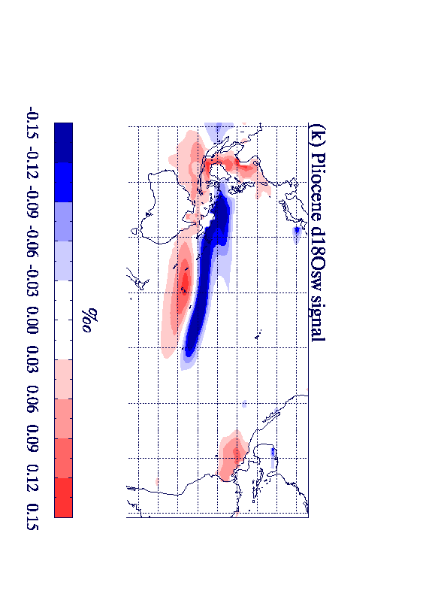
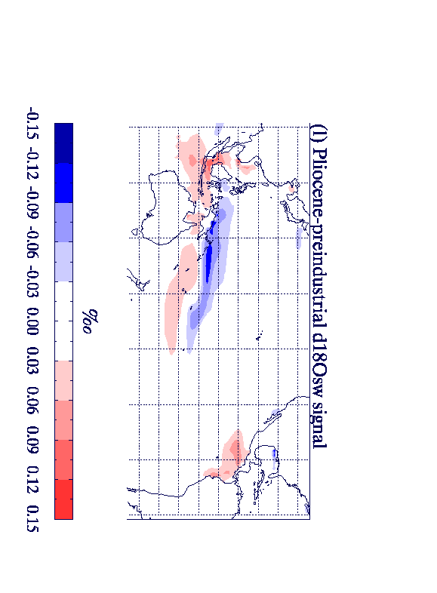
Structure of El Niño in HadCM3:
Temperature: Preind Temperature: Pliocene Temperature difference
δ¹⁸O_{sw}: Preind δ¹⁸O_{sw}: Pliocene δ¹⁸O_{sw}: difference
Notes:
Have changed this to M2 TIMESLICE 11 as it is clearer and fits in better with the rest of the presentation

Slide 4
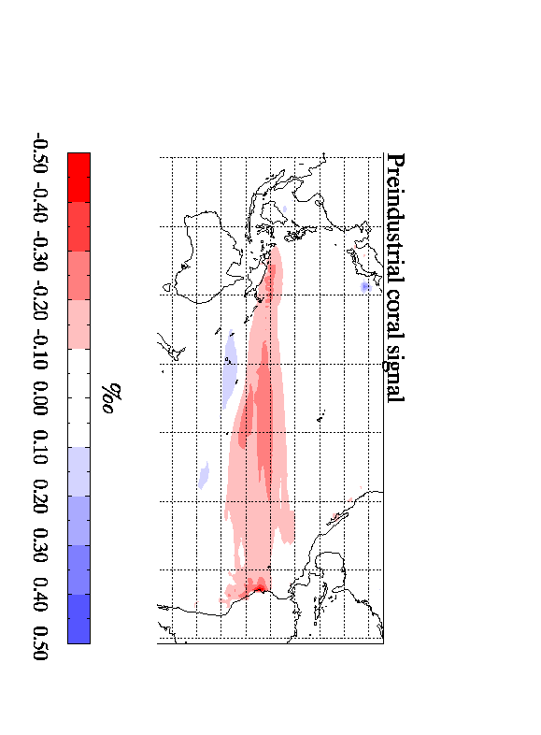
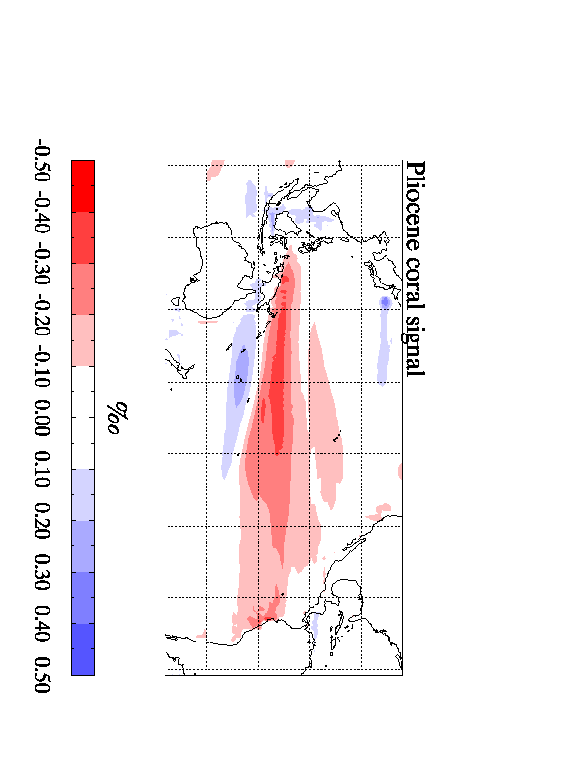
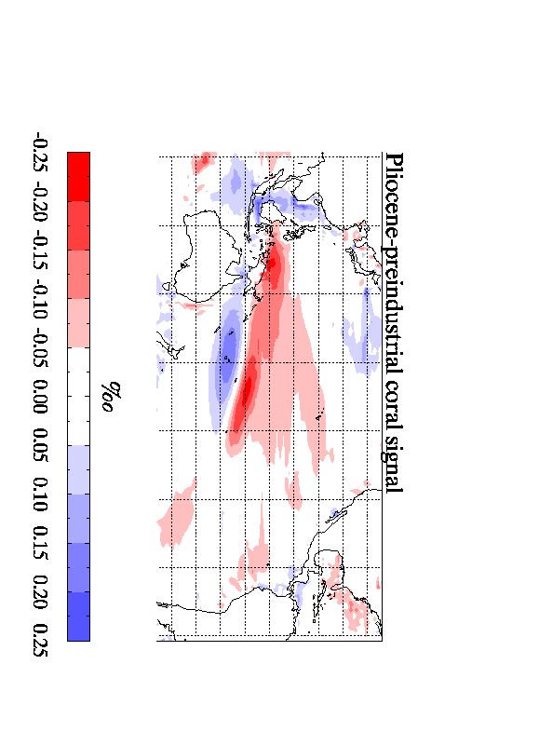
Structure of El Niño in HadCM3 (coral):
δ¹⁸O_{c}: Preind δ¹⁸O_{c}: Pliocene δ¹⁸O_{c}: difference
Temperature difference δ¹⁸O_{sw} difference
Notes:
The change in d18osw is mainly due to the hydrological cycle – which is stronger in the Pliocene (see extra slide1)

Slide 5
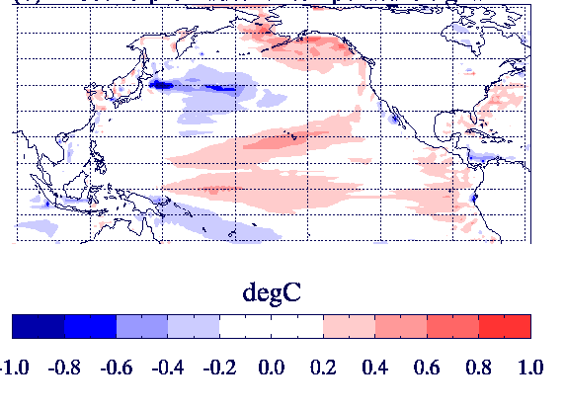
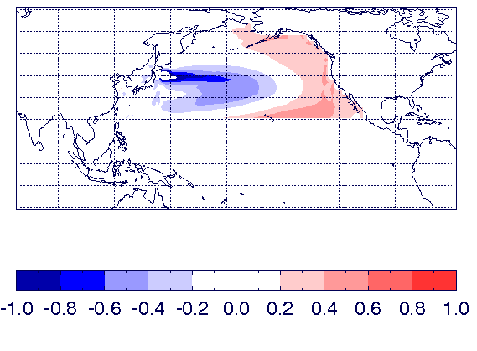
The Pacific Decadal Oscillation and its relationship with El Niño
El Niño temperature: Pliocene-preind
PDO : EOF1 of Pacific temp North of 20°N
The PDO is typically 15% stronger in the Pliocene simulation
Pliocene simulation has a stronger PDO-ENSO relationship
Caution: Centennial scale variability➔ relationship not constant
Notes:
PDO is about 15% stronger in the Pliocene simulation
The centennial scale variability means that although this is true in general it is possible to find centuries where this is not the case

Slide 6
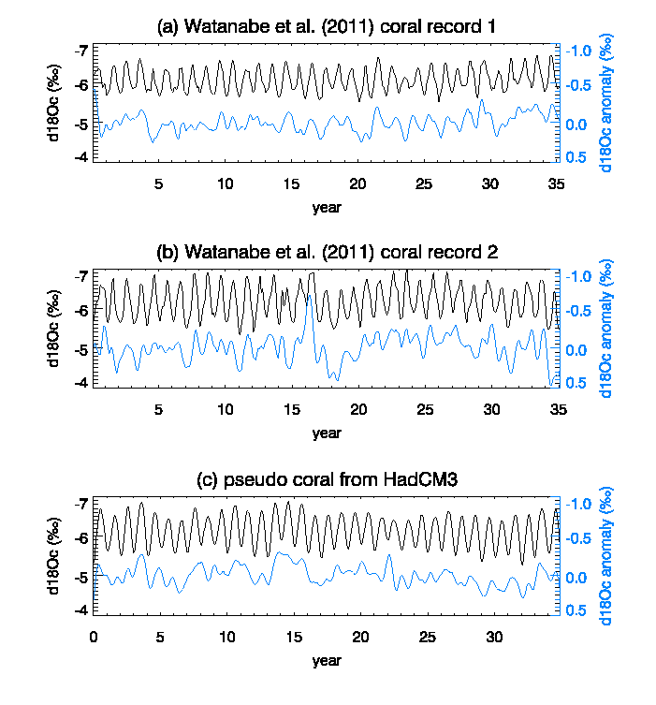
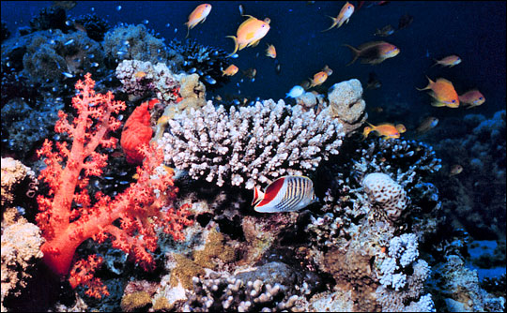
Model-data comparison for Pliocene coral

Slide 7
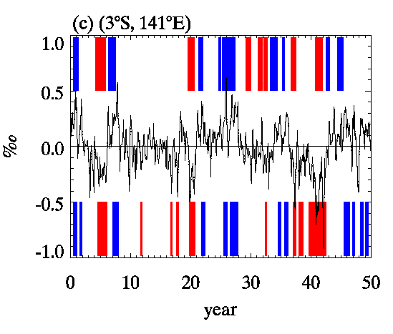
Can El Niño be detected in Coral data?
True/Target
El Niño/ La Nina events
⬅ HadCM3 ‘pseudo-coral’ at site
⬅ El Niño/ La Nina estimated from the ‘pseudo coral’
This ‘pseudo coral’ has a skill* of 0.71.
(Where 1.0 is perfect skill and 0.0 is random chance).
$$skill=\left(\left\{\frac{1}{3}\left(corr EN+corr LN+corr normal\right)\right\}−\frac{1}{3}\right)/\frac{2}{3}$$
Notes:
Put picture of site in here

Slide 8
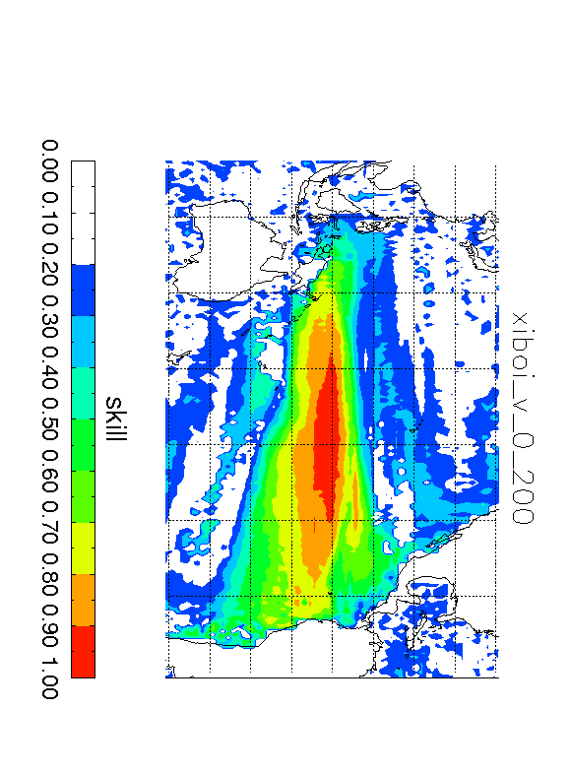
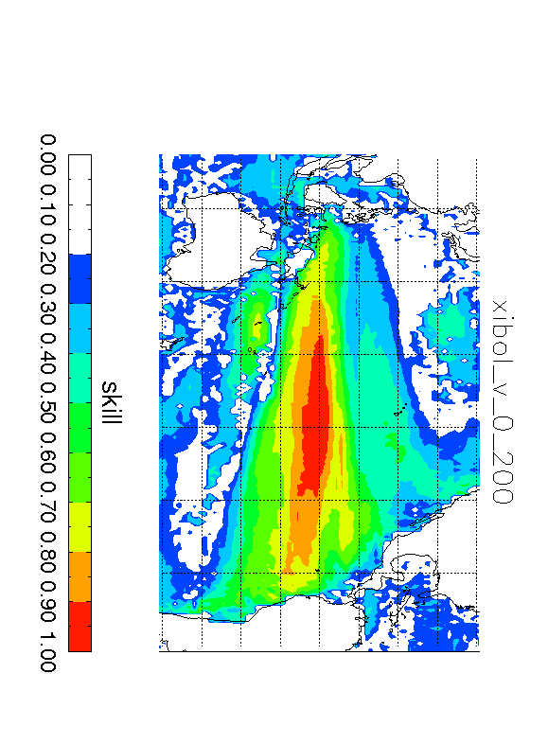
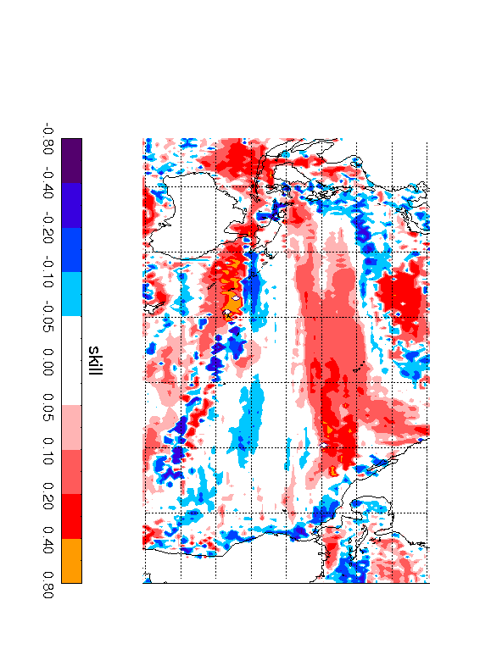
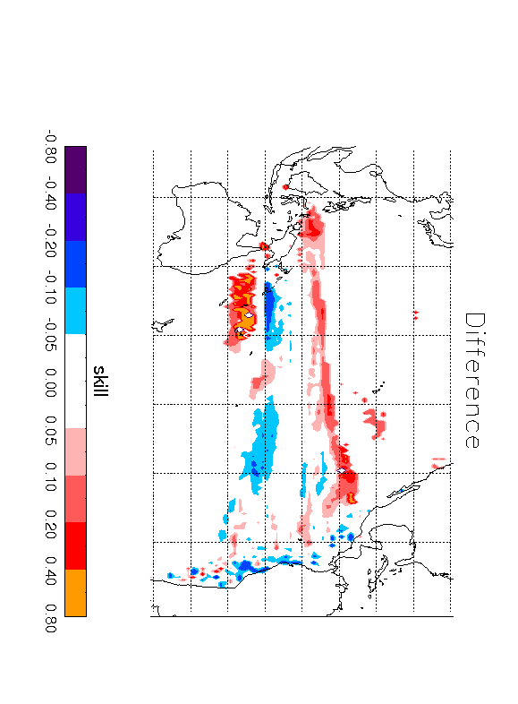
Where can El Niño could be detected in coral data? HadCM3 results.
Preindustrial skill Pliocene skill Difference
Difference in
high skill regions
Notes:
The difference in high skill regions shows regions where the skill is reasonable (>0.5) in either the Pliocene or the preindustrial, and there is a difference in skill between the two locations Note that the changes to the East of Australia are due to the intensification of the hydrological cycle. Changes north of the Equator are due to the expansion of the temperature signal
SKILL was calculated as follows:
X=(correctly detected elnino/total el nino) + (correctly detected lanina/total la nina) + ( correctly detected normal/total normal) ; allowing for 2 months margin or error
SKILL=((X/3)-0.33) / 0.66 ; to give a normalised skill between 0 and 1 and random chance producing a skill of zero.

Slide 9
Can El Niño be detected in planktonic foraminifera data?
Age ma
Location 90W 3S
Data from Scroxton et al (2011)

Slide 10
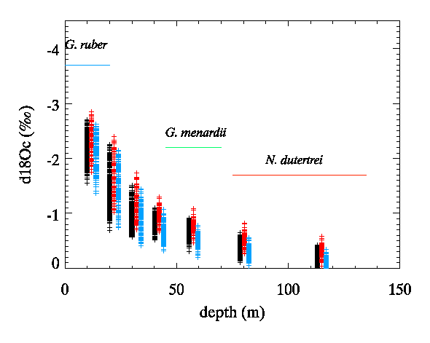
Results for the pre-industrial
Location 90W 3S
WARMER
COLDER
El Niño
La Nina

Slide 11
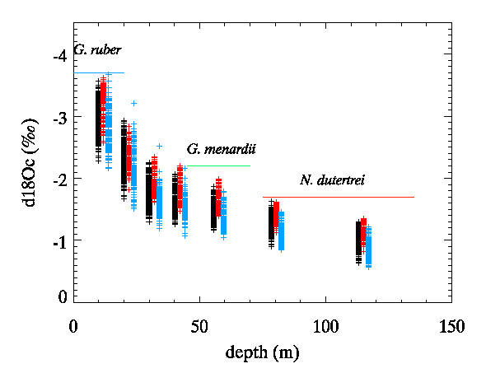
Results for the Pliocene
Location 90W 3S
WARMER
COLDER
El Niño
La Nina

Slide 12
Why are results different for the modern and the Pliocene at this location?
1. δ¹⁸O(seawater) is more variable in the Pliocene. In this region, δ¹⁸O(seawater) variability is not related to ENSO and so large δ¹⁸O(seawater) variability can contaminate the results
Pre-Industrial
Pliocene

Slide 13
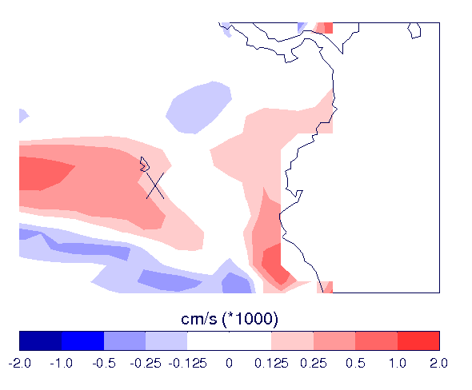
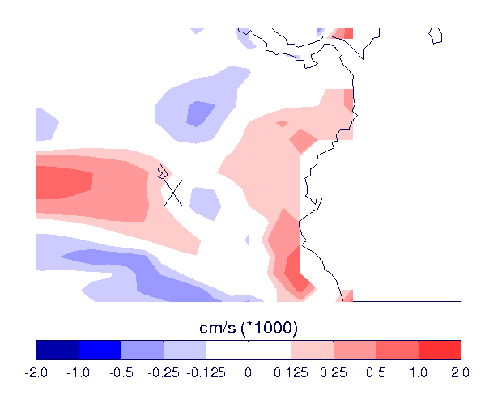
Why are results different for the modern and the Pliocene?
2. The site is on the edge of an upwelling zone in the modern. In the Pliocene it lies between upwelling and downwelling zones meaning that interannual variability at this location can be large.
Pre-industrial
Pliocene

Slide 14
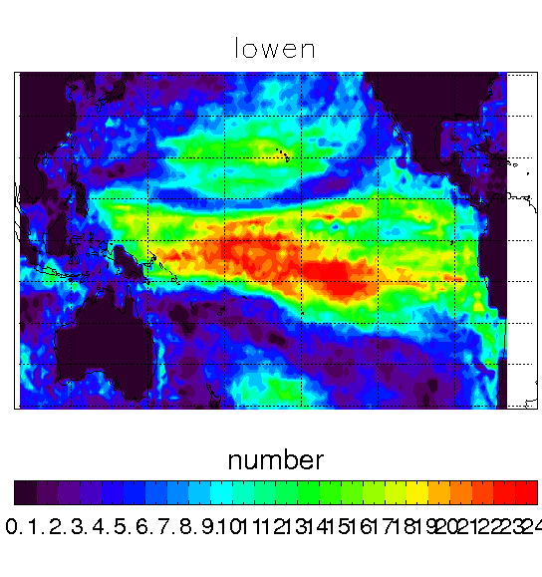
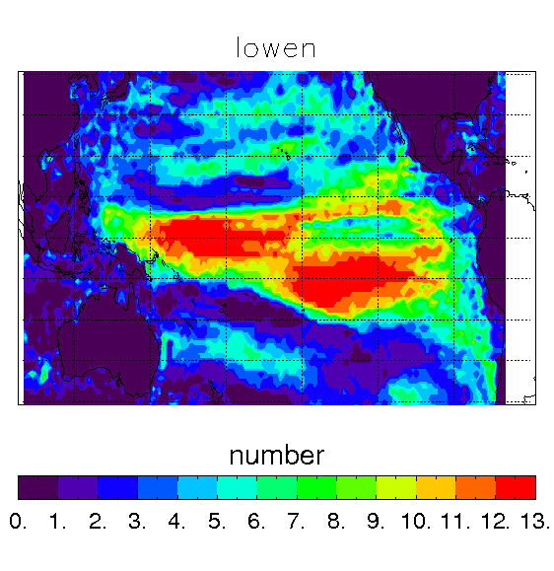
Where can El Niño be detected in individual planktonic foraminifera data? HadCM3 results.
Pre-industrial Pliocene

Slide 15
Conclusions
In the Pliocene HadCM3 suggests El Niño events were:
Stronger
Temperature anomaly shifted to the West
More strongly related to the PDO
El Niño events have a stronger signal in proxy data in the western half of the Pacific due to
Shift in temperature
Intensification of hydrological cycle throughout tropics
Skill in predicting El Niño from proxy data can change between the Pliocene and preindustrial but is usually:
Similar for coral data
Better in the Pliocene for individual planktonic foraminifera data – to verify!
Research leading to these results has received funding from the European Research Council under the European Union’s Seventh Framework Programme (FP7/2007-2013) / ERC grant agreement no. 278636.

Slide 16
EXTRA SLIDES

Slide 17
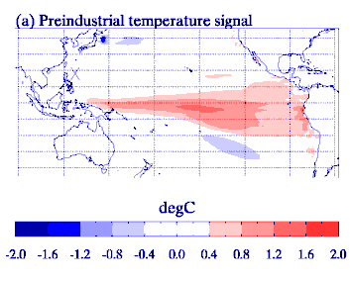
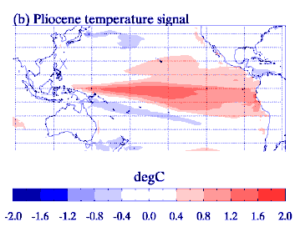
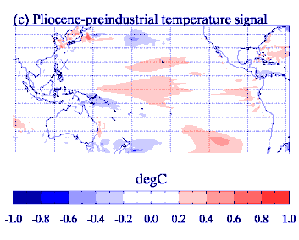
Structure of El Niño in the Pliocene: 2. Precipitation

Slide 18
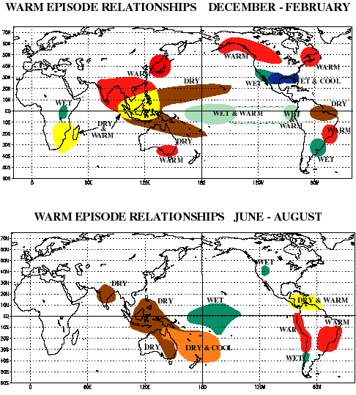
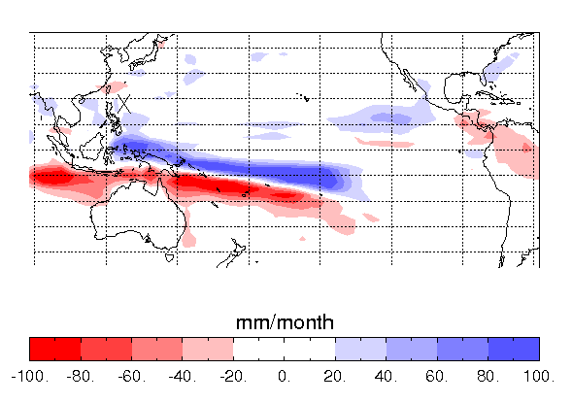
Data-model comparison to interpret Pliocene El Nino
For the modern this region is drier in El Nino years. These precipitation patterns are not correctly reproduced by HadCM3.
Perhaps compare data with another HadCM3 region.
HadCM3 modern precipitation
El Nino - long term mean
Notes:
Shows that HadCM3 does not quite get the precipitation pattern correct

Slide 19
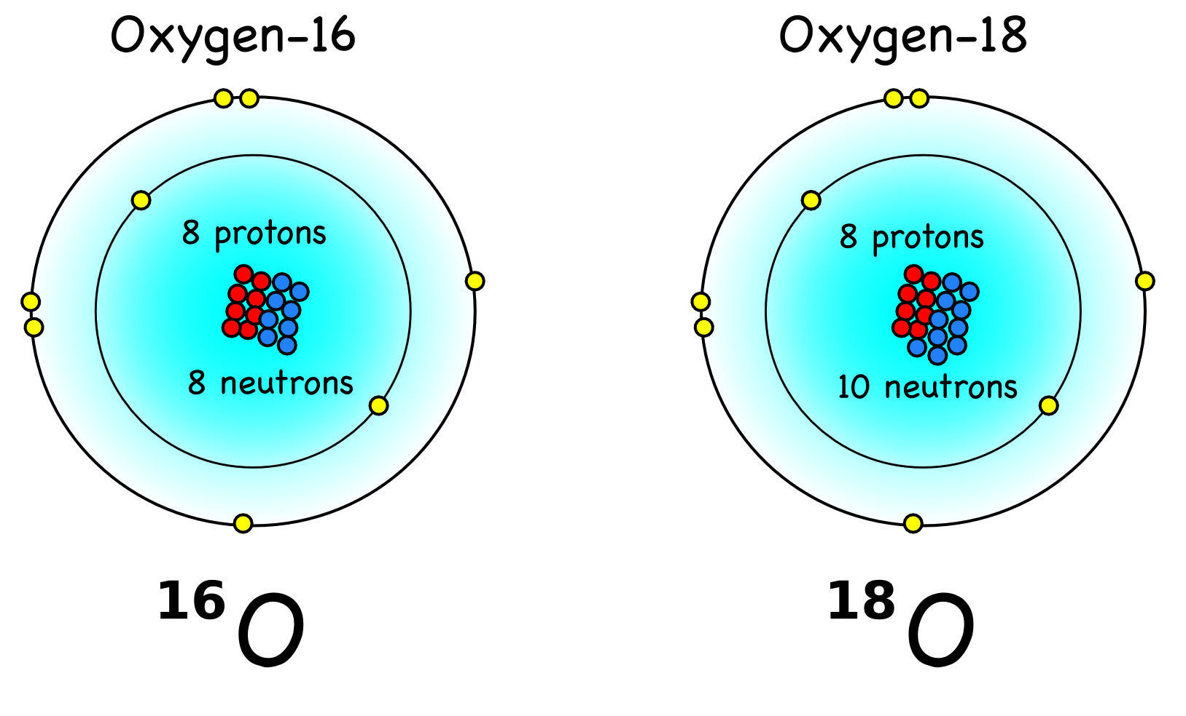
What is δ¹⁸O?
All natural waters contains some oxygen-16 and some oxygen-18.
Anything which incorporates water will incorporate some oxygen-16 and some oxygen-18.
δ¹⁸O is a measurement
of the relative amounts of
oxygen-16 and oxygen-18.
Different values of δ¹⁸O are expected for different climates.

Slide 20
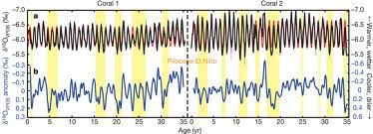
El Nino Characteristics Present-day
THE THEORY
Warmer temperatures➔reduced δ¹⁸O_{coral}
Less precipitation ➔increased δ¹⁸O_{p}
➔increased δ¹⁸O_{sw}
➔increased δ¹⁸O_{coral}
BUT what is happening here?

Slide 21
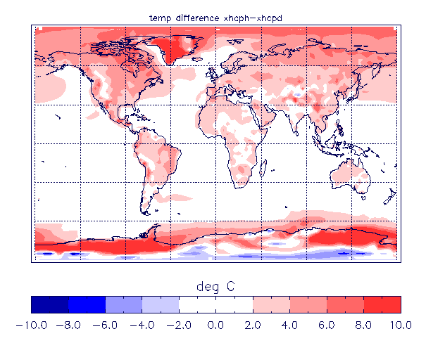
1. The climate → the Pliocene
Mid Pliocene (~3.205Ma)
CO₂ ~405ppm
Continents similar to today
Ice volume reduced by 1/3
Orbit close to modern
HadCM3 – annual temperature difference
Mid Pliocene – Pre-industrial.
Notes:
Check reasonable vs observations.

Slide 22
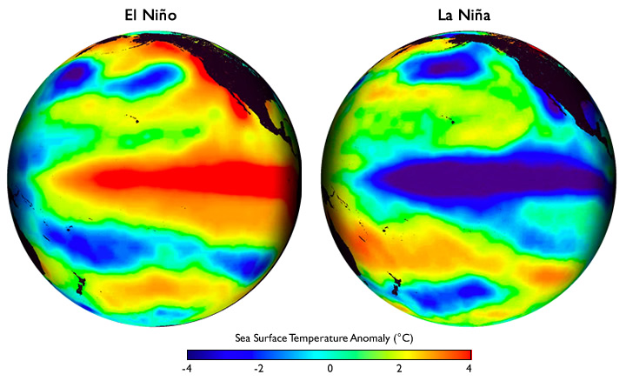
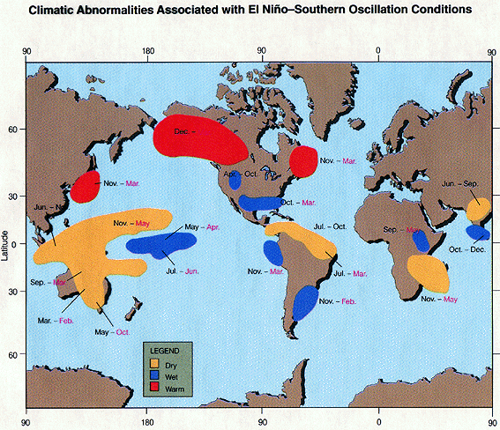
2. The variability ➔ ENSO
The El Niño Southern Oscillation (ENSO)
Tropical Pacific phenomena that dominates Earth’s interannual climate variability
El Niño – warm episode
La Nina – cold episode
There is an ENSO signal in temperature, precipitation, atmospheric pressure, depth of thermocline etc.
Notes:
The El

Slide 23
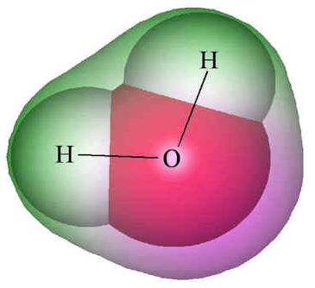
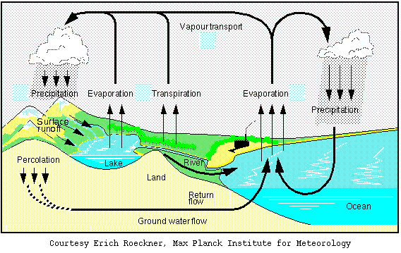
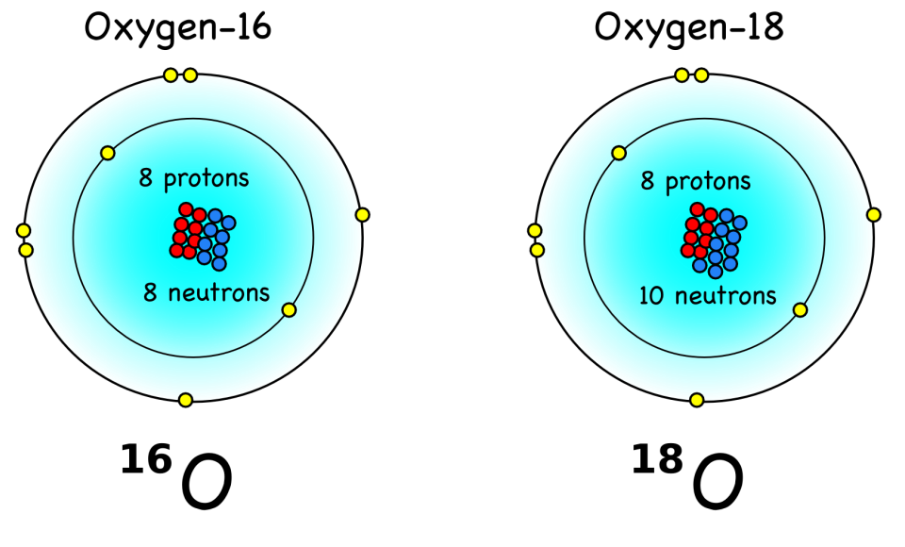
3. The modelling ➔ water isotopes
HadCM3 coupled atmosphere-ocean – water isotope GCM
δ¹⁸O
Notes:
Check reasonable vs observations.

Slide 24
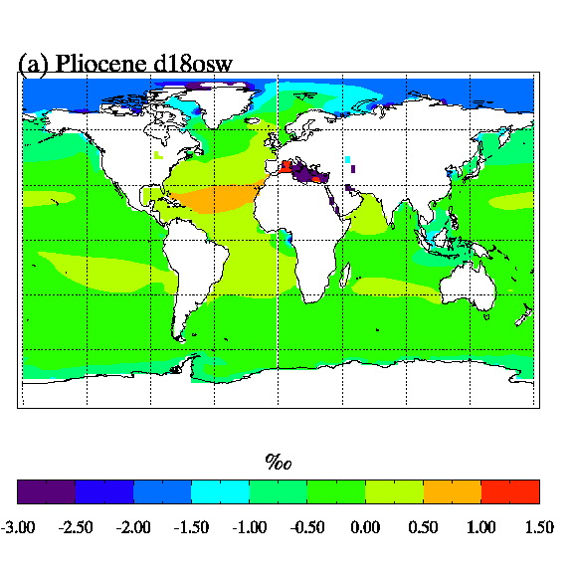
Typical changes in δ¹⁸O(seawater)
This can be combined with temperature to estimate Pliocene coral δ¹⁸O or foraminifera δ¹⁸O

