Slide 1
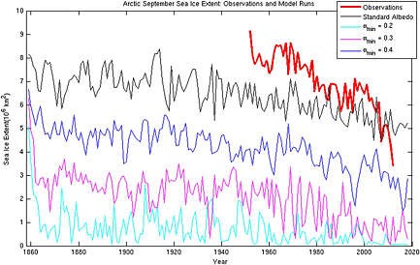
Can uncertainties in sea ice albedo reconcile patterns of data‐model discord for the Pliocene and 20th/21st centuries?
Geophysical Research Letters Volume 41, Issue 6, pages 2011-2018, 20 MAR 2014 DOI: 10.1002/2013GL058872 http://onlinelibrary.wiley.com/doi/10.1002/2013GL058872/full#grl51487-fig-0003
Notes:
Arctic September sea ice extent (10⁶ km²) from observations (thick red line) and 4 HadCM3 transient simulations with varying minimum sea ice albedos.
IF THIS IMAGE HAS BEEN PROVIDED BY OR IS OWNED BY A THIRD PARTY, AS INDICATED IN THE CAPTION LINE, THEN FURTHER PERMISSION MAY BE NEEDED BEFORE ANY FURTHER USE. PLEASE CONTACT WILEY'S PERMISSIONS DEPARTMENT ON PERMISSIONS@WILEY.COM OR USE THE RIGHTSLINK SERVICE BY CLICKING ON THE 'REQUEST PERMISSIONS' LINK ACCOMPANYING THIS ARTICLE. WILEY OR AUTHOR OWNED IMAGES MAY BE USED FOR NON-COMMERCIAL PURPOSES, SUBJECT TO PROPER CITATION OF THE ARTICLE, AUTHOR, AND PUBLISHER.

