Slide 1
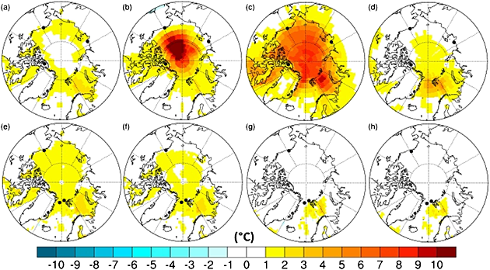
Can uncertainties in sea ice albedo reconcile patterns of data‐model discord for the Pliocene and 20th/21st centuries?
Geophysical Research Letters Volume 41, Issue 6, pages 2011-2018, 20 MAR 2014 DOI: 10.1002/2013GL058872 http://onlinelibrary.wiley.com/doi/10.1002/2013GL058872/full#grl51487-fig-0002
Notes:
Mean seasonal temperature (°C) anomalies (alternative minus standard) for Pliocene simulation with α_{min}=0.2, showing (a and e) summer (JJA), (b and f) autumn (SON), (c and g) winter (DJF), and (d and h) spring (MAM). Figures a–d show the SAT anomalies, with Figures d–f displaying SST anomalies. Locations of data sites from Tables and are also shown.
IF THIS IMAGE HAS BEEN PROVIDED BY OR IS OWNED BY A THIRD PARTY, AS INDICATED IN THE CAPTION LINE, THEN FURTHER PERMISSION MAY BE NEEDED BEFORE ANY FURTHER USE. PLEASE CONTACT WILEY'S PERMISSIONS DEPARTMENT ON PERMISSIONS@WILEY.COM OR USE THE RIGHTSLINK SERVICE BY CLICKING ON THE 'REQUEST PERMISSIONS' LINK ACCOMPANYING THIS ARTICLE. WILEY OR AUTHOR OWNED IMAGES MAY BE USED FOR NON-COMMERCIAL PURPOSES, SUBJECT TO PROPER CITATION OF THE ARTICLE, AUTHOR, AND PUBLISHER.

