Slide 1
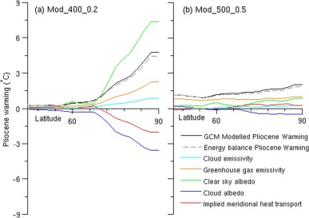
Fig. 9. Energy balance analysis north of 45°N for (a) Mod_400_0.2, (b) Mod_500_0.2. Plots show zonal mean warming for each of the energy balance components, along with the zonal mean SAT increase compared to the mid-Pliocene control, and the approximated zonal...
Fergus W. Howell, Alan M. Haywood, Harry J. Dowsett, Steven J. Pickering
Sensitivity of Pliocene Arctic climate to orbital forcing, atmospheric CO2 and sea ice albedo parameterisation
Earth and Planetary Science Letters, Volume 441, 2016, 133–142
http://dx.doi.org/10.1016/j.epsl.2016.02.036

