Slide 1
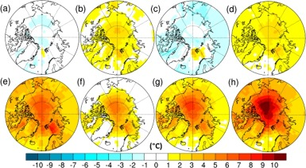
Fig. 4. Mean annual SAT (°C) anomaly (alternative minus control) for simulations: (a) Mar_400_0.5, (b) Jul_400_0.5, (c) Jul_300_0.5, (d) Mod_500_0.5, (e) Jul_500_0.5, (f) Mod_400_0.2, (g) Mod_500_0.2, (h) Jul_500_0.2. Control simulation is Mod_400_0.5.
Fergus W. Howell, Alan M. Haywood, Harry J. Dowsett, Steven J. Pickering
Sensitivity of Pliocene Arctic climate to orbital forcing, atmospheric CO2 and sea ice albedo parameterisation
Earth and Planetary Science Letters, Volume 441, 2016, 133–142
http://dx.doi.org/10.1016/j.epsl.2016.02.036

