Slide 1
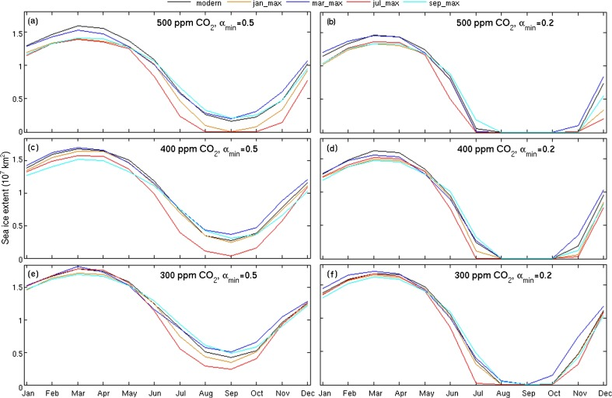
Fig. 2. Annual sea ice extent (107 km2) cycle for all 30 ensemble members. Each panel shows the five orbital simulations with the same pCO2 and minimum albedo combinations. The only difference between simulations in any given panel is the orbital configuration...
Fergus W. Howell, Alan M. Haywood, Harry J. Dowsett, Steven J. Pickering
Sensitivity of Pliocene Arctic climate to orbital forcing, atmospheric CO2 and sea ice albedo parameterisation
Earth and Planetary Science Letters, Volume 441, 2016, 133–142
http://dx.doi.org/10.1016/j.epsl.2016.02.036

