Slide 1
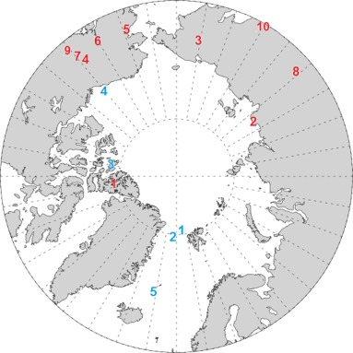
Fig. 1. Location of marine (blue) and terrestrial (red) data sites. Marine data sites: 1. ODP 910C, 2. ODP 909C, 3. Meighen Island, 4. Colvillian, 5. ODP 907A. Terrestrial data sites: 1. Beaver Pond, 2. Lena River, 3. Lake El'gygytgyn, 4. Alaska Circle, 5. Bli...
Fergus W. Howell, Alan M. Haywood, Harry J. Dowsett, Steven J. Pickering
Sensitivity of Pliocene Arctic climate to orbital forcing, atmospheric CO2 and sea ice albedo parameterisation
Earth and Planetary Science Letters, Volume 441, 2016, 133–142
http://dx.doi.org/10.1016/j.epsl.2016.02.036

