Slide 1
A Draft Palaeoclimate Strategy for NCAS
Jonathan Gregory, Alan Haywood, Manoj Joshi, Robin Smith
1. Why palaeoclimate?
2. Grand challenges
3. Strategy aim
4. Strategy components
5. Wider implications
Resources

Slide 2
1. Why Palaeoclimate?
Uncertainties highlighted in climate prediction involve aspects of the climate that have changed in the past (e.g. ENSO).
Palaeoclimatology can assess whether these changes are consistent with current theories of the climate system and if not, why not.
Palaeoclimate provides a unique test-bed for models that project large changes in the future to be evaluated using true out-of-sample tests of comparable magnitude.

Slide 3
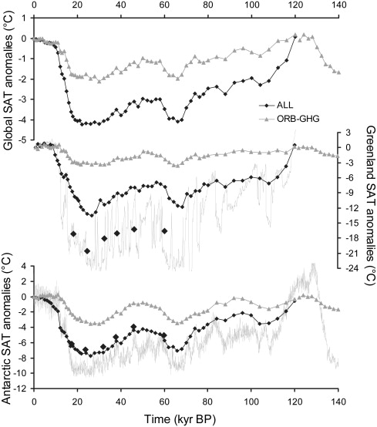
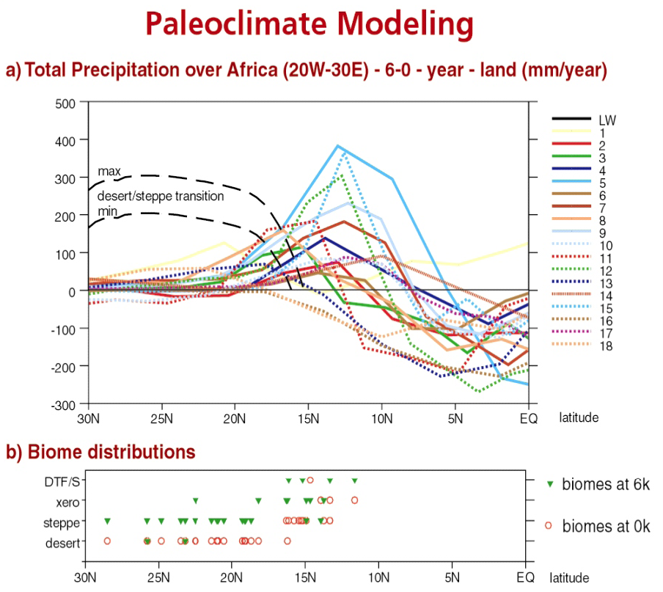
2. Grand Challenges in Palaeoclimate
Reproducing the observed record of variability and change
Reconciling palaeoclimate simulations with climate archives
Singarayer and Valdes (2010)
Joussaume, S. et al. (1999)

Slide 4
3. What does the strategy aim to do?
To ensure that the UK continues to improving the sophistication of modelling to face the grand challenges of palaeoclimate (overcome previous limitations)
HadCM3 family of climate models become the pre-eminent international choice for intermediate resolution Earth system modelling
Ensure that the UK continues to take a leading role in international research programmes (e.g. PMIP) comparing structurally different models, and structurally different models to observations (the geological record).
Application of the latest/practical version of the UM to CMIP5/PMIP3 identified time intervals

Slide 5
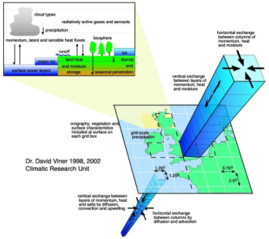
4. Components of the Strategy
1. Development of the HadCM3-family of climate models so that they become the pre-eminent international choice for intermediate resolution Earth system modelling
Still widely used for palaeoclimate applications
NERC ESM strategy envisages replacement for immediate level modelling in long term but a lifetime of ~10 years is still planned
ACTIONS:
i) Maintenance of this family
ii) Development of this family to address new scientific questions of sufficient importance to attract external funding
HadCM3

Slide 6
Development of the HadCM3-family
Maintenance:
CMS effort to improve the portability of the models
CMS effort to improve the flexibility for the creation of ancillary files for model
configuration
CMS effort to improve the performance of the model on parallel computers
A percentage of a manager to co-ordinate development effort, facilitate
communication across the community of users (many of whom also do some
development) and promote uptake by new users and provide them with help and advice
Development:
MOSES2.2 land surface scheme and accompanying interactive vegetation models
not well tuned in FAMOUS – correct this
Enhanced coupling to the GLIMMER ice sheet model (implementation of a more
Physical scheme for the calculation of ice sheet mass balance. This would create a
state-of –the-art atmosphere-ice-sheet coupling*.

Slide 7
Development of the HadCM3-family
Development:
Inclusion of proxy formation models (oxygen-isotopes, C-13, Pa/Th and Nd)
A general ocean biogeochemistry model suitable for longer-term Earth system studies
(BIOGEM and SEDGEM or perhaps the MIT Darwin model (for ocean acidification)*
Dust, aerosols and atmospheric chemistry exist within the UM framework, they have
not been used for intermediate level modelling efforts – examine the best options for
implementation and execute.
Integrated modelling - coupling climate model to economic models. Computational
efficiency of this family of models might enable a big step fwd.

Slide 8
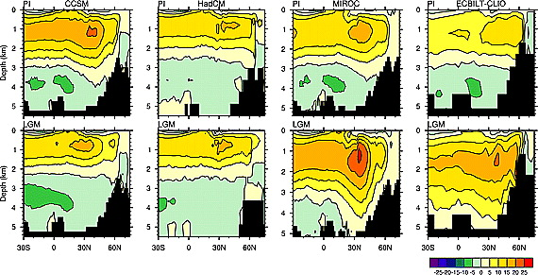
4. Components of the Strategy
2. To ensure that the UK continuous to have a leading role in international research programmes (e.g. PMIP) comparing structurally different models, and structurally different models to observations (the geological record)
Otto-Bliesner et al. (2007)

Slide 9
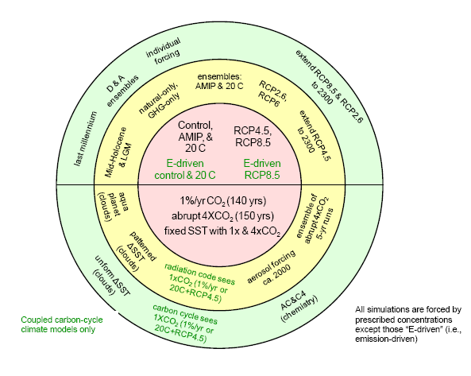
A leading role in PMIP3 and beyond
UM Version
UM Version 6.6.3 – HadGEM2 AO and ES set up with agreed PMIP3/CMIP5 boundary conditions
This will enable palaeoclimates to be examined in:
Unprecedented resolution
2) With the inclusion of additional Earth System feedbacks leading to an improved
understanding of climate evolution
PMIP3/CMIP5 Identified Experiments
The Last Millennium
The Mid-Holocene Climate Optimum*
The Last Glacial Maximum
Glacial Inception
The Deglacial Period
The Last Interglacial
The Pliocene
Taylor et al. (2009)

Slide 10
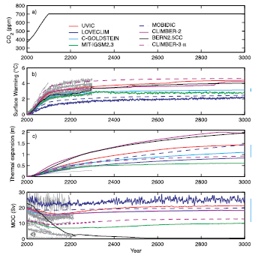
5. Wider Implications and Connections
Increasing interest in longer term predictions in IPCC, highlighted by the National Academy
and DECC
Longer term sensitivity or Earth System Sensitivity
How will processes in the climate system operating on long timescales influence the eventual response of global mean temperature to a given CO₂ stabilisation scenario
Long term impacts of possible geo-engineering solutions
Both require computationally efficient ESMs
General interest in assessment of AR5-class model performance for palaeoclimate scenarios
Unified tools means greater collaboration and
scientific output and relevance for UK palaeoclimate
Doney et al., 2004

Slide 11
Resources
Maintenance/development of HadCM3-family (development/maintenance work only)
Maintenance: 20% of a manger plus 7 months of dedicated CMS
Development: Maximum 48 months of PDRA time, minimum 38 months
CMIP5/PMIP3 Research with HadGEM2 (AO and ES)
36 months of PDRA time plus ~6000 node hours and ~4 TB of disk space

