Slide 1


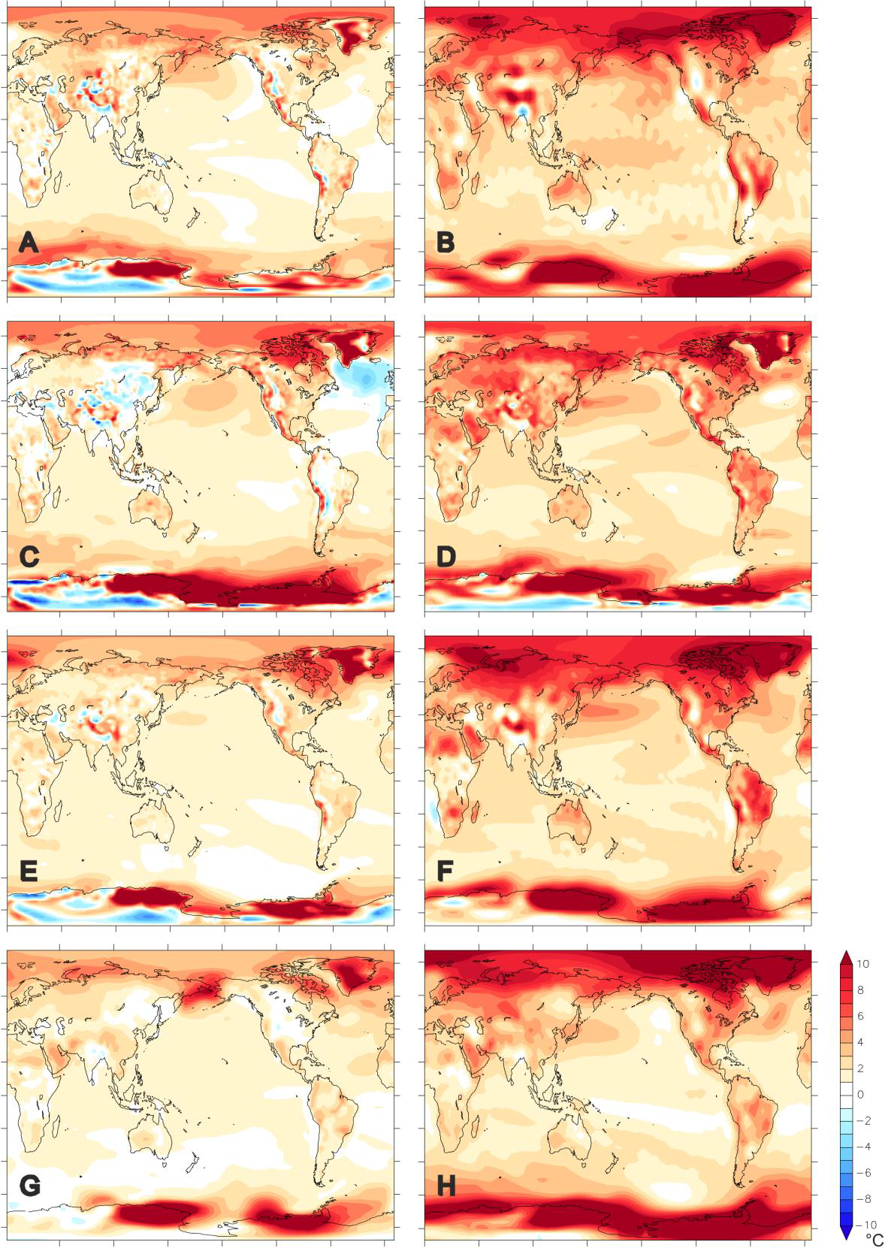
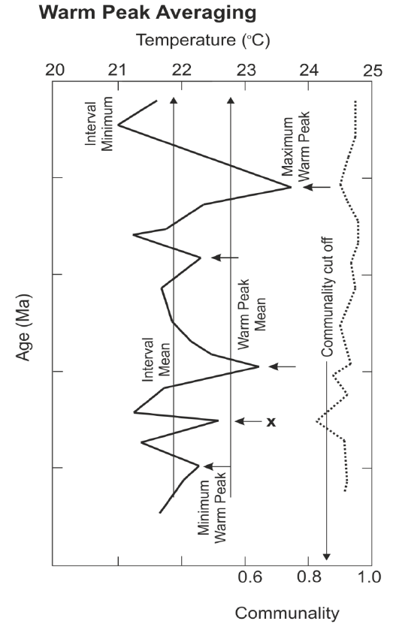
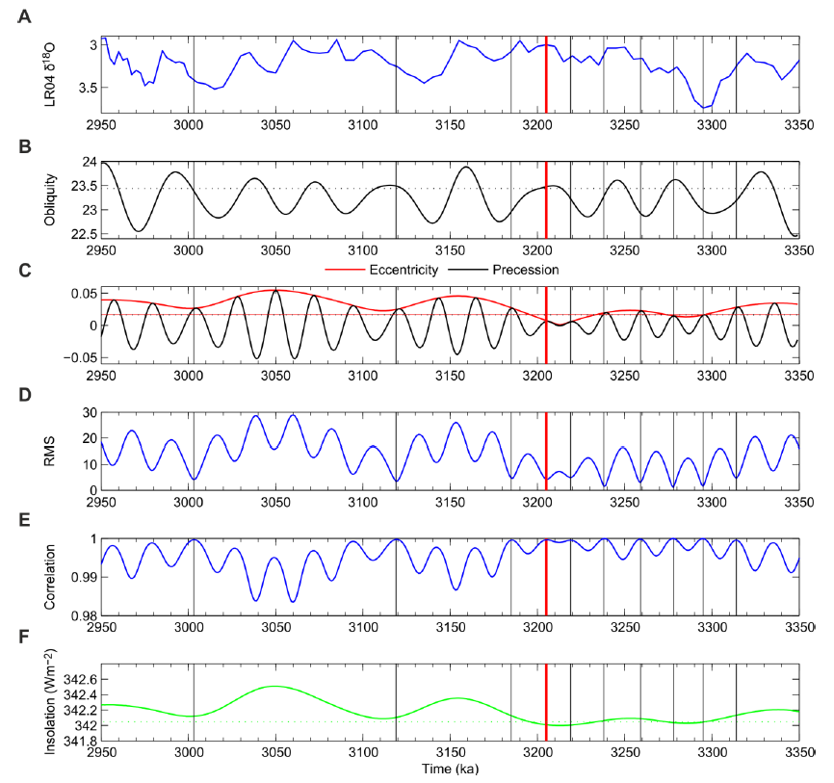
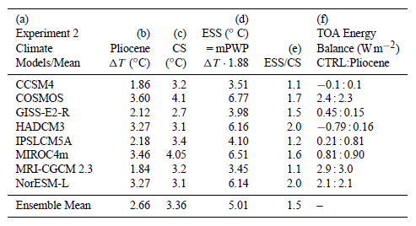
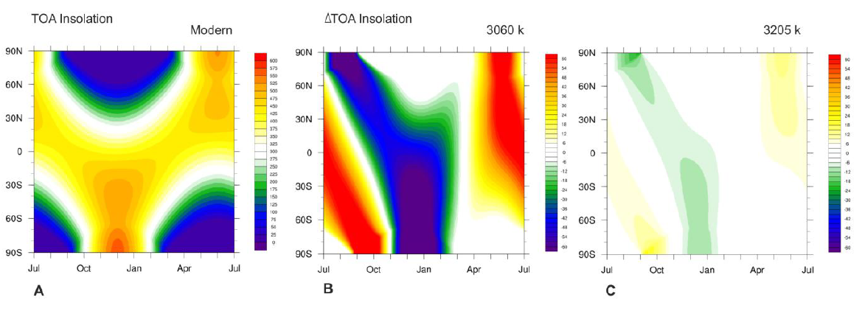
EGU2013-4265: Pliocene constraints on longer term climate sensitivity
Alan M. Haywood¹, Daniel J. Hill^{1/2}, Aisling M. Dolan¹, Daniel J. Lunt³ and PlioMIP Participants
¹ School of Earth and Environment, University of Leeds, Leeds, UK Contact email: earamh@leeds.ac.uk; ²British Geological Survey, Keyworth, UK; ³University of Bristol, Bristol, UK.
1. Background
4. Individual Model Anomalies
PlioMIP (Pliocene Model Intercomparison Project) represents the first time that a period with higher than pre-industrial levels of atmospheric CO₂ and global temperatures within the range predicted for 2100AD has been subjected to a rigorous PMIP-style model intercomparison (Palaeoclimate Modelling Intercomparison Project). The first experiment is for atmospheric-only General Circulation Models (GCMs), while the second is for atmosphere-ocean GCMs, which we focus on here.
The mid-Pliocene warm period has provided a focus for data synthesis and palaeoclimate modelling for the last two decades and is now being used to address Climate Sensitivity. Earth System Sensitivity (or longer term Climate Sensitivity). Is the equilibrium global mean near-surface (~2 m) air temperature response to a sustained doubling of atmospheric CO₂ concentrations, including all feedbacks and processes apart from those associated with the carbon cycle itself. By taking account of long timescale feedbacks, models can be used to estimate ESS.
Left: PlioMIP Experiment 2 model anomalies for annual mean SAT (°C) for (A) CCSM4, (B) COSMOS, (C) GISS-E2-R, (D) HadCM3, (E) IPSLCM5A. (F) MIROC4m, (G) MRI-CGCM2.3, (H) NorESM-L.
Right: same as Left but for Total Precipitation Rate (mm/day).
2. Participating Models and Global ΔSAT/SST & Climate Sensitivity
PlioMIP Modelling Groups - Experiment 2
Group | Contacts | Model
Hadley - UK | Alan Haywood, Dan Lunt, Fran Bragg | HadCM3
NCAR | Bette Otto-Bliesner and Nan Rosenbloom | CCSM4
GISS | Mark Chandler | GISS Model ER
Bjerknes/Bergen | Kerim H. Nisancioglu | NorESM
IAP/CAS | Zheng Weipeng, Zhang Zhongshi, Qing Yang | FGOALS-g2.0, FOAM1.5
Center for Climate System Research, University of Tokyo | Ayako Abe-Ouchi, Wing Le Chan, Ryota O'ishi | MIROC 3.2 GCM
Alfred Wegener Institute for Polar and Marine Research | Christian Stepanek | COSMOS 1.2.0
Laboratoire des Sciences du Climat et de l'Environment (LSCE) | Camille Contoux, Anne Jost, Gilles Ramstein | IPSLCM5A
University of Tsukuba | Youichi Kamae, Hiroaki Ueda | MRI-CGCM 2.3
5. Earth System Sensitivity
6. Reducing Uncertainty in ESS: Time Slice
PlioMIP models Δ global annual mean surface air temperature and sea surface temperature (°C) compared to estimates of each models Climate Sensitivity.
Here, we use the PlioMIP simulations from Experiment 2 to estimate ESS using a similar approach to Lunt et al. (2010). In these experiments the Pliocene orographic effect is negligible and we consider the elevated CO₂ to be the ultimate forcing of the simulated Pliocene warmth, and thus our simulations represent the equilibrium state of the world at 405 ppmv CO₂. To convert this into the usual definition of ESS (i.e. a CO₂ doubling from 280 to 560 ppmv), the Pliocene warming is multiplied by ln(560.0/280.0)/ln(405.0/280.0) = 1.88.
3. Multi-Model Means
Top left : warm peak averaging of Pliocene SSTs. Top right: orbital solutions to identify a time slice for future palaeoenvironmental reconstruction.
Left: PlioMIP Experiment 2 multi-model mean anomalies for SAT (°C; top), SST (°C; middle) and total precipitation rate (mm/day; bottom). Middle same as left but showing zonal averages. Right: standard deviation of left panels.
Insolation predictions from the La04 solution for modern (left), 3060 kyr minus modern (middle), 3205 kyr minus modern (right).

