Slide 1
PUBLIC LECTURE
Alan- I figure you and I have about 40-45 minutes. Someone will say a few opening words and we will lose a few minutes there. I really want the audience to be able to ask questions- even far off the topic, of “climate experts.” SO we need maybe 10-15 min for that.
I’ll do my part and you will already be on stage and just seamlessly take over when I hand you the pointer. This okay with you? My slides may change a little but basically this is what will come before you. A few are being created while I go to the beach and meditate…I need a gin and tonic(s) and some time with you.

Slide 2
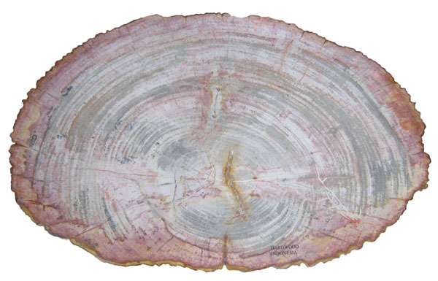
Paleoclimate: Climate Change Lessons from the Past
Harry Dowsett
U.S. Geological Survey
&
Alan Haywood
Leeds University

Slide 3
Paleoclimate Data & Reconstruction
Paleoclimate Modeling
(Alan Haywood)
Questions for the Experts
(Paul Valdes &
Bette Otto-Bliesner)

Slide 4
Your world is changing (it’s getting warmer)
http://www.copenhagendiagnosis.com

Slide 5
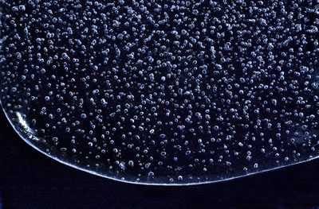
Composite CO₂ record from Antarctica
385-400
Dome C
Vostok
Taylor
Siegenthaler et al., 2005. Stable Carbon Cycle–Climate Relationship During the Late Pleistocene. Science, 310: 1313-1317.

Slide 6
Pleistocene | Pliocene
IPCC
LR04 Stack
Modified from
LR04 Stack: Lisiecki, L.E. and Raymo, M.E., 2005.
A Pliocene-Pleistocene stack of 57 globally distributed
benthic δ¹⁸O records. Paleoceanography, 20: PA1003.

Slide 7
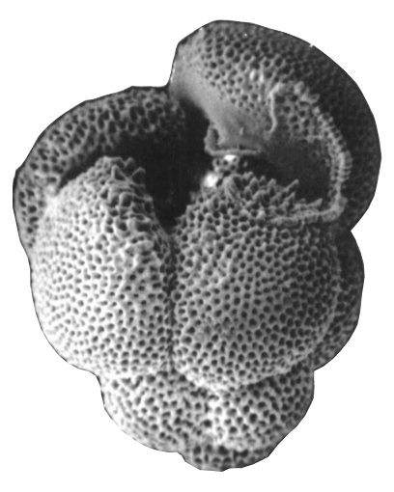
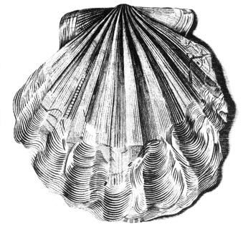
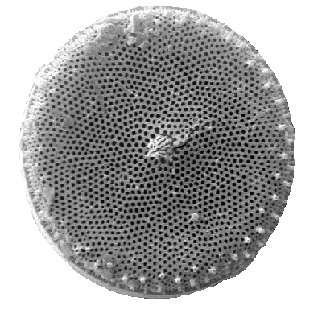
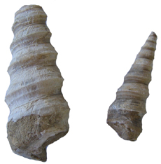
Paleoclimate Data Analysis

Slide 8
WARM -------------------------- COLD

Slide 9
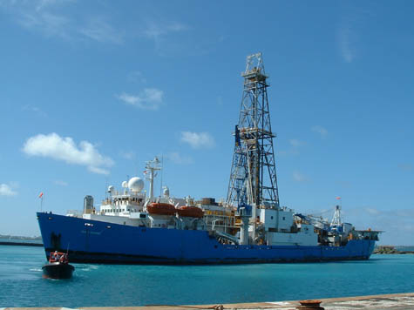
δ¹⁸O Mg/Ca
atmosphere
sea surface
transfer functions
modern analog techniques
mixed layer
δ¹⁸O Mg/Ca
thermocline
cold warm
δ¹⁸O Mg/Ca
water
sediment

Slide 10
SST MAP WITH LOCALITIES

Slide 11
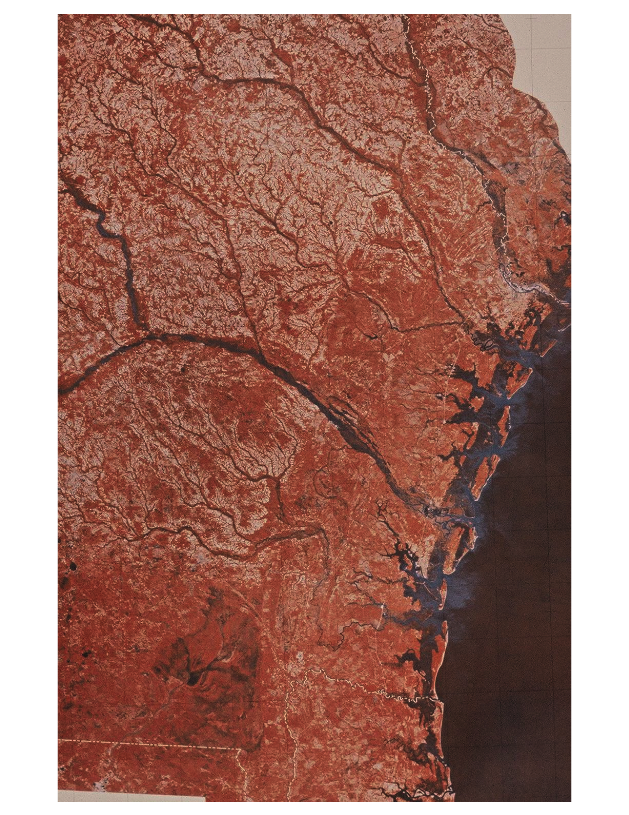
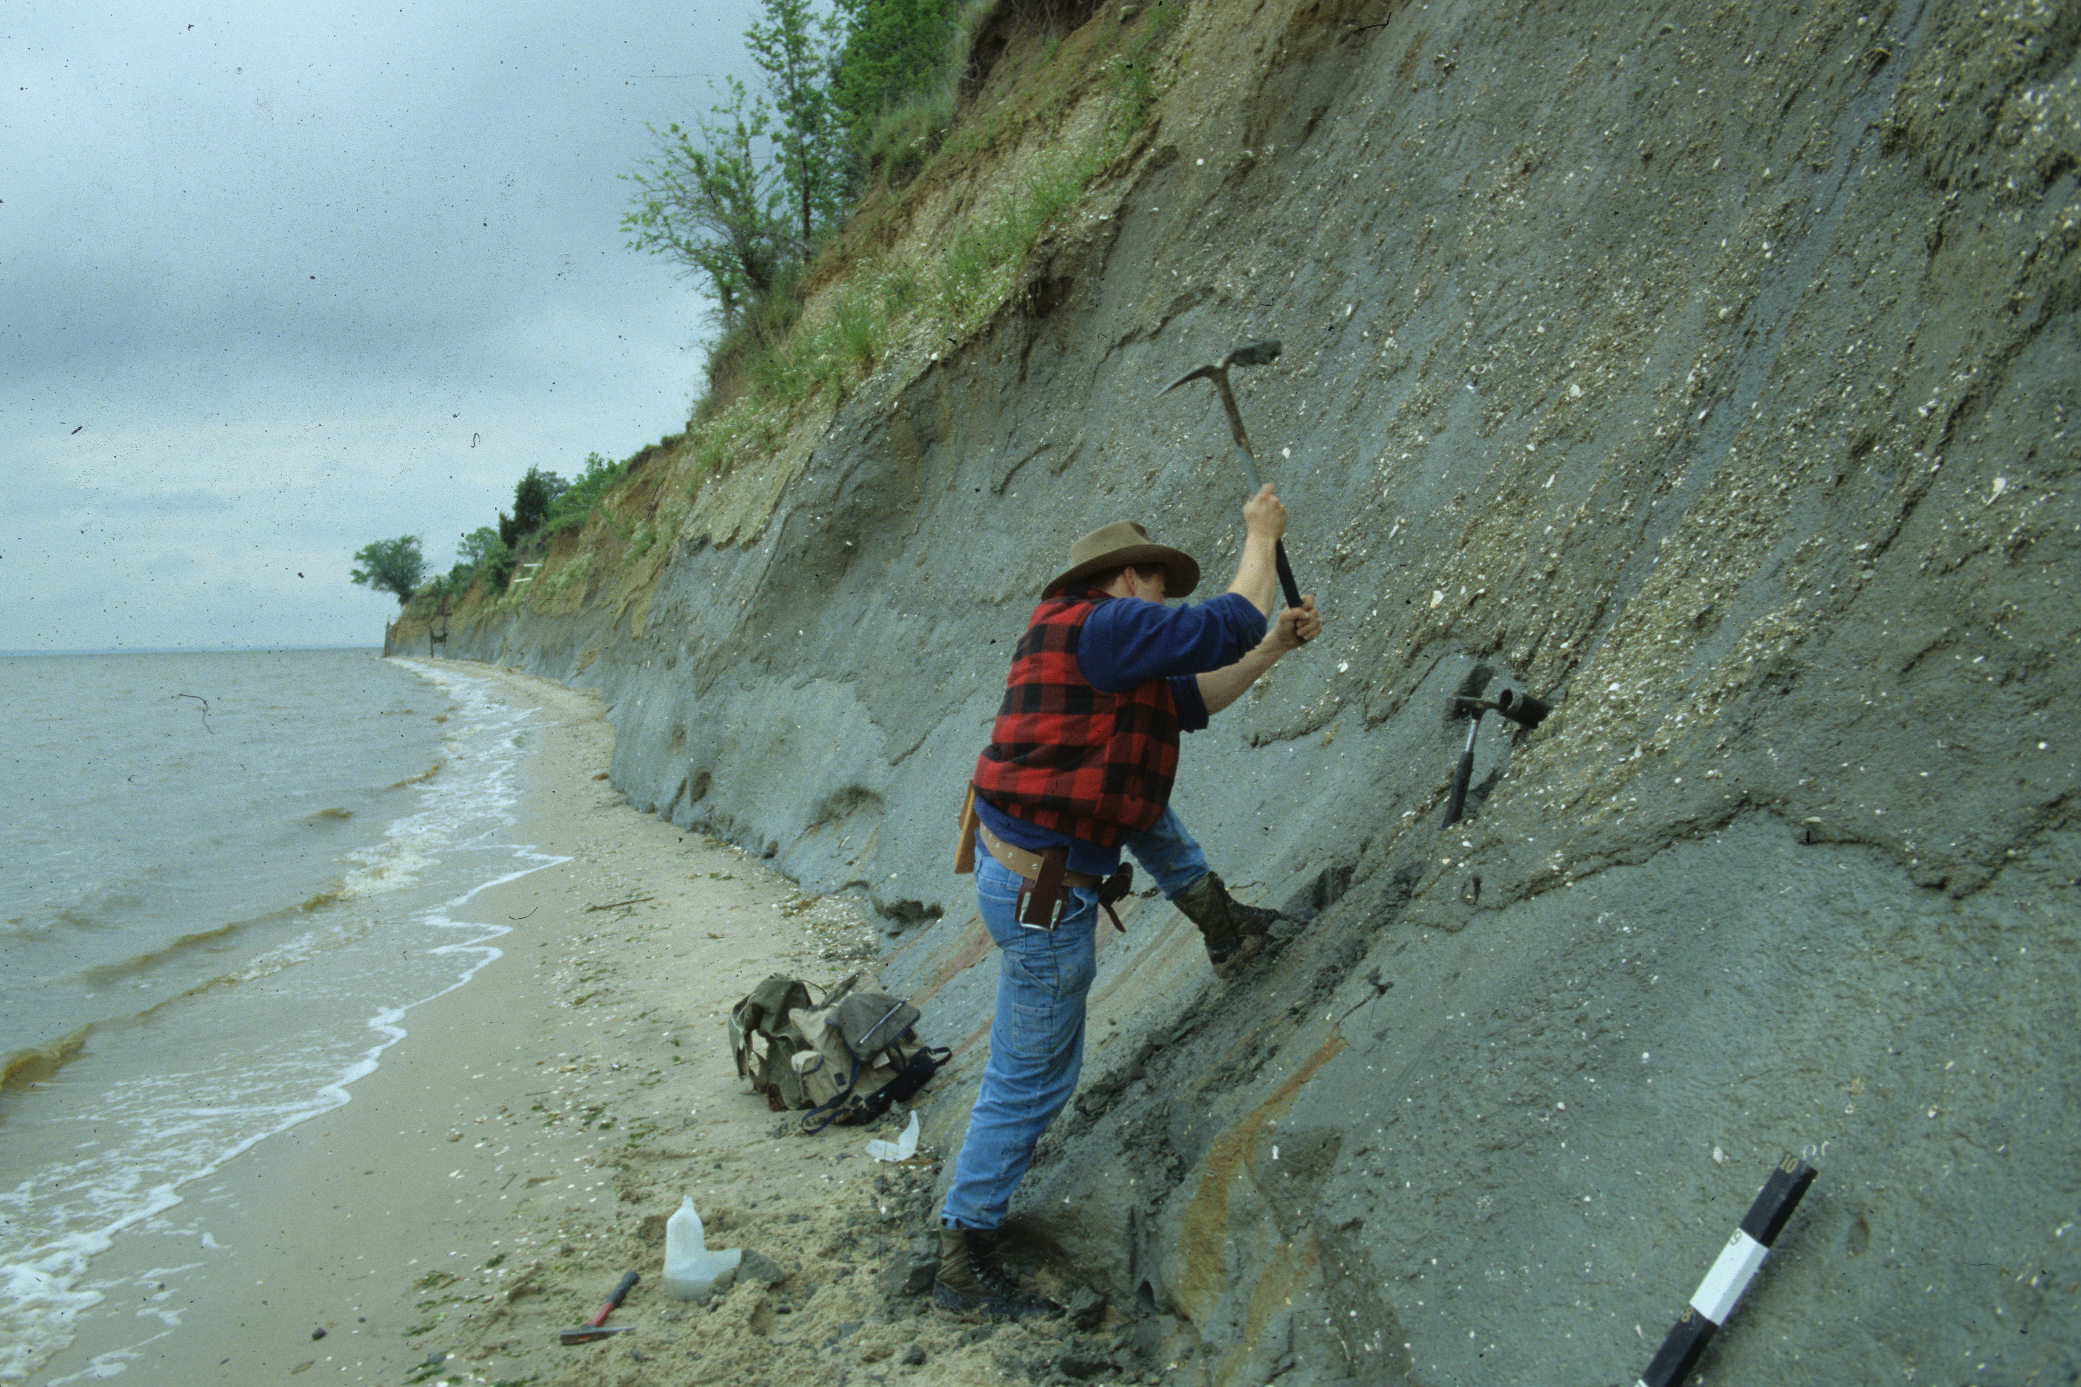
Pliocene sea-level Atlantic Coastal Plain
Sea-level was
approximately 25m
above present day…
Orangeburg Scarp, ACP
Dowsett, H.J. and Cronin, T.M., 1990. High eustatic sea level during the middle Pliocene: Evidence from
the southeastern U.S. Atlantic Coastal Plain. Geology, 18(5): 435-438.

Slide 12
ENTIRE PRISM RECONSTRUCTION

Slide 13
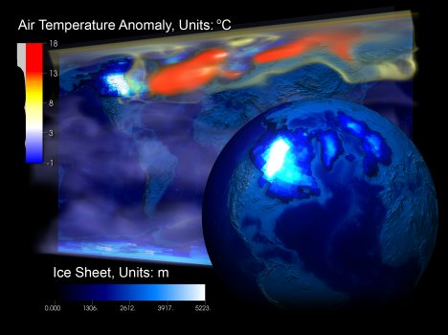
What are Global Climate Models?

Slide 14
Definition and a healthy philosophy regarding climate models

Slide 15
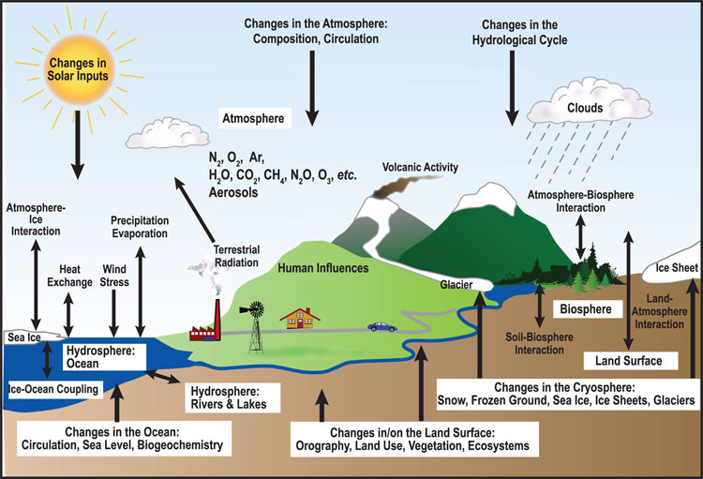
What do they represent?

Slide 16
How have they developed over time?
Present
ATMOSPHERE
LAND
OCEAN
ICE
SULPHUR
CARBON
CHEMISTRY
1999
ATMOSPHERE
LAND
OCEAN
ICE
SULPHUR
CARBON
1997
ATMOSPHERE
LAND
OCEAN
ICE
SULPHUR
1992
ATMOSPHERE
LAND
OCEAN
ICE
Component models
are constructed off-line
and coupled in to the
climate model when
sufficiently developed
1990
ATMOSPHERE
LAND
OCEAN
1985
ATMOSPHERE
LAND
1960s
ATMOSPHERE
Notes:
6

Slide 17
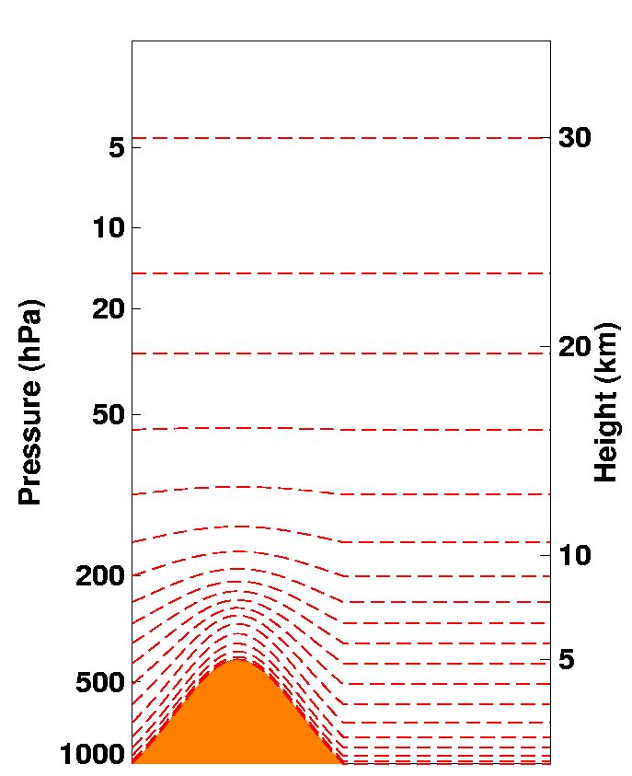
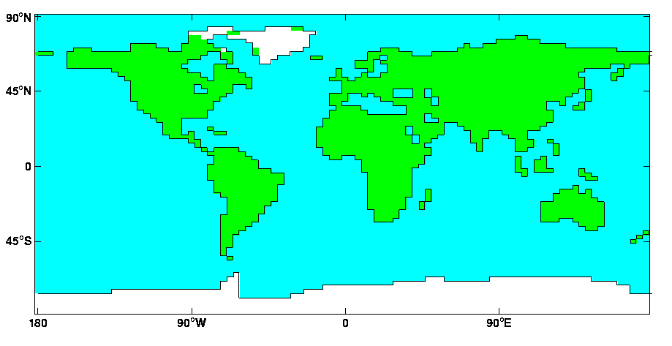
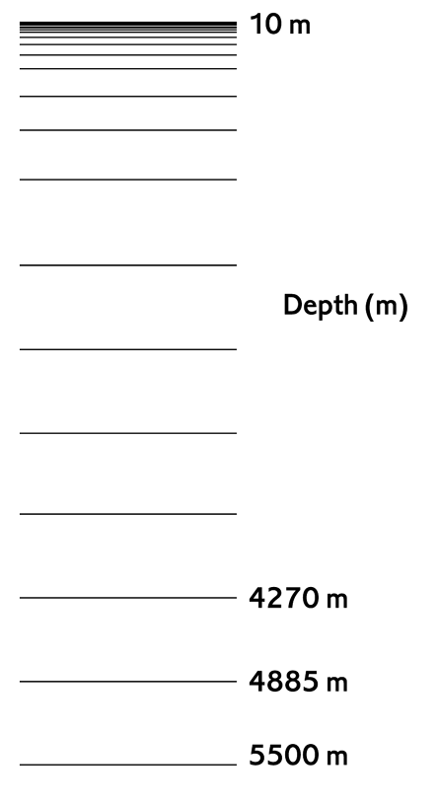
How do they see our planet?
19 Atmospheric Levels
20 Ocean Levels

Slide 18
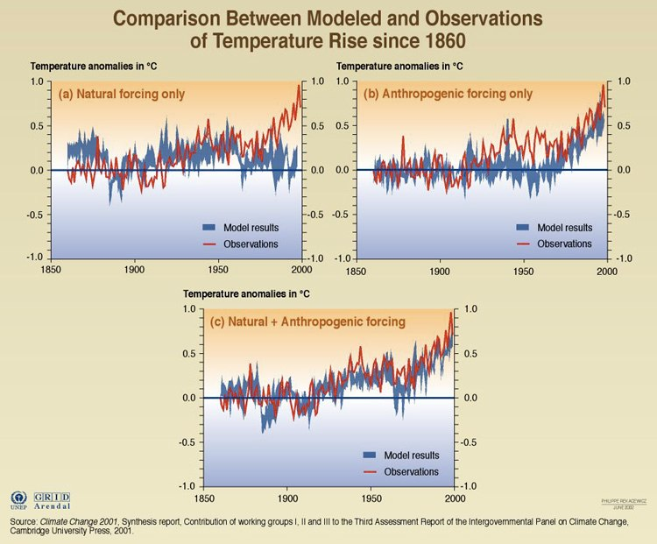
How are they tested?

Slide 19
ENTIRE PRISM RECONSTRUCTION

