Slide 1
The Palaeontological Association 2014 – Annual Address
Understanding Ancient Earth Climates and Environments using Models and Data
What can global climate models do for you, and what can you do for them?
Alan Haywood
With contributions from Aisling Dolan, Harry Dowsett, Daniel Hill, Fergus Howell, Stephen Hunter, Dan Lunt, Caroline Prescott

Slide 2
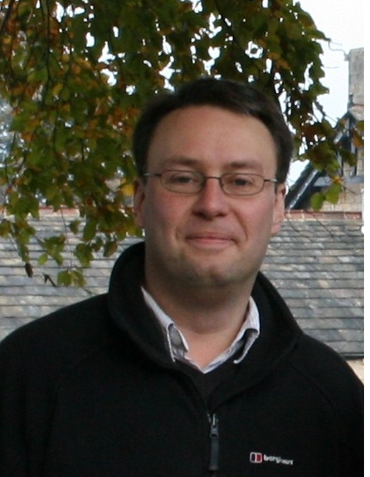
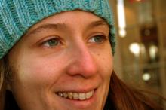
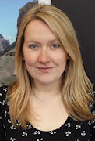
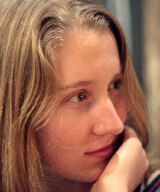
Palaeoclimate Modelling Services (for all your palaeoclimate modelling needs…)
Lauren Gregoire
Me (you know)
Daniel Hill
Aisling Dolan
Ruza Ivanovic
Anja Schmidt

Slide 3
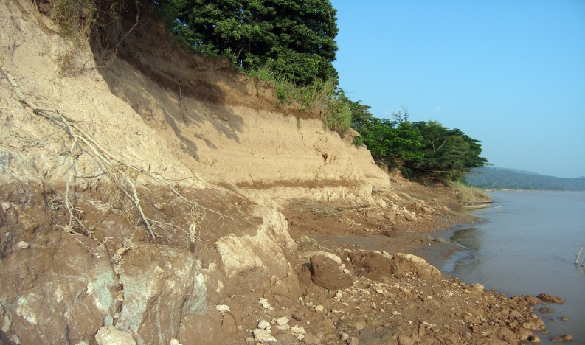
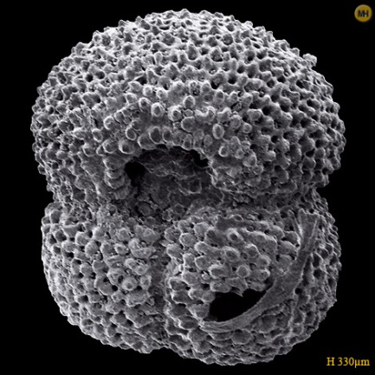
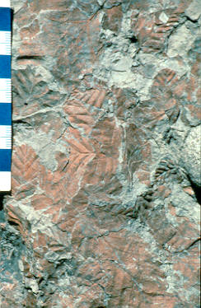
Data and models combine

Slide 4
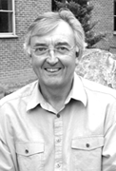
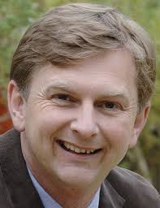
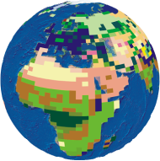
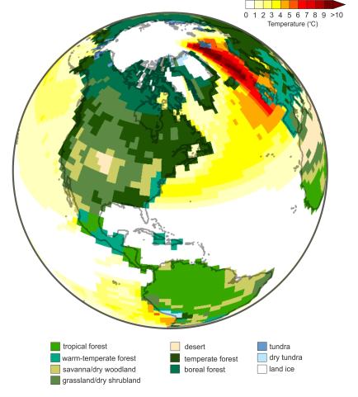
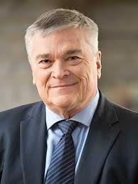
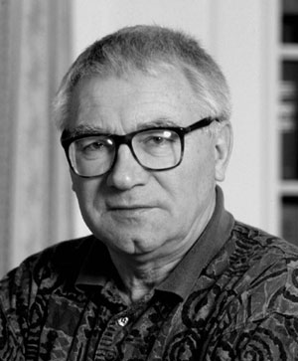
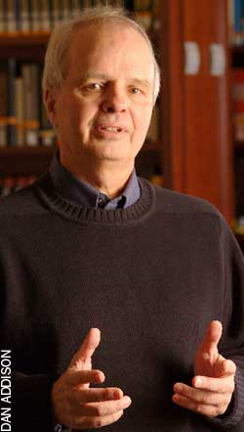
In the footsteps of giants

Slide 5
Model definition and philosophy

Slide 6
Models are everywhere
Models are of central importance in many scientific contexts:
the Bohr model of the atom,
the MIT bag model of the nucleon,
the Gaussian-chain model of a polymer,
the Lorenz model of the atmosphere,
the Lotka-Volterra model of predator-prey interaction,
the double helix model of DNA,
agent-based and evolutionary models in the social sciences,
In science we are are spend a great deal of time building, testing, comparing and revising models.
Models are one of the primary instruments of modern science.

Slide 7
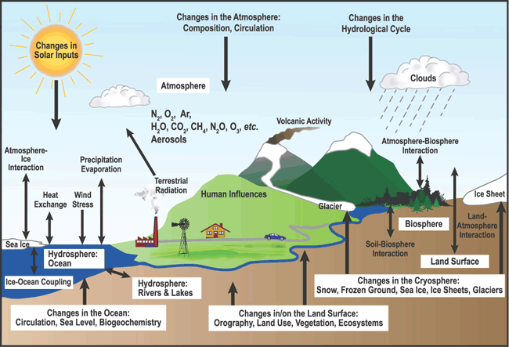
The climate system

Slide 8
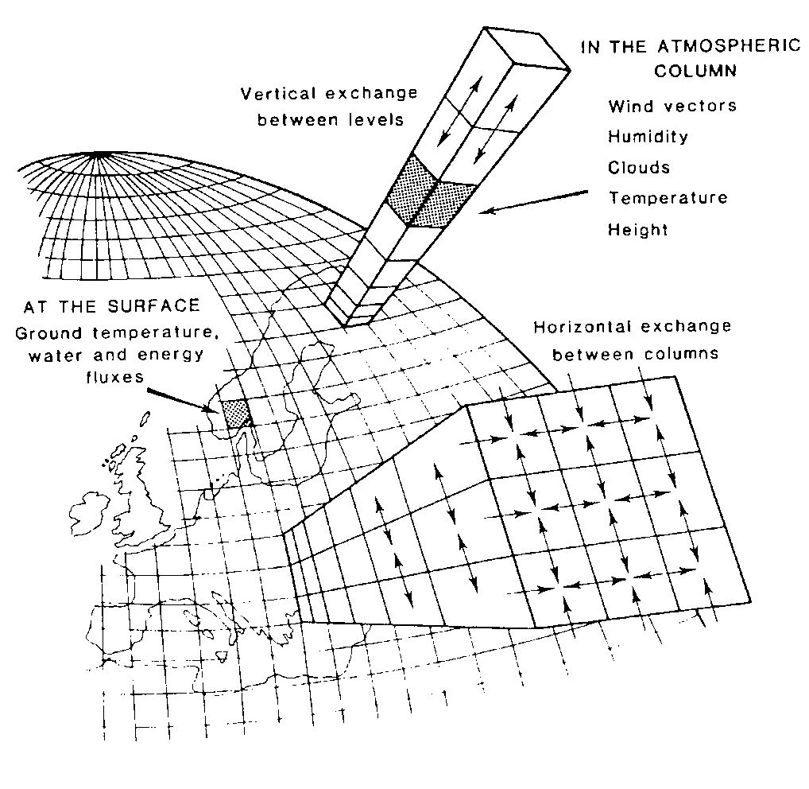
General Circulation Models
A climate model needs to simulate albedo, emissivity and general circulation.
Use “first principles”
Newton's Laws of Motion
1st Law of Thermodynamics
Conservation of Mass and Moisture

Slide 9
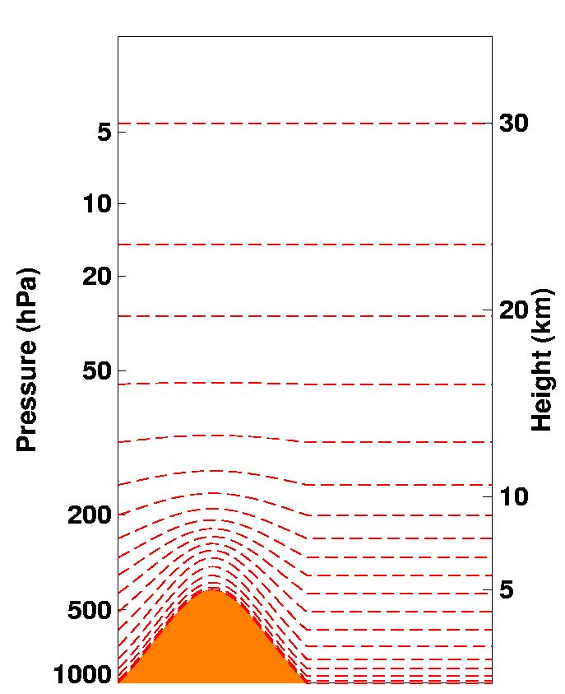
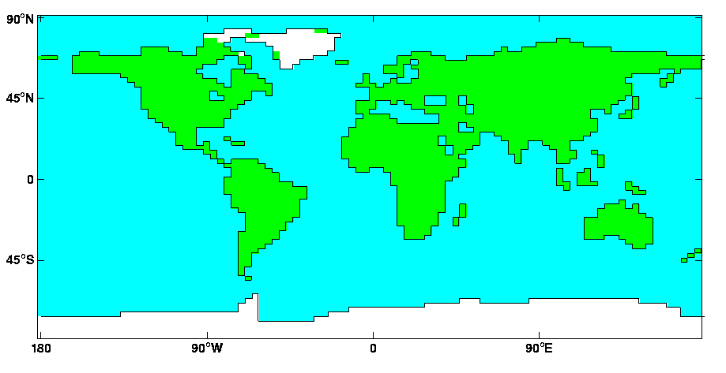
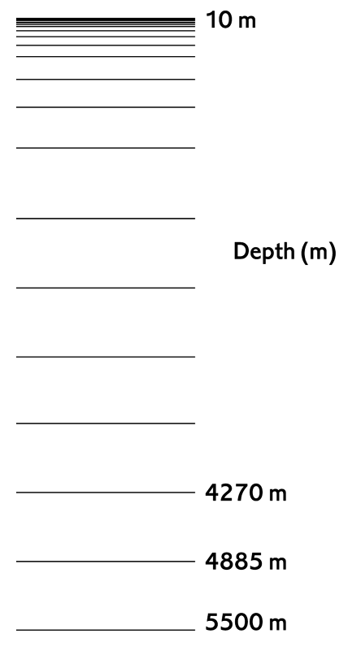
HadCM3 GCM
Atmospheric resolution: 3.75 by 2.5 degrees
19 Atmospheric Levels
Ocean resolution :1.25 by 1.25
20 Ocean Levels

Slide 10
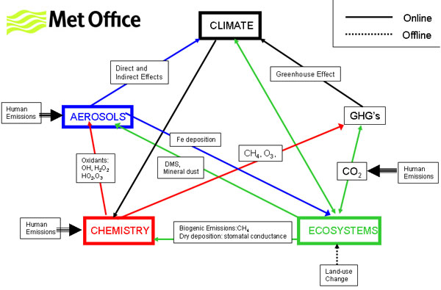
The rise of Earth System Models

Slide 11
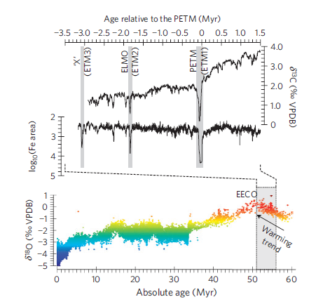
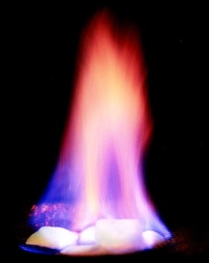
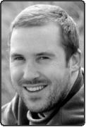
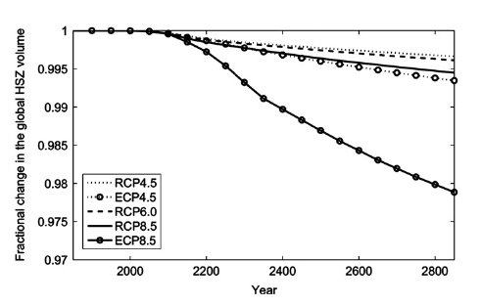
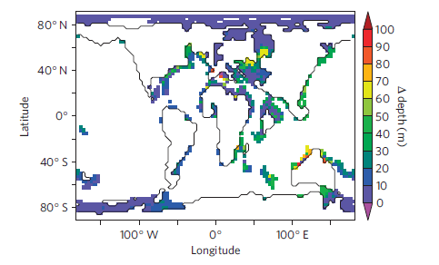
Addressing big questions – the Carbon Cycle
(EPSL, 2013)
(Nature Geoscience, 2011)

Slide 12
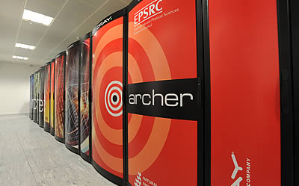
We need powerful computers
The national supercomputer (ARCHER)
2 quadrillion operations per second.

Slide 13
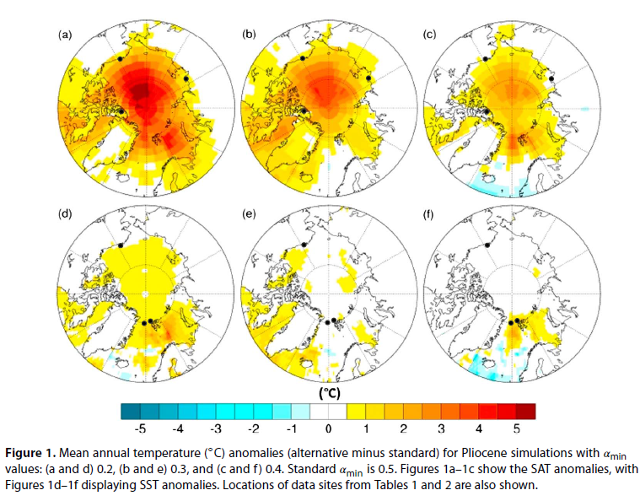
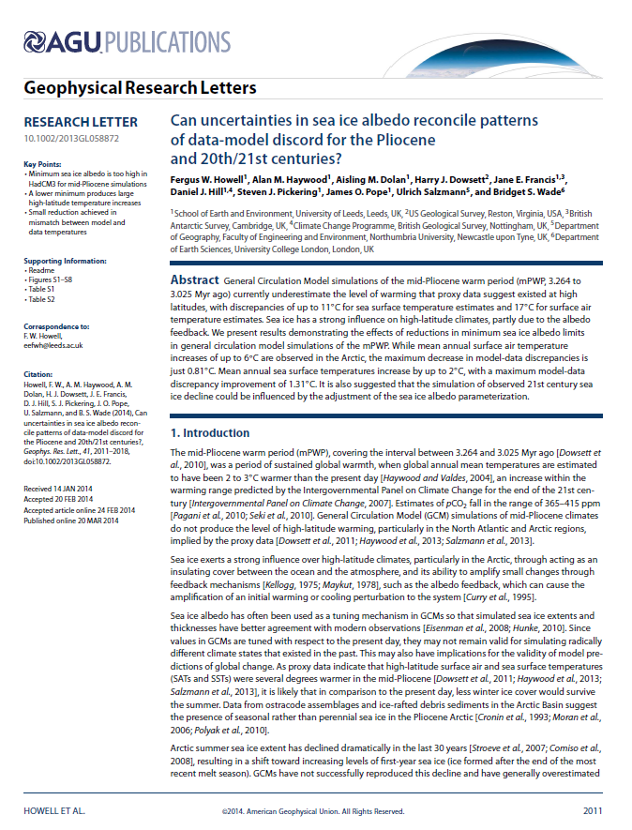
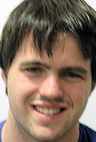
Models are tuned to the modern
We make an assumption that a model which is good for the modern is good for the past (or future): how good are our model parameters?

Slide 14
Models are tuned to the modern
Pre-industrial summer sea ice concentration %
Pliocene summer sea ice concentration %
A good model for the modern may not be a good model for the past (or the future)
We need to perform out of sample evaluations of model performance and therefore we must work on palaeo and we must have a strong connection to the data community

Slide 15
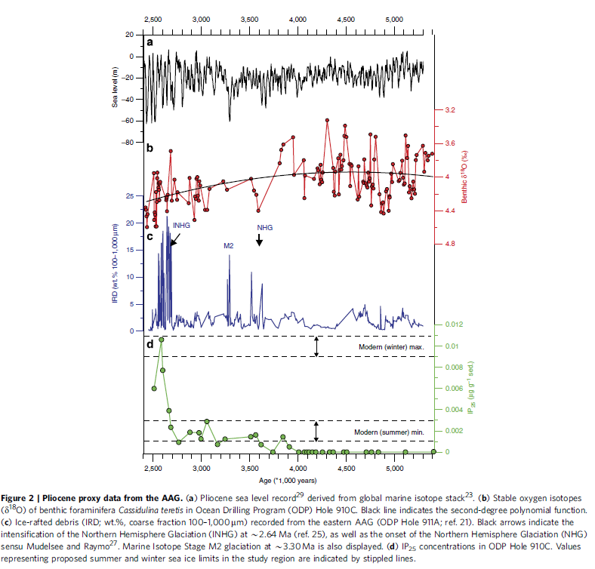
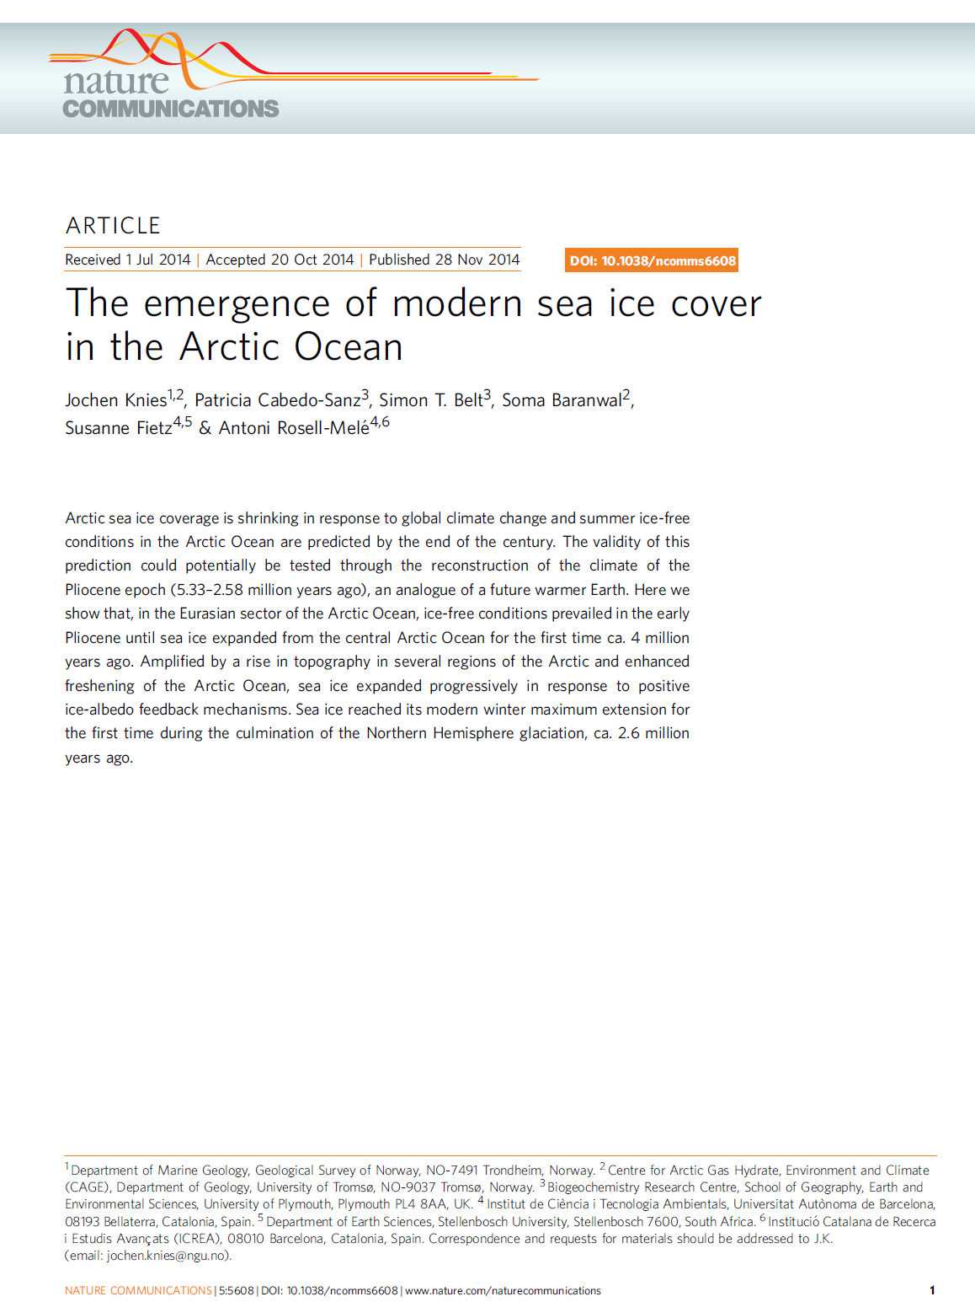
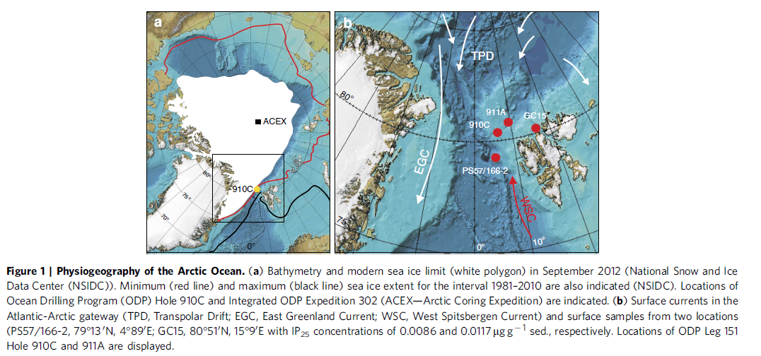
Palaeo data community always delivers

Slide 16
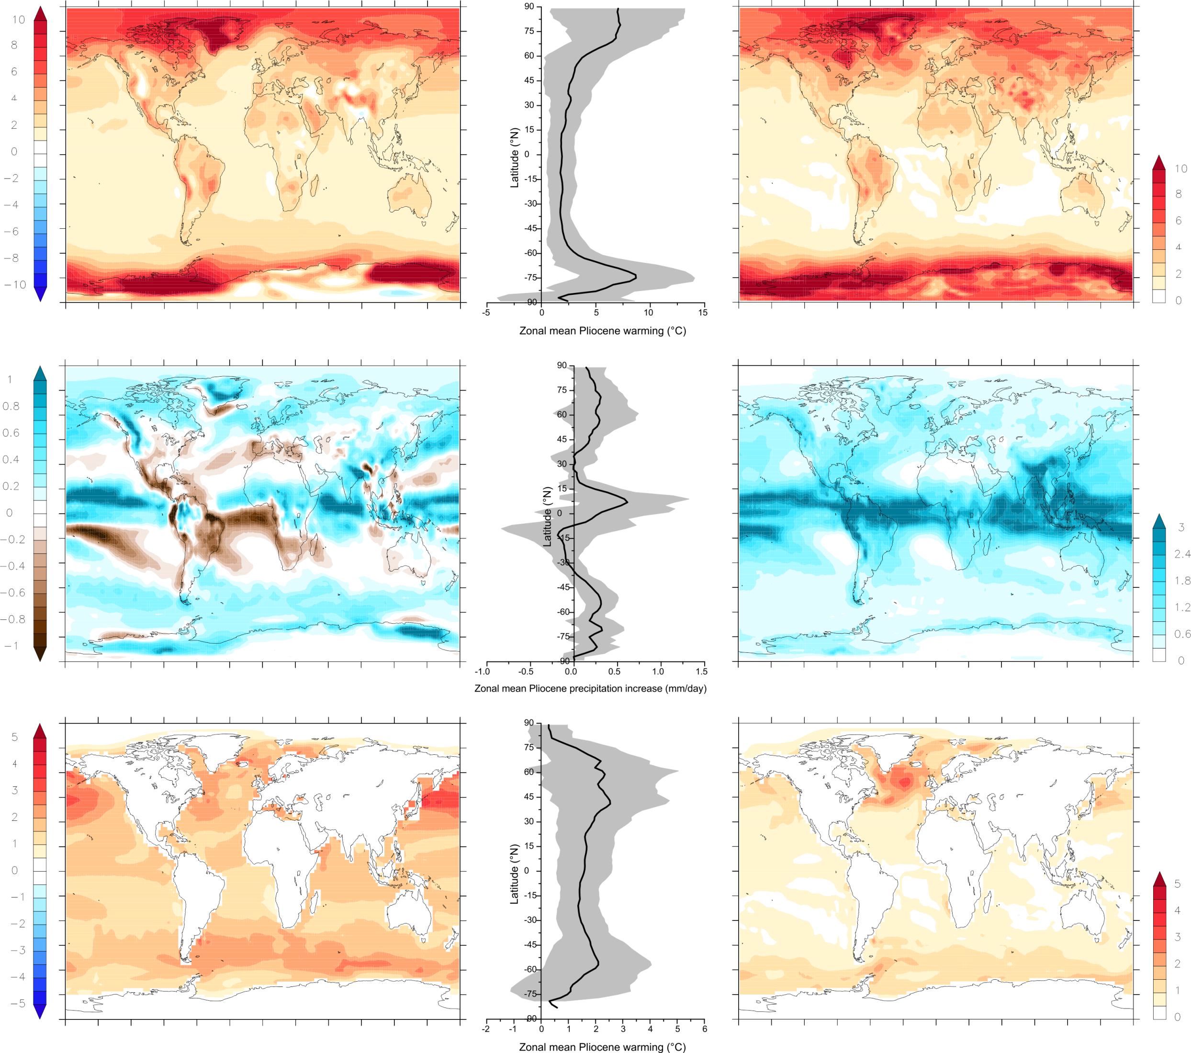
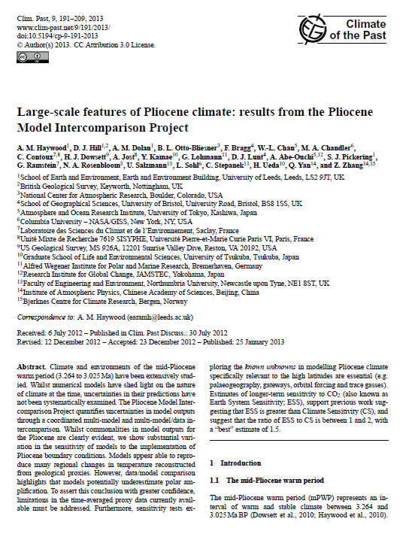
Pliocene Model Intercomparison Project
Caveat emptor
Surface Air Temperature (°C)
Total Precipitation (mm/day)
Sea Surface Temperature (°C)
STD Deviation
Multi Model Mean Ann.
Identified consistency in surface temperature change across models in the tropics. Lack of consistency identified in model responses at high latitudes. In contrast models diverge most clearly for changes in total precipitation rate in the tropics (Haywood et al., 2013)

Slide 17
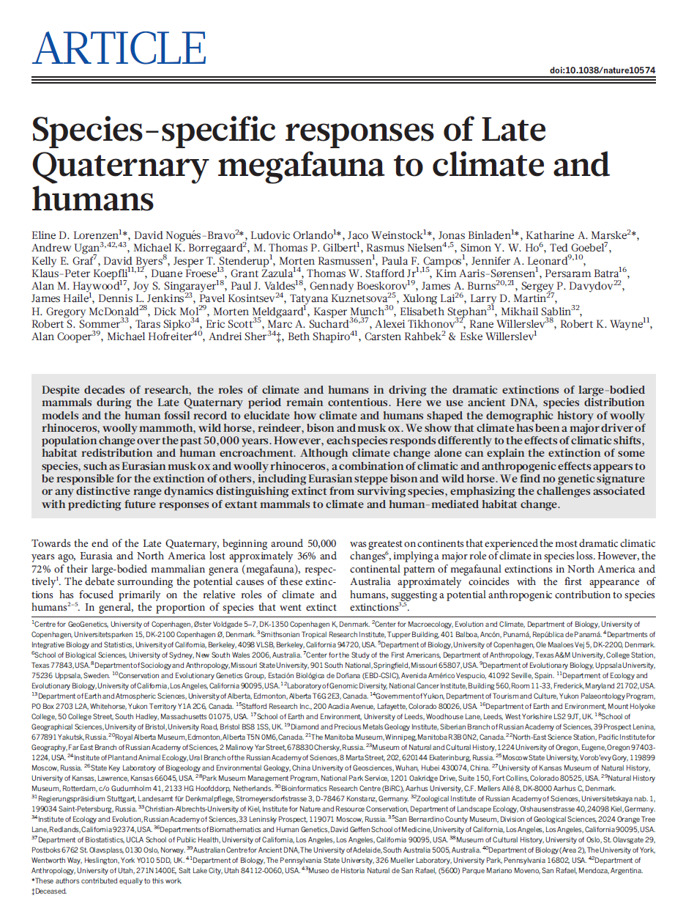
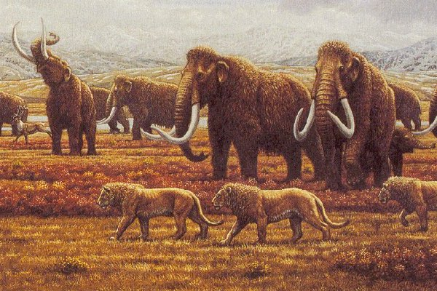
When climate models are often at their best
When they are combined with data for evaluation
When multiple models are used to examine the same question
When multiple techniques are used to address the same question
Influence of:
Climate change
Habitat change
Human encroachment

Slide 18
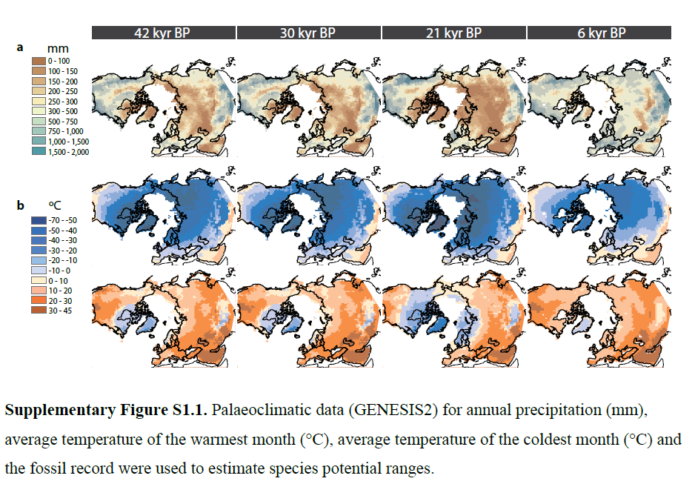
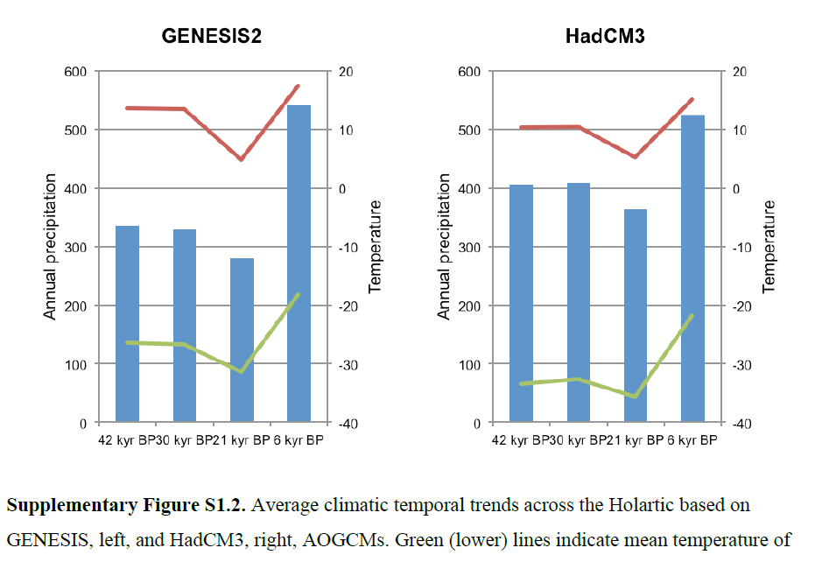
Quaternary mega fauna
Species Distribution Modelling – including climate model outputs
Megafauna ancient DNA extraction, amplification and sequencing
Megafauna ancient DNA sequence analysis
Gene-climate correlation
Temporal and spatial overlap of humans and megafauna

Slide 19
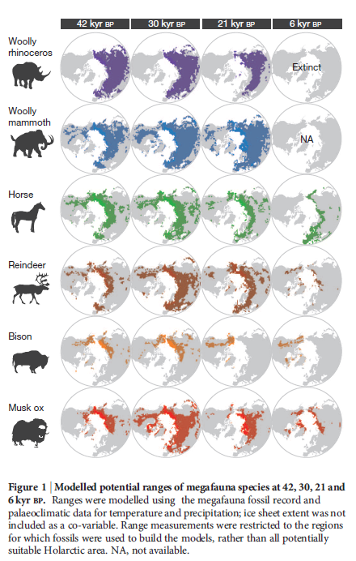
Quaternary mega fauna
Climate as a major driver of population change over the last 50,000 yrs
Each species responds differently to climate, habitat change and human encroachment
Climate can explain the extinction of Eurasian Musk ox and Woolly Rhino
Combination of effects involved in the extinction of other species
No unique genetic signature or range dynamics distinguishing extinct or extant species – future behaviour difficult to predict

Slide 20
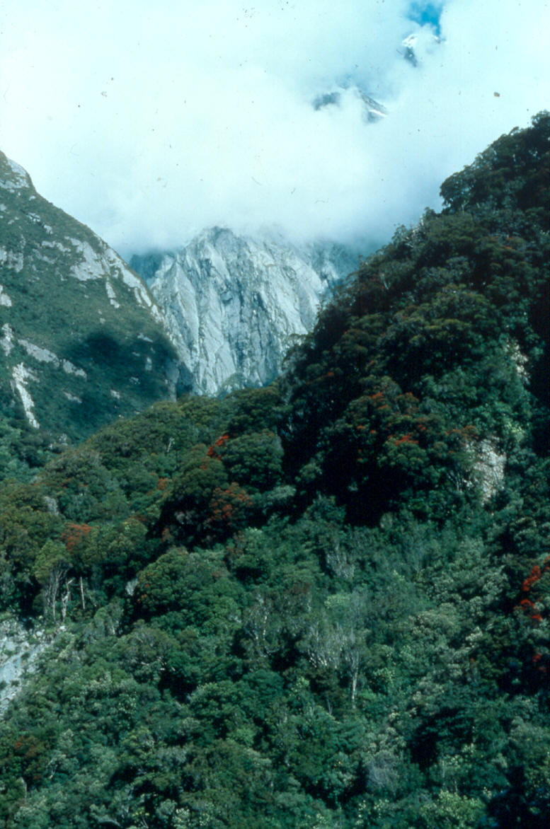
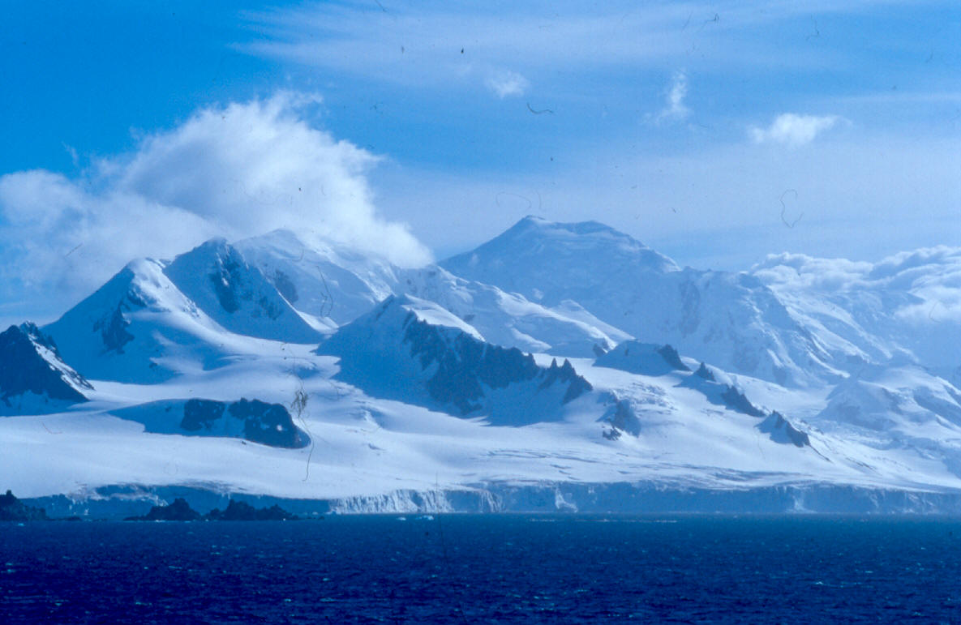
Palaeocene
Present
Antarctica: from Greenhouse to Ice-house
Mechanisms for Antarctic
Ice-Sheet Initiation
• Ocean Gateways
• Antarctic elevation
• Declining atmospheric CO₂ concentration

Slide 21
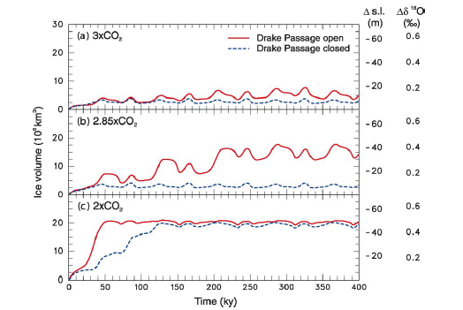
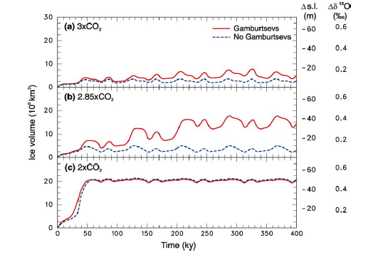
A study ahead of its time
DeConto & Pollard (2003).

Slide 22
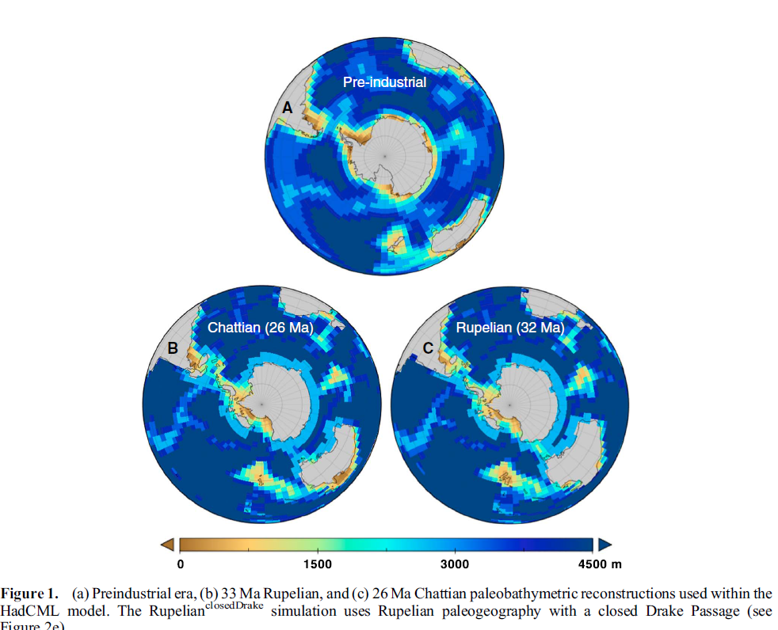
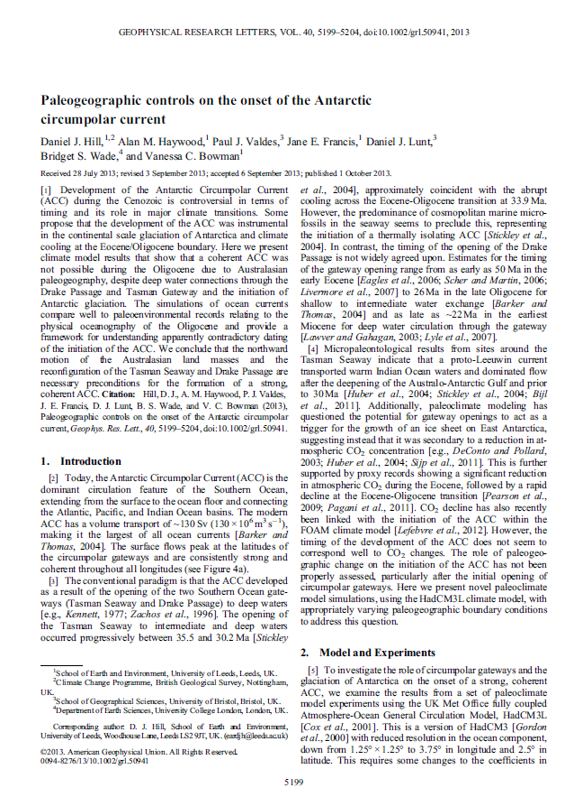
Understanding the ocean circulation response

Slide 23
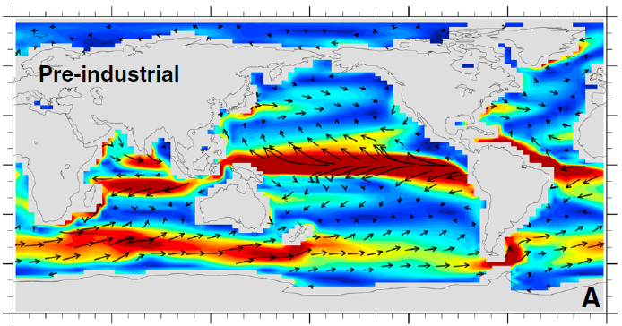
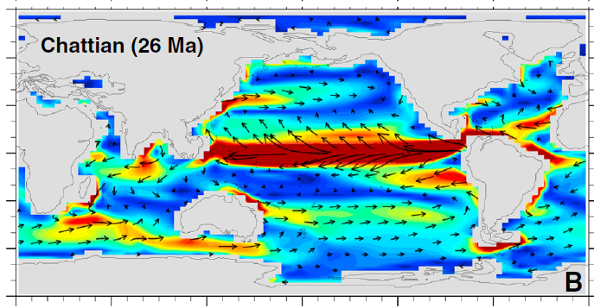
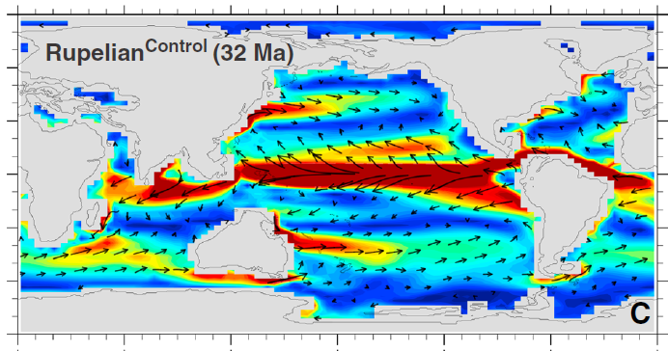
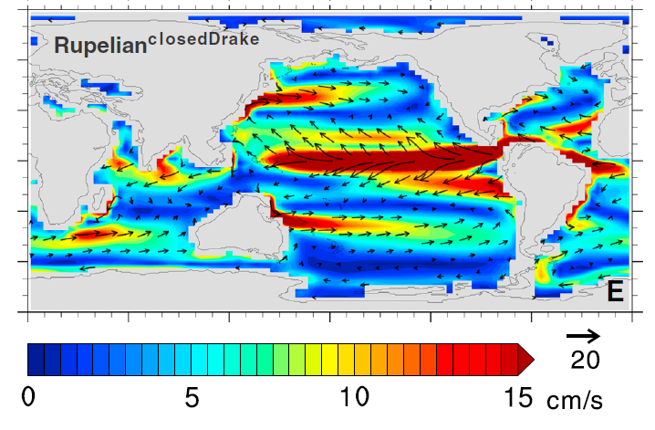
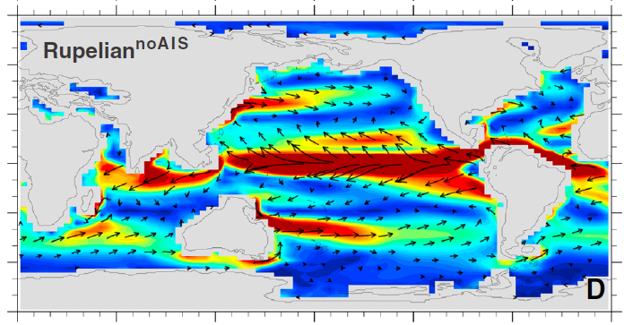
Understanding the ocean circulation response (Eocene-Oligocene)

Slide 24
Climate Sensitivity – equilibrium global annual mean temperature response to a doubling of CO₂ from fast feedbacks

Slide 25
Earth System Sensitivity – equilibrium global annual mean temperature response to a doubling of CO₂ from fast and slow feedbacks

Slide 26
Earth System Sensitivity – equilibrium global annual mean temperature response to a doubling of CO₂ from fast and slow feedbacks

Slide 27
Use models to account for appropriate slow feedbacks & remove non-relevant factors
ESS 30 to 50% greater than CS

Slide 28
Pliocene Model Intercomparison Project

Slide 29
PlioMIP results - ESS
Can use PlioMIP results to tell us something about ESS
Model | Pliocene warming (K) | Climate Sensitivity | Earth System Sensitivity | ESS / CS
CCSM4 | 1.86 | 3.2 | 3.51 | 1.1
COSMOS | 3.60 | 4.1 | 6.77 | 1.7
GISS-E2-R | 2.12 | 2.7 | 3.98 | 1.5
HadCM3 | 3.27 | 3.1 | 6.16 | 2.0
IPSLCM5A | 2.18 | 3.4 | 4.10 | 1.2
MIROC4m | 3.46 | 4.1 | 6.51 | 1.6
MRI-CGCM 2.3 | 1.84 | 3.2 | 3.45 | 1.1
NorESM-L | 3.27 | 3.1 | 6.14 | 2.0
Ensemble mean | 2.66 | 3.36 | 5.01 | 1.5

Slide 30
But…
Red = Full Transient. Blue = Fixed Veg. and Interactive Ice Sheets. Green = Fixed Ice and Dynamic Vegetation.

Slide 31
Pliocene Uncertainty…
Challenges…
Mean Annual SST comparison
(with Model and Data Errors)
Degree of data-model discordance (anomaly versus anomaly)
Notes:
One of the key findings in PlioMIP Phase 1 was the potential underestimation of model-predicted surface temperature warming in the high latitudes. Understanding model-data discord is non-trivial and can rarely be attributed to a single factor. The complexity of understanding model-data discord is highlighted by the PMIP Triangle (Figure 1) which is an effective means to describe potential uncertainty space and has at is vertices model physics (structural and parameter uncertainty), model boundary conditions and limitations in proxy data.

Slide 32
Causes of data/model mismatch
Uncertainty
Space

Slide 33
In deep time we have compared apples and oranges
DATA
MODEL
At each site temperature or precipitation change is a function of the prevailing orbital, and other forcings, that change over time.
Unless proxy syntheses truly reconstruct geographically extensive single events in time they will suffer from aliasing
Temperature and precipitation predicted for a fixed moment in time with a single prescribed set of forcings and a prescribed set of boundary conditions (CO₂, ice sheets etc.)
Hypothesise that a significant component of data-model inconsistencies that we have documented in deep time is because we are not comparing like for like with regard to data and models.

Slide 34
A lesson from and practical application of Milanković Theory

Slide 35
New interval to focus on (KM3/5 to M2)
Displays a near modern orbital configuration, before and after the time slice
In a known warm peak in the benthic oxygen isotope record

Slide 36
Pliocene Uncertainty…
Seeing through the mist
New model results showing the differences in annual mean SAT between two interglacial events during the Pliocene (Prescott et al. 2014).

Slide 37
Pliocene Uncertainty…
Seeing through the mist
New model results showing the differences between two interglacial events during the Pliocene (Prescott et al. 2014)
Seasonal differences in SAT are more prominent - greater implications for environmental reconstructions.

Slide 38
Peak warmth is not synchronous
Demonstrated problems with aliasing in proxy records.
Necessitates move forward towards Quaternary methods of modelling and data collection.
Targeting narrower windows of time and discrete time slices.
[Prescott et al. 2014]

Slide 39
New modelling approaches

Slide 40
Exploring the unknown…together

Slide 41
Conclusions
1. Models (of all types) are an essential part of modern science.
2. Palaeo provides out of sample tests for the same numerical models that are used to predict the future – what is the true predictive capability of our models, not how well are they tuned to represent modern climate.
3. Palaeoclimate modelling is at its best when working in concert with evidence from the geological record, and can be used to test big geologically-driven hypotheses.
4. Climate models help us see beyond the limitations of the geological record, not everything is preserved, and what could the systems behaviour been like.
5. They help us (modellers and geologists alike) to ask better questions.

