Slide 1
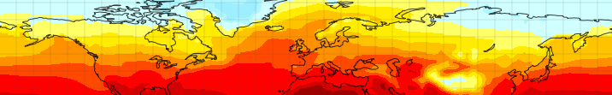


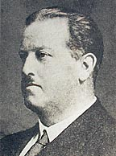









Palynology Group Meeting 2014
“Palynology in the Modelling World”
The von Post Lecture:
Can Models Reproduce Climates of the Past?
Alan Haywood, Aisling Dolan, Stephen Hunter, Daniel Hill, Ulrich Salzmann, Harry Dowsett, Bette Otto-Bliesner, Dan Lunt
Ernst Jakob Lennart von Post (June 16, 1884 - January 11, 1951).

Slide 2
Palynology Group Meeting 2014
“Palynology in the Modelling World”
Can Models Reproduce Climates of the Past?
No!
Sometimes
To within known uncertainties often they can!
Yes or no isn't really the point, ask a better question

Slide 3

Ernst Jakob Lennart von Post (June 16, 1884 - January 11, 1951)
Credited with producing the first modern-type pollen spectra/diagram
Worked for the Swedish Geological Survey for 21 years as a peat specialist with a focus on stratigraphy correlating peat layers locally
Influenced by A.G. Hogbom and the development of the concept of the global geochemical carbon cycle
Strong interest in Quaternary climate and sea-level change in Sweden.
One of the founders of modern palynology

Slide 4
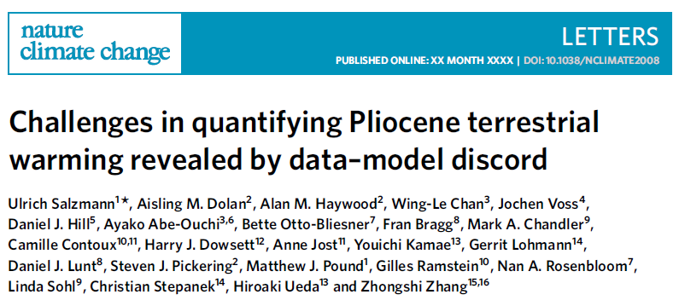
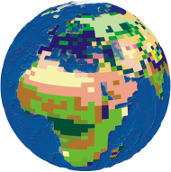
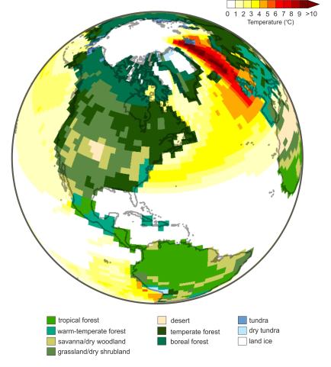
Contents
1. Models in Science
2. Global Climate Models
3. Testing geologically led big
hypotheses
4. Detecting regional climate change
5. Challenges in quantitative DMC
6. Way ahead and conclusions

Slide 5
Models are everywhere
Models are of central importance in many scientific contexts. Consider the centrality of:
the Bohr model of the atom
the MIT bag model of the nucleon,
the Gaussian-chain model of a polymer,
the Lorenz model of the atmosphere,
the Lotka-Volterra model of predator-prey interaction, the double helix model of DNA,
agent-based and evolutionary models in the social sciences,
In science we are are spend a great deal of time building, testing, comparing and revising models.
Models are one of the principal instruments of modern science.

Slide 6
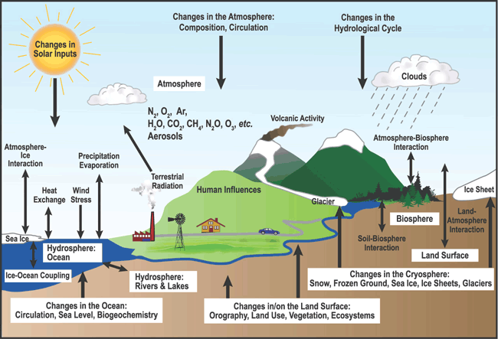
The Climate System

Slide 7
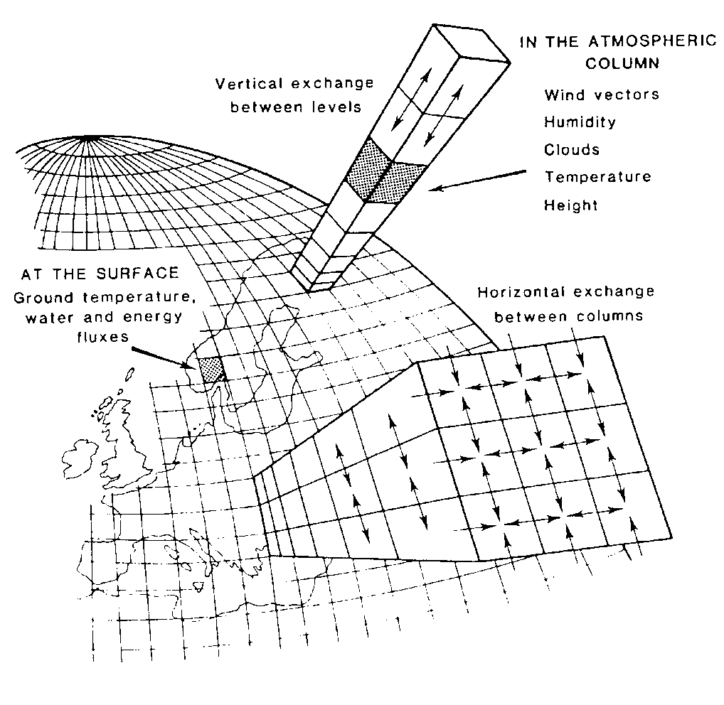
Global Climate Models
Model needs to simulate albedo, emissivity and general circulation.
Use “first principles”
Newton's Laws of Motion
1st Law of Thermodynamics
Conservation of Mass and Moisture
Hydrostatic Balance
Ideal Gas Law

Slide 8
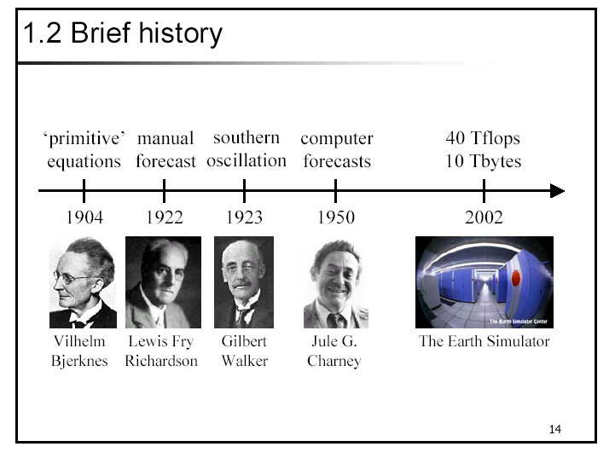
Brief history of numerical climate modelling

Slide 9
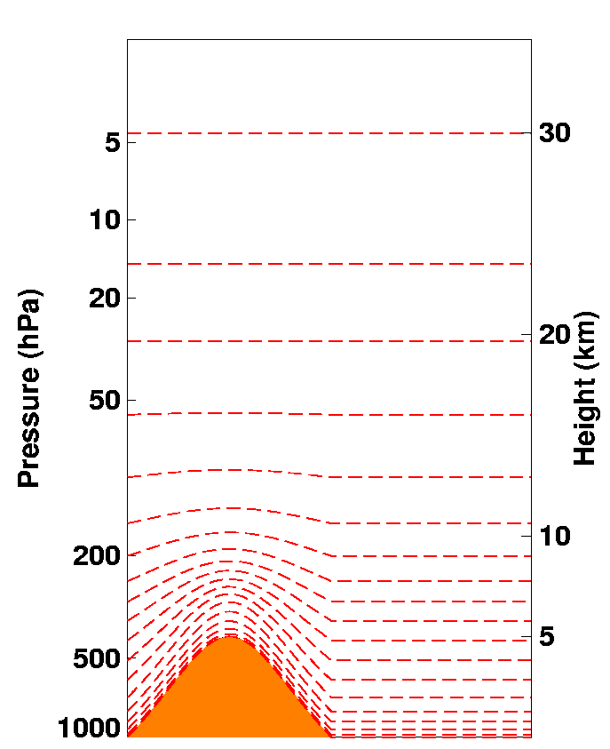
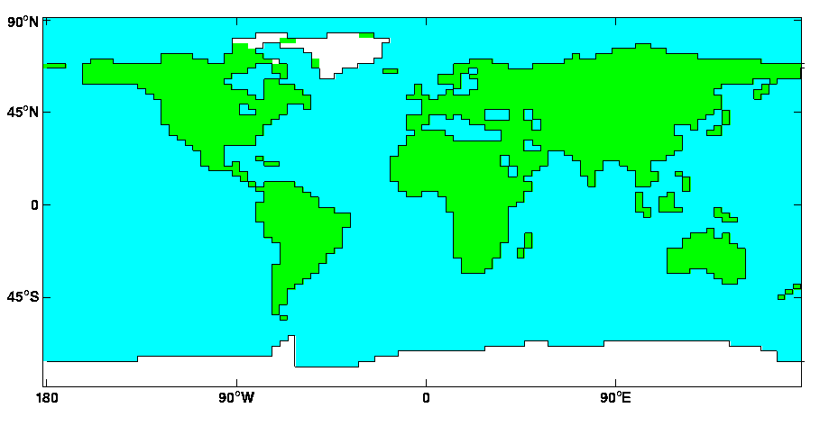
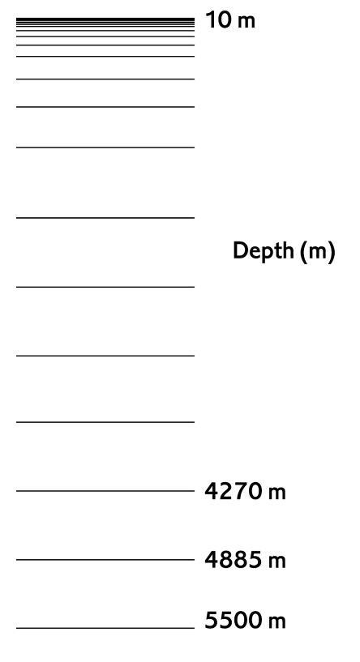
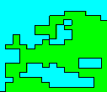
HadCM3 GCM
Atmospheric resolution: 3.75 by 2.5 degrees
19 Atmospheric Levels
Ocean resolution :1.25 by 1.25
20 Ocean Levels

Slide 10
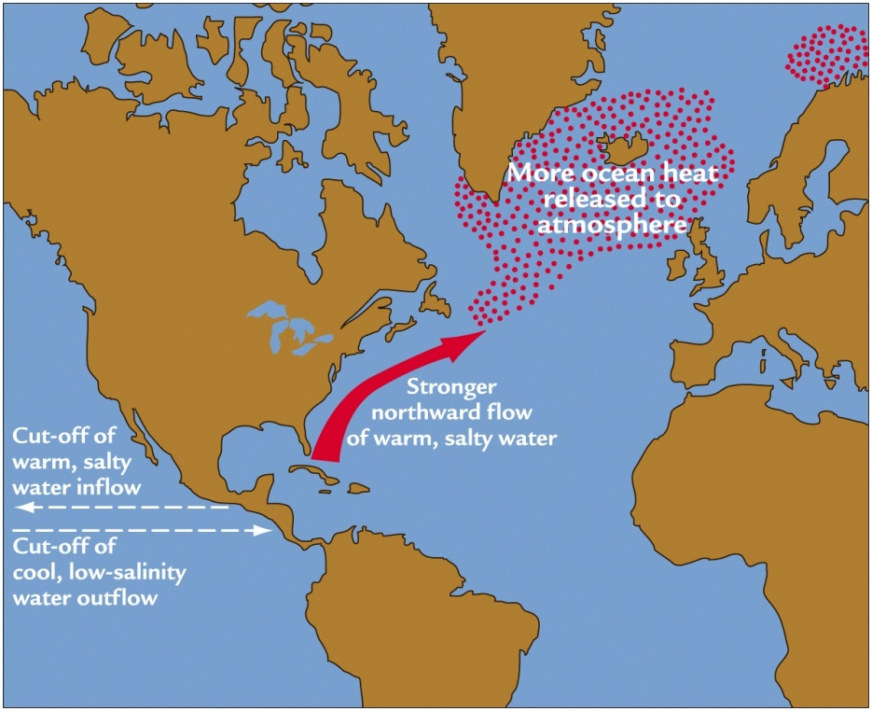
  The Cause of Northern Hemisphere Glaciation?
5 main hypotheses
Closure of Panama Seaway
Tectonic Uplift
Termination of ‘Permanent El Nino’
Decrease in CO₂
Orbital variations
Ruddiman, p163
Bartoli et al. (2005).

Slide 11
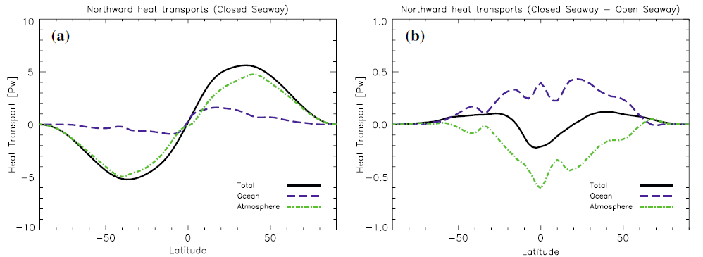
Did it do what we expect?

Slide 12
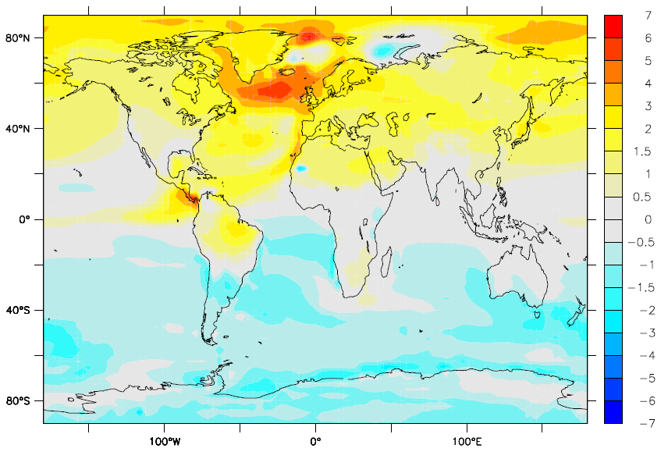
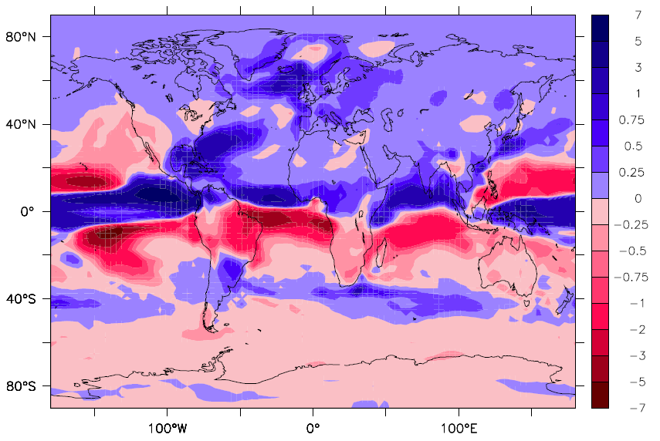
Astonishingly yes it did!

Slide 13
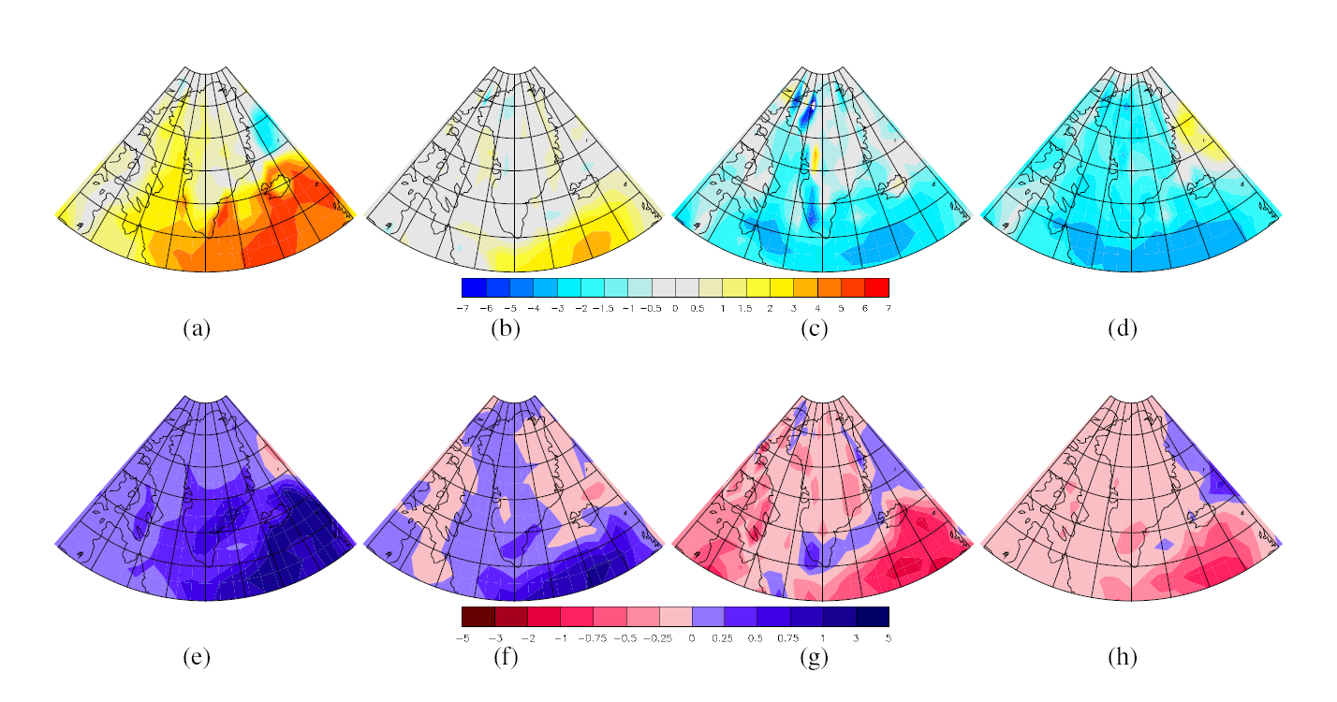
GCM results…
Panama
ENSO
Rockies
CO2
Temp
Precip

Slide 14
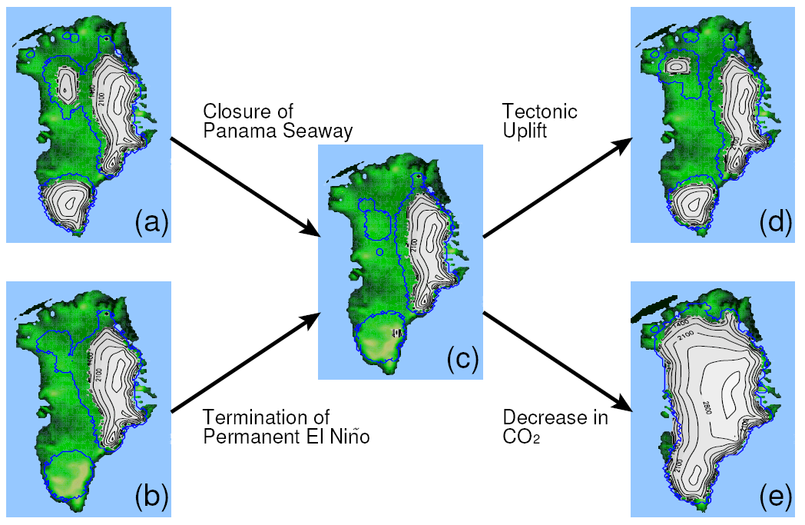
Ice sheet model results…

Slide 15
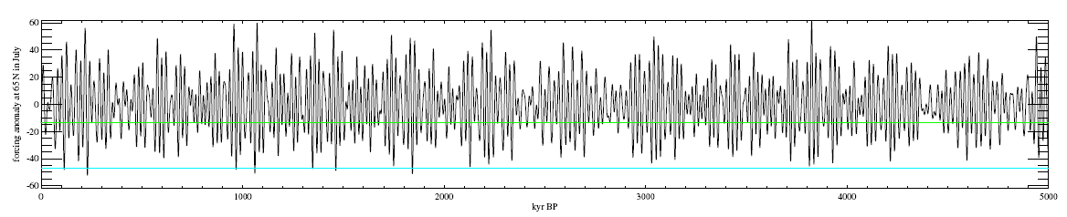
  The Causes of Northern Hemisphere Glaciation?
Orbital forcing hypothesis
From Berger and Loutre (1991).

Slide 16
Ice sheet model results…(2)
Extent of ‘cold orbit’ ice sheet

Slide 17











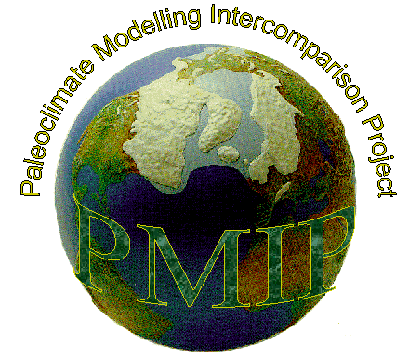


























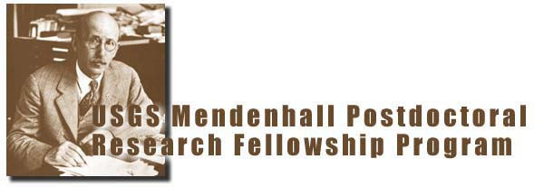
PlioMIP collaboration

Slide 18
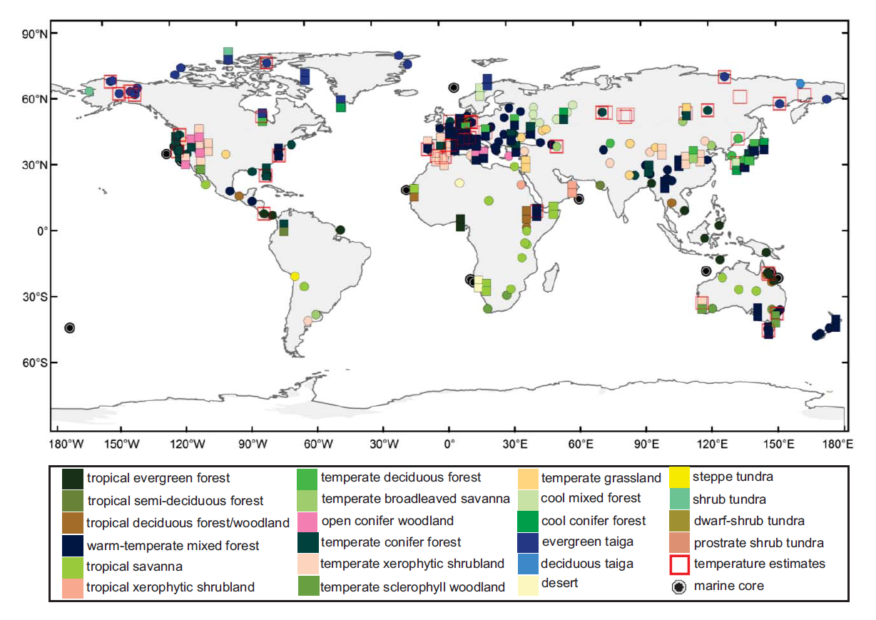
Terrestrial data/model comparison (DMC)
45 palaeobotanical sites where surface temperature can be estimated
(Nature Climate Change– Salzmann et al. 2013)

Slide 19
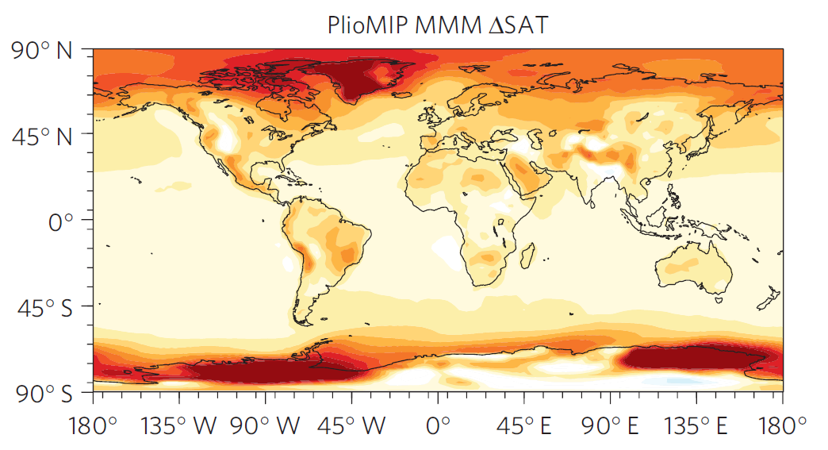
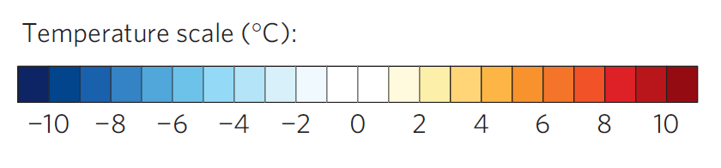
Terrestrial DMC – Multi-Model Mean
(Nature Climate Change– Salzmann et al. 2013)

Slide 20
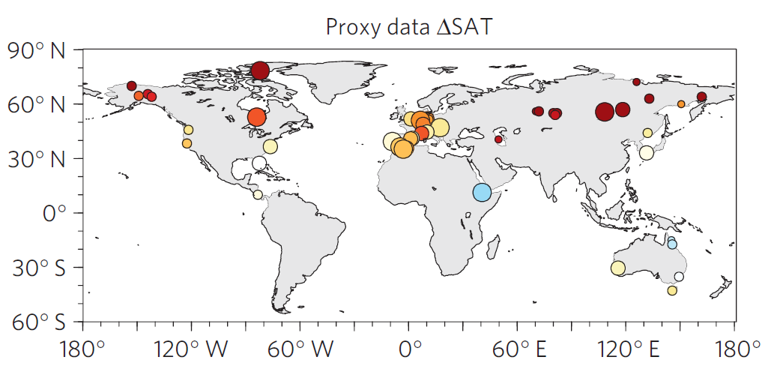
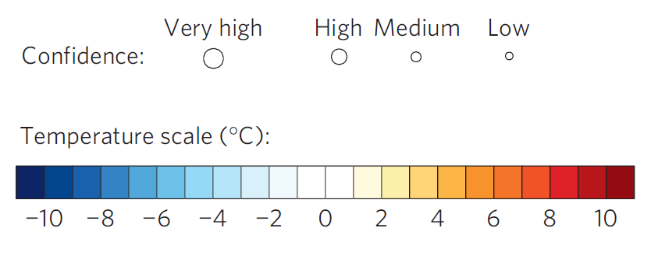
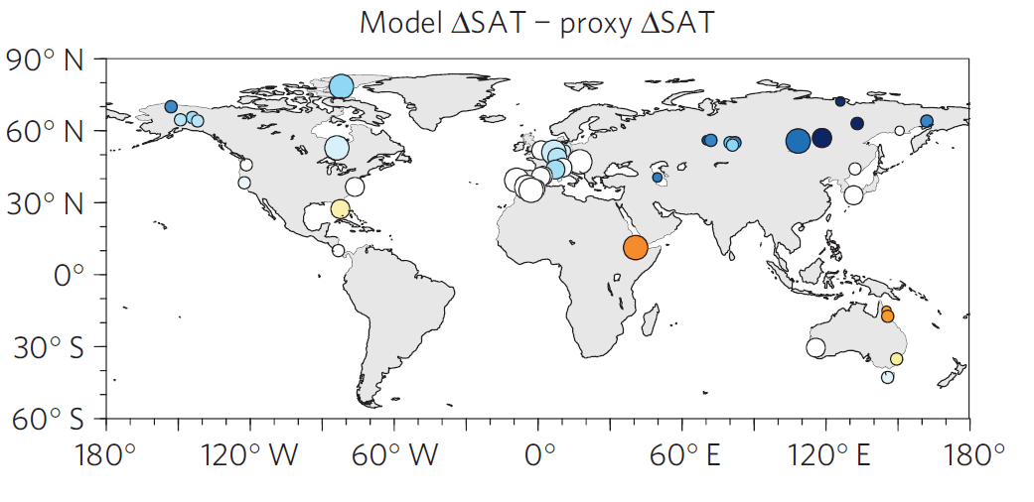
Terrestrial DMC (proxy signal versus model signal
Proxy-based temperature anomaly
Degree of data-model discordance (anomaly versus anomaly)
(Nature Climate Change– Salzmann et al. 2013)

Slide 21
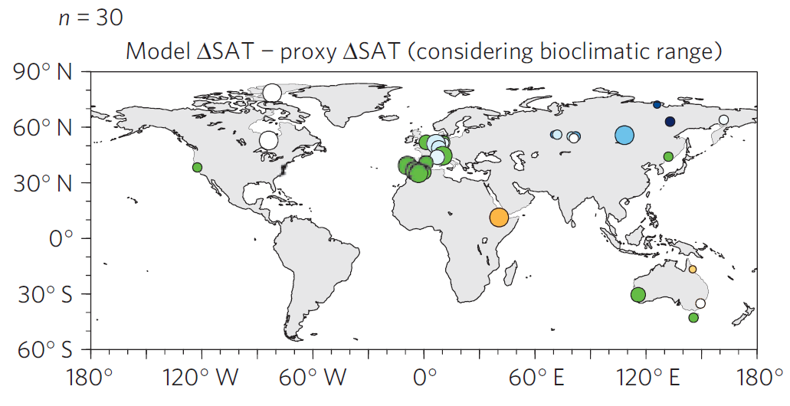
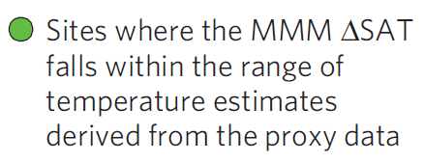
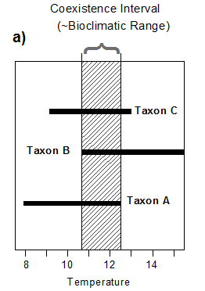
Terrestrial DMC (bioclimatic range)
(Nature Climate Change– Salzmann et al. 2013)

Slide 22
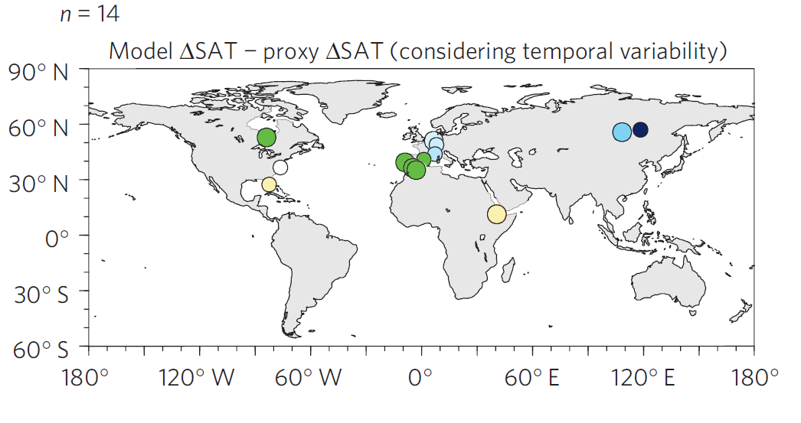
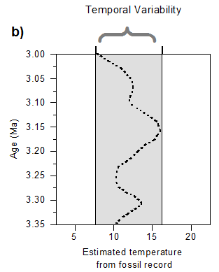
Pliocene Uncertainty…
Terrestrial DMC (temporal variability)
(Nature Climate Change– Salzmann et al. 2013)

Slide 23
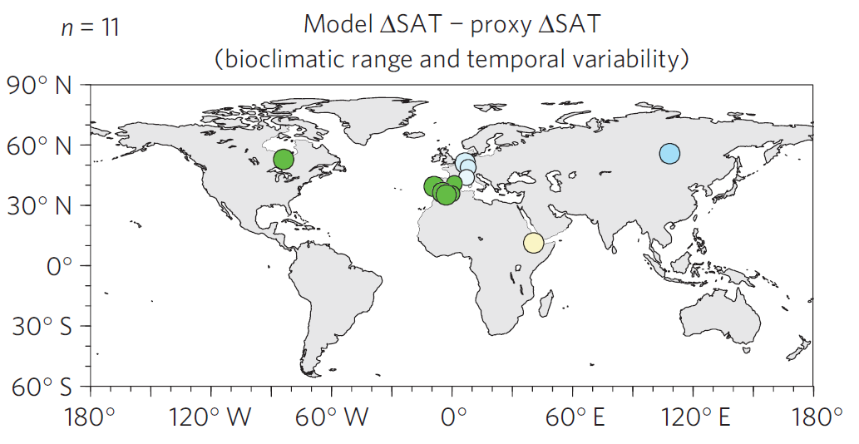
Pliocene Uncertainty…
Terrestrial DMC (bioclimatic range and temporal variability)
+
(Nature Climate Change– Salzmann et al. 2013)

Slide 24
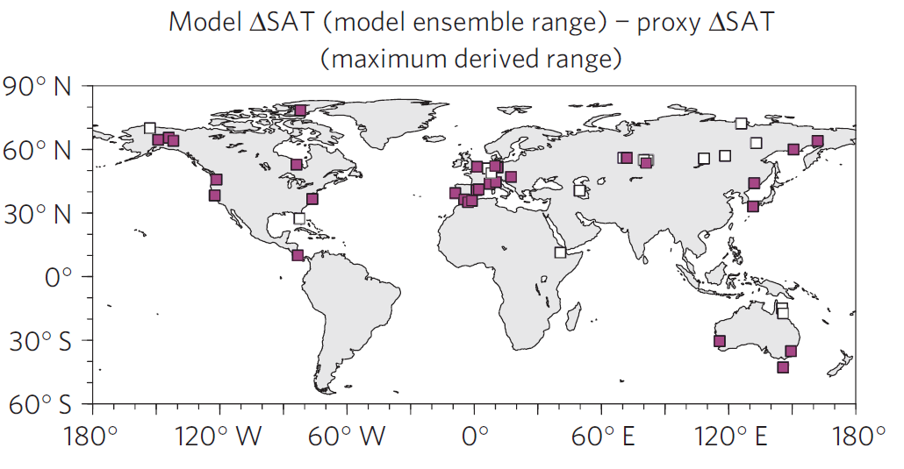
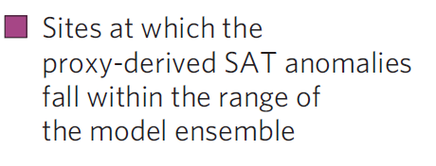
Terrestrial DMC (ensemble range)
(Nature Climate Change– Salzmann et al. 2013)

Slide 25
Need to consider what we are comparing to…
Proxy Data
Model
Represents the mean of the maximum warming response to forcing throughout the mPWP at each individual site, at the sampling resolution of each of the individual cores
Unlikely to be synchronous
Likely to be effects of boundary conditions changing during the mPWP
Likely to be transient effects
Equilibrium response (e.g. 500 to 1000 years should be sufficient for surface climate) to fixed forcing, appropriate for a mPWP interglacial.
Equilibrium temperatures for a fixed moment in time, if there was ever a moment with exactly these forcings.
No impact of orbital forcing (fixed at modern) or other changing boundary conditions.
Notes:
In theory models should be able to reproduce peak Pliocene warmth at every site across the globe. However, we need to know sensitivity of each site to all mPWP orbital changes, every BC change and uncertainty and if there are transient or non-linear effects to account for
OR
We could do a time slice

Slide 26
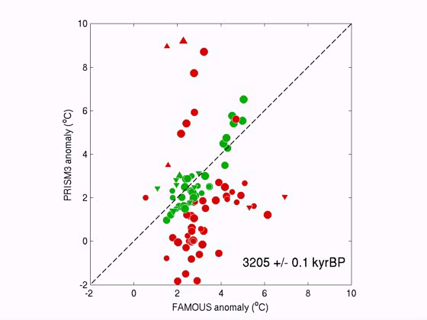
Pliocene Uncertainty…
Thought experiment (SSTs)

Slide 27
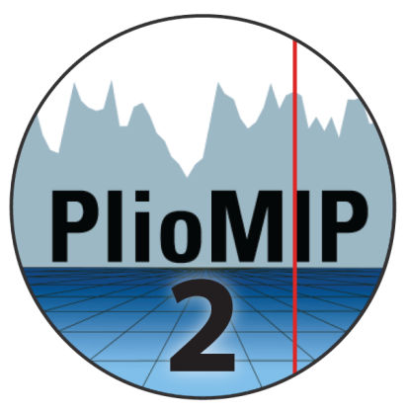
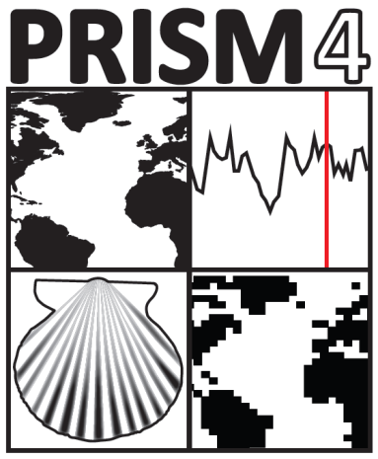
Pliocene Uncertainty…
PlioMIP Phase 2
Data Uncertainty
Analytical, Spatial, Temporal
Boundary Condition Uncertainty
Orbital forcing, Greenhouse gases, Topography
Modelling Uncertainty
Structural, Parameter

Slide 28
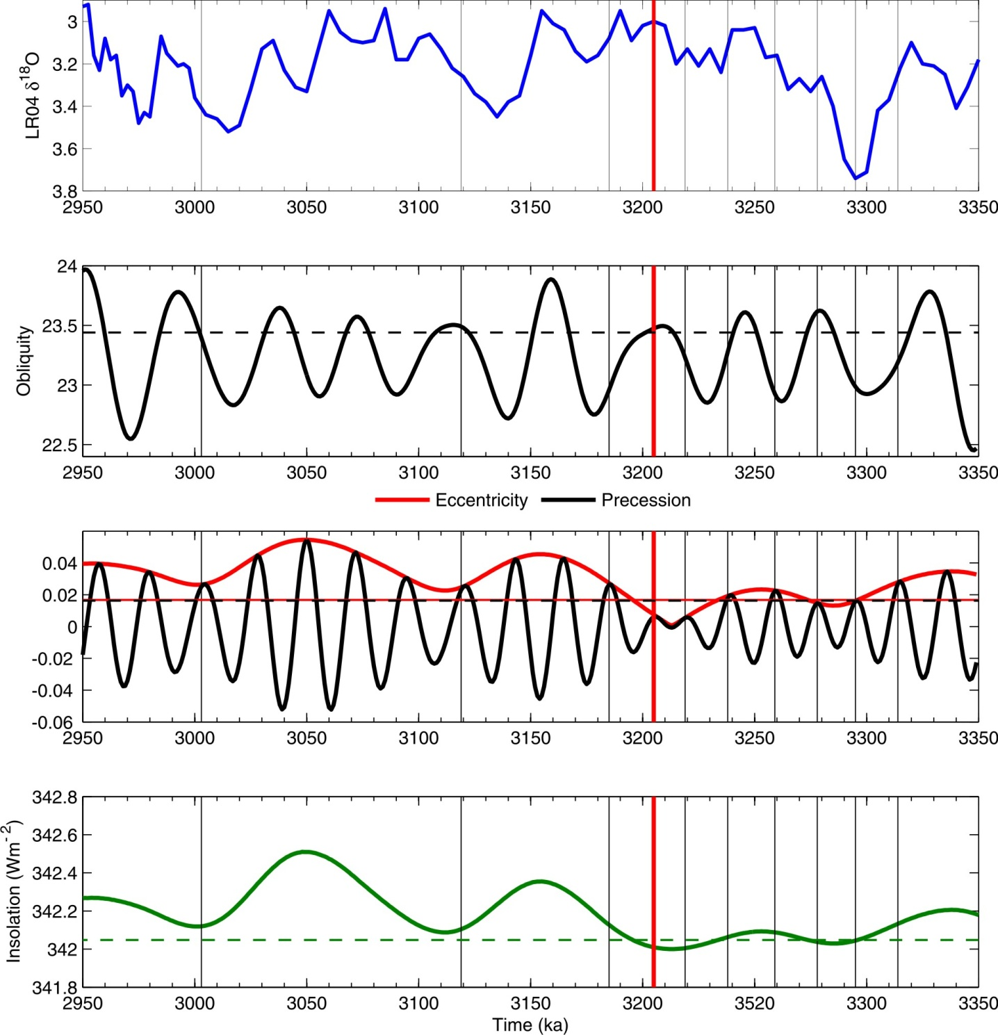
Pliocene time slice
First Pliocene Time Slice (3.205 Ma) at KM5c will form part of PlioMIP Phase 2 which is currently under construction
(Haywood et al., 2013 – in press)

Slide 29
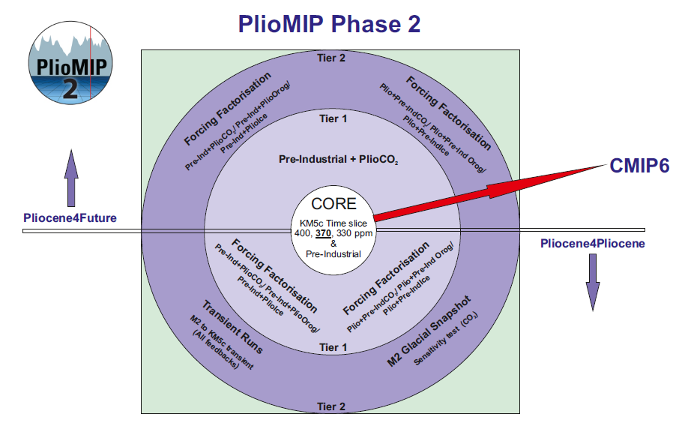
PlioMIP Phase 2
New Experiments

Slide 30
Why conduct transient simulations?
Transient climate
Understand climate variability through the Pliocene
Large scale features and transient dynamics
Compare snap-shot vs. transient
are there regions that are particularly dynamic?
Increasing complexity
Look at effect of different earth system components
Conduct Data-model comparison (DMC)
Better understand Pliocene Earth system sensitivity

Slide 31
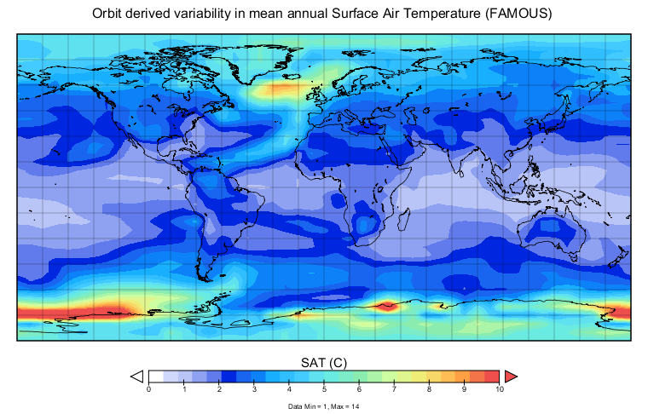
Transient variability (annual)

Slide 32
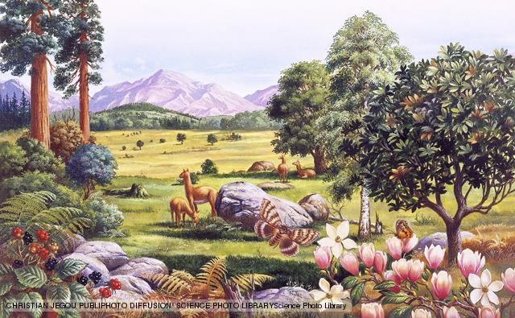
Conclusions
1. We try and say too much on the basis of just 1 model
2. Uncertainties in model and proxy data are considerable
3. The PlioMIP ensemble range is wide enough to overlap the terrestrial proxy signal at most locations – where is the discord?
4. Proxy data can not be used in the way we want – to discriminate between individual members of an ensemble
5. You must know exactly where you are in time to do this
6. The concept of the ‘stable Pliocene’ is obsolete

