Slide 1



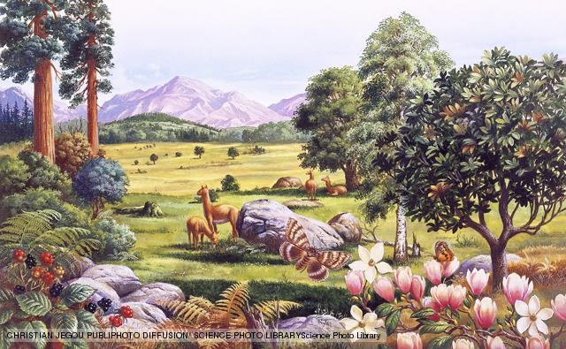


Reconstructing Earth's last interval of greater global warmth: progress, pitfalls and future challenges
Prof. Alan M. Haywood
School of Earth and Environment, University of Leeds, UK
Contributions from: Sarah Bonham, Aisling Dolan, Harry Dowsett, Andrey Ganopolski , Dan Hill, Nabil Khélifi, Dan Lunt, James Pope and PlioMIP Participants

Slide 2
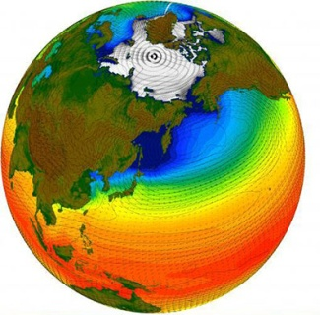
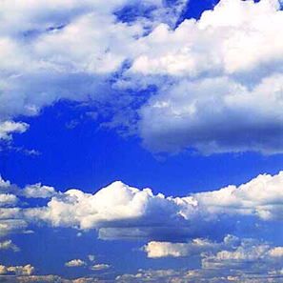
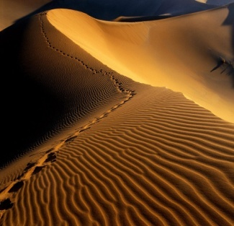
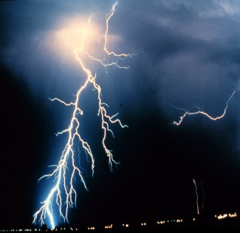


Talk Outline
  Inspiration and approaches to palaeo
  Climate evolution - the last 5 million years
  Why the Pliocene and the mid-Pliocene?
  Changing view of mid Pliocene environments
  Data/model comparisons and uncertainty
  Future outlook
Notes:
2
16 Institute and ca. 120 Wissenschaftler beteiligen sich an IMPETUS

Slide 3

1. Inspiration and approaches to palaeo
Uncertainties highlighted in climate prediction involve aspects of the climate that have changed in the past (e.g. ENSO).
Palaeoclimatology can assess whether these changes are consistent with current theories of the climate system and if not, why not.
Palaeoclimate provides a unique test-bed for models that project large changes in the future to be evaluated using true out-of-sample tests of comparable magnitude.
Notes:
16 Institute and ca. 120 Wissenschaftler beteiligen sich an IMPETUS

Slide 4
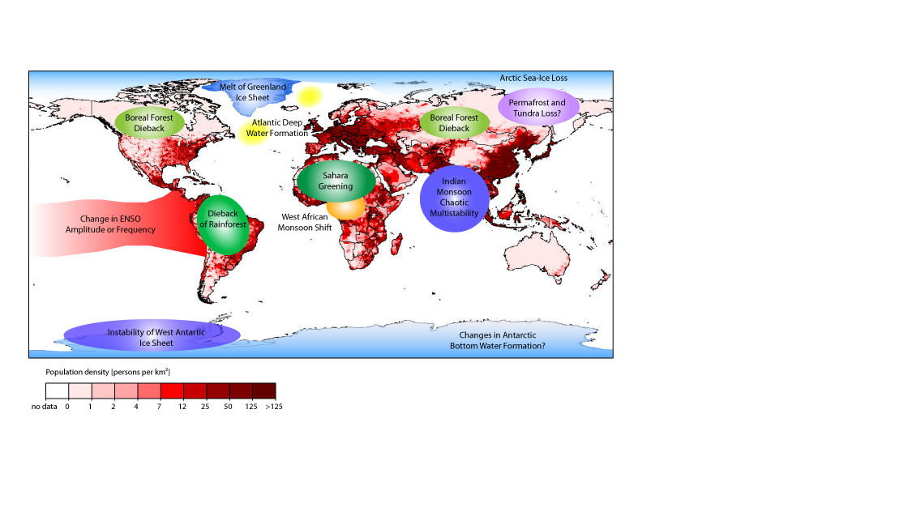
1. Inspiration and approaches to palaeo
- Policy relevant tipping elements
Adapted from Lenton et al. (2008).
Notes:
16 Institute and ca. 120 Wissenschaftler beteiligen sich an IMPETUS

Slide 5
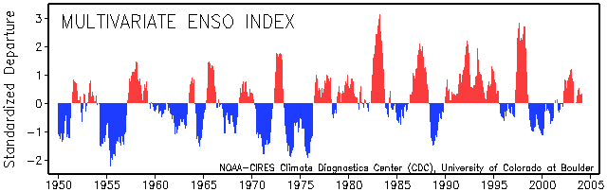
1. Inspiration and approaches to palaeo
- ENSO as an example
  Shift in frequency/amplitude of El Nino
  Attribution to warming due to anthropogenic emissions of greenhouse gases?

Slide 6
1. Inspiration and approaches to palaeo
- Analogue Issues
MODERN: Annual mean Precip.
minus Evap. 2 × minus 1× PAL CO₂
EOCENE: annual mean Precip.
minus Evap. 2 × minus 1× PAL CO₂
Haywood et al. (2011). Phil. Trans. R. Soc. A.
Notes:
16 Institute and ca. 120 Wissenschaftler beteiligen sich an IMPETUS

Slide 7
1. Inspiration and approaches to palaeo
- Climate and Earth System Sensitivity
Climate Sensitivity
Earth System Sensitivity
Lunt et al. (2010). Nature Geoscience
Notes:
16 Institute and ca. 120 Wissenschaftler beteiligen sich an IMPETUS

Slide 8
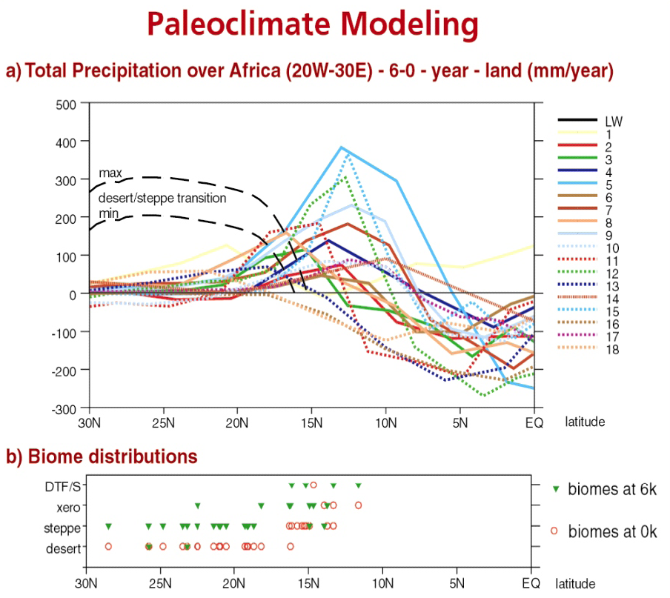
1. Inspiration and approaches to palaeo
- Grand Challenges
Reproducing the observed record of variability and change
Reconciling palaeoclimate simulations with climate archives
Assessment of climate and earth system sensitivity
Joussaume, S. et al. (1999)
Notes:
16 Institute and ca. 120 Wissenschaftler beteiligen sich an IMPETUS

Slide 9
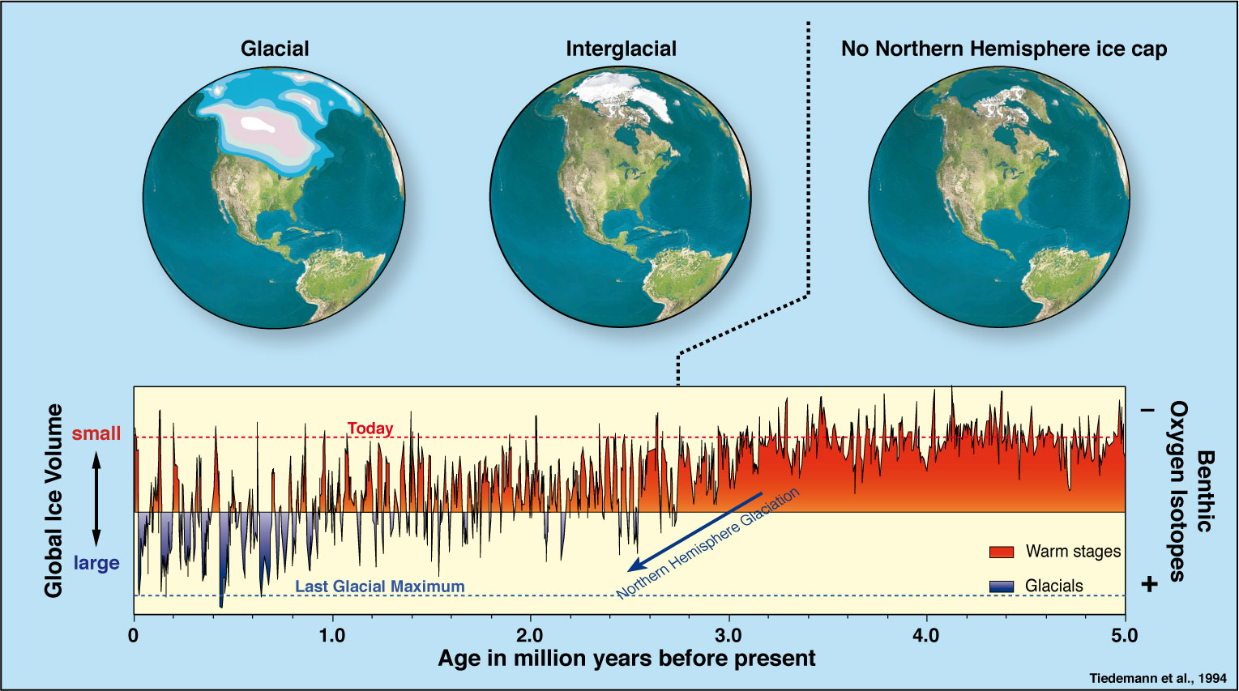
2. Climate evolution – the last 5 million years

Slide 10
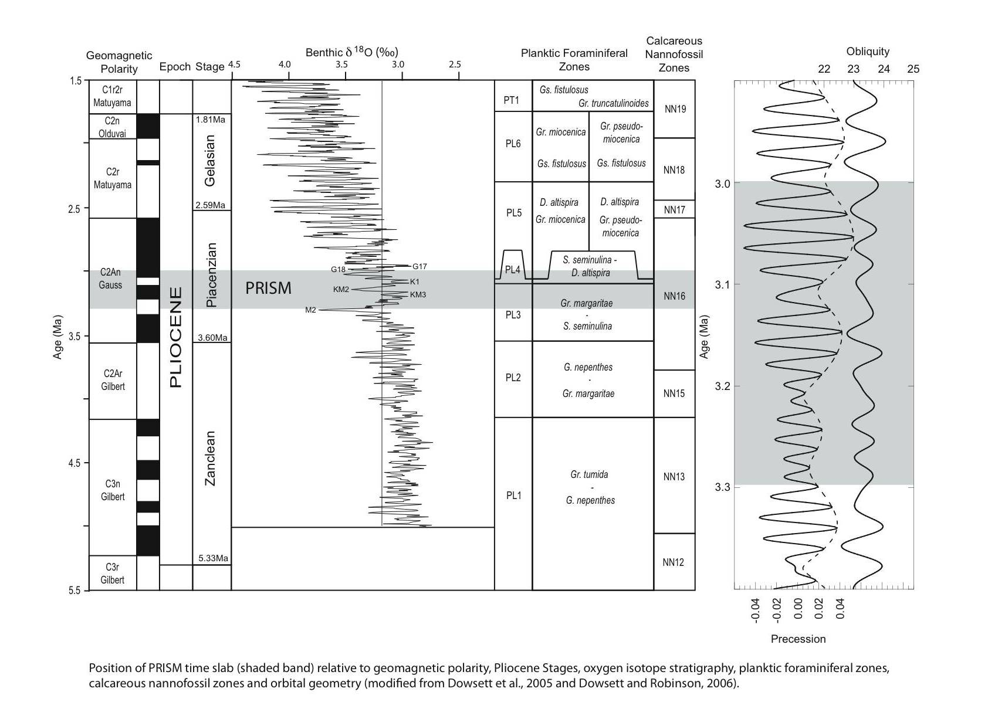
3. Why the Pliocene and mid-Pliocene?
We have abundant geological data for the Pliocene
Pliocene CO₂ concentrations were almost the same as today
Continents were in their modern positions
Pliocene ecosystems were similar to modern
Notes:
16 Institute and ca. 120 Wissenschaftler beteiligen sich an IMPETUS

Slide 11
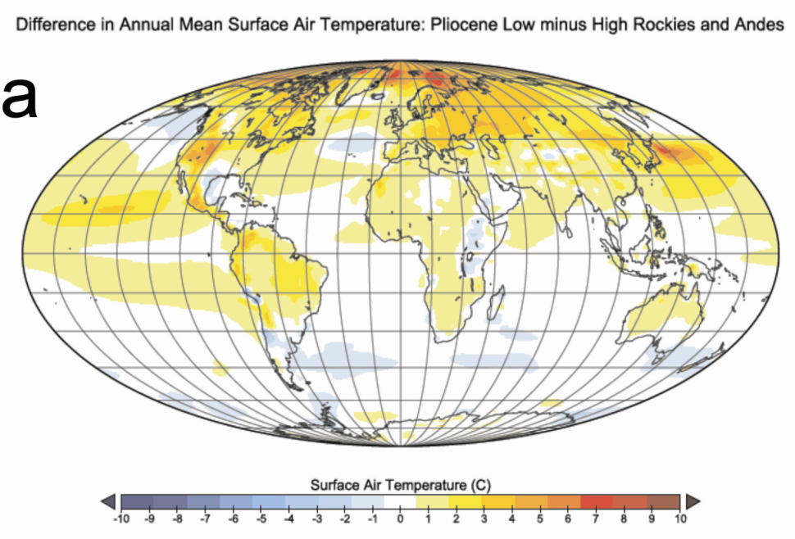
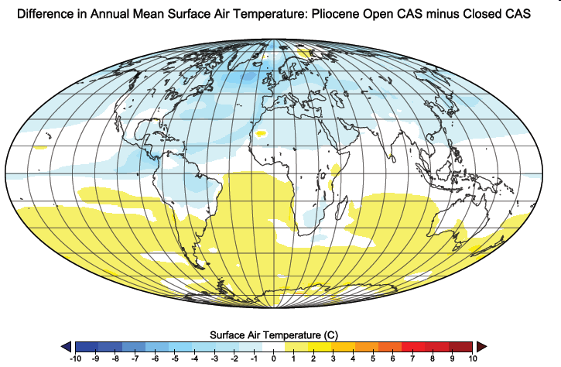

3. Why the Pliocene and mid-Pliocene?
Haywood et al. (2011)
Notes:
16 Institute and ca. 120 Wissenschaftler beteiligen sich an IMPETUS

Slide 12
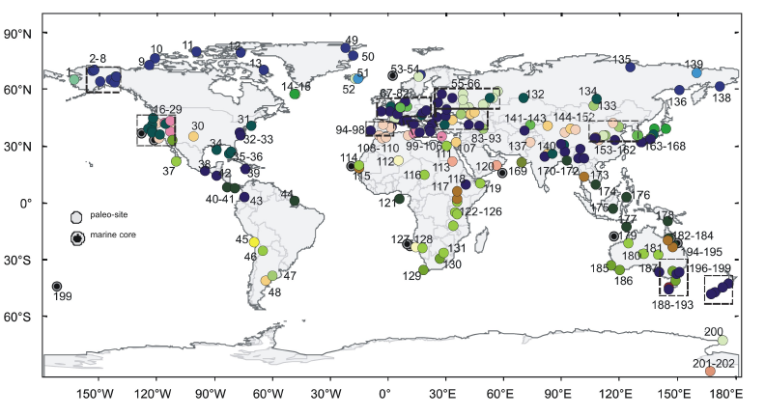
Enough data to show very interesting parallels!
Notes:
12
16 Institute and ca. 120 Wissenschaftler beteiligen sich an IMPETUS

Slide 13
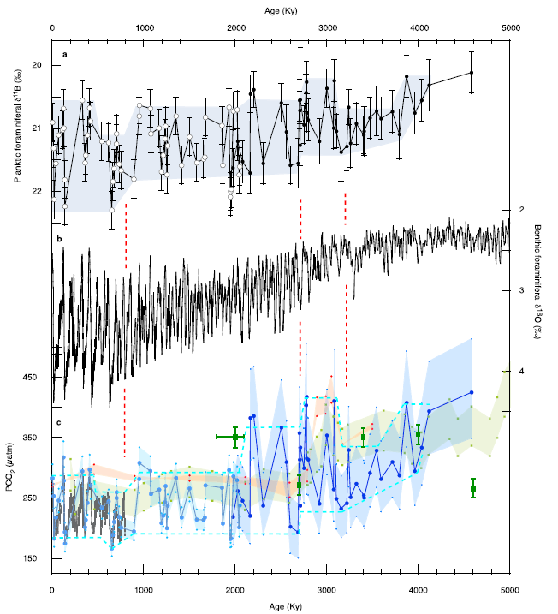
The Pliocene climate/CO₂ paradox!?
4. Changing view of mid-Pliocene environments
Bartoli et al. (2011). Paleoceanography compilation.
Notes:
13

Slide 14
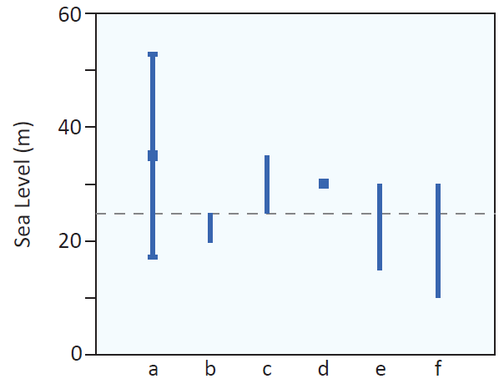
- Range in Sea Level Estimates
4. Changing view of mid-Pliocene environments
Meters ASL
Dowsett & Cronin (1990) Shoreline
Wardlaw & Quinn (1991) Diagenetic Model
Brigham-Grette & Carter (1992) Shoreline
Naish (2008) Sequence Strat.
Dwyer & Chandler (2009) Isotopic
Kaufman & Brigham-Grette (1993) Shoreline
Haq et al. (1987) Sequence Strat.
Naish & Wilson (2009) Sequence Strat
60
35 ±17
25
40
40
Dowsett et al. (2010).
20
15 to 30
30

Slide 15
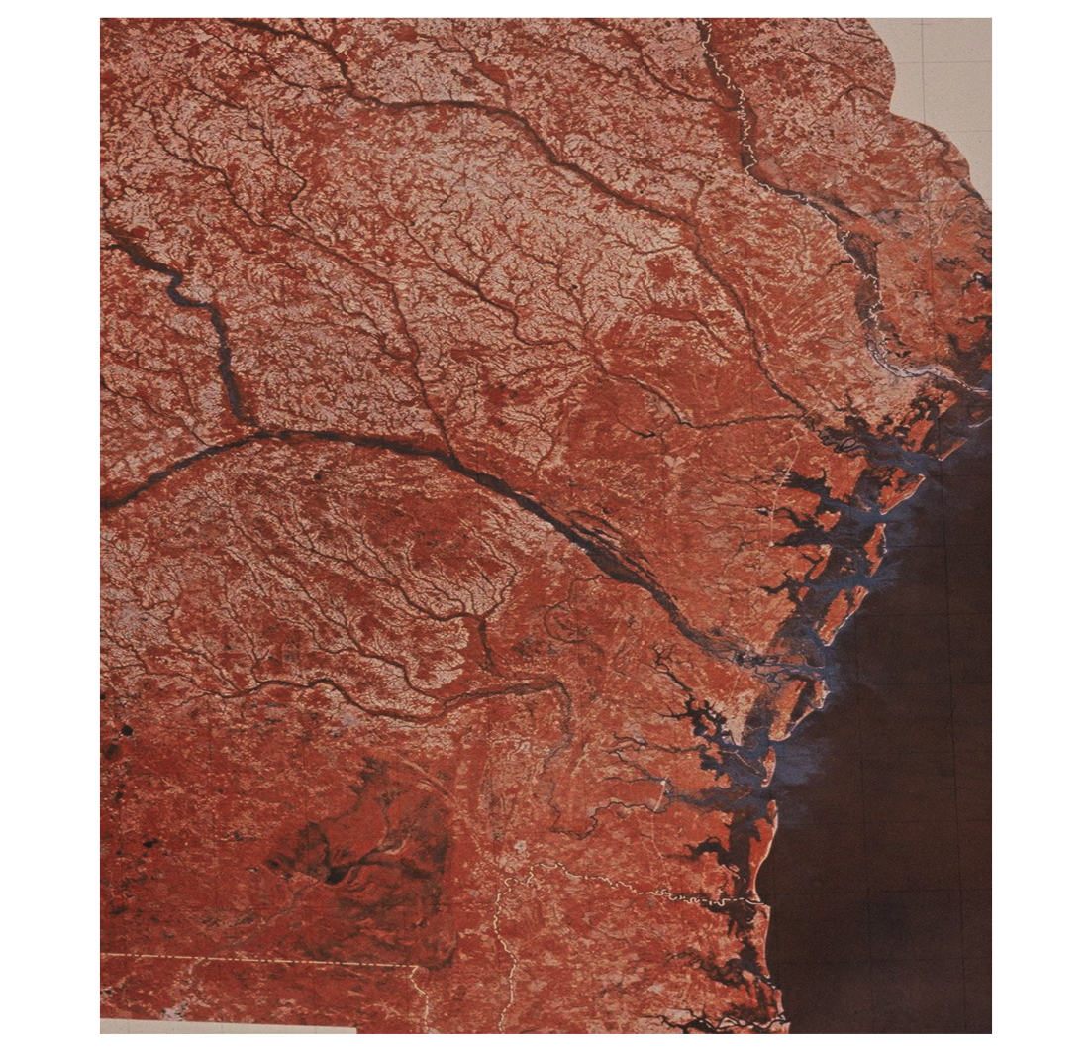
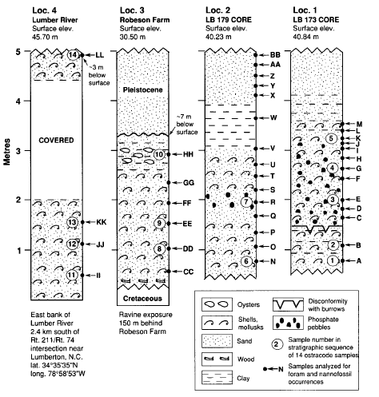
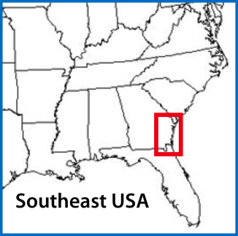
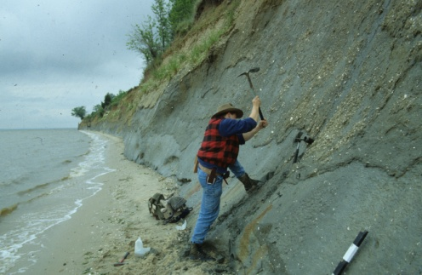
Pliocene sea-Level: Atlantic coastal plain
4. Changing view of mid-Pliocene environments
Orangeburg Scarp, ACP
Dowsett, H.J. and Cronin, T.M., 1990. High eustatic sea level during the middle Pliocene: Evidence from the southeastern U.S. Atlantic Coastal Plain. Geology, 18(5): 435-438.

Slide 16
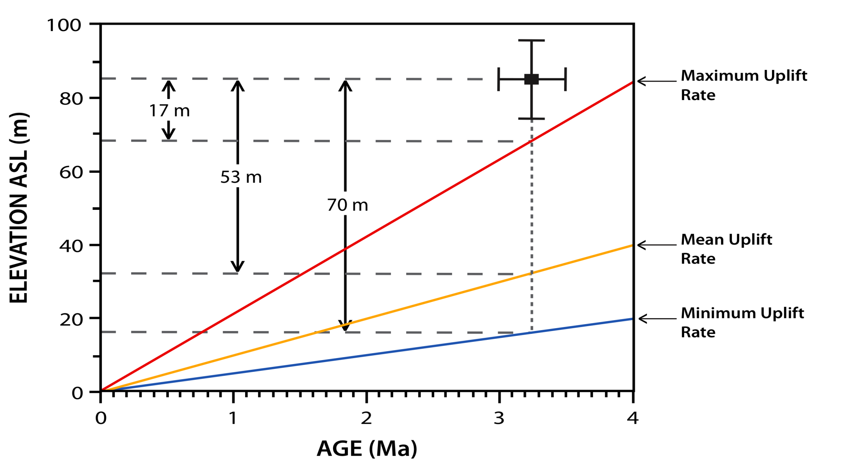
Sea-level: estimating uplift rates
4. Changing view of mid-Pliocene environments
Dowsett, H.J. and Cronin, T.M., 1990. High eustatic sea level during the middle Pliocene: Evidence from the southeastern U.S. Atlantic Coastal Plain. Geology, 18(5): 435-438.

Slide 17
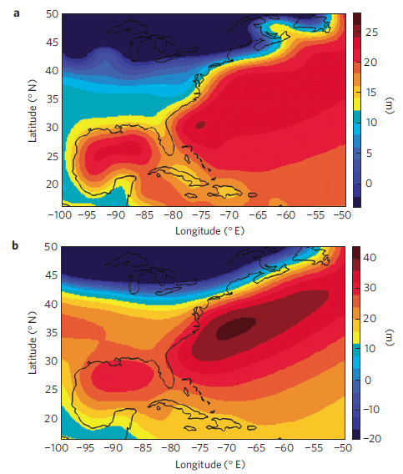
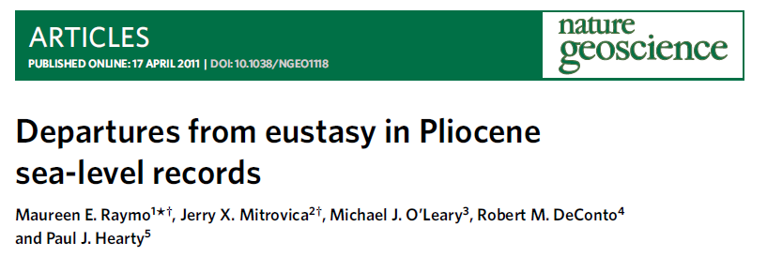
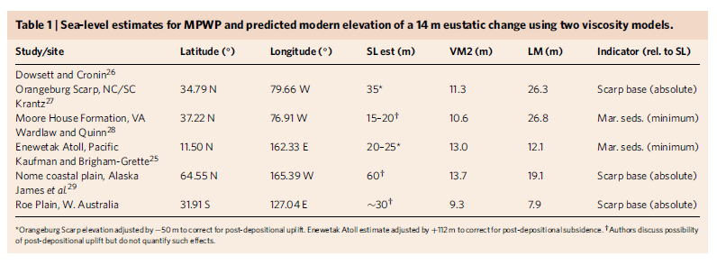

Sea-level: a new spanner in the works!
4. Changing view of mid-Pliocene environments

Slide 18
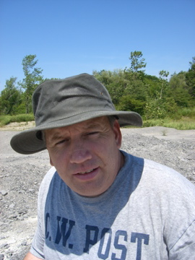
4. Changing view of mid-Pliocene environments
Pliocene Research Interpretation & Synoptic Mapping
Notes:
16 Institute and ca. 120 Wissenschaftler beteiligen sich an IMPETUS

Slide 19
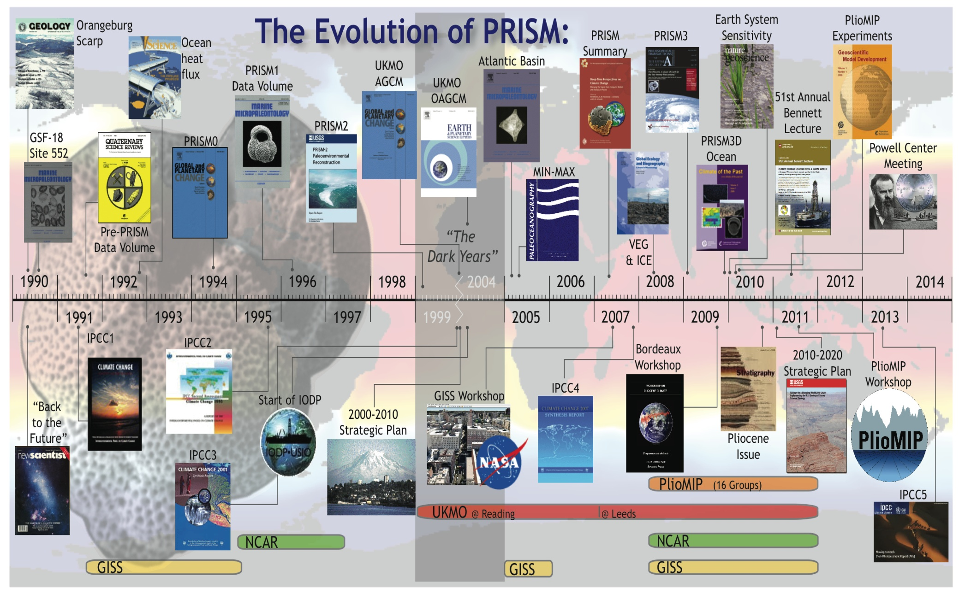
4. Changing view of mid-Pliocene environments

Slide 20
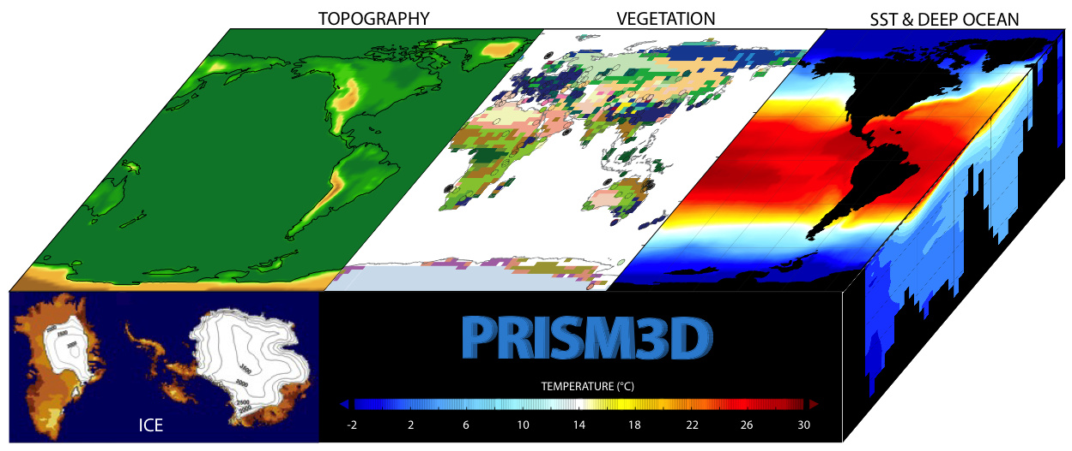
PRISM3D Reconstruction
4. Changing view of mid-Pliocene environments
Vegetation
Biomes
Sea Surface
Temperature
Topography
Sea Ice
Sea Level
Deep Ocean
Temperature
Land Ice
Notes:
This cartoon simply illustrates the various data sets and their relationships to each other.
Enough introduction to PRISM.
I think I’m here to talk about our sea surface temperatures since those are the only data I actually know something about.

Slide 21
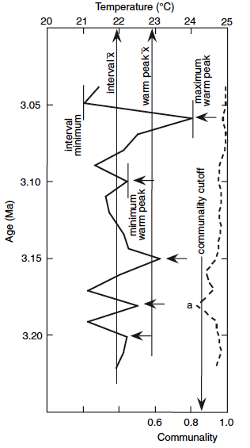
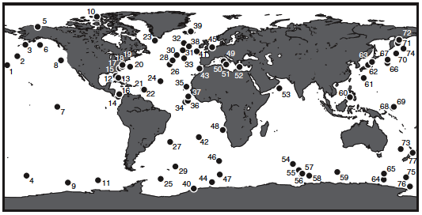
Warm Peak Averaging
Interval Minimum
Interval Maximum
Interval Mean
Warm Peak Mean
Minimum Warm Peak
Maximum Warm Peak
x
“Warm Peak Averaging extracts the warm
phase of mid-Pliocene SST…”

Slide 22
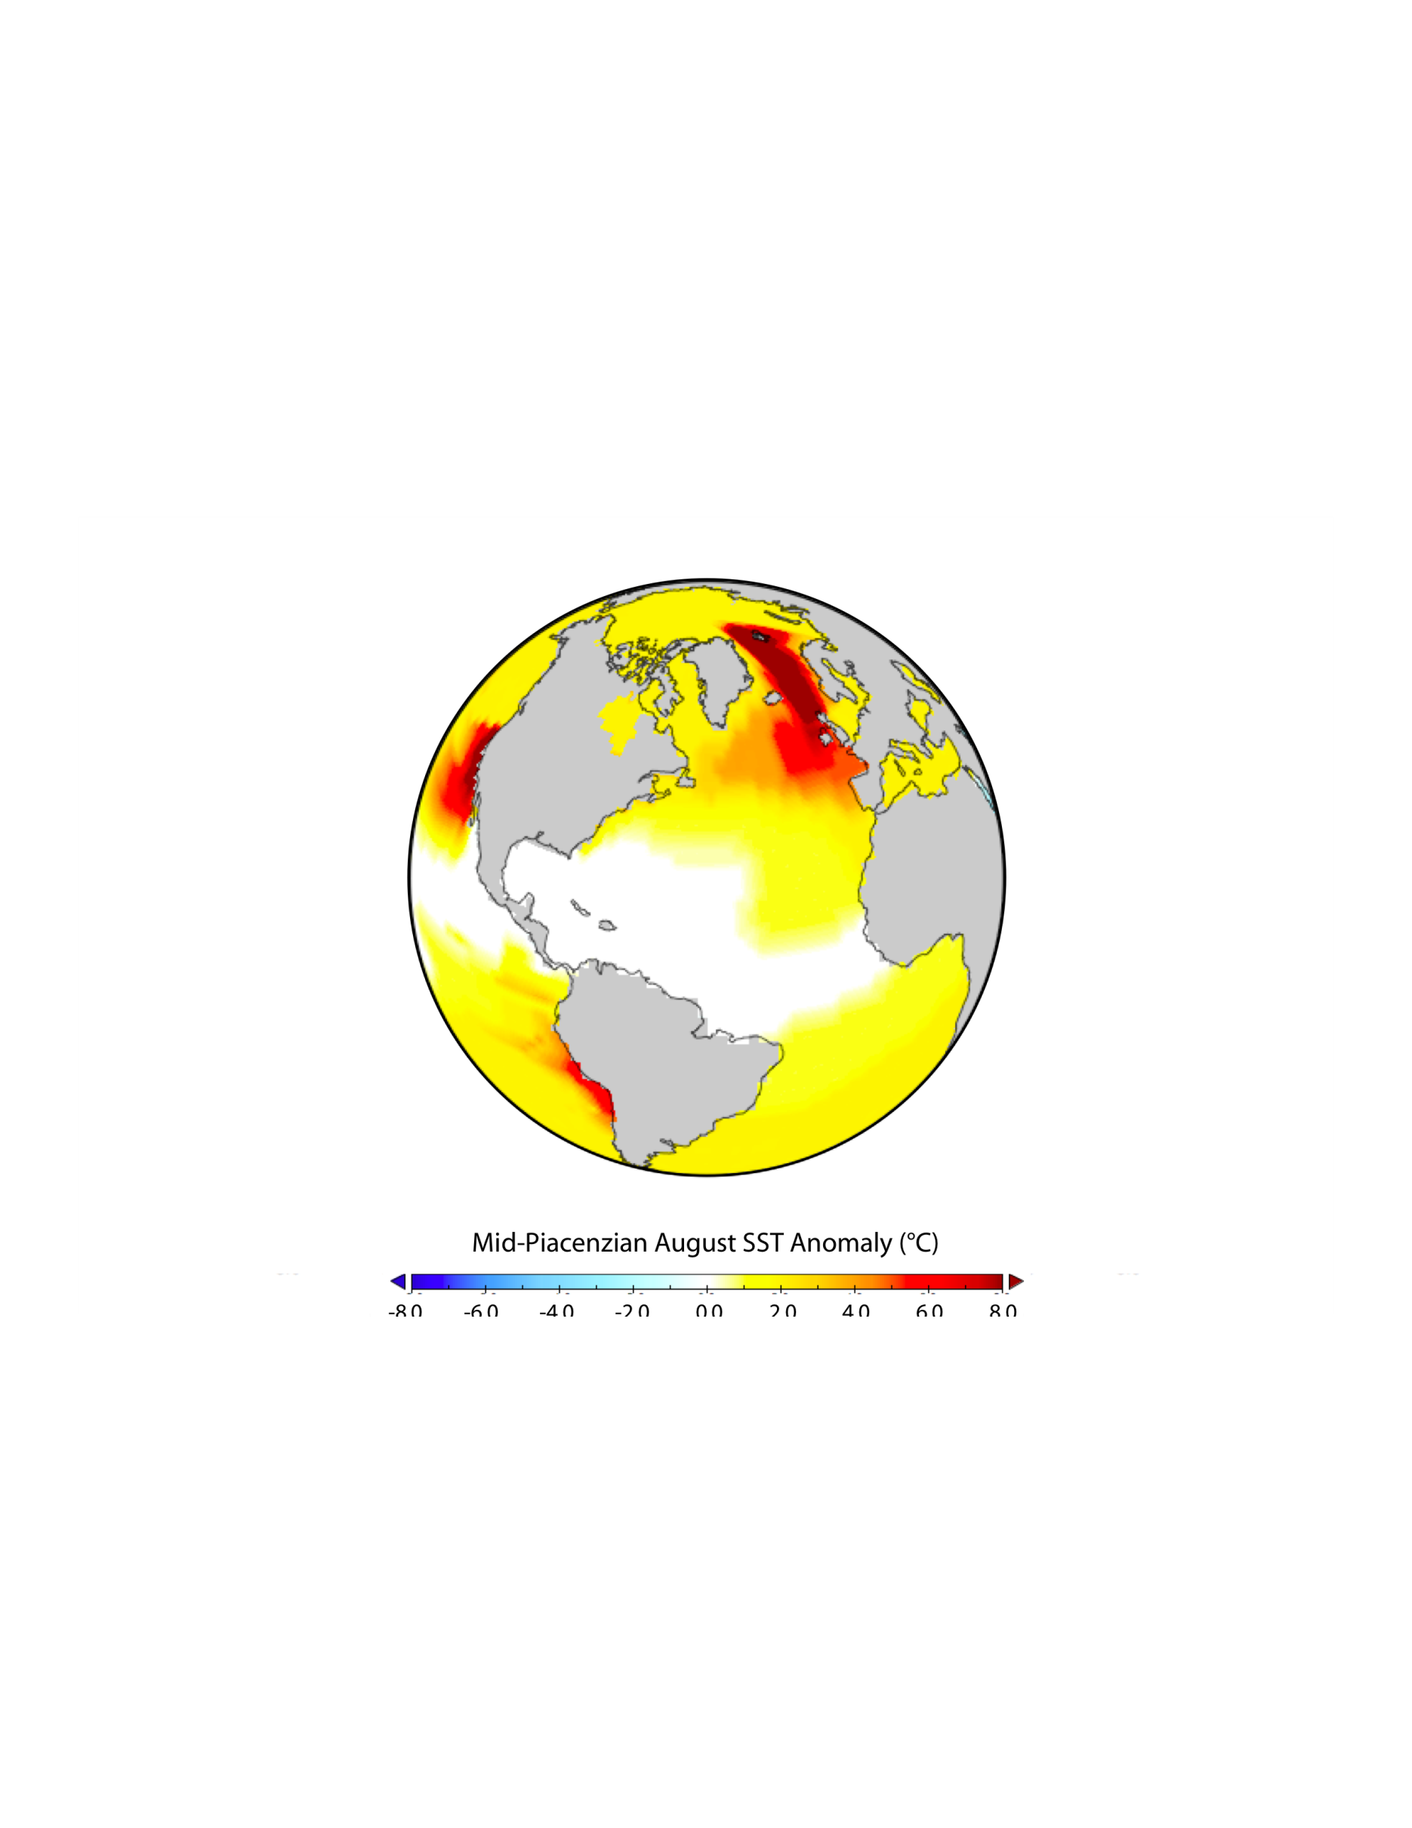
mid-Pliocene conditions
4. Changing view of mid-Pliocene environments
Less land ice = higher sea level
Less sea ice in the high latitudes
Warmer upwelling zones
Reduced equator to pole surface temperature gradient
Enhanced poleward ocean heat transport/CO₂ increase
ENSO keeps on ticking

Slide 23
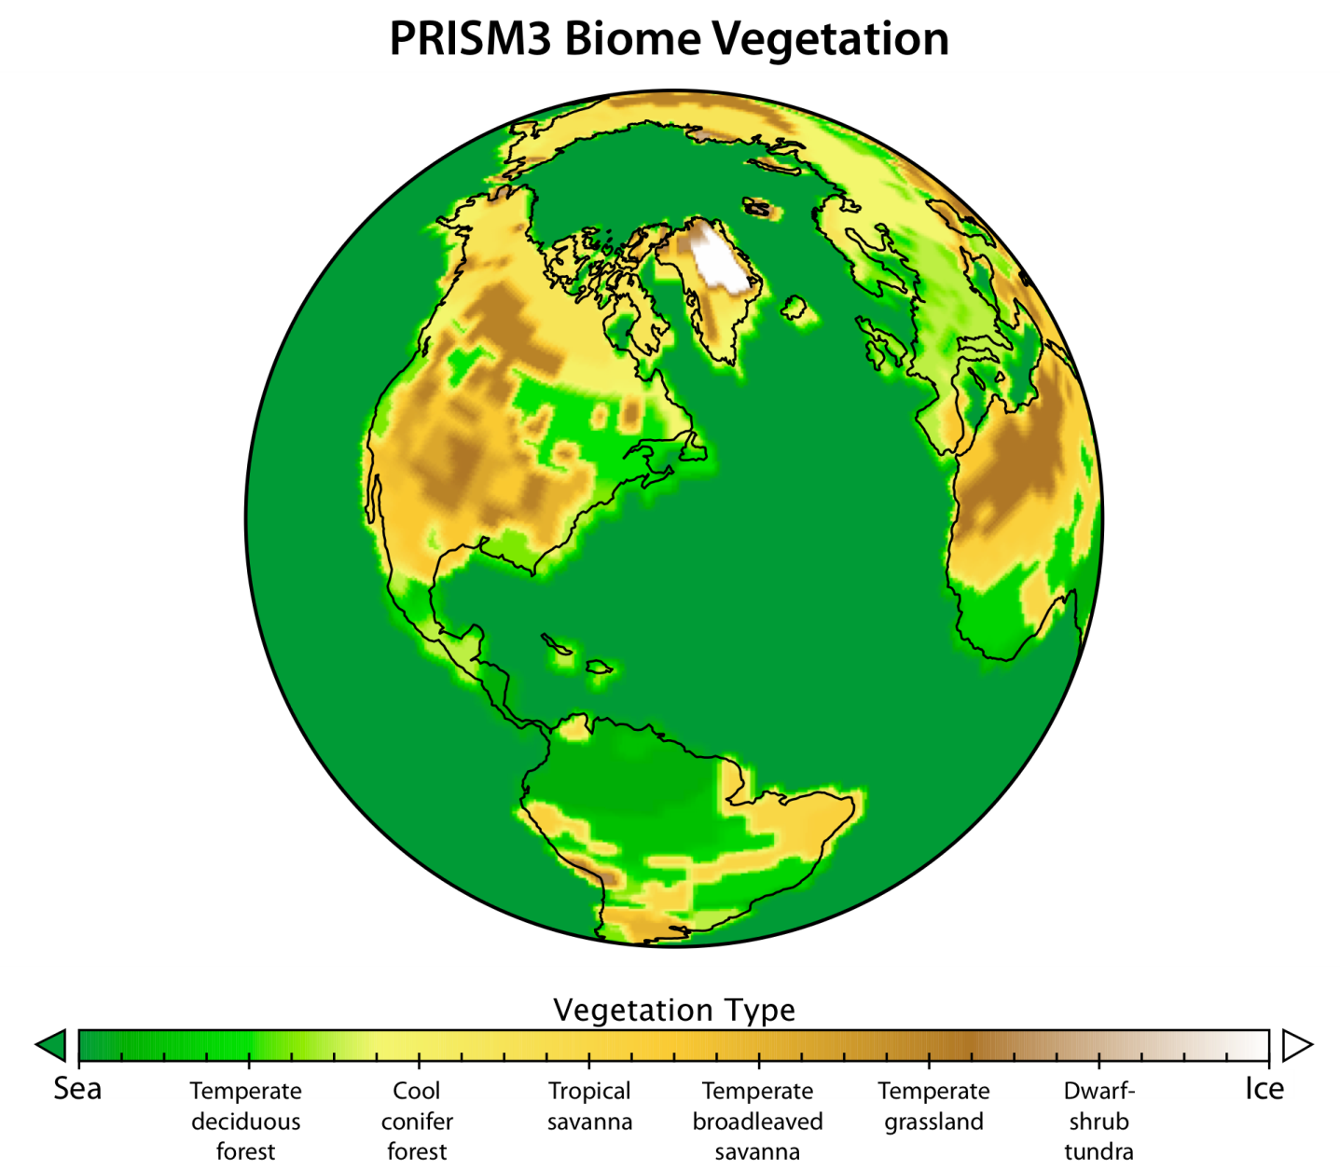
4. Changing view of mid-Pliocene environments
mid-Pliocene conditions
Tundra BIOME nearly absent
Reduced deserts
Poleward shift in
most BIOMES
Notes:
23

Slide 24
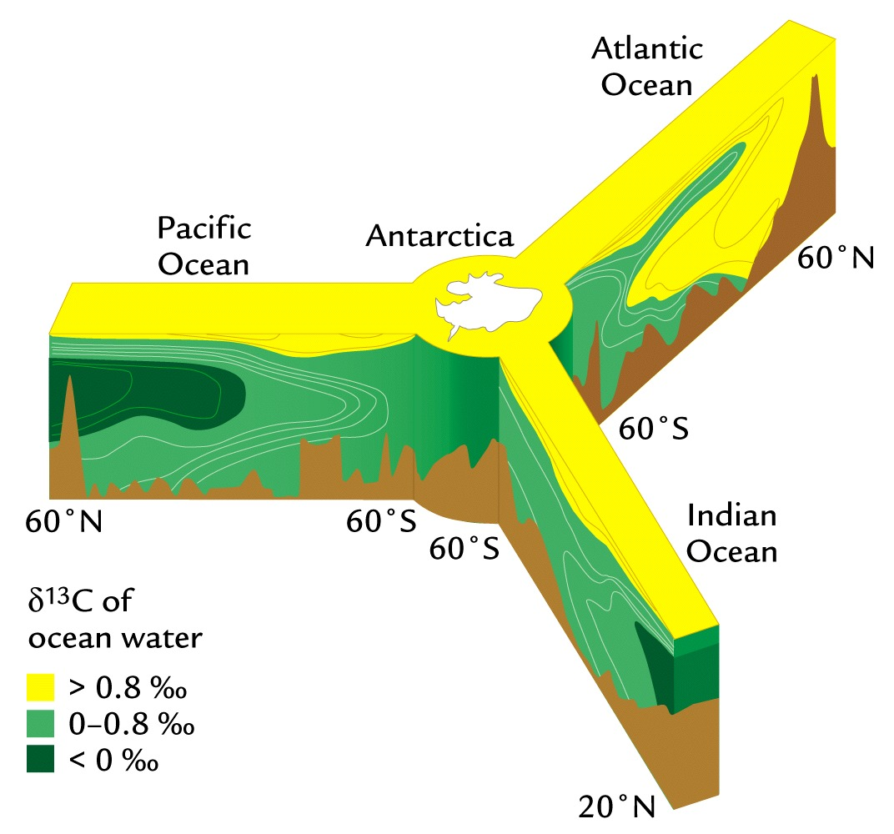
- Ocean circulation
4. Changing view of mid-Pliocene environments
Warmer deep ocean temperatures
Enhanced NCW production

Slide 25
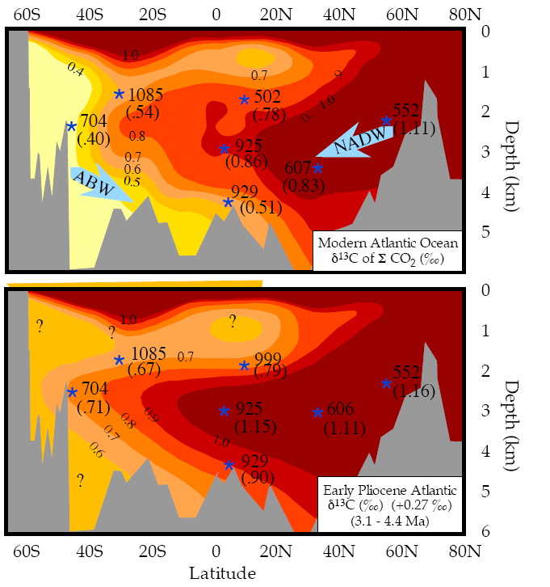
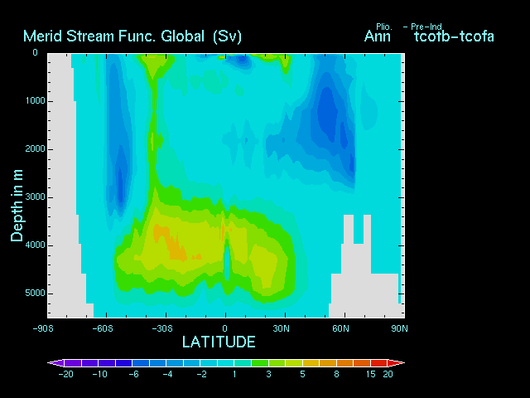
4. Changing view of mid-Pliocene environments
- Ocean circulation
Ravelo et al. (2007)
Notes:
25
16 Institute and ca. 120 Wissenschaftler beteiligen sich an IMPETUS

Slide 26
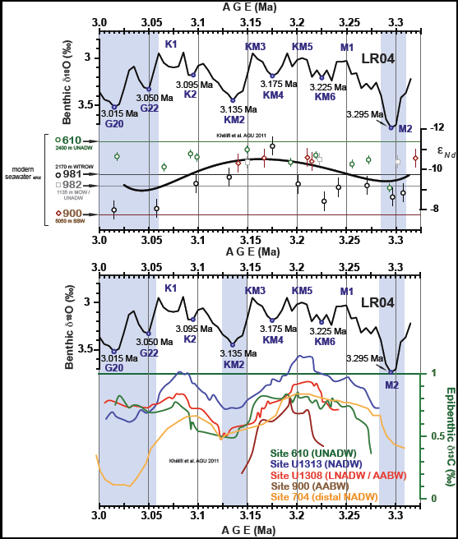
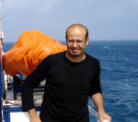
4. Changing view of mid-Pliocene environments
- Ocean circulation
Nd data from Nabil Khélifi (AGU 2011).
Notes:
26
16 Institute and ca. 120 Wissenschaftler beteiligen sich an IMPETUS

Slide 27
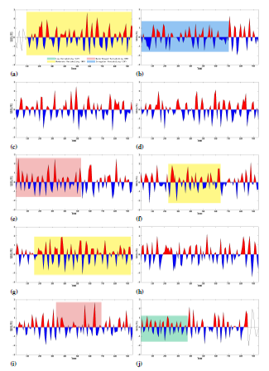
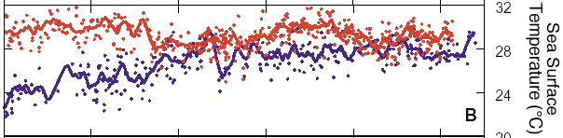
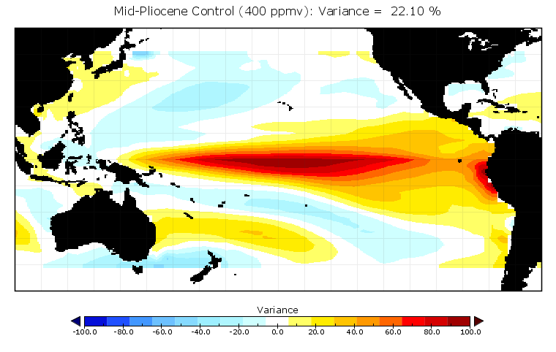
4. Changing view of mid-Pliocene environments
Climate variability/oscillations - ENSO
Mg/Ca SSTs
0
3
5
Wara et al. (2005)
Age (Ma)‏
Haywood et al. (2007)
Bonham (2011)
Notes:
16 Institute and ca. 120 Wissenschaftler beteiligen sich an IMPETUS

Slide 28
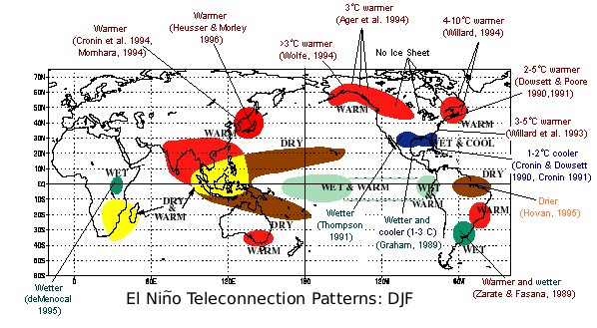
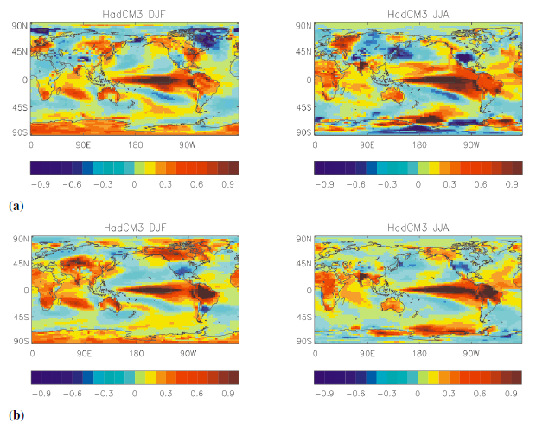
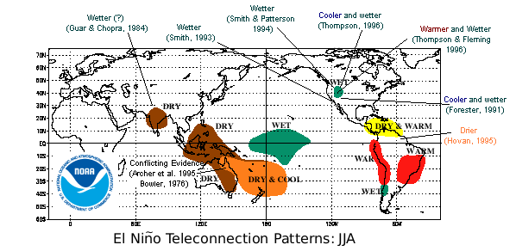
4. Changing view of mid-Pliocene environments
Climate variability/oscillations - ENSO
Molnar and Cane (2002 & 2007)
Bonham et al. (2009)
Notes:
16 Institute and ca. 120 Wissenschaftler beteiligen sich an IMPETUS

Slide 29
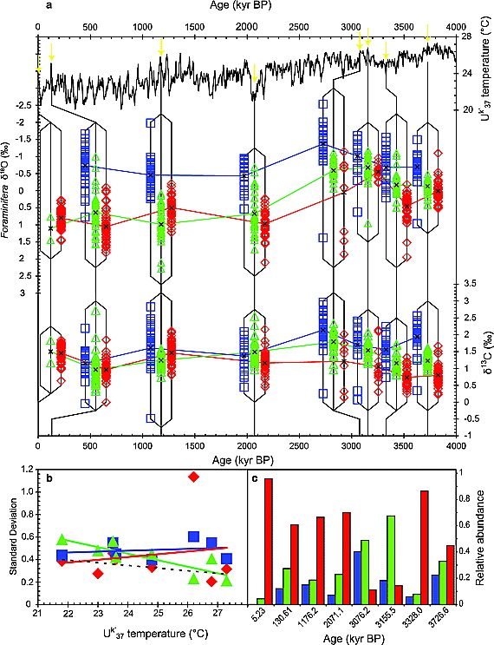
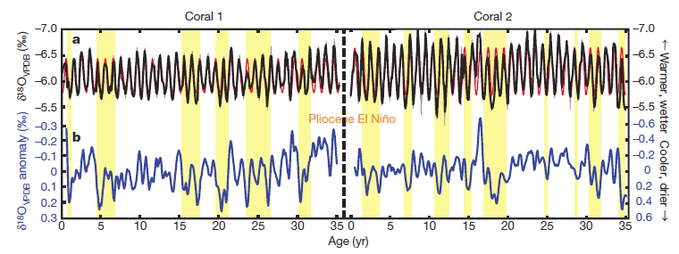
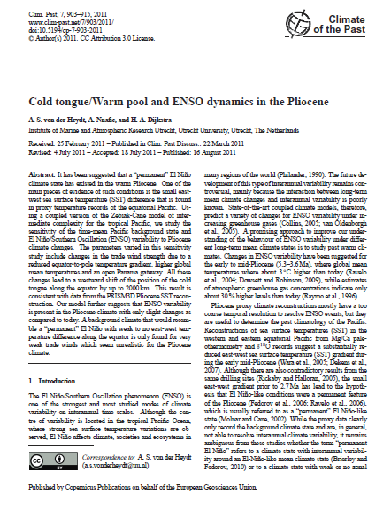
4. Changing view of mid-Pliocene environments
Climate variability/oscillations - ENSO
Wantanabe et al. (2011).
Scroxton et al. (2011).
Notes:
16 Institute and ca. 120 Wissenschaftler beteiligen sich an IMPETUS

Slide 30
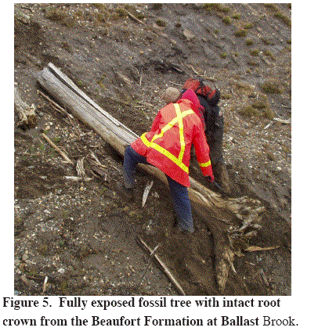
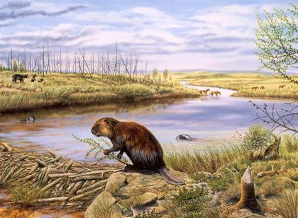
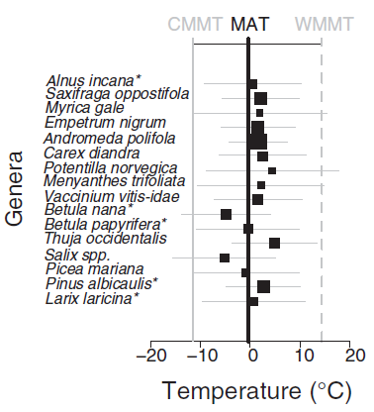
4. Changing view of mid-Pliocene environments
- High latitude climate/polar amplification
Ballantyne et al. (2011)
Lunt et al. (in-press)
Notes:
16 Institute and ca. 120 Wissenschaftler beteiligen sich an IMPETUS

Slide 31
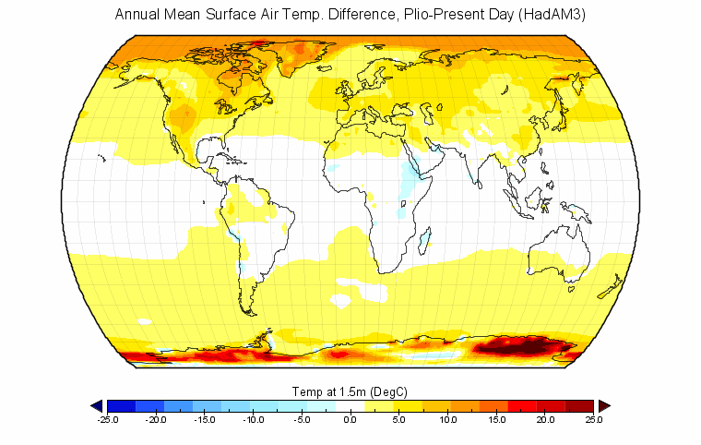
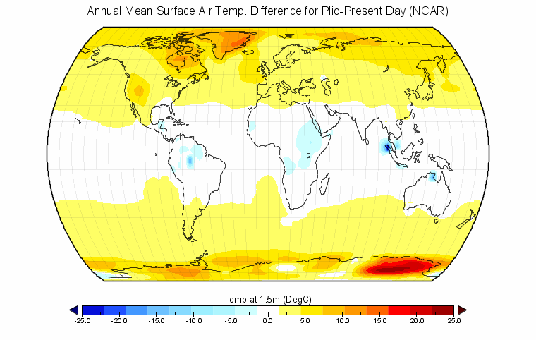

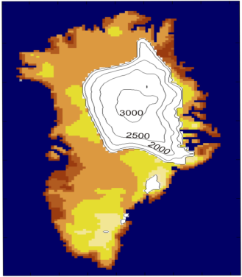



5. Data/model comparison and uncertainty
Elephant in the room - model dependency
Haywood et al. (2009)
Notes:
16 Institute and ca. 120 Wissenschaftler beteiligen sich an IMPETUS

Slide 32


5. Data/model comparison and uncertainty
Elephant in the room - model dependency
http://www.geosci-modeldev.net/special_issue5.html
Notes:
16 Institute and ca. 120 Wissenschaftler beteiligen sich an IMPETUS

Slide 33
5. Data/model comparison and uncertainty
- PlioMIP Modelling Groups
Group | Contact | PlioMIP Exp 1 | PlioMIP Exp 2
Hadley - UK | Alan Haywood, Dan Lunt, Paul Valdes | HadAM3 | HadCM3
University of New South Wales | Steven J. Phipps | CSIRO Mk3L Version 1.2 | CSIRO Mk3L Version 1.2
NCAR | Bette Otto-Bliesner, Nan Rosenbloom |  | CCSM4
University of Massachusetts, Amhearst | Rob DeConto, Sebastian Koenig | Genesis V. 3.0
Laboratoire de Physique Atmosphérique et Planétaire (LPAP) | Alexandra Henrot | Planet Simulator version Most 15
GISS | Mark Chandler | GCMAM3, GISS Model E | GISS Model E-R
Bjerknes/Bergen | Kerim H. Nisancioglu | NorESM | NorESM
IAP/CAS | Zheng Weipeng, Zhang Zhongshi, Qing Yang | CAM3 | FGOALS-g2.0, FOAM1.5
Koninklijk Nederlands Meteorologisch Instituut | Nanne Weber, Erik Tuenter | EC-Earth v.2 | EC-Earth v.2
Center for Climate System Research, University of Tokyo | Ayako Abe-Ouchi, Wing Le Chan, Ryota O'ishi | MIROC 3.2 GCM | MIROC 3.2 GCM
Alfred Wegener Institute for Polar and Marine Research | Christian Stepanek | COSMOS 1.2.0 | COSMOS 1.2.0
University of Kiel, Germany | Birgit Schneider |  | AOGCM KCM v1.2.2
Laboratoire des Sciences du Climat et de l'Environment (LSCE) | Camille Contoux,Anne Jost, Gilles Ramstein | LMDZ | IPSLCM5A
University of Tsukuba | Youichi Kamae, Hiroaki Ueda | MRI-CGCM 2.3 | MRI-CGCM 2.3
Notes:
33
16 Institute and ca. 120 Wissenschaftler beteiligen sich an IMPETUS

Slide 34




5. Data/model comparison and uncertainty
- Initial comparison to SST data
Dowsett et al. (submitted)
Notes:
16 Institute and ca. 120 Wissenschaftler beteiligen sich an IMPETUS

Slide 35


5. Data/model comparison and uncertainty
- Does it tell us anything new?
Dowsett et al. (submitted)
Notes:
16 Institute and ca. 120 Wissenschaftler beteiligen sich an IMPETUS

Slide 36


5. Data/model comparison and uncertainty
- Its not just the models that are variable!
Dowsett et al. (submitted)
Notes:
16 Institute and ca. 120 Wissenschaftler beteiligen sich an IMPETUS

Slide 37

5. Data/model comparison and uncertainty
- Trouble on land as well as the seas
Salzmann et al. (in-prep)
Notes:
16 Institute and ca. 120 Wissenschaftler beteiligen sich an IMPETUS

Slide 38

5. Data/model comparison and uncertainty
Are our models really that wrong...
Annual mean temperature change (Pliocene minus Pre-Ind)
Notes:
16 Institute and ca. 120 Wissenschaftler beteiligen sich an IMPETUS

Slide 39


5. Data/model comparison and uncertainty
- the known unknowns and Occam's razor
CO₂ and other trace gases
Topography
Insolation - collapse to a time slice rather than slab
Land/sea mask and bathymetry

Slide 40



5. Data/model comparison and uncertainty
- Unconstrained conditions, unconstrained effects...
Lunt et al. (2008)
Bigg and ??? (2002)
Robinson et al. (2011)

Slide 41
1. Inspiration and approaches to palaeo
- Analogue Issues
Notes:
16 Institute and ca. 120 Wissenschaftler beteiligen sich an IMPETUS

