Slide 1
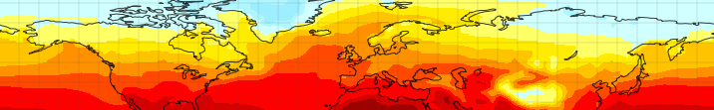
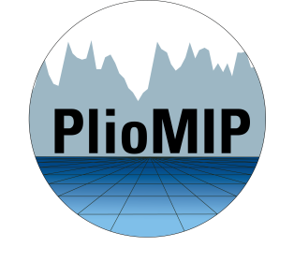
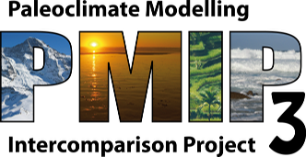





The importance of Pliocene time slices for environmental synthesis and climate modelling
Alan M. Haywood
Co-authors: Caroline Prescott, Aisling Dolan, Harry Dowsett, Stephen Hunter, Ulrich Salzmann, PlioMIP Participants

Slide 2

A 400 ppm world
What has
changed?
How much is
yet to come?
Timescale matters

Slide 3

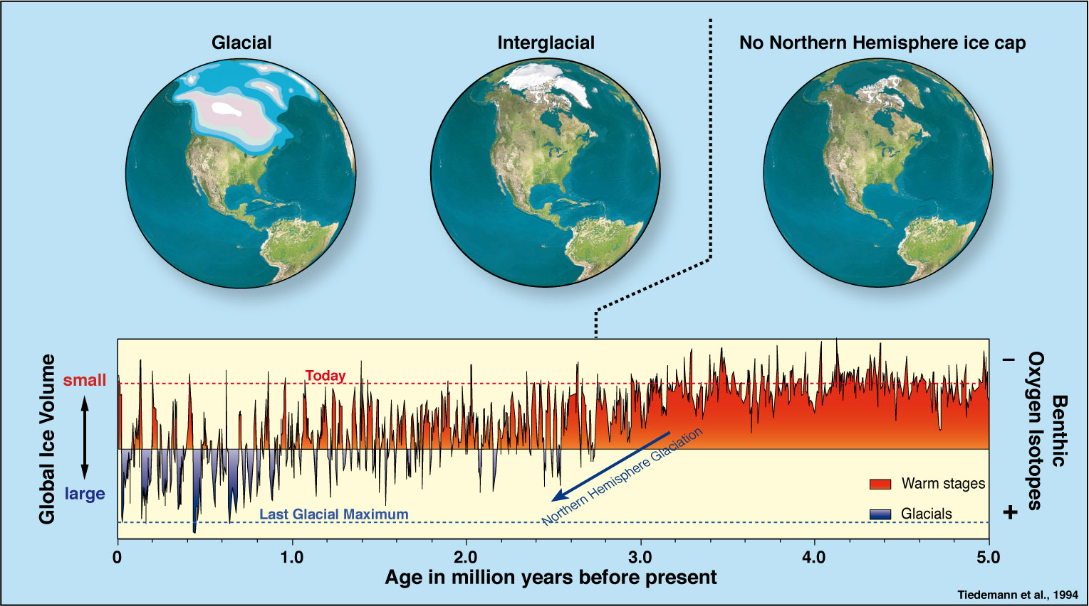

The Pliocene

Slide 4




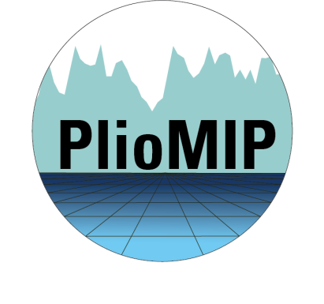




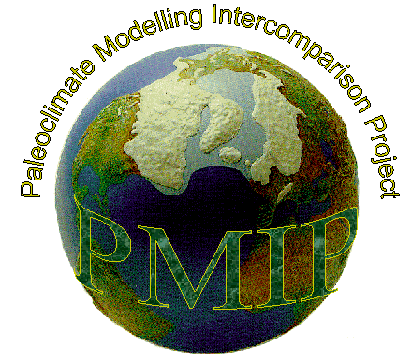


























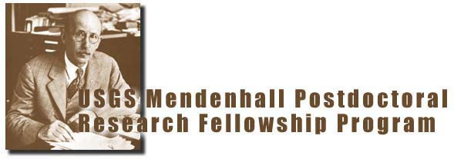
PlioMIP collaboration

Slide 5
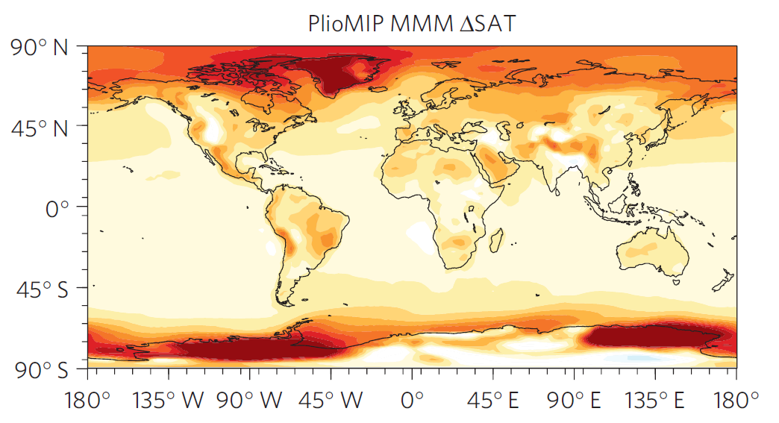
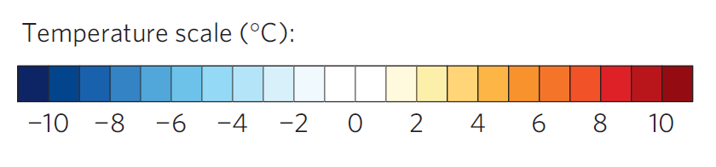
PlioMIP Multi-Model Mean Annual Temp. Change
(Nature Climate Change– Salzmann et al. 2013)

Slide 6
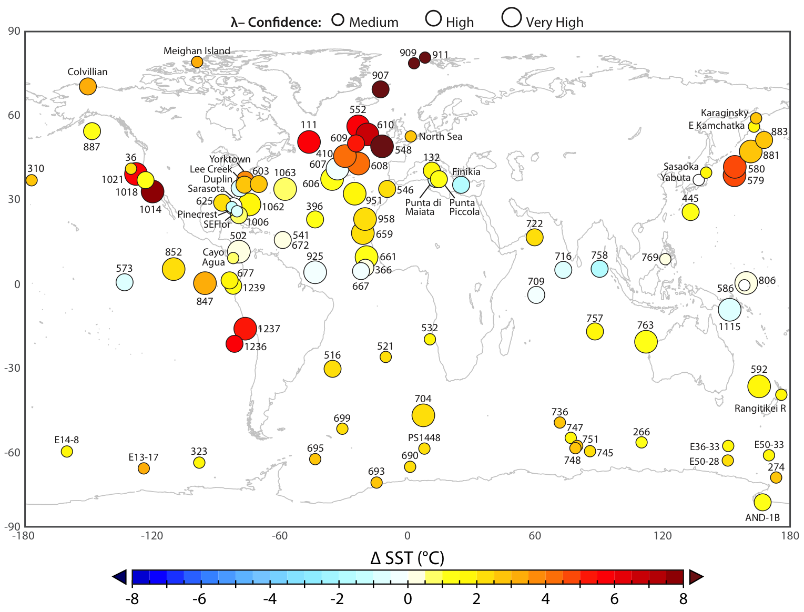
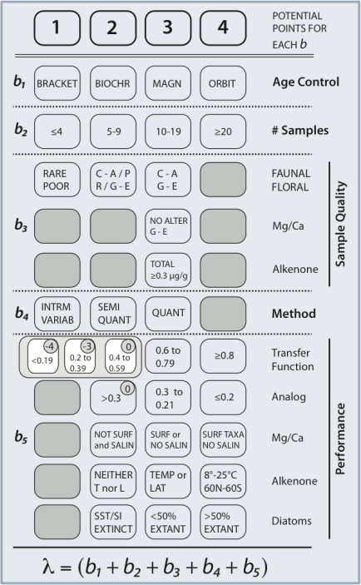
Pliocene SST Data
(Nature Climate Change– Dowsett et al., 2012)

Slide 7
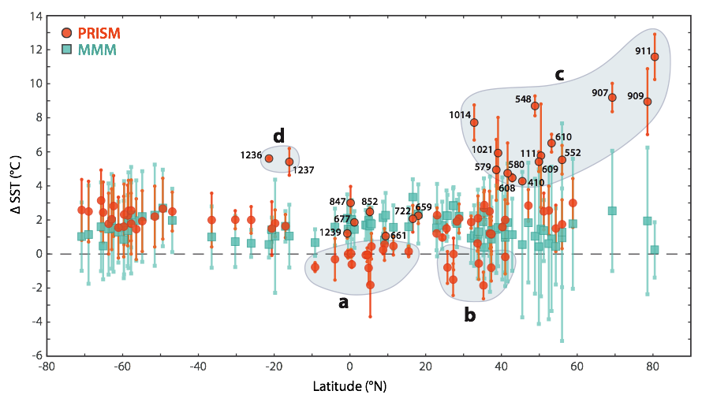
SST Data/Model Comparison
Mean Annual SST comparison (with Model and Data Errors)

Slide 8
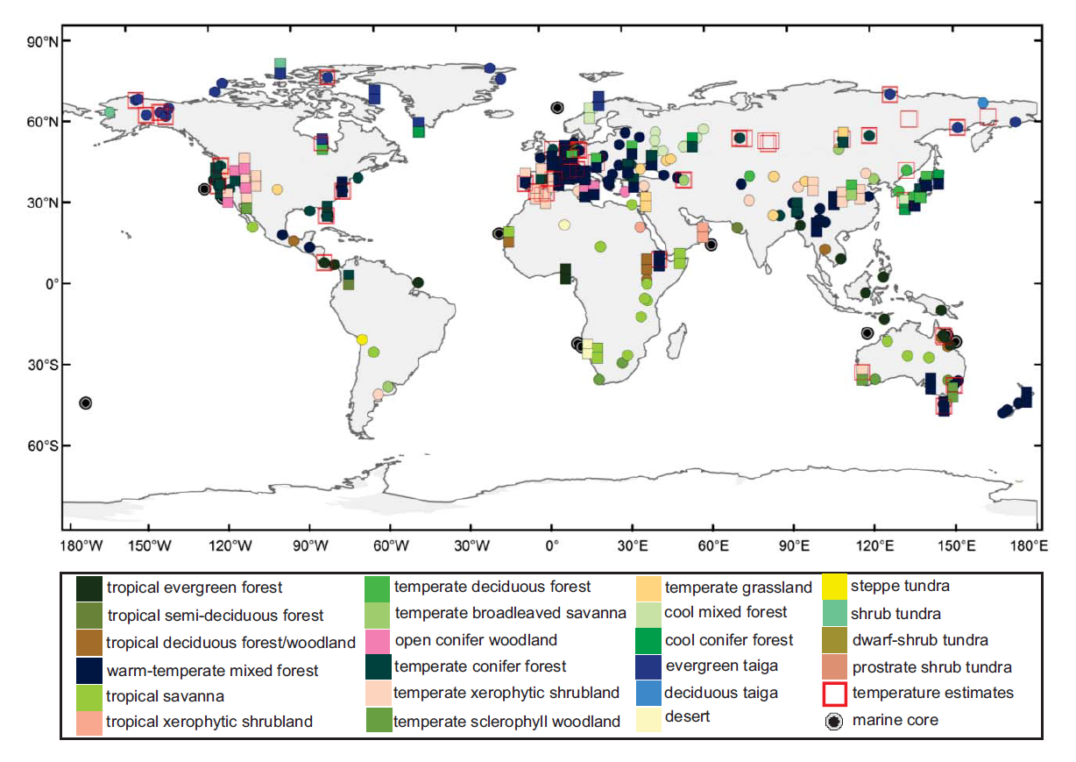
Terrestrial DMC
45 palaeobotanical sites where surface temperature can be estimated
(Nature Climate Change– Salzmann et al, in review)

Slide 9
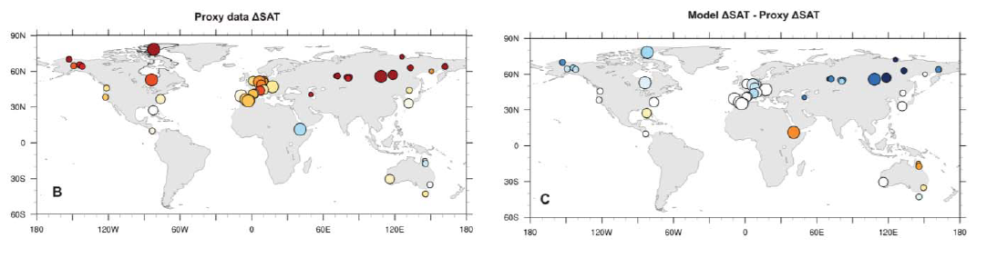
Terrestrial DMC
Proxy-based temperature anomaly
Degree of data-model discordance (anomaly versus anomaly)
(Nature Climate Change– Salzmann et al, in review)

Slide 10
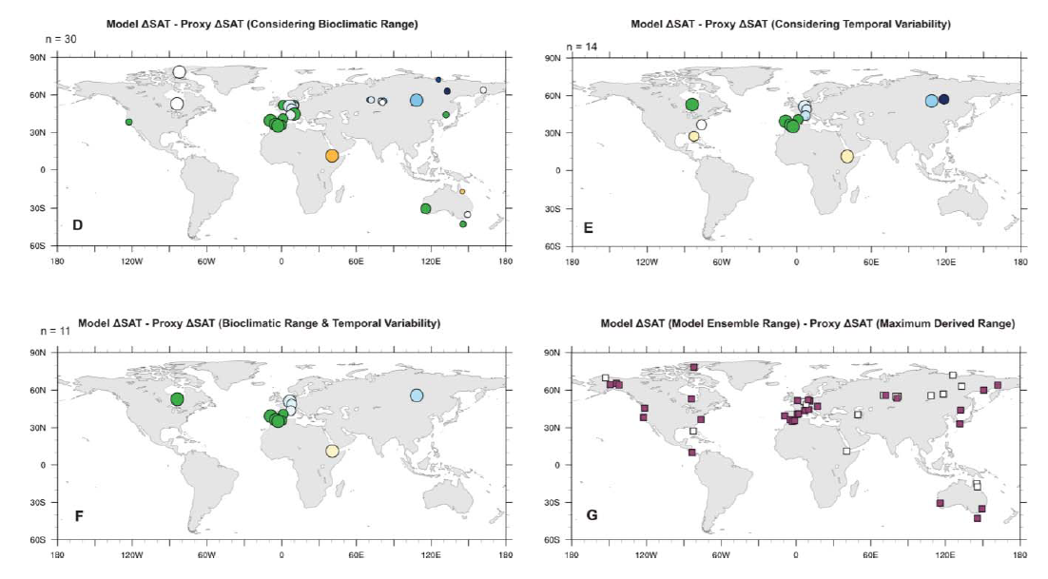
Terrestrial DMC
(Nature Climate Change– Salzmann et al, in review)

Slide 11
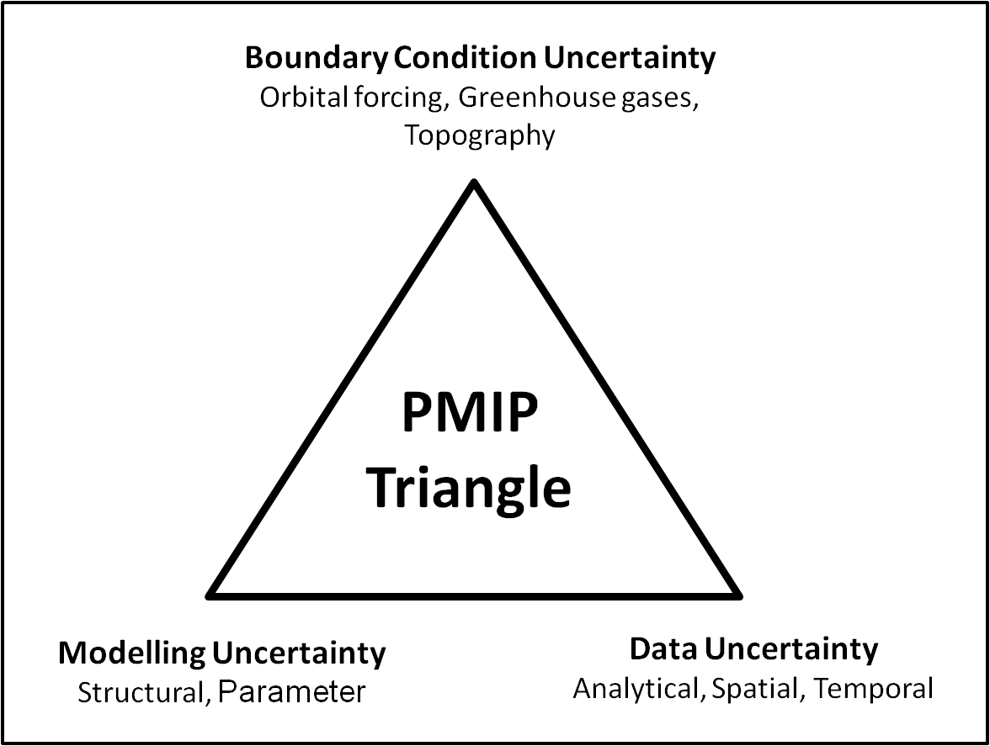
Triangle of Uncertainty
(Haywood et al., 2012)

Slide 12
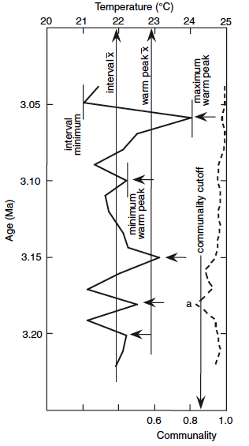
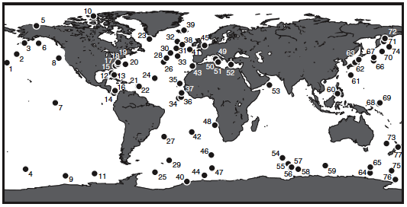
Warm Peak Averaging
Interval Minimum
Interval Maximum
Interval Mean
Warm Peak Mean
Minimum Warm Peak
Maximum Warm Peak
x
“Warm Peak Averaging extracts the warm
phase of mid-Pliocene SST…”

Slide 13

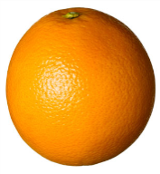
Data-Model Comparison
DATA
MODEL
PRISM Time Slab is 240,000 yr to 1 million yr wide
At each site the proxy data is an average of a warm climate signal that occurred during the time slab
Likely to be boundary conditions changing throughout the time slab
SST/SAT for a fixed moment in time for the prescribed forcings
With set boundary conditions
Hypothesise that a component of the data-model inconsistencies is because we are not comparing the same thing…

Slide 14
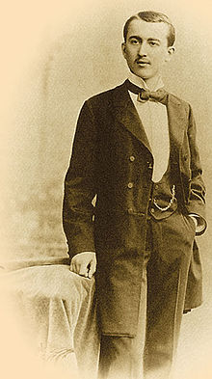
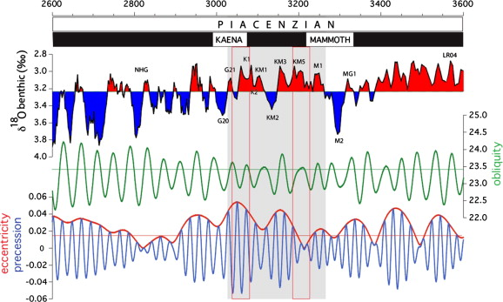
A Lesson and Practical Application of Milanković Theory

Slide 15
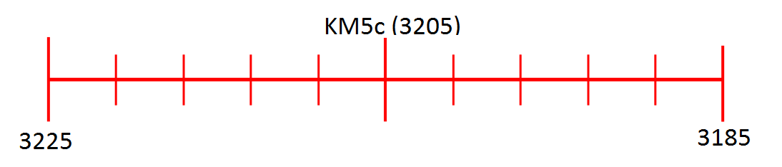
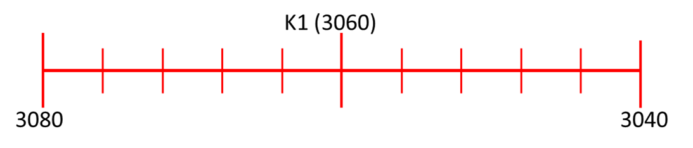
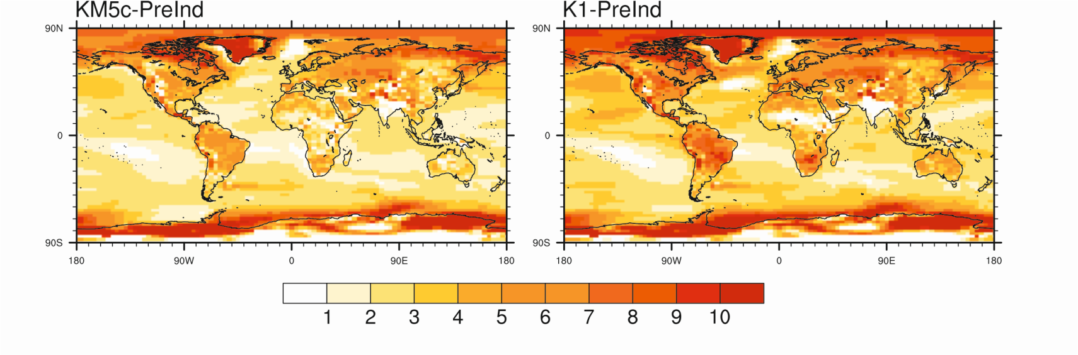
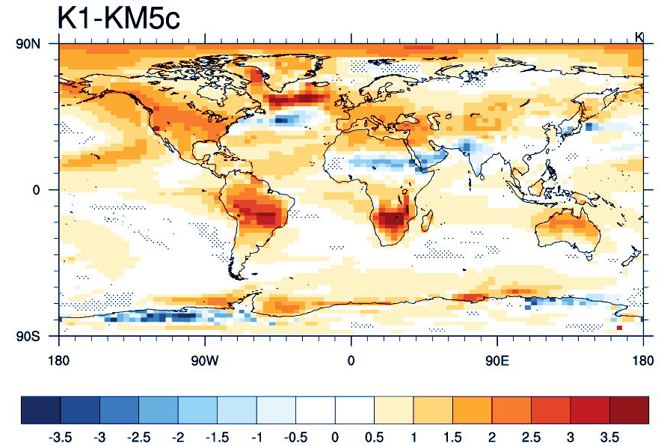
Pliocene Uncertainty…
PlioMIP2 - Frontiers
New model results showing the differences in annual mean SAT between two interglacial events during the Pliocene (Prescott et al. in-press, EPSL).

Slide 16
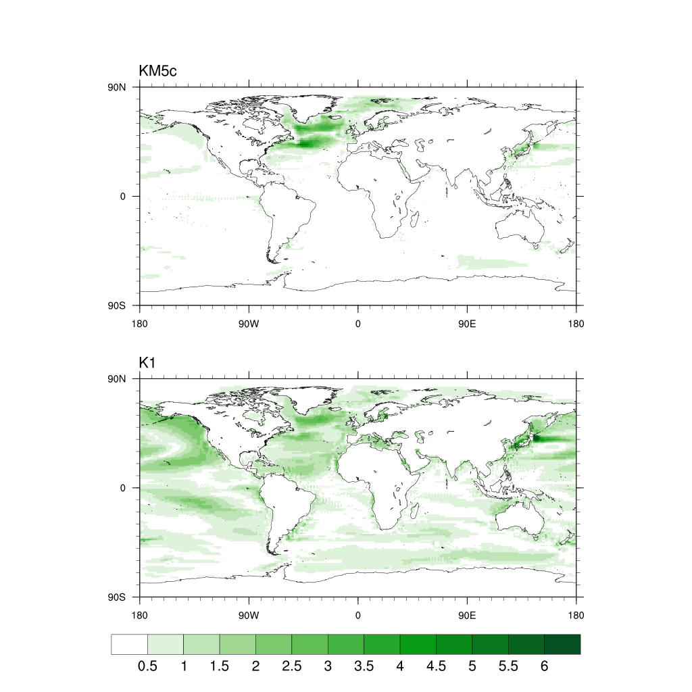
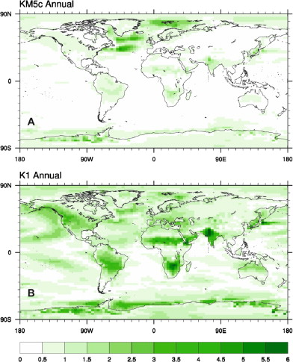

Slide 17
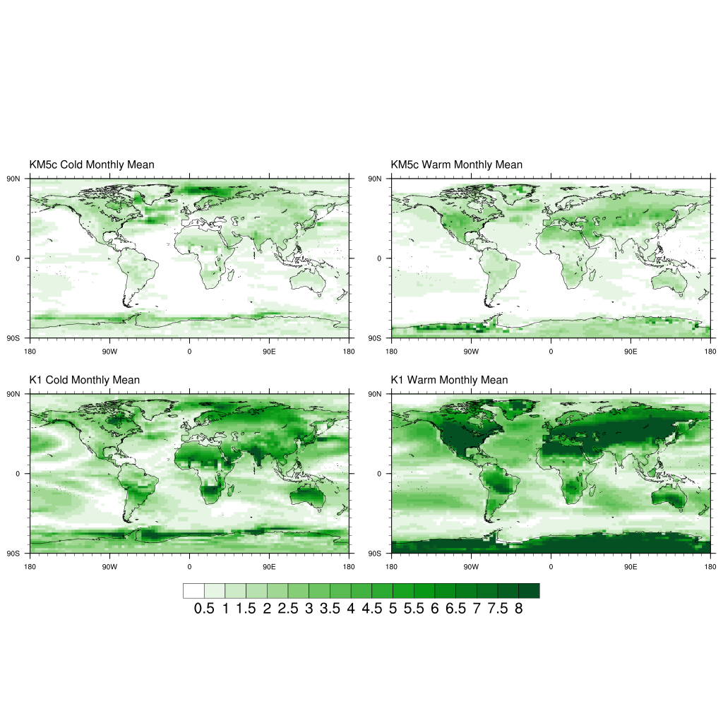
Pliocene Uncertainty…
PlioMIP2 - Frontiers
New model results showing the differences between two interglacial events during the Pliocene (Prescott et al., 2014, EPSL)
Seasonal differences in SAT are more prominent and have greater implications for proxy reconstructions.

Slide 18
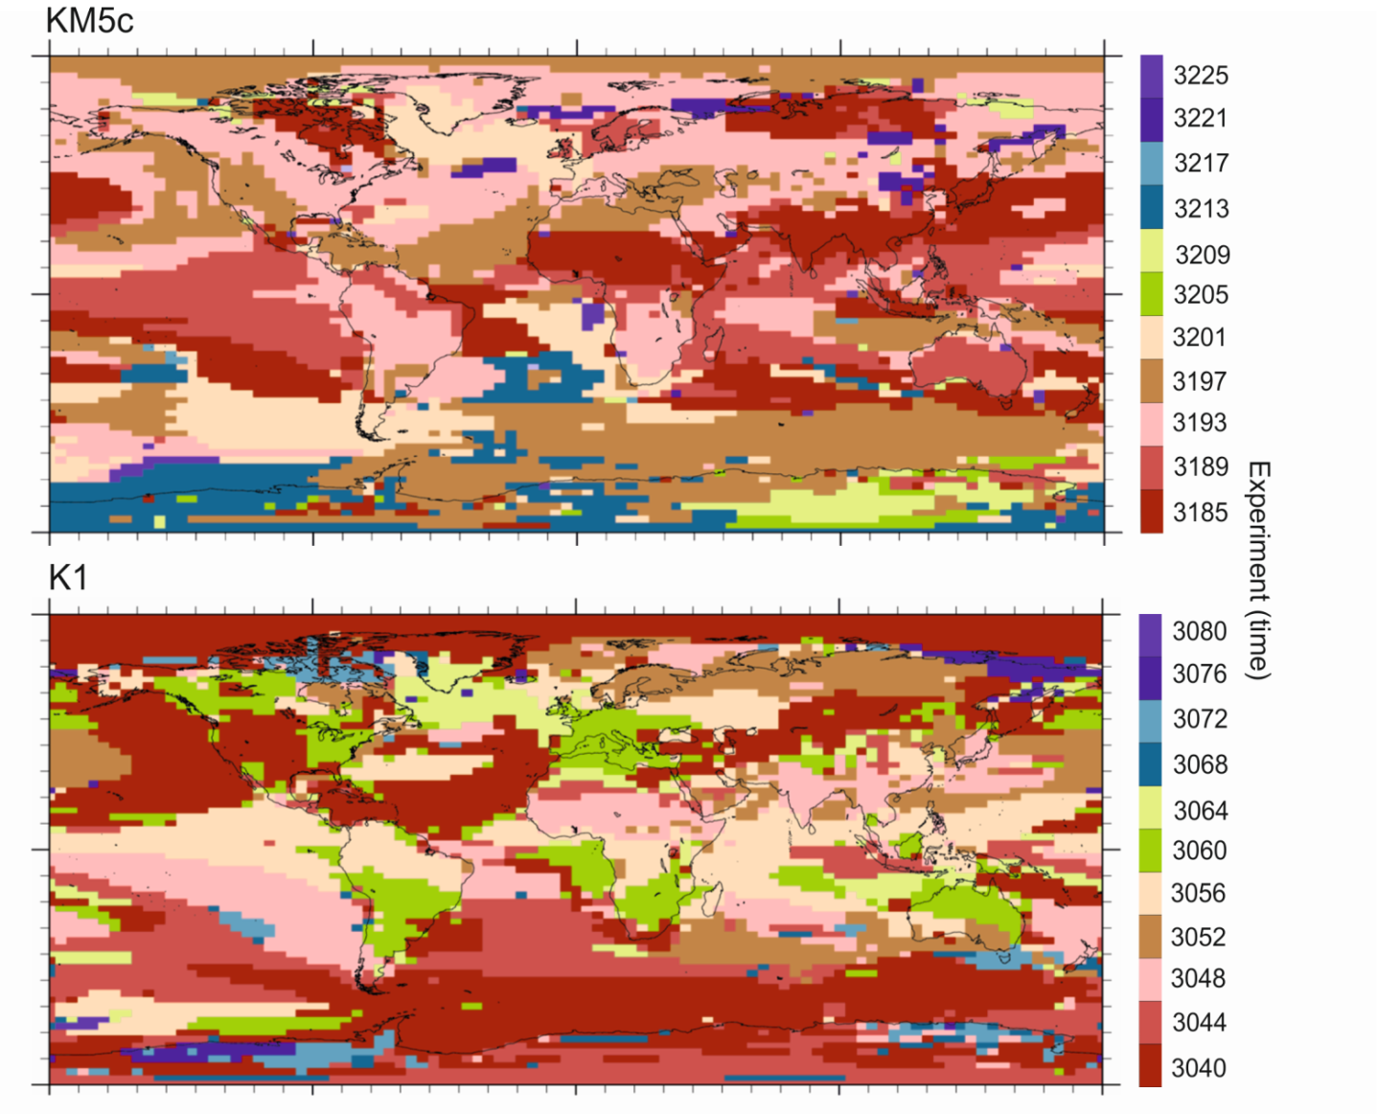
PlioMIP Phase 2
Demonstrated potential problems due to aliasing in proxy records.
Necessitates targeting specific time slices rather than the traditional 300 kyr to 1 Myr as in PlioMIP Phase 1.
[Prescott et al, in press, EPSL]

Slide 19
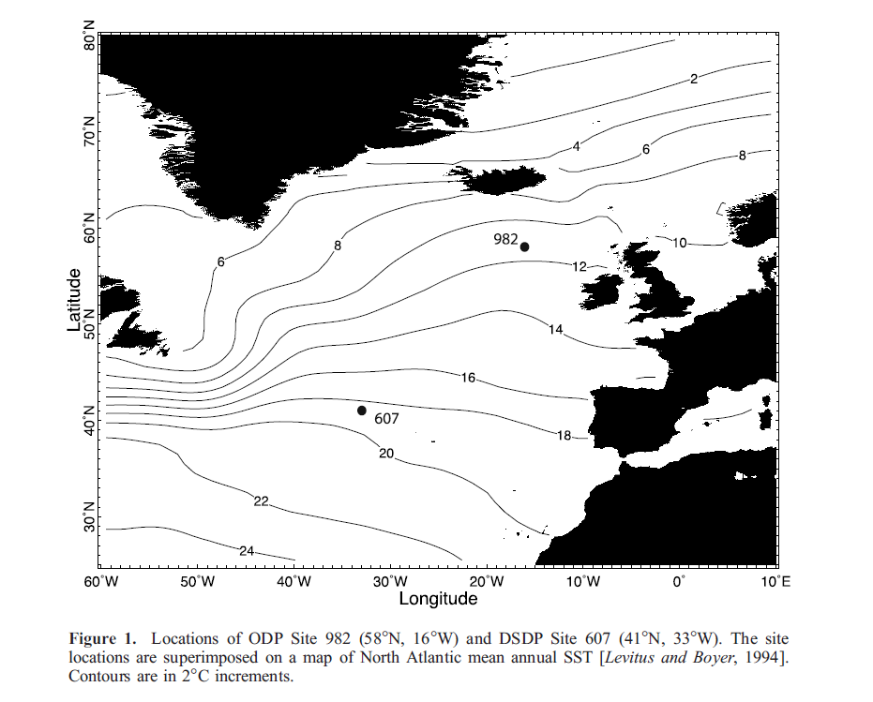

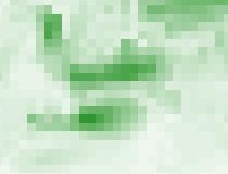

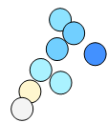
Fit to known regions of data/model discord
6
0

Slide 20
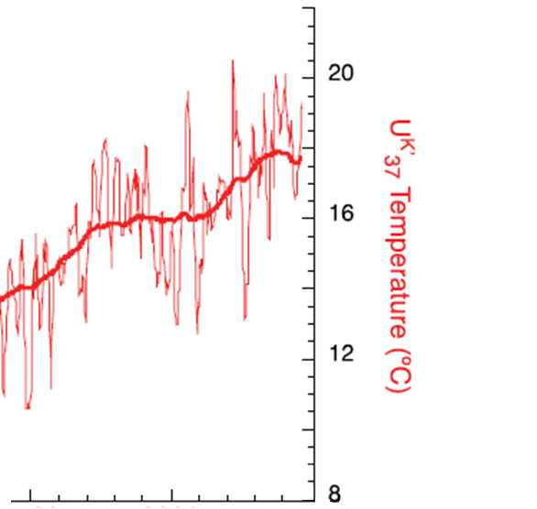
Supported by proxy data?
Lawrence et al. (2009).
Found surprisingly high variability of sea surface conditions at these sites

Slide 21
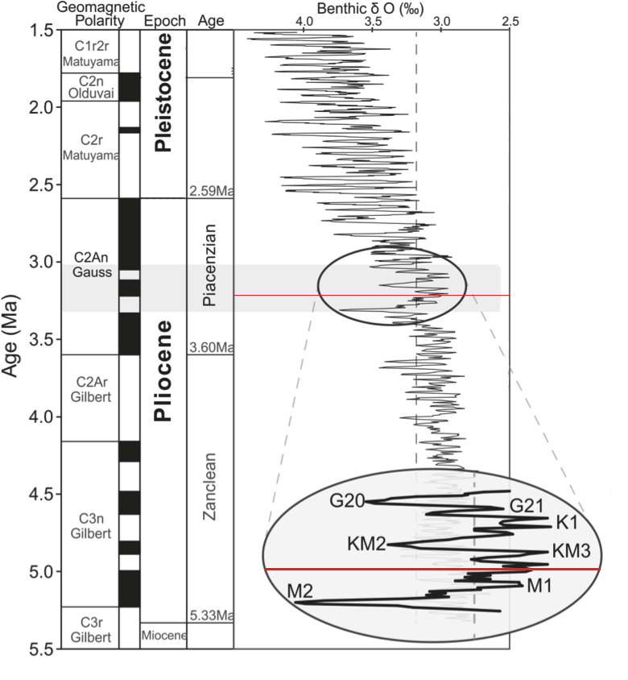
Time slice
‘Time slice’ instead of a ‘time slab’
Criteria for time slice (including):
Within the existing PRISM time slab
Orbit close to modern
In a negative isotope peak
Haywood et al. (2013)
3.205 Ma

Slide 22
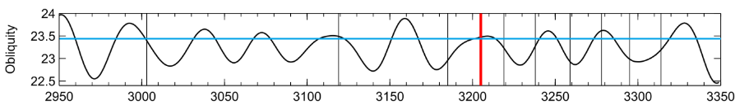
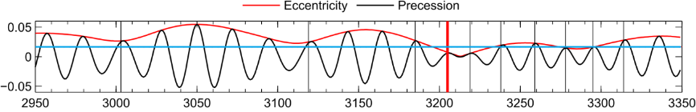
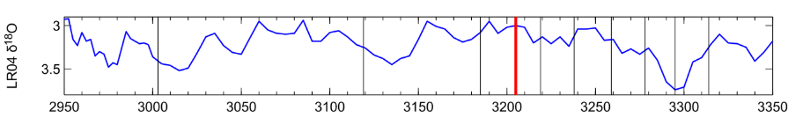
Time slice
Displays a near modern orbital configuration, before and after the time slice
In a known warm peak in the benthic oxygen isotope record

Slide 23
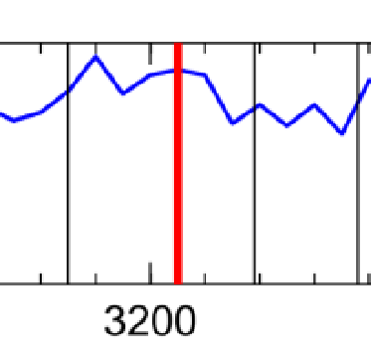
Time slice
Of significant duration to allow climate to respond as fully as possible

Slide 24
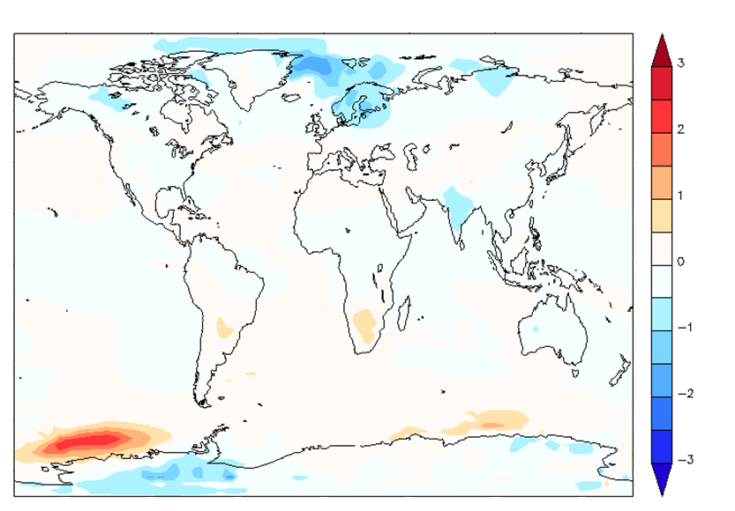
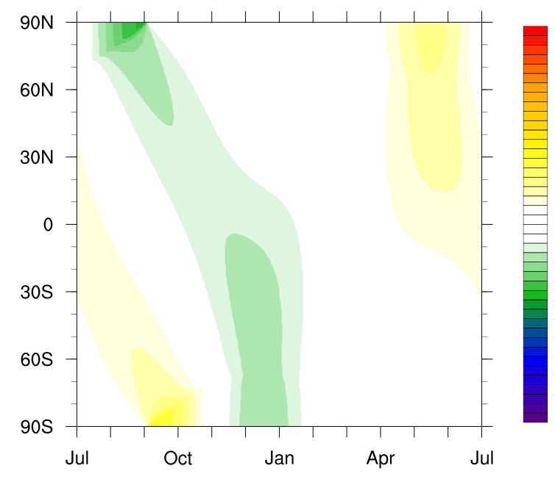
Time slice
Annual mean temperature difference between a time slice simulation and a Pliocene simulation with a modern orbit (°C)
3
2
The difference in insolation at the top of the atmosphere (TOA) between the time slice and modern
(W m⁻²)
1
0
60
-1
-2
0
-3
-60

Slide 25
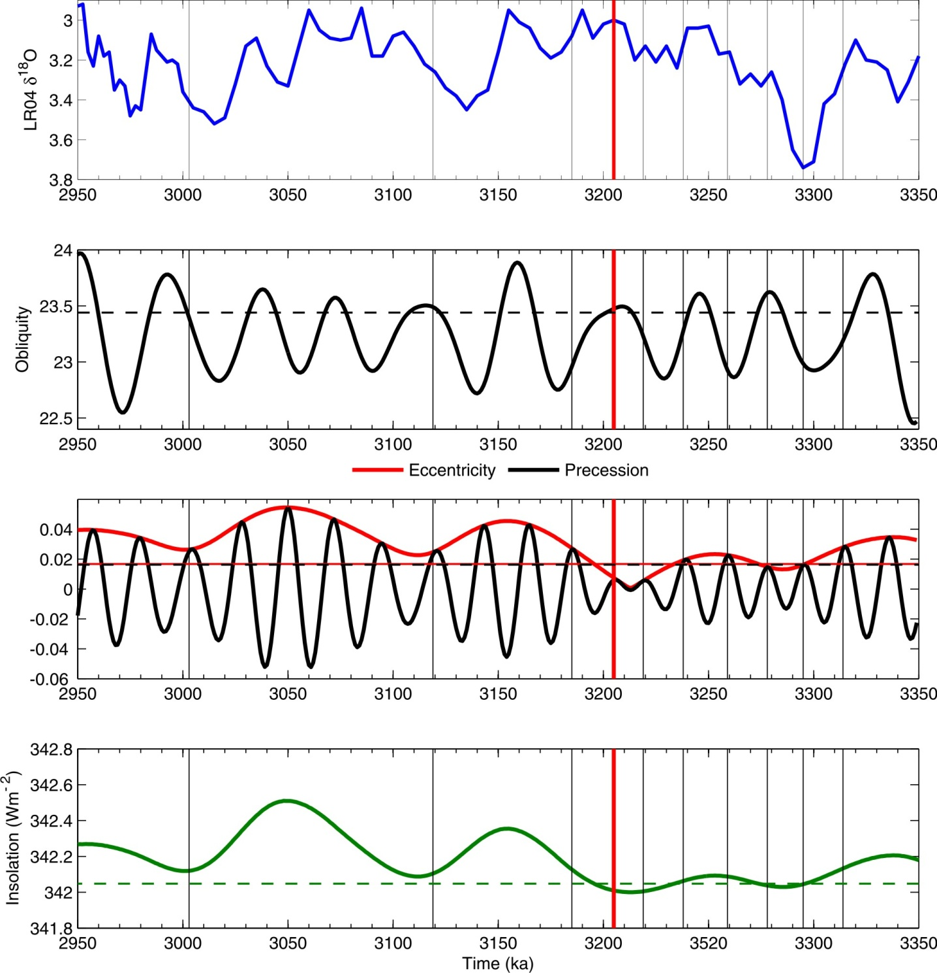
Pliocene time slice
First Pliocene Time Slice (3.205 Ma) is the centre piece of PlioMIP Phase 2 which is currently under construction.
(Haywood et al., 2013 – Philosophical Transactions of the Royal Society A)

Slide 26
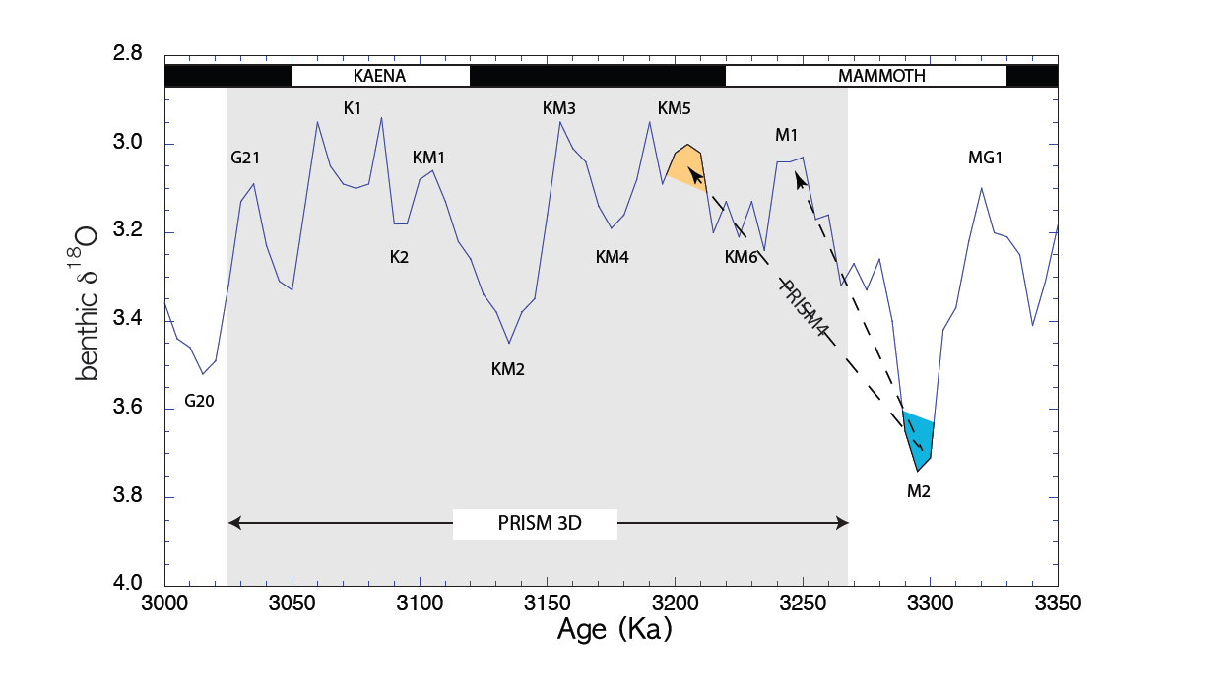
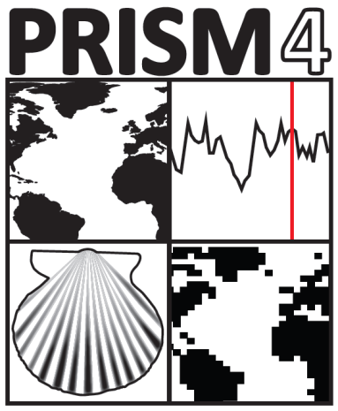
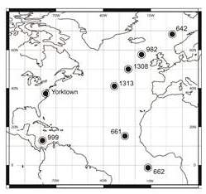
New Data for Model Evaluation
Emerging proxy data identified by the PRISM Group
Notes:
Short, high-resolution time series extending from MIS M2 through KM5 will be necessary to meet the evaluation requirements of PlioMIP Phase 2. Marine sequences will depend upon chronology from the LR04 time scale and should have multiple paleoenvironmental proxies. Previous work from the paleoclimate data community suggests a number of sites potentially suitable for evaluation of PlioMIP Phase 2 model outputs (e.g. Dowsett et al., 2012; 2013, Fedorov, 2013; Salzmann et al., 2013, Brigham-Grete et al., 2013). Well dated, high resolution records from the continental interior are extremely scarce and terrestrial reconstructions will be mostly based on marine sequences. The primary areas of discord between simulated and estimated Pliocene paleoclimate conditions identified in PlioMIP Phase 1 include the mid-to-high latitude North Atlantic, tropics and upwelling regions. The PRISM4 marine and terrestrial contribution to the PlioMIP Phase 2 community evaluation data set is initially concentrated in the North Atlantic region (Figure z).

Slide 27
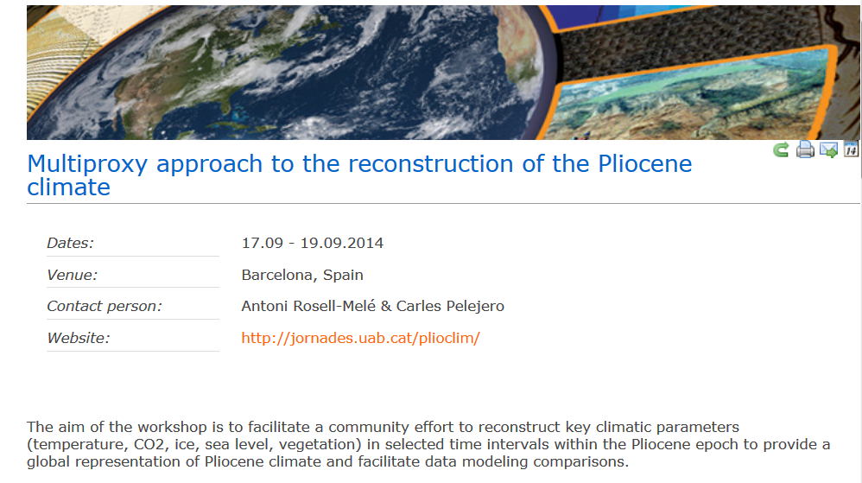
New Data for Model Evaluation
Co-ordinated effort from the data community – Workshop Barcelona, Sept 2014
Notes:
We propose to organize a workshop to quick start a new concerted effort of the international community to go a step further than PRISM in order to reduce current uncertainties on Pliocene climate. Following on from the model set by initiatives such as CLIMAP (Climate long-range investigation, mapping, and prediction) and MARGO (Multiproxy approach for the reconstruction of the glacial ocean surface), our aim is to bring together leading experts and younger scientists studying Pliocene climate to:
1. Provide consensus agreements on priority time slices to focus research efforts.
2. Appraise performance of available proxies on temperature (marine and continental) and CO2.
3. Compile all the available information on the cryosphere, sea level and vegetation
4. Collate and harmonise all the available proxy data and place them into a common framework for a multi-proxy climate reconstruction
5. Undertake data-modeling comparisons to ascertain strengths and weaknesses of models to incorporate on future assessments of the IPCC
The workshop objective would be to create a working group and initiate an open international project involving data gathering, sharing and harmonisation, with the aim of producing a new Pliocene synthesis. This effort would take place in close collaboration with the paleomodeling community collaborating in the PlioMIP project, representatives of which would attend the workshop.

Slide 28
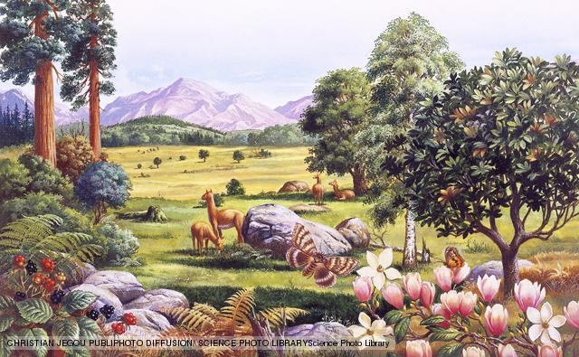
Conclusions
1. We said too much on the basis of too few models – now fixed
2. Global annual mean temperature increase of *********
3. Enhanced hydrological cycle with changes in monsoons
4. Little consistency in predictions for changes in AMOC
5. CO₂ drives changes in the tropics, clear sky albedo dominates at the poles
6. Models struggle to warm high latitudes enough but…
7. ….the concept of the ‘stable Pliocene’ is obsolete
8. We need better time constraints on our syntheses of proxy data

Slide 29

Acknowledgments
Research leading to these results has received funding from the European Research Council under the European Union's Seventh Framework Programme (FP7/2007-2013) / ERC grant agreement no. 278636.

