Slide 1
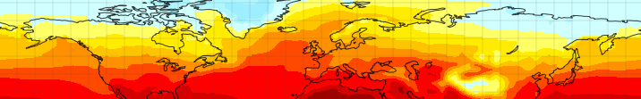











Modelling Pliocene warmth: how far have we come and what can we do next?
Alan Haywood, Aisling Dolan, Stephen Hunter, Daniel Hill, Ulrich Salzmann, Harry Dowsett, Bette Otto-Bliesner, Mark Chandler, Dan Lunt, David Rowley and the PlioMIP Participants

Slide 2

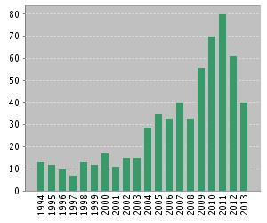
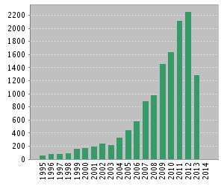
A Phoenix from the ashes
The PlioMIP Pinnacle (Mt PlioMIP)
Number of papers/yr
Number of citations/yr
Search: Pliocene + Climate + Model
Articles on Pliocene + Climate attracted over 7000 citations in 2012, ~ 2000 more than the LGM.

Slide 3
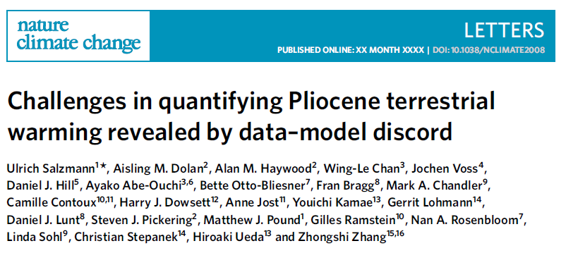

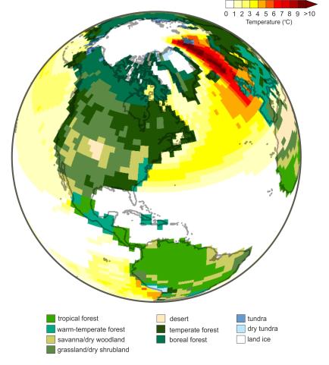
Contents
1. The land story – terrestrial data/model comparison
2. Identifying uncertainties
3. Towards the time slice(s)
4. What next
PlioMIP2
Transient simulations
5. Conclusions

Slide 4









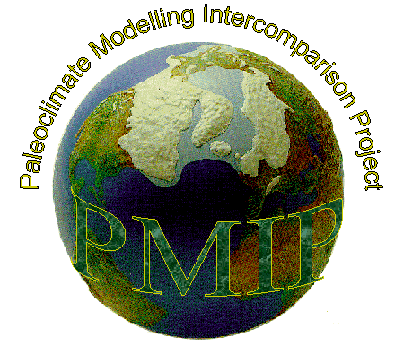



























PlioMIP collaboration

Slide 5
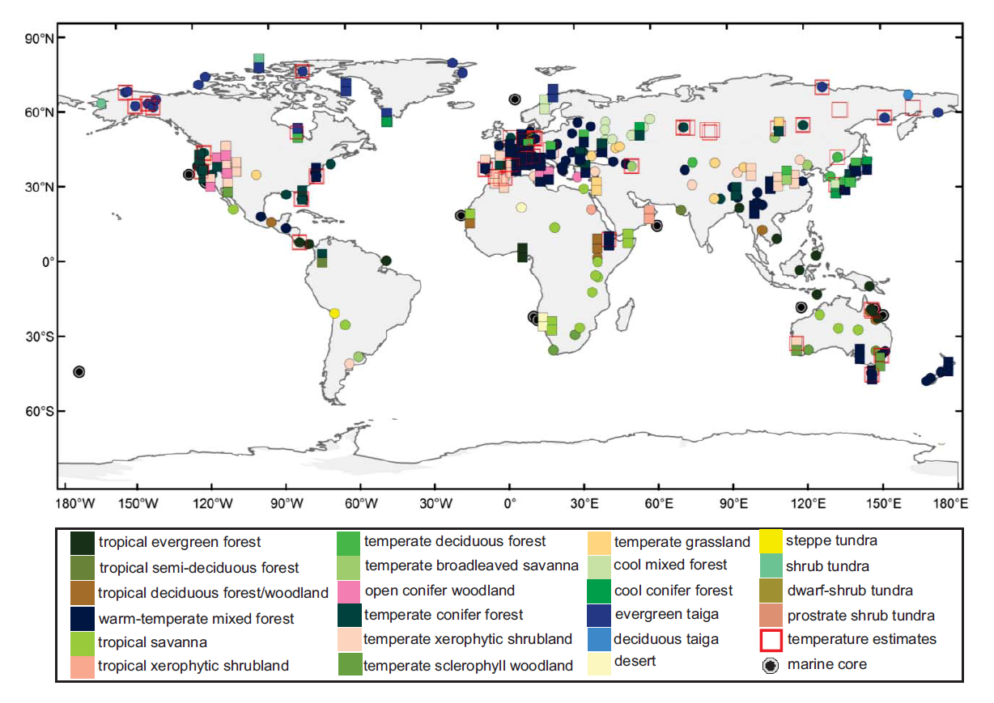
Terrestrial data/model comparison (DMC)
45 palaeobotanical sites where surface temperature can be estimated
(Nature Climate Change– Salzmann et al. 2013)

Slide 6
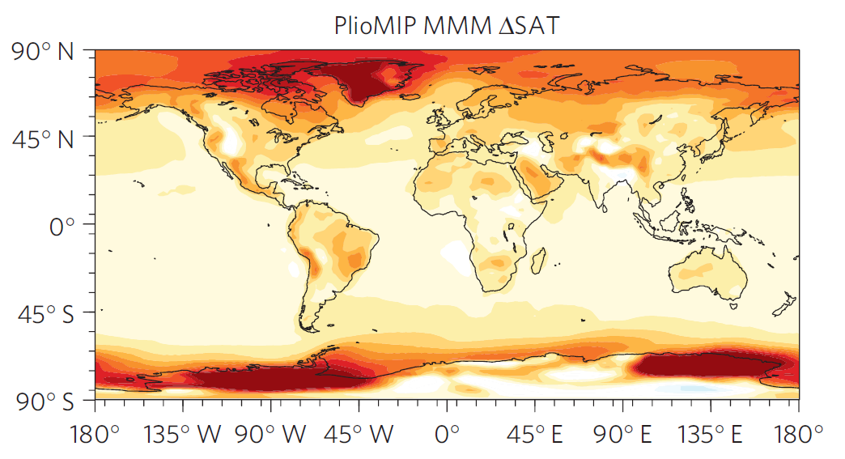
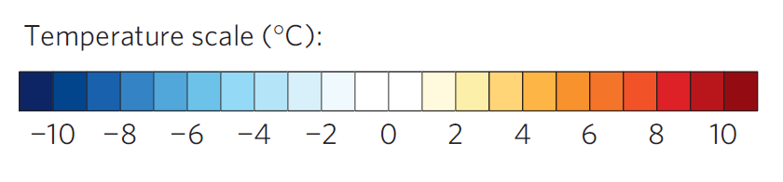
Terrestrial DMC – Multi-Model Mean
(Nature Climate Change– Salzmann et al. 2013)

Slide 7
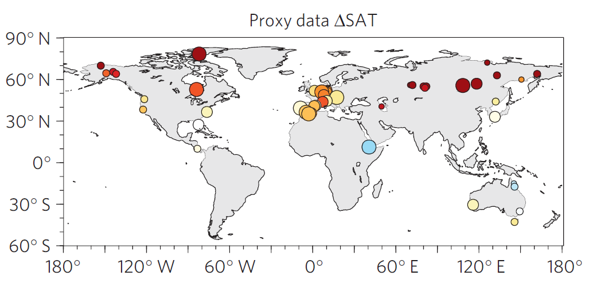
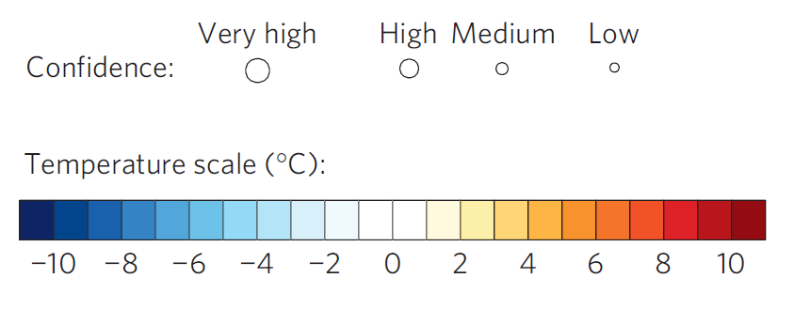
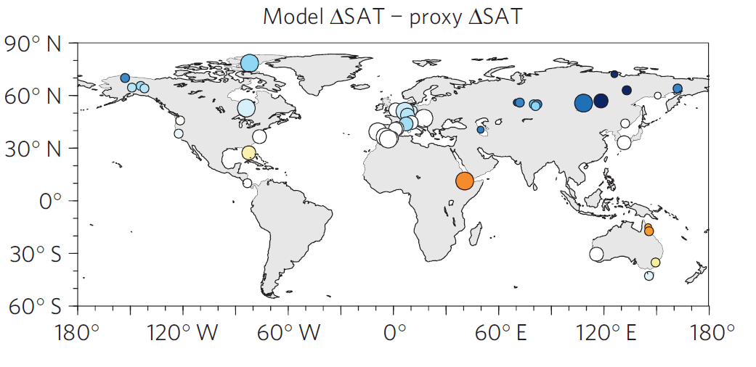
Terrestrial DMC (proxy signal versus model signal
Proxy-based temperature anomaly
Degree of data-model discordance (anomaly versus anomaly)
(Nature Climate Change– Salzmann et al. 2013)

Slide 8
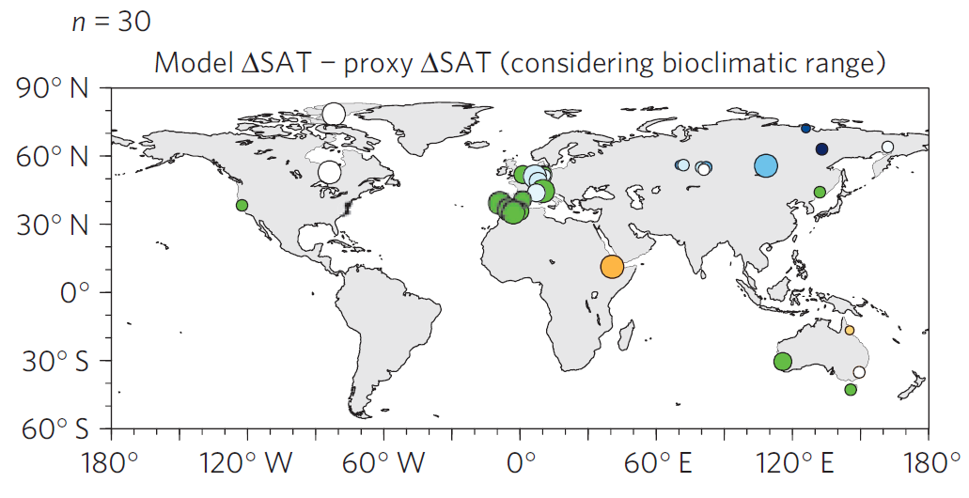
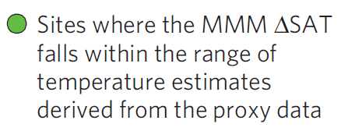
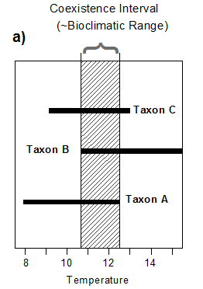
Terrestrial DMC (bioclimatic range)
(Nature Climate Change– Salzmann et al. 2013)

Slide 9
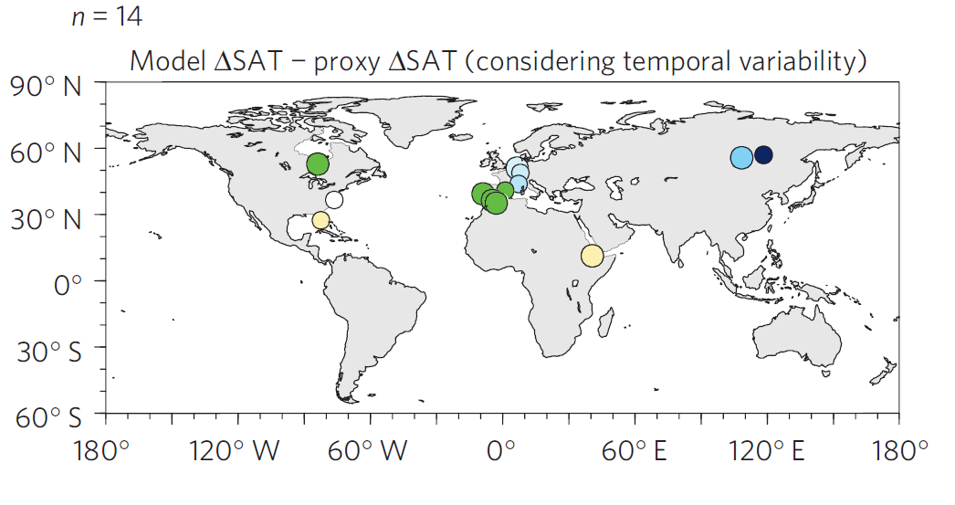
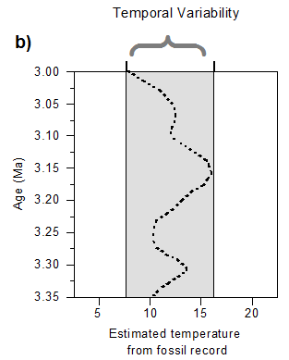
Pliocene Uncertainty…
Terrestrial DMC (temporal variability)
(Nature Climate Change– Salzmann et al. 2013)

Slide 10
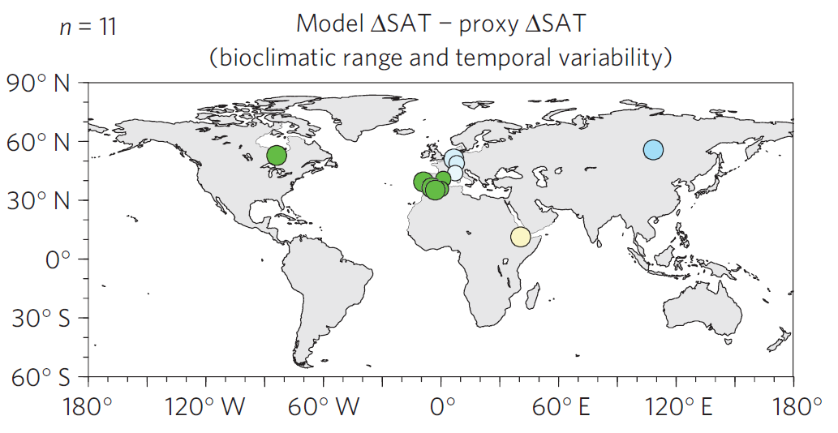
Pliocene Uncertainty…
Terrestrial DMC (bioclimatic range and temporal variability)
+
(Nature Climate Change– Salzmann et al. 2013)

Slide 11
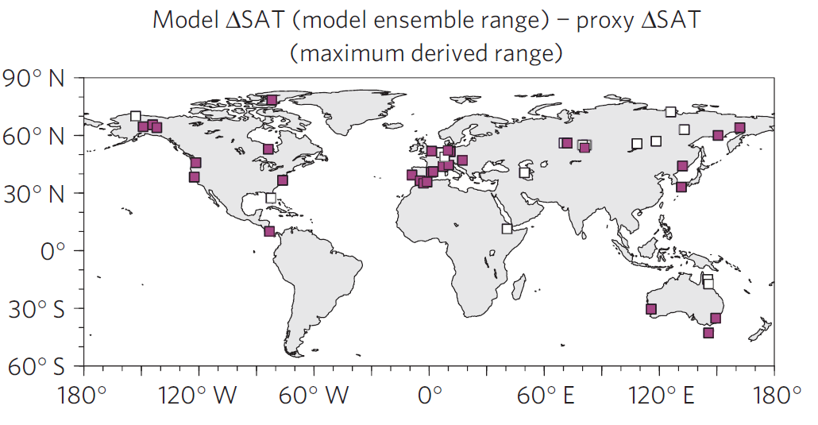
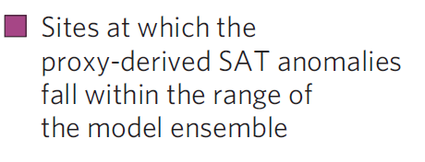
Terrestrial DMC (ensemble range)
(Nature Climate Change– Salzmann et al. 2013)

Slide 12
Need to consider what we are comparing to…
Proxy Data
Model
Represents the mean of the maximum warming response to forcing throughout the mPWP at each individual site, at the sampling resolution of each of the individual cores
Unlikely to be synchronous
Likely to be effects of boundary conditions changing during the mPWP
Likely to be transient effects
Equilibrium response (e.g. 500 to 1000 years should be sufficient for surface climate) to fixed forcing, appropriate for a mPWP interglacial.
Equilibrium temperatures for a fixed moment in time, if there was ever a moment with exactly these forcings.
No impact of orbital forcing (fixed at modern) or other changing boundary conditions.
Notes:
In theory models should be able to reproduce peak Pliocene warmth at every site across the globe. However, we need to know sensitivity of each site to all mPWP orbital changes, every BC change and uncertainty and if there are transient or non-linear effects to account for
OR
We could do a time slice

Slide 13
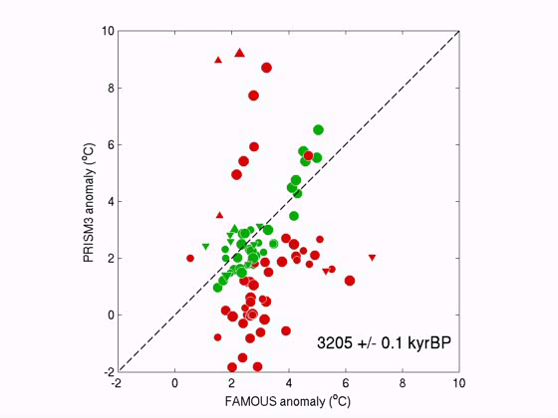
Pliocene Uncertainty…
Thought experiment (SSTs)

Slide 14
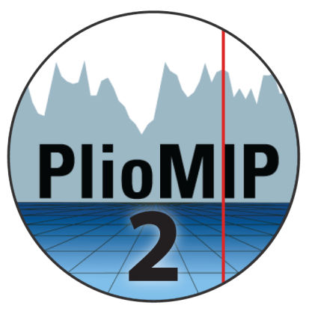
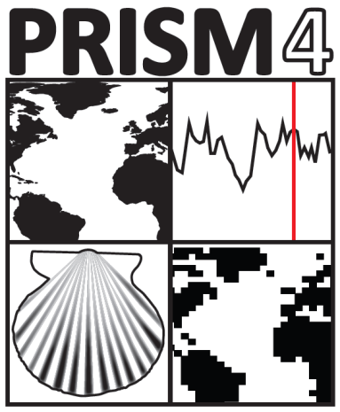
Pliocene Uncertainty…
PlioMIP Phase 2
Data Uncertainty
Analytical, Spatial, Temporal
Boundary Condition Uncertainty
Orbital forcing, Greenhouse gases, Topography
Modelling Uncertainty
Structural, Parameter

Slide 15
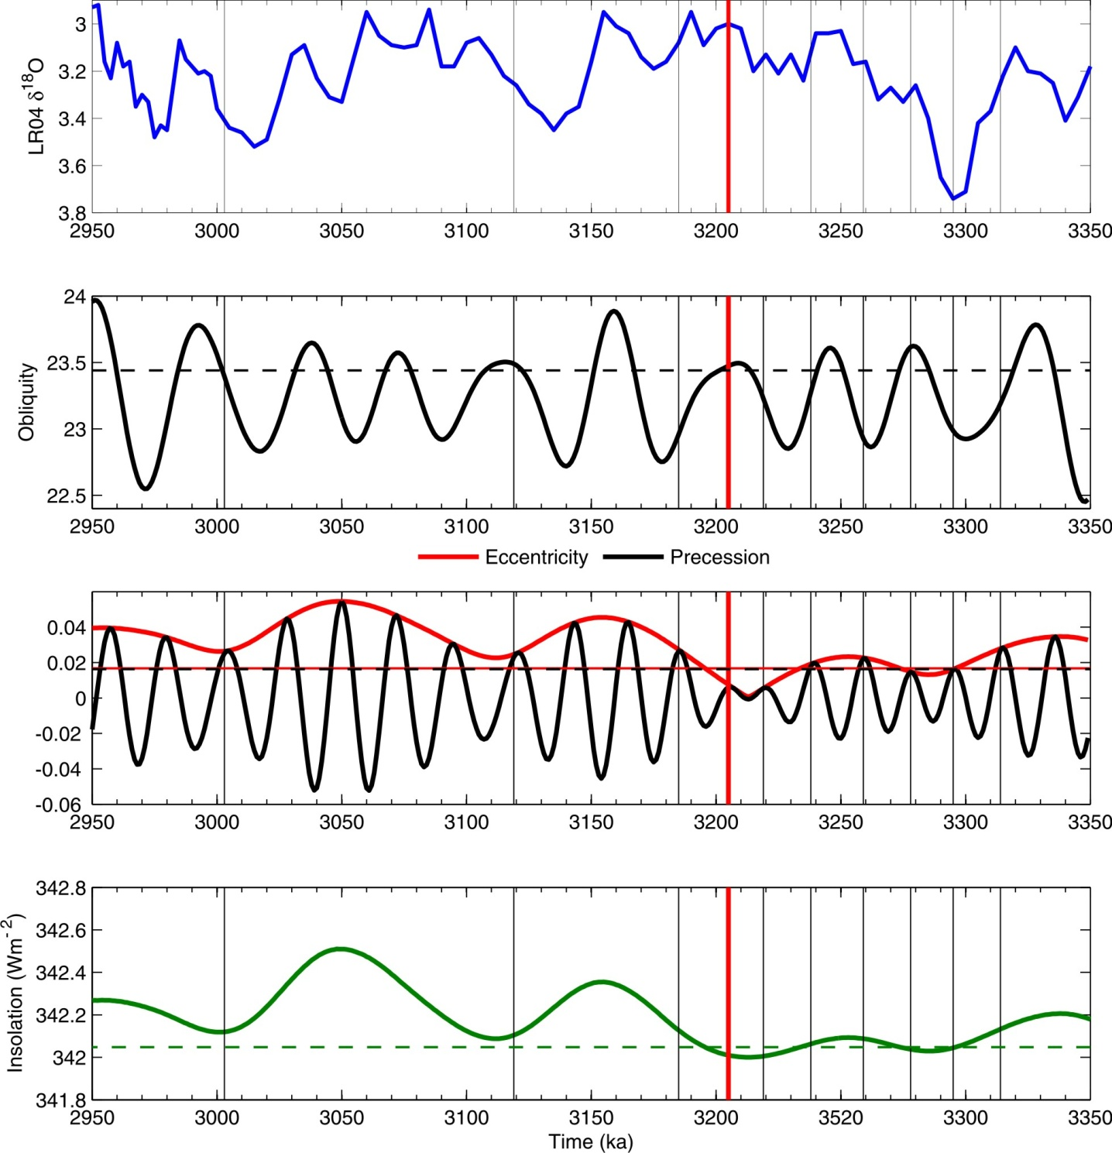
Pliocene time slice
First Pliocene Time Slice (3.205 Ma) at KM5c will form part of PlioMIP Phase 2 which is currently under construction
(Haywood et al., 2013 – in press)

Slide 16
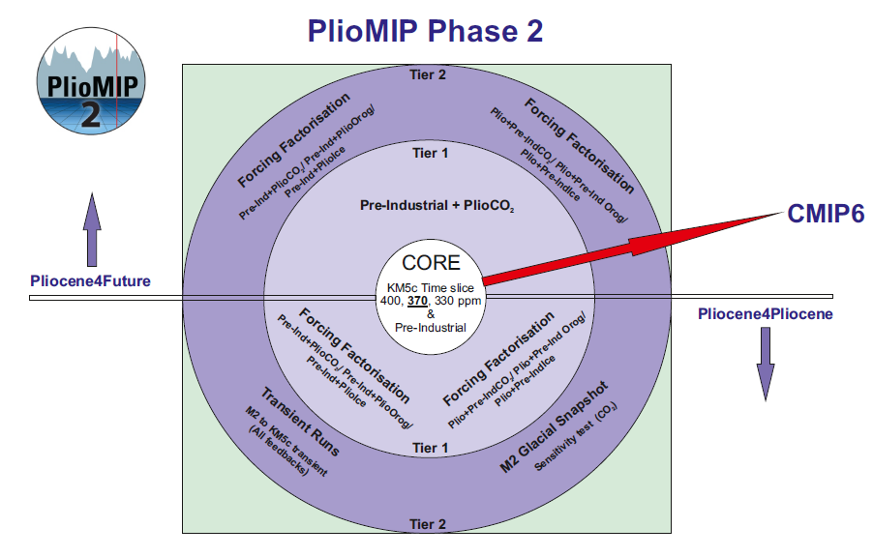
PlioMIP Phase 2
New Experiments

Slide 17
Why conduct transient simulations?
Transient climate
Understand climate variability through the Pliocene
Large scale features and transient dynamics
Compare snap-shot vs. transient
are there regions that are particularly dynamic?
Increasing complexity
Look at effect of different earth system components
Conduct Data-model comparison (DMC)
Better understand Pliocene Earth system sensitivity

Slide 18
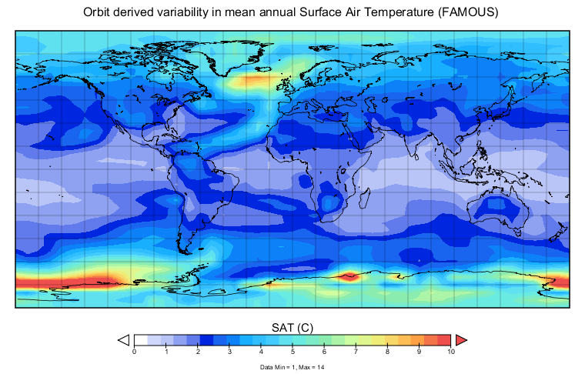
Transient variability (annual)

Slide 19
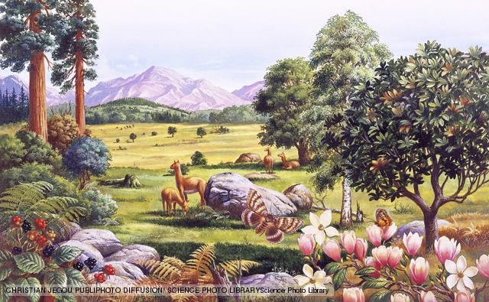
Conclusions
1. We try and say too much on the basis of just 1 model
2. Uncertainties in model and proxy data are considerable
3. The PlioMIP ensemble range is wide enough to overlap the terrestrial proxy signal at most locations – where is the discord?
4. Proxy data can not be used in the way we want – to discriminate between individual members of an ensemble
5. You must know exactly where you are in time to do this
6. The concept of the ‘stable Pliocene’ is obsolete

