Slide 1
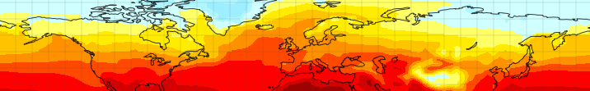











Understanding Pliocene Climate: The Pliocene Model Intercomparison Project
Alan Haywood, Aisling Dolan, Stephen Hunter, Daniel Hill, Ulrich Salzmann, Harry Dowsett, Bette Otto-Bliesner, Mark Chandler, Dan Lunt, David Rowley and the PlioMIP Participants

Slide 2

A 400 ppm world
What has
changed?
How much is
yet to come?
Timescale matters

Slide 3

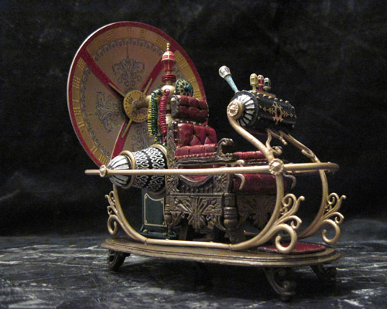

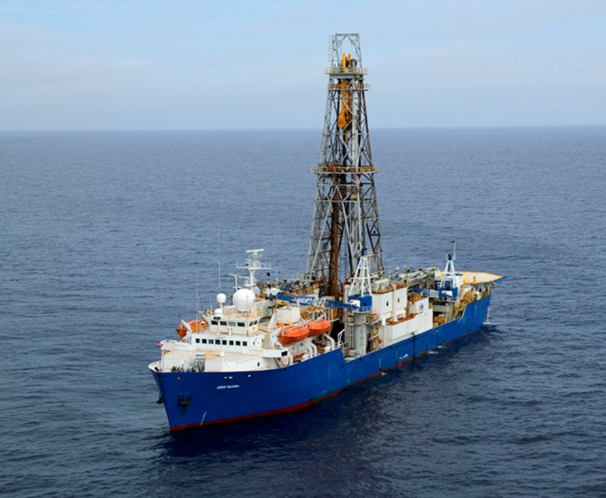

Slide 4

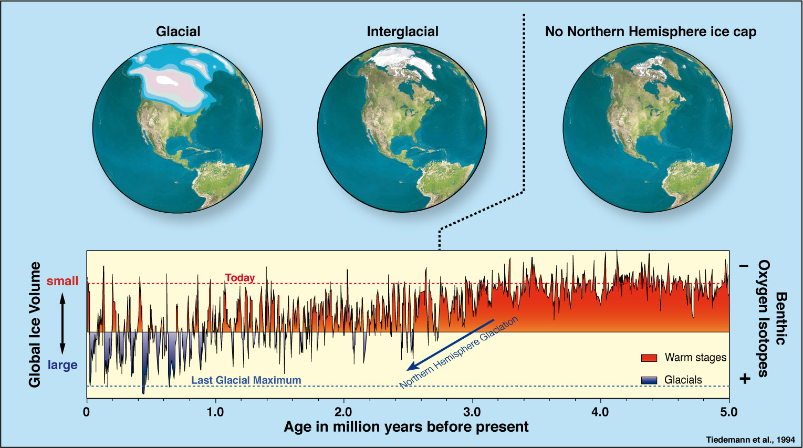

The Pliocene

Slide 5
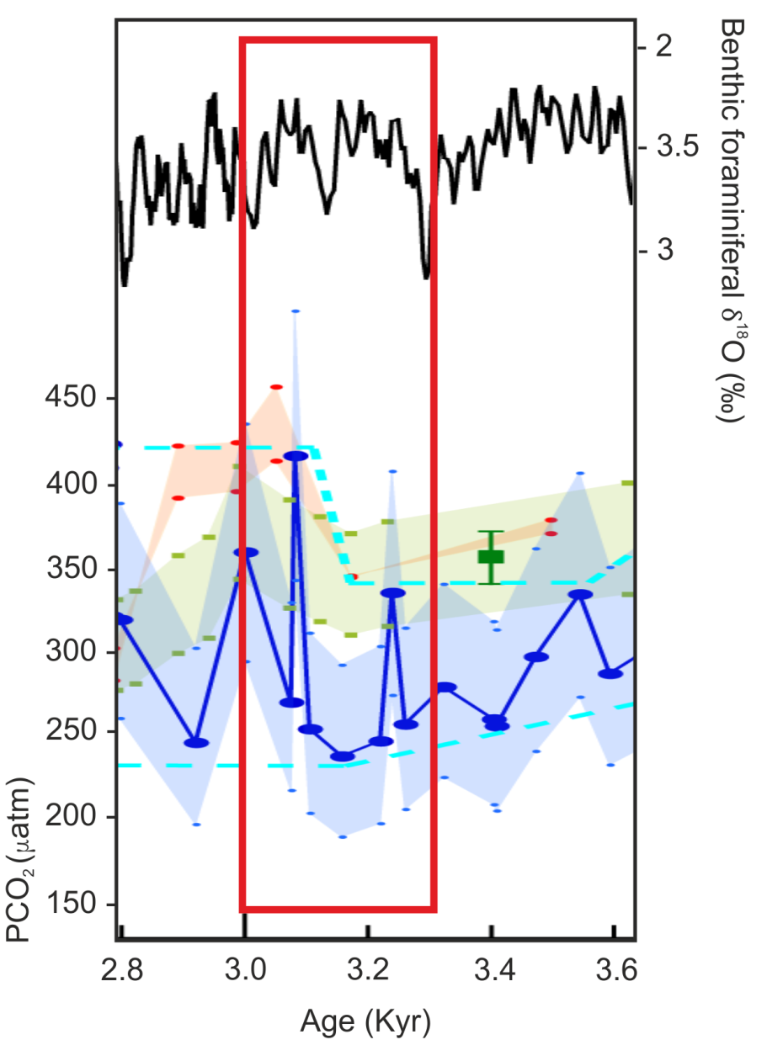
CO₂ Summary
CO₂ levels were also varying during the mid-Pliocene Warm Period
Moreover, there is uncertainty in the proxy reconstructions of absolute high CO₂ levels
Thus it is necessary to consider a range of CO₂ levels when modelling the ice sheets of the mid-Pliocene
280 to 450+ ppmv
Adapted fro m Bartoli et al. (2011)

Slide 6

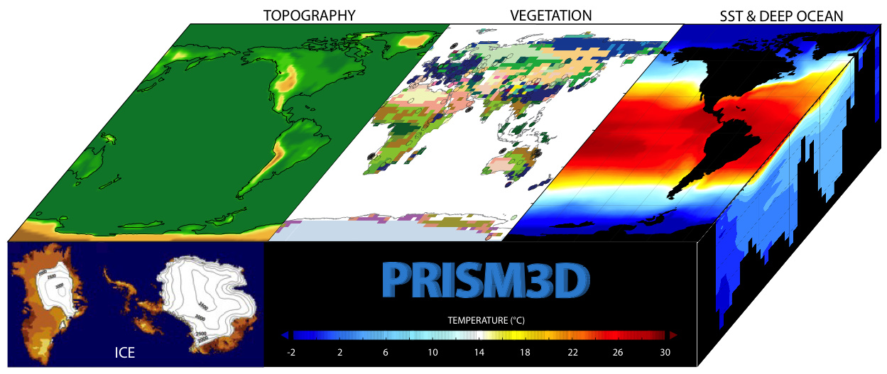
A Geological Odyssey
Vegetation
Biomes
Sea Surface
Temperature
Topography
Sea Ice
Sea Level
Deep Ocean
Temperature
Land Ice

Slide 7
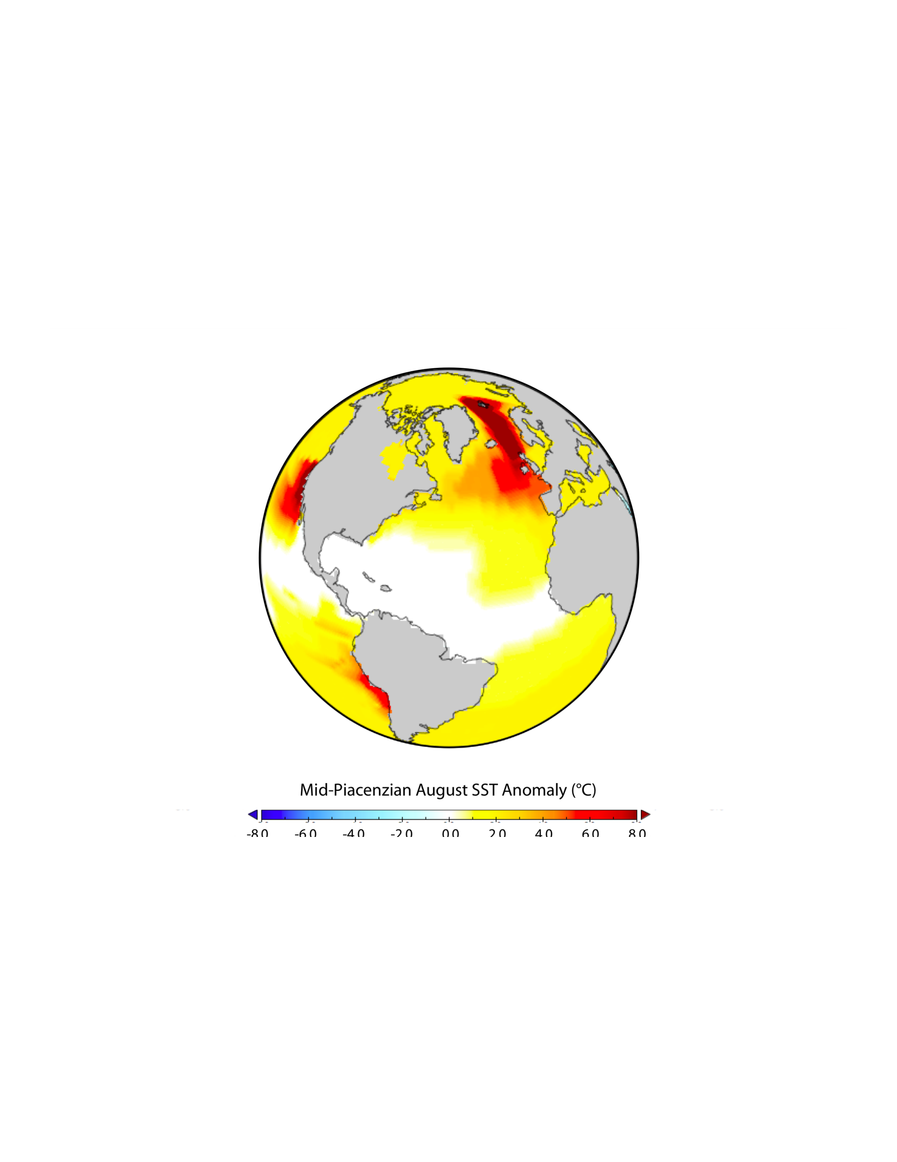
mid-Pliocene conditions
View of mid-Pliocene environments
Less land ice = higher sea level
Less sea ice in the high latitudes
Warmer upwelling zones
Reduced equator to pole surface temperature gradient
ENSO keeps on ticking
Enhanced poleward ocean heat transport/CO₂ increase

Slide 8
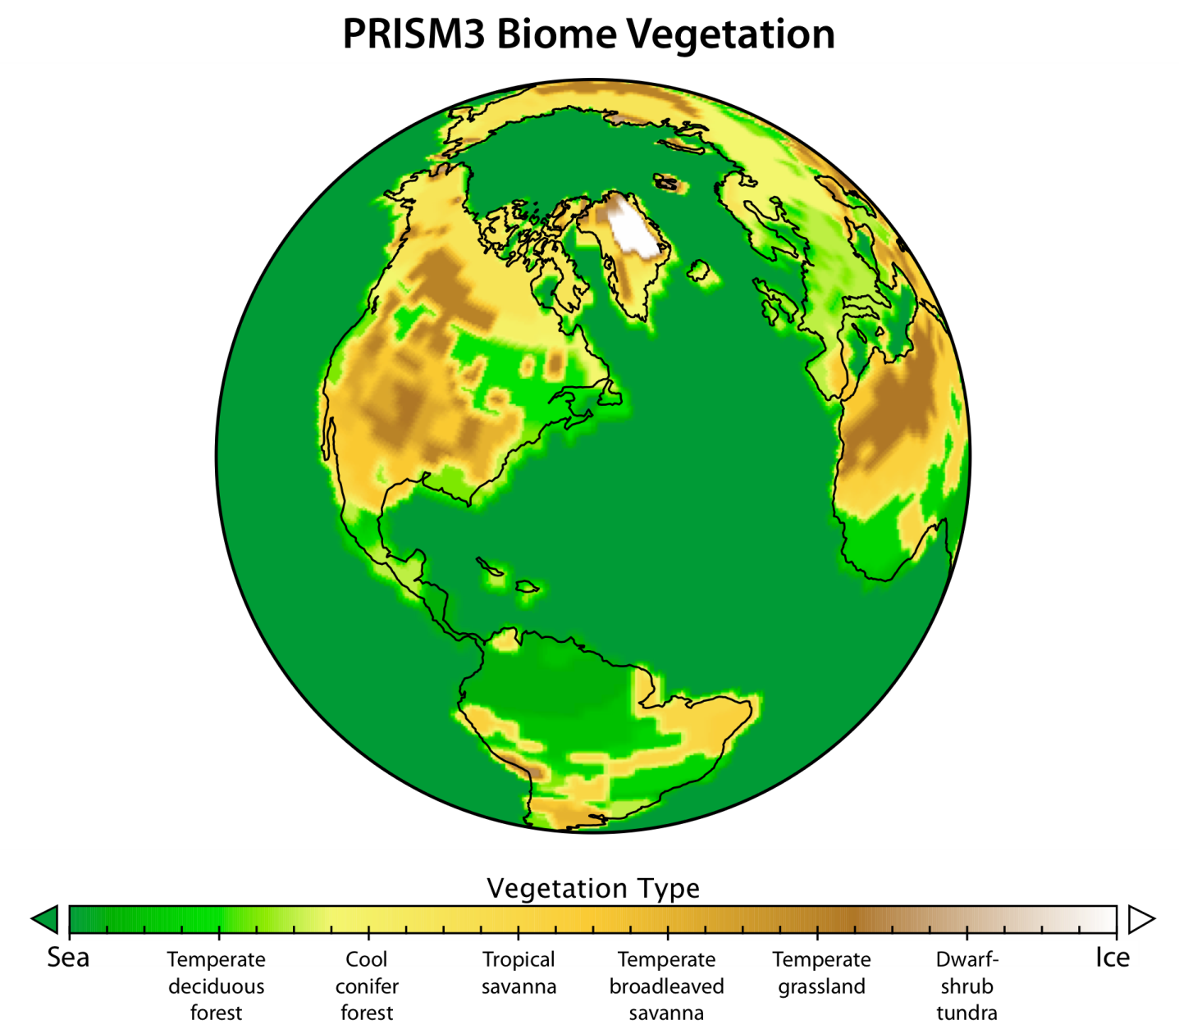
Changing view of mid-Pliocene environments
mid-Pliocene conditions
Tundra BIOME nearly absent
Reduced deserts
Poleward shift in
most BIOMES
Notes:
8

Slide 9




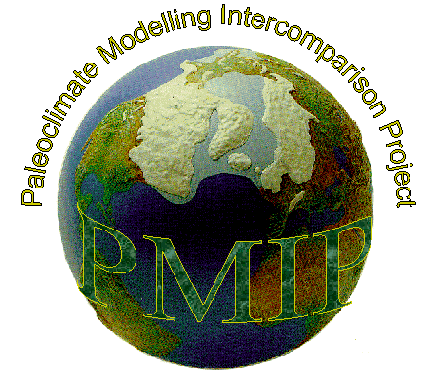































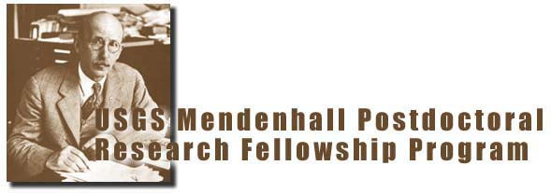
PlioMIP collaboration

Slide 10
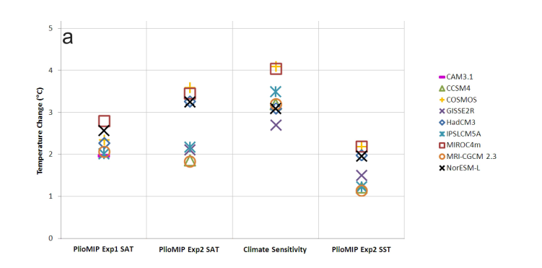
PlioMIP Results
Pliocene temperature increases
(Haywood et al., 2013 – Climate of the Past)

Slide 11
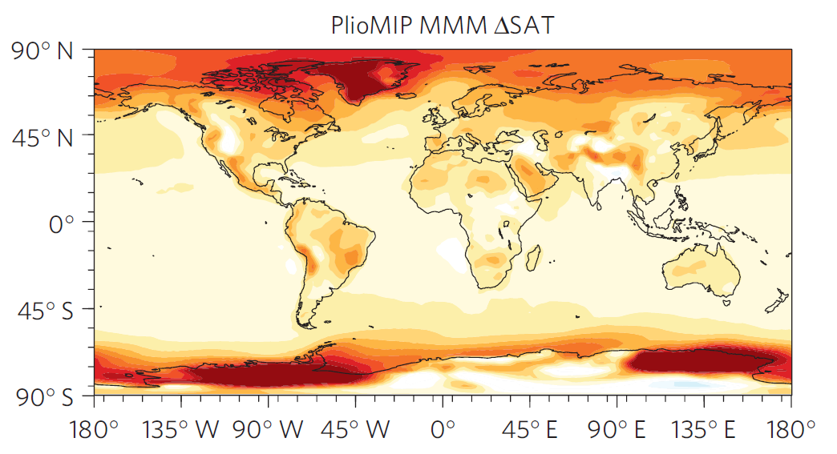
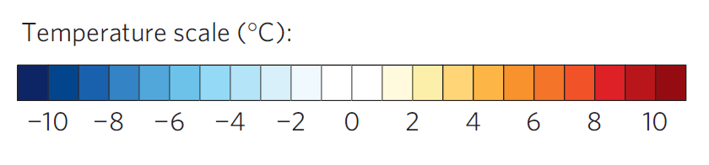
Surface Air Temperatures (°C) – Multi-Model Mean
(Nature Climate Change– Salzmann et al. 2013)

Slide 12
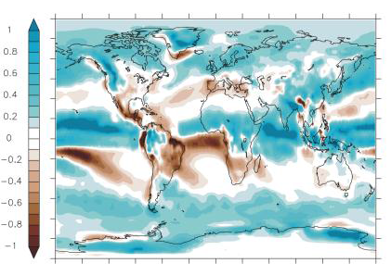
Total Precipitation Rate (mm/day) – Multi-Model Mean
(Haywood et al., 2013 – Climate of the Past)

Slide 13
Energy balance slide

Slide 14
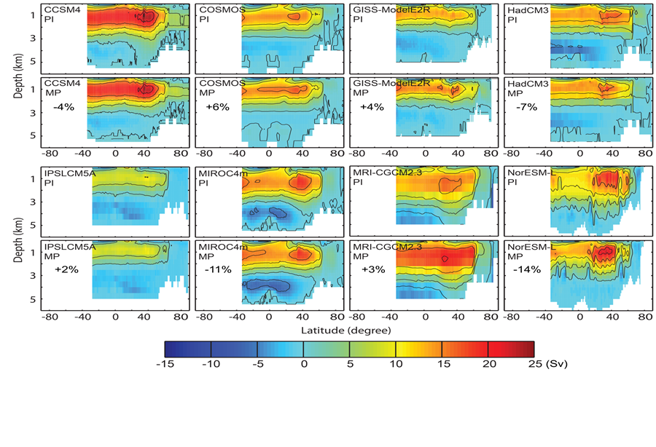
PlioMIP Results
Changes in the AMOC (Zhang et al., 2013)
Notes:
North Atlantic Heat Transport
Increased ocean heat transport, particularly in the North Atlantic, has long be suggested as one of the primary drivers of Pliocene warming. However, the PlioMIP simulations show no systematic increases in ocean heat transport (OHT), even in simulations where the overturning circulation is significantly enhanced (e.g. GISS and MRI in Figure 4).
Simulated pre-industrial (PI) and mid-Pliocene (MP) Atlantic Meridional Overturning Circulation (AMOC) for each of the PlioMIP models. Numbers refer to change in OHT

Slide 15
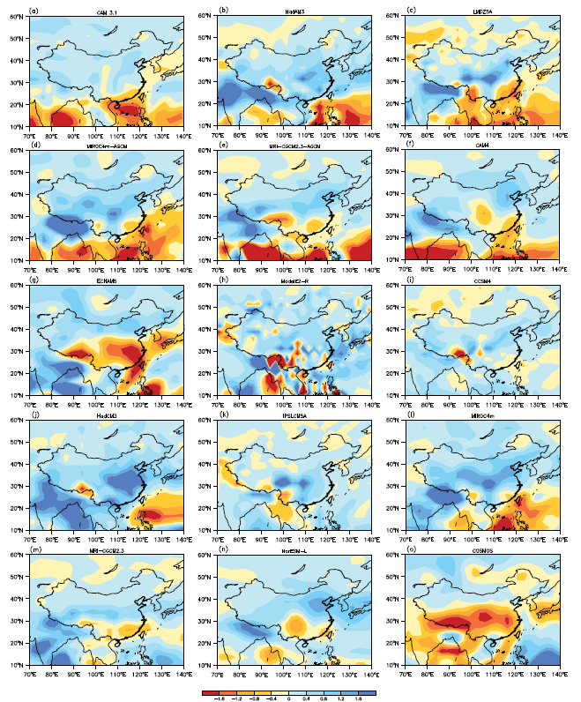
Monsoons
Mean precipitation (mm/day) differences over East Asia highlighting modelled changes in the Monsoon intensity (Zhang et al., 2013 CP)
Notes:
Compared to the pre-industrial, the multi-model ensemble mean (MMM) of all models shows the East Asian summer winds (EASW) largely strengthen in monsoon China, and the East Asian winter winds (EAWW) strengthen in south monsoon China but slightly weaken in north monsoon China in mid-Pliocene. The MMM of all models also illustrates a warmer and wetter mid-Pliocene climate in China. The simulated weakened mid-Pliocene EAWW in north monsoon China and intensified EASW in monsoon China agree well with geological reconstructions. However, there is a large model-model discrepancy in simulating mid-Pliocene EAWW, which should be further addressed in the future work of PlioMIP.

Slide 16
PlioMIP Results
Can use PlioMIP results to tell us something about ESS
Model | Pliocene warming (K) | Climate Sensitivity | Earth System Sensitivity | ESS / CS
CCSM4 | 1.86 | 3.2 | 3.51 | 1.1
COSMOS | 3.60 | 4.1 | 6.77 | 1.7
GISS-E2-R | 2.12 | 2.7 | 3.98 | 1.5
HadCM3 | 3.27 | 3.1 | 6.16 | 2.0
IPSLCM5A | 2.18 | 3.4 | 4.10 | 1.2
MIROC4m | 3.46 | 4.1 | 6.51 | 1.6
MRI-CGCM 2.3 | 1.84 | 3.2 | 3.45 | 1.1
NorESM-L | 3.27 | 3.1 | 6.14 | 2.0
Ensemble mean | 2.66 | 3.36 | 5.01 | 1.5

Slide 17
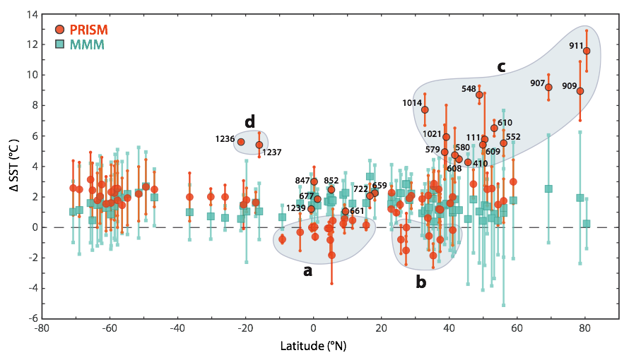
SST Data/Model Comparison
Point-based Mean Annual SST comparison
(Dowsett et al., 2013 – Scientific Reports)

Slide 18
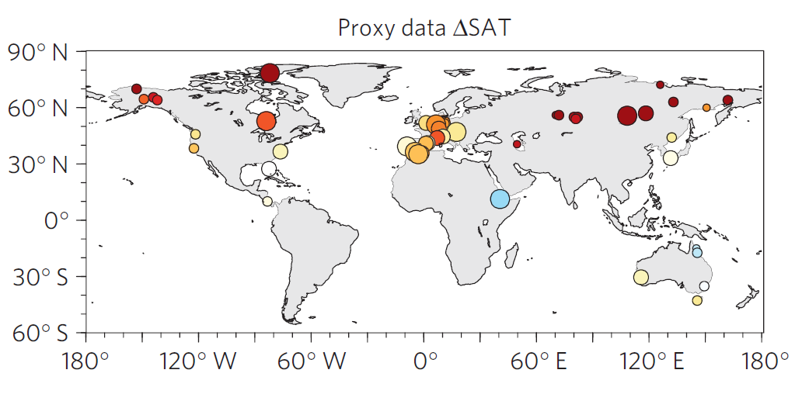
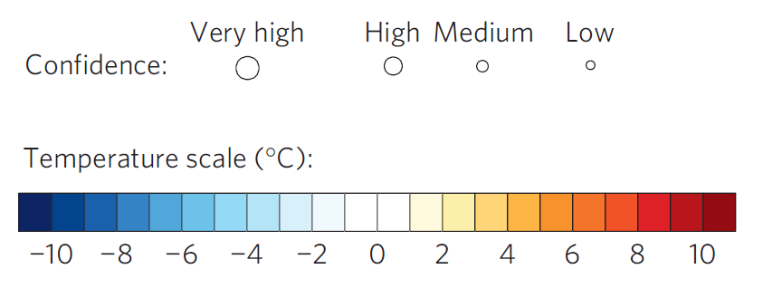
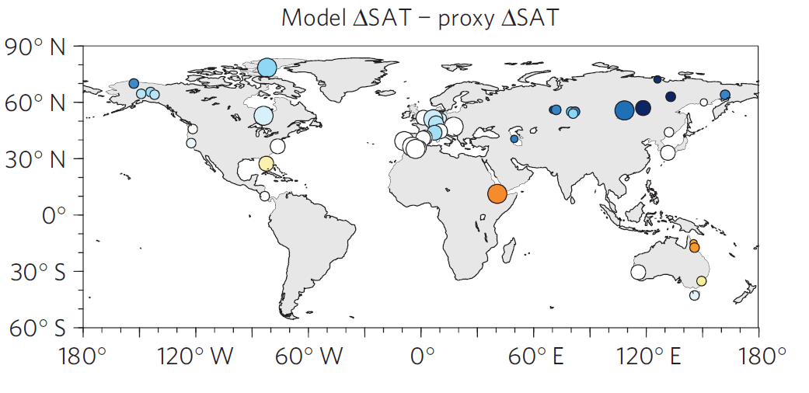
Terrestrial DMC (proxy signal versus model signal
Proxy-based temperature anomaly
Degree of data-model discordance (anomaly versus anomaly)
(Nature Climate Change– Salzmann et al. 2013)

Slide 19
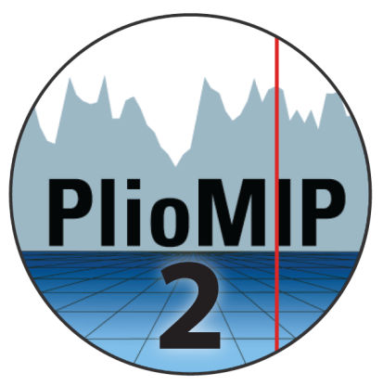
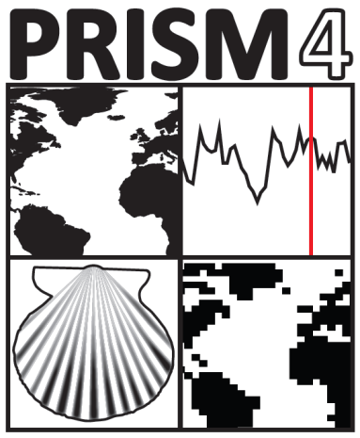
Pliocene Uncertainty…
PlioMIP Phase 2
Data Uncertainty
Analytical, Spatial, Temporal
Boundary Condition Uncertainty
Orbital forcing, Greenhouse gases, Topography
Modelling Uncertainty
Structural, Parameter

Slide 20
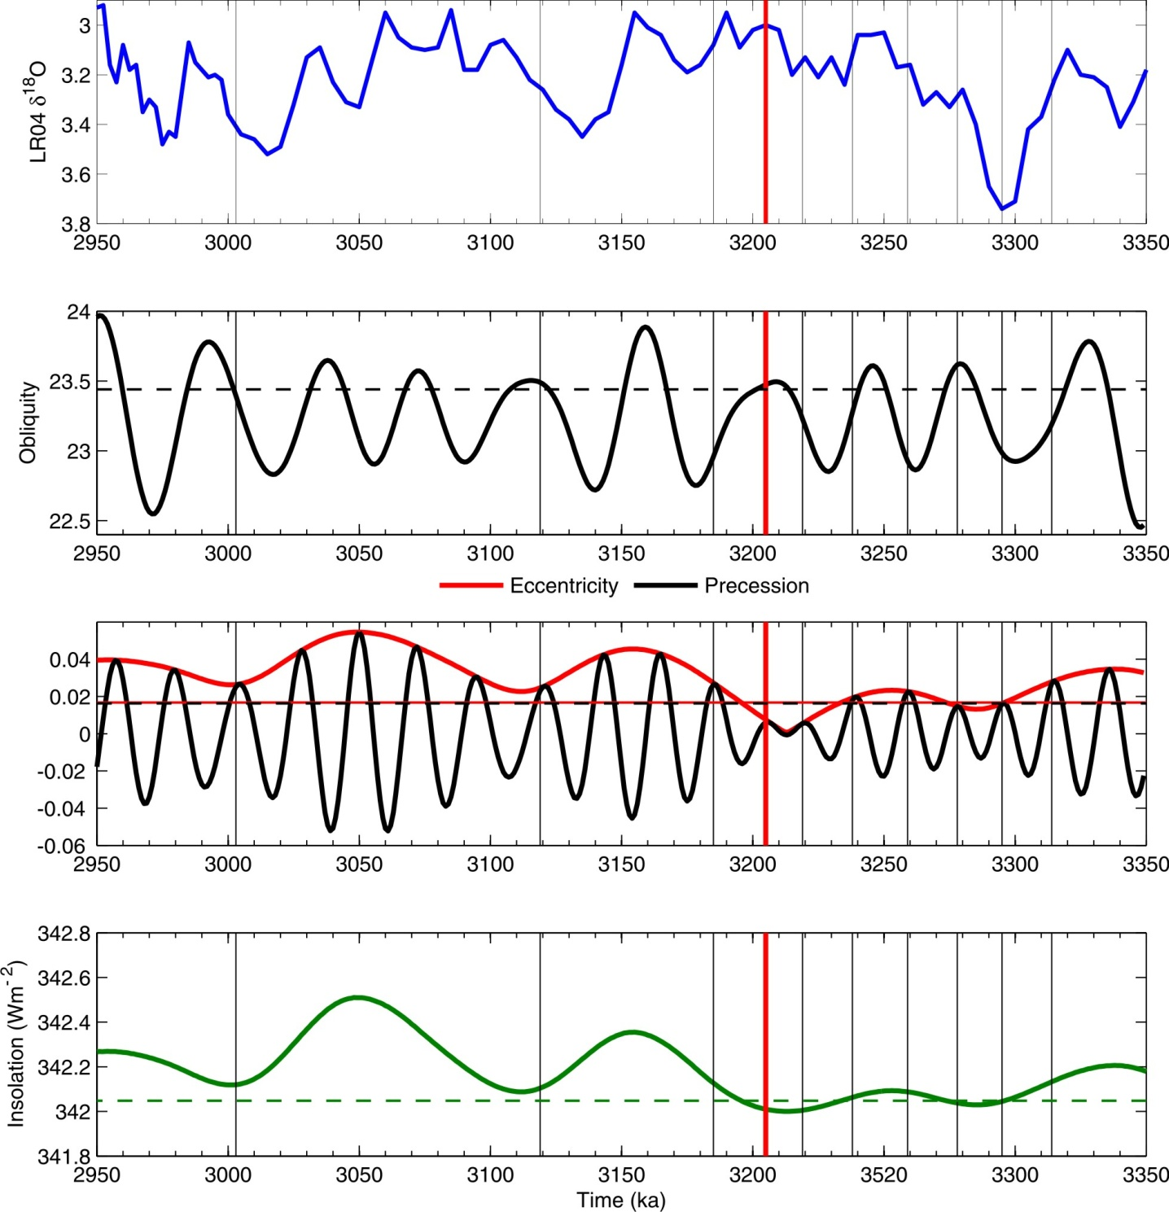
Pliocene time slices
First Pliocene Time Slice (3.205 Ma) is the centre piece of PlioMIP Phase 2 which is currently under construction.
(Haywood et al., 2013 – Philosophical Transactions of the Royal Society A)

Slide 21
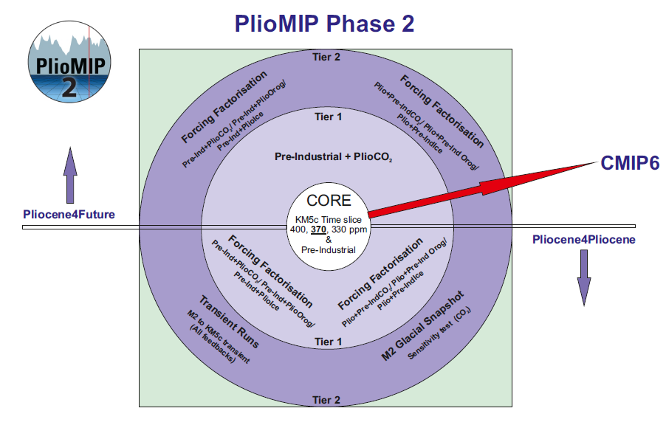
PlioMIP Phase 2

Slide 22



Slide 23
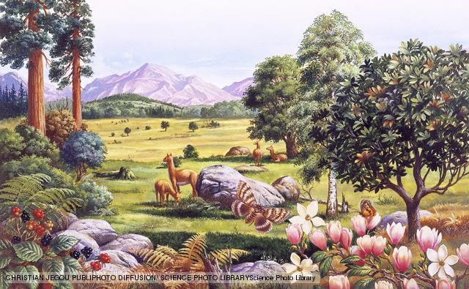
Conclusions
1. We said too much on the basis of too few models – now fixed
2. Global annual mean temperature increase of *********
3. Enhanced hydrological cycle with changes in monsoons
4. Little consistency in predictions for changes in AMOC
5. CO₂ drives changes in the tropics, clear sky albedo dominates at the poles
6. Models struggle to warm high latitudes enough but…
7. ….the concept of the ‘stable Pliocene’ is obsolete
8. We need better time constraints on our syntheses of proxy data

Slide 24


Lectureship Available – Permanent
(Marine Micropaleontology)
Permanent position (Associate Professor)
Low teaching/admin
Within a big and growing palaeo group
Healthy start up funds
Ideal for an Early Career Scientist
Contact: Alan Haywood (earamh@leeds.ac.uk)

