Slide 1


Insights into climate mechanisms and process of a warmer world
Alan Haywood
earamh@leeds.ac.uk
With important contributions from Aisling Dolan, Daniel Hill, Fergus Howell, Julia Tindall and PlioMIP1 and 2 participants
Chinese Academy of Sciences 2016
Research leading to these results has received funding from the European Research Council under the European Union’s Seventh Framework Programme (FP7/2007-2013) / ERC grant agreement no. 278636.

Slide 2
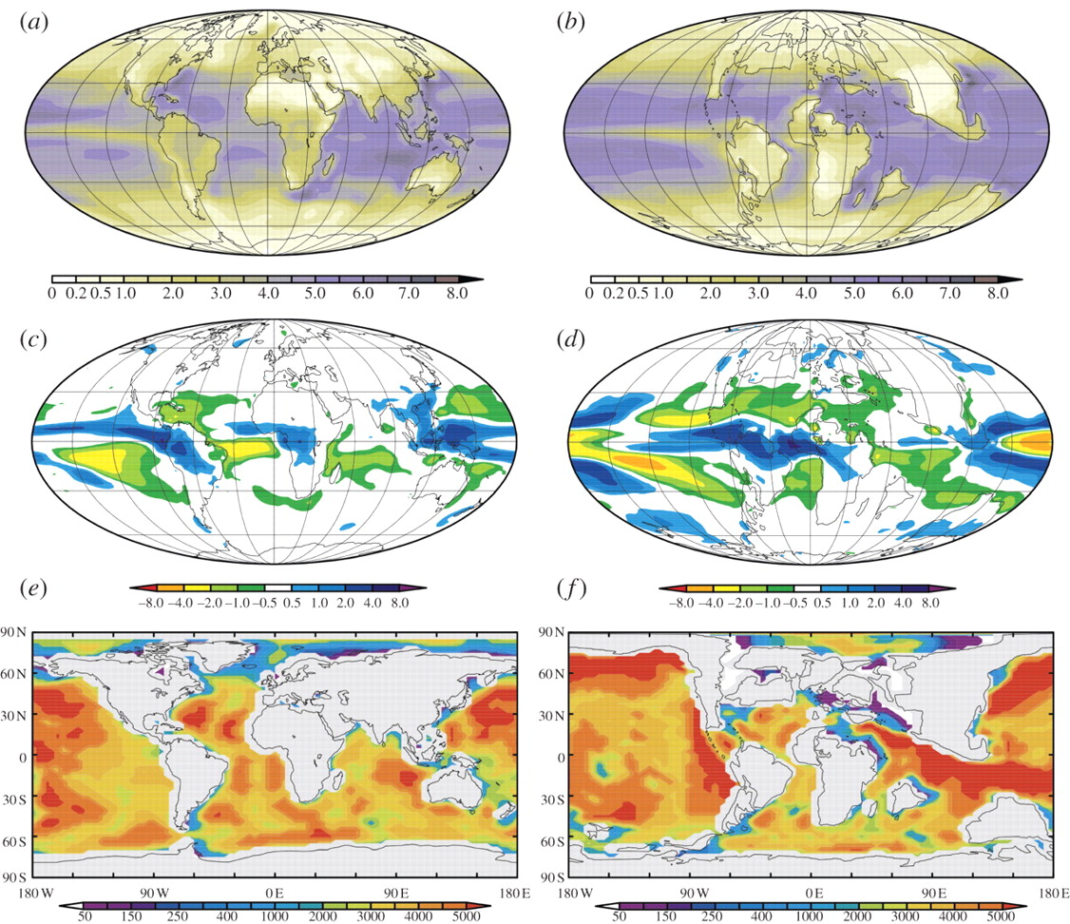

Analogue issues
HadCM3 predictions for a future climate-change experiment and a Maastrichtian experiment:
Annual Mean P-E response to a doubling of CO₂
Haywood et al. Phil. Trans. R. Soc. A 2011;369:933-956.
Notes:
HadCM3 predictions for a future climate-change experiment and the Maastrichtian experiment: (a) annual mean evaporation rate (mm d−1) for 2×PAL CO2 experiment; (b) annual mean evaporation rate (mm d−1) for 2×PAL CO2 Maastrichtian experiment; (c) difference in annual mean precipitation minus evaporation rate (P – E; mm d−1) between a 2×PAL CO2 experiment and a pre-industrial experiment; (d) difference in annual mean precipitation minus evaporation rate (P – E; mm d−1) between a 2×PAL CO2 Maastrichtian experiment and a pre-industrial CO2 Maastrichtian experiment; (e,f) prescribed bathymetry (m) in HadCM3 for the modern and Maastrichtian simulations. Note the increased area of shallow marine seas (epeiric seas) in the Maastrichtian case. (Online version in colour.)‏

Slide 3
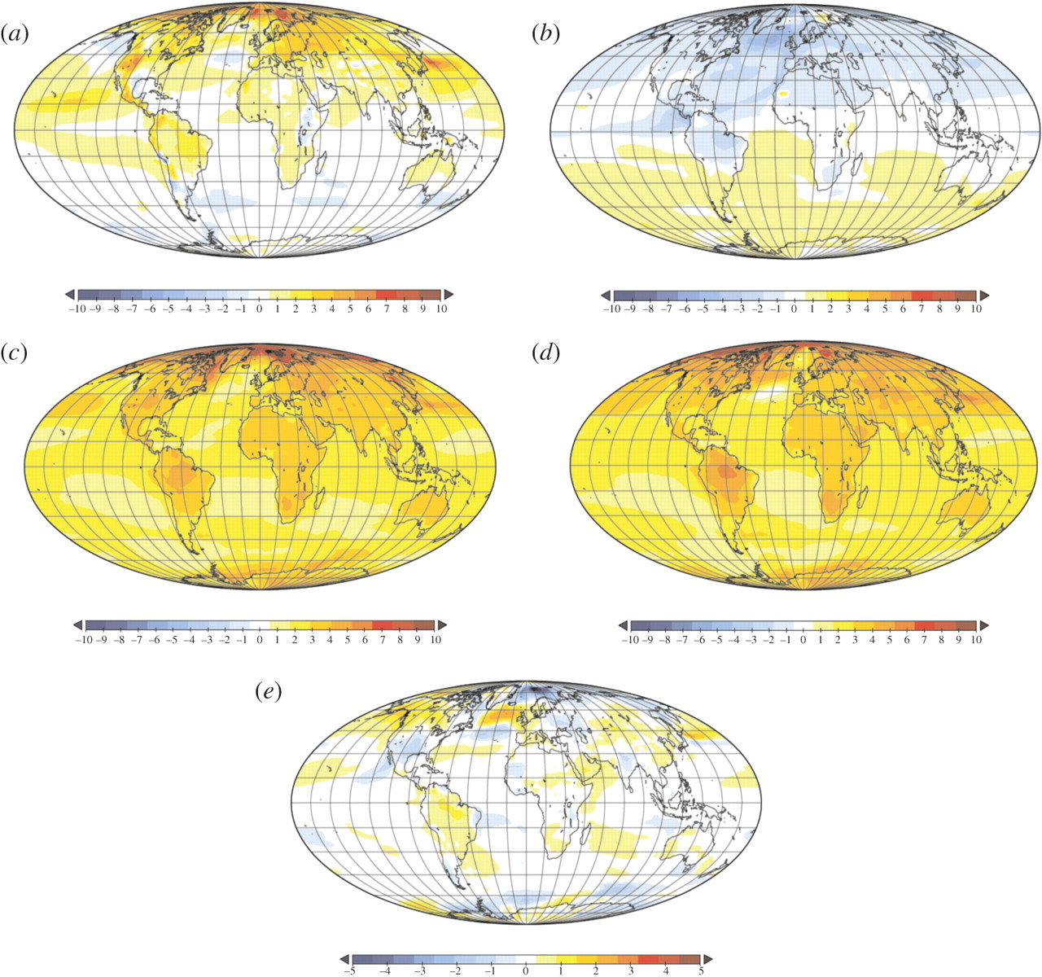
Analogue issues
HadCM3 sensitivity tests for the Pliocene:
SAT – Annual Mean (ºC)
American Cordillera
CAS
Pliocene ×2 CO₂
Pre-industrial ×2 CO₂
C minus D
Haywood et al. Phil. Trans. R. Soc. A 2011;369:933-956.
Notes:
HadCM3 sensitivity tests for the mPWP: (a) difference in annual mean surface air temperature (SAT; °C) between two experiments, one with the Western Cordillera of North and South America at modern height, the other reduced by 50%; (b) difference in annual mean surface air temperature between an open and closed Central American Seaway experiment; (c) difference in annual mean surface air temperature between a 560 and 280 ppmv CO2 simulation; (d) difference in annual mean surface air temperature between a future climate-change experiment (560 ppmv CO2) and an experiment for the pre-industrial era (280 ppmv CO2); and (e) difference between (c) and (d). (Online version in colour.)‏

Slide 4

Understanding processes/mechanisms/feedbacks

Slide 5
Talk content
This talk will focus on processes/feedbacks and mechanisms relevant to the oceans by reference to:
NH High latitudes/Arctic
Equatorial region and the El-Nino Southern Oscillation (stable water isotopes)
Palaeogeography and regional climate change

Slide 6
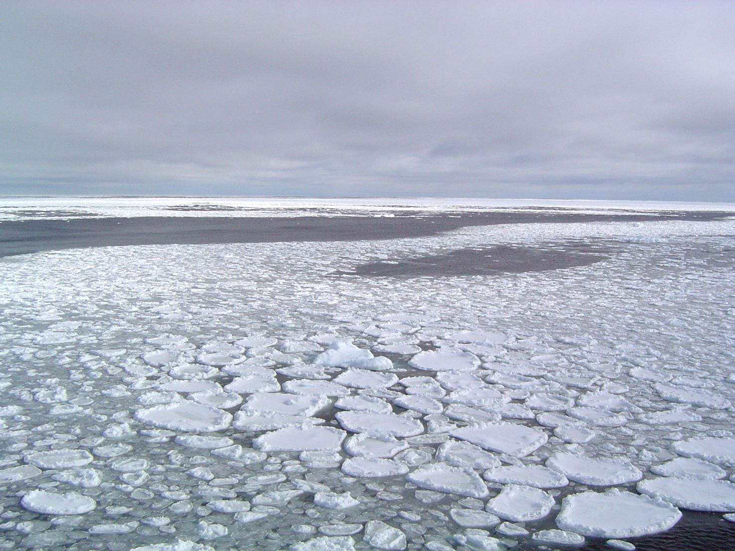

Slide 7
Specific questions
How well do climate models simulate high latitude change during the warm Pliocene?
What factors are important in model-predicted polar amplification?
3. How do simulations of Pliocene sea-ice change vis-à-vis the modern (pre-industrial)
4. What can be done to alter model predictions of sea-ice and therefore the magnitude of high latitude warming?

Slide 8
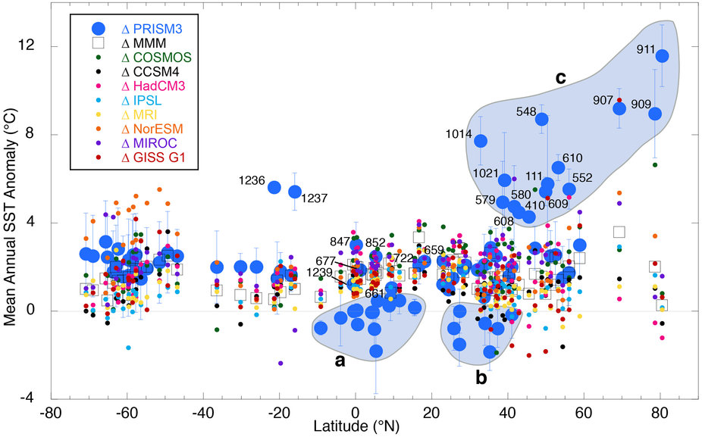
Data/model comparison - SSTs
Dowsett et al. (2013). Scientific Reports.

Slide 9
Consistent model results? – PlioMIP Phase 1
Surface Air temp. Annual Mean
SST. Annual Mean
Haywood et al. (2013). Hill et al. (2014), both in CP

Slide 10
Energy Balance Analysis –PlioMIP Phase 1
Hill et al. (2014). CP

Slide 11
Pre-Industrial and Pliocene sea-ice
Annual Cycle Ann. Cycle STD (extent/thickness) Relationships
Reduced sea-ice in the warm Pliocene.
Spread in model predicted sea ice extent twice as great for the Pliocene.
Correlation between predicted temperature and Pliocene Arctic sea ice twice as strong.
Howell et al. (2016) - CP

Slide 12
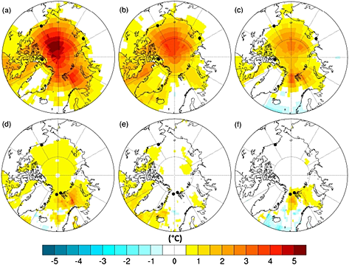
Temperature and sea-ice albedo relationships in the Arctic
New observations of Arctic sea-ice albedo.
Changing nature of sea-ice (multi-year/seasonal)
Is our model overly constrained by mid-20th Century observations?
Mean annual temperature (°C) anomalies (alternative minus standard) for Pliocene simulations with α_{min} values: (a and d) 0.2, (b and e) 0.3, and (c and f) 0.4. Standard α_{min} is 0.5.
Figures a–c show the SAT anomalies, with Figures d–f displaying SST anomalies.
Howell et al. (2014) Geophysical Research Letters
Notes:
Mean annual temperature (°C) anomalies (alternative minus standard) for Pliocene simulations with α_{min} values: (a and d) 0.2, (b and e) 0.3, and (c and f) 0.4. Standard α_{min} is 0.5. Figures a–c show the SAT anomalies, with Figures d–f displaying SST anomalies. Locations of data sites from Tables and are also shown.
IF THIS IMAGE HAS BEEN PROVIDED BY OR IS OWNED BY A THIRD PARTY, AS INDICATED IN THE CAPTION LINE, THEN FURTHER PERMISSION MAY BE NEEDED BEFORE ANY FURTHER USE. PLEASE CONTACT WILEY'S PERMISSIONS DEPARTMENT ON PERMISSIONS@WILEY.COM OR USE THE RIGHTSLINK SERVICE BY CLICKING ON THE 'REQUEST PERMISSIONS' LINK ACCOMPANYING THIS ARTICLE. WILEY OR AUTHOR OWNED IMAGES MAY BE USED FOR NON-COMMERCIAL PURPOSES, SUBJECT TO PROPER CITATION OF THE ARTICLE, AUTHOR, AND PUBLISHER.

Slide 13
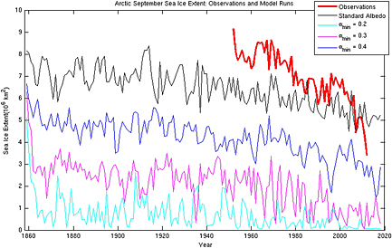
Impact on simulated sea-ice trends
Howell et al. (2014) Geophysical Research Letters

Slide 14
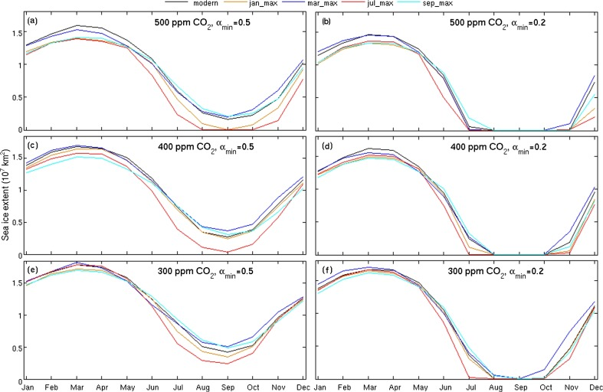
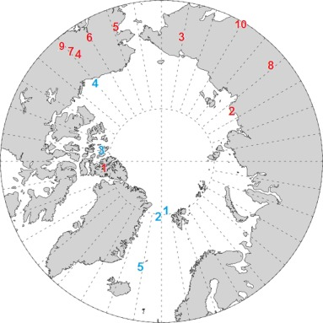
A number of other variable to play with
(orbit and CO₂ in concert with albedo)
Howell et al. (2016) - EPSL

Slide 15
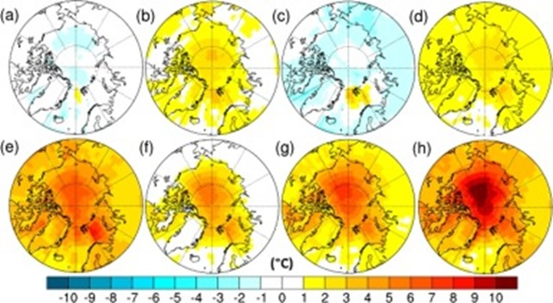
Impact on simulated high latitude temperatures
Mean annual SAT (°C) anomaly (alternative minus control) for various combinations of forcings etc.

Slide 16
Conclusions – Arctic
Warming amplified in the high latitudes of the NH
Clear sky albedo and CO₂ primarily responsible
Spread in model response
Models more consistent for pre-industrial sea-ice extent than Pliocene sea-ice extent
Seasonally sea ice free in 4/8 models
Uncertainty in sea-ice albedo/temperature relationships can alter a models response
Uncertainties in CO₂ forcing, orbital forcing also very important and change can drastically change model predictions

Slide 17


Slide 18
Specific questions
How was the structure of El Niño different in the Pliocene? (2500 year HadCM3 simulation)
What are the reasons for these differences? (including relationship with the Pacific Decadal Oscillation)
What would Pliocene El-Niño look like in marine proxy data?
4. Which regions provide a good representation of Pliocene El Niño?
HadCM3 temperature
Transfer function
Modelled δ¹⁸O_{c}
HadCM3 δ¹⁸O_{sw}

Slide 19
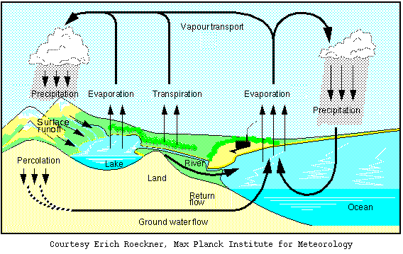
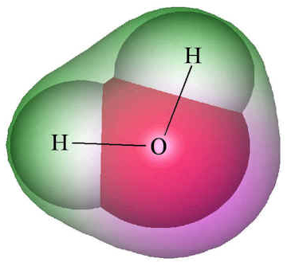
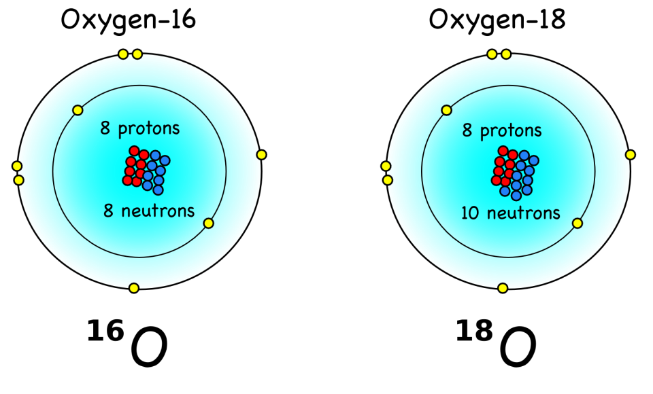
The modelling ➔ water isotopes
HadCM3 coupled atmosphere-ocean – water isotope GCM
δ¹⁸O
Notes:
Check reasonable vs observations.

Slide 20
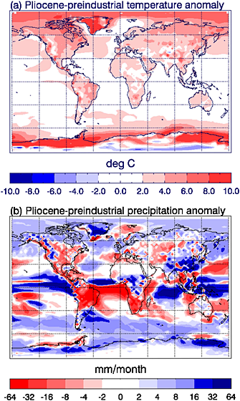
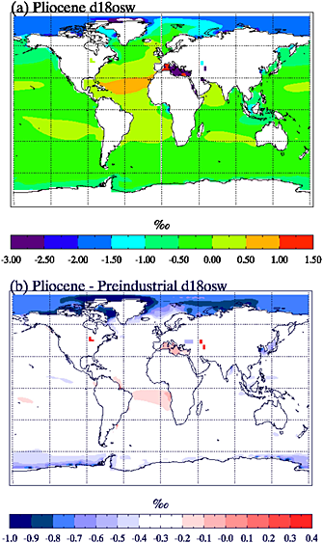
Modelling oxygen isotopes in the Pliocene: Large‐scale features over the land and ocean
Tindall, J.C. & Haywood, A.M. (2015). Paleoceanography Volume 30, Issue 9, pages 1183-1201, 20 SEP 2015 DOI: 10.1002/2014PA002774.
Notes:
(a) Modeled Pliocene‐preindustrial temperature anomaly and (b) modeled Pliocene‐preindustrial precipitation anomaly.
IF THIS IMAGE HAS BEEN PROVIDED BY OR IS OWNED BY A THIRD PARTY, AS INDICATED IN THE CAPTION LINE, THEN FURTHER PERMISSION MAY BE NEEDED BEFORE ANY FURTHER USE. PLEASE CONTACT WILEY'S PERMISSIONS DEPARTMENT ON PERMISSIONS@WILEY.COM OR USE THE RIGHTSLINK SERVICE BY CLICKING ON THE 'REQUEST PERMISSIONS' LINK ACCOMPANYING THIS ARTICLE. WILEY OR AUTHOR OWNED IMAGES MAY BE USED FOR NON-COMMERCIAL PURPOSES, SUBJECT TO PROPER CITATION OF THE ARTICLE, AUTHOR, AND PUBLISHER.

Slide 21
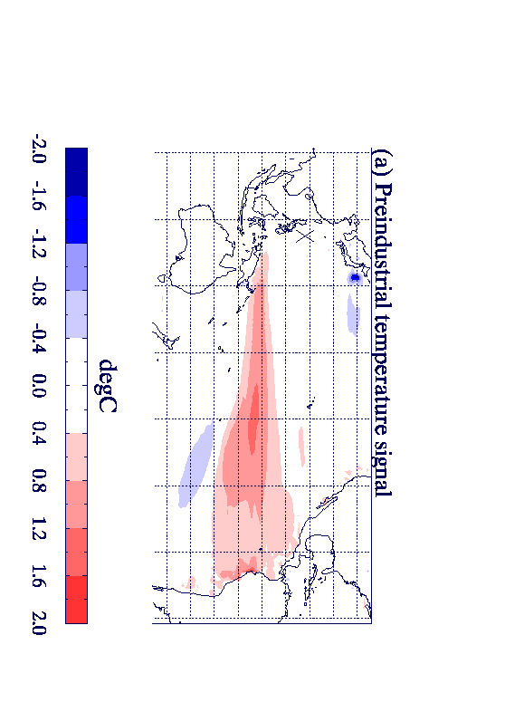
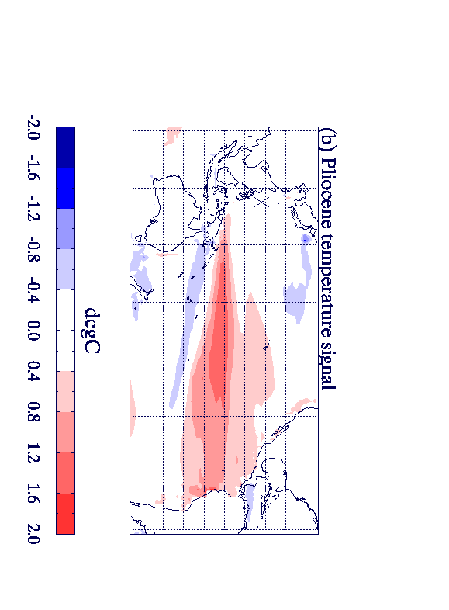
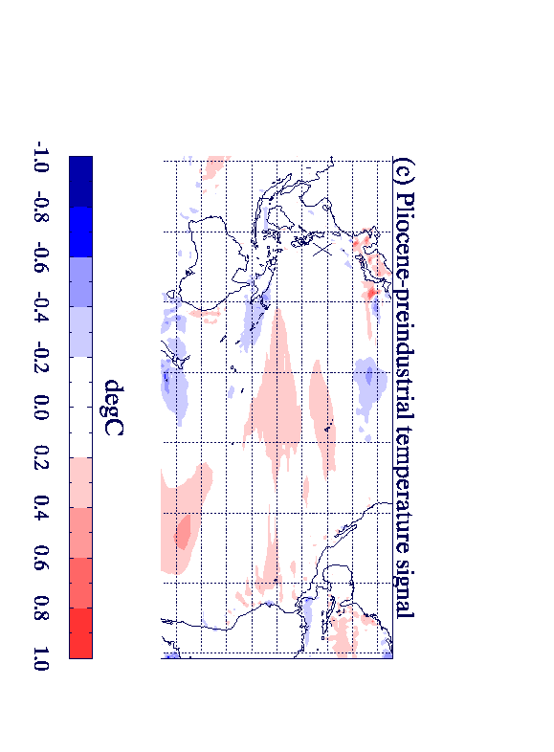
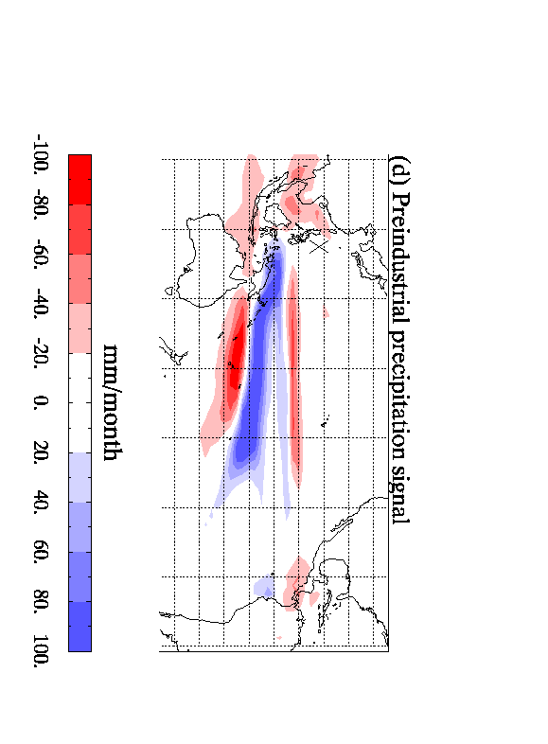
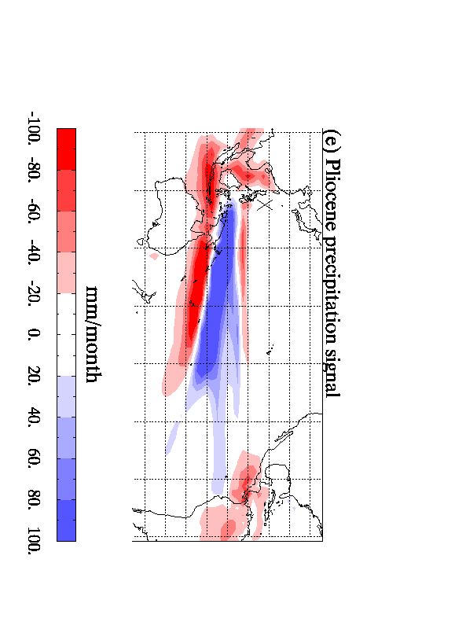
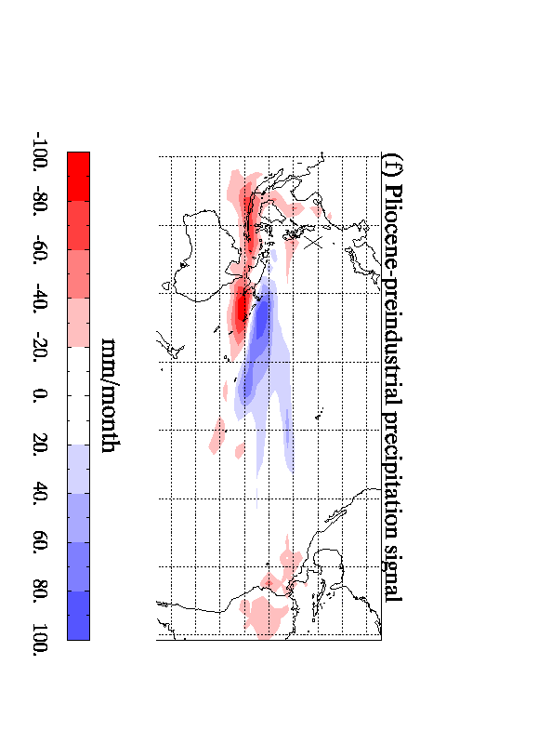
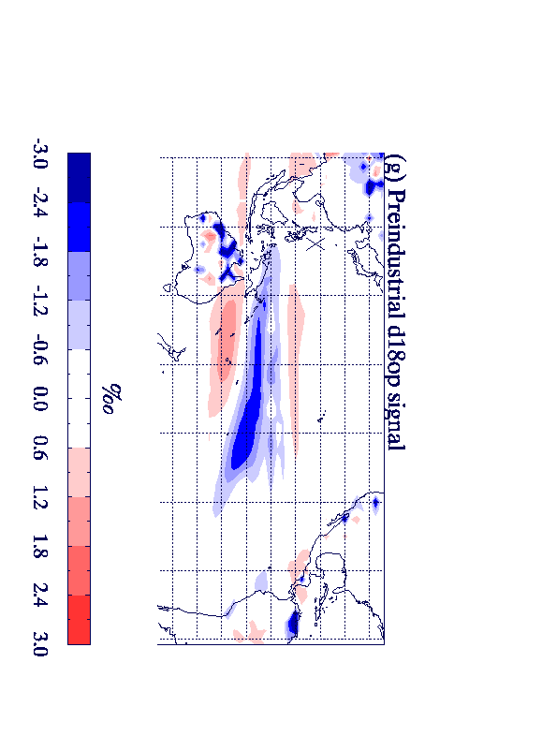
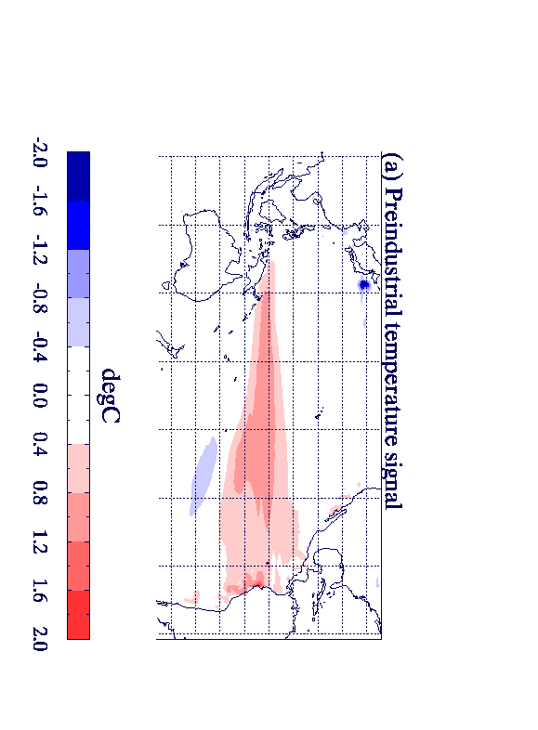
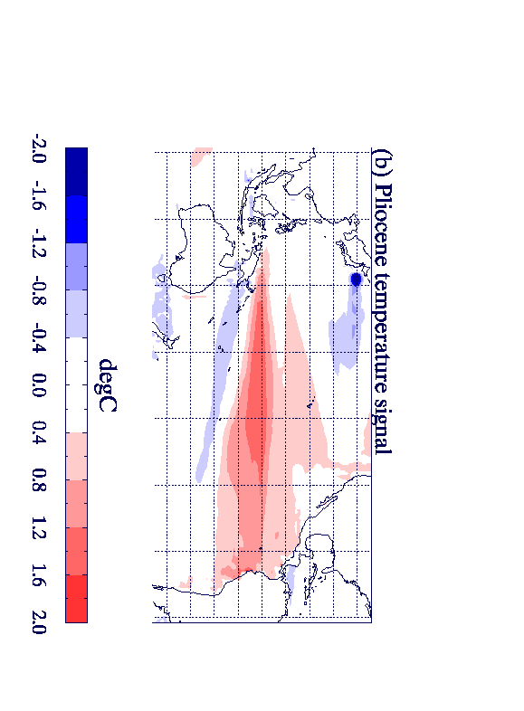
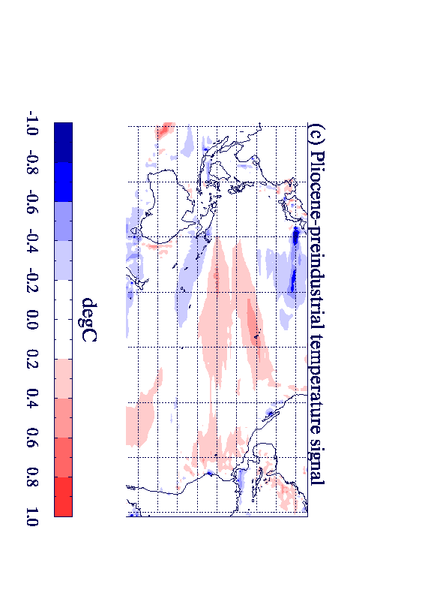
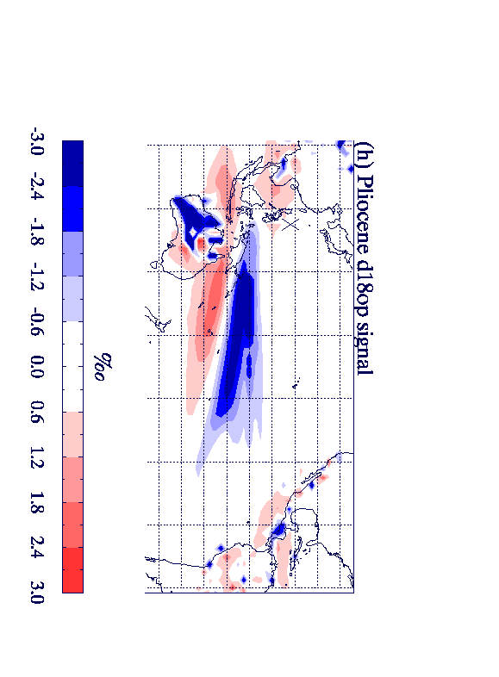
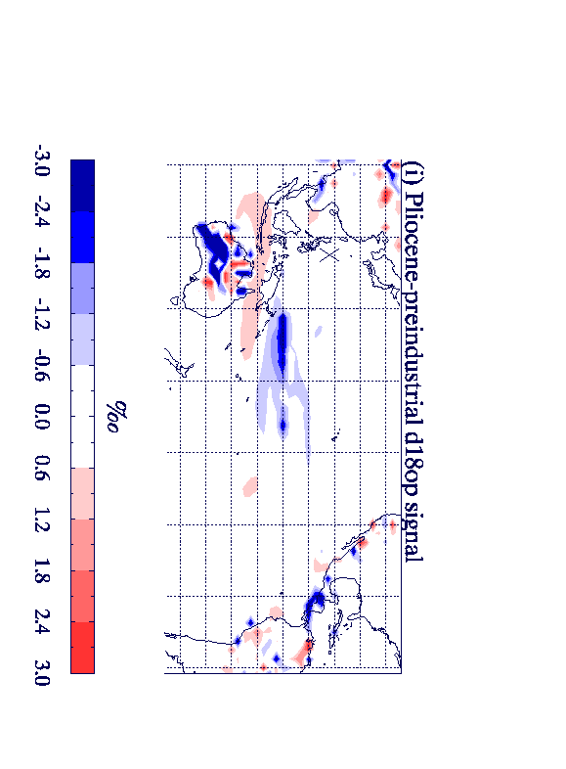
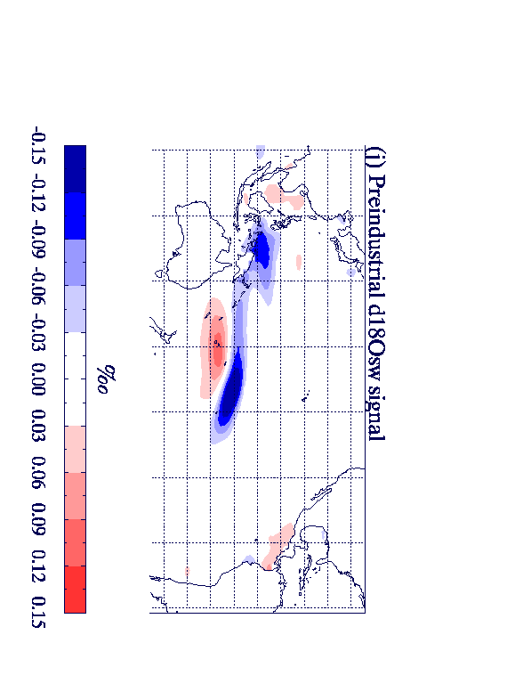
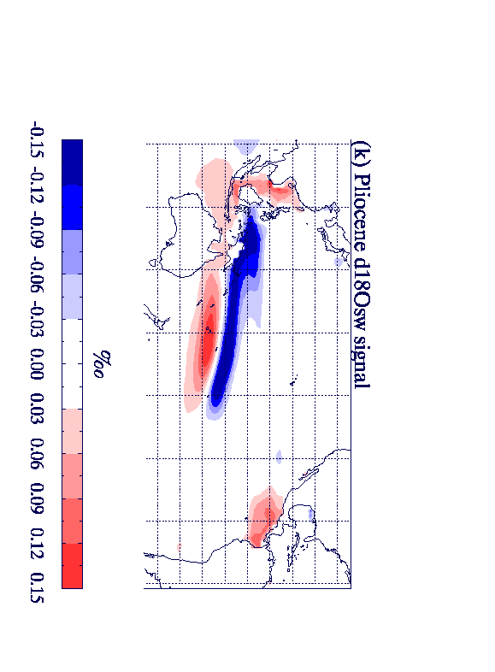
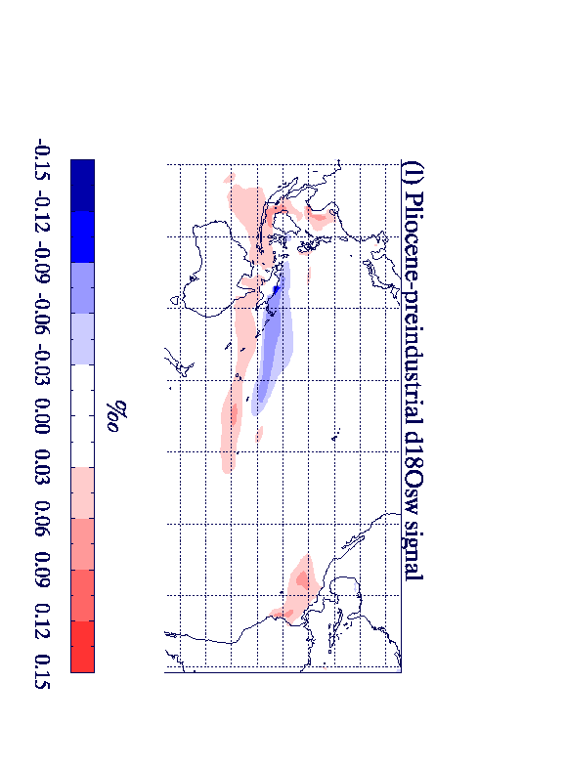
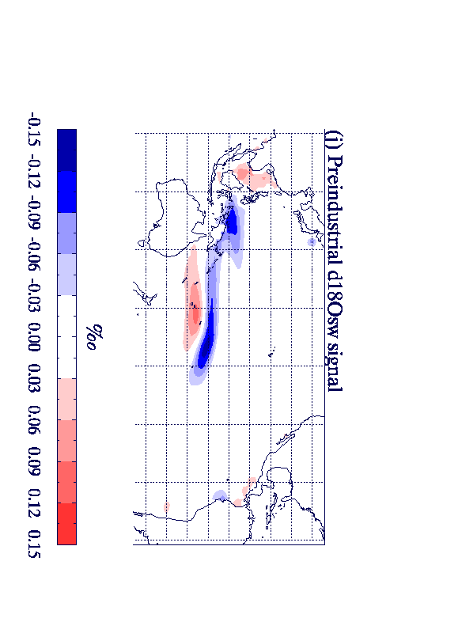
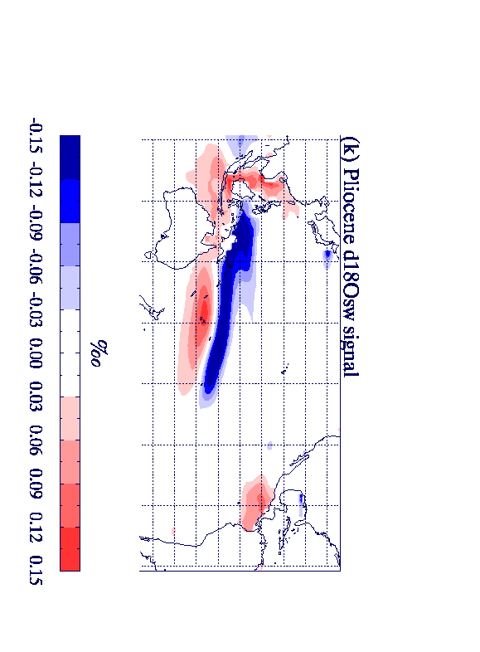
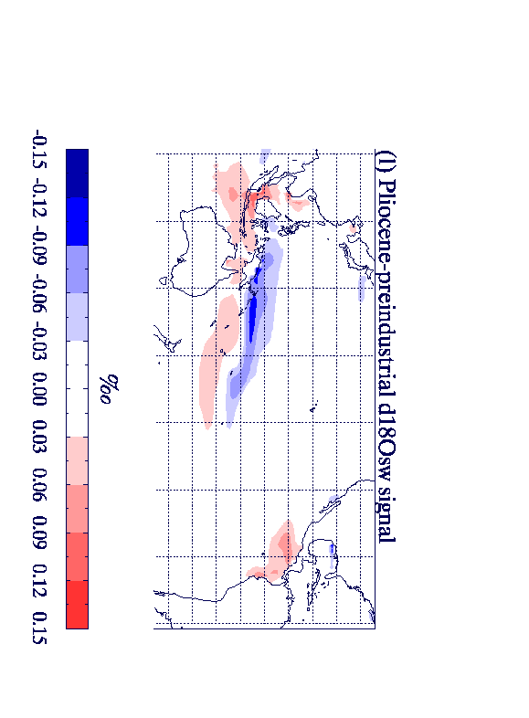
Structure of El Niño in HadCM3:
Temperature: Preind Temperature: Pliocene Temperature difference
δ¹⁸O_{sw}: Preind δ¹⁸O_{sw}: Pliocene δ¹⁸O_{sw}: difference
Tindall, J.C. & Haywood, A.M. (in review). Paleoceanography.
Notes:
Have changed this to M2 TIMESLICE 11 as it is clearer and fits in better with the rest of the presentation

Slide 22
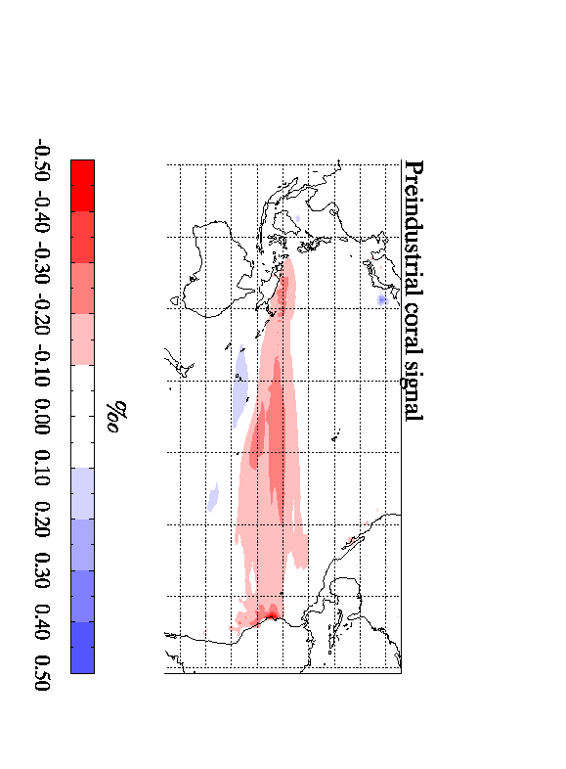
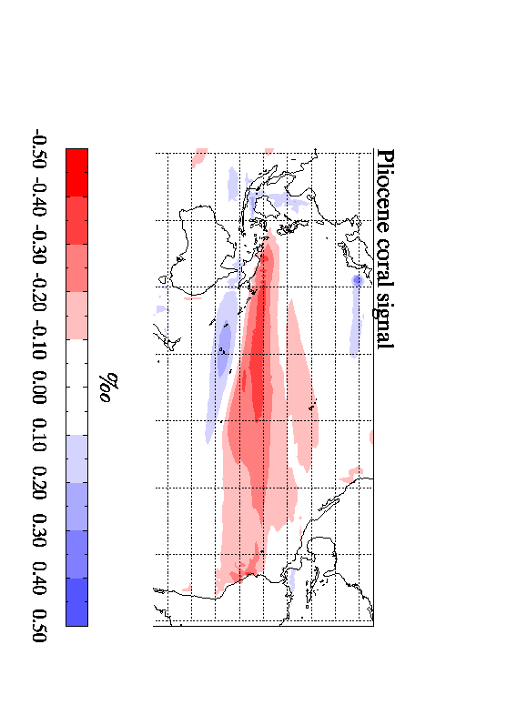
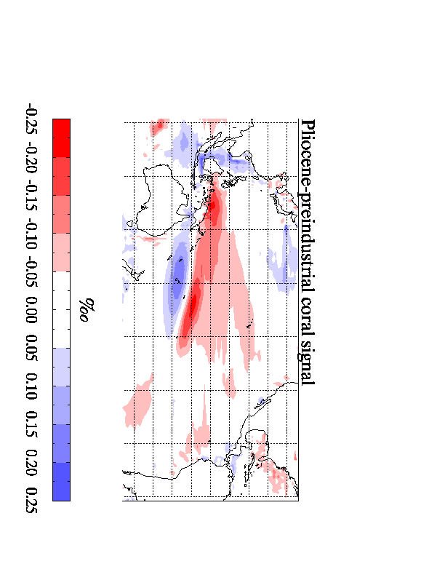
Structure of El Niño in HadCM3 (coral):
δ¹⁸O_{c}: Preind δ¹⁸O_{c}: Pliocene δ¹⁸O_{c}: difference
Temperature difference δ¹⁸O_{sw} difference
Notes:
The change in d18osw is mainly due to the hydrological cycle – which is stronger in the Pliocene (see extra slide1)

Slide 23
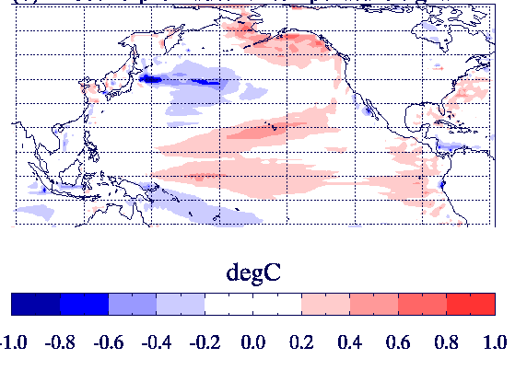
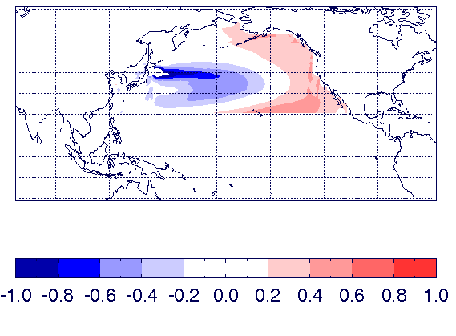
The Pacific Decadal Oscillation and its relationship with El Niño
El Niño temperature: Pliocene-preind
PDO : EOF1 of Pacific temp North of 20°N
The PDO is typically 15% stronger in the Pliocene simulation
Pliocene simulation has a stronger PDO-ENSO relationship
Caution: Centennial scale variability➔ relationship not constant
Notes:
PDO is about 15% stronger in the Pliocene simulation
The centennial scale variability means that although this is true in general it is possible to find centuries where this is not the case

Slide 24
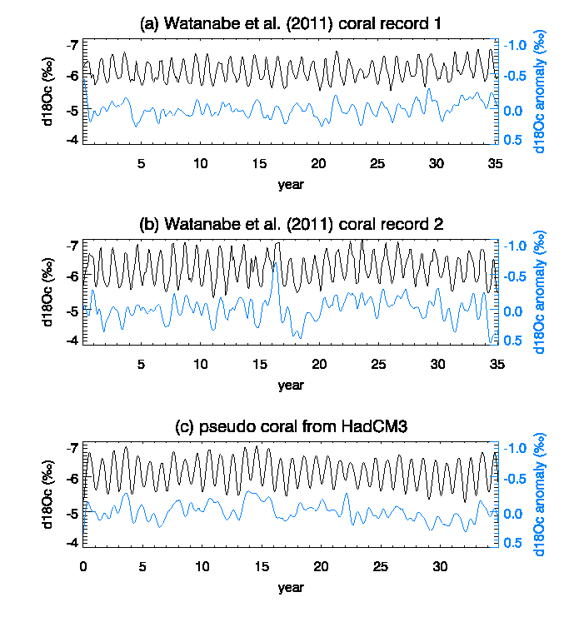
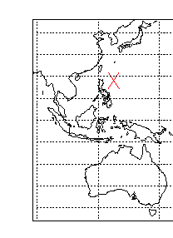
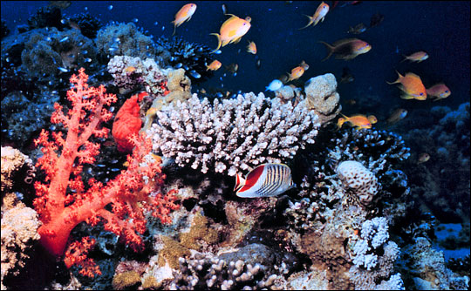
Model-data comparison for Pliocene coral

Slide 25
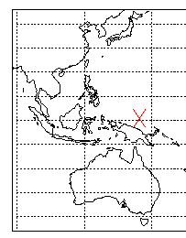
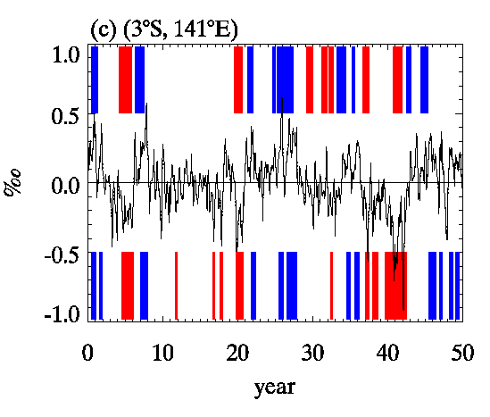
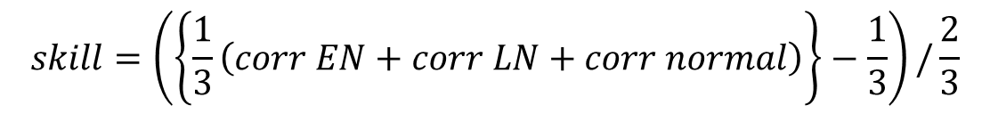
Can El Niño be detected in Coral data?
True/Target
El Niño/ La Nina events
⬅ HadCM3 ‘pseudo-coral’ at site
⬅ El Niño/ La Nina estimated from the ‘pseudo coral’
This ‘pseudo coral’ has a skill* of 0.71.
(Where 1.0 is perfect skill and 0.0 is random chance).
$$skill=\left(\left\{\frac{1}{3}\left(corr EN+corr LN+corr normal\right)\right\}−\frac{1}{3}\right)/\frac{2}{3}$$
Notes:
Put picture of site in here

Slide 26
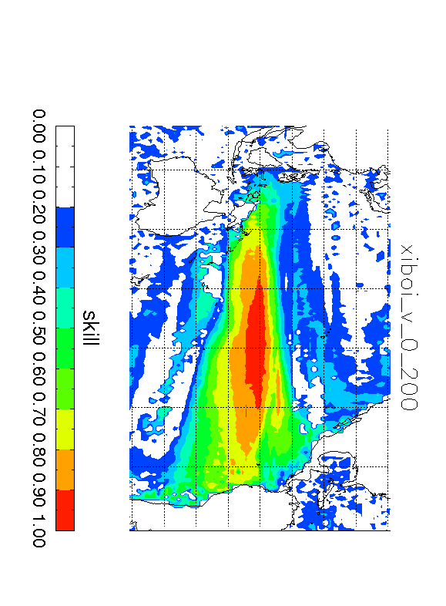
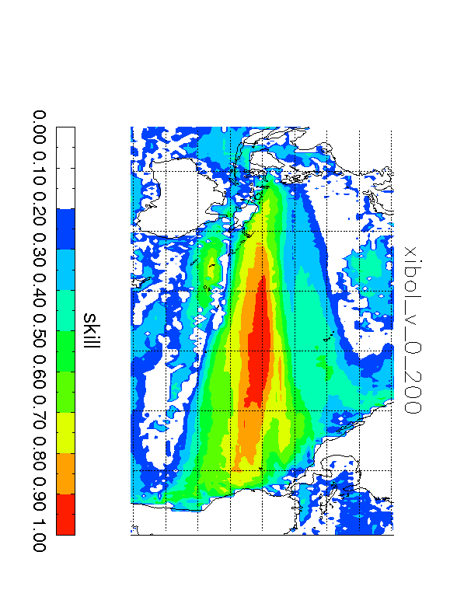
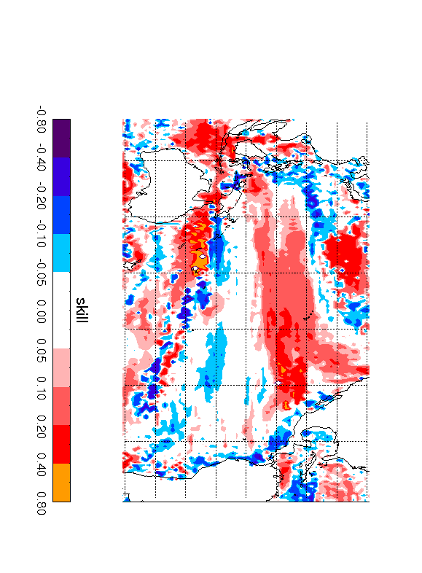
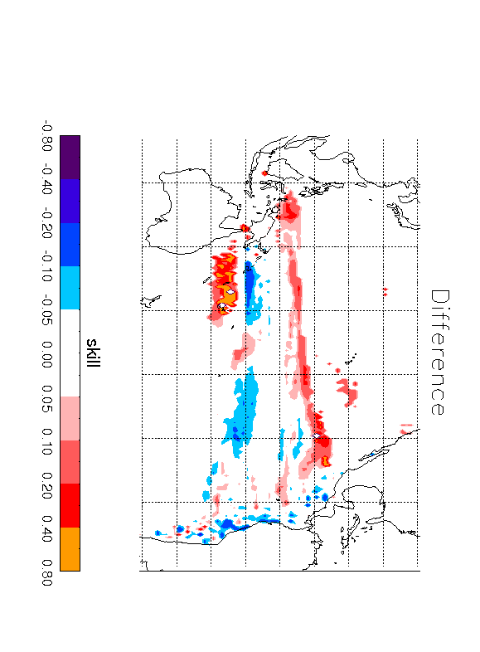
Where can El Niño could be detected in coral data? HadCM3 results.
Preindustrial skill Pliocene skill Difference
Difference in
high skill regions
Notes:
The difference in high skill regions shows regions where the skill is reasonable (>0.5) in either the Pliocene or the preindustrial, and there is a difference in skill between the two locations Note that the changes to the East of Australia are due to the intensification of the hydrological cycle. Changes north of the Equator are due to the expansion of the temperature signal
SKILL was calculated as follows:
X=(correctly detected elnino/total el nino) + (correctly detected lanina/total la nina) + ( correctly detected normal/total normal) ; allowing for 2 months margin or error
SKILL=((X/3)-0.33) / 0.66 ; to give a normalised skill between 0 and 1 and random chance producing a skill of zero.

Slide 27
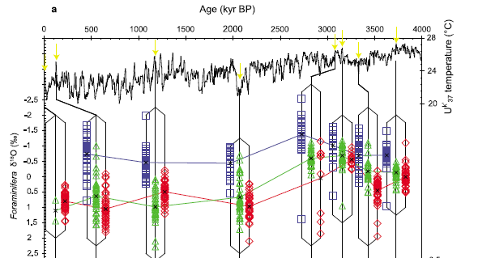
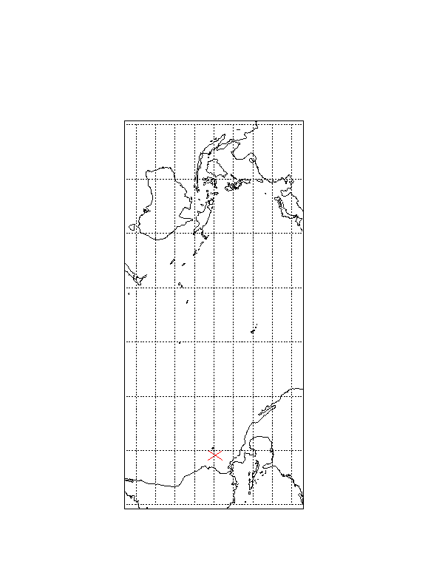
Can El Niño be detected in planktonic foraminifera data?
Age ma
Location 90W 3S
Data from Scroxton et al (2011)

Slide 28
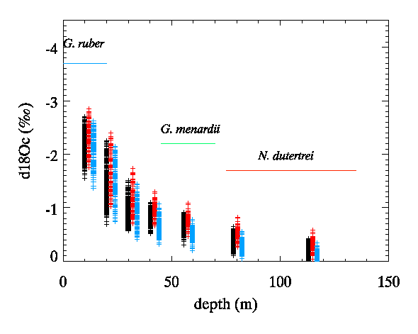
Results for the pre-industrial
Location 90W 3S
WARMER
COLDER
El Niño
La Nina

Slide 29

Results for the Pliocene
Location 90W 3S
WARMER
COLDER
El Niño
La Nina

Slide 30


Why are results different for the modern and the Pliocene at this location?
1. δ¹⁸O(seawater) is more variable in the Pliocene. In this region, δ¹⁸O(seawater) variability is not related to ENSO and so large δ¹⁸O (seawater) variability can contaminate the results
Pre-Industrial
Pliocene

Slide 31


Why are results different for the modern and the Pliocene?
2. The site is on the edge of an upwelling zone in the modern. In the Pliocene it lies between upwelling and downwelling zones meaning that interannual variability at this location can be large.
Pre-industrial
Pliocene

Slide 32
Where can El Niño be detected in individual planktonic foraminifera data? HadCM3 results

Slide 33
Conclusions - Tropics
In the Pliocene HadCM3 suggests El Niño events were:
  Stronger
  Temperature anomaly shifted to the West
  More strongly related to the PDO
El Niño events have a stronger signal in proxy data in the western half of the Pacific due to:
  Shift in temperature
  Intensification of hydrological cycle throughout tropics
Skill in predicting El Niño from proxy data can change between the Pliocene and preindustrial but is usually:
  Similar for coral data
  Better in the Pliocene for individual planktonic foraminifera data – to verify!

Slide 34
Challenges/Opportunities
Hill. D.J. (2015) – EPSL.

Slide 35
Challenges/Opportunities
Hill. D.J. (2015) – EPSL.

