Slide 1

The School of Earth and Environment, University of Leeds & an introduction to Palaeoclimate Modelling
Prof. Alan Haywood
Director of Research and Innovation

Slide 2


The City of Leeds
3rd largest city in the UK
  Student population over 70,000
One of the UK’s largest centres for business, legal and financial services
Excellent transport links
  Just over 2 hours from London by train
  International airports in Leeds and Manchester
Located in Yorkshire
  the happiest place to live in the UK
  centre in the North of England for sports, the arts, theatre, opera and music
  Bustling city within a short distance to beautiful countryside
Edinburgh
Manchester
Sheffield
London
Bristol

Slide 3
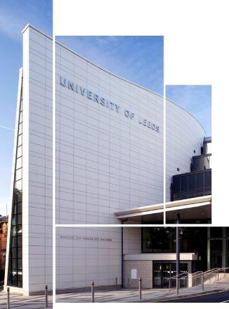
The University
Established in 1904, Russell Group University
One of the largest universities in the UK with over 32,000 students from over 145 countries
Over 500 Undergraduate and 300 Masters programmes
Top 100 University in the world (QS 2015)
Top 10 in the UK for Research (REF 2014)
Winner: Entrepreneurial University of the Year
(THE Awards 2015)
UK University of the Year
(Sunday Times 2017)

Slide 4
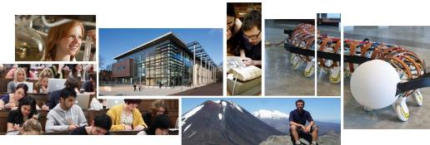
Faculties
Faculties
Arts
Business
Biological Sciences
Education, Social Sciences and Law
Engineering
Environment
Mathematics and Physical Sciences
Medicine and Health
Performance, Visual Arts and Communications
Faculty of Environment
Composed of the School of Earth and Environment, School of Geography and the Institute for Transport Studies.
Connected to several major cross University initiatives in:
  Water
  Food
  Energy
  Climate Change
  Sustainable Cities
  Petroleum Geology.

Slide 5
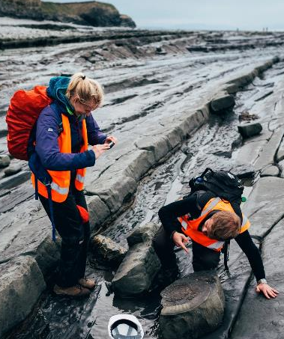
School of Earth and Environment
Integration of world-leading academic expertise in the geosciences with climate & sustainability research
Top 5 for Research Performance in UK
(REF, 2014)
Top 5 for academic reputation in Earth Sciences
(QS World University Rankings 2016)
Top 10 for academic reputation in Environmental Science
(QS World University Rankings 2016)
c.120 academic staff, over 150 research staff
c.250 PhD students enabling hands-on research opportunities
www.see.leeds.ac.uk

Slide 6
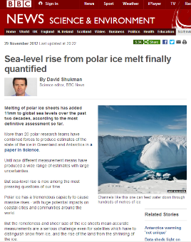





School of Earth and Environment
> £17 million in research income last year
Major transformational research: water@Leeds; Africa College; CCCEP; Energy; Partnership with the UK Met Office
Centre for the Observation and Modelling of Earthquakes, Volcanoes and Tectonics (COMET)
Centre for Polar Observation and Modelling (CPOM)
National Centre for Atmospheric Science (NCAS)
Petroleum@Leeds
Priestly International Centre for Climate Change
High impact stories in the media

Slide 7
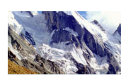
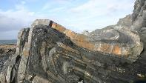
Research
Our research is carried out within five institutes which represent our core research areas, but much of our work is cross-cutting, tackling complex global challenges such as climate change, energy security and natural hazard management.
Earth Surface Science Institute (ESSI)
Environmental geochemistry, reconstructions of past environments, biological evolution and extinction through Earth history, palaeoclimate and biochemical modelling, experimental, isotope and organic chemistry, and water and land quality.
Institute of Applied Geoscience (IAG)
The institute comprises six core research groups, covering Sedimentology, Hydrogeology and Engineering Geology, Petrophysics, Geomechanics and Reservoir Modelling, Basin Structure, Applied Geophysics and Minerals and Ore Geology.

Slide 8

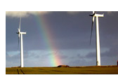

Research
Institute of Geophysics and Tectonics (IGT)
The Institute of Geophysics and Tectonics has a strong international profile in a wide range of disciplines including Geodynamics, Structural Geology, Geomagnetism, Geodesy, Seismology, Igneous and Metamorphic Petrology, Isotope Geochemistry, Hydrothermal Processes and Volcanology.
Institute for Climate and Atmospheric Science (ICAS)
ICAS is the UK’s most diverse academic institute for atmospheric research, making fundamental advances in our understanding of climate change, weather, atmospheric composition, palaeo-climates, and impacts on our planet and society.
Sustainability Research Institute (SRI)
The Sustainability Research Institute conducts internationally recognised, academically excellent and problem-oriented interdisciplinary research and teaching on environmental, social and economic aspects of sustainability.

Slide 9



ESSI: Earth Surface Science Institute
Evolution & maintenance of a habitable planet
Nutrient controls on oxygenation
Modern analogues of ancient environments
Origin and nature of mass extinction events throughout Earth history
Black shale formation and characterisation of low oxygen environments
The long-term evolution of ocean chemistry
Stable isotope geochemistry (C, S, N, O)
Biogeochemical modelling
Feedbacks between weathering, nutrients, oxygenation, climate on geological timescales
Box models, Earth System Modelling, and reaction transport modelling
Notes:
Seismic research focuses on the identification and separation of volcanic seismic signals and their attribution to distinct volcanic processes such as magma ascent, pressurisation and magma extrusion.
Deformation and InSAR to remotely monitor eruptions and magma movements within the crust.

Slide 10











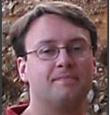

Modellers of
Palaeo@Leeds

Slide 11
Palaeo@Leeds modelling
“We conduct fundamental and holistic research into the evolution of our planet’s climate and environment. Through a combination of data acquisition, data synthesis and numerical environmental and climate modelling, we use an examination of Earth History as a natural laboratory to understand the complex interactions and variability of our planet’s climate, environment and life support systems.”

Slide 12
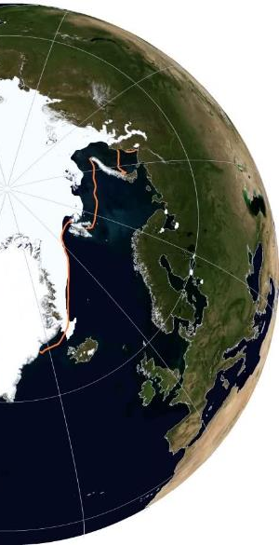
Palaeo@Leeds modelling
Global climate models
Atmosphere, ocean, land surface, sea ice
Hadley Centre (FAMOUS, HadCM3, HadGEM)
Cryosphere models
Ice sheets, icebergs
BASISM, GLIMMER/BISICLES, Bigg et al. iceberg model
Biosphere models
Biomes, ecosystems
BIOME4, Madingley Model, wetlands
Carbon models
Methane hydrates, geological carbon cycle
Methane hydrates, COPSE/GEOCARB
Notes:
Although climate models are our primary tool we also use a wide range of other Earth system models

Slide 13
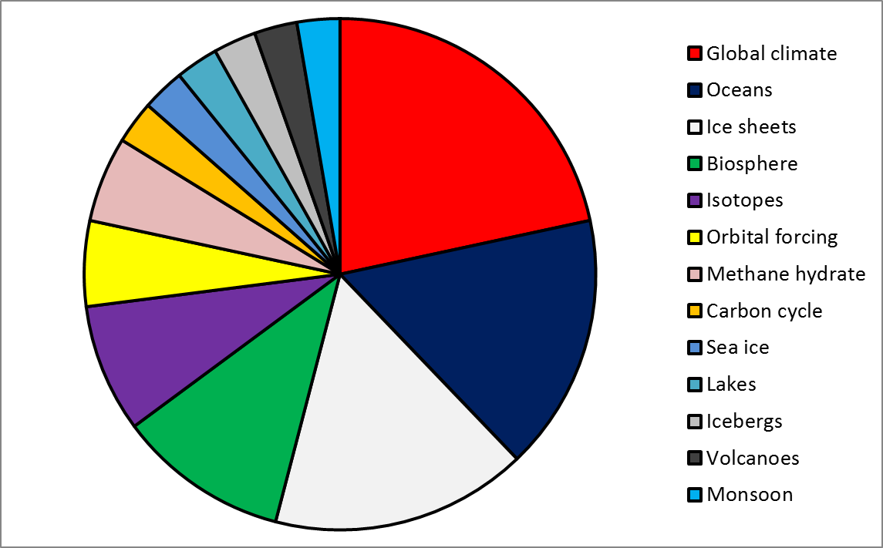
Palaeo@Leeds modelling
Earth System Components Studied
Notes:
This is an analysis of the papers we have published in the last few years showing that over half our work is in climate, oceans and ice sheets, but that we also cover a whole range of other parts of the Earth system

Slide 14
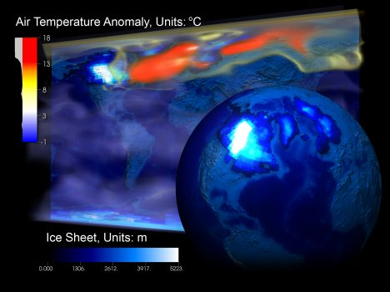
Introduction to Climate Models:
History & Basic Structure
Topics covered:
1. Climate models
2. Brief history
3. Parameterization
4. Uncertainties
5. Palaeo applications

Slide 15
Models in science
Models are of central importance in many scientific contexts:
the Bohr model of the atom,
the MIT bag model of the nucleon,
the Gaussian-chain model of a polymer,
the Lorenz model of the atmosphere,
the Lotka-Volterra model of predator-prey interaction,
the double helix model of DNA,
agent-based and evolutionary models in the social sciences,
In science we are are spend a great deal of time building, testing, comparing and revising models.
Models are one of the primary instruments of modern science.

Slide 16
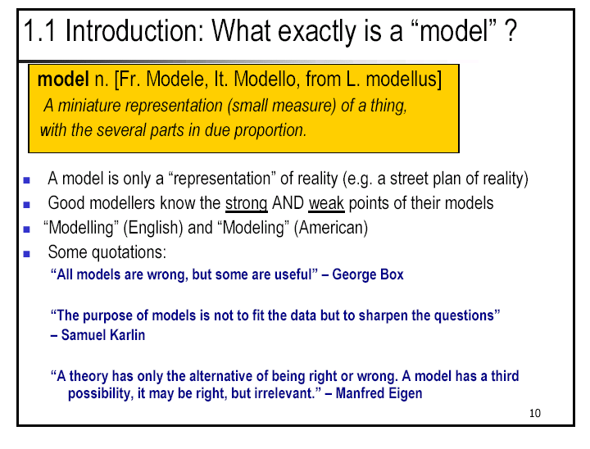
Definition and a healthy philosophy regarding climate modelling

Slide 17
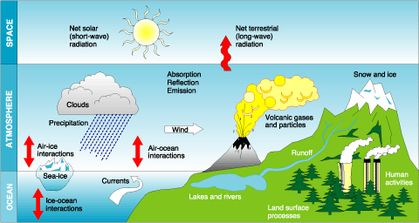
The Climate System

Slide 18
Brief History of Climate Modelling
1922: Lewis Fry Richardson
  basic equations and methodology of numerical weather prediction
1950: Charney, Fjørtoft and von Neumann (1950)
  first numerical weather forecast (barotropic vorticity equation model)
1956: Norman Phillips
  first general circulation experiment (two-layer, quasi-geostrophic hemispheric model)
1963: Smagorinsky, Manabe and collaborators at GFDL, USA
  9 level primitive equation model
1960s and 1970s: Other groups and their offshoots began work
  University of California Los Angeles (UCLA), National Center for Atmospheric Research
  (NCAR, Boulder, Colorado) and UK Meteorological Office
1990s: Atmospheric Model Intercomparison Project (AMIP)
  Results from about 30 atmospheric models from around the world
2007: IPCC Forth Assessment Report
  climate projections to 2100 from numerous coupled ocean-atmosphere-cryosphere
  models.

Slide 19
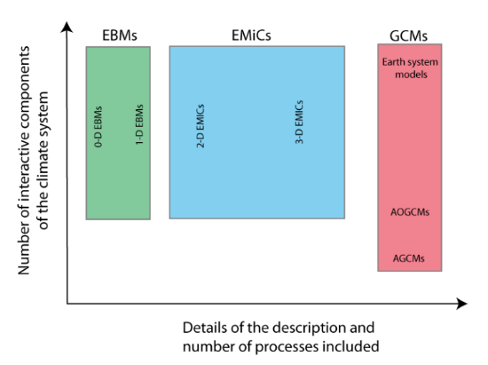
Types of Model
Energy Balance Models
Earth Models of Intermediate Complexity
General Circulation Models
Goose et al. (2010) – Online Textbook

Slide 20

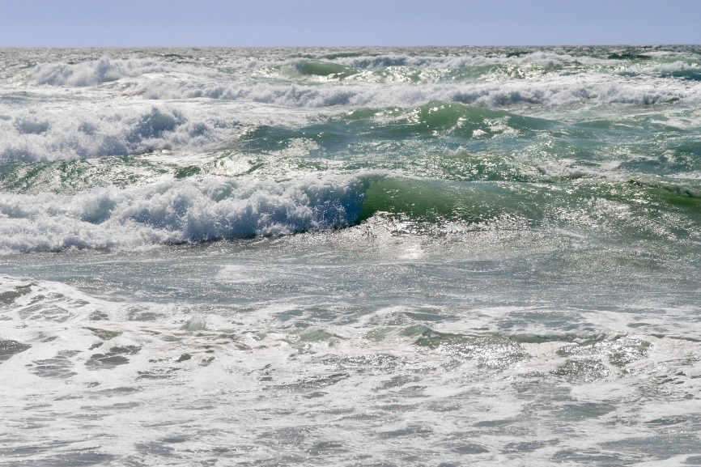
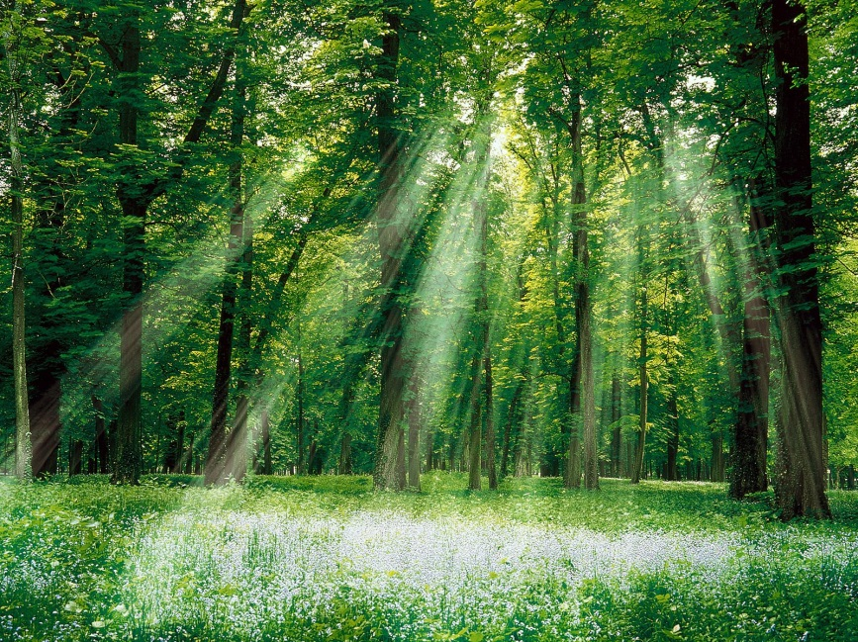
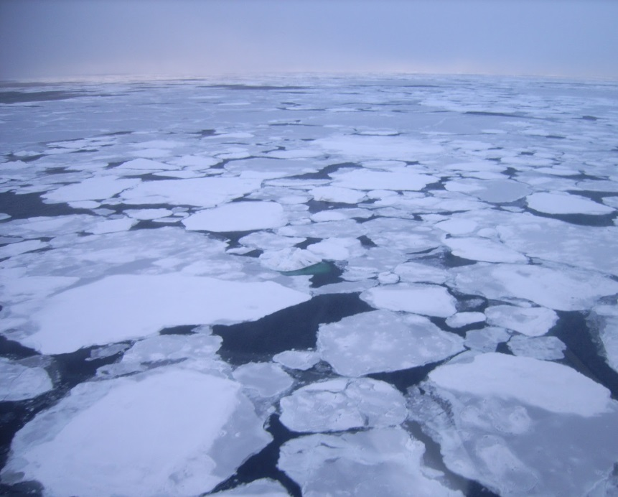
General Circulation Model’s (GCM) include:
Atmosphere
Ocean
Vegetation
Sea ice
Also can include: carbon cycle, aerosols, chemistry, biology, ice sheets, etc.
Notes:
From http://serc.carleton.edu/eet/envisioningclimatechange/part_2.html
20

Slide 21
Development of Met Office Models
Now
ATMOSPHERE
LAND
OCEAN
ICE
SULPHUR
CARBON
CHEMISTRY
1999
ATMOSPHERE
LAND
OCEAN
ICE
SULPHUR
CARBON
1997
ATMOSPHERE
LAND
OCEAN
ICE
SULPHUR
1992
ATMOSPHERE
LAND
OCEAN
ICE
Component models
are constructed off-line
and coupled in to the
climate model when
sufficiently developed
1988
ATMOSPHERE
LAND
OCEAN
1985
ATMOSPHERE
LAND
1960s
ATMOSPHERE
Notes:
6

Slide 22
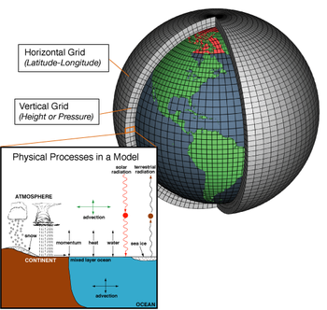
General Circulation Modelling (GCM)
Initial conditions, provided only at time=0
Temperature,
Pressure,
Humidity,
Clouds,
Winds etc.
Boundary conditions, provided throughout simulation can include:
Trace gases (e.g. CO₂)
Continental configuration
Solar forcing
Ice sheets
Notes:
96 * 73 *19 gridcells in atmosphere. ~150,000
Every 30 minutes

Slide 23
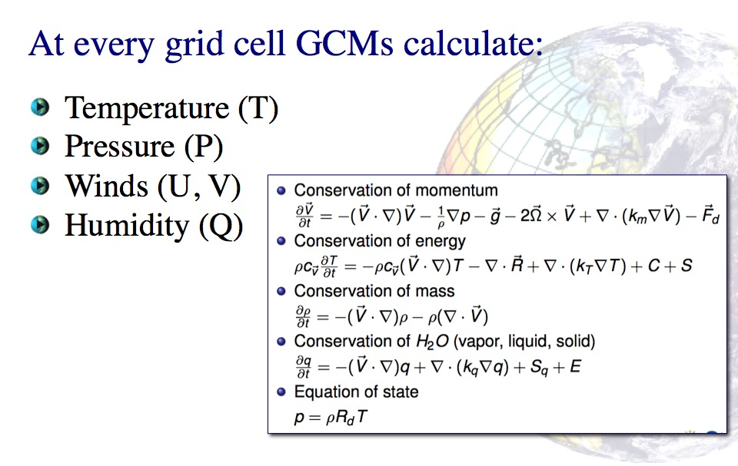
Fundamental Equations

Slide 24
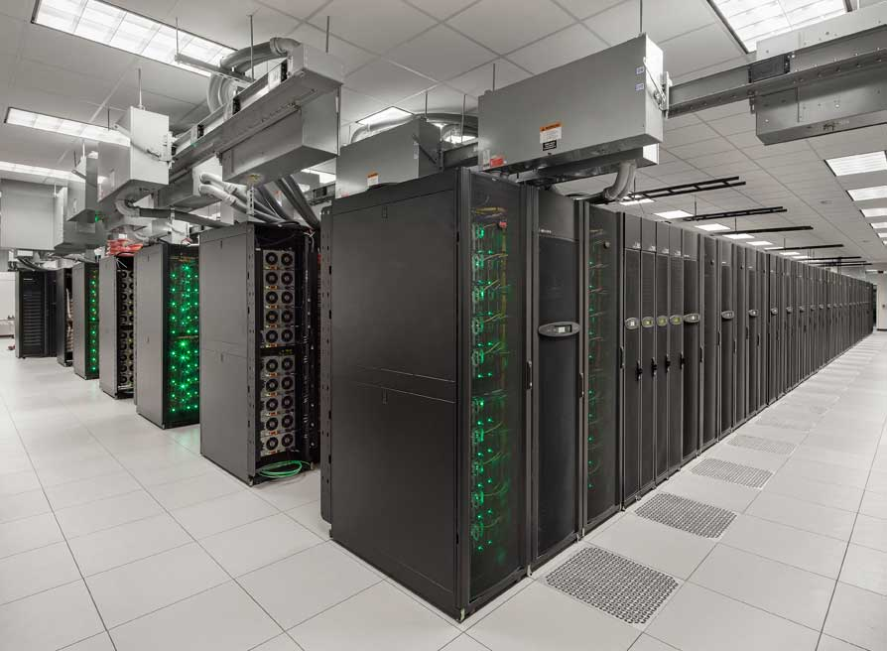
Supercomputers

Slide 25
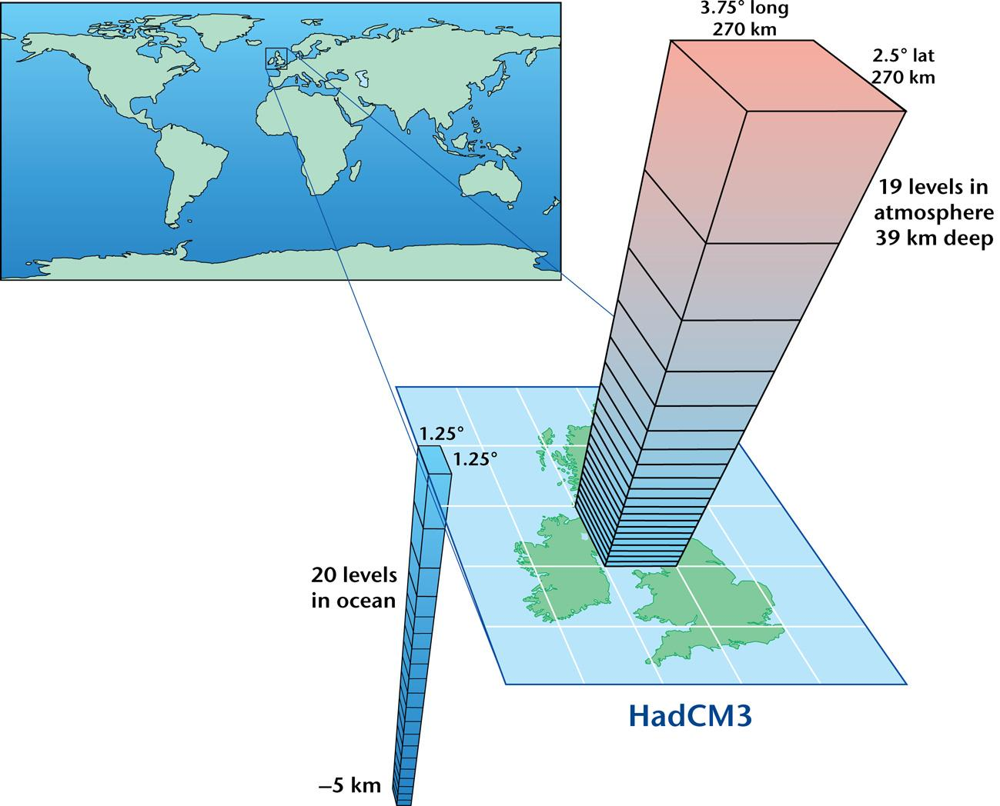
The Hadley Centre GCM – HadCM3
HadCM3 can produce >50 years of model simulation per day
Newer versions of the Hadley Centre Model are much slower ~2 years/day.

Slide 26
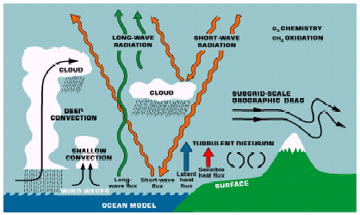
Parameterized processes in the ECMWF model

Slide 27
The horizontal and vertical resolutions of climate models need to be high enough to avoid numerical errors and to resolve the basic dynamical and transport processes.
There is a trade-off between resolution and computing time, but model resolutions are increasing continually, as more computer power becomes available.
There is also a trade off between model complexity and computer time.
Balancing Competing Demands

Slide 28
Primary Research Focus in Climate
Change Science
Simulation of the historical or near-historical record
Analysis of the observed record of variability
Projection for the next 100 years
Greatest Strengths
Spatial and temporal character of the Observations.
Measurement of physical quantities that define the state of the atmosphere and ocean.
Greatest Weaknesses
Sense of change.
Sense of the integration of the Earth System.

Slide 29
In contrast: A Research Focus in Earth History
Greatest Strengths
Spectacular sense of change (Furry Alligator Syndrome)
True integrated system response
Greatest Weaknesses
Proxies rather than state variables
Limited spatial and temporal resolution
“The greatest weaknesses in a research focus on the modern record are the greatest strengths of Earth System History”

Slide 30
Do models agree?
IPCC, AR5, Fig TS.14

Slide 31
Uncertainties
Regional patterns of change from different models are different
Source: IPCC Fourth Assessment Report

Slide 32
Models have less agreement for rainfall than temperature projections
MMM signal is not significant (within internal variability)
Signal is significant and models agree on sign of change
IPCC, AR5, Fig TS.16
Notes:
Figure TS.16: Maps of multi-model results for the scenarios RCP2.6, RCP4.5, RCP6.0 and RCP8.5 in 2081–2100 of average percent change in mean precipitation. Changes are shown relative to 1986–2005. The number of CMIP5 models to calculate the multi-model mean is indicated in the upper right corner of each panel. Hatching indicates regions where the multi model mean signal is less than one standard deviation of internal variability. Stippling indicates regions where the multi model mean signal is greater than two standard deviations of internal variability and where 90% of models agree on the sign of change (see Box 12.1). {Figure 12.22; Annex I}

Slide 33
Uncertainties
Models differ in their projection of dangerous events
Source: IPCC Fourth Assessment Report

Slide 34
Why do uncertainties exist?
Models have “errors” i.e. when simulating present-day climate and
climate change, there is a mismatch between the model and the
observations. Differences in model formulation can lead to
differences in climate change feedbacks.

Slide 35
Uncertainty
Uncertainty: The lack of certainty, A state of having limited knowledge where it is impossible to exactly describe the existing state, a future outcome, or more than one possible outcome.

Slide 36
How to deal with uncertainties?
Continue to improve models until global and regional projections converge | Climate change already happened by the time models converge Is convergence a useful indicator of reliability?
Use techniques other than comprehensive climate modelling | Cannot extrapolate from noisy (possibly non-existent) time series Simple models cannot provide all the information Climate change may not be linear
Combine information from climate models, observations (+ palaeo) and understanding to quantify the uncertainty in projections | Risk-based approached used in other disciplines where scientific uncertainties exist

Slide 37
Climate Change Projection/Retrodiction
In the presence of uncertainties in climate model
projections we can adopt a probabilistic approach
Sources of uncertainty:
  Initial conditions, natural variability
  Boundary conditions, emissions/concentrations of
  greenhouse gases and other forcing agents
  Model errors and uncertainty, different models giving
  different projections
Probabilistic climate projections (for e.g. 2100) cannot
be easily verified in the way that probabilistic weather
forecasts are. Challenges in the world of palaeo data/model
comparisons too.

Slide 38
Climate Change Projection/Retrodiction
…however, we can still use ensemble and probabilistic techniques
in climate change projection/retrodiction
Need a different strategy for generating the ensemble as initial
conditions are not the leading source of uncertainty
  The “multi-model” ensemble, MME
  The “perturbed-physics” ensemble, PPE
Need something in place of the verification cycle –
assume that models which are good at reproducing observed/palaeo
climate change are also good at simulating future climate change.

Slide 39
Multi-Model Ensemble
A collection of the world’s climate models, sometimes called an
“ensemble of opportunity”.
Currently coordinated by projects like CMIP-Coupled Model
Intercomparison Project and housed at PCMDI, California,
PMIP (LSCE, France).
A relatively large “gene-pool” of possible models, although it is
common to share some components
Models are “tuned” to reproduce observed data – although
formal tuning is not performed

Slide 40
Perturbed Physics Ensemble
Take one model structure and perturb uncertain parameters
and possible switch in/out different subroutines.
Can control experimental design, systematically explore and
isolate uncertainties from different components
Potential for many more ensemble members
Unable to fully explore “structural” uncertainties
HadCM3 widely used (MOHC and climateprediction.net) but
other modelling groups are dipping their toes in the water

Slide 41
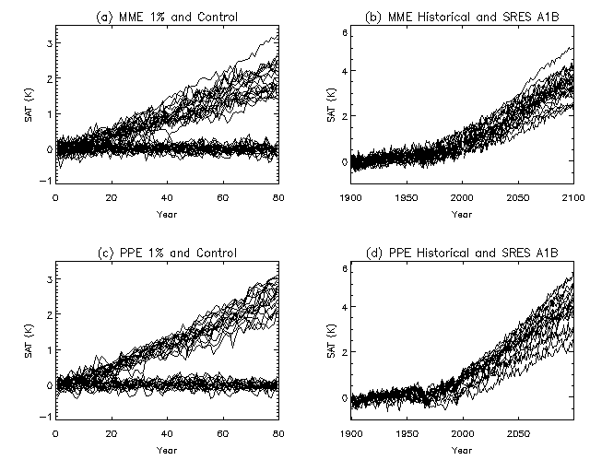
Comparison of MMEs and PPEs
Global mean temperature change in MMEs and PPEs under different scenarios
PPEs capable of sampling global response uncertainties

Slide 42
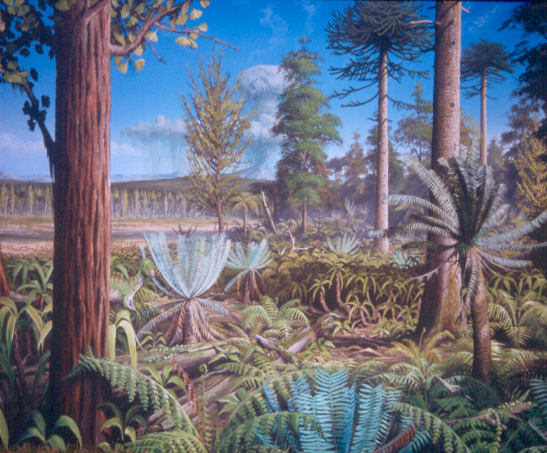
Cretaceous Climates & Ice-Sheets
Palaeobotanical
Evidence
Cretaceous forest 120
million years ago on the
Antarctic Peninsula.
reconstruction based
on PhD of Jodie Howe,
University of Leeds/BAS,
painted by Robert Nichols.

Slide 43
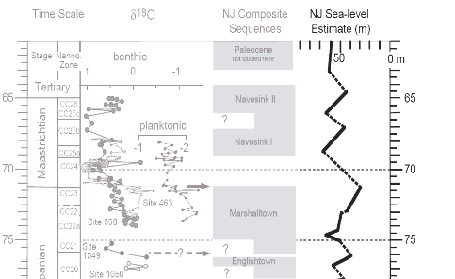
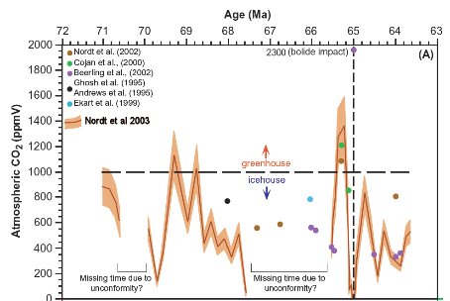
Evidence for large, rapid sea-level changes (Miller et al., 2005)
Evidence for eustatic nature
Pace and magnitude suggest glacial origin.
Suggest moderate-sized ice sheets (5 - 10 × 10⁶ km³ ).
Paced by Milankovitch forcing.
CO₂ levels through the Maastrichtian
2 greenhouse episodes 1000-1400 ppm
But suggestions of CO₂ low-points at ~70 and 66 Ma.
(Nordt et al., 2003; Beerling et al., 2002).

Slide 44
How to create a Maastrictian model
Change solar output ~0.6% less than present
CO₂ (and other gases) 4 x pre-industrial (but could be 2x to 8x.
Volcanic activity Assume same as today.
Change in orbit Same as present, but perform sensitivity simulations
Palaeogeography Including sea-level/ orography/ bathymetry/land ice
Previous modelling also required prescription of vegetation, and sea surface temperatures (or ocean heat transport) but this is no longer needed.

Slide 45
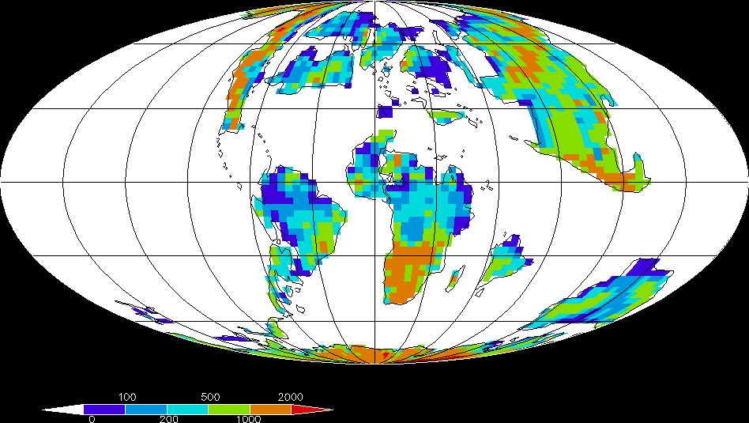
Maastrictian Orography
At climate model resolution. Original palaeogeographies from Paul Markwick

Slide 46
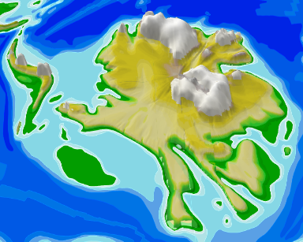
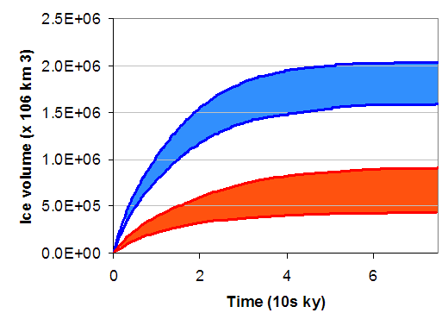
Ice Sheets in a Greenhouse World
Suite of HadCM3 derived palaeoclimates
  2, 4, and 6 x CO₂
  Further runs being carried out including 1 x CO₂
Comparison against climate proxy database
Climate then used to drive a BAS ice-sheet model.
2xCO₂
4xCO₂ + favourable orbit
2xCO₂ - ~ 2 x 10⁶ km³ ice

Slide 47
Summary
General Circulation Models are useful tools to understand climate
Whilst originally developed to improve our understanding of the system, they are now commonly used for climate prediction
However complex they still represent a simplified version of reality
Quantifying uncertainty is now a major scientific activity
Earth history can provide out of sample tests for climate models
Caution is needed in interpreting data/model discord
Model developments will improve the links between data and models
Models and data can be used to address big hypotheses proposed to understand the evolution of planets climate and environments.

Slide 48
