Slide 1
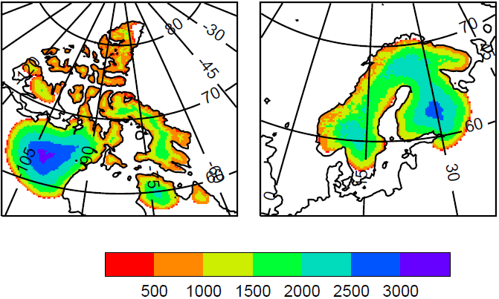
Simulating growth of ice sheets at the start of a glacial period
In order to study the interaction of climate and ice sheets, we use the FAMOUS AOGCM coupled to the Glimmer ice sheet model. Over several tens of millennia, ice sheets grow in NW America and Scandinavia, and they promote their own growth by cooling their local climate, because of their high albedo and surface altitude. There is a negative feedback at some ice-sheet margins due to anomalous anticyclonic circulation, reducing cloudiness and mitigating the cooling.
Thickness in metres of steady-state ice-sheets in two domains under constant orbital forcing and CO₂ of 115 ka ago, around the start of the last glacial period.
Gregory et al., 2012, Climate of the Past

Slide 2
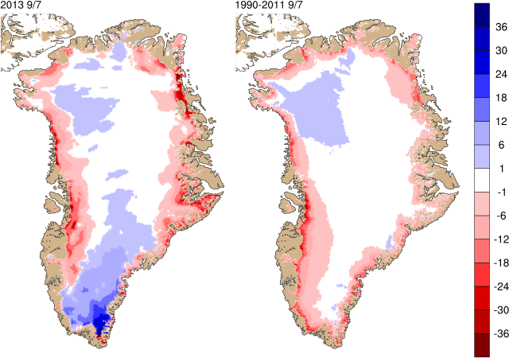
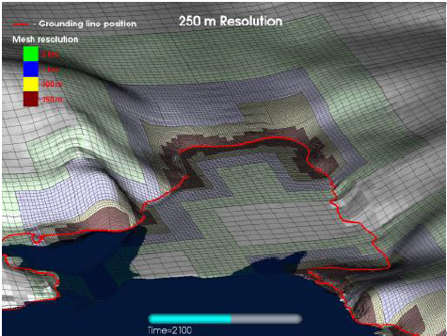
Next-generation climate—ice-sheet coupling for the Unified Model
Dynamic ice-sheets important in the Earth system on human timescales as well as paleoclimate
Mismatch of spatial/time resolution between ice-sheet and atmosphere /oceans makes coupled modelling a particular challenge
Coupling to Glimmer-CISM and BISICLES is in development
mm/day
Daily surface mass balance for Greenland compared to the last decade from the DMI regional model (beta.dmi.dk/en/groenland/maalinger/greenland-ice-sheet-surface-mass-budget)
Pine Island Glacier, Antarctica, simulated on the adaptive mesh of the BISICLES ice-sheet model

Slide 3
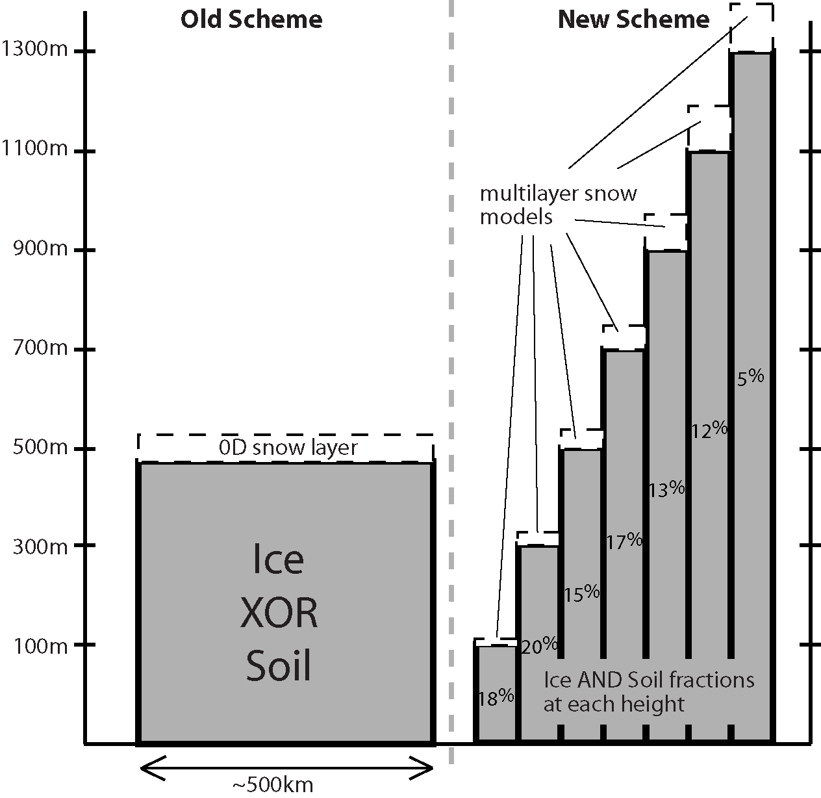
Next-generation climate—ice-sheet coupling for the Unified Model
Within NCAS, new scheme to explicitly model surface mass balance within JULES has been developed
Allows conservation of water/energy between climate and ice-sheet models
Subgridscale orography with multilayer snowpack models with prognostic albedo, refreezing of surface melt according to the density profile
Currently being evaluated in FAMOUS, HadRM3. Will be implemented in
UK-EMS1

Slide 4
Modelling δ¹⁸O with the HaCM3 coupled atmosphere ocean GCM
Useful for:
Interpreting palaeodata
Understanding the hydrological cycle (including attribution of recent changes)
Model assessment and validation

Slide 5
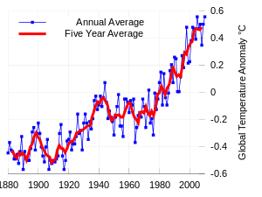
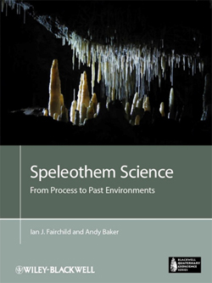
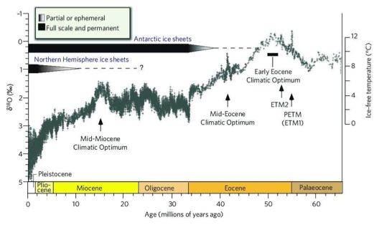
Understanding past climates
Instrumental record 1880-present
δ¹⁸O from Greenland ice cores (last 250ka)
δ¹⁸O from deep sea dwelling foraminifera
Notes:
Prior to 1850 there are no observational records of climate.
If we want to understand climate prior to that time we need to use proxy data.
The most abundant source of proxy data for past climates is d18o in various archives – the most well known is ice cores which record d18o in precipitation directly – but d18o can also be measured in many other archives such as foraminifera, coral, lake sediments, speleothems – providing information about the climate over timescales of millions of years.

Slide 6
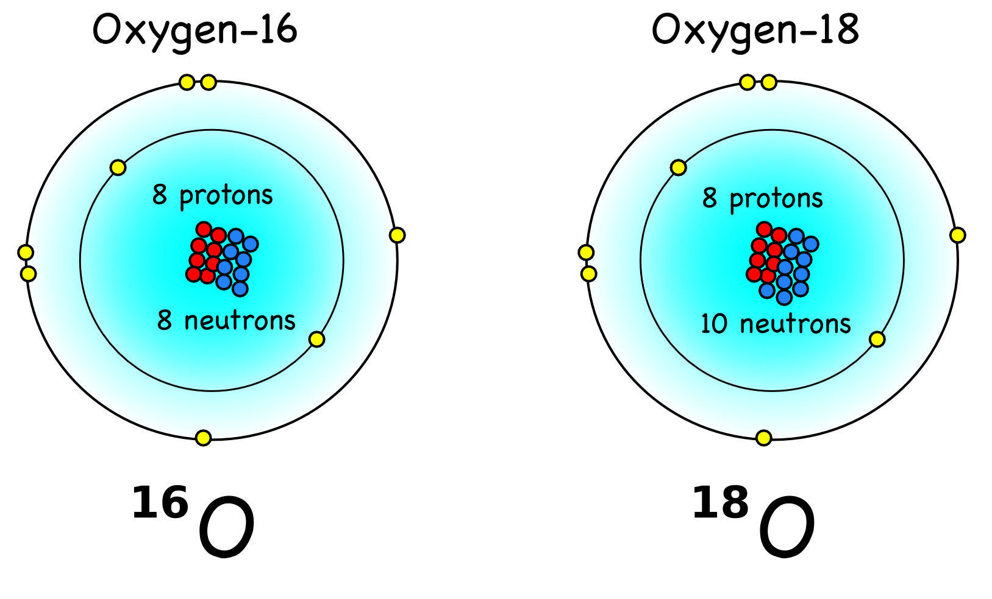
What is δ¹⁸O?
All natural waters contains some oxygen-16 and some oxygen-18.
Anything which incorporates water will incorporate some oxygen-16 and some oxygen-18.
δ¹⁸O is a measurement
of the relative amounts of
oxygen-16 and oxygen-18.
Different values of δ¹⁸O are expected for different climates.
Notes:
Optional slide – depending on exactly how much background you think is needed – and how much time you have.

Slide 7
Interpreting δ¹⁸O records.
Need to know δ¹⁸O_{seawater} (for marine proxies) or how to interpret δ¹⁸O_{precipitation} (for terrestrial proxies).
BUT we have reasonable knowledge of the processes that control δ¹⁸O throughout of the hydrological cycle
Add δ¹⁸O to the hydrological cycle of a GCM – which can predict δ¹⁸O_{precip} and δ¹⁸O_{seawater}
HadCM3 + δ¹⁸O GCM.
Notes:
This slide is about how we can incorporate into the hydrological cycle of a GCM

Slide 8
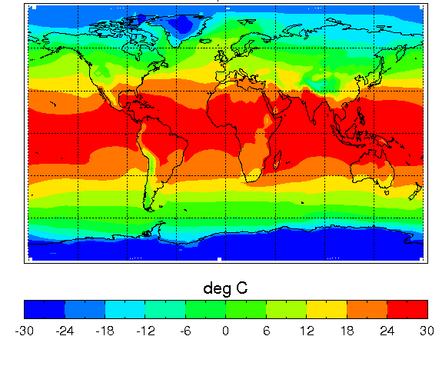
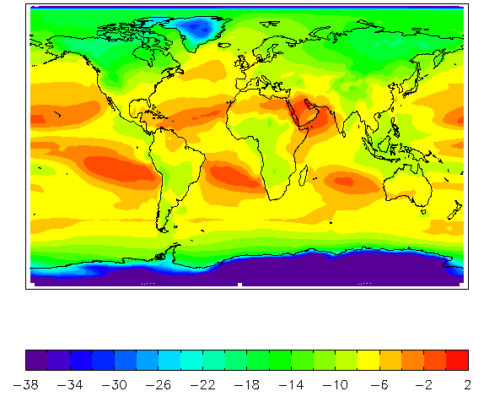
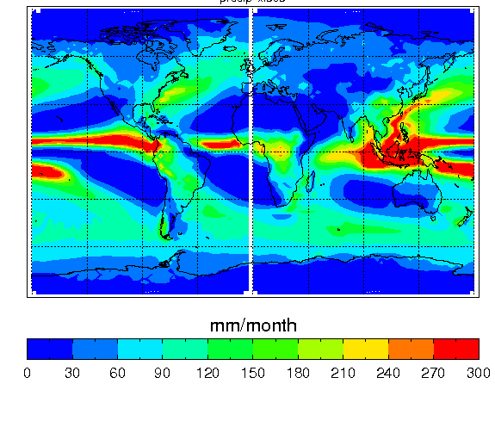
How does δ¹⁸O in precipitation relate to climate?
d¹⁸O_{p} (‰)
Notes:
This is the slide for the modern spatial relationships from HadCM3
It is clear that d18op is directly related to temperature at high latitudes and inversely related to precipitation in the tropics.
However the relationships are not exact and may change at different locations and for different time periods – hence we need an isotope enabled GCM to help interpret the paleodata in a more accurate way.

Slide 9
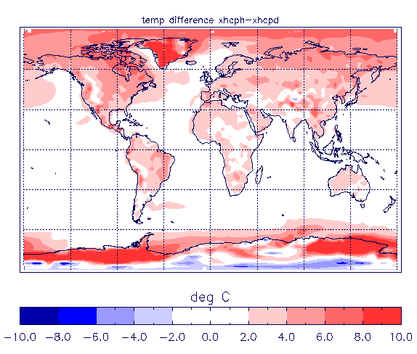
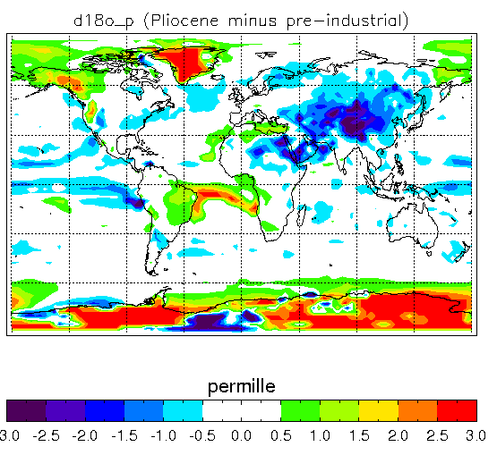
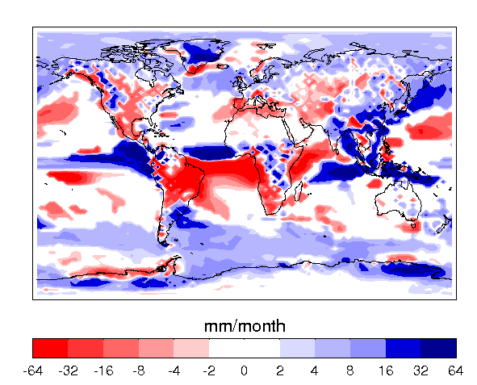
Temperature (Pliocene-Pre-Ind)
δ¹⁸Ο_precipitation (Pliocene-Pre-Ind)
Precipitation (Pliocene-Pre-Ind)
δ¹⁸O_{precipitation} is related to temperature at high latitudes and inversely related to precipitation in the tropics.
But reality it is more complex.
Notes:
MAY NOT WANT TO USE THIS NOW WE HAVE THE MODERN SLIDE
Pliocene d18o anomalies, temperature anomalies and precipitation anomalies.
Can see the relationship between d18op and temperature at high latitudes and inverse relationship between d18op and precipitation at low latitudes. These relationships would look clearer on a modern plot – however, this Pliocene plot highlights how the relationships are not always direct and related to local patterns.

Slide 10
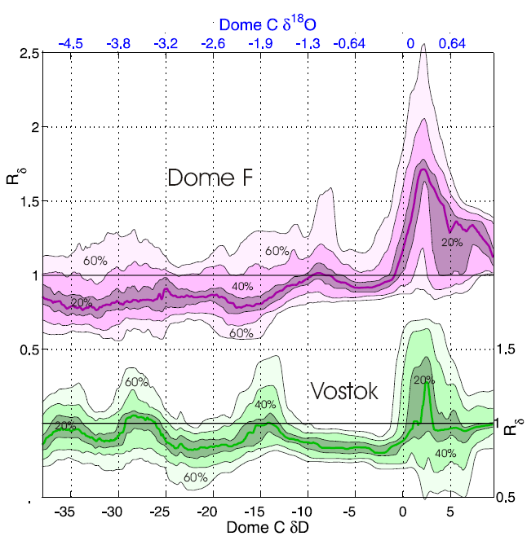
Scientific Output Using HadCM3+ δ¹⁸O 1. Reinterpretation of temperature changes over the last interglacial.
The paleothermometer:
δ¹⁸O=aT_{s}+b ?
<- cooler warmer→
Sime et al, Nature 2009
Notes:
For Antarctica it is thought that d18o is linearly related to temperature by the paleothermometer equation – shown.
However Louise looked at different ice core sites and found that in warm climates d18o was changing differently at different sites. (The figure shows Dome F and Vostok d18o and R shows the ratio between d18o change at DomeF/Vostok and the d18o change at Dome C – so if Dome F and Dome C were changing in the same way then we should get R=1. Note that R is close to 1 in cool climates but in warm climates R is not 1 so that the ice core sites d18o are changing differently in warmer climates).
The next question is why are the different ice core sites showing different d18o changes. Does it reflect temperature differences between the sites or does it reflect a change in the paleothermometer – ie is a changing in the equation.
The data has posed a question that the model can help answer. Modelling work with HadCM3 was able to reproduce this d18o change and attribute it. We found that the change in d18o did not actually represent real temperature change but was attributed to changes in the paleothermometer value ‘a’.
The changes in the paleothermometer from this work suggested that previous interglacial temperatures over Antarctica were about 6K warmer than today – which is approximately double the widely quoted value of 3K.

Slide 11
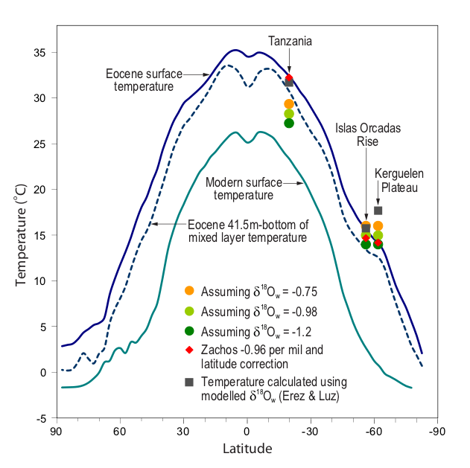
Scientific Output Using HadCM3 +δ¹⁸O 2. Effects of using modelled δ¹⁸O_{sw} on Early Eocene (~55ma) SST reconstruction
T°C=a-b(δ ¹⁸O_{c}-δ¹⁸Ο_{sw})
Tindall et al EPSL 2010
Notes:
50-54.7ma.
This is an example of using Planktonic foraminifera to reconstruct early Eocene temperatures for the 55ma.
We see that the temperature obtained from the Planktonic foraminifera d18oc is dependent on d18osw. There are no independent proxies for this – however a global constant value has often been used for past climates.
Here we show that if the temperature is reconstructed using the global constant value we get a much shallower equator-pole slope than if the temperature was reconstructed using the d18osw we have obtained from the model.
Using the modelled d18osw as a ‘bridge’ between model and data increases model data agreement for the Eocene and gives us more confidence in climate reconstructions of this time.
(Note the Kergulen Plateau is a special case as it is in a region of high d18o gradients. It shows how not accounting for d18osw properly could miss some of the longitudinal variation in temperature).
(Note an omission in this plot is that we are comparing site data with latitudinal means. However this is the best way to show what we did on a single slide).

Slide 12
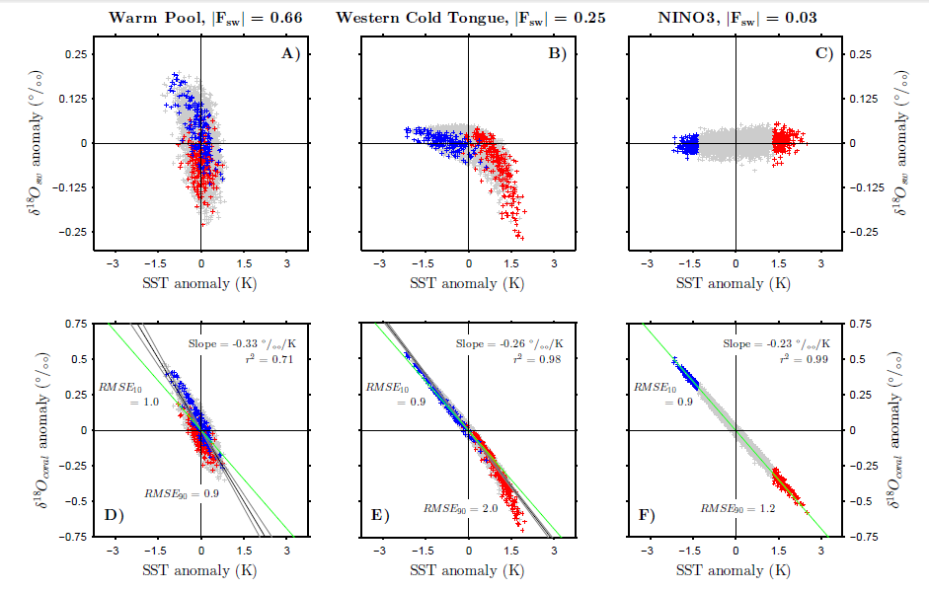
Scientific Output Using HadCM3+ δ¹⁸O 3. Interpretation of coral data over last millennium
Coral temperature:
T(ºC)≈2.25 – 5(δ¹⁸Oc- δ¹⁸O_{sw})
Leclerk and Schmidt (2001)
δ¹⁸O_{C} is δ¹⁸O in coral
δ¹⁸O_{sw} is δ¹⁸O in seawater
Fraction of δ¹⁸O _coral variability that is due to δ¹⁸O _seawater variability
Russon et al, Climate of the Past 2013
Notes:
This is Tom’s work using the isotope model to look at El Nino in coral records over the last millenium.
The map is the Pacific ocean and the colors show the regions where d18o_sw variability contributes noticeably to the temperature variability. So in the Nino 3 region, d18o_sw is not important and d18o_coral can be thought of as a temperature proxy. In the Western Pacific warm pool region and the Western Cold Tongue region d18o_sw variability will contribute to d18o_coral variability and we need to account for this. The top scatter plots show how the three variables in the coral-temp_d18osw equation covary. So in the Nino 3 region there is no correlation between d18o_sw and SST, in the Warm Pool there is an (almost) linear correlation and in the Western Cold Tongue region there is little correlation for cold events but there is a strong linear correlation for warm events. Where there is a strong correlation between d18o_sw and temperature this will lead to the coral being incorrectly interpreted.
For example for the coral to give us the correct temperatures we would expect to see the relationship between d18ocoral and SST (bottom scatter plots) lying along the green line (as they do for the NINO3 region). In the Western Cold Tongue region we would be correctly interpreting coral from the La Nina/normal/weak El nino climate but we would be overestimating the temperature by ~1.5K for the warmest El Ninos. In the warm pool we would be overestimating the magnitude of both cold and warm events. If these results hold then this is quite important, as the historic El Nino/La Nina cycles are not as strong as previously thought and we would have weaker baseline variability to compare with what we see in this ‘anthropogenic’ era.

Slide 13
Work in progress with HadCM3 + δ¹⁸O
Who | Time Period | Why
Leeds | Pliocene (~3ma) | Interpret ocean and terrestrial paleoproxies
Bristol | Miocene (23-5ma) | Interpret seasonal based ocean proxies
Bristol | Deglaciation | Understand how climate and proxies are related across rapid climate change events
BAS | Deglaciation | Understand orbital signals in Antarctic Ice cores
Future work using HadCM3 + δ¹⁸O?
Who | Reason | Status
Leeds | Attribution of recent changes in hydrological cycle over Amazon | Recently funded
Nottingham | Interpretation of Lake isotopes to understand global hydrological changes over last 2000 years | To NERC July 2013
BAS | Understand ice shelf collapse across the Antarctic Peninsula throughout the Holocene | To NERC July 2013

Slide 14
Current/future limitations
HadCM3 is no longer the latest version of the UM
Many projects which are currently using HadCM3 would benefit from increased resolution and the additional processes which are in newer versions of the UM.
We would like the data community to continue to collaborate with us – rather than other international groups (e.g. NCAR) which are currently implementing isotope tracers in the latest versions of their model
Development time to add isotope tracers to the full hydrological cycle is large and we need to be thinking about taking this forward now so that the UK retains this facility.

Slide 15
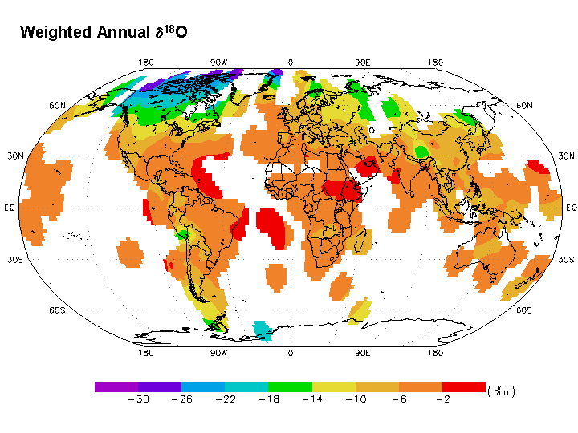
Can δ¹⁸O observations help improve ESM’s? Data for recent past
GNIP (Global Network of Isotopes in Precipitation) 1961→ , 115,000 measurements, 1000 stations, 125 countries
Is being supplemented by new databases GNIR( Global Network of Isotopes in Rivers) and MIBA( Moisture isotopes in Biosphere and Atmosphere)
Observations of isotopes in seawater
Figure is average annual δ¹⁸O from the GNIP database
Overall these databases provide an independent source of observations for validating an ESM hydrological cycle - a vital component to understand and prepare for future change.
Notes:
This is some information about recent observations.
Note from information such as this d18o in precipitation is related to temperature at high latitudes and inversely related to precipitation amount at low latitudes.
Work with isotope enabled GCM’s has helped to reinterpret how temperature and d18o are related on a variety of timescales and shown that the relationship between temperature and d18o is more complex than initially thought.
Another benefit of having all this recent data is for an extra source of model validation. We could alter the parameters of a GCM and see if we can reproduce this better.

