Slide 1
EUREC4A Forecast Caribbean Meteorological Organization (CMO) and Partners Date: D = 12/02/2020
Wed 12 February 2020
Gregory Cato. Cecile, Oscar, Sheryl

Slide 2
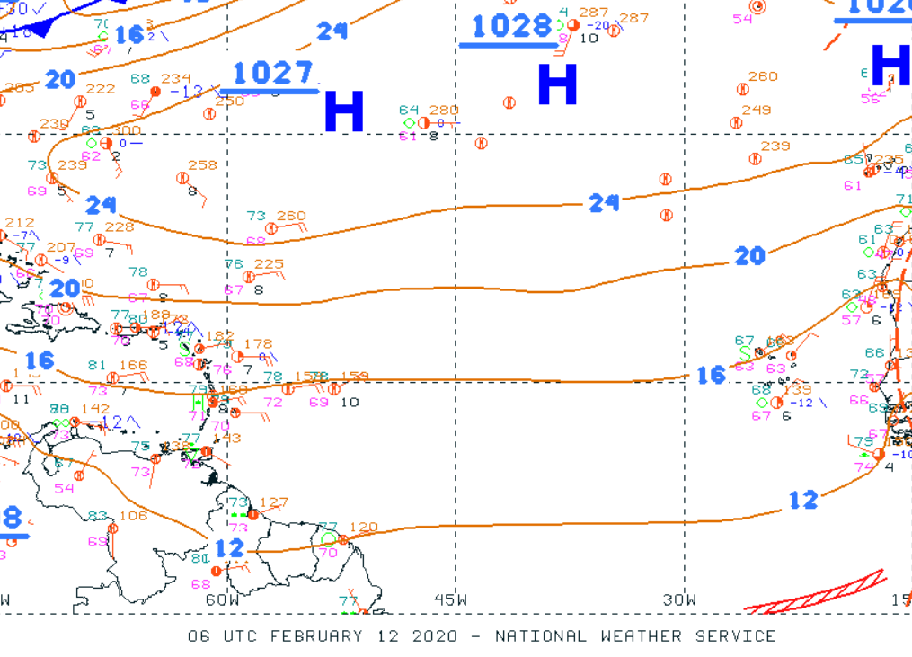
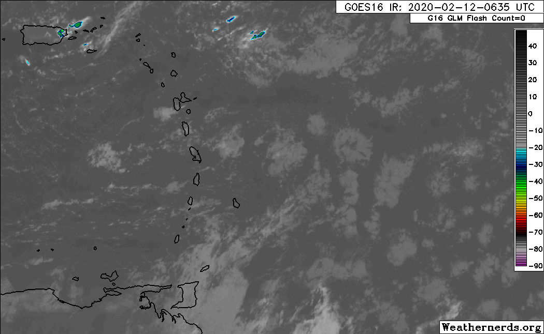
06 Z Surface Analysis

Slide 3
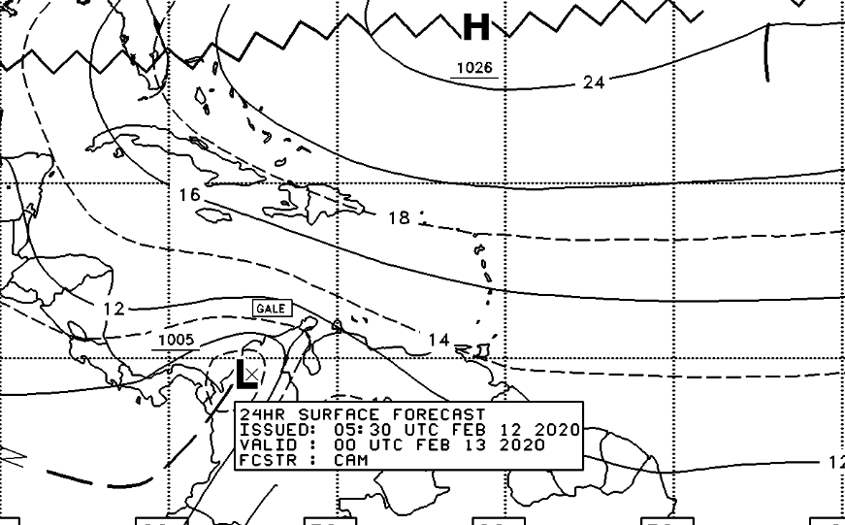
Synoptic analysis chart, 00Z 13TH February

Slide 4
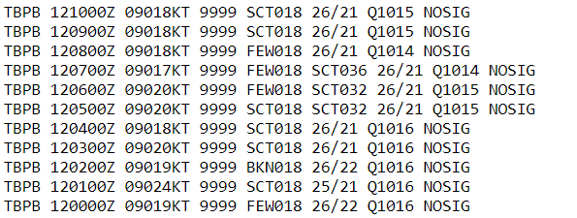
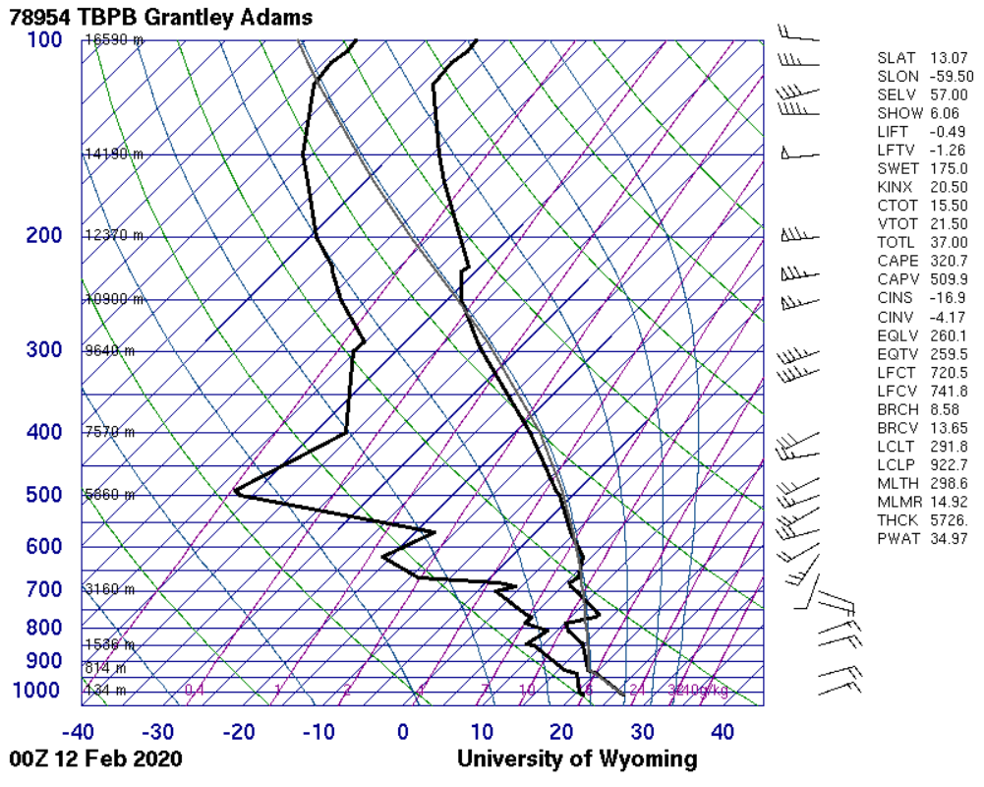
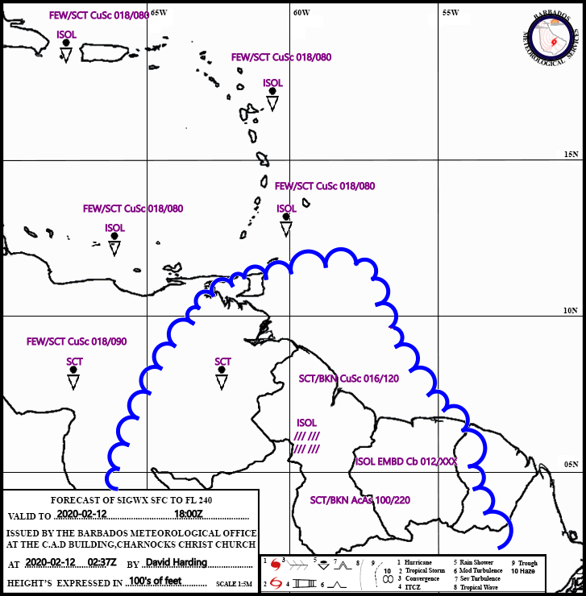
Sounding and Metars MET 8
Relatively Moist lower levels. Dry Mid. Expect Occasional Turb.
SITE LLEWM present: winds 20 knots or more below and above 5000ft

Slide 5
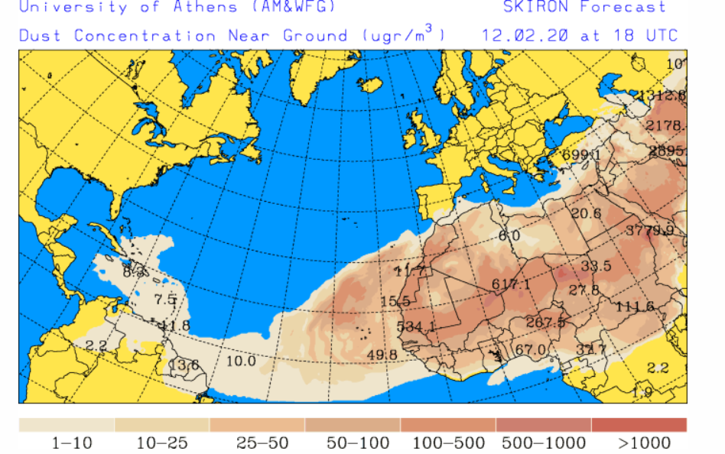
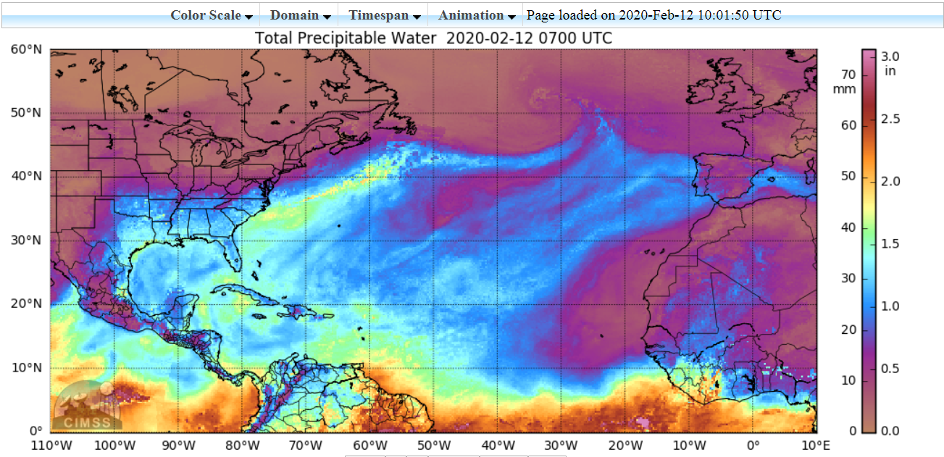
TPW & DUST HAZE CONCENTRATION
Moisture in patches over Eastern Caribbean(Central Windwards/South). Varying intensities of Dust haze. Improvement likely soon.

Slide 6
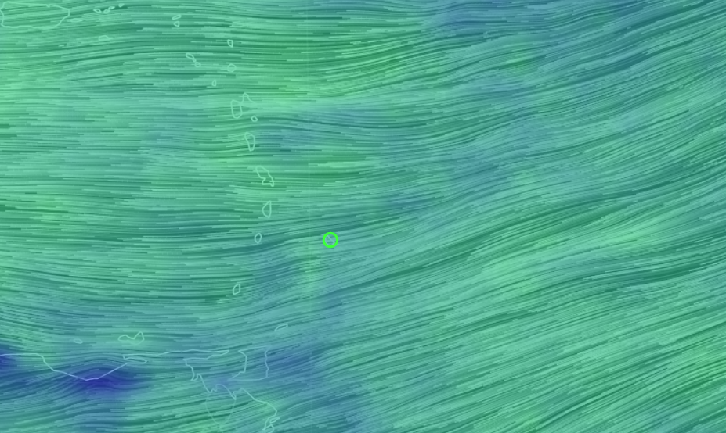
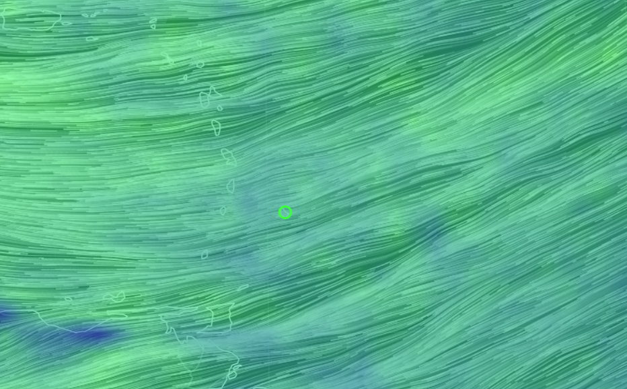
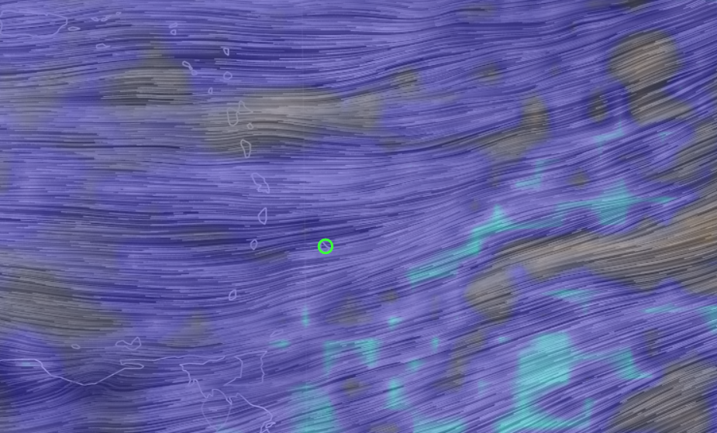
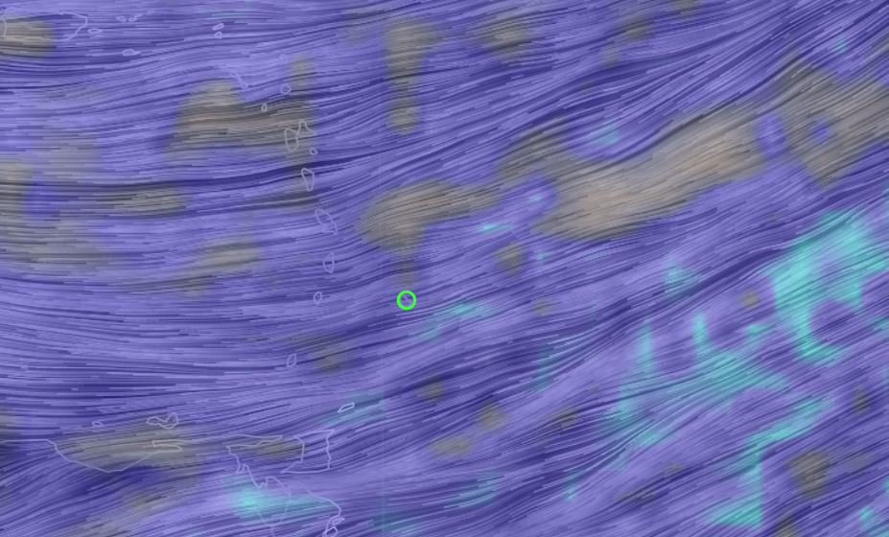
850 mb winds and RH
12z 12th 12z 13th
12Z 12th 12z 13th

Slide 7
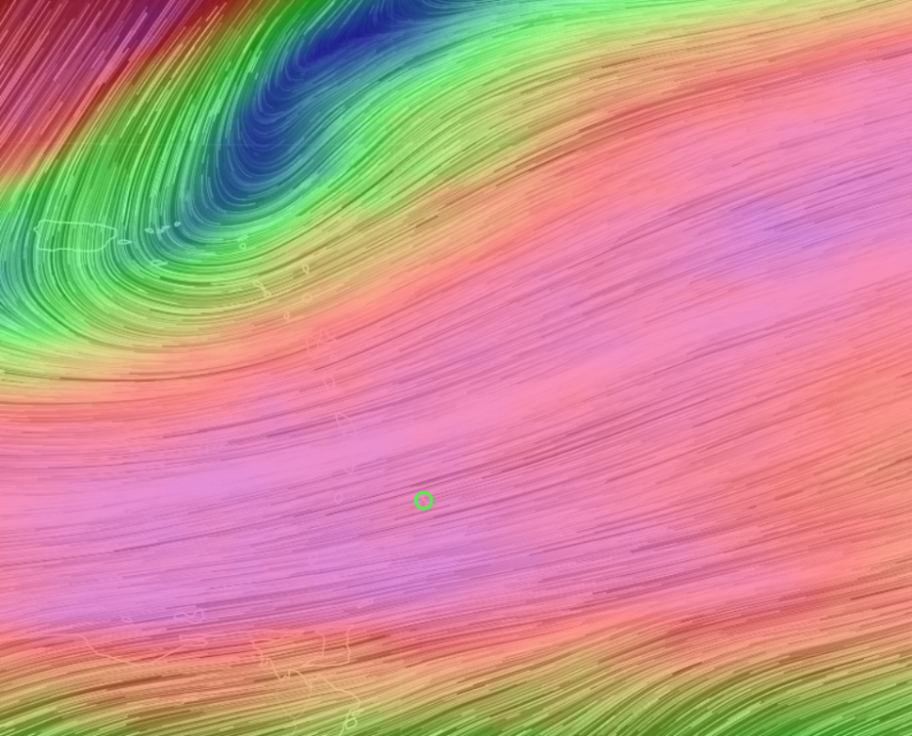
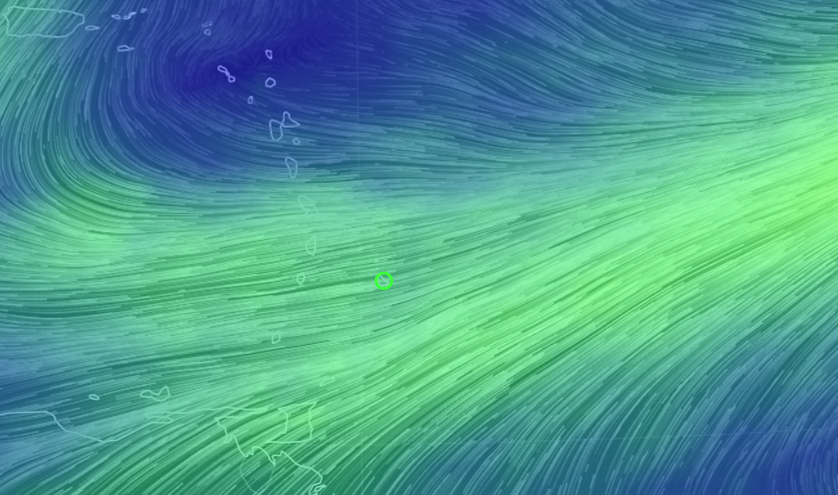
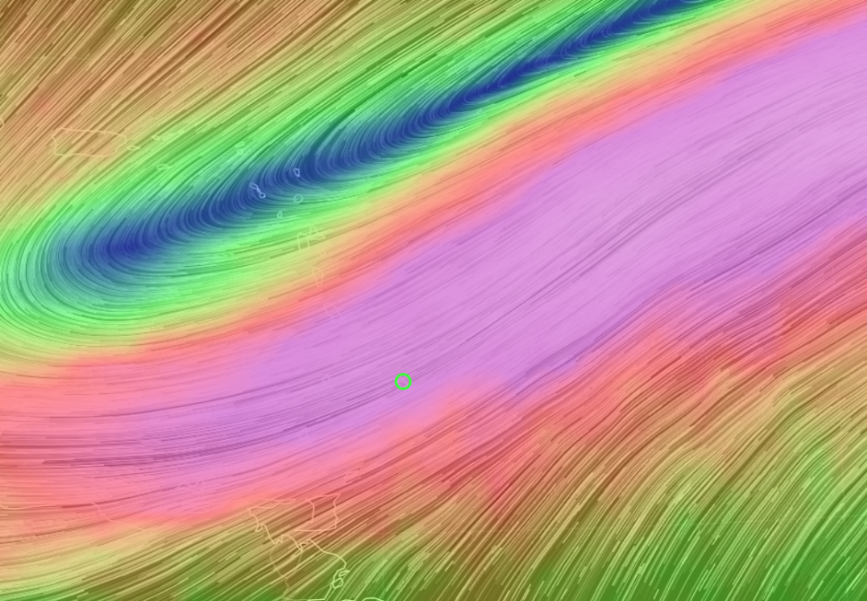
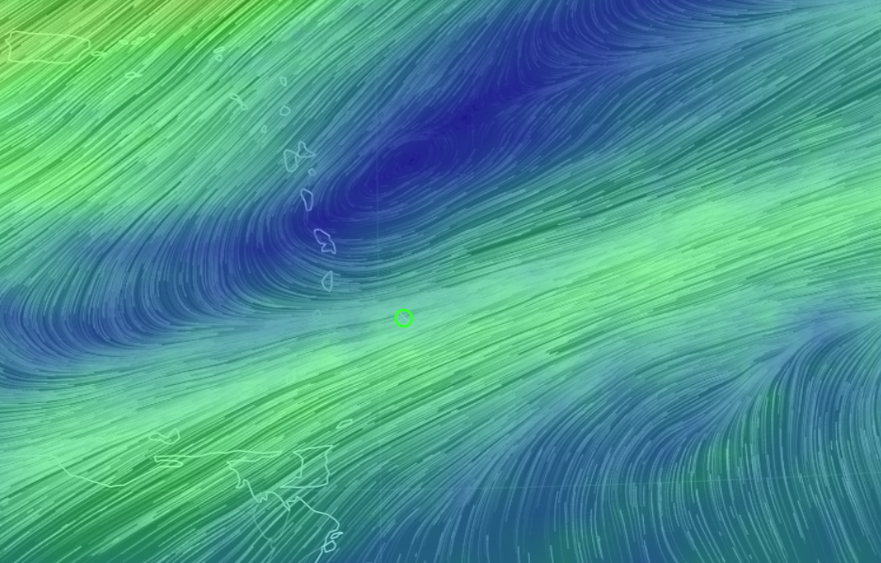
500 & 250 mb winds
12Z 12th
12z 13th
12z 12th
12z 13th
Troughs become more
organised over the next24 hours
500mb low over
Northern Windwards
Upper level trough amplifies
Notes:
500 10th and 11th 12z and 250 10th and 11th 12z

Slide 8
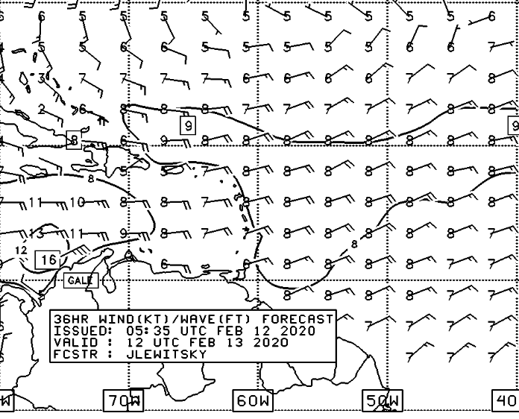
Seas Conditions
MeteoFrance
Wednesday 2pm or Wed 18utc
A small craft advisory is in effect for above normal sea swells. Small craft operators and sea bathers should exercise caution
Moderate to rough.
Swell: 2.0m to 3.0m (7ft to 9 ft)
D Winds: ENE at 30-40kph or (15-25mph)
D+1 Winds: ENE – E 30-45kph or (19-28mph)
D Hightides: 6:17 am & 6:26pm LST
D+1 Hightides: 6:59 am & 7:19pm LST

Slide 9
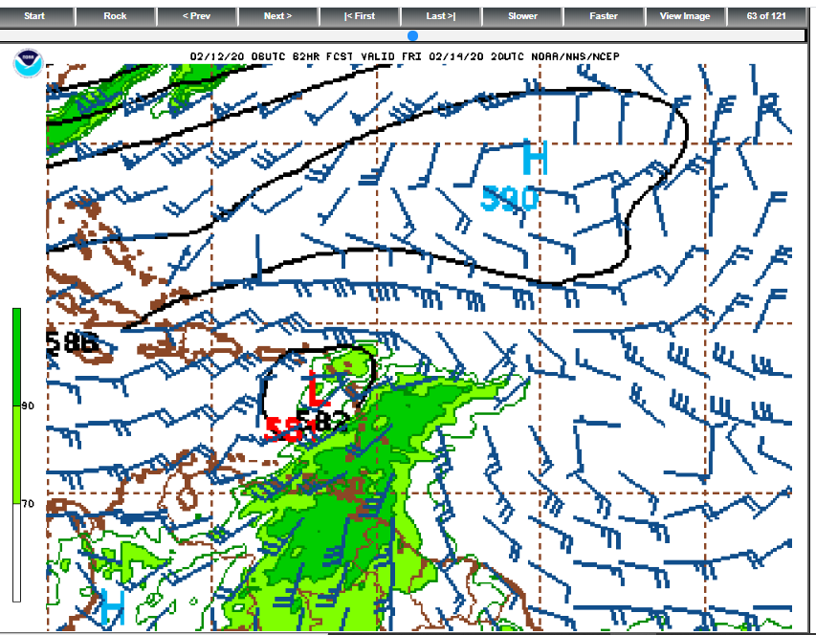
OUTLOOK D+2: MID/UPPER LEVEL CHANGES
SIGNIFICANT INCREASE IN MID LEVEL MOISTURE FORECASTED FOR FRIDAY/SATURDAY
UPPER LEVEL TROF WILL PROVIDE SOME DIFFLUENCE
FRIDAY/SATURDAYFORECAST:
WE MAY SEE A SIGNIFICANT INCREASE IN CONVECTIVE ACTIVITY WITH RESULTANT CLOUDY CONDITIONS AND SOME HEAVIER SHOWERS FRIDAY INTO SATURDAY

Slide 10
Summary
Ridging at surface for D and D+1
Breezy conditions to persist as tight pressure gradient remains
Dust haze with gradual improvement likely over the next 24 hrs
Moist Lower atmosphere, although likely to increase in 24 hrs.
Mid-UL Trough axis oriented NE/SW through eastern Caribbean providing marginal favourable conditions aloft for convective development.
Today’s forecast: Partly cloudy to occasionally cloudy at times, slightly hazy and breezy with some scattered showers. Mixture of Sugar, gravel and flower type patterns are likely to be present.
Tomorrow’s forecast: Possible haze reduction. Although dry in mid levels, possible increase in cloudiness and or shower activity due to U/L dynamics.
OUTLOOK D+2: Possible heavier showers as mid and upper levels become more favourable

