Slide 1
EUREC4A Forecast Caribbean Meteorological Organization (CMO) and Partners Date: 29/01/2019
Presenters
Oscar (TTMS), Anton (TTMS), Letitia (A&BMS), Cecile (Meteo France)

Slide 2
Forcast Verification FROM 27/01/20
D1: Mostly sunny conditions Forcasted:
D2: Slight increase in moisture with occasional light showers
Both Forecasts did pretty well..????

Slide 3
Slide 1: Synoptic analysis chart, 0000 UTC Day D
Ridge continues to dominate. Dry mid levels as SAL encroaches into area.
SAL Forecast to persist for the next 2-3 days.
Approaching wind surge
<Synoptic chart here>

Slide 4
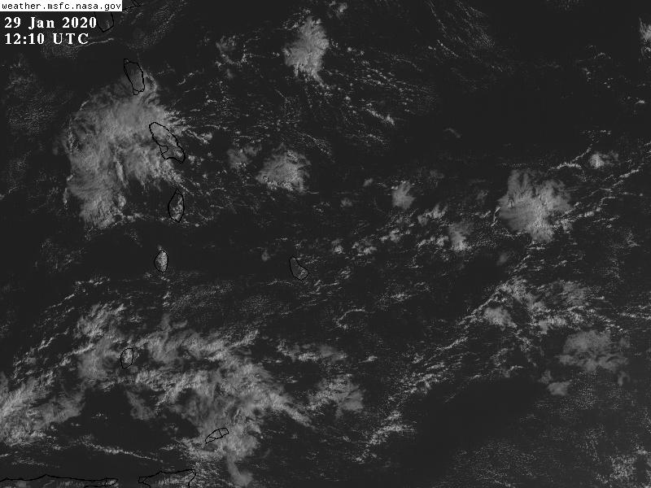
Visible Sat Image
Shallow , scattered low cloud.
Flower and gravel type
<Synoptic chart here>

Slide 5
Tiphigram: TBPB 1200Z 28th
MOIST LOW LEVELS: MOISTURE TO 800 hpa/5000-6000ft
Light winds 10-15kts ESE-S <10,000 FT
<Figure here>

Slide 6
SOUNDING 0000Z 29TH
DRYER LOW LEVELS.
LOW LEVEL WINDS REMAIN FAIRLY LIGHT. 10-15kts ESE-S
BUT EXPECTED TO INCREASE SLIGHTLY WITHIN 12-24 hrs to 15-20kts

Slide 7
EUREC4A 2KM: REFLECTED SHORT WAVE 1500Z 29TH
MODEL FORECAST SHOWS SHALLOW SCATTERED FLOWER AND GRAVEL TYPE CUMULUS AROUND BARBADOS.
AREA OF MORE WIDESPREAD CLOUD TO SE AND S.
<Figure here>

Slide 8
SEAS
SEAS ARE SLIGHT TO MODERATE. WAVES 3-5FT. NE SWELL.
MODELS ARE FORECASTING A SLIGHT INCREASE IN SEAS TO
4-6FT OVERNIGHT ANDAINTAINING OVER THE NEXT 2-3 DAYS.
<Figure here>

Slide 9
FLIGHT LEVEL WINDS: FL050 VALID 1800Z
FLIGHT LEVEL WINDS ARE
SE 5-10kts
Forecated to increase
10-20 kts over the next 2-3 days
Text items.

Slide 10
FLIGHT LEVEL WINDS: FL100 VALID 1800Z
FLIGHT LEVEL WINDS ARE
SE 5-10kts
Forecasted to increase to 10-20kts over the next 2-3 days

Slide 11
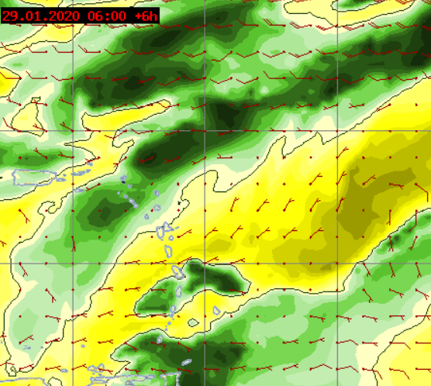
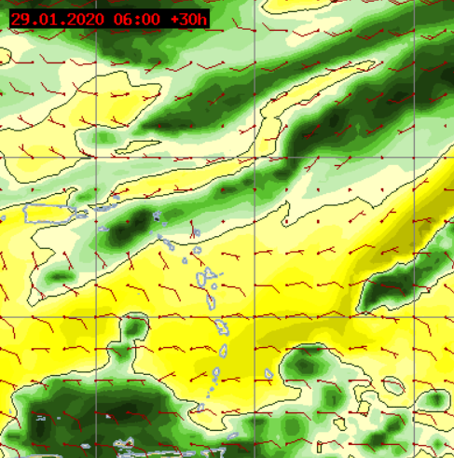
800 MB RH 29 & 30
SOME MOISTURE AROUND BARBADOS BELOW 800MBS
800MB 12Z (D) 29.01.20
800 MB 12Z (D+1) 30.01.20

Slide 12
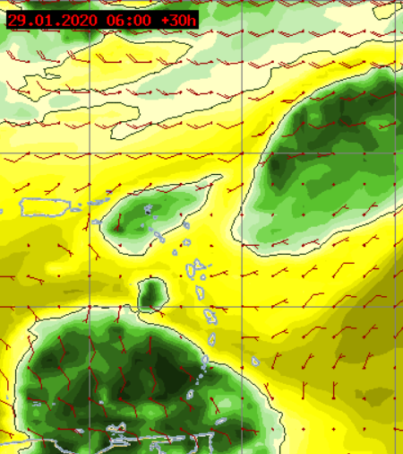
700 MB RH 29TH & 30TH
700 mbs. SHOWS DRY CONDITIONS AROUND BARBADOS.
MOISTURE REMAINS S OVER SOUTHERN ISLANDS
(D) 12Z 29.01.20
(D+1) 12Z 30.01.20

Slide 13
SUMMARY
DRY AND STABLE SYNOPTIC ENVIRONMENT: SAL ENCROACHING
LIGHT LOW LEVEL WINDS: NO TURBULENCE. WINDS FORECASTED TO INCREASE SLIGHTLY D+1 BUT <20KTS
SEAS ARE SLIGHT TO MODERATE 1.5M BUT EXPECTED TO INCREASE SLIGHTLY TO 2.0M BY D+1
FORECAST: GENERALLY SUNNY AND AT TIMES BREEZY CONDITIONS. GOOD SHALLOW CLOUD OBSERVING CONDITIONS

Slide 14
THE END
THANK YOU
????

