Slide 1
EUREC4A Forecast Caribbean Meteorological Organization (CMO) and Partners Date: 27TH JANUARY,2020
Prepared by :
ANDRE, OSCAR, CECILE & LYNDON

Slide 2
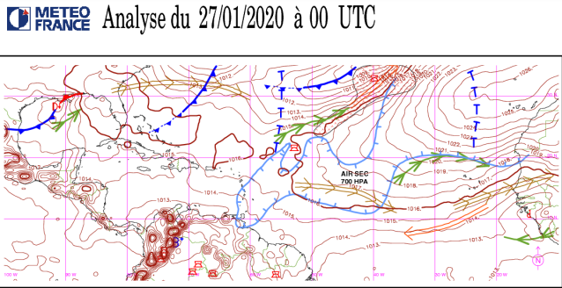
Slide 1: Synoptic analysis chart, 1200 UTC Day D
Ridge continue across the Atlantic and Caribbean
Dry air intrusion at 700mb
Upper level trough to the N & jet to ENE

Slide 3
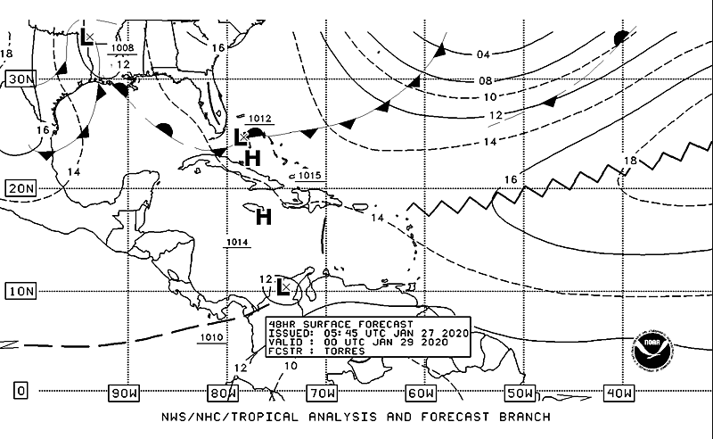
Slide 1b: Synoptic forecast chart valid for 0000 UTC, 29th Jan,2020
<Synoptic chart here>
Ridge continue to dominate the Eastern Caribbean.
Slack pressure gradient

Slide 4
TBPB SOUNDING AT 00Z 27th

Slide 5
Current

Slide 6
18Z winds today vs 18z winds tomorrow

Slide 7
Marine forecast valid 1200Z 28th Jan, 2020
Seas:
Current conditions are moderate waves 4-6 ft.
Forecasted, slight to moderate waves 3-5 ft.

Slide 8
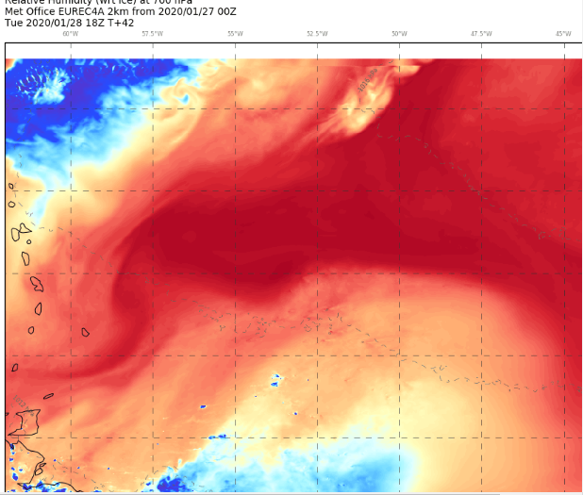
Outlook

Slide 9
Summary
Ridge dominant
Dry mid- level
Slack pressure gradient/ light wind 10-15kt
Seas moderate today
Forecast
Generally fair.
Seas slight to moderate waves 3-5 ft.
OUTLOOK D+1
Slight increase in low level moisture
Partly cloudy with occasional light isolated showers with improvement by afternoon (mainly sugar and gravel type clouds)

Slide 10
Verification of previous forecast
Summary of previous forecast

