Slide 1
EUREC4A Briefing 23 Jan 2020
Presentation by
Lawrence Pologne

Slide 2
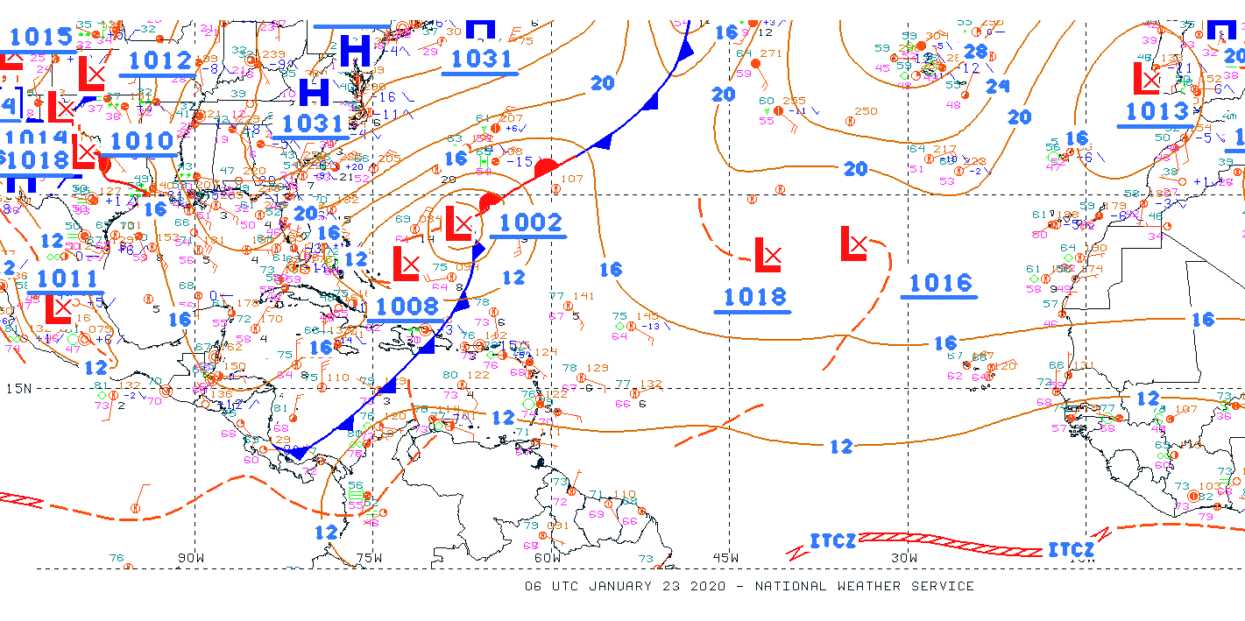
Synoptic Chart Analysis 0600 UTC
Shear line is moving out of area.
Approaching cold front from NW inducing slack pressure gradient; hence lighter winds.

Slide 3
Soundings for Barbados
Lower atmosphere remains moist but conditionally unstable;
wind speeds in the lower atmosphere abated;
Subtropical Jet exit region over area (75 kts) → maintaining unstable conditions
1200Z 22 Jan 2020
0000Z 23 Jan 2020

Slide 4
Wave Heights
Wave heights in the vicinity and east of Barbados: 2 to 6 ft.

Slide 5
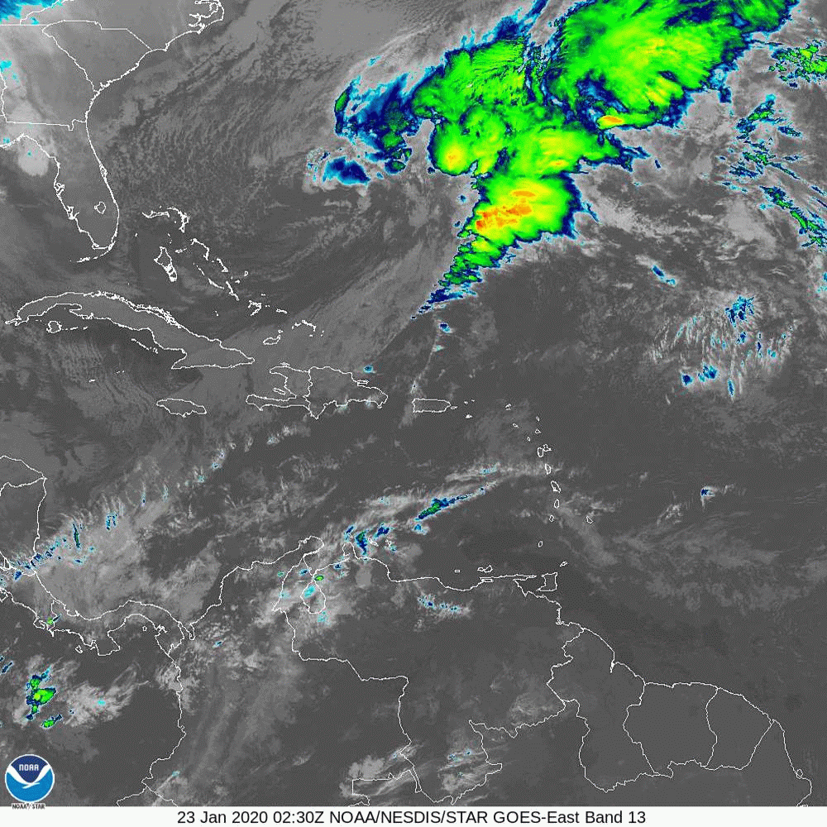
Satellite Imagery
Shear line leaves residual cumulus/stratocumulus clouds.
Subtropical Jet in vicinity.

Slide 6
Forecast Model (GFS)
850 mb Winds/ MSLP
200 mb Winds; STJ remains over area

Slide 7
Summary
A moist and unstable atmosphere will trigger some showers mainly during the morning.
Showers are expected to decrease by afternoon.
Stratified/sheet type layer clouds expected (cumulus/stratocumulus)
Waves up to 8 ft can be expected

