Slide 1
EUREC4A Briefing 20 Jan 2020
Presentation by
Anton Wiltshire
Shanea Young
Carolyn Peck

Slide 2
Synoptic analysis chart, 0000 UTC Day D
Synoptic features- Induced Trough from the Stationary front.
Based on the winds I expect a return flow across Barbados.

Slide 3
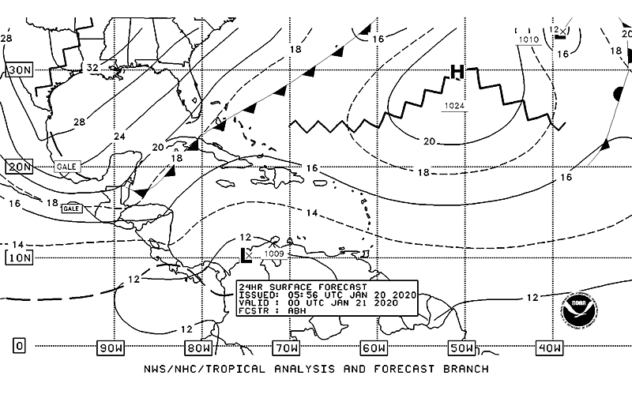
Synoptic forecast chart 0000 UTC, D+1
Synoptic features- High Pressure Ridge

Slide 4
Soundings for Barbados
1200Z 19 Jan 2020
0000Z 20 Jan 2020

Slide 5
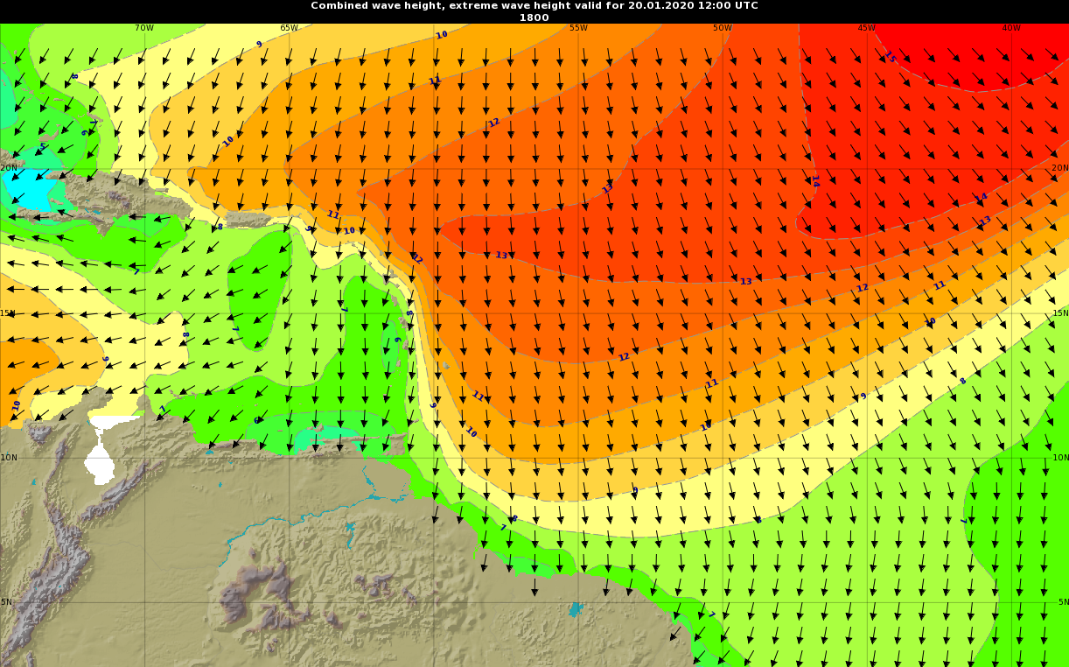
Wave Heights and Periods
Wave heights of up to 12ft can be expected on eastern sides of Barbados

Slide 6
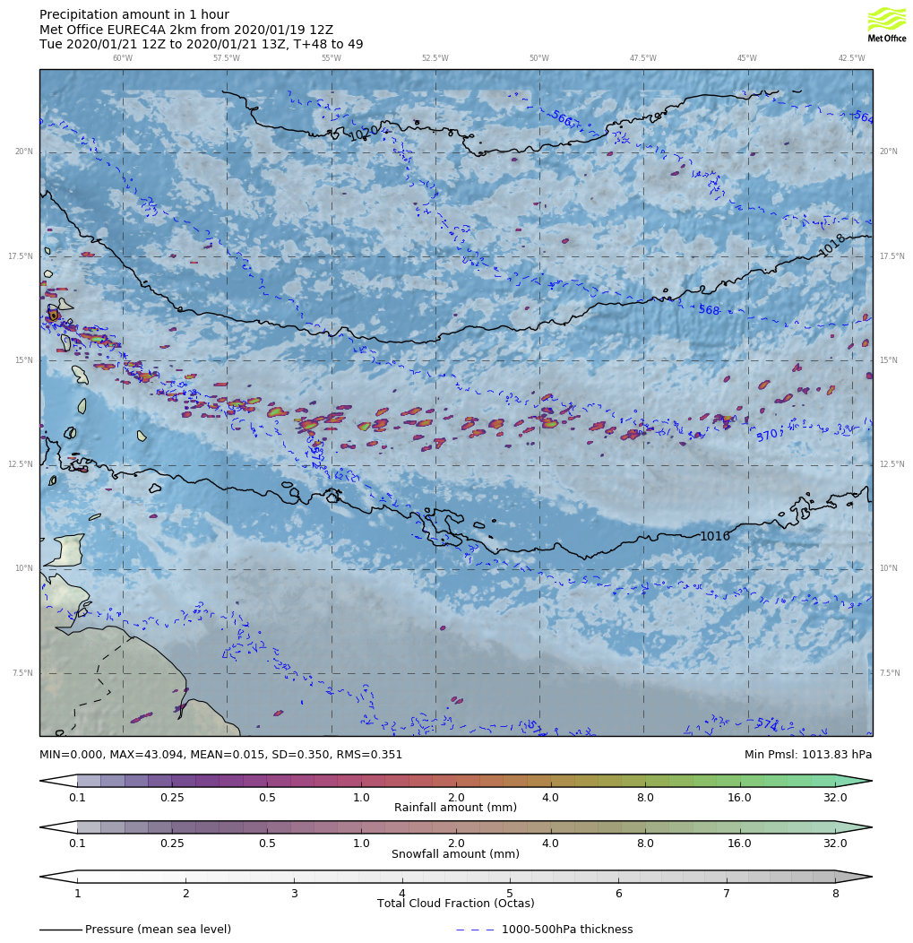
Synoptic Analysis D+1
Advancing shear line from over The Leewards expected to be just North of Barbados.
Tomorrow afternoon likely periods of cloudiness with few showers can be expected

Slide 7
Summary
Mostly sunny conditions for this morning with few showers/rainy intervals for this afternoon
Stratified/sheet type layer clouds expected
Ridge is dominant
Waves up to 4m can be expected

