Slide 1




UK University and Met Office contribution to YMC
HotHouse: The Maritime Continent – Engine Room of the Global Climate System
Cathryn Birch^{1,2}
Adrian Matthews³, Steve Woolnough⁴, John Marsham², Ryan Neely², Paul Barret¹, Prince Xavier¹, Victoria Smith⁵
¹UK Met Office, ²University of Leeds, ³University of East Anglia, ⁴University of Reading, ⁵National Centre for Atmospheric Science

Slide 2

Introduction
Proposal for 5 year £3.7 million ($5.6 million USD) project, with observations Jan-Feb 2019
Current status of proposal:
  Outline proposal submitted in March 2015: successful
  Full proposal submitted Nov 2015: outcome expected July 2016
  Average success rate 30-50%
  Subsequent opportunities to submit a revised project (modelling)
This talk contains:
  Science objectives
  Ground and ocean instrumentation overview
  Aircraft campaign overview
  Modelling strategy
  Key questions

Slide 3
Science objectives
Joint MetOffice–UK University science objective is to understand the diurnal evolution of the boundary layer, convection initiation and the dynamics of storm development and their offshore propagation
FAAM Bae146 aircraft (~1 month), longer term deployment of ground instrumentation (~1+ year)
Highly dependant on local sites and permissions (and grant success)
Currently dates and location are flexible – extremely keen to co-locate with other groups
Plans for high-resolution modelling studies
Met Office are able to provide model forecast products for YMC

Slide 4
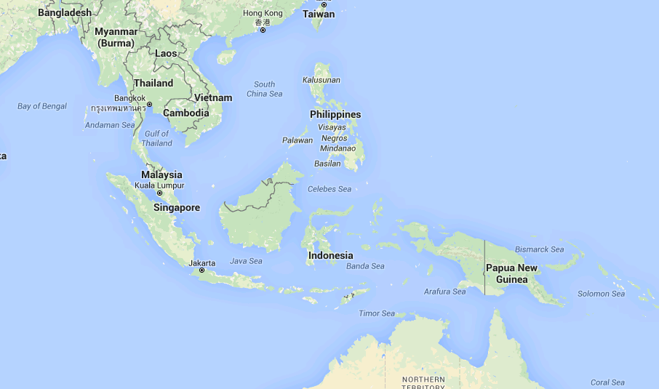
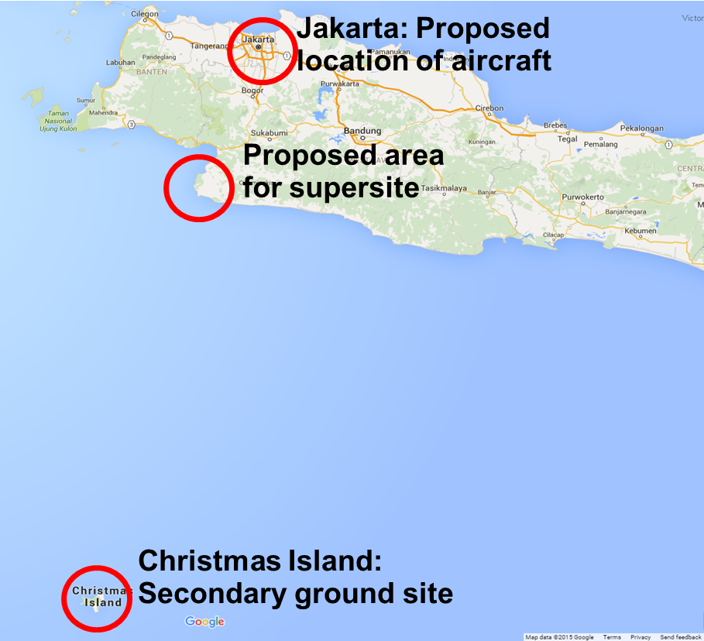
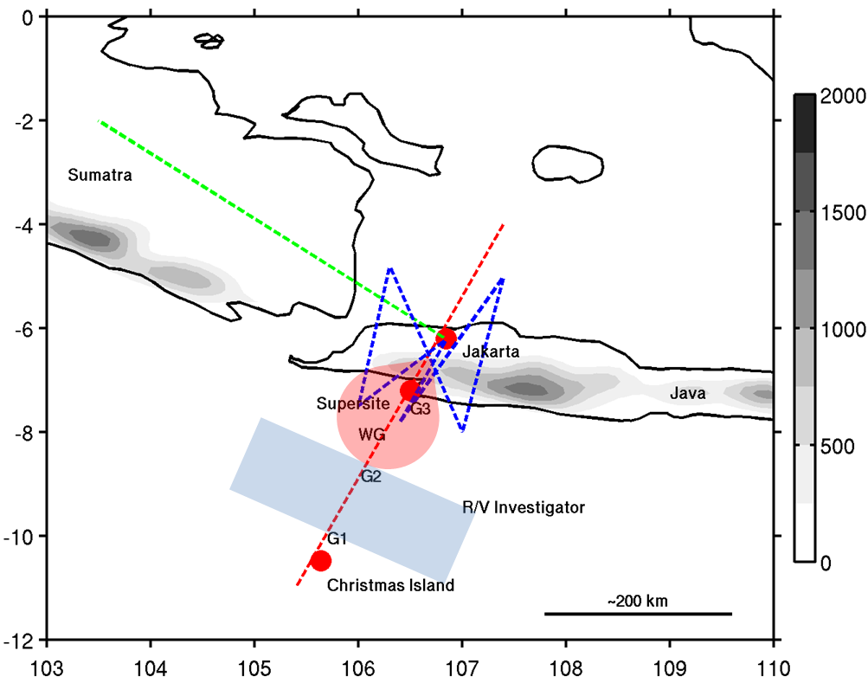
Field campaign overview
Field campaign to take place 15 Jan – 1 March 2019
R/V Investigator?

Slide 5
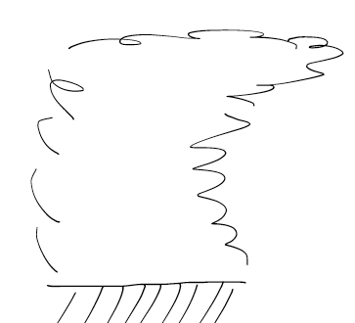







Field campaign overview
MCS
Afternoon
Night-Morning
MRU / NERC
Latent and sensible fluxes
MCS
R/V
Investigator
BAe146
Wind- and Buoyancy-
Driven Mixing
Java
Xmas
Shuyi Chen (UoMiami)

Slide 6
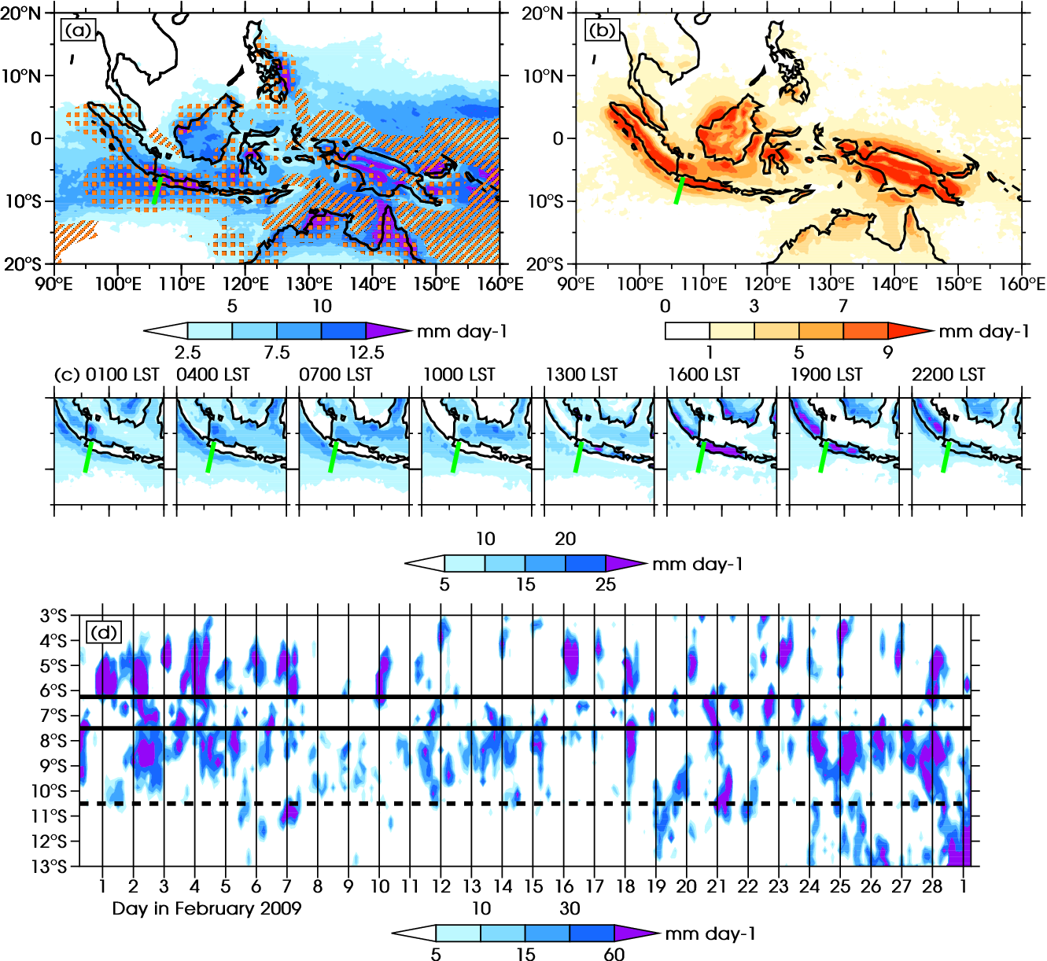
Field campaign overview
Mean November-April climatology
High mean rainfall
High diurnal amplitude
Offshore propagation
MJO at beginning of the month, which dissipates

Slide 7
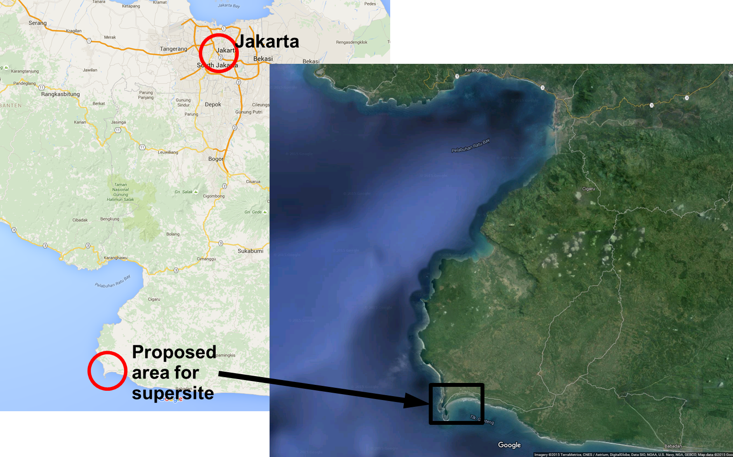
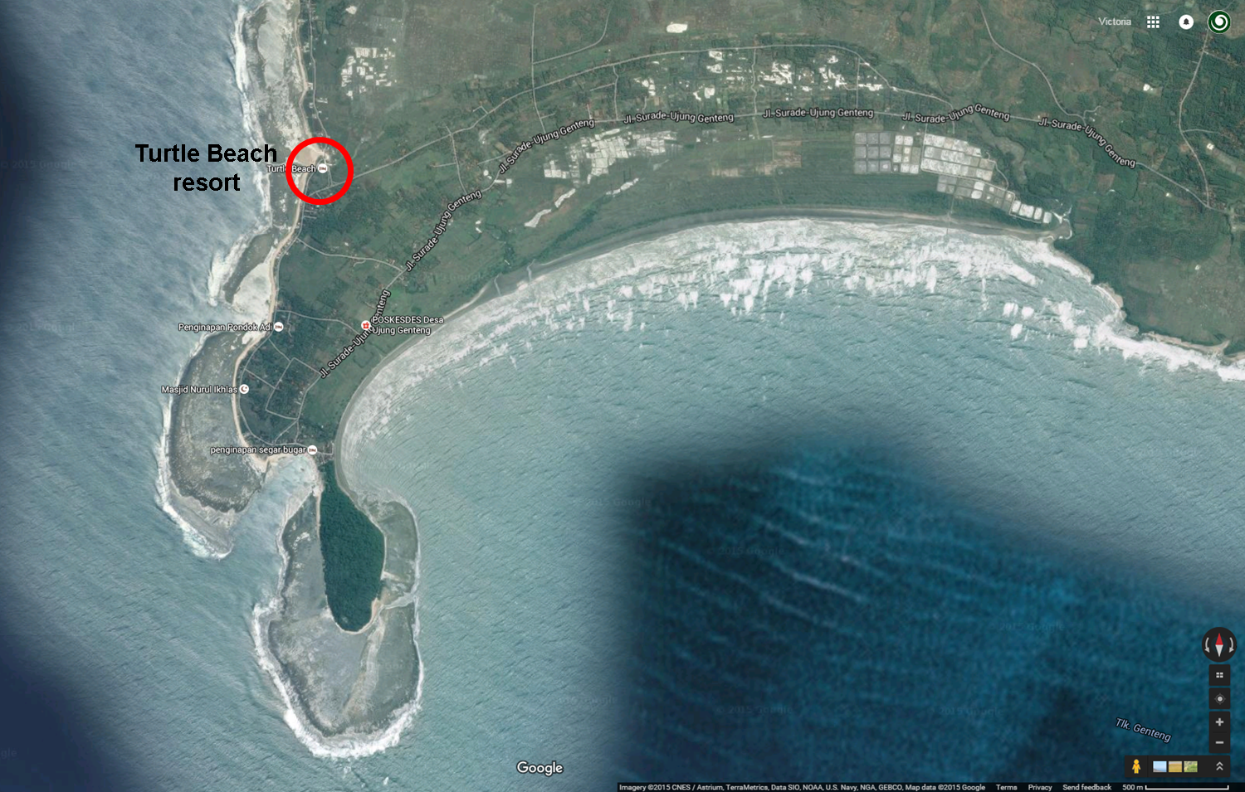
Ground supersite
Multi-platform suite of instruments
Comprehensive observations of the land – sea diurnal cycle
Both in-situ and remote sensing instruments
Based primarily around X-band dual polarisation Doppler radar

Slide 8
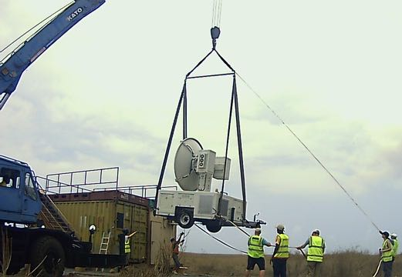
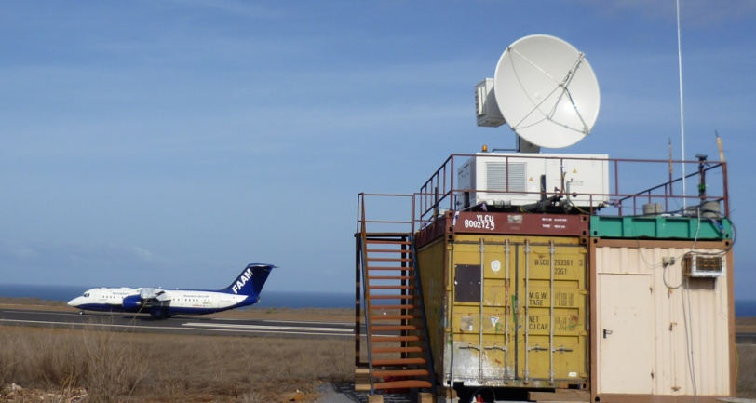
Ground supersite
X-Band Doppler Radar
Areal precipitation
Radial winds
Polarisation parameters
Clear-air echoes at close range from insects
Maximum range 200km (100-150 km is typical)
Sits on two 20ft shipping containers
Office container with A/C plus empty one for storage
Crane/forklift required
Power by diesel generator
Site availability – any local government land or similar? Security?
Internet/network options. Satellite? Mobile data?
Local assistance with logistics – hire a local manager?

Slide 9
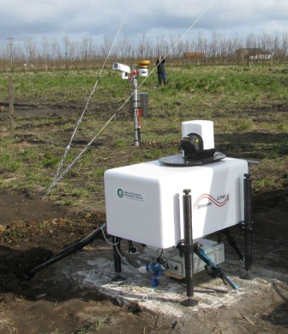
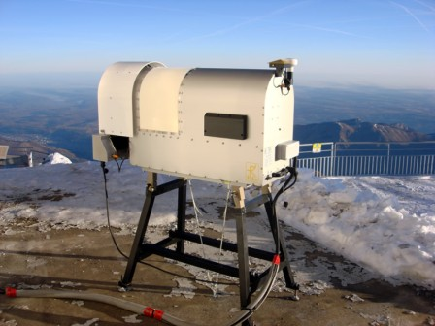
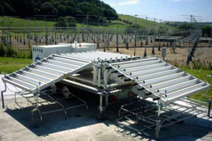
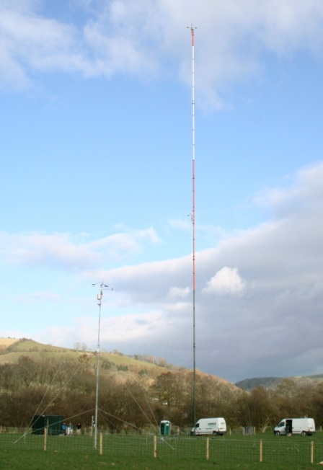
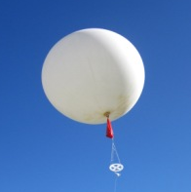
Ground supersite
Doppler aerosol LiDAR
Scanning radiometer
Boundary layer wind profiler
Wind speed and direction
Max. range 8km
Profiles of aerosol backscatter and radial velocity
Max. range 9.6km
Vertical profiles of T, RH
Liquid water path
Stability indices
Flux towers
  p, T, q
  10Hz 3D winds
  10Hz H20 and CO2
  LW, SW radiation
  Soil temperature and moisture
Vaisala RS41 radiosonde system
300+ sondes to launch (~8 per day for 6 weeks)

Slide 10

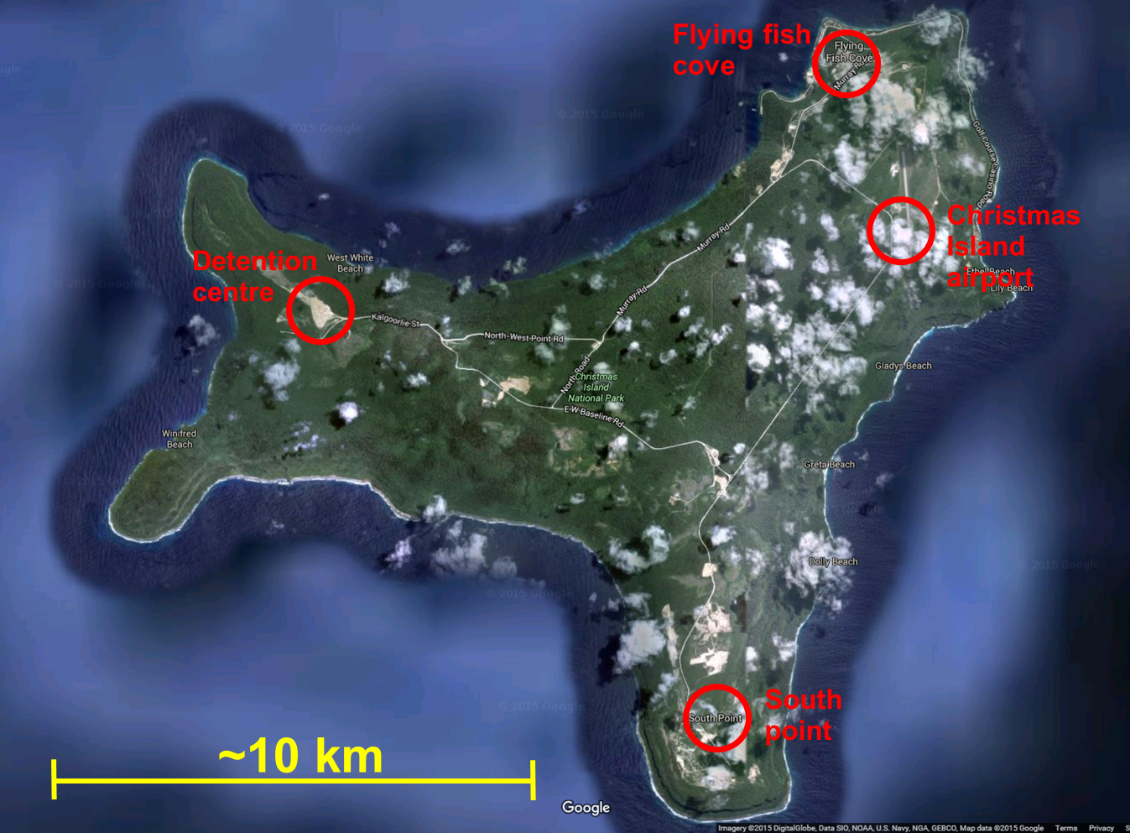
Christmas Island
Cloud Radar 94 Ghz
Doppler LIDAR
Microwave Radiometer
Flux towers
Vaisala RS41 radiosonde system
300+ sondes to launch (~8 per day for 6 weeks)
Possibility of a 3rd radiosonde station for e.g. R/V Investigator
Could share the 600 radiosondes between 3 locations
  p, T, q
  10Hz 3D winds
  10Hz H20 and CO2
  LW, SW radiation
  Soil temperature and moisture

Slide 11
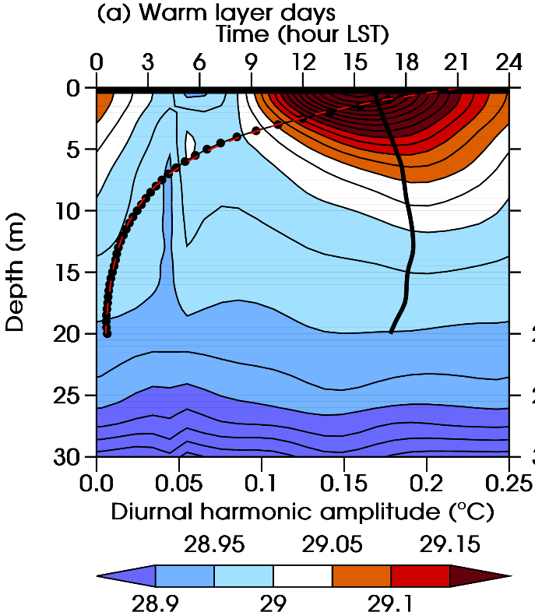
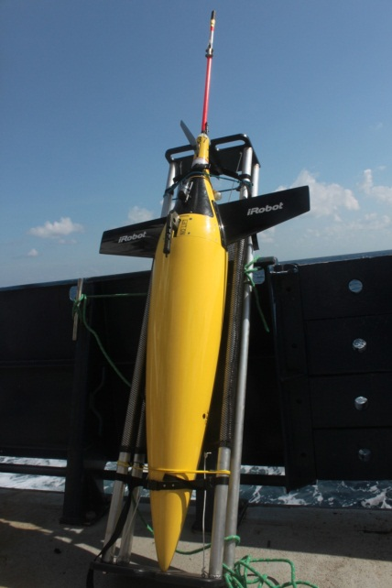
Christmas Island
Unmanned seagliders will be launched for Christmas Island in Dec 2018
Seagliders dive every 2 hours to depths of ~1km – diurnal cycle
Measure upper ocean structure (T, salinity, chlorophyll, dissolved oxygen)
Operate automatically for up to 4-5 months, data communicated via satellite

Slide 12
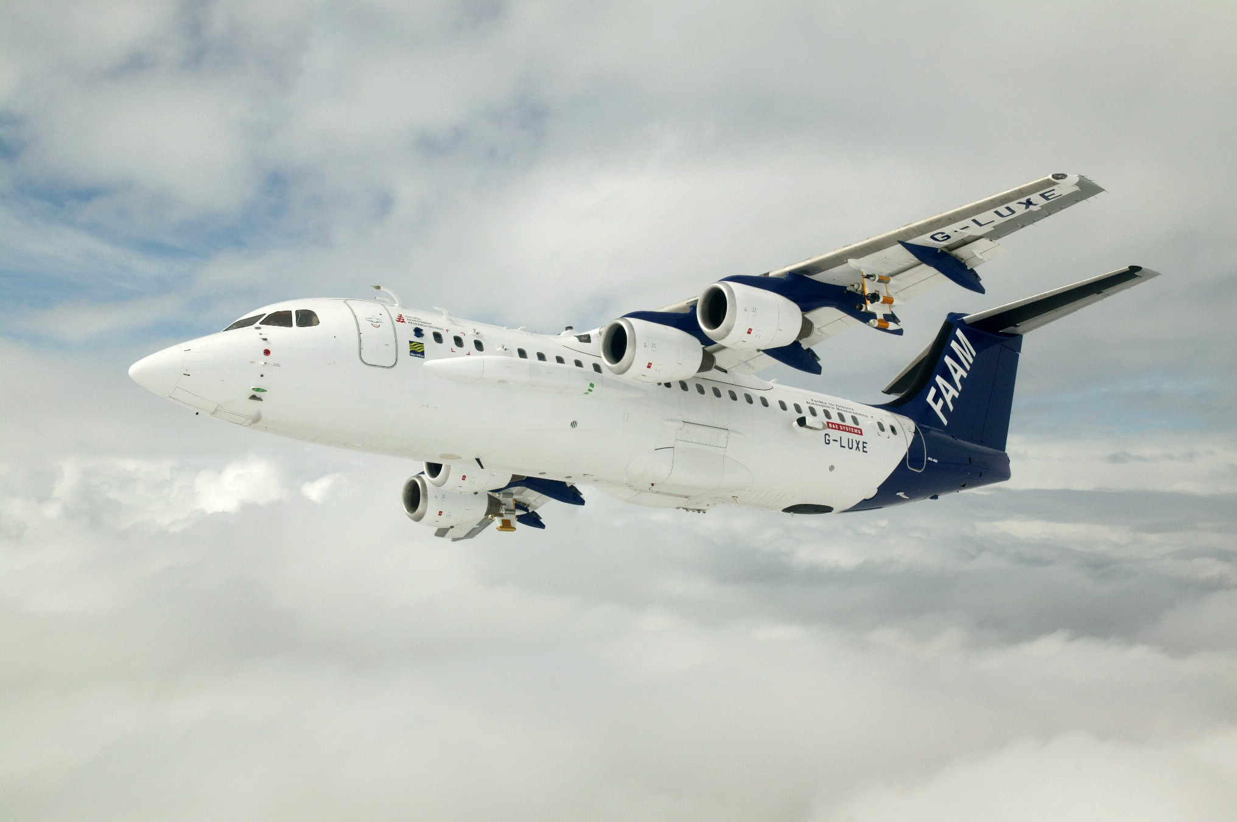
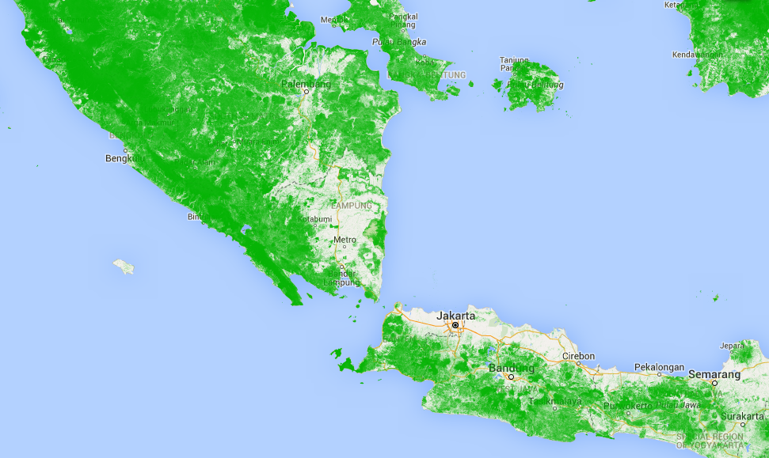
Aircraft campaign
FAAM BAe146-301
5.5 week deployment in Jan-Feb 2019
Based at Halim (Jakarta) airport
24 flights of 4.5 hours
147 dropsondes (6 per flight)
Aircraft campaign flight paths

Slide 13
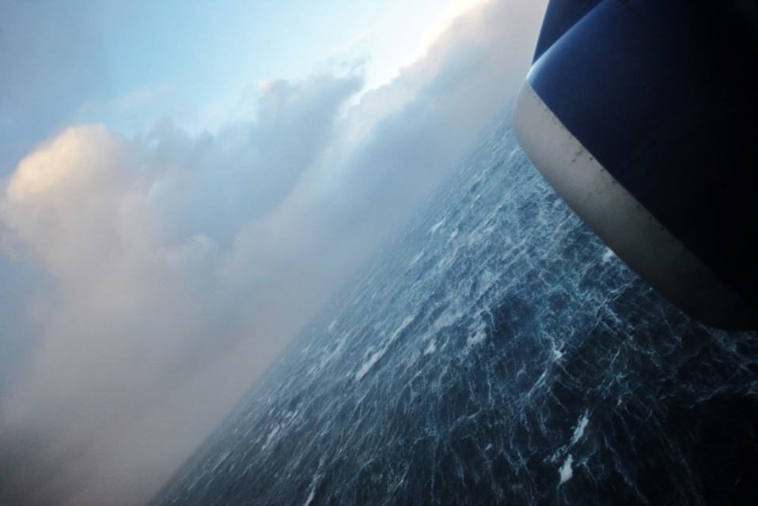
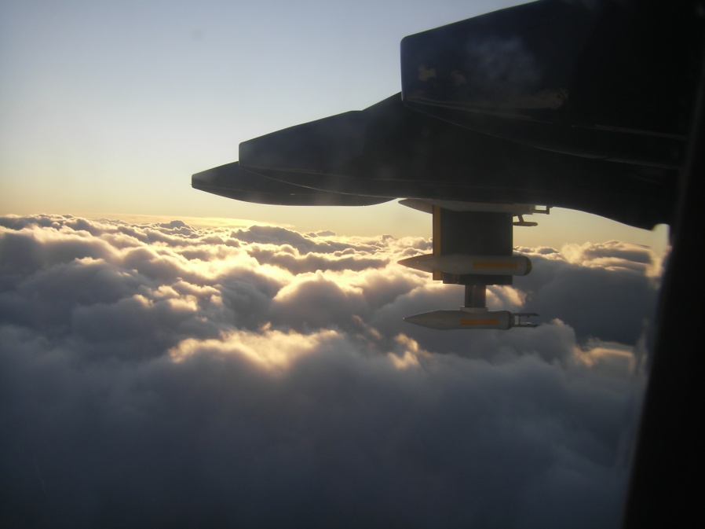
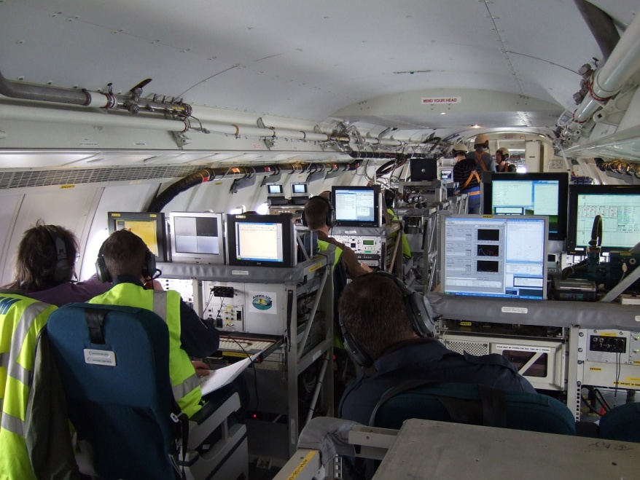
Aircraft campaign
Basic Meteorology
T, P, q
Wind components, turbulence and fluxes
LWC, IWC
Position, attitude
Sea Surface Temperature
Dropsondes: T,q,winds
Across wind “surface” flux measurements (100ft a.s.l.)
In-situ measurements
Cloud and Aerosols
Full size range 0.1 µm to 6 mm: PCASP, CDP, CIP15, CIP100
Cloud Condensation Nuclei Counter
Basic chemistry O₃, CO
~10 science crew
If flight permissions and research permits for Indonesia have not been obtained by April 2018 we will relocate to Malaysia or Australia

Slide 14
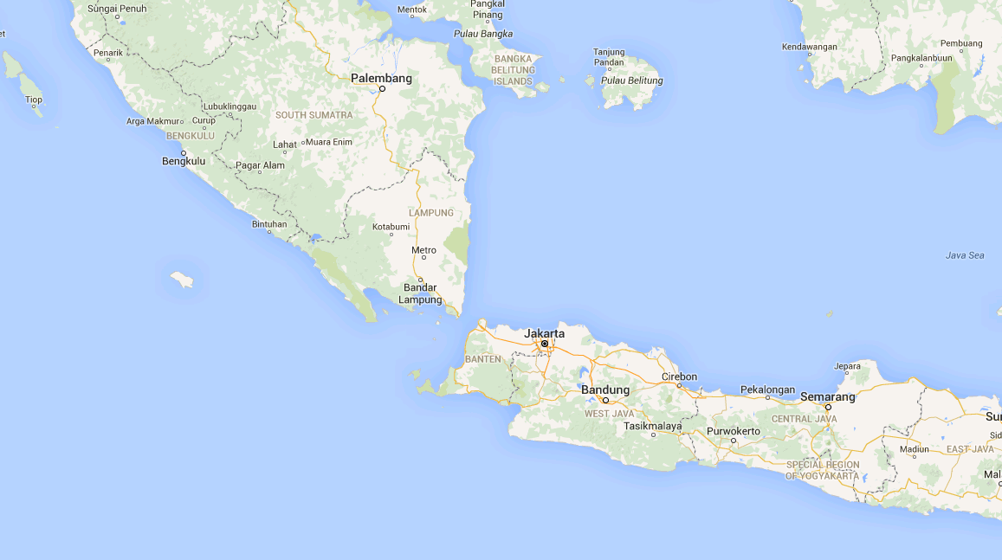
Modelling strategy
Met Office Unified Model simulations
15km standard configuration
2km convection-permitting
10xDJF seasons including 2019
20 sensitivity tests of 10 days
Coupled to an ocean mixed-layer model (MetUM-GOML)
Driven by ERA-I or MetUM analyses
200m convection-permitting
20 case studies of two days at various locations to coincide with observations
Driven by ERA-I or MetUM analyses

Slide 15
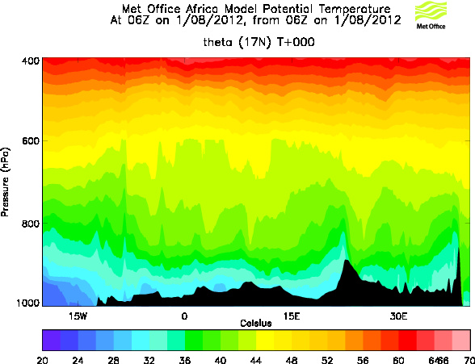
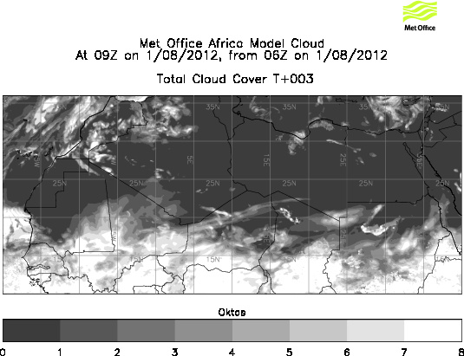
Forecast products for YMC campaign
Met Office will provide forecast products for the field campaign:
Twice daily global NWP forecasts (~17km)
Daily 3-day convective scale model forecasts (2 or 4 km)
Any model diagnostic could be plotted
Made available via ftp
Coordination with MSS?

Slide 16
Conclusions and key questions
Are any other groups planning to locate on Java or Christmas Island?
We would like to visit potential ground sites in Jan/Feb 2017
We are keen to collaborate and co-locate our instrumentation with other groups. Plan is flexible to avoid instrument duplication etc
We will require assistance with:
  Locating ground sites on Java and Xmas Island
  Obtaining research permits and flight permissions for aircraft
Cut off is April 2018 – look to Malaysia or possibly Australia

Slide 17
Thank you

